Slide 1
Electronic Visit Verification (EVV) in Massachusetts
Stakeholder Dialogue Session #3
South Shore Elder Services – Braintree, MA
May 21, 2019
SSES, 5/21/19

Slide 2
Today’s Agenda
EVV Overview & EVV Stakeholder Engagement https://www.mass.gov/info-details/electronic-visit-verification
Topics for Review
High Level Process Workflow
Scheduling Policies
Future Dialogue Sessions
SSES, 5/21/19

Slide 3
21st Century Cures Act Mandates EVV Use
Electronic Visit Verification (EVV) refers to the technology a worker uses during a home visit to capture information about the services provided
The 21st Century Cures Act (federal law) requires EVV for the following Medicaid services:
Personal care by 1/1/2020
Home health by 1/1/2023
EVV is required for Medicaid services but EOEA will be requiring it for EOEA Non-Medicaid services as well
Schedule for EVV implementation
Original Cures Act
Initial personal care deadline
Deadline with exemption
Deadline for home health
Jan. 2019
Jan. 2020
Jan. 2021
Jan. 2022
Jan. 2023
Jan. 2024
New law HR 6042
Initial personal care deadline
Deadline with exemption
Deadline for home health
Deadline with exemption
SSES, 5/21/19

Slide 4
EVV Requirements
To meet federal requirements, EVV systems must verify:
Type of service performed;
Individual receiving the service;
Date of the service;
Location of service delivery;
Individual providing the service; and
Time the service begins and ends
SSES, 5/21/19

Slide 5
Massachusetts’ goals for EVV implementation
Efficiency: Reduce administrative burden of paper timesheets
Program Integrity: Reduce billing errors and unauthorized spending
Effective Compliance: Provide an EVV system that complies with federal Medicaid requirements, minimizes burden on users, and does not disrupt the provision of services
SSES, 5/21/19

Slide 6
Terms Used in Today’s Session
Alternate EVV or Alt. EVV – Refers to EVV systems used by provider agencies that are NOT the MyTimesheet EVV System. These are “Alternative” EVV systems.
Data Aggregator – System that combines or “aggregates” EVV data from provider agencies. Provider agencies using Alt. EVV systems will send their EVV data to Optum’s data aggregator. MyTimesheet data will also flow into the data aggregator.
MyTimesheet – Optum’s EVV system that can be used by provider agencies to collect EVV data
Optum – Vendor that EOHHS selected to provide the MyTimesheet & Data Aggregator EVV Systems.
SSES, 5/21/19

Slide 7
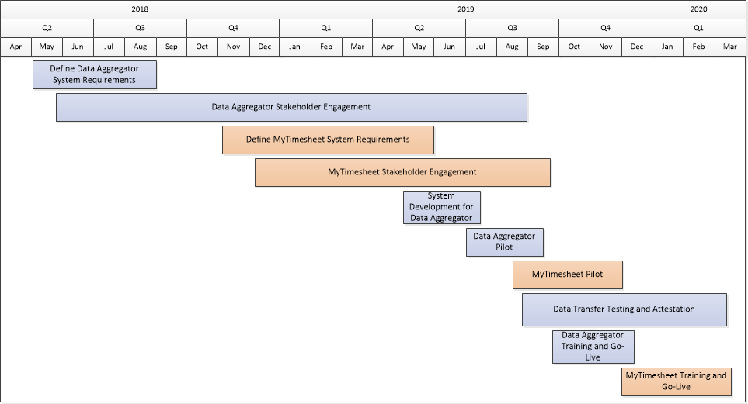
EVV Estimated Timeline
Provider organizations using Alternate EVV systems will:
Attest to meeting Cures Act and EOHHS requirements
Complete a data transfer testing process
Both Data Aggregator and MyTimesheet will be piloted before statewide deployment
SSES, 5/21/19

Slide 8
EOHHS EVV Stakeholder Engagement (to date)
16 Public Listening Sessions in 2017
11 stakeholder workgroup sessions in 2017
9 Meetings with ASAPs & Providers in early to mid-2018
Home Care Alliance EVV Expo in August 2018
Presentation on EVV to ASAP/AAA Executive Directors in October 2018
Presentation at Home Care Quarterly Meeting in May 2017, August 2017, and November 2018
EVV Meeting with ASAP Contract Managers in December 2018
Alternate EVV Implementation Listening Session in February 2019
2 EVV Regional Provider Dialogue Session in April and May 2019
SSES, 5/21/19

Slide 9
Objective of Dialogue Sessions
Obtain feedback from provider agencies on different aspects of EVV
Ensure that EOHHS and Optum are on the right track before system is developed and plans are finalized
Make system or policy changes based on additional review from feedback
Hear from providers across the Commonwealth and engage as partners
Engage with all stakeholders across the Commonwealth, not just those who are located in Metro-Boston
Facilitate relationships between EOHHS, Optum, EOEA and provider agencies
Address a broad range of topics
Not all stakeholders will be able to attend all sessions but format should allow all stakeholders to attend at least one session
Supplement with other modes of education and input
SSES, 5/21/19

Slide 10
Topics Addressed and Highlights of Past Dialogue Sessions
April 24 Session – Alt. EVV Data File
Need to review Non-Electronic Visit reasons
May 8 Session – Alt. EVV Data File Submission
Alt-EVV vendors need time to develop data file and meet standards
Need to review capture of care program
Need to consider capturing home health data
Most of the requested data fields seemed reasonable
Need to clarify how providers should handle visits where multiple services are delivered
Need to consider how EVV relates to Provider Direct
Presentations from sessions posted at https://www.mass.gov/info-details/electronic-visit-verification
SSES, 5/21/19

Slide 11
Today’s Session Discussion
Today’s Topics
High-Level Overview of MyTimesheet
Workflow Review - Process that outlines a consumer being referred for services, the provider accepting of the referral, service provision and the provider being paid by an ASAP
Scheduling policies, procedures, and considerations
SSES, 5/21/19

Slide 12
EVV Process Overview - MyTimesheet
Provider Organization Scenario
Provider Agency Dashboard
EVV system
ASAP Care Manager creates and keeps current a service authorization in SIMS
SIMS sends service authorization record file to the EVV system.
Receives the service authorization
Schedules care worker
Monitors changes and updates worker schedule (frequency, duration, suspensions, terminations)
Checks Schedule
Checks in (GPS tag)
Creates Service report
Checks out (GPS tag)
Reviews completed visits for CURES Act requirements
Places exceptions in supervisor box for processing
Enables confirmed visits for billing extract
SEND
Authorization
worker Mobile
Application
SSES, 5/21/19

Slide 13
High Level Workflow
Timing
Service month
+1-5 days
+5-25 days
+25-30 days
+2-3 months
1. Care Manager assesses consumer needs to develop person-centered care plan
2. Case mgr. searches for provider to accept the case
4a. W/in 48 hrs. in SAMS Care Manager assigns provider & authorizes services
5. ASAP generates Service Orders for initiating the service delivery data upload
7. ASAP works with provider to resolve errors
8a. ASAP pays providers
9. ASAP sends payment voucher to EOEA for reimbursement
ASAP
3. Coordinator accepts referral with Care Manager & assigns worker
6. Coordinator prepares invoice and .csv file for upload to Provider Direct
8b.Reconciled, billable Alt EVV visit data uploaded to State EVV aggregator
New step for Alt. EVV Providers
Provider
Suspensions &
Service Authorization changes
**For users of MyTimesheet, no manual upload to the data aggregator is needed
4b. Worker visits consumer & logs visit in EVV System
Worker
SSES, 5/21/19

Slide 14
Scheduling Policies
We are looking for feedback from all provider agencies (both MyTimesheet and Alt-EVV users)
We want to know how you address certain scheduling situations
If you have an idea of how a current process could be improved, we want to hear it
If we haven’t addressed an area of scheduling that you think is important to review, please let us know
SSES, 5/21/19

Slide 15
Scheduling Policies
Scheduling and Authorizations
Do you remove/cancel future appointments when a member’s authorization has ended? If so, how does that process work? If not, has that created issues?
Does your system apply restrictions on scheduling based on the service authorization? For example, will your EVV system prevent you from scheduling a visit if the member has reached the maximum number of authorized service units?
Urgent/Emergency Appointments
Are there situations where a worker performs a visit prior to scheduling and/or authorization? If so, how frequent are such visits and how are they handled?
How do you handle/schedule urgent appointments?
How do you schedule visits without authorizations?
Would it be problematic if emergency visits were required to be scheduled before the worker could perform the visit?
SSES, 5/21/19

Slide 16
Scheduling Policies
Exceptions to Schedule
When a worker is checking in, what do you consider to be "late” (e.g.10 minutes after scheduled time, 15 minutes, etc.)?
When a worker is checking out, what do you consider to be “early” (e.g.10 minutes before scheduled time, 15 minutes, etc.)?
What if a worker provides a different service than the one that was scheduled?
Capturing Information
What is your current process for electronically capturing when a worker works with multiple consumers at the same time?
Do workers capture or confirm services, ADLs, IADLs, or tasks that are provided during their visit? Are captured or confirmed items per EOEA regulations and terminology?
Other
What are your most common reasons for reschedule requests from consumers?
Do consumers “sign” the “timesheet” once the services are completed during each visit? If so, how does this work and have you had any issues with this process?
SSES, 5/21/19

Slide 17
EVV Stakeholder Dialogue Schedule
June
2019
Elders Services of Berkshire County
Pittsfield, MA, June 7, 2019 10am-12pm
Springwell
Waltham, MA, June 24, 2019 10am-12pm
July
2019
LifePath
Greenfield, MA, July 16, 2019 2-4pm
August
2019
Elder Service of the Cape Cod
South Dennis, MA, August 14, 2019 11am-1pm
SSES, 5/21/19

Slide 18
Thank You!
Information about EOHHS’ EVV Implementation can be found at:
https://www.mass.gov/info-details/electronic-visit-verification
Feedback/questions related to EVV can be submitted to EOHHS by emailing:
EVVfeedback@State.MA.US
SSES, 5/21/19

