Slide 1
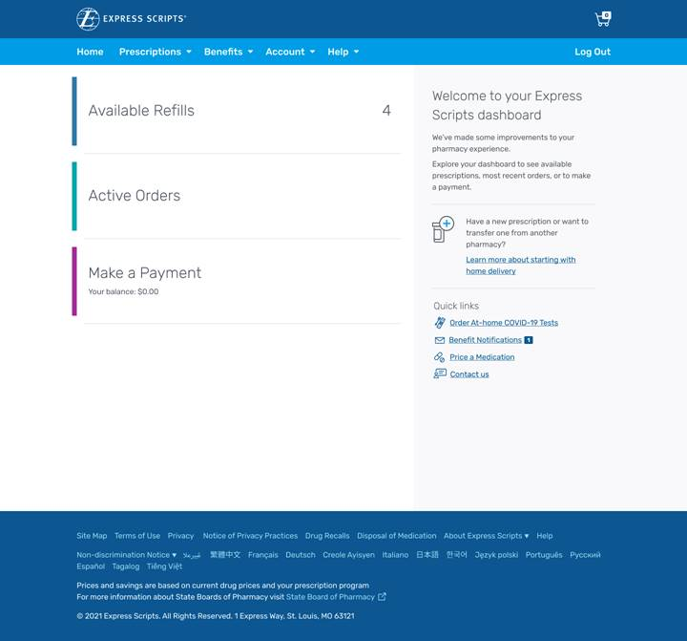
Landing page
COVID-19 Resource Center provides direct link to landing page after member login
After login, quick link is shown on homepage on the right hand side

Slide 2
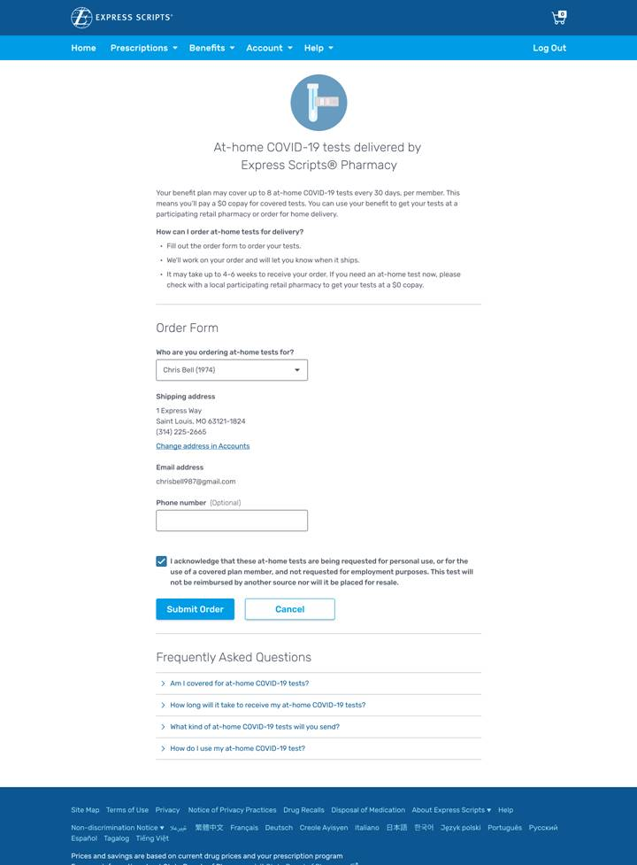
Order form
Drop down section allows eligible members to order COVID-19 OTC test kits
Member information including shipping address and email address auto populate
If member shipping address is not on file, member will be prompted to add their address
Member must acknowledge attestation before submitting order
Frequently asked questions are available below the form

Slide 3
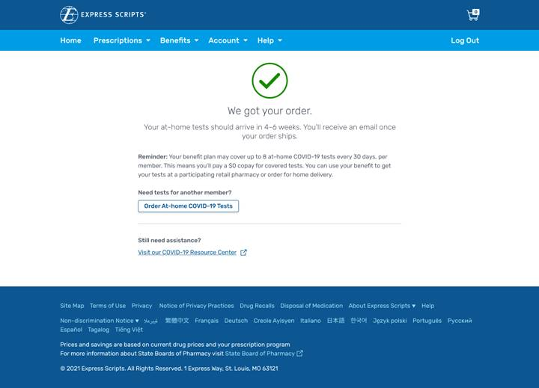
Confirmation page
After order is submitted, the confirmation page is shown
This page also allows for a quick link to order COVID-19 OTC test kits for another member

