Slide 1
Falls Risk and Prevention in People with Intellectual and Developmental Disabilities (IDD)
Presented by the Massachusetts Department of Developmental Services (DDS) and the Center for Developmental Disabilities Evaluation and Research (CDDER), UMass Medical School

Slide 2

Agenda
Overview of Falls Risk in IDD
Falls Risk Factors
Prevention strategies
Assessing falls risk
  Tools
Post-fall Considerations
Lessons learned from research projects

Slide 3

Falls Risk – Across the lifespan
The risk of falling for people with intellectual and developmental disability (IDD) is similar to the risk of falling in the elderly population (over age 65) but is experienced across the lifespan.
Higher risk at earlier ages
Notes:
This means that people with IDD experience more falls than people their own age, and falls at younger ages than you see in the general population.

Slide 4
Falls Risk – Greater than the general population
Falls are more common in people with IDD aged 18-64 than in the same age group across the general population
People with IDD fall at least as often as the elderly population (similar fall rates)
Notes:
Falls are more common in people with IDD aged 18-64 than people their own age who do not have these disabilities
People with intellectual and developmental disabilities experience frequent falls and at higher rates than in the general population. Depending on the study, the falls in this population are estimated at 33% - 57% each year.
Falls rate vary by study, but generally show rates that are at least as high as the elderly population, which is estimated to be between 0.45 and 0.65 falls per person per year, but as high as 1.00 per person/year in some studies.

Slide 5
Falls in the DDS Population
Nationally, about 30% of adults with I/DD fall each year
About two-thirds of adults who fall will fall more than once
15% of falls result in serious injury
  In one HCSIS analysis there were 1500 serous falls
May be as many as 10,000 falls happening each year

Slide 6
High Injury Rates
Falls contribute to as many as 50-60% of reported injuries regardless of age.
Significantly more likely (RR=2.9) than adults in the general population to experience at least one injury from a fall.
Emergency Room (ER) usage data consistently identifies injuries as the top causes of ER visits and falls as the top cause of injury.
Falls can also be fatal.
Notes:
Additionally, we see high injury rates from falls in this population. Nationally, falls contribute to as many as 50%-60% of injuries, regardless of age. Finlayson et al. (2010) found that adults with intellectual disabilities aged 18–64 years were significantly more likely (RR= 2.9) than the adults in the same age group in the general population to have experienced at least one injury caused by a fall.
ER usage data in MA and others states consistently identifies injury as the top cause of ER visit, and falls as the top cause of injury.

Slide 7
Fall Complications
Physical Injury
    Major and minor injuries
    15% of falls result in serious injuries
Psychological
Fear of falling
    50% of people who fall avoid activities out of fear of falling again
-Tedaskar, Rein, ‘Falls and People with Intellectual & Developmental Disabilities’

Slide 8
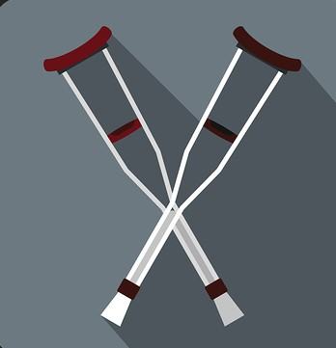
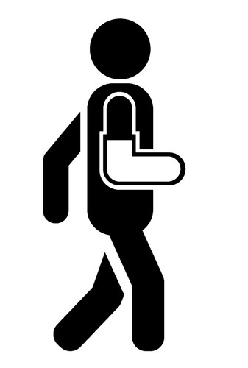
Repeat Falls
About two-thirds of adults who fall will fall again.
Each time someone experiences a fall, it increases their risk of not only falling again, but of eventually suffering a more serious injury from that fall.
Every fall matters!
Notes:
A word on repeat falls. Each time someone experiences a fall, it increases their risk of not only falling again, but of eventually suffering a more serious injury from that fall. You may see this in your own programs. That person who stumbles 5 times but always manages to catch themselves until the 6th time they stumble and down they go, striking their head or fracturing their arm. We would encourage you to think of every stumble, or every near miss, as a risk factor for experiencing a more serious fall. What you want to do is treat the underlying cause of that stumble and we’ll get to that in a minute.

Slide 9
What is a fall?
A fall is any loss of balance or uncontrolled, unintended contact with a surface or object. This includes the floor, furnishings or other persons.
This also Includes falling back onto a chair or bed after rising, if the transition is not controlled.
**Previous falls are a risk factor for more serious falls**
Notes:
Now that we know people with IDD are at increased risk of falling – and of experiencing injuries from those falls – let’s back out a little and describe what we mean by a ‘fall’. There are many definitions of falls, and you should choose one appropriate for your situation. Here is the definition we generally use.
Remember: We said earlier that 2/3 of people who fall will fall again. This means that a :”near fall” (i.e. standing up and falling back down into the chair, due to a loss of balance or perhaps weak leg strength) is potentially as important as a fall which results in impact with the floor. It’s not uncommon to review a person’s history after they’ve suffered a major fall, for example, a broken bone, and see that they has several previous falls that were minor.

Slide 10
Falls Risk Factors
Notes:
Why are people at risk of falling?

Slide 11
Why Falls Occur
Falls are caused by a combination of internal (intrinsic) AND external (extrinsic) risk factors.
Notes:
Falls in individuals with I/DD are caused by a combination of internal factors (e.g., acute and chronic disease, adverse medication effects) and external factors (e.g., environmental hazards and obstacles interfering with mobility).
The likelihood of falling increases with the number of risk factors a person has.

Slide 12
Internal Falls Risk Factors
Previous Falls
Poor eyesight or vision loss
Weak muscle strength
Weak or unstable balance
Unsteady gait (walking)
Elimination problems
Cognitive Impairments
Medication
**The greater the number of risk factors,
the greater the falls risk**
Notes:
Internal risk factors for falls include the following:
Previous falls: Previous falls: we see this again and again in the literature. Each time someone experiences a fall, it increases their risk of not only falling again, but of eventually suffering a more serious injury from that fall. You may see this in your own programs. That person who stumbles 5 times but always manages to catch themselves until the 6th time they stumble and down they go, striking their head or fracturing their arm. We would encourage you to think of every stumble, or every near miss, as a risk factor for experiencing a more serious fall. What you want to do is treat the underlying cause of that stumble and we’ll get to that in a minute.
Clients who have fallen previously are far more likely to fall again. Many clients who fall do so repeatedly.
Poor vision: Eye problems can cause blurriness or limits vision, which may keep a client from seeing hazards and objects in his or her path and can lead to trips and slips. Sometimes eyeglasses can cause more problems (bifocals)
Muscle weakness (upper and/or lower extremities): Diseases and conditions such as arthritis, diabetes, and stroke can alter muscle strength in the legs and arms. As a result, using leg and arm strength while getting out of a bed or up from a chair or toilet becomes much more difficult. This can easily lead to balance loss and increased fall risk.
Unstable balance and/or transfers: Disorders such as stroke, arthritis, and Parkinson’s disease may affect a client’s balance. As a result, transferring from chairs and toilets becomes more difficult.
Unstable gait: Disorders such as stroke, arthritis, diabetes, and Parkinson’s disease may also affect a client’s balance. As a result, walking becomes more difficult.
Elimination problems: An inability to control one’s bladder function and fear of losing urine leads to a sense of urgency to use the bathroom. Often, clients will rush to the bathroom, exceeding their safe walking abilities and increasing their chance of falling.
Cognitive impairment: Cognitive impairment increases the risk of falls because the individual is unable to think clearly. As a result, clients may experience great difficulty differentiating between safe and hazardous activities (e.g., they may try to stand or get out of bed when they should not) and differentiating between safe and hazardous environmental conditions (e.g., they may not recognize that a wet floor is unsafe to walk on).
Medications: Taking too much medication or the wrong combination of drugs can affect a client’s judgment, coordination, and balance.

Slide 13
Other Fall Risk Factors
Dizziness
Low blood pressure
Fatigue
Delirium (sudden confusion)
Dehydration
Urinary Tract Infections
Low Blood Pressure:
- Dizziness can be in place for as long as 25 – 30 minutes after moving from lying or sitting to standing
- In nursing homes, most falls happen after a meal
Notes:
These are risk factors that might appear suddenly, often at the onset of an illness or after starting a new drug. These can affect a person’s balance and increase fall risk.
Special word on Low Blood Pressure:
Low Blood pressure that drops too much when someone gets up can increase risk of falling. This condition is called postural hypotension can be a result of dehydration or certain medications. It might also be linked to diabetes, urological conditions such as Parkenson’s or an infection. It will make a person more dizzy. This dizziness can last as long as 25 to 30 minutes after a person moves from lying down or sitting to a standing position.
Most falls happen in nursing home after a meal (postprandial)

Slide 14
Associated Conditions
Seizure or other neurological disorders
Aggressive behaviors
Impaired ambulation or mobility
Osteoporosis (fracture risk)
Notes:
These are some conditions that are associated with increased falls risk, which means if you have one of these you are more likely to be at increased fall risk.

Slide 15
Medication Use
Common side effects like dizziness, confusion, fatigue, and sleepiness can affect a person's fall risk
Anti-seizure, psychotropic and antidepressants are most likely to cause this fall risk
New drugs can cause new interactions
Check your handout
Notes:
We have a handout with the medications that are most often associated with increased falls risk that I’ll include for download at the end.
If someone is starting a new drug, that might be a good time to provide extra supervision to watch for increased falls risk.

Slide 16
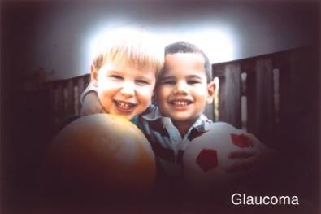
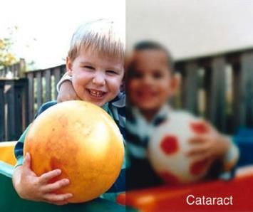
Vision Loss
41% of adults have some form of ocular anomaly
17% of adults have significant Vision Loss
  55% of this group is 40 years of age or older
-Pictures courtesy of Lisa DiBonaventura, M.A., COMS
Notes:
I want to highlight the importance of vision in falls risk. This is a study that was conducted in MA and refers to adults served by DDS. As you can see from these numbers, many people with IDD have undiagnosed and undetected visual anomalies.
What are some of the common vision loss issues you might see? Here we have a picture of two friends and I’m guessing most of you can see that just fine. If you had Glaucoma, here’s what you might see. I know this is a slightly different picture so bear with me – but look how narrow your field of vision is now. If you had Cataracts, here’s the blurriness that you might experience. Imagine that you have glaucoma or cataracts and you’re standing on the back deck. How likely is it that you’ll notice the steps? Or that raised board that’s a tripping hazard?

Slide 17
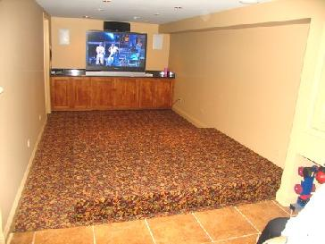
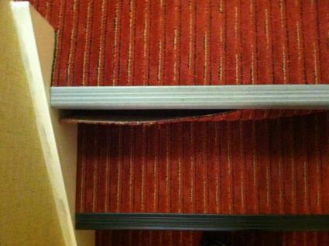
Vision Related Risks
Impaired depth perception
Poor edge contrast sensitivity
- Lisa DiBonaventura, M.A., COMS
Notes:
Additionally, people with IDD may also be more likely to have impaired depth perception and impaired edge contrast sensitivity, which means difficulty with distinguishing between finer and finer increments of light vs. dark. This increases the fall risk if the person fails to see that they need to step down from a curb onto a similarly colored pavement, for example, or fails to see the step up from one room to another. In this picture (on the left) there is a step up from the linoleum and another step down on the other side of the carpet. This multivariate carpet makes the steps very difficult to see. You can address this by using color contrast (especially at stair edges) like the second picture, which is still not great, but better. Better to use bright colors, for example neon tape.

Slide 18
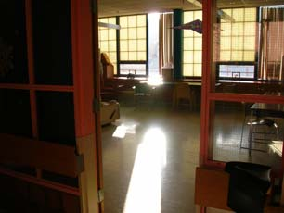
Vision Related Risks
Blur from lower lens of multifocal glasses
Decreased ability for eyes to adjust to light levels
Sensitivity to glare
Check vision annually!
- Lisa DiBonaventura, M.A., COMS
Notes:
Here are a few other vision related risks. Notice the glare in the picture. Imagine if that floor was wet. It would be very difficult to see a wet spot in this glare, even for the average person.

Slide 19
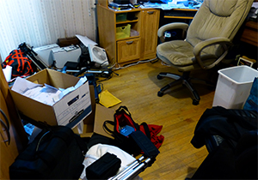
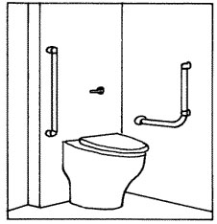
Environmental Risk Factors
Slippery or wet floor surfaces
Low-seated chairs and toilets
Poor or dim lighting
Lack of bathroom handrails
Clutter
Notes:
Of course we cannot talk about falls risk without mentioning the environment. This might be the area that staff can have the greatest impact in reducing a person’s fall risk. All these things here contribute to an unsafe environment.
Low-seated chairs and toilets, especially those without adequate armrests or grab rail supports, may be difficult to get up from and increase the risk of falling. This is especially a risk factor for clients with muscle weakness and nervous system diseases.
Bathroom handrails. Check to see where the client grabs before installing the handrail.

Slide 20
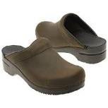
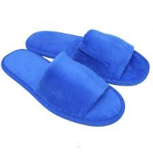
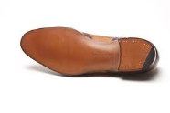
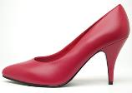
Environmental Factors Continued
Unstable furniture
Lack of handrails on stairs or steps
Broken canes, walkers, wheelchairs
Improper footwear
Notes:
Stairs or steps. Lack of handrails on both sides of stairway to support balance when climbing/ descending steps can increase fall risk.

Slide 21
Prevention Strategies

Slide 22
Preventive Strategies
Medical
Rehabilitative
Environmental
Staff
Educational
Use of Fall/Injury Prevention Devices
Notes:
Once a client’s potential for or risk of falling has been identified, it is important to plan interventions or strategies aimed at reducing the likelihood of falling. Any fall prevention strategies that are implemented should be based on the client’s specific risk factors. Preventive strategies address both internal and external risk factors and include

Slide 23
Medical Strategies
Recognize signs and symptoms of underlying illness
Review medication usage and potentially discontinue inappropriate or excessive medications
Diagnose and treat osteoporosis
-Tedaskar, Rein, ‘Falls and People with Intellectual & Developmental Disabilities’
Notes:
One of the first strategies for preventing falls is in recognizing signs and symptom of underlying disease that may be increasing a person’s fall risk. These are conditions like dehydration or UTI’s which can make a person dizzy and unsteady. Constipation. Visual disorders, gait and balance impairment, muscle weakness, etc.
Diagnosing and treating osteoporosis can help to prevent severe injuries (e.g., hip fracture) that might be sustained during a fall. Current recommendation is to begin screening for osteoporosis as early as age 50, if risk factors are present. These include long term use of anti-seizure and anti-psychotic medications, lack of exercise, poor diet (lack of calcium and vit D), post-menopausal or women who have never had a child

Slide 24

Rehabilitative Strategies
Exercise programs
  Walking and endurance
  Training geared towards increasing balance, strength, and flexibility
  Ensure footwear fits properly and is slip-resistant
  Consider canes and walkers to improve balance
-Tedaskar, Rein, ‘Falls and People with Intellectual & Developmental Disabilities’
Notes:
These consist of exercise programs, ensuring proper footwear, and using ambulation devices to assist with mobility.
All shoes and slippers worn by individuals should fit properly (i.e., not too tight or loose) and be slip-resistant. Balance is generally better with shoes that have thin and nonslip soles rather than footwear with thicker soles, such as sneakers or running shoes, which may interfere with balance. Consider custom-fitted shoes for foot problems.
For individuals with gait and balance disorders, canes and walkers can be used to maintain or improve balance and mobility. If in use, wheelchairs should be tailored to meet the specific needs of an individual and should be evaluated routinely to ensure that they are being used safely.

Slide 25

Environmental Strategies
  Identifying and eliminating hazards
    Reduce clutter
    Install grab bars and handrails
    Replace lights
    Remove unstable or low furniture
    Use color contrast
  Simplifying the environment to improve mobility
    Reposition furniture
    Consider door alarms
-Tedaskar, Rein, ‘Falls and People with Intellectual & Developmental Disabilities’

Slide 26
Staff Strategies
Staff have a key role in reducing falls:
  Be aware of which persons are at fall risk
  Report any sudden “change of condition” in persons
  Anticipate the needs of persons at fall risk and meet their needs
  Provide extra supervision for persons at particular fall risk
How to communicate risk across locations or shifts?
-Tedaskar, Rein, ‘Falls and People with Intellectual & Developmental Disabilities’

Slide 27
Educational Strategies
Educate people about their own fall risk
  Ask for assistance when rising from a seated position
  Ask for assistance when walking
  Be extra cautious during icy or slippery conditions

Slide 28
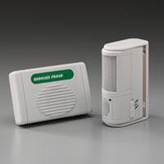

Fall/Injury Prevention Devices
Notes:
Even after instituting all reasonable fall preventive measures, some people will remain at risk for falls. For these individuals, available strategies aimed at reducing the risk of falls and/or injuries include the use of exit alarms and hip protectors.
Exit alarms are devices designed to warn staff that someone who should not be attempting to leave their chair or wheelchair unassisted are doing so.
Hip protectors are devices designed to protect the hip bones during a fall. In essence, hip protectors act to reduce the risk of hip fracture by absorbing the force of the fall (i.e., performing as shock absorbers) and/or diverting this force away from the hip bone (i.e., the energy of the fall is then absorbed by soft tissues and muscles surrounding the hip bone).

Slide 29
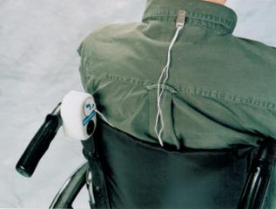
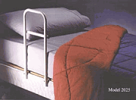
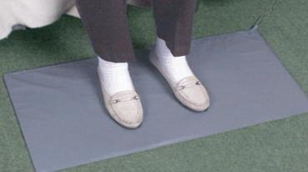

Fall/Injury Prevention Devices
Notes:
Additional falls prevention devices to consider

Slide 30
Fall Assessment
Who is most at risk?
Notes:
The Who

Slide 31
How to Stop Falls
Falls can be reduced by adhering to an organized step-by step process:
  Determine who is at risk of falling and why
  Incorporate one or more of the preventive strategies designed to reduce that fall risk
  Conduct post-fall assessments to identify patterns and assess intervention effectiveness
Notes:
Make sure staff know what to do when someone falls. What is the agency policy? Ask staff what is their agency policy about falls. Ok, here’s some tools.

Slide 32
Step One: Assess Fall Risk
There are many ways to assess risk:
Falls Risk Checklist
2. Timed Get Up and Go

Slide 33
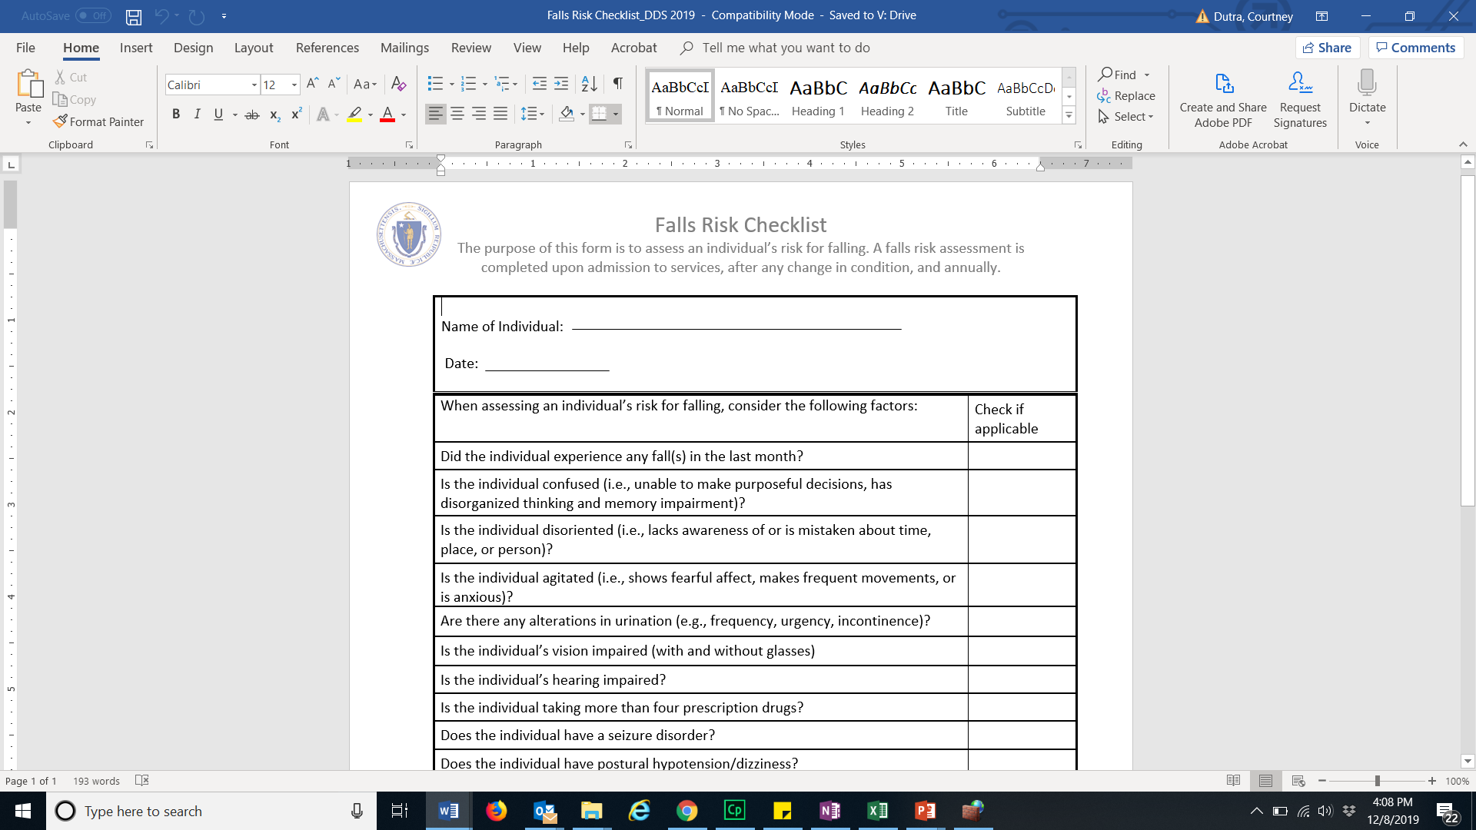
Fall Risk Assessment
Use the fall risk checklist
Assess fall risk at least annually
Notes:
Purpose: To identify falls risk
What to Assess:
10+ factors known to be associated with falls risk. This includes things like taking 4 or more medications, unsteady balance, previous history of falls, etc. It’s recommended that you assess for falls risk annually using a checklist.
When to Assess:
Admission, change in condition, regularly

Slide 34
Spectrum of Fall Risk
Few Risk Factors
Fall Risk
Many Risk Factors
Low Risk
High Risk
Generally, more checks indicate an increased falls risk
Notes:
Generally, the more risk factors present the higher that person’s risk for falling.

Slide 35
TUG (Timed get Up and Go)
Timed get up and go test
Person rises from seated position, walks about 10 feet (3 meters), turns, walks back then sits again
Watch for unsteady balance and gait and refer as necessary.
https://www.cdc.gov/steadi/pdf/STEADI-Assessment-TUG-508.pdf
Notes:
This is another way you can assess a person’s fall risk using the Timed get up and go. If an individual looks unsteady, they probably are. Refer individual for balance evaluation

Slide 36
Step Two: Implement falls prevention strategies
This may include developing a falls protocol or risk plan
It will probably include Universal AND Individual Strategies
PT or OT customized interventions
Notes:
Universal: Environmental safety, Meeting basic needs, such as providing clients with chairs that are easy to get up from, making sure that wheelchair brakes work and are activated during client transfers, making sure that clients are wearing nonslip footwear, daily monitoring of fall risk.

Slide 37
Step Three: Post-Fall Assessment
S Symptoms preceding the fall
P Previous falls
L Location of fall
A Activity
T Time of day
T Trauma
-Tedaskar, Rein, ‘Falls and People with Intellectual & Developmental Disabilities’
Notes:
SPLATT is a term used in national literature sources and in the field to gather information after a fall has occurred. This a form that staff complete after all falls to record the following factors. The purpose of this to recognize patterns and then assess whether or not the interventions are working.
Can give 1 or 2 examples here.

Slide 38
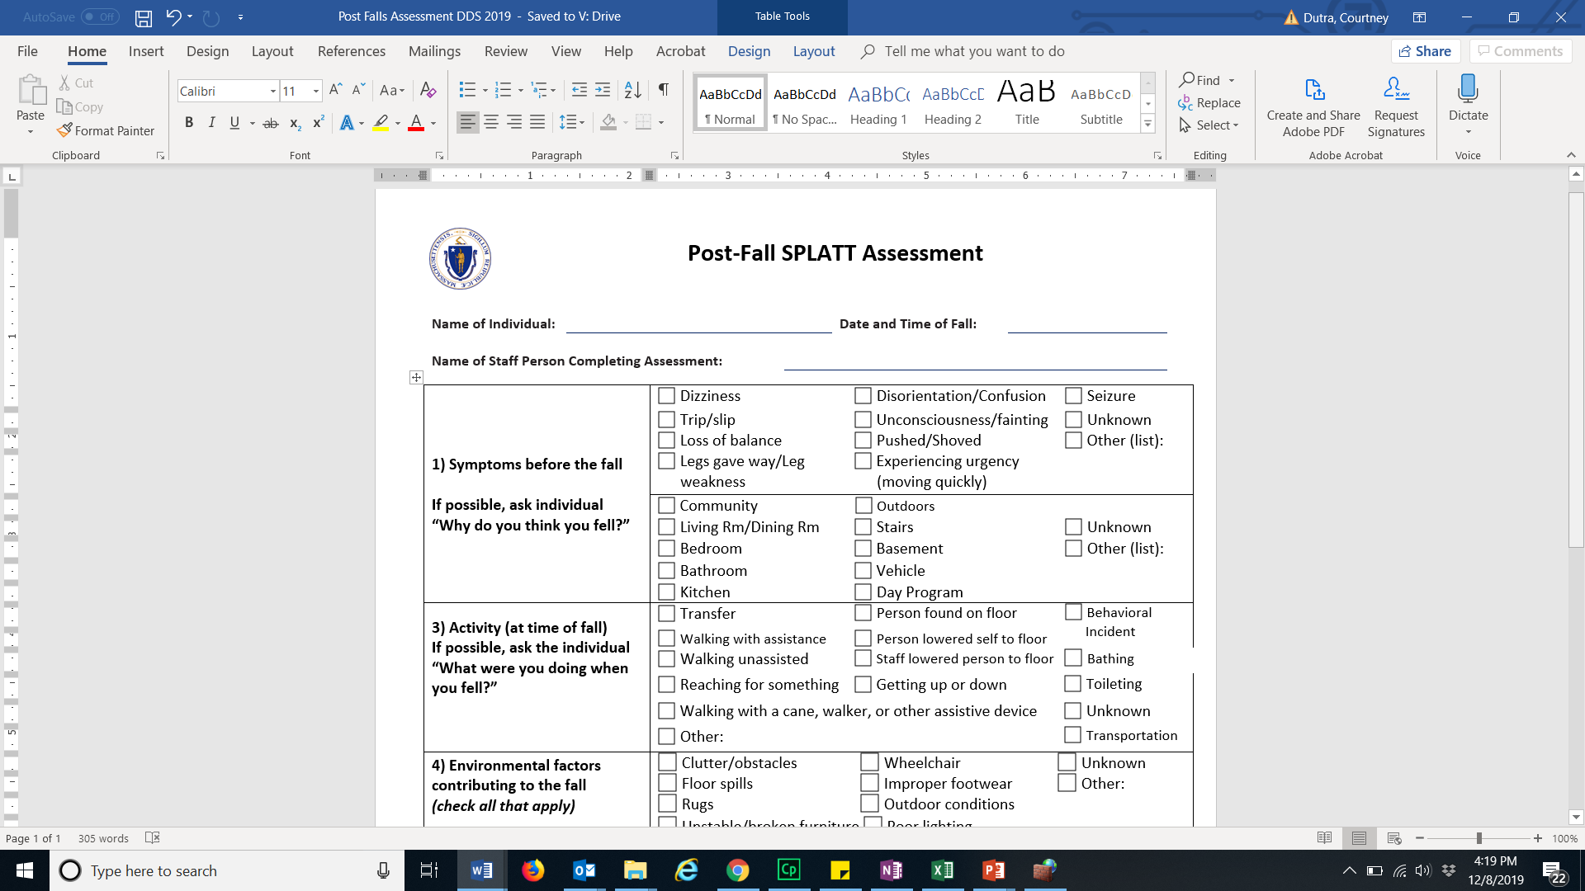
DDS Post-Fall Assessment

Slide 39
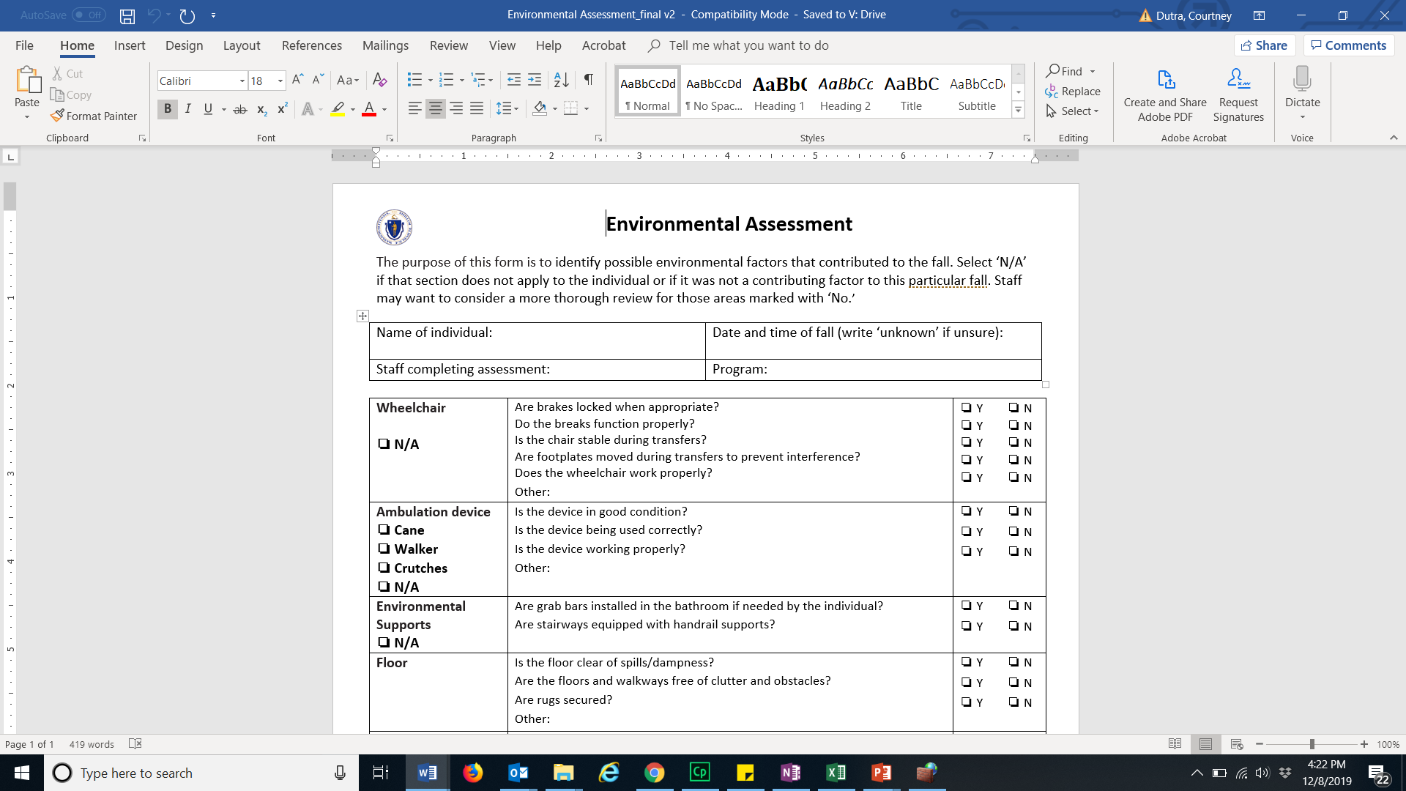
Environmental Assessment

Slide 40
Step Four: Follow-Up
Determine whether intervention(s) are working to reduce fall and injury risk
If yes, continue with the risk plan
If not, ask “Why?” Revisit risk assessment and amend care plan
Design new interventions, if necessary

Slide 41
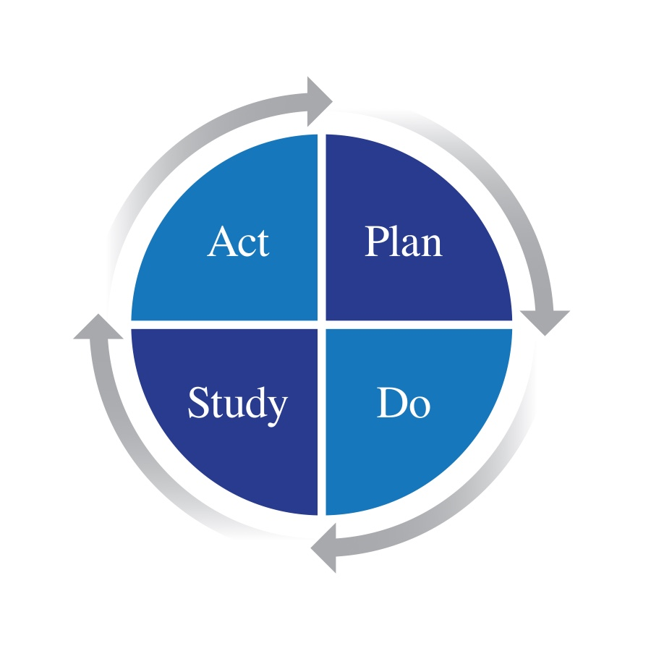
Falls Prevention Cycle
Notes:
To review: this is the cycle of falls prevention. Plan (assess fall risk), Do (intervention), Study (track falls to see if the interventions are working), and Act (act on the results of those findings).
How to communicate this back to homes? One idea is a sheet of paper that goes to home with recommendations and home completes with observations of how it’s working

Slide 42
Research “Lessons Learned”
Notes:
Now we’ll share some data and strategies we’ve learned through the two research projects we conducted and we’ll share an example of how a provider implemented a falls prevention program.

Slide 43
Falls Community Application
STOP Falls Pilot | VRS Clinical Intervention
910 Individuals for 6 months | 58 people over 6 months
Staff tracked all falls and completed post-fall assessments | Received therapy interventions 3x a week
Piloted tool use | Characterize the intervention
Identify falls patterns to reduce risk | Capture data on falls risk factors
Notes:
CDDER conducted a pilot with almost 1,000 people in community-based residences to test tool implementation and effectiveness.
CDDER partnered with an outpatient provider of clinical services (OT/PT) to assess individual falls risk and deliver a customized falls prevention intervention in community-based settings.

Slide 44
Results
STOP Falls Pilot | VRS Clinical Intervention
33% reduction in monthly rate of falls and reduction in # of people who fell | 81% of the participants (n=30) had a reduction in the Falls Risk Index score
Factors that increased falls risk: Recent falls history (5x), unsteady balance (5x),4 or more prescription drugs (2.5x) | High falls risk driven by: falls history, difficulty walking, unsafe footwear, tripping hazard, and medication use
Loss of Balance and Trip/Slip (53%) were the most common ‘why’ | Risk factors correlated with reduction in falls risk: reduced in unsafe footwear (26), ambulation (35), toileting (15) and improved balance (18).
46% of falls occur while the person was “walking around” | Most common interventions: 55% were therapeutic exercises to develop strength and endurance, ROM and /flexibility
Notes:
STOP Falls: Rates dropped from 12.3 falls per 100 people in the first month of the pilot to 8.2 falls per person in the remaining 5 months. This represents a 33% reduction in the monthly rate of falls between the pre-intervention period and the post-intervention period. In addition, there was a statistically significant decrease in the proportion of people experiencing one or more falls in the first month, compared to the subsequent 5 months of the pilot
So, we saw an impact in both the number of falls and the number of people who fell.
Risk factors correlated with reduction in falls risk: notice that 26 our of the 30 people reduced in unsafe footwear!!
Additional interventions: Dynamic activities to improve functional performance, direct (one-on-one) with the patient
62%, Self-care/home mgmt. training (e.g., ADLs and compensatory training, instructions in use of assistive technology devices)
69%

Slide 45

“Improper footwear”
Falls are associated with shoes that are loose, worn, or backless. High heeled (more than 1”) or narrow-heeled.
Bare feet and socks increase risk.
Poor fit [feet grow with age; also they swell)
Shoes with thin, hard soles are preferable, with Velcro fasteners or gussets. This allows the person’s feet to feel the sensations that help them maintain balance.
Slip-resistant socks for night walking.
“Updated Guidelines for Prevention of Falls in Older Persons”, American Geriatric Society and British Geriatric Society
Notes:
There is a lot of guidance on footwear as it relates to falls prevention.
Evaluate the footwear at the time of the fall for fit and style.
Consider custom-fitted shoes for foot problems.

Slide 46
Case Studies
Notes:
Now we’ll share some data and strategies we’ve learned through the two research projects we conducted and we’ll share an example of how a provider implemented a falls prevention program.

Slide 47
CASE STUDY #1
Gertrude is 57 and has Down Syndrome
She takes a multivitamin, calcium, and eye drops for dry eyes every day
She lives in a community residence which recently underwent a major renovation
Last winter she broke her hip
She appears confused, refuses to go outside in the cold, and bumps into things

Slide 48
CASE STUDY #2
Elizabeth is 45 years old with limited verbal skills
She has a seizure disorder and takes Tegretol 3 times a day
No longer interested in favorite activities
Seems a little unsteady and has difficulty navigating the carpeted stairs to her room
Recently fell in the community and skinned her knees

Slide 49
CASE STUDY #3
Jonathan is 78 years old
He has a seizure disorder and takes Tegretol 3 times a day
Takes hypertension medication and a diuretic in the early morning
Has almost fallen on several occasions in the bathroom and is incontinent of urine
Staff encourage him to wait for assistance when he is unsteady, but he refuses

Slide 50
CASE STUDY #4
Eric is 47 years old and has CP
He has a significant seizure disorder and takes Tegretol and Keppra 4x/day, along with a multivitamin and Colace
Lately, Eric seems less able to help with transfers and has fallen once transferring into the bathtub
He has started to refuse baths and only allows certain staff to help him

Slide 51
References
Finlayson, M. et al (2010). Injuries, falls and accidents among adults with intellectual disabilities. Prospective cohort study. JIDR, 54(11), 966-980.
Sherrard J, Tonge BJ & Ozanne-Smith J (2001) Injury in young people with intellectual disability: descriptive epidemiology. Injury Prevention 7, 56-61.
Hsieh, K., Heller, T., & Miller, B. (2001). Risk factors for injuries and falls among adults with developmental disabilities. JIDR, 45(1), 76-82.
Cox, CR et all (2010). Incidence of and risk factors for falls among adults with an intellectual disability. JIDR 54(12) 1045-1057.
Grant, HJ. (2001). Falls among person who have developmental disabilities in institutional and group home settings. Journal on Developmental Disabilities, 8(1), 57-73.
Wagemans, AMA & Cluitmans, JJM. (2006). Falls and fractures: a major health risk for adults with intellectual disabilities in residential settings. Journal of Policy and Practice in Intellectual Disabilities 3, 136-138.
Smulders, E., Enkelaar, L. Weerdesteyn, V., Geurts, A. C. H. & van Schrojenstein Lantman-deValk, H. (2013). Falls in older persons with intellectual disabilities:fall rate, circumstances and consequences. Journal of Intellectual Disability Research. 57(12). December.

Slide 52
References
Willgoss TG, Yohannes AM & Mitchell D. (2010) Review of risk factors and preventative strategies for fall related injuries in people with intellectual disabilities. Journal of Clinical Nursing 19, 2100–9.
Sherrard J, Tonge BJ & Ozanne-Smith J (2001) Injury in young people with intellectual disability: descriptive epidemiology. Injury Prevention 7, 56-61.
Wang D, McDermott S, Sease T. (2002). Analysis of hospital use for injury among individuals with mental retardation. Journal of Injury Control and Safety Promotion 9 (v2), 30.

