Slide 1
Family Engagement
Spring Statewide Conference
June 5, 2017

Slide 2
Title I Family Engagement
Same:
Family Engagement policy for the district AND every Title I school
Parents need to have opportunity to review those policies annually
School compact provided for all Title I families
School must provide an annual Title I meeting
What’s New:
Language is now Family Engagement
Posting report card to district website meets requirements
Must notify parents if their child taught for 4 or more weeks by a teacher not meeting licensure requirements
Must notify all parents of their right to request teacher qualifications
Notes:
SEC 3115(c) REQUIRED SUBGRANTEE ACTIVITIES.—An eligible entity receiving funds under section 3114(a) shall use the funds—
(3) to provide and implement other effective activities and strategies that enhance or supplement language instruction educational programs for English learners which –
(A) shall include parent, family, and community engagement activities; and
(B) may include strategies that serve to coordinate and align related programs.

Slide 3
Title IIA Family Engagement
Districts are required to consult with parents/families when developing/updating district improvement plans.
Suggestions for consulting families:
Consult school councils
Conduct parent surveys
Include parent members on school/district improvement plan committees

Slide 4
Title III Family Engagement
MA has always required a family engagement component to Title III grant applications. Now, under ESSA, family engagement is a requirement of an approvable Title III grant.
Today during the “Innovative Uses of Title III” session (Session 4), one Title III district will make a brief presentation of what they have done to meet this requirement.
Information about how districts can enhance or improve their Family Engagement activities will be forthcoming from the DESE.
More information regarding Title III (including Family Engagement) can be found here: https://www2.ed.gov/policy/elsec/leg/essa/essatitleiiiguidenglishlearners92016.pdf
Notes:
SEC 3115(c) REQUIRED SUBGRANTEE ACTIVITIES.—An eligible entity receiving funds under section 3114(a) shall use the funds—
(3) to provide and implement other effective activities and strategies that enhance or supplement language instruction educational programs for English learners which –
(A) shall include parent, family, and community engagement activities; and
(B) may include strategies that serve to coordinate and align related programs.

Slide 5
Middleborough Public Schools
Middleborough Family Resource Center

Slide 6
MFRC Established
The Middleborough Family Resource Center was established on September 28, 2015 as a part time service to the 3 elementary schools. Funded by the HBB PTA and Title I, the FRC reached over 150 families encompassing 1:1 services and transition programming (Kindergarten).
In the fall of 2016, the Family Resource Center Coordinator Position was increased to Full Time within the 3 elementary schools.

Slide 7
Connecting and Collecting
Upon launching the FRC last year, we immediately began to gather information and resources by connecting and collaborating with our community partners. These partnerships have been imperative for the FRC to refer and inform families in a timely manner as well as develop new programming for families.
A selection of the Partnerships Developed:
Middleborough Area Assistance Coalition (COA, St.VdP, YMCA, Town Depts, Housing (multi), WIC, EI, Salvation Army)
Local Community Service Agencies (Systems of Care Meetings)
South Shore Community Action Council
Coordinated Family and Community Engagement
Soule Farm Education Homestead
Middleborough Public Library

Slide 8
Connecting and Sharing with MPS
Along with community based efforts, the FRC began to define the functions of the FRC and share with MPS Staff and Families.
Share within the Schools (PTA, Staff Meetings, Family Nights, School Committee, Health and Wellness Committee)
Establish Referral and Data Collection Processes (Working with Pupil Personnel and Admin, developed plan for connecting with families)
Start serving Families (85 Families Served 2015-2016 school year)

Slide 9
Family Engagement- Parent Ed and Support
Along with Referrals for support to families in accessing information and services, the FRC has been able to offer programming to families such as:
McLean Grant funded Parent Workshop to parents of children age 3 to 8 - Understanding and Managing Your Child’s Behavior
McLean Grant funded partnership with COA- Grandparent/Kinship Care Group

Slide 10
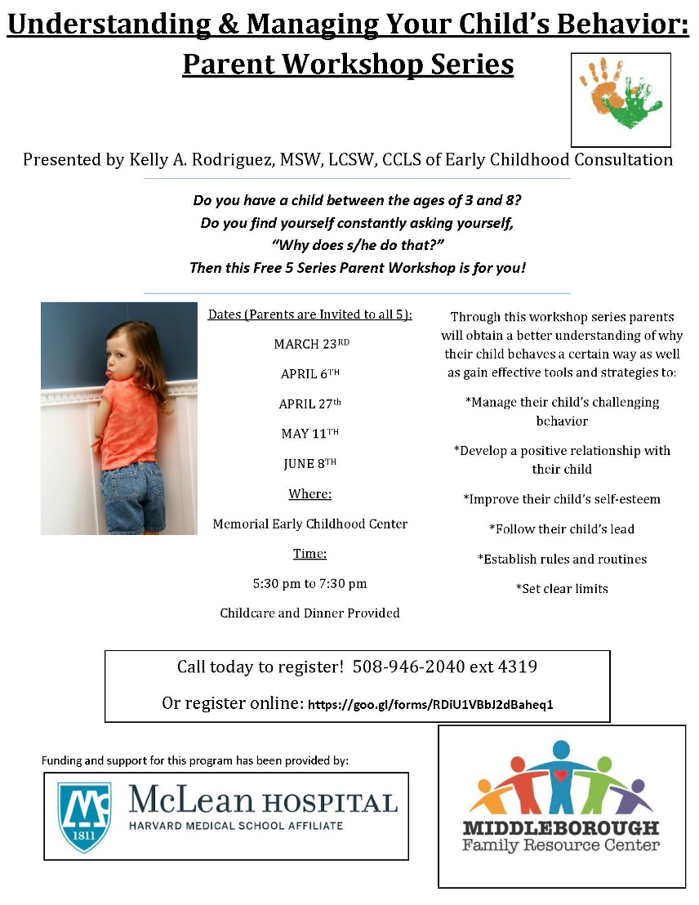
Parent Workshop- ages 3 to 8

Slide 11

Kinship Caregivers Group

Slide 12
Family Engagement-Transitions
A goal for the FRC last year was to develop a Transitions Program for our families and students entering into Kindergarten and First Grade.
K Summer Social
Boohoo/Woohoo Breakfast
Movie Nights for 1st Grade Families
Countdown to K Calendars for Distribution to Class of 2031
The FRC collaborated with the MECC PTA CFCE, Middleboro Children’s Library, and Soule Farm Homestead Education Center in the development of the above programming

Slide 13
Family Programming- McLean Funded
In collaboration with the Council on Aging in Middleboro, Grandparents and Kinship Caregivers are offered a Support Group; held on Monday evenings including dinner and child care
Understanding and Managing Your Child’s Behavior, a Program developed for Caregivers of children ages 3 to 8 who are behaviorally challenging– A 5 Part Workshop with dinner and child care- Presented by Kelly Rodriguez of Early Education Consultation

Slide 14
Families Reached by FRC
2015-2016
85 Families Served
Plus 65 Families attended K Summer Social
2016-2017
______ Families Served

Slide 15
Primary Areas of Support
Nutrition
Housing & Utilities
Clothing & Winter Coats
Child Care and Employment
Emotional and Behavioral Health
Healthcare- Access to Insurance (Masshealth)

Slide 16
Nutrition
Families experiencing food insecurity can access resources through the FRC
Referrals to local food pantries
Sharing of DTA information
Sharing of Application for Food Service Program
The FRC is began the snack support program during the current school year and at this time sends home 600 snacks a month to 30 children.
Currently planning a Summer Eating Program and Resource Guide

Slide 17
Housing & Utilities
The FRC can refer families to Housing Solutions for Homelessness Prevention Programs.
The FRC will collaborate with community partners for support in paying utility bills.
The FRC will work with local resources to support a family who finds themselves in an emergency homeless situation.
The FRC will help families apply and interview for housing as well as connect with Housing Authority.

Slide 18
Emotional and Behavioral Health
Families seeking support in accessing Emotional and Behavioral Health Services and Resources can start the process at the Resource Center. This continued to be a challenging area for the FRC to help with entering into the 2nd year in the district
A goal the FRC set was to obtain a Care Coordination Service that goes a bit further than calling the back of the insurance card.
The FRC applied for a grant from McLean and obtained funding to provide the 23,116 Middleborough residents with INTERFACE

Slide 19
More on Emotional and Behavioral Health
The FRC works to connect with providers in the area by attending the local Community Service Agency’s System of Care meetings each month in Taunton and Plymouth.
As well, the FRC shares the Community Resource Guide (developed by the Wellness Committee) with a Parent/Guardian

Slide 20
Other areas of support
Families can be referred to the FRC for support in accessing Health Insurance Application Support and Information
Students experiencing an emergency placement with a family member or families experiencing emergency homelessness receive a bag of clothes and supplies
Families seeking Tutoring, Extra curricular, Child Care, and Employment Services can connect with the FRC for support

Slide 21
Organizing & Sharing Resources
It was evident within the first few weeks that resources and information to be shared with families was abundant.. And so the Blog was born:
Middleborofamilyresourcecenter.blogspot.com
We are also on Facebook-https://www.facebook.com/MiddleboroughFamilyResourceCenter/

Slide 22

Branding the FRC
Gratitude to Judy Cochran, a Middleborough Public School Parent, for the creation of our Logo!

Slide 23

Informational Brochure

Slide 24
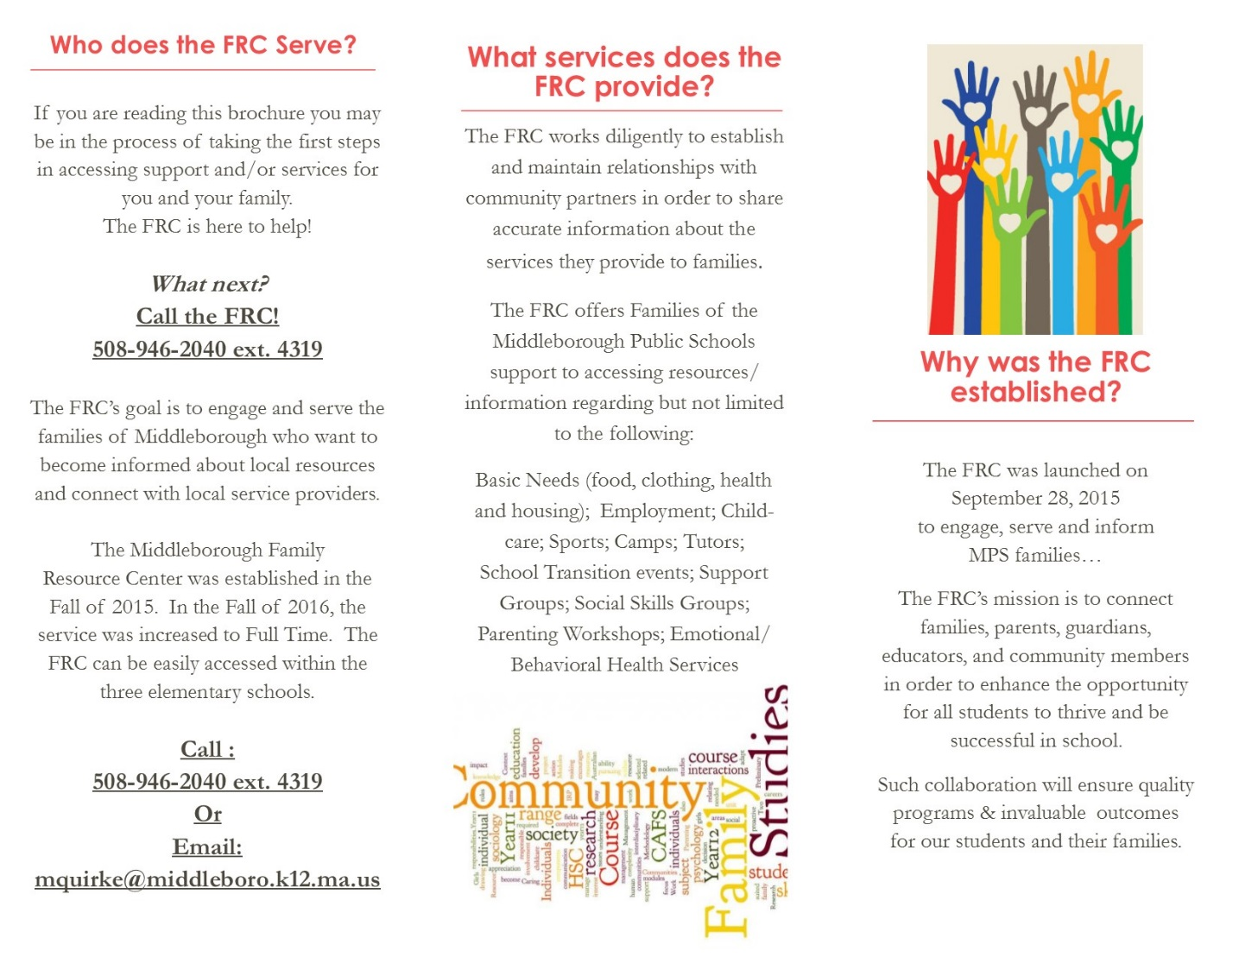
Informational Brochure

