Slide 1
Family Child Care Capacity Pilot

Slide 2
Legislative History
The state’s Fiscal Year 2025 budget included a change to the General Laws governing EEC that removed language that set a cap on the number of children Family Child Care programs could care for, known as group sizes, at 10 children. At the time, FCC providers were the only provider type that was subject to this cap on group sizes through state law.
The removal of this language meant EEC’s FCC licensing regulations define group sizes for FCC providers.
While EEC’s FCC licensing regulations currently maintain group sizes for FCCs at 10 children, the change to the law has enabled EEC to consider FCC group size and ratios as a part of its ongoing regulatory review.

Slide 3
Family Child Care Capacity Pilot Program
The Family Child Care (FCC) Capacity Pilot Program will evaluate the feasibility of increasing licensed enrollment in Family Child Care homes from 10 to 12 children while maintaining program quality, safety, and regulatory compliance.
The pilot will follow a small group of FCC providers granted permission to serve up to 12 children, collect operational data, educator and family feedback, and licensing monitoring outcomes to inform future regulatory, policy, and support decisions related to FCC capacity, staffing ratios, groupings and licensing structures.
The Pilot will help identify:
Key challenges
Staffing issues
Compliance trends
Impacts to licensors
System impacts

Slide 4

Feedback for Pilot Design
Licensor Learning Circles
FCC Licensing team worked together to put together a pilot proposal and learning goals.
FCC Educator Working Group
Gathered feedback from educators across the state on pilot design, participation and learning goals.
FCC Systems Working Group
Gathered feedback from FCC Systems staff on pilot design and support needed for pilot success.
Feedback Survey
Short survey shared with working group members to weigh in on design elements.

Slide 5
Pilot Eligibility
EEC will send eligible FCC providers (1,374 in total) information on how to apply.
To participate FCC providers should meet the following criteria:
  License is in good standing (no pending enforcement actions, sanctions, or serious licensing violations)
  Licensed for 10 children
  Program has operated continuously with a licensed capacity of 10 for at least 3 full years
Target pilot size: 25-30 programs, ~5 per region to ensure statewide representation and varied program types.

Slide 6
Pilot Participation Requirements
Staffing
Licensee resides in the home and actively works full time with children
1 full time Certified Assistant
Additional staff approved, at a minimum, as Regular Assistants
Facility
35 sq ft/child (420sq ft minimum indoor space for 12)
900 sq ft outdoor space meeting current regs (or approved alternative playground)
Operates on 1st or 2nd floor or basement only
Notifications
Local Municipality
Local Fire Department
FCC System
CCR&R
CACFP
Parents & Guardians
Program/Educator
Updated parent handbook
Staff schedule
Staff records checklist
Compliance with transportation regulations
Monitoring and Data
Attend pilot orientation
Submit monthly attendance
Complete survey and feedback activities
Participate in 2 monitoring visits within the first 6 months
Attend exit meeting
Notes:
Erin

Slide 7
Pilot Selection Criteria
Each category evaluates a program’s readiness to manage expanded enrollment safely.
Criteria | Description
Learning and Adaptability | Educator’s readiness to participate in the pilot and their ability to adapt program operations
Engagement | Educator’s engagement in professional development, initiatives, and communication with licensing
Educator and Program Experience | Educator’s experience operating an FCC program and ability to maintain quality while caring for a larger group
Family Needs | Educator’s communication and partnership with families and how increased capacity will support family needs
Staffing Consistency | Educator’s ability to maintain safe supervision and consistent staffing practices while caring for a larger group
Attendance Record | To evaluate consistency and capacity of enrollment/attendance over the previous month, prioritizing programs that maintain full or near-full attendance (10 children).
Notes:
Erin

Slide 8
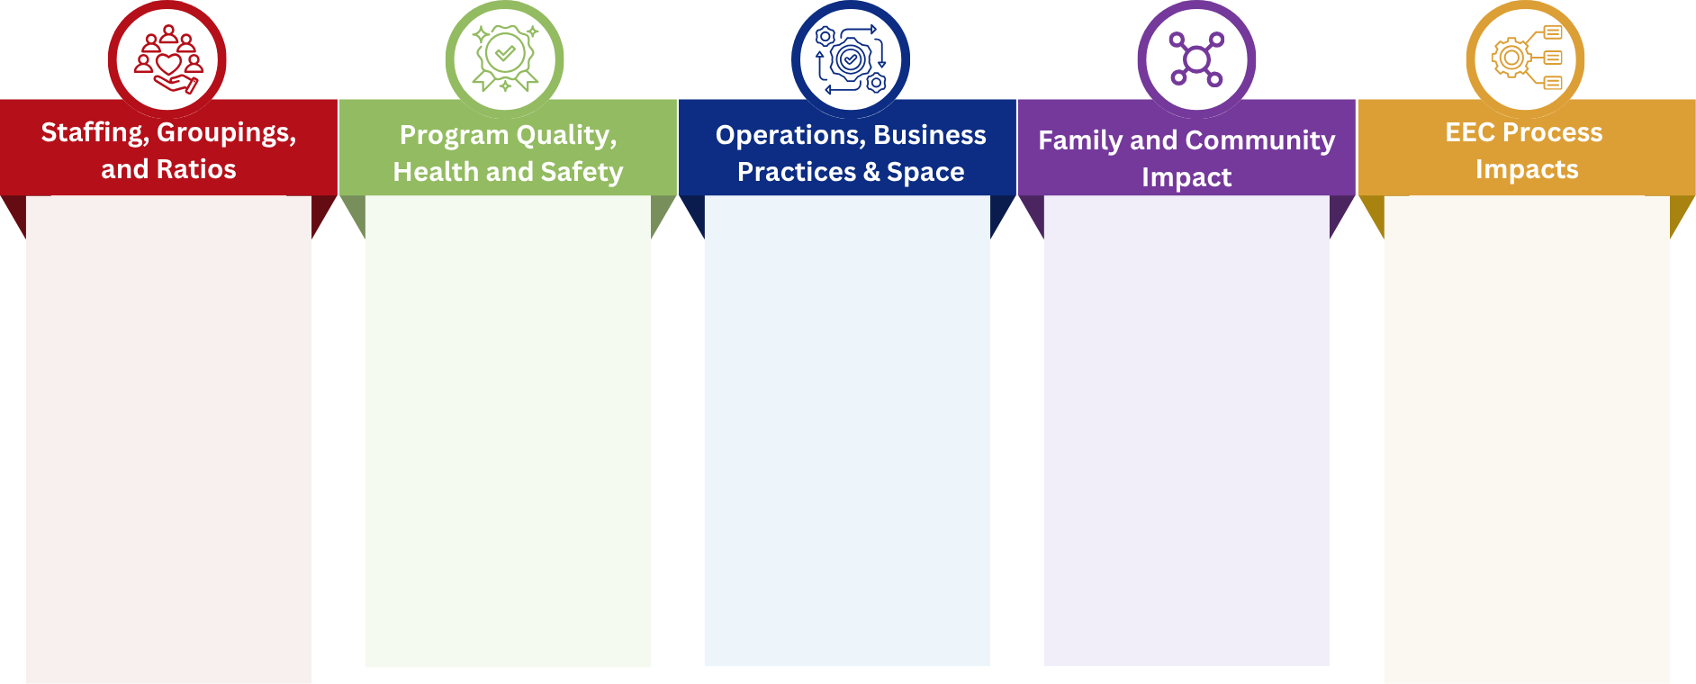
Learning from the Pilot
Key Questions to help inform regulation, policy, and support updates.
How staffing patterns shift
Approaches to recruitment and retention
Wage structures
Impact on complaints/non-compliances
Educator-licensor relationship
Multi-age curriculum
Changes to program philosophy/core values
Quality supports needed
Process for scaling from 10 to 12
Operational adjustments required
Insurance and liability considerations
Impact on space needs
Changes in program costs, revenue and budgets
Sibling care continuity
Community demand
Seasonal shifts in care
Impact of licensors’ workload
LEAD enhancements required

Slide 9
Timeline
Proposed next steps for the pilot program
Winter/ Spring
June
July
August
Pilot design
Engagement with the licensing team, FCC Systems and FCC Educators to create the pilot scope and eligibility.
Application opens
Qualified FCC Programs are invited to apply. The application will be open for one month.
Application review
EEC team reviews all applications looking for a variety of programs across all regions.
Pilot begins
Throughout the process the EEC team will be working with pilot participants to collect data and gather feedback.

