Slide 1
Setting You Up for Success:
Child Care Stabilization Grant Compliance
April 2022

Slide 2
Session Protocols

Slide 3
Session Protocols
Attendees will be on mute.
Translation is available; please select the correct channel.
The Chat and Q&A boxes will be disabled for this session.
  EEC will be presenting FAQs at the end of this session.
  An evening Office Hours session will be scheduled for another date.

Slide 4
Agenda and Introductions

Slide 5
Agenda and Introductions
Introductions
  Setting the Stage
  Acronyms and Definitions
Compliance with Grant Requirements
Expenditure Tracking
Internal Controls
Fiscal Monitoring
Resources and Additional Information
Disclaimer
Frequently Asked Questions

Slide 6
Agenda and Introductions (continued)
Today’s speakers:
Alicia Siryon-Wells, Associate Commissioner for Audit Resolution, Department of Early Education and Care
Anthony Trapasso, Managing Director, KPMG LLP
David Gmelich, Director, KPMG LLP
Evan Lehman, Director, KPMG LLP
Caitlin N. Carney, Senior Associate, KPMG LLP
Dominique Moran, Associate, KPMG LLP
Julia Mati, Associate, KPMG LLP

Slide 7
Setting the Stage

Slide 8
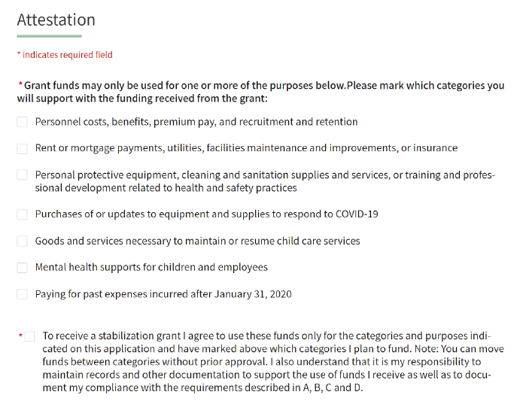
Setting the Stage
Your responsibility
As a recipient of Child Care Stabilization Grant (the Grant) funds, you are responsible for ensuring proper use of the Grant funds and maintaining appropriate documentation related to Grant fund expenditures.
Accordingly, you should be:
  Spending the Grant funds only on allowable uses
  Referring to the attestations in the grant application to how to maintain documentation for grant expenditures

Slide 9
Setting the Stage (continued)
Purpose
The purpose of this presentation is to:
  Remind you of the Grant’s requirements
  Share helpful suggestions for complying with the Grant’s requirements
  Provide you an opportunity to ask questions on these topics.
As a qualifying child care provider, you are:
An existing licensed provider of child care at the time you applied to (EEC) for the Grant funds
Open and available to provide child care services on the date you applied for Grant funds (this includes existing child care providers who, on the date they applied, were temporarily closed due to reasons relating to the COVID-19 public health emergency)
A funded program approved by EEC or run by private schools that otherwise meet the conditions or criteria above.
Source:
The Administration for Children and Families ARP Act Child Care Stabilization Grants CCDF-ACF-IM-2021-02

Slide 10
Polling Question #1

Slide 11
Polling Question #1
Have you ever received funds from EEC before?
Yes
No
Not sure

Slide 12
Acronyms and Definitions

Slide 13
Acronyms and Definitions
Acronyms
Acronym | Definition
ACF | Administration for Children and Families
ARP Act | American Rescue Plan Act
LEAD | Licensing Education Analytic Database
EEC | Massachusetts Department of Early Education and Care

Slide 14
Acronyms and Definitions (continued)
Definitions
Term | Definition
Program Error | Unintentional errors based on information entered in the Grant application that result in overpayment of Grant funds will result in recoupment of funds.
Intentional Program Error | Any violation or misapplication of law, regulation, or policy governing the administration of Grant funds, regardless of whether such a violation results in recoupment.
Attestation | An official verification of something as true or authentic.
Expenditure | A payment with either cash or credit to purchase goods or services.
Internal Control | Processes used by management to help an entity achieve its objectives.
Fiscal Monitoring | A review process to ensure proper use of Grant funds.
Notes:
Attestation: Attestation Definition & Meaning - Merriam-Webster
Expenditure: What is an Expenditure? - Overview, Guide and Examples (corporatefinanceinstitute.com) (was spending too much time looking for a definition from an official gov/accounting website)
Internal control: greenbook

Slide 15
Acronyms and Definitions (continued)
Definitions (continued)
Term | Definition
Fraud | The wrongful or criminal deception intended to result in financial or personal gain. Fraud includes false representation of fact, making false statements, or concealment of information.
Waste | The thoughtless or careless expenditure, mismanagement, or abuse of resources. Waste also includes incurring unnecessary costs resulting from inefficient or ineffective practices, systems, or controls.
Abuse | Excessive or improper use of a thing, or to use something in a manner contrary to the natural or legal rules for its use. Abuse can occur in financial or nonfinancial settings.
Duplication of Benefits | Occurs when a person, household, business, government, or other entity receives financial assistance from multiple sources for the same purpose, and the total assistance received for that purpose is more than the total need for assistance.
Allowability of Expenditure | How grant funds are permitted to be used under relevant rules and regulations (specifics to be discussed later in presentation).
Notes:
Attestation: Attestation Definition & Meaning - Merriam-Webster
Expenditure: What is an Expenditure? - Overview, Guide and Examples (corporatefinanceinstitute.com) (was spending too much time looking for a definition from an official gov/accounting website)
Internal control: greenbook
FWA - OIG What is considered fraud, waste, or abuse? | Office of Inspector General (usaid.gov)
DOB – Lowell, mass gov Duplication-of-Benefits-Notice (lowellma.gov)

Slide 16
Polling Question #2

Slide 17
Polling Question #2
What are you most interested in learning about today?
Internal controls
Expenditure tracking and overall documentation
Attestation
Managing multiple funding sources from EEC and other entities
Fraud, waste, and abuse
I’m not sure, but I’m excited to find out!

Slide 18
Polling Question #3

Slide 19
Polling Question #3
How much support do you think your organization will need to comply with Child Care Stabilization Grant requirements?
A lot of support
Some support
No support

Slide 20
Allowability of Fund Expenditures

Slide 21

Allowability of Fund Expenditures
How may Grant funds be used?
Personnel salaries and wages:
  Includes hiring incentives for new employees and bonuses for existing employees.
  Remember: As of the submission date of the Grant application, you must continue to pay full compensation to staff (including benefits) and may not involuntarily furlough staff.
Rent, utilities, facilities maintenance, and insurance:
  The Grant funds may not be used for construction or major renovations per 45 Code of Federal Regulations 98.2.
  Major renovations are structural changes to the foundation, roof, floor, exterior, or load-bearing walls of a facility; the extension of a facility to increase its floor area; or extensive alteration of a facility such as to significantly change its function and purpose, even if such renovation does not include any structural change.
Notes:
Construction Clipart Vector Art, Icons, and Graphics for Free Download (vecteezy.com)

Slide 22
Allowability of Fund Expenditures (continued)
Personal protective equipment, cleaning, and other health and safety practices
Equipment and supplies
Goods and services related to the child care facility, program, and providers, including professional development
Mental health services
Paying for past expenses incurred after January 31, 2020, including COVID-19-related debt
Sources:
ARP Act, Child Care Stabilization Section 2022, p. 30–31
The Administration for Children and Families, ARP Act Child Care Stabilization Grants CCDF-ACF-IM-2021-02

Slide 23
Maintenance of Documentation

Slide 24
Maintenance of Documentation
EEC may request to review supporting documentation following a provider’s receipt of Grant funds.
Providers should consider:
Using the Grant expenditure template or a similar tool to track the Grant fund expenditures
Recording transactions in an accurate and timely fashion and retaining adequate support to substantiate the expenditures.

Slide 25
Maintenance of Documentation (continued)
Example documentation to help demonstrate permissible use of the Grant funds:
For payroll, benefits, and paid leave time:
  Payroll and benefit records from a payroll report or a payroll ledger
  Employee timecards and pay stubs
For rent or mortgage, business, operating costs, utilities, and maintenance:
  Mortgage or rental space agreements
  Utility statements
  Paid invoices and/or receipts for purchases of materials and supplies

Slide 26
Maintenance of Documentation (continued)
For program materials:
  Electronic receipts from websites for purchase of educational materials
  Paper receipts from traditional retailers.
Important: You must be able to readily produce the necessary documentation and data to satisfy state or federal review requests.
Sources:
ARP Act, Child Care Stabilization Section 2022, p. 30–31
Office of Inspector General, Lessons Learned for CARES Act Awards

Slide 27
Expenditure Tracking

Slide 28
Expenditure Tracking
While you are required to keep supporting documentation, you are highly encouraged to also have a tracker of all expenditures made with Grant funds.
To accomplish this, you should record basic information about each expenditure, such as:
Date of the expenditure
Amount of the expenditure (in dollars)
Which category of allowable use the expenditure falls under
The form of supporting documentation on file for the expenditure.

Slide 29
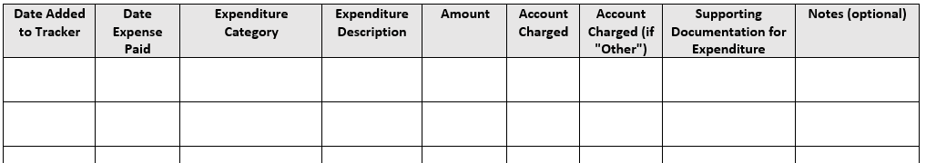
Expenditure Tracking (continued)
If you do already have a tool you use, then ensure all data elements below are included, or consider updating your tool.
If you don’t already have a tool, something like this in place, then EEC has a template for you to utilize that we will walk-through now.

Slide 30
Understanding the Importance of Attestation

Slide 31
Understanding the Importance of Attestation
When you make an attestation, you’re guaranteeing something is true.
EEC and the federal government expect that you can provide documentation to support any attestations you make as part of the Grant program.
During each application cycle, check to ensure you are still in compliance with the attestation statements on the application. If you are not in compliance, then you must take the necessary steps to comply before applying for Grant funds again.
It may be helpful to turn the list of attestations into a checklist and review the list prior to recertification.

Slide 32
Understanding the Importance of Attestation (continued)
What you attest to every time you apply for Grant funds continued:

Slide 33
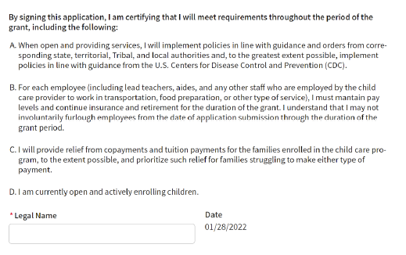
Understanding the Importance of Attestation (continued)
What you attest to every time you apply for Grant funds:
Sources:
GSA Application
FCC Application

Slide 34
Internal Controls

Slide 35

Internal Controls
Internal control defined: Internal control activities are processes used by management to help an entity achieve its objectives.
Why implement internal controls?
Help run operations efficiently and effectively
Help prevent or detect problems and/or to identify them sooner if an issue occurs
Reduce possibility of mismanagement and error
Comply with applicable laws and regulations.

Slide 36
Internal Controls (continued)
What internal controls might be applicable to managing Grant funds?
Processes to help ensure accurate and timely recording of transactions:
  Setting a recurring reminder (e.g., using an email calendar feature) to record transactions (e.g., on a weekly basis) and review the recorded transactions for accuracy
  If possible, have more than one individual periodically review the organization’s financial records.
Processes to retain appropriate documentation of transactions and policies:
  Drafting/using a checklist of required documentation and periodically verifying all documents are complete, accurate, and protected from unauthorized access

Slide 37
Internal Controls (continued)
Processes that may help reduce the risk of fraud, waste, and abuse:
  Having processes clearly laid out and reviewed/confirmed to help ensure they can be readily followed
  Protecting physical security of assets such as property, equipment, and inventory:
      Keeping filing cabinets locked
      If records are digitized, then installing proper information technology security measures

Slide 38
Internal Controls (continued)
What should you do once internal controls are implemented?
Review the internal controls regularly and ask yourself:
  Are key transactions prepared and formally approved (e.g., is there documented evidence of approval such as an email or a reviewer’s initials/date on the document evidencing the review)?
  Are key documents assembled and securely stored?
  “What can go wrong” and “What can I do to help prevent that?”
Review these policies for relevance and effectiveness on a regular basis (at least annually), such as when key procedures are added or when new employees join the team.
Take appropriate corrective action if deficiencies are identified.
Encourage continuous improvement to existing internal controls and monitoring.
Sources:
Massachusetts, COVID-19 Pandemic Response Internal Controls Guidance
Massachusetts Comptroller, Internal Control Guide

Slide 39
Internal Controls (continued)
If you are a smaller provider, then it may not be feasible to implement certain internal controls. Potential internal control limitations include:
Resource constraints
Conflicts of interest
The lack of necessary skills or training.
You should consider each of these potential limitations when creating and reviewing internal controls for your operation and determine if any alternative approaches are feasible where appropriate.

Slide 40
Receiving Grant Funds from Multiple Sources

Slide 41
Receiving Grant Funds from Multiple Sources
Providers are allowed to receive grant funding from multiple sources, but it is important to ensure these funds are being tracked separately:
If these funds overlap, then you may be unable to demonstrate the funds are being spent on allowable purposes defined by each specific grant requirement.
What should you do if you are receiving funds from multiple grant programs?
Document the amount of funds received from each source and keep it on file for your reference when considering proper use of funds.
Review the terms of each grant program to clearly understand the allowable (and nonallowable) uses of grant funds.

Slide 42
Receiving Grant Funds from Multiple Sources (continued)
What should you do if you are receiving funds from different grant programs? (continued)
Segregate funds from different grant funding sources, whether physically separating checks or depositing the funds in different bank accounts.
When populating the expenditure trackers (described previously), make sure to only include funds received from the Grant program.
Implement internal controls over processes for the use of separate grant funds, so staff do not try to claim expenses already covered by another grant.
Sources:
COVID-19 Pandemic Response Internal Controls Guidance
Massachusetts Comptroller, Internal Control Guide
Pandemic Response and Accountability Committee, Lessons Learned in Oversight of Pandemic Relief Funds

Slide 43
Fraud, Waste, and Abuse

Slide 44
Fraud, Waste, and Abuse
What can you do to reduce the overall risk of fraud, waste, and abuse?
Keep complete and organized supporting documentation for all financial transactions.
Brainstorm potential fraud risks applicable to your organization and consider preventative measures.
Implement internal controls applicable to your organization.
Periodically review existing internal controls for applicability and efficiency.
Confirm your compliance with the application’s attestation statements before submitting the application.
Ensure staff roles and organization support proper segregation of duties.
Sources:
COVID-19 Pandemic Response Internal Controls Guidance
Massachusetts Comptroller, Internal Control Guide
Pandemic Response and Accountability Committee, Lessons Learned in Oversight of Pandemic Relief Funds

Slide 45
Fiscal Monitoring

Slide 46
Fiscal Monitoring
What is fiscal monitoring?
Fiscal monitoring is the review process that EEC will employ to help ensure you are using Grant funds correctly.
Purpose
To help you ensure that you have the processes and documentation in place to successfully comply with the Grant’s requirements.
Additional information
EEC or its designee will conduct fiscal monitoring over the use of the Grant funds.
If you have received grants from EEC or other government agencies before, you have likely been through fiscal monitoring.
Some programs already undergo fiscal monitoring from EEC and CCRR.
Fiscal monitoring is a great opportunity for partnership and learning.

Slide 47
Fiscal Monitoring (continued)
Additional information (continued)
Fiscal monitoring is not voluntary (it is required).
EEC or its designee will notify you if you are selected for a review:
There will be no unannounced visits or requests.
This notification will include whether the review will be conducted on-site or remotely.
Due to the large number of grantees, these reviews will be ongoing.

Slide 48
Fiscal Monitoring (continued)
What you might see as part of the fiscal monitoring program:
Requests for documentation evidencing expenditures made with Grant funds (to assess compliance with the fund)
Completion of a questionnaire that may include inquiries seeking:
  General provider information
  Information about your accounting systems/processes
  Internal controls in place
A report from EEC or its designee communicating results from fiscal monitoring activities and any recommendations for improvement
What should you do to prepare?
As always, you should:
Retain documentation to support each expenditure (e.g., receipts, checks, etc.)
Document all significant conversations or correspondence regarding use of the Grant funds, including management processes/topic, points of use (e.g., retain meeting minutes/emails, etc.)

Slide 49
Fiscal Monitoring (continued)
What should you do to prepare? (continued)
As always, you should:
Identify and assess potential ways to improve your internal controls, specifically those related to documentation of expenditures (discussed on slides 23-26).
Things to note:
In cases of noncompliance, EEC will work with programs in the appropriate and required resolutions.
For additional guidance, review the “Resources and Additional Information” section.
Please do not send EEC or its designee any sensitive data or personally identifiable information.

Slide 50
Frequently Asked Questions

Slide 51
Frequently Asked Questions
When and where will a copy of the slide deck from the training session be available?
  EEC will send a copy of the slide deck to those who registered for the trainings later this week.
  Translated versions of the slide deck and other materials including a recording of the webinars will be posted on EEC’s Engagement Portal in mid-April:
    Live Engagement — EEC Strategic Plan Portal
What is the timeline for the funding of the Child Care Stabilization Grant (Grant)?
  Funding will continue thru June 2022. Future funding awaits further appropriations.
What is the deadline for spending down all Stabilization Grant funds?
  Recipients of the C3 Grant are considered subawards, therefore, there is no deadline for the expending of the grant.

Slide 52
Frequently Asked Questions
Do we have to spend all grant funding each month?
Recipients of the C3 grant are not required to spend the finding within the month the funds are received.
Are we allowed to use our grant money all on one category? For example: just use it for payroll.
Funds can be spent in any of the allowable categories.
I agree to the C3 Grant Attestations every month; what documentation do I need to prove these attestations?
Within the Grant Attestation, you attest to using the funds for at least one of the allowable categories. Supporting documentation must be retained to demonstrate that the expenditure falls within the allowable use categories.
General examples of documentation include, but are not limited to, receipts (electronic or paper), paid invoices, payroll records, and employee timecards.

Slide 53
Frequently Asked Questions
Are there deadlines for when funding from the Grant needs to be spent by?
  Recipients of the C3 grant are considered subawards, therefore, there is no deadline for the expending of the grant.
If I have not been tracking my expenses for the Grant, what is the appropriate course of action?
  EEC expects that all providers receiving funding from the Grant are tracking expenses and retaining supporting documentation, as State and Federal reviews may occur. Your organization may be asked to provide supporting documentation for proof of allowable use.
Do we need to show evidence that an allowable expense is an amount above and beyond what we would have spent before receiving grant funds?
Child Care program only need to recipients only need to submit documentation related to the C3 grant.

Slide 54
Frequently Asked Questions
How can I best prepare for a fiscal monitoring review? What if I am not selected for a fiscal monitoring review?
To prepare for a fiscal monitoring review, you should consider:
Documenting all expenditures made with Grant funds by using the recommended Expenditure Tracker, which can be found in LEAD, or a similar tool, that includes at a minimum:
  the date of the expenditure;
  the amount (in dollars) of the expenditure;
  the category of allowable uses the expenditure falls under; and
  the type of supporting documentation for the expenditure.
Retaining documentation to support each expenditure (e.g., receipts, checks, etc.); and
Reviewing training materials provided by EEC.
The responsibilities for documentation are the same regardless of whether you are selected for review or not. If you have not been selected for a review, that means you should use that time to prepare as you may be selected for review or asked for supporting documentation in the future.

Slide 55
Frequently Asked Questions
Will EEC make an unscheduled visit to conduct fiscal monitoring activities? How will I know if I’m required to participate in the fiscal monitoring process?
  EEC will not make an unscheduled visit for fiscal monitoring activities. EEC will notify you in advance if a review will occur and whether the review will be on-site or remotely.
During the fiscal monitoring review process, will other sources of funding be reviewed outside of the Child Care Stabilization Grant (such as a PPE loan)?
  The Child Care Stabilization Grant is the sole focus of fiscal monitoring reviews.

Slide 56
Frequently Asked Questions
I receive multiple streams of funding from EEC and other state agencies; how do I manage this appropriately?
When receiving multiple streams of funding from EEC, you should:
Document the amount(s) of funds received from each source separately;
Review the terms of each grant program to clearly understand the allowable (and nonallowable) uses;
Segregate funds among each of the different grant funding sources, whether physically separating checks or depositing the funds in different bank accounts; and
Use the Expenditure Tracker, which can be found in LEAD, for only funds received from the Child Care Stabilization Grant program.

Slide 57
Frequently Asked Questions
What type of private information should not be submitted during the fiscal monitoring review process?
  Private information such as social security information, home addresses of employees, fingerprint records, driver’s licenses numbers, medical information, credit card information, bank account numbers of employees, etc. are pieces of private information that should not be sent to EEC or its designee during the fiscal monitoring review.
Where can the Expenditure Tracker document be located?
  The Expenditure Tracker can be found in LEAD. This will be made available at the end of the training sessions, likely in mid-to-late April.
What might happen if I am selected for fiscal monitoring and I do not have all of the documentation to support my grant spending?
  EEC will work with programs in determining what would be acceptable documentation to support the expending of grant funds.

Slide 58
Frequently Asked Questions
What are the regulations for how the Grant Award can be used for payroll?
  Employers are required to pay all employees “full compensation,” which is the amount paid to the employee as of the application submission date.
    If an employee is hourly, full compensation is the employee’s hourly rate, not their total earnings for a certain period.
      You may not decrease an hourly employee’s rate, but are allowed to decrease the employee’s hours in a given week.
      You may not furlough any employees.
  Bonuses are allowable, including incentives for doing a good job or for staying with the organization for a specified amount of time.
  Stipends are allowable, including transportation to work and Covid-19 vaccine appointments.
  Benefits are allowable, including health, dental, and vision insurance; scholarships; paid sick or family leave; and retirement contributions ongoing professional development or training, premium or hazard pay.
Notes:
ARPA:
“Personnel costs, including payroll and salaries or similar compensation for an employee (including any sole proprietor or independent contractor), employee benefits, premium pay, or costs for employee recruitment and retention.”
“For each employee, the provider will pay not less than the full compensation, including any benefits, that was provided to the employee as of the date of submission of the application for the subgrant (referred to in this subclause as ‘‘full compensation’’), and will not take any action that reduces the weekly amount of the employee’s compensation below the weekly amount of full compensation, or that reduces the employee’s rate of compensation below the rate of full compensation, including the involuntary furloughing of any employee employed on the date of submission of the application for the subgrant”
Child Care Development Fund- Administration for Children and Families-Information Memorandum (CCDF-ACF-IM-2021)
Wages and benefits for child care program personnel, including increases in compensation for any staff in a child care center or family child care providers and their employees; health, dental, and vision insurance; scholarships; paid sick or family leave; and retirement contributions. Raising the wages of child care staff is a central part of stabilizing the industry, and lead agencies are strongly encouraged to prioritize this use of funds. Other examples of allowable personnel costs include ongoing professional development or training, premium or hazard pay, staff bonuses, and employee transportation costs to or from work.
Child care providers may also use resources to support staff in accessing COVID-19 vaccines, including paid time off for vaccine appointments and to manage side effects, as well as transportation costs to vaccine appointments.

Slide 59
Frequently Asked Questions
What is the difference between a major renovation and building updates/maintenance?
  Major renovations include:
    Structural changes to the foundation, roof, floor exterior or load-bearing walls of a facility
    Extension of a facility to increase its floor area
    Extensive alteration of a facility such as to significantly change its function and purpose, even if such renovation does include structural change.
  Building updates or maintenance to the facility and/or grounds are changes that do not change the fundamental structure of the building or change the function or purpose of the facility.

Slide 60
Frequently Asked Questions
What is the difference between a major renovation and building updates/maintenance? (continued)
  Some examples of allowable use can be, but are not limited to:
    Fixing your HVAC system
    Removing snow or other weather-related services
    Updating the playground
    Installing new carpeting or flooring
    Replacing outdated fixtures and general repairs
  Please reference the link of the major renovation’s definition for further guidance, see 45 CFR § 98.2 –CCDF-ACF Information Memorandum

Slide 61
Frequently Asked Questions
Is the grant award funding of the Child Care Stabilization Grant taxable?
In a recent webinar hosted by the Office of Child Care Technical Assistance Network, national family child care business expert Tom Copeland provided an overview of the stabilization grants and how family child care homes can handle the tax implications. The tax implications of the grants depend on several factors, namely, how the provider uses the funds, the provider’s household income, and possibly the state in which they live.
Family child care providers must report any portion of the stabilization grant that they use to pay themselves as taxable income on their federal and state income tax return (unless their state chooses to make the grant not taxable).
  https://buildinitiative.org/resource-library/what-are-the-tax-considerations-of-the-american-rescue-plan-act-arpa-child-care-stabilization-grants-for-home-based-child-care-providers/
EEC advises childcare programs consult with Accountants on their tax status.

Slide 62
Frequently Asked Questions
How do I find out how much I have received in grant funds?
You should be able to review your payments in LEAD. If you feel there are missing payments, direct your questions to the Help Desk at 1-833-600-2074 or eecgrantsupport@mtxb2b.com.
Below are the steps you will need to take to get a listing of your paid amounts.
Go to https://eeclead.force.com/EEC_Login.
Enter your LEAD username, enter your LEAD password, and click Login.
On the homepage, click on the Grant Management tile to open the Grants Management system and Dashboard.
Click Log in on the desired Program to go to that Program’s EEC ARPA Grants page.
If there are multiple Programs registered, “Search Provider” to quickly locate the Provider.
Now you are on the Dashboard page, scroll down to the Recertification Section.
The Recertification section will contain the list of all applications including - Funding Month, Fund Distribution Status, Projected Amount, and Due Date.

Slide 63
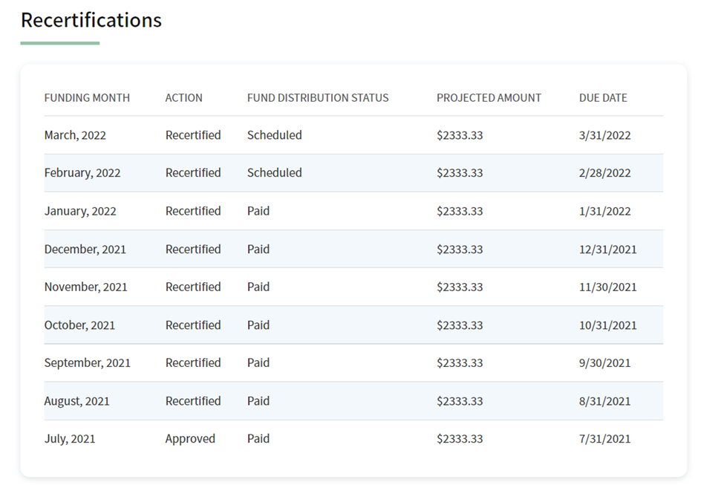
Frequently Asked Questions
How do I find out how much I have received in grant funds?

Slide 64
Resources and Additional Information

Slide 65
Resources and Additional Information
Join us for our “Office Hours” to ask follow-up questions related to Grant compliance. You can join us at the below dates and times:
Office Hours
  Friday, April 8th 1-3pm
  Tuesday, April 12th 10am-12pm
EEC resources:
EEC’s YouTube Channel: EEC ARPA Child Care Stabilization Grant Video Support – YouTube
Child Care Stabilization Grants Website: Commonwealth Cares for Children / Child Care Stabilization Grants | Mass.gov
Child Care Stabilization Grants FAQs: Child Care Stabilization Grants FAQs | Mass.gov
Grant Applications (LEAD): EEC: Login (force.com)

Slide 66
Resources and Additional Information (continued)
Grant requirement resources:
ACF Information Memorandum ARP Act Child Care Stabilization Funds: https://www.acf.hhs.gov/sites/default/files/documents/occ/CCDF-ACF-IM-2021-02.pdf
American Rescue Plan Act: PUBL002.PS (congress.gov)
Massachusetts Supplemental Budget: https://malegislature.gov/Bills/192/H3973
New York Office of Children and Family Services: https://ocfs.ny.gov/main/contracts/funding/COVID-relief/child care-stabilization/child care-Stabilization-Grant-Provider-Attestation.en.es.pdf
Additional helpful resources:
Federal Office of Inspector General: DOI OIG Lessons Learned for CARES Act Awards (oversight.gov)
Pandemic Response Accountability Committee: https://www.pandemicoversight.gov/media/file/pandemic-response-accountability-committee-lessons-learned0pdf

Slide 67
Resources and Additional Information (continued)
Additional helpful resources (continued)
ACF Internal Controls Resources https://child careta.acf.hhs.gov/resource/strengthening-stabilization-grant-integrity-internal-controls
COVID-19 Pandemic Response Internal Controls Guidance: COVID-19 Pandemic Response Internal Controls Guidance – Office of the Comptroller (macomptroller.org)
Massachusetts Comptroller Internal Control Guide: internal-control-guide.pdf (macomptroller.org)
Lowell, Massachusetts Government: https://www.lowellma.gov/DocumentCenter/View/14194/Duplication-of-Benefits-Notice
GAO Greenbook: GAO-14-704G, Standards for Internal Control in the Federal Government
Washington State Child Care Stabilization Grant Spending and Documentation Guide: SpendDocGuide.pdf (wa.gov)

Slide 68
Disclaimer
KPMG LLP disclaimer
The information being provided today is the sole property and opinion of the Massachusetts Department of Early Education and Care (EEC) and has been approved in its entirety for content and accuracy by EEC. The information is being provided by EEC, and does not represent any opinion, counsel, advice, or information belonging to KPMG LLP.

Slide 69
Thank You

