Slide 1
Massachusetts Federal Funds Partnership
-This meeting will be recorded. ​
-Please mute yourself after arrival.
-Please submit your questions via the chat function.
-Questions will be answered during Q&A.
February 2026 Meeting

Slide 2
Agenda
Federal Updates
FFIO Updates & Open Federal Funding Opportunities
Q&A
Municipal and Tribal Technical Assistance Awards Announcement, Round 1 – Lieutenant Governor Kim Driscoll
Community One Stop Program - Anne Gobi, Director of Rural Affairs

Slide 3
MTTA Round 1 Award Announcement
-Lieutenant Governor Kim Driscoll

Slide 4
MTTA Round 1 Awards
MTTA Round 1 Awardees
  Town of Agawam - $50,000
    To offset costs to file for IRS Direct Pay Tax Credits.
  Town of Barnstable - $75,000
    To support permitting requirements for fish passage project at Upper Marstons Mills Pond.
  City of Brockton - $125,000
    To cover an application fee with the EPA for credit assistance acquiring the Aquaria Desalination Plant in Dighton.
  City of Gardner - $150,000
    To support planning and analysis related to a downtown economic impact study.
  City of Lawrence - $70,000
    To hire additional staff to manage FY2023 Safe Streets and Roads for All grant.
  City of Lynn - $200,000
    To hire personnel to support pursuit of federal funds for land acquisition and shoreline restoration of the South Harbor neighborhood.
  Town of Nantucket - $7,500
    To offset costs to file for IRS Direct Pay Tax Credits.
  City of Newburyport - $4,000
    To offset costs to file for IRS Direct Pay Tax Credits.
  North Shore Community Development Corporation (NSCDC) - $195,000
    To hire a consultant to support administration and filing for HUD Section 202 Funding for a senior housing project.
  Town of Stoneham - $47,250
    To offset costs to file for IRS Direct Pay Tax Credits.
  Town of Westhampton - $16,500
    To offset costs to file for IRS Direct Pay Tax Credits.

Slide 5
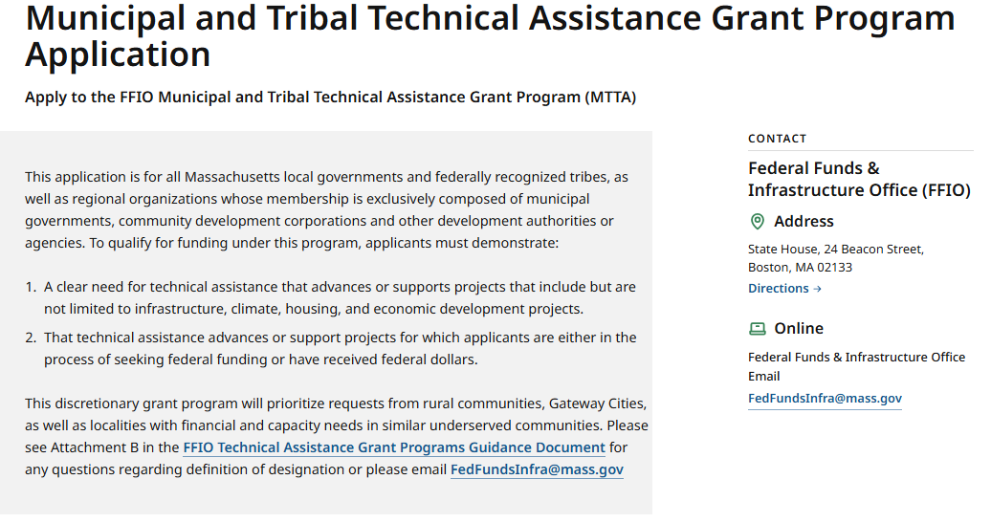
We are continuing to accept applications for MTTA!
Today’s announcement is just the first round of awards! We currently have pending applications under review and are continuing to accept applications on a rolling basis.
Learn more and apply at FFIO’s website:
  FFIO Technical Assistance Programs | Mass.gov
  Email: fedfundsinfra@mass.gov with questions!

Slide 6
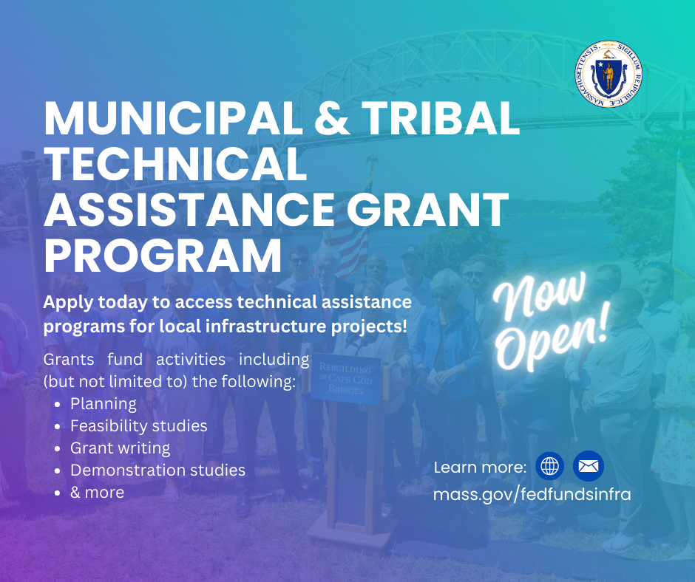
The Municipal and Tribal Technical Assistance (MTTA) Program
  FFIO’s Municipal & Tribal Technical Assistance Grant Program is accepting applications on a rolling basis. Projects must either be pursuing federal funding or have received federal funding.
  Grant funds support the following activities:
  Planning
  Feasibility studies
  Grant-writing
  Post-award implementation support
  Hiring personnel
  & more!

Slide 7
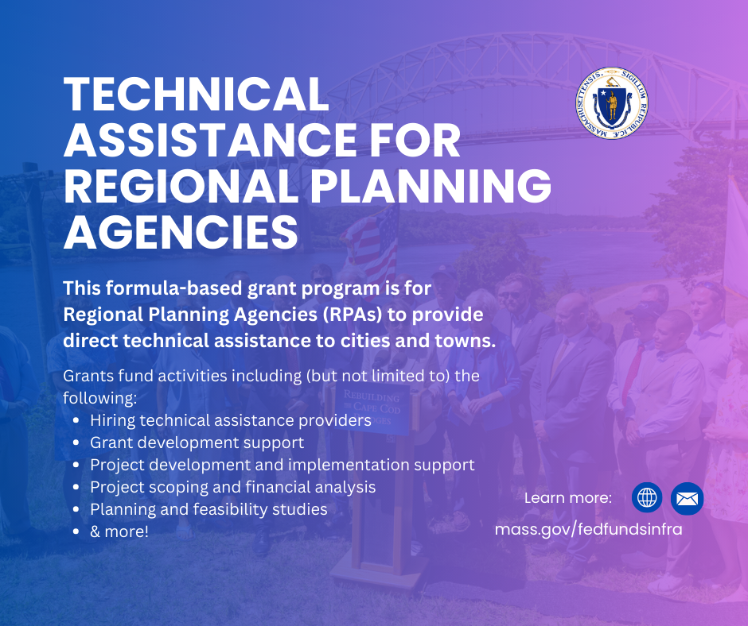
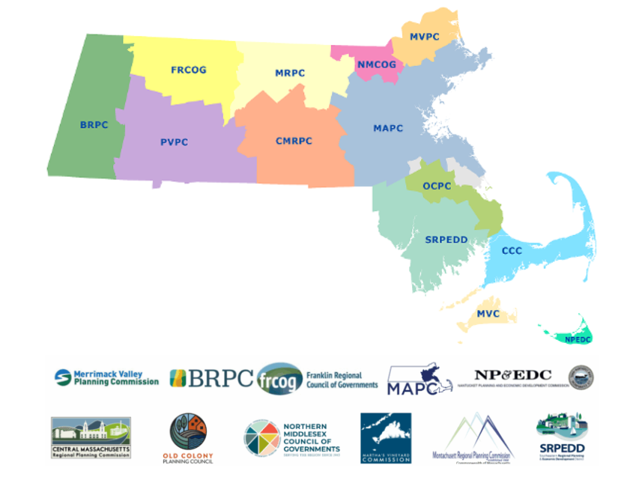
Technical Assistance for Regional Planning Agencies
In addition to MTTA – TARPA awards have been made to each of our state’s 13 regional planning agencies!

Slide 8
Federal Updates

Slide 9
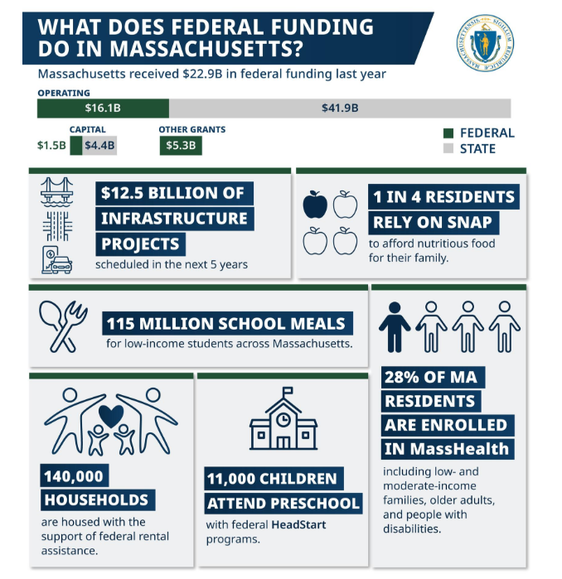
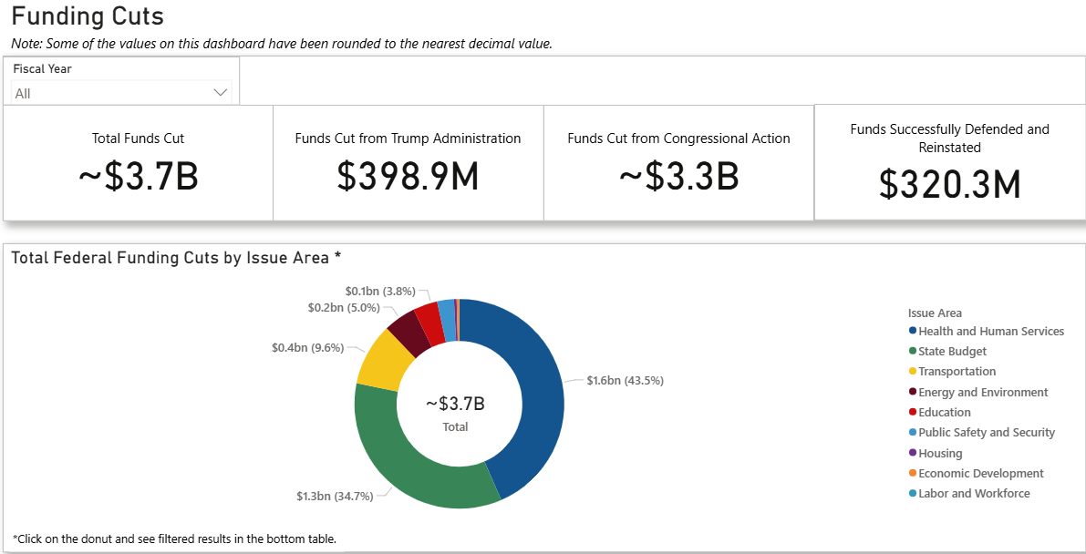
Mass.gov/FedImpact
Massachusetts is Tracking and Communicating the Impact of Federal Funding Cuts
Website updated weekly on federal funding impacts

Slide 10
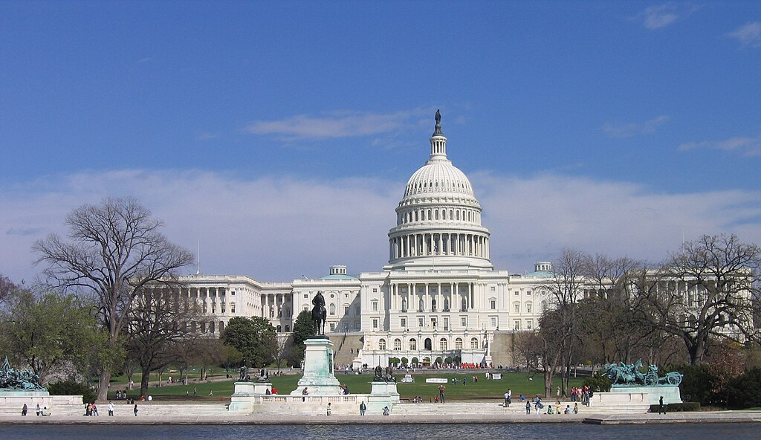
Federal Budget Updates
  Latest update
  To date, 11 of the 12 annual appropriations bills have been passed for FY2026. Notably, Congress has been unable to come to a long-term deal for the Department of Homeland Security (DHS), and the agency is currently shut down. DHS agencies which received funding from the BBB are largely unimpacted by the shutdown.

Slide 11



Get in touch with FFIO
Find more information on Federal Funds Partnership meetings, video recordings, grant lists, and other resources on the FFIO website.
Follow FFIO on LinkedIn to see the latest updates from our office.
Contact the FFIO email inbox (FedFundsInfra@mass.gov) for questions about federal grant opportunities!

Slide 12
Open Federal Funding Opportunities

Slide 13
Recently Opened Federal Grants
Grant Name | Eligibility | Max Award | Cost Share (Match) | Deadline
BJA FY25 Public Safety and Mental Health Initiative | State & Local governments, Federally-recognized tribes, and certain nonprofits (See NOFO for more) | $3M | Yes (See NOFO for details.) | 3/30/2026
BJA FY25 Local Law Enforcement Crime Gun Intelligence Center Integration Initiative | State, County, City, Township, Tribal, or Special district Governments, Tribes + (See NOFO for more.) | $700,000 | No match requirement. | 3/30/2026
Region 1 Fiscal Year 2025 Wetland Program Development Grants | Indian Tribes, State & Local Governments, Higher Ed., Interstate agencies, and Intertribal consortia | $350,000 | Minimum: 25% | 4/24/2026
*See FFIO’s monthly newsletter for the more open grants relevant to municipalities and tribes. To sign up, email fedfundsinfra@mass.gov. See grants.gov for full list of open federal grant opportunities.

Slide 14
COMMUNITY ONE STOP FOR GROWTH
FY27 Round

Slide 15
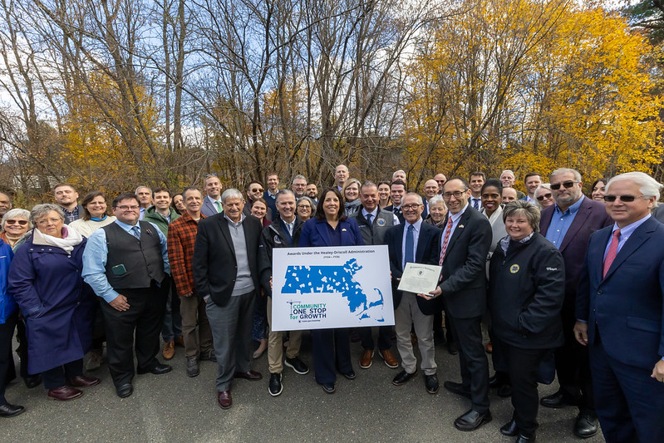
One Stop Overview: Brief History
Launched in January of 2021, the One Stop is a single application portal and collaborative review process designed to streamline the experience for the applicant and better coordinate economic development programs and staff on engagement and grant making.
The One Stop was created as part of the 2019 Economic Development Plan. Communities voiced frustration with not knowing about, and the challenges in accessing, state funding resources to help them advance their goals for economic growth.
The One Stop reorients the Commonwealth from a passive reviewer of funding requests to an active partner in economic development strategy, priorities, and investment.

Slide 16
One Stop Overview: Key Benefits
Easy Access to Multiple Programs | Projects can be considered for funding by multiple programs simultaneously, saving time on research and applications to different agencies and programs.
Guidance & Partnerships | Applicants can receive key feedback through optional Expression of Interest process and Virtual Office Hour sessions before completing a full application.
Collaborative Review | The Collaborative Review improves state funding coordination, awareness, and support for municipal community development goals.
360° View | Program staff get a full view of communities’ priorities, allowing the state to understand community vision beyond a single application.
Program Referrals | Staff can provide referrals to additional programs to support applicants’ priorities that do not fit within One Stop.

Slide 17

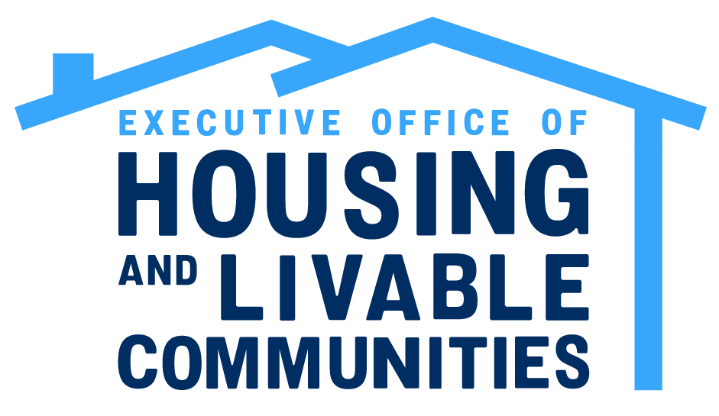

One Stop Overview: One Stop Programs
Executive Office of Economic Development
  MassWorks Infrastructure Program
  Rural Development Fund
  Massachusetts Vacant Storefront Program
  Massachusetts Downtown Initiative Capital Grant Program *New*
  Seaport Economic Council Grant Program *New*
Executive Office of Housing and Livable Communities
  HousingWorks Infrastructure Program
  Housing Choice Grant Program
  Community Planning Grants Program
  MBTA Community Catalyst Fund
MassDevelopment Finance Agency
  Underutilized Properties Program
  Site Readiness Program
  Brownfields Redevelopment Fund
  Real Estate Services Technical Assistance
  TDI Equity Investment Program

Slide 18
Development Continuum
To help guide applicants, the One Stop uses a Development Continuum that describes how a typical economic development project moves from concept to reality within diverse communities.
All projects submitted through the One Stop will fit within one Development Continuum category.
This continuum separates economic development activities into two broad categories:
Preparing for Growth - Grants to support activities and initial steps by community-based actors to attract and guide private investment in a community.
Catalyzing Specific Projects - Grants to support the private development of commercial, industrial and residential investment projects that further the community vision.
Preparing for Growth |  |  | Catalyzing Specific Projects
Planning & Zoning | Downtown Activation | Site Preparation | Building (Vertical Construction)
 |  |  | Infrastructure (Horizontal Construction)

Slide 19
One Stop Overview: The One Stop Process
Guidance Phase
Opportunity for applicants to receive guidance on project ideas through the Expression of Interest (EOI), Webinars, and Virtual Office Hours prior to submitting a Full Application.
Full Application
Designed to guide applicants to apply based on what their projects aims to do within the development lifecycle, on a scale that we call the Development Continuum.
Collaborative Review
Applications are not submitted to specific grant programs, but rather categories that are reviewed by multiple programs that best fit the funding needs of the project.
Award Decision
The multifaceted collaborative review process results in the recommendation of the most impactful projects across the state.

Slide 20
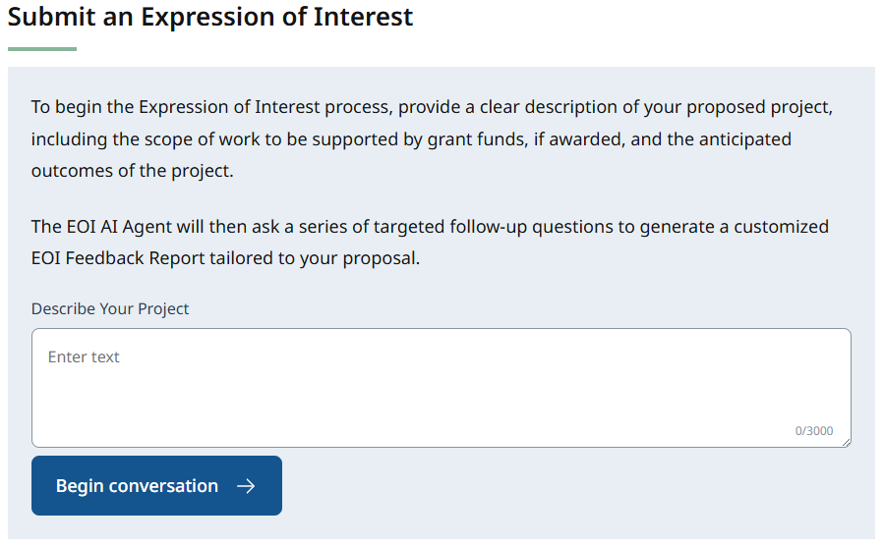
Guidance Phase: Expression of Interest
The Expression of Interest (EOI) allow prospective applicants the opportunity to receive guidance on priority projects before submitting a Full Application.
The EOI is now powered by AI to provide instant feedback tailored to each individual project.
Users will provide a project description and the EOI Agent asks follow up questions to determine whether the project is a fit for any One Stop programs.
If the project fits, feedback will include the names of the programs, why they were identified as a fit, and tips on how to be competitive for funding.
If the project is not a fit, there will be an explanation and referrals to outside programs, as applicable.
The EOI Tool is currently in beta: EOED staff monitor the system to ensure the most accurate information is provided.
Longer EOI Period: The EOI will remain open through the Full Application deadline

Slide 21
Guidance Phase: Virtual Office Hours and Webinars
Virtual Office Hour Sessions
One Stop General Guidance Office Hours – One Stop staff will hold several office hours to answer general One Stop process and technology questions.
Program Office Hours – Office hour sessions hosted by program staff to answer applicant questions about the respective program(s).
One Stop Webinars
  One Stop Webinar 1: One Stop Overview
  One Stop Webinar 2: Application Guidance
  Prerecorded Technology Webinars:
    Navigating IGX
    Expression of Interest Tool
    Navigating the Full Application
  Prerecorded webinars focused on each One Stop program

Slide 22
Guidance Phase: Webinars
One Stop Webinars
  One Stop Webinar 1: One Stop Overview Webinar ←You Are Here
  One Stop Webinar 2: One Stop Application Guidance Webinar – February 4, 2026
  One Stop Webinar 3: Prerecorded Technology Webinar – To Be Posted February 5, 2026
Program Webinars
  Prerecorded webinars focused on each One Stop program – To Be Posted February 12, 2026

Slide 23
Full Application
The Full Application is the Vehicle for Requesting Funding Through the One Stop
The Full Application opens in conjunction with the January MMA Connect 351 conference.
Applicants can begin working on the Full Application in the IGX System but cannot submit until the Full Application Submission Period begins in May.
The final deadline to submit a Full Application is June 3, 2026.
Following the submission deadline, the Collaborative Review process will begin. Applications will be judged on the following criteria:
  Decision letters are expected to be sent in the Fall of 2026, followed by announcement events.
  Programs will begin contracting following award announcements.
Achievable Project Scope Ability to Execute & Leadership Achievable Timeline | Reasonable Budget, Showing Commitment Outcomes and Impact Progress to Date, Showing Commitment

Slide 24
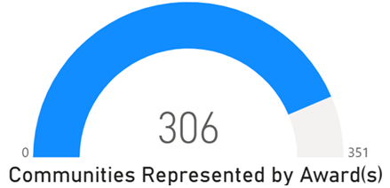
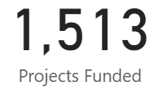
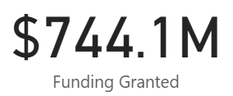
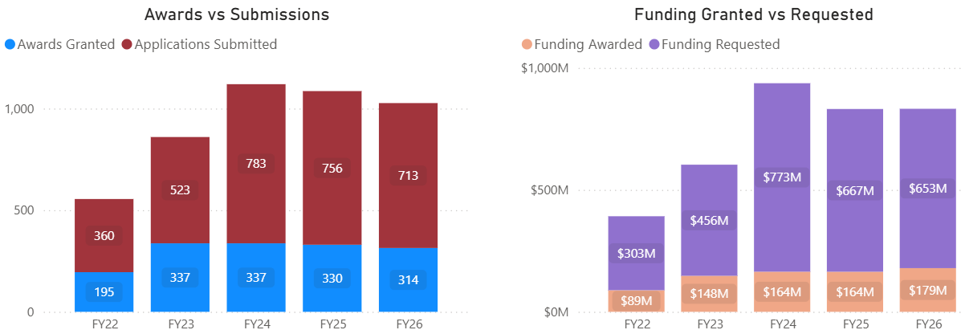
Past Results
The first five rounds of the One Stop have resulted in:
Funding through the One Stop is extremely competitive:

Slide 25
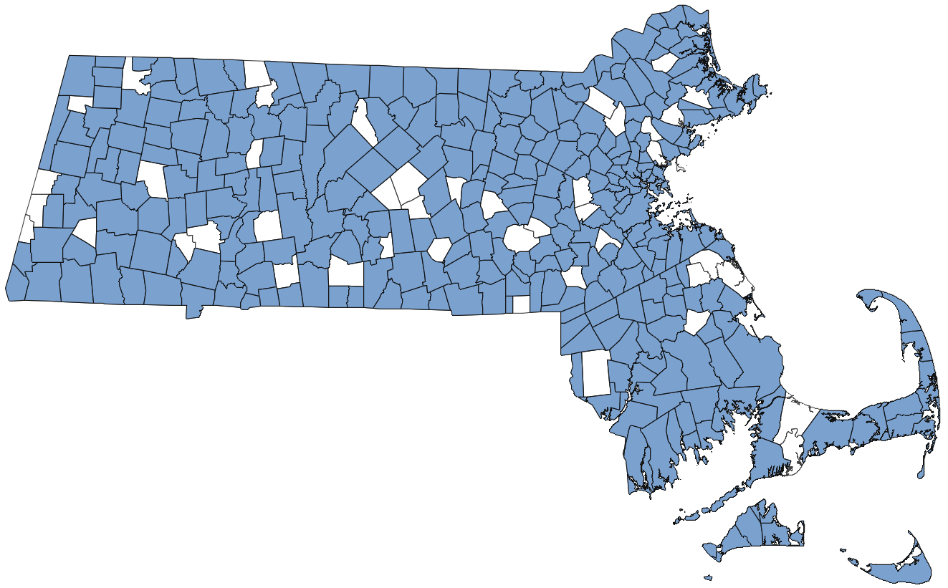
Past Results: Community Coverage
In the five rounds to date, 87% of all communities across the Commonwealth have been represented by at least one award from the One Stop. This includes awards in all 26 Gateway Cities and 158 of the state’s 181 rural towns.

Slide 26
Development Continuum: Applicant Eligibility
 | Preparing for Growth |  |  |  | Catalyzing Specific Projects
Applicant Type | Planning & Zoning | Downtown Activation | Downtown Activation | Site Preparation | Building | Infrastructure
Public Organizations (Municipal and Other Public) | Eligible For All Programs in the One Stop |  | All Programs | All Programs | All Programs | All Programs
Non-Profit | None |  | None | Site Readiness Program | Underutilized Properties Program, TDI Equity Investment | None
For-Profit | None |  | None | None | Underutilized Properties Program, TDI Equity Investment | None

Slide 27

One Stop Overview: FY27 Timeline
JAN
Jan.
  One Stop Launch: January 2026
    The One Stop officially launches in coordination with the MA Connect 351 Conference
    Applicants may begin working on their Full Applications but cannot submit.
  Guidance Phase: January 2026 – April 2026
    Expression of Interest
    Webinars
    Office Hours
  Full Application Submission Period: May 4 – June 3, 2026
    Applicants may formally submit Full Applications for funding consideration
  Review and Approval: June 2026 – September 2026
  Notification of Awards: Fall of 2026
Oct.

Slide 28

Q&A
Place your questions in the chat!

Slide 29
Federal Funds Partnership Meeting Schedule
Future meeting dates:
  Tuesday, March 24th 2-3 pm
  Tuesday, April 28th 2-3 pm

