Slide 1
Advisory Council on Alzheimer’s Disease and All Other Dementias
Executive Office of Elder Affairs
Elizabeth Chen, Secretary
February 6, 2024
3:00-5:00 pm
Video Conference

Slide 2
Agenda
Welcome, Logistics, Introductions (10 min)
Interprofessional Dementia Care: Status and Discussion (30 min)
Annual Report: Present, Discuss, and Vote (40 min)
Discussion of Council’s Role Around Early Dementia Detection and Diagnosis (25 min)
Reflections and Future Planning (10 min)
Next Steps and Vote to Adjourn (5 min)

Slide 3
Interprofessional Dementia Care
Status and Discussion
February 6, 2024
Team Co-Leads
Alina Sibley, CNP
Team Lead for Geri-Pal Home Care
Baystate Health
Springfield, MA
alina.sibley@baystatehealth.org
Christopher Wight, LICSW Clinical Social Worker, Dementia Care Collaborative Division of Palliative Care and Geriatric Medicine Massachusetts General Hospital
Boston, MA cwight@mgh.harvard.edu

Slide 4
Our Team
Team Co-Leads: Alina Sibley, CNP and Christopher Wight, LICSW
Yeimy S. Aleman Miranda
Patient Service Representative
Baystate Memory Assessment and Care Clinic, Department of Medicine
Baystate Medical Center,
Springfield, MA
Stephen Bonasera, MD, PhD
Chief, Division of Geriatrics & Palliative Care
Medical Director, Baystate Memory Assessment and Care Clinic
Department of Medicine
Baystate Medical Center,
Springfield, MA
Kathryn M. Corelli, MD
Internal Medicine Physician, Chestnut Hill, MA
Joe Costello
Organizational Consultant and Dementia Advocate
Brent P. Forester, MD, MSc.
(Council Member)
Dr. Francis S. Arkin Chair of Psychiatry,
Tufts University School of Medicine
Chief and Chair, Department of Psychiatry, Tufts Medical Center
Director of Behavioral Health,
Tufts Medicine
Lenore Jackson-Pope, RN, BSN, MSM, CCRP
Co-Director of Primary Care Outreach
Center for Alzheimer Research and Treatment (CART) and
Massachusetts Alzheimer’s Disease Research Center (MADRC)
Mass General Brigham
Boston, MA
Jayne Kelleher
Home Care Director, Bethany at Home, Framingham, MA
Board Member of Massachusetts Home Care Aide Council
Liz McCarthy
Health Systems Director
New England Region, Alzheimer’s Association
Pam Mirick, RN
Former Family Caregiver, Retired Nurse
Christine Ritchie, MD, MSPH (Council Member)
Kenneth L. Minaker Endowed Chair in Geriatric Medicine
Research Director, MGH Division of Palliative Care and Geriatric Medicine
Director, Mongan Institute Center for Aging and Serious Illness
Director, MGH Dementia Care Collaborative
Professor of Medicine, Harvard Medical School
Boston, MA
Wayne S. Saltsman, MD, PhD, CMD, AGSF
Chief Medical Officer, All Care VNA,
Hospice & Private Home Care Services
Lynn, MA
Amy Walsh
Project Manager
Institute for Health Care Improvement (IHI)
Boston, MA
C

Slide 5
Interprofessional Dementia Care
Goal
Develop a plan that ensures that staff in primary care across the state receive the training and support needed to build and retain interprofessional dementia care teams
C

Slide 6
Updates and Accomplishments
Recruited the Council’s team on Interprofessional Dementia Care. Discussed the team’s goal, originally focused on several health care settings (primary care, acute care, home care, and long-term care); and agreed to prioritize primary care settings as the team’s sole focus in calendar year 2024. Began identifying the services, outcomes, and benefits expected from interprofessional teams to both justify these teams and determine effective team composition. Why we narrowed the focus to primary care: Focusing on one setting improves the team’s ability to make progress in calendar year 2024. The need for coordination and effectiveness is greatest in primary care which experiences significant resource constraints and involves the greatest number of professional roles. The new Alzheimer’s therapies are restricted to MCI and early Alzheimer’s, underscoring the urgency of early detection and diagnosis through primary care.
6
C

Slide 7
Interprofessional Dementia Care Our Team’s Approach
(Calendar Year 2024)
January-March
April-June
July-September
October-December
(1)
Provide Justification for Interprofessional Dementia Care
Teams in Primary
Care
(2)
Propose Adaptations & Approaches to the Age-friendly Health System (AFHS) Initiative
(3)
Collaborate with Institute for Healthcare Improvement (IHI)
(4)
Develop
Training Recommendations
and
Resource List
a) Determine effective team composition by identifying services, outcomes, and benefits of primary care professionals on an interprofessional dementia care team.
a) With the needs of people affected by dementia in mind, examine the AFHS initiative’s 4M’s (What Matters, Medication, Mentation, Mobility).
Work with IHI to review and revise our suggested dementia-specific adaptations and approaches to the AFHS Initiative.
Identify and articulate key training attributes that would be beneficial for all members of an interprofessional
dementia care team
in a primary care setting.
b) To justify interprofessional dementia care teams, reflect on identified outcomes and benefits; and clearly articulate reasons for a collaborative interprofessional care team.
b) Suggest adjustments to enhance the AFHS initiative’s support for individuals and families at risk of or affected by dementia.
b) Develop recommendations and resource list around available and effective training.
7
A

Slide 8
Challenges and Potential Solutions
Multiple stressors and competing demands of frontline clinicians; difficulty in securing protected time for training
Ensure recommended training is practical and valuable, e.g., synchronous & asynchronous options, continuing education opportunities; advise that training be incorporated into training/planning for Annual Wellness Visits; and include guidance on including stakeholders in education plan design.
Lack of funding to implement Age-Friendly Health System (AFHS) initiatives
Link this work to AFHS recognition; and provide advice on grant funding resources.
Gaps in perceived value of dementia care among clinicians, systems, patients, and families; and confusion around the roles of various clinicians and specialists
Describe how interprofessional dementia care teams can effectively address this challenge.
Absence of individual responsible and accountable for planning, communication, and internal team coordination activities required to ensure everyone works together as a cohesive team
Consider recommending that one team member be responsible and accountable for conducting activities that ensure cohesive teamwork; consider training options for that individual; and advise primary care settings to implement a phased-in interprofessional team approach.
An unclear business case is of significant concern. Insufficient funding hinders team creation, and some essential services lack reimbursement
Find ways to address the need for a financial model to support integrated, holistic dementia care from diagnosis to end of life. Place initial focus on the GUIDE initiative participants; and develop an approach to bring other primary care organizations into the fold.
8
A

Slide 9
COUNCIL DISCUSSION (15 min)
Your Questions or Comments?
Our Questions:
(1) FINANCIAL MODELS?
Do you know of any financial models that
support integrated, holistic dementia care?
(2) POLICIES & LEGISLATION?
Are there any policies or legislation that the Council could endorse to improve the likelihood of implementation of our team’s recommendations?
(3) COLLABORATION WITH MASSHEALTH?
Is there potential to collaborate with MassHealth to promote interprofessional dementia care in primary care for dual
eligibles, akin to the successful behavioral health initiatives?
C

Slide 10
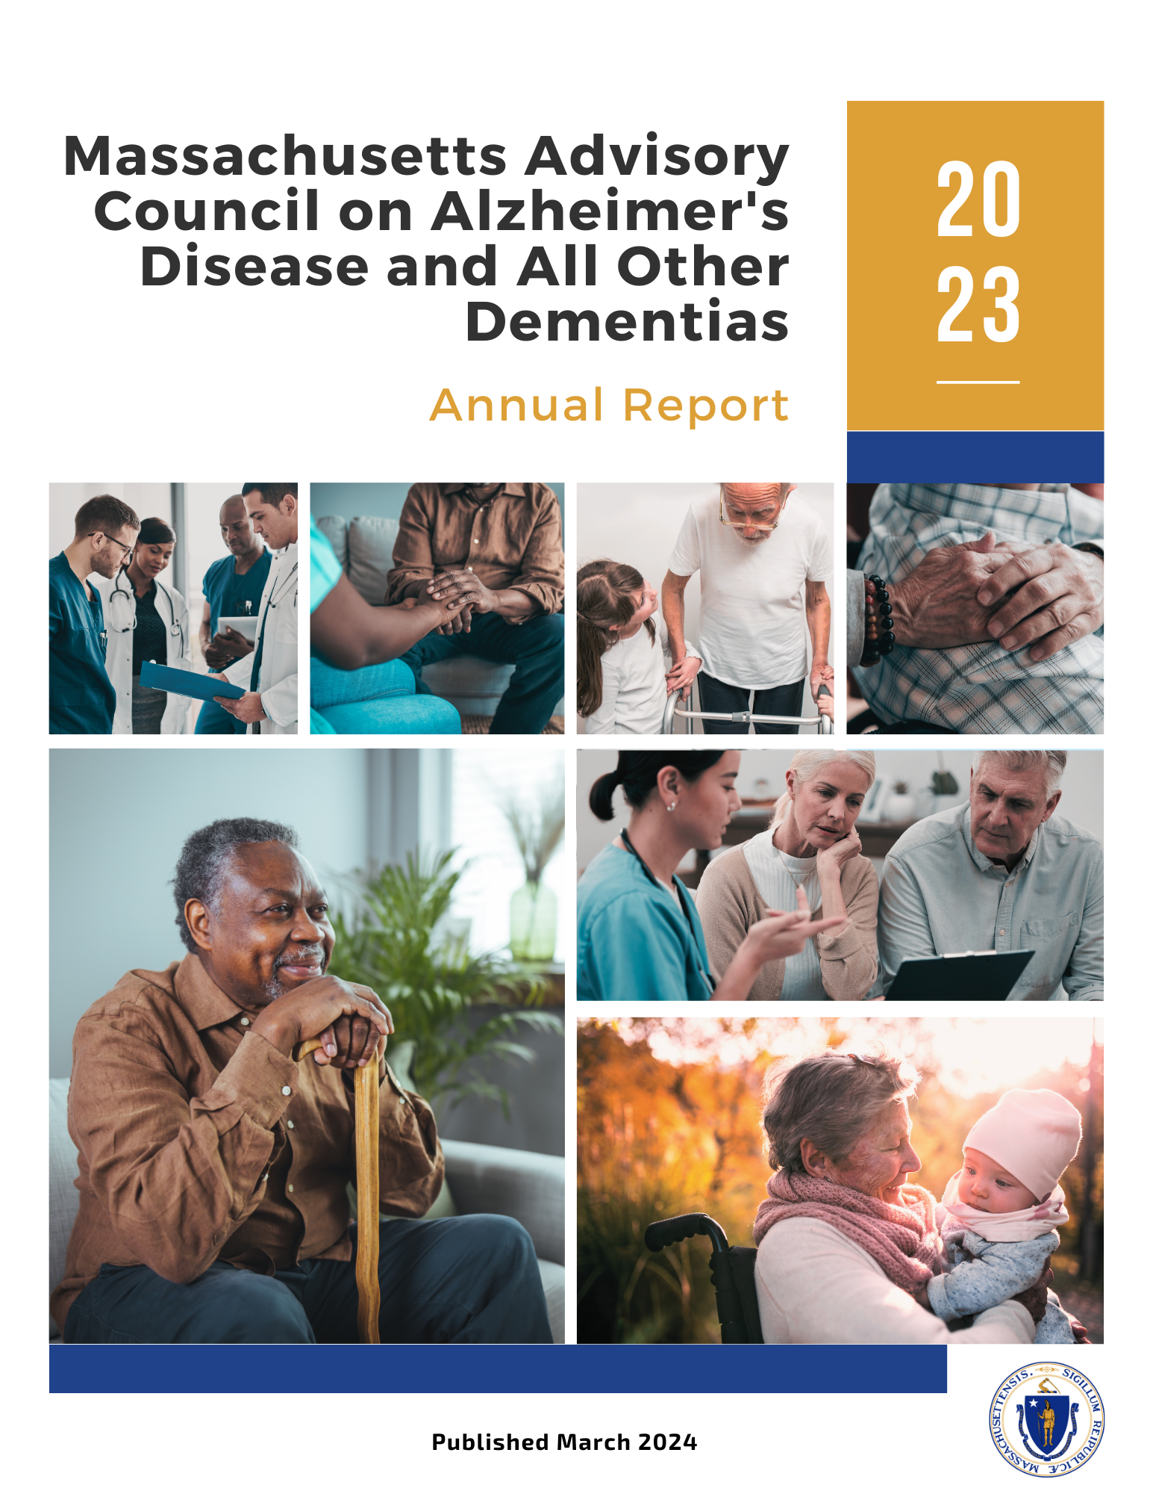
Annual Report Review, 2023
Present Highlights
DRAFT
Annual Report Review
Present Highlights
Provide Comments
Vote
10

Slide 11
Executive Summary
Briefly highlights progress in 2023 and next steps for 2024.
Refers to the state plan as a living document to guide our progress; and lists the state plan’s seven workstreams.
Indicates that state plan amendments are documented in our annual reports; five appear in this year’s report.
Notes removal of Research workstream from Council’s scope, stating other organizations are more capable of achieving its stated goal and recommendation:
Goal - Advance dementia research in Massachusetts
Recommendation - Increase diversity of dementia research and researchers
Recognizes importance of all types of ADRD research and that recent and upcoming innovations and breakthroughs affect much of our work.
Notes an intention to stay abreast of research and reflect on it while developing recommendations, policies, programs, and guidance.

Slide 12
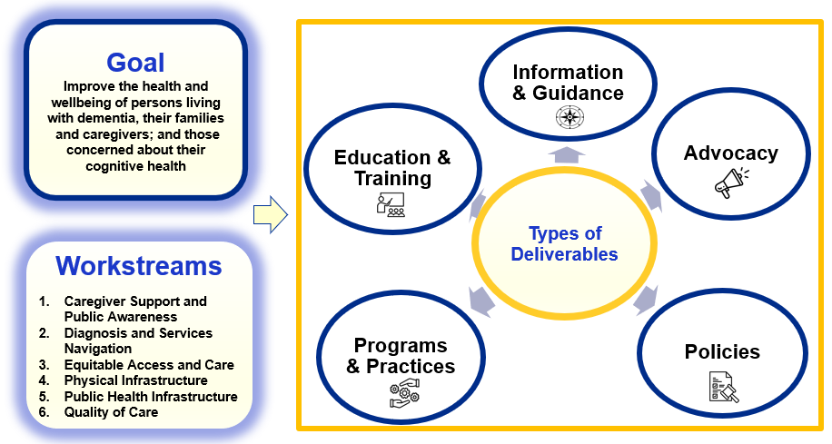
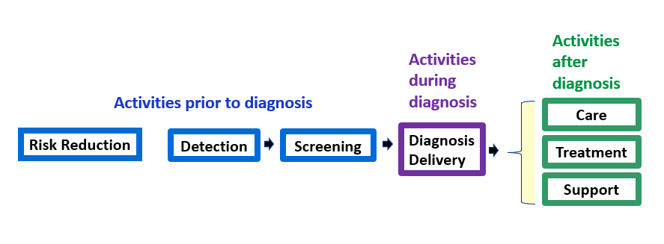
Introduction
Introduces the report as the work of the Council, established under Chapter 220 of the Acts of 2018.
Refers to lists of Council members (Appendix A) and members of the teams working on its behalf (Appendix B).
Presents the two figures below.
Figure 1: The Council’s Goal, Workstreams, and
Types of Deliverables
Figure 2: Key Activities Impacting
the Council’s Goal

Slide 13
Introduction
Provides examples of challenges facing our residents affected by dementia.
Emphasizes the importance of diversity, equity, and inclusion; and our approach for integrating these concepts into our work.
Briefly describes our process of engaging teams to examine challenges; develop recommendations; seek advice from the Council; and implement solutions.
Expresses gratitude for the volunteers that make the Council’s progress possible.

Slide 14
Implementing Effective and
Sustainable Solutions
Includes seven sections, one for each of the following seven workstreams, presenting progress in 2023 and next steps for 2024
Caregiver Support and Public Awareness
Diagnosis and Services Navigation
Equitable Access and Care
Physical Infrastructure
Public Health Infrastructure
Quality of Care
Research

Slide 15
1. Caregiver Support and Public Awareness
Workstream Leads
Barbara Meehan, Council Member - Dementia Advocate, Former Caregiver
Hector R. Montesino, Council Member - President and CEO, Embrace Home Care and Health Services, Dementia Advocate

Slide 16
1. Caregiver Support and Public Awareness
Progress and Next Steps (Some Highlights)
Public Service Announcement and Video Production
Began developing a brief public service announcement in three languages (English, Spanish, and Portuguese).
Recruited caregivers to participate in video interviews in Spanish and Portuguese to discuss assistance received and how they received it.
Caregiver Experience with Aging Services Access Points (ASAPs)
Executive Office of Elder Affairs (EOEA) attained insights in 2023 on how to better serve older adults and caregivers of people living with dementia:
Update of ASAP Designation Review Process - EOEA began evaluating interactions between ASAPs and consumers, including caregivers.
EOEA’s Branding and Market Research - Improved understanding of service needs; how residents engage with services; and barriers that may prevent individuals from accessing services.

Slide 17
2. Diagnosis and Services Navigation
Workstream Lead
James Wessler, Council Member - President and CEO, Alzheimer’s Association, MA/NH Chapter and New England Regional Leader

Slide 18
2. Diagnosis and Services Navigation
Progress and Next Steps (Some Highlights)
Toolkit for Acute Care Settings
Developed and distributed toolkit for acute care settings with dementia screening and training options for dementia operations plans.
Expansion of Dementia Care Coordination (DCC)
Secured state funding in fiscal year 2024 to expand access to the Alzheimer’s Association Dementia Care Coordination program.
Screening in Home Care Program
Developed approach to identify and implement opportunities for home care consumers to advocate for appropriate screening, diagnosis, care, support, and treatment. Will reassess in 2025.

Slide 19
3. Equitable Access and Care
Workstream Leads
Jatin Dave, MD, Council Member - Chief Medical Officer, MassHealth; Director, Office of Clinical Affairs, Commonwealth Medicine, UMass Chan Medical School
Hugo Aparicio, MD, MPH, Council Member - Assistant Professor of Neurology, Boston University School of Medicine; Faculty Lead of the Research and Policy Team Program at the BU Center for Antiracist Research; Stroke Specialist in the Department of Neurology, Boston Medical Center

Slide 20
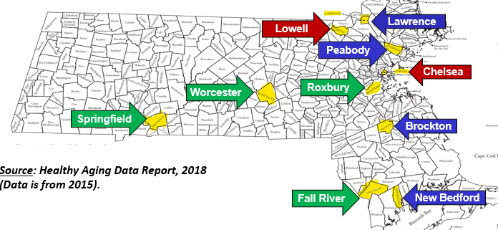
3. Equitable Access and Care
Progress and Next Steps (Some Highlights)
Examined Cultural Barriers and Geographic Health Disparities
Convened inclusive discussions about challenges and cultural barriers experienced by individuals affected by dementia and began identifying solutions.
Reviewed and discussed Massachusetts-specific data on race and geographic health disparities.
Launched Equity and Inclusion (EI) Team
Built a team to review the Council’s work with a “diversity, equity, and inclusion (DEI) lens.”
DEI

Slide 21
4. Physical Infrastructure
Workstream Lead
Secretary Elizabeth C. Chen, PhD, MBA, MPH, Council Chair - Secretary, Massachusetts Executive Office of Elder Affairs

Slide 22
4. Physical Infrastructure
Progress and Next Steps (Some Highlights)
Physical Infrastructure Projects Seeking State or Municipal Funding
Identified specific state and municipal funding sources and procurements; prioritized the most promising opportunities; and collaborated with funders.
Made significant progress in ensuring that funders explicitly prioritize or stipulate requirements for incorporating age and dementia friendly features in physical infrastructure projects.
Improved Stakeholder Awareness and Understanding
Proactively distributed the Council's guide on age and dementia friendly design; and delivered presentations to numerous stakeholders and organizations.

Slide 23
5. Quality of Care
Workstream Lead
Linda Pellegrini, MS, GNP-BC, Council Member - Geriatric Nurse Practitioner, UMass Memorial Medical Center

Slide 24
5. Quality of Care
Progress and Next Steps (Some Highlights)
Person-Directed Care Planning
Identified the essential characteristics of effective person-driven dementia care plans; and reviewed existing care planning models.
Agreed on the team’s approach and targeted milestones for 2024.
Provided advice to Ariadne Labs on its development of a person-centered assessment and care plan tool.
Interprofessional Dementia Care
Formed a team on Interprofessional Dementia Care; made progress in determining effective dementia care team composition, services, outcomes, and benefits.

Slide 25
6. Research

Slide 26
6. Research
Progress and Next Steps (Some Highlights)
Removed Research Workstream from Council’s Scope
Removed this workstream’s goal of “advancing dementia research in Massachusetts;” and its recommendation to “increase diversity of dementia research and researchers.”
Acknowledge that better qualified organizations are currently conducting activities designed to achieve this workstream’s goal and objectives.
Will continue to use our knowledge about ongoing dementia-related research as we develop recommendations, policies, programs, and guidance.

Slide 27
7. Risk Reduction and Public Health
Infrastructure
Workstream Lead(s)
To be determined

Slide 28
7. Risk Reduction and Public Health Infrastructure
Progress and Next Steps (Some Highlights)
Assessed Interest in Statewide Grant Opportunity
In early 2023, engaged in discussions with DPH officials to discuss 5-year CDC grant opportunity “Building our Largest Dementia (BOLD) Infrastructure.”
Due to competing and important demands on staff time at DPH, it was determined that 2023 was not an opportune time to apply.
Springfield’s Healthy Brain Initiative
In the absence of statewide grant funding around this workstream’s goal; and after examining geographic disparities in prevalence of dementia and dementia risk factors, shifted to a localized approach.
Pursued grant opportunities and received a grant in late 2023 to implement “Springfield’s Healthy Brain Initiative,” a community outreach program to promote better brain health.

Slide 29
Looking to the Future
Reminds readers that the Council will regularly amend the state plan and continue to bring appropriate stakeholders to the table to implement solutions.
Refers to the five amendments to the state plan adopted in 2023, which are included in the final section of the annual report.

Slide 30
Amendments to the State Plan, 2023
Includes amendments to the state plan’s recommendations around:
Caregiver Support and Public Awareness
Equitable Access and Care
Care Planning
Interprofessional Dementia
Research

Slide 31
Annual Report Review, 2023
Provide Comments and Vote (20 min)
DRAFT
Annual Report Review
Present Highlights
Provide Comments
Vote
31

Slide 32
4. Discussion of Council’s Role Around Early Detection and Diagnosis (25 min)
Which two do Council Members believe are the areas of greatest need?
Equitable access to screening, assessment, and diagnosis
Culturally sensitive provider/patient communication that respects culturally diverse beliefs, which may include stigmatizing perceptions of dementia
MCI and early dementia detection and screening by health care workers
Access to culturally sensitive cognitive assessments, including family observations, clinician interviews, and diagnostic testing (biomarkers)
Public awareness of early warning signs (individuals and health care providers)
Role of emerging technologies on access to screening and diagnosis
Effective communication of diagnosis
Other?
2. What practical strategies can this Council implement as part of the work of its existing teams to significantly enhance detection and/or diagnosis?

Slide 33
5. Council Discussion (10 min)
Reflections and Future Planning
How do you feel about the Council’s progress?
Where do you see gaps or areas that need more of our attention?
What are the challenges or concerns that may hinder our progress?

Slide 34
5. Next Steps & Vote to Adjourn (5 min)
Next Steps
Submit the Council’s annual report in March 2024
Next Council Meeting on May 7, 2024
Council Meetings
(3:00 pm to 5:00 pm)
5/7/24
8/6/24
11/5/24
Vote to Adjourn

