Slide 1
Digital Accessibility and Equity Governance Board Community Outreach Working Group Meeting
February 6, 2025

Slide 2
Meeting Agenda
Introduction and Roll Call
Internal Feedback Group
Feedback Session Flyer
Feedback Survey
Working Group Next Steps
Working Group Remarks
Public Remarks

Slide 3
Introduction and Roll Call

Slide 4
Working Group Member Roll Call
Jason Snyder, Secretary, Executive Office of Technology Services and Security
Ashley Bloom, CIAO, Executive Office of Technology Services and Security
Antoine Harrison, Secretariat CIO, Executive Office of Education
Greg Martin, CIO, Executive Office of Energy and Environmental Affairs
Yarlennys Villaman, Director of Community Affairs, Governor’s Office
John Oliveira, Commissioner, Massachusetts Commission for the Blind
Minh Ha, Public Member

Slide 5
Community Outreach Working Group Objective
Engage community stakeholders to collect feedback to enhance accessibility across digital channels.

Slide 6
Internal Feedback Group

Slide 7
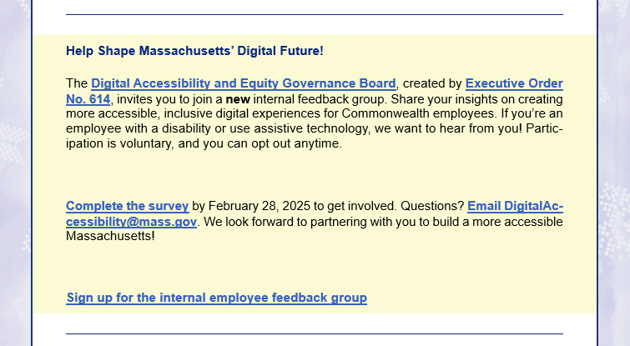
Feedback Group Information Has Been Released
The January Commonwealth Connection posted information about the internal feedback group member signup.

Slide 8
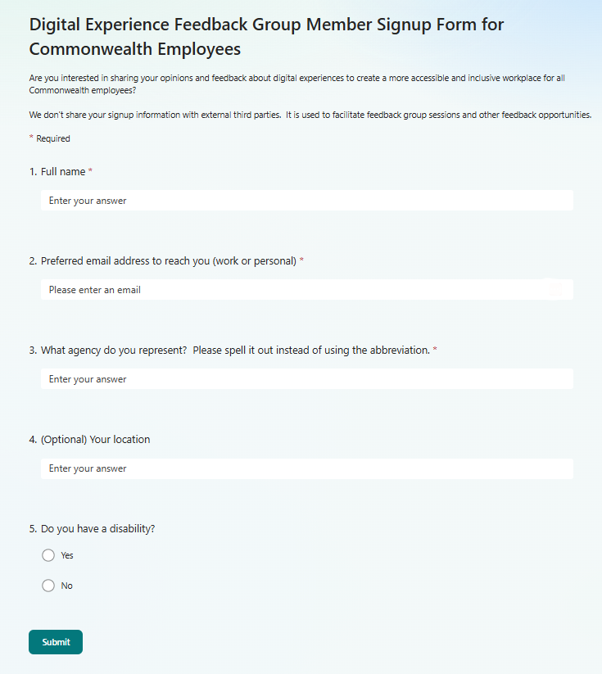
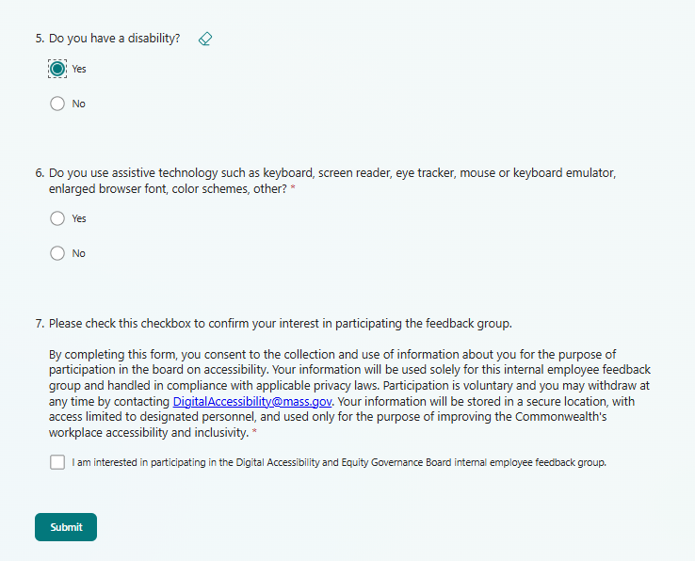
Signup Survey
The survey is open until February 28.
Survey questions:
Full name
Preferred email address to reach you (work or personal)
What agency do you represent?
(Optional) Your location
Do you have a disability? [Yes/No]
(For “Yes” to Q5) Do you use assistive technology such as keyboard, screen reader, eye tracker, mouse or keyboard emulator, enlarged browser font, color schemes, other? [Yes/No]
I am interested in participating in the Digital Accessibility and Equity Governance Board internal employee feedback group. [Checkbox]

Slide 9
Participant Member Pools
Some signups to the group – need more members
Any suggestions to promote the group?
Reach out to ADA coordinators
Internal newsletters at secretariats and/or agencies
Any proper channels on Teams

Slide 10
Feedback Session Flyer

Slide 11
Use of the Flyer
Notice upcoming feedback sessions:
Date
URL
Contact info. for questions
Distributed as PDF
Template to serve both internal and external feedback session notices

Slide 12
Review the 1st Draft
This version intends to define the necessary text information and its layout
More graphic treatment will be done at the next iteration.

Slide 13
Review and Decide the Headline
Headline options:
Make your voice heard: Tell us your experiences with digital accessibility in the Commonwealth
We need your voice! Help us improve digital accessibility at the Commonwealth
Help us improve digital accessibility at the Commonwealth! Share your experience with the Commonwealth digital services as a person with a disability or an assistive technology user.
Tell us about your digital experience with the Commonwealth.
We’d love to hear your stories as a person with a disability or an assistive technology user.

Slide 14
Feedback Survey

Slide 15
Survey Development Steps
Meet with the experience-research specialist
Identify survey questions
Select a survey platform
Identify where the survey will live on mass.gov for findability and completion
Identify administration and maintenance tasks and personnel for them

Slide 16
Next Steps for Community Outreach Working Group

Slide 17
What is Next for This Working Group
Coming up for the group:
Review the 2nd draft of the flyer (Possibly finalize it)
Continue working on the feedback survey
Discuss the logistics to schedule and organize employee and constituent feedback sessions
Discuss feedback collection and usage process

Slide 18
Working Group Member Remarks

Slide 19
Public Remarks

Slide 20
Guidelines for Public Remarks
Time permitting, members of the public are welcomed to provide comments and feedback.
If you would like to speak:
Indicate your desire to provide public comments by using the “raise hand” feature or by commenting in the meeting chat.
Keep remarks to 3 minutes
State your name clearly and any organization you represent
You may also send a comment in the chat (include your name) and the comment will be read out loud on your behalf.

Slide 21
Thank You

