Slide 1
Federal funds & infrastructure office community tour
Suffolk University, Boston
April 9, 2025

Slide 2
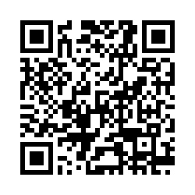
Municipal needs survey
Please take 5 minutes to fill out this form and help us learn more about how our office can support you to best leverage available and upcoming federal funding opportunities!

Slide 3
Agenda
Federal Matching Funds Legislation
New Federal Funding Opportunities
Q&A / Discussion
About FFIO
MassDOT Municipal Grants
Local Government Engagement
Audience Engagement Exercise
Direct Pay
GrantWell: Simplifying Federal Grant Application Processes with AI

Slide 4
About the Federal Funds and Infrastructure Office (FFIO)
Officially created by Executive Order No. 624, and tasked with implementing a whole-of-government to compete for federal funding by:
Leading bi-weekly meetings of the interagency Advisory Council on Federal Funds and Infrastructure
Identifying and tracking key federal funding opportunities and Massachusetts applications through the State Clearinghouse
Implementing the Federal Match legislation (Chapter 214 of the Acts of 2024)
Leading the Massachusetts Federal Funds Partnership and other meetings to support local governments in their applications for federal funding

Slide 5
Local Government Engagement

Slide 6
The Partnership provides key federal grant information to the local governments of MA.
FFIO leads the monthly Massachusetts Federal Funds Partnership meeting. This forum delivers federal funding updates and offers a platform for addressing questions related to the many funding opportunities at the disposal of cities, towns and tribal organizations.
Massachusetts Federal funds partnership
Previous Federal Funds Partnership Meeting Tuesday, March 25th
Project Prioritization
MBI Launchpad Program Presentation
Next Federal Funds Partnership Meeting Tuesday, April 22nd
Safe Streets and Roads for All (SS4A) Presentation

Slide 7
engagement with RPAs and federally recognized tribes
Previous Monthly Meeting with MARPA + Federally Recognized Tribes Friday, March 7th
Project Prioritization
MBI Presentation
Next Monthly Meeting with MARPA + Federally Recognized Tribes Friday, May 2nd
Working with RPA’s and agencies to identify technical assistance gaps and priority projects.

Slide 8
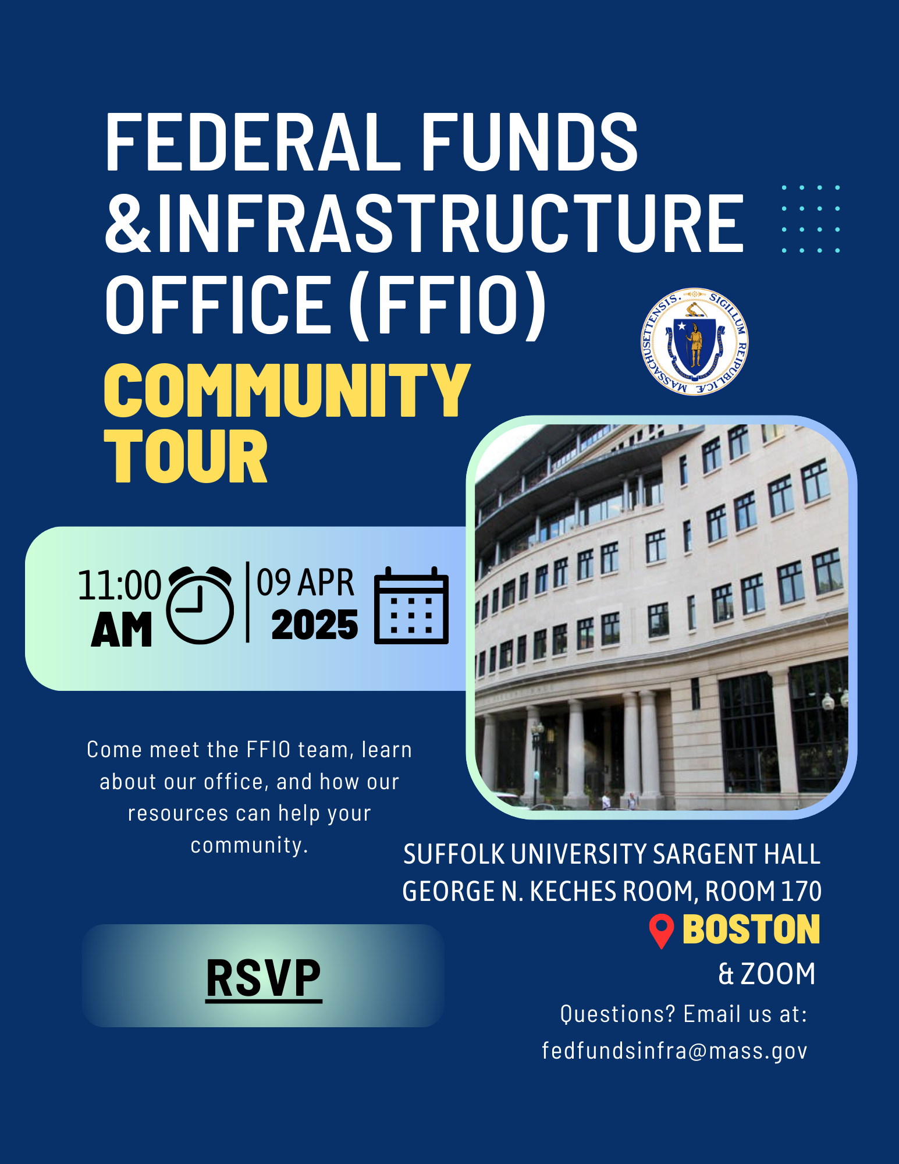
FFIO Community Tour
INFORMATION SHARING: Provide information on federal grant application resources made available by the new legislation
UNDERSTAND NEEDS AND PRIORITIES: Seek community input on priority projects seeking federal funding
GATHER FEEDBACK: Solicit feedback on the Federal Funds Partnership and other FFIO processes
PITTSFIELD
BOSTON
SPRINGFIELD
(May 7)
WORCESTER
BROCKTON
HAVERHILL

Slide 9
Federal Matching Funds Legislation

Slide 10
Massachusetts Federal match legislation
Matching Funds
Unlocks up to $750M for matching funds for federal programs
Eligible entities, including RPA’s can now apply for match via the FFIO Match Request Form
Learn more on the new Massachusetts Matching Funds Website
Other Financial Assistance for Municipalities
Allocates up to $50M in the form of grants, loans, or other financial assistance, which may be directed to municipalities.
Explore providing start-up capital for Direct Pay-eligible projects, etc.
Technical Assistance for Municipalities
Allocates up to $12M for technical support to munis for grant application development and implementation assistance for successful awards
Leverage existing municipal outreach (partnership meetings, upcoming community tour, etc.) to understand municipal needs

Slide 11
Eligible applicants:
State agencies
Independent governmental state or public entities (quasis)
Municipalities (cities and towns)
Tribes
Regional planning agencies (RPAs)
Community development corporations (CDCs)
Other development authorities or agencies
Private entities (under review)
Application process:
Fill out Federal Matching Funds Form
Email supporting materials to fedfundsinfra@mass.gov
Questions on form or materials: reach out to Bob and Sam
If your agency works with munis on a federal program, have the muni who would be award recipient apply for match
Timeline:
Three (3) weeks prior to federal application submission
FFIO and ANF review on a rolling basis (for now)
Still reviewing how to process retroactive requests
Matching funds process

Slide 12
Project Prioritization Process
Develop Project Prioritization List
Aggregate priority projects through RPAs, EJ organizations, the Road Show, engagement with mayors, Fed Funds Partnership meetings, EEA's Green Communities and MVP program, etc.
Identify potential federal funding sources, other potential financial assistance (e.g., match funding, loans, grants), and TA roadblocks.
Create and execute plan to advances issues related to these projects.

Slide 13
New Federal Funding Opportunities

Slide 14
TRANSPORTATION
Grant Name | Eligibility | Max Award | Cost Share | Deadline
Safe Streets and Roads for All (SS4A) | Local Governments, Tribes, Universities, School Districts | $25,000,000 | 20% (with exceptions) | 6/26/2025
PROTECT Grant | State, Local Governments, Tribes | $60,000,000 | 0-20% | Expected Timeline: Spring 2025
Port Infrastructure Development Program | State, Local Governments, Tribes | $112,500,000 | 20% (with exceptions) | 4/30/2025

Slide 15
CLIMATE
Grant Name | Eligibility | Max Award | Cost Share | Deadline
Candidate Species Conservation Fund | State, Local Governments, Tribes, Universities, School Districts, Nonprofits, Small Businesses, Individuals | N/A Total Program Funding: $500,000 | N/A | 9/30/2025
Partnership for Fish and Wildlife | State, Local Governments, Tribes, For-Profits, Nonprofits | $750,000 | N/A | 9/30/2025
Round 3 - Habitat Restoration | State, Local Governments, Tribes, NGOs, Small Businesses, Universities | $2,000,000 | N/A | 5/16/2025
Coastal Program | State, Local Governments, Tribes, Universities, School Districts, Housing Authorities, Nonprofits, Small Businesses, Individuals | $500,000 | N/A | 9/30/2025

Slide 16
research/education
Grant Name | Eligibility | Max Award | Cost Share | Deadline
NEH: Humanities Initiative | Institutions of Higher Education | $150,000 | N/A | 5/6/2025
Maternal and Child Health Research Consortium (MCH RC) | State, Local Governments, Tribes, Nonprofits | $800,000 | N/A | 4/23/2025
NSF - Applied Mathematics | Unrestricted | N/A | N/A | 11/17/2025
FY26 Department of Defense Multidisciplinary Research Program of the University Research Initiative (MURI) | Universities | $4,500,000 | N/A | 9/5/2025
Fire Science Innovations through Research and Education | Unrestricted | N/A | N/A | 6/20/2025
D.4 University Leadership Initiative 2 (ULI2)- NASA | Unrestricted (target: Universities) | N/A | N/A | 6/26/2025

Slide 17
THRIVING communities (Public safety, Water, MiSc)
Grant Name | Eligibility | Max Award | Cost Share | Deadline
EDA Public Works Program (PWEAA) | States, Local Governments, Tribes, Universities, NGOs | $30,000,000 | 20-40% | Rolling
Drug Free Communities Support Program | Local Governments, States, NGOs, Tribes, Schools. | $125K | 100% | 5/5/2025

Slide 18
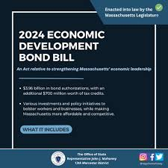
Other opportunities:
DIRECT PAY TAX CREDITS

Slide 19
MassDOT Municipal Grants

Slide 20
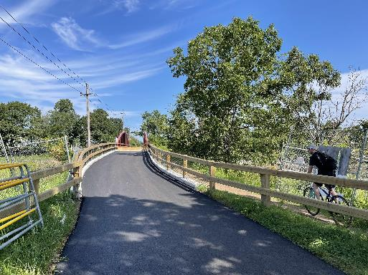
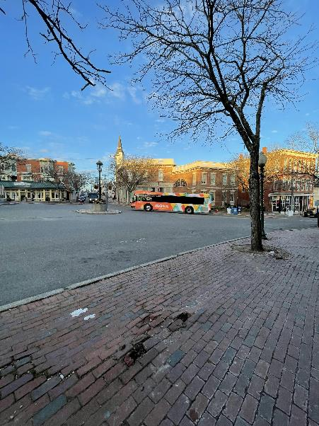
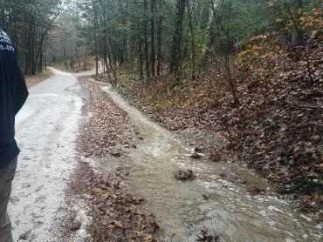
About the Municipal Grants Engagement (MGE) Group
MassDOT’s Municipal Grants Engagement Group’s mission is to connect municipalities with federal funding opportunities to advance local and regional transportation needs.
The group will also provide technical assistance to Massachusetts communities, with a focus on rural areas and Gateway Cities, to prepare projects for the receipt of federal funding, develop discretionary grant applications, and assist with coordination efforts across MassDOT, municipalities, and our partner agencies.

Slide 21
Municipal Grants Engagement Group Resources
Eligibility Guidance / Program “Match Making:” Assisting municipalities in determining eligibility for federal discretionary and formula funding programs and appropriate funding alternatives.
Project Scoping Assistance: Providing technical assistance for early-stage planning activities, including but not limited to: Conceptual Designs/Sketch Plans; Crash Diagrams & Hot Spot Analysis; Road Safety Audits (RSAs); Traffic Impact Studies; Speed Studies; Existing Conditions & Data Collection.
Grant Application Assistance (for Joint State and Municipal Priorities): Providing technical assistance in drafting and reviewing grant applications, including project narratives, budgets, and responses to merit criteria.
Letters of Support: Drafting and issuing MassDOT letters of support for grant applications to demonstrate agency endorsement.
Match Funding Coordination: Advising on strategies to identify and secure local, state, or other match funding for federal grant applications. Coordinating with state funding programs to ensure alignment with grant application requirements.
Post-Award Support: Helping municipalities manage awarded grants, including guidance on reporting, documentation, and financial oversight to ensure compliance with grant terms.

Slide 22
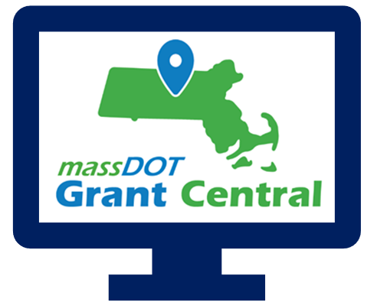
Grant Central
Funding Programs
Grant Central Users
Chapter 90 | Complete Streets | Local Bottleneck Reduction | Municipal Pavement | Municipal Small Bridge | Shared Streets and Spaces
The Public | Municipal Officials | Regional Transit Authorities | MassDOT Staff
636 unique Municipal Users

Slide 24
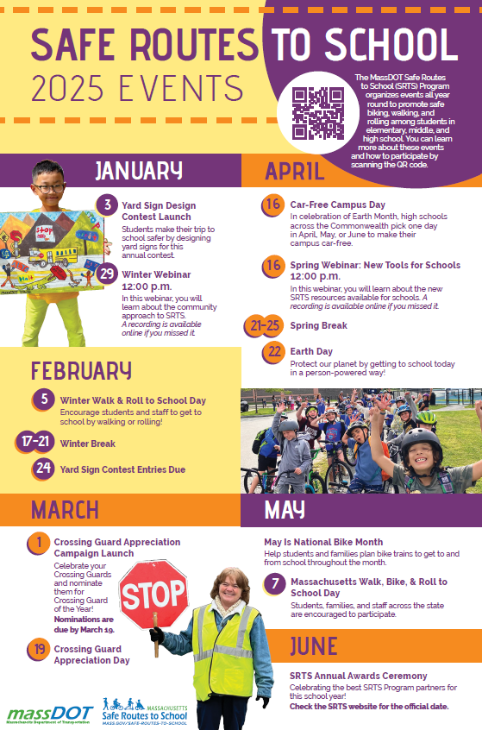
Safe Routes to School (https://www.mass.gov/safe-routes-to-school)
The MassDOT Safe Routes to School (SRTS) Program organizes events all year round to promote safe biking, walking, and rolling among students in
elementary, middle, and high school. You can learn more about these events
and how to participate by scanning the QR code.

Slide 25
Key Dates
Complete Streets: Results of the FY25 Round 1 were announced the week of January 13, 2025. The next Tier 3 application round opens in April, but we are always accepting Tier 1 and Tier 2 submissions!
Shared Streets & Spaces: January 13, 2025 was the last day to submit an application for this round. We anticipate the results of this application round to be announced in April 2025.
Municipal Small Bridge Program: The FY25 application round closed on Monday, February 3, 2025. We anticipate the results of this application round to be announced in late April 2025.
Local Bottleneck Reduction Program: MassDOT announced the results of the latest application round in early January and assigning designers to the awarded communities before the end of the month.
Safe Routes to School Signs & Lines and Infrastructure Grants: Launching in late August or early September 2025.

Slide 26
Resources and Contact Information
Derek Krevat: Derek.Krevat@dot.state.ma.us
Kristen (Pennucci) Rebelo: Kristen.E.Rebelo@DOT.state.ma.us
Grant Central: MassDOTGrantCenral@DOT.state.ma.us
U.S. DOT Navigator: https://www.transportation.gov/dot-navigator
Grants.gov: https://www.grants.gov/search-grants
MA Federal Funds & Infrastructure Office: https://www.mass.gov/orgs/federal-funds-infrastructure-office

Slide 27
Direct Pay Overview
Governor's Office of Climate Innovation and Resilience
Jonathan Schrag, Deputy Climate Chief
Governor’s Office of Climate Innovation and Resilience

Slide 28
Agenda
What is Direct Pay?
Applicable Credits for Direct Pay
Credit Amounts and Bonuses
2023 Projects
Helpful Resources

Slide 29
What is Direct Pay?
The Inflation Reduction Act (IRA) makes the largest investment in clean energy in United States history, and much of that investment is delivered via tax incentives.
Under the IRA, tax-exempt and governmental entities – such as municipalities- that do not owe Federal income taxes are, for the first time, able to receive a payment equal to the full value of tax credits for building qualifying clean energy projects or making qualifying investments. This is called Direct Pay (also known as Elective Pay).
By filing a return and using Direct Pay, these entities can receive a cash refund from the IRS for certain clean energy projects.
Under current law, Direct Pay lasts for a decade; it applies to projects put into service January 1, 2023 through December 31, 2032 creating a decade of tax opportunity to save money on necessary infrastructure replacements and upgrades.
The overall potential of these tax credits is unlimited. In most cases, the Investment Tax Credit results in a refund equal to 30% of the project investment.

Slide 30
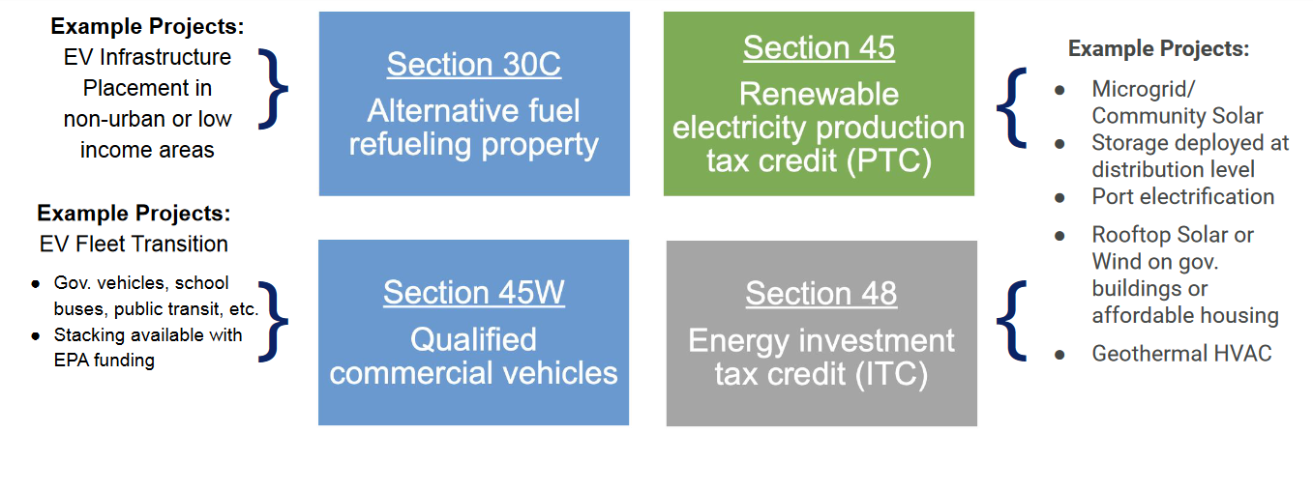
Most relevant tax credits for municipalities
v

Slide 31
Credit Amounts
The most common credit is the Investment Tax Credit (ITC). The amount of the ITC is calculated as a base credit of 6% on the investment basis of the project.
For the replacement of existing municipal vehicle fleets with new electric vehicles, entities can receive up to $7,500 per light vehicle and up to $40,000 per larger vehicle.

Slide 32
Some Basics on Bonuses
Please Note: Additional details apply
Low-income Communities
10-20% bonus
… if project is in a low-income community with extra bonus if residential or econ benefit project
Energy Communities
10% bonus
…if project is in historical “energy community” (i.e., closed coal mine, some brownfield sites)
Prevailing Wage and Apprenticeship**
5x bonus
…if reqs for prevailing wages and registered apprentices are met
Domestic Content* **
…if 100% of applicable steel and iron and an applicable share of ‘manufactured products” produced in U.S.
10% bonus
ITC only
Applies to both ITC tax basis and PTC rate
Applies to both ITC tax basis and PTC rate
Applies to both ITC tax basis and PTC rate
* - On December,28, 2023, IRS issued new guidance on this rule for projects beginning in 2024 (see Notice 2024-9)
** - Applicable for projects of a size >1MW

Slide 33
How Direct Pay Credits and Bonuses Affect a $2M Project
Example:
A municipality with brownfield status installs microgrid with solar and energy storage.
Eligible for an ITC (Energy ITC, Sec. 48)
Project cost is $2M
Town recoups 40% of project in tax credits.
$600,000
$120,000

Slide 34
The state’s process timeline for 2023 projects
IRS recommended date (120 days before filing deadline)
Successfully filed on 11/14!
Consult legal counsel and tax advisors
Gather necessary information for each qualifying project
(1) Form 990-T
(2) Form 3800
(3) Applicable source form

Slide 35
2023 Massachusetts Projects
In November, ANF successfully filed more than 80 Direct Pay-eligible projects with the IRS, including:
Sec 30C: Alternative Fuel Property
Fall River Heritage State Park
Sec. 45W: Commercial EVs
Dozens of light EVs purchased by OSD
Sec. 45: Investment Tax Credit
Solar and Geothermal Projects at the Veterans’ Home in Chelsea

Slide 36
Next Steps for Elective Pay: 2024 Projects
Identify projects in the pipeline with in-service dates of 2024 or later:
Build an internal team by working with financial advisors and counsel to confirm eligibility, gather documentation, address key questions.
Complete pre-registration for each project in the IRS Pre-registration portal. This should be completed 120 days prior to the tax filing deadline.
File Tax Forms generally 4.5 months after the end of the tax period.
May 15th for calendar year filers and November 15th for fiscal year filers.
2. Inventory capital needs (new construction, retrofits or vehicles) over the next decade:
Include tax credit value into real estate and vehicle fleet planning.
Ensure architects, designers, and facilities managers are aware of tax credit opportunities.
3. Make a plan for how your municipality will get its share of refunds over the next decade.

Slide 37
Helpful Resources
FFIO’s Direct Pay Information Page
Elect Pay Overview
CAP webinar on Direct Pay
Lawyers for Good Government Elective Pay resources, including worksheets on:
EV Purchase
EV Infrastructure
Tracking ITC and PTC projects
Slides from a presentation to local governments (but provides overview of Direct Pay for all)
IRS Video Tutorial on pre-registration
IRS Q&A

Slide 38
Thank you!

Slide 39
GrantWell: Simplifying Federal Grant Application Process With AI
AI4Impact x Federal Funds and Infrastructure Office
Jai Surya Kode
Anjith Prakash

Slide 40
We are student researchers from Northeastern University working on this project as part of AI4Impact program.
AI4Impact partners state agencies and Northeastern University to develop innovative, sustainable, and impactful AI-driven solutions
About us
GrantWell is a free, public AI-enabled grant-writing tool designed to streamline the application process.

Slide 42
We would like to hear from you!
What challenges do you face when applying for federal grants?
Do you want to help us build GrantWell?
What tools do you use to assist in grant writing?
Jai Surya Kode | Anjith Prakash
www.burnes.northeastern.edu

Slide 43
Successful Grant Applications
$342 million in Massachusetts Awards for Reconnecting Communities including $335M for the Allston Multimodal Project
$156 million award through Solar for All Program for clean energy investments to up to 31,000 low-income and affordable homes
$993 million award for the Cape Cod Bridges from the Bridge Investment Program
$105 million to Massachusetts entities from the Environmental Protection Agency’s Clean School Bus Program for low and zero emission school buses
$147 million from the National Telecommunications and Information Agency’s Broadband, Equity, Access, and Deployment program to expand high speed internet access
$472 Million for North Station Draw Bridge as part of the Multimodal Project Discretionary Grant Program

Slide 44
Municipal needs survey
Please take 5 minutes to fill out this form and help us learn more about how our office can support you to best leverage available and upcoming federal funding opportunities!

Slide 45
Discussion and q&a
As a reminder, we can help with:
Helpful information for us:
Looking for grants
Developing application
Advocating for submitted applications
Match grants to projects
Help look for partners/co-applicants (CBOs, other states, state agencies, universities, etc.)
Advice on labor standards, DEI , climate, language.
Review application
Letters of support from the state or congressionals
Calls and in-person advocacy when FFIO is in DC.
Get award dates/application status
-Are there any upcoming grants you are preparing for? Developing applications?
- What kind of technical assistance on these grants would be the most helpful for you?
- Do you have any applications pending or stuck?
-Are you looking for partners/co-applicants?
-Looking for gap financing for projects?
-
Reach us anytime at: FedFundsInfra@mass.gov.

Slide 46
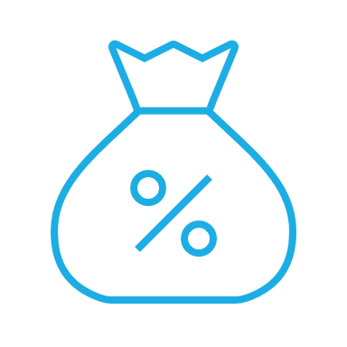
Please join us for our office hours, bring your questions, and discuss priority projects! Feel free to move around tables!
Transportation
Climate and Resiliency
Tech/
Economic Development
Office hours
Direct Pay
Priority Projects

