Slide 1
Federal funds & infrastructure office community tour
Massasoit Community College, Brockton
March 25, 2025

Slide 2
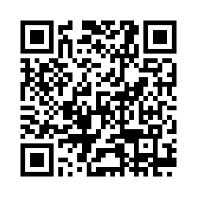
Municipal needs survey
Please take 5 minutes to fill out this form and help us learn more about how our office can support you to best leverage available and upcoming federal funding opportunities!

Slide 3
Agenda
Federal Matching Funds Legislation
New Federal Funding Opportunities
Q&A / Discussion
About FFIO
MassDOT: Municipal Grants Team ​
Local Government Engagement
Audience Engagement Exercise
Nate Keenan: Department Director at MA Clean Water Trust
Direct Pay
GrantWell: Simplifying Federal Grant Application Processes with AI

Slide 4
About the Federal Funds and Infrastructure Office (FFIO)
Officially created by Executive Order No. 624, and tasked with implementing a whole-of-government to compete for federal funding by:
Leading bi-weekly meetings of the interagency Advisory Council on Federal Funds and Infrastructure
Identifying and tracking key federal funding opportunities and Massachusetts applications through the State Clearinghouse
Implementing the Federal Match legislation (Chapter 214 of the Acts of 2024)
Leading the Massachusetts Federal Funds Partnership and other meetings to support local governments in their applications for federal funding

Slide 5
Local Government Engagement

Slide 6
The Partnership provides key federal grant information to the local governments of MA.
FFIO leads the monthly Massachusetts Federal Funds Partnership meeting. This forum delivers federal funding updates and offers a platform for addressing questions related to the many funding opportunities at the disposal of cities, towns and tribal organizations.
Massachusetts Federal funds partnership
Previous Federal Funds Partnership Meeting Tuesday, February 25th
National League of Cities Presentation on federal budget reconciliation and legislative updates for municipalities
Next Federal Funds Partnership Meeting (Today!) Tuesday, March 25th
^{-Project prioritization}
-MBI Launchpad Program Presentation

Slide 7
engagement with RPAs and federally recognized tribes
Previous Monthly Meeting with MARPA + Federally Recognized Tribes Friday, March 7th
Project prioritization
MBI Presentation
Next Monthly Meeting with MARPA + Federally Recognized Tribes Friday, April 4th
Working with RPA’s and agencies to identify technical assistance gaps.

Slide 8
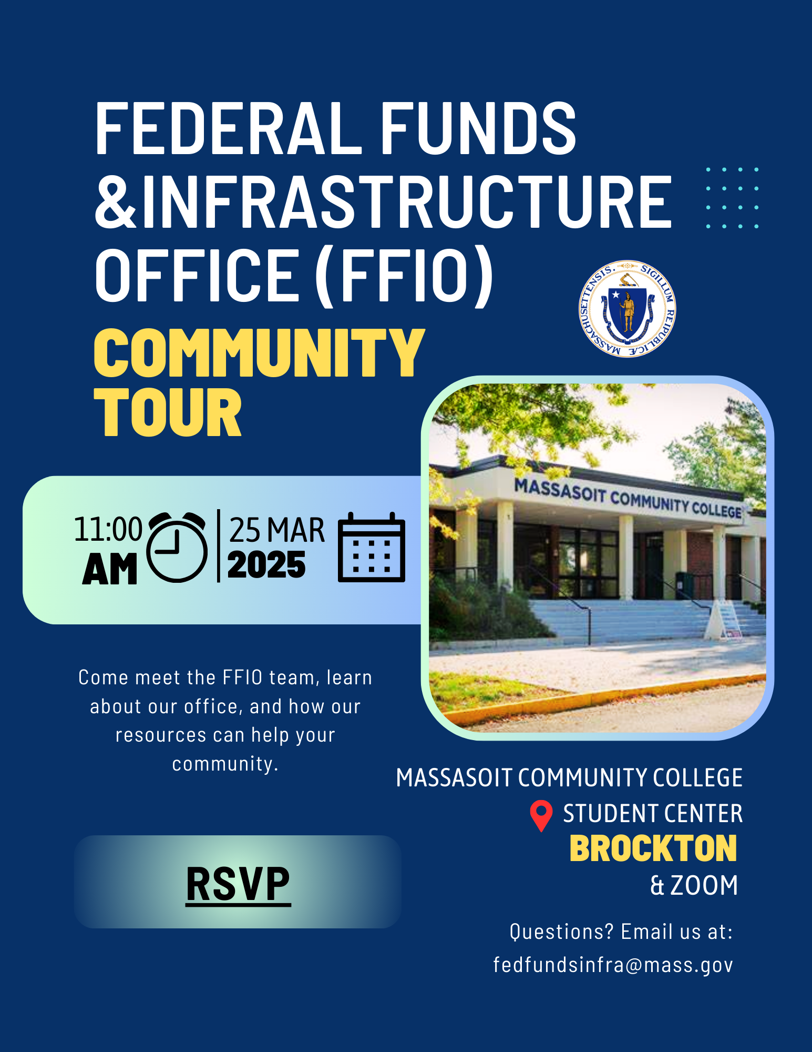


FFIO Community Tour
INFORMATION SHARING: Provide information on federal grant application resources made available by the new legislation
UNDERSTAND NEEDS AND PRIORITIES: Seek community input on priority projects seeking federal funding
GATHER FEEDBACK: Solicit feedback on the Federal Funds Partnership and other FFIO processes
PITTSFIELD
BROCKTON
BOSTON
(April 9th)
HAVERHILL
WORCESTER

Slide 9
Federal Matching Funds Legislation

Slide 10
Massachusetts Federal match legislation
Matching Funds
Unlocks up to $750M for matching funds for federal programs
Eligible entities, including RPA’s can now apply for match via the FFIO Match Request Form
Learn more on the new Massachusetts Matching Funds Website
Other Financial Assistance for Municipalities
Allocates up to $50M in the form of grants, loans, or other financial assistance, which may be directed to municipalities.
Explore providing start-up capital for Direct Pay-eligible projects, etc.
Technical Assistance for Municipalities
Allocates up to $12M for technical support to munis for grant application development and implementation assistance for successful awards
Leverage existing municipal outreach (partnership meetings, upcoming community tour, etc.) to understand municipal needs

Slide 11
Eligible applicants:
State agencies
Independent governmental state or public entities (quasis)
Municipalities (cities and towns)
Tribes
Regional planning agencies (RPAs)
Community development corporations (CDCs)
Other development authorities or agencies
Private entities (under review)
Application process:
Fill out Federal Matching Funds Form
Email supporting materials to fedfundsinfra@mass.gov
Questions on form or materials: reach out to Bob and Sam
If your agency works with munis on a federal program, have the muni who would be award recipient apply for match
Timeline:
Three (3) weeks prior to federal application submission
FFIO and ANF review on a rolling basis (for now)
Still reviewing how to process retroactive requests
Matching funds process
Notes:
Pioneer valley example

Slide 12

Project Prioritization Process
Develop Project Prioritization List
Aggregate priority projects through RPAs, EJ organizations, the Road Show, engagement with mayors, Fed Funds Partnership meetings, EEA's Green Communities and MVP program, etc.
Identify potential federal funding sources, other potential financial assistance (e.g., match funding, loans, grants), and TA roadblocks.
Create and execute plan to advances issues related to these projects.

Slide 13
New Federal Funding Opportunities

Slide 14
TRANSPORTATION
Grant Name | Eligibility | Max Award | Cost Share | Deadline
Rural and Tribal Assistance Pilot Program | Rural Local Governments, Tribes | $2,250,000 | N/A | 4/17/2025
PROTECT Grant | State, Local Governments, Tribes | $60,000,000 | 0-20% | Expected Timeline: Spring 2025
Port Infrastructure Development Program | State, Local Governments, Tribes | $112,500,000 | 20% (with exceptions) | 4/30/2024
Safe Streets and Roads for All (SS4A) | Local Governments, Tribes, Universities, School Districts | TBA | TBA | Expected Timeline: Spring 2025

Slide 15
CLIMATE
Grant Name | Eligibility | Max Award | Cost Share | Deadline
Candidate Species Conservation Fund | State, Local Governments, Tribes, Universities, School Districts, Nonprofits, Small Businesses, Individuals | N/A Total Program Funding: $500,000 | N/A | 9/30/2025
Partnership for Fish and Wildlife | State, Local Governments, Tribes, For-Profits, Nonprofits | $750,000 | N/A | 9/30/2025
Round 3 - Habitat Restoration | State, Local Governments, Tribes, NGOs, Small Businesses, Universities | $2,000,000 | N/A | 5/16/2025
Coastal Program | State, Local Governments, Tribes, Universities, School Districts, Housing Authorities, Nonprofits, Small Businesses, Individuals | $500,000 | N/A | 9/30/2025

Slide 16
THRIVING communities (Public safety, Water, MiSc)
Grant Name | Eligibility | Max Award | Cost Share | Deadline
Connect and Protect: Law Enforcement Behavioral Health Response Program | State, Local Governments, Tribes, Universities | $550,000 | 20-40% | 4/3/2025
EDA Public Works Program (PWEAA) | States, Local Governments, Tribes, Universities, NGOs | $30,000,000 | 20-40% | Rolling
Humanities Initiatives | Public and Private Universities | $150,000 | N/A | 5/6/2025

Slide 17
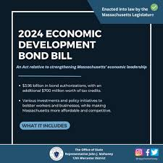







Other opportunities:
DIRECT PAY TAX CREDITS

Slide 18

MassDOT Municipal Grants Federal Funds & Infrastructure Office Community Tour March 25, 2025

Slide 19
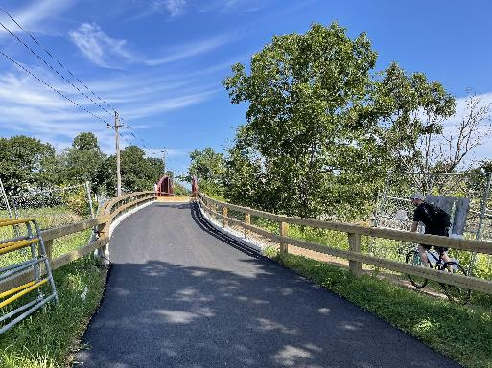
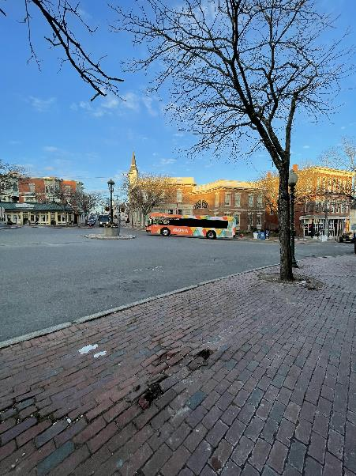
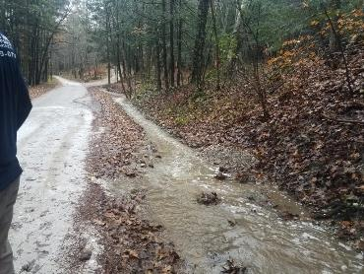
About the Municipal Grants Engagement (MGE) Group
MassDOT’s Municipal Grants Engagement Group’s mission is to connect municipalities with federal funding opportunities to advance local and regional transportation needs.
The group will also provide technical assistance to Massachusetts communities, with a focus on rural areas and Gateway Cities, to prepare projects for the receipt of federal funding, develop discretionary grant applications, and assist with coordination efforts across MassDOT, municipalities, and our partner agencies.

Slide 20
Specific Activities (Outreach and Engagement)
Eligibility Guidance / Program “Match Making:” Assisting municipalities in determining eligibility for federal discretionary and formula funding programs and appropriate funding alternatives.
Grant Application Assistance (for Joint State and Municipal Priorities): Providing technical assistance in drafting and reviewing grant applications, including project narratives, budgets, and responses to merit criteria.
Letters of Support: Drafting and issuing MassDOT letters of support for grant applications to demonstrate agency endorsement.
Match Funding Coordination: Advising on strategies to identify and secure local, state, or other match funding for federal grant applications. Coordinating with state funding programs to ensure alignment with grant application requirements.
Post-Award Support (if requested in advance): Helping municipalities manage awarded grants, including guidance on reporting, documentation, and financial oversight to ensure compliance with grant terms.

Slide 21
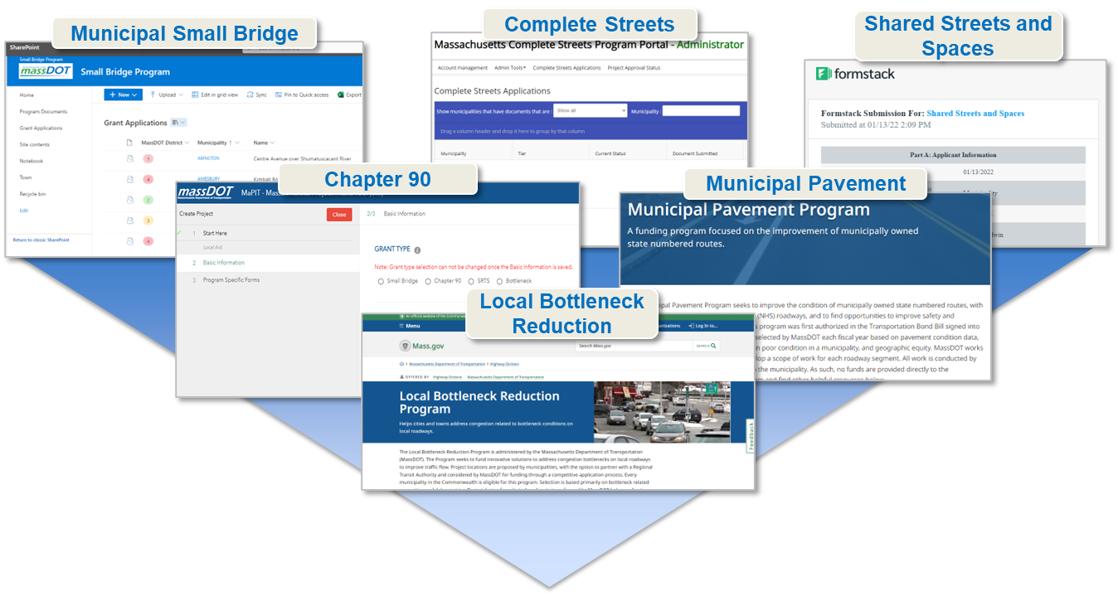
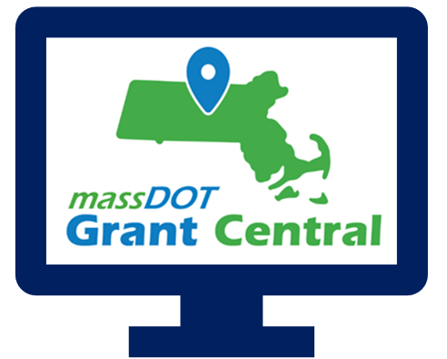
Grant Central
Funding Programs
Grant Central Users
Chapter 90 | Complete Streets | Local Bottleneck Reduction | Municipal Pavement | Municipal Small Bridge | Shared Streets and Spaces
The Public | Municipal Officials | Regional Transit Authorities | MassDOT Staff
636 unique Municipal Users

Slide 22
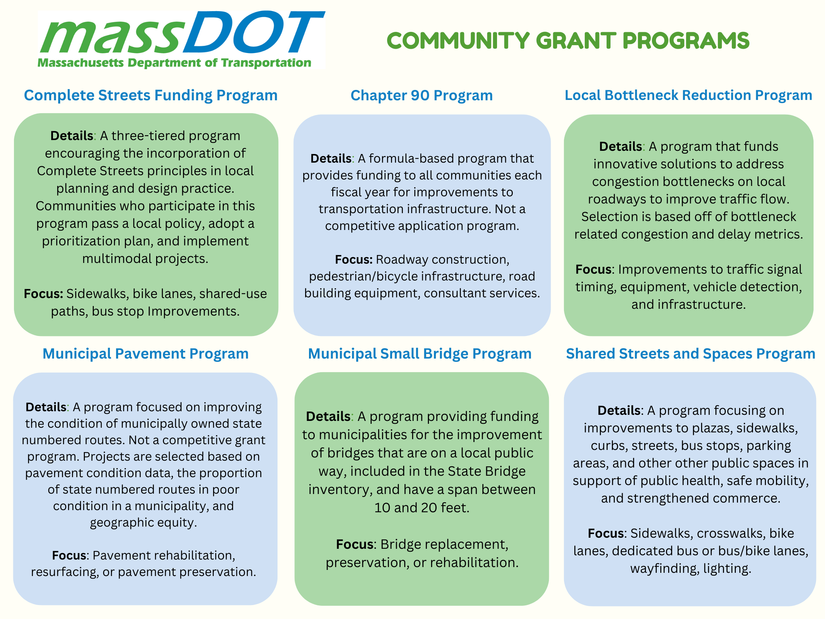

Slide 23
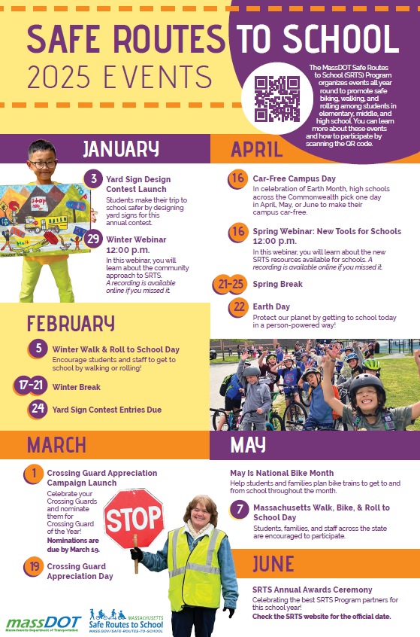
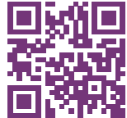
Safe Routes to School (https://www.mass.gov/safe-routes-to-school)
The MassDOT Safe Routes to School (SRTS) Program organizes events all year round to promote safe biking, walking, and rolling among students in
elementary, middle, and high school. You can learn more about these events
and how to participate by scanning the QR code.

Slide 24
Key Dates
Complete Streets: Results of the FY25 Round 1 were announced the week of January 13, 2025. The next Tier 3 application round opens in April, but we are always accepting Tier 1 and Tier 2 submissions!
Shared Streets & Spaces: January 13, 2025 was the last day to submit an application for this round. We anticipate the results of this application round to be announced in April 2025.
Municipal Small Bridge Program: The FY25 application round closed on Monday, February 3, 2025. We anticipate the results of this application round to be announced in late April 2025.
Local Bottleneck Reduction Program: MassDOT announced the results of the latest application round in early January and assigning designers to the awarded communities before the end of the month.
Safe Routes to School Signs & Lines and Infrastructure Grants: Launching in late August or early September 2025.

Slide 25
Resources and Contact Information
Derek Krevat: Derek.Krevat@dot.state.ma.us
Kristen (Pennucci) Rebelo: Kristen.E.Rebelo@DOT.state.ma.us
Grant Central: MassDOTGrantCenral@DOT.state.ma.us
U.S. DOT Navigator: https://www.transportation.gov/dot-navigator
Grants.gov: https://www.grants.gov/search-grants
MA Federal Funds & Infrastructure Office: https://www.mass.gov/orgs/federal-funds-infrastructure-office

Slide 26


The Massachusetts Clean Water Trust
SRF Programs

Slide 27



About the Massachusetts Clean Water Trust
The Massachusetts Clean Water Trust was established in 1989 to finance projects to:
IMPROVE
water quality
PROTECT
the environment
in the Commonwealth through the provision of low-cost capital financing to cities, towns, and other eligible entities
PROTECT
public health
SRF loans are funded by annual grants from the U.S. Environmental Protection Agency (EPA) and state matching funds.
The Trust and MassDEP jointly administer the Clean Water (CW) and Drinking Water (DW) State Revolving Funds (SRFs) which assist communities in complying with the Clean Water and Safe Drinking Water Acts.
To date, the Trust has financed approximately $9.1 billion in loans for nearly 300 communities, serving 97% of the Commonwealth’s population.

Slide 29
Advantages to Financing through the Trust
Fixed Low-Interest Rates
These rates are established by law and offer a stable planning tool for communities
Loans with a 20-year term will have an interest rate of 2%
Loans with a term over 20 years will generally have an interest rate of 2.4%
Certain projects qualify for reduced or 0% interest
Interim Loans (Construction Loans)
The Trust offers interim loans with no fees or interest charged
These loans allow for one-stop financing through the Trust
Flexible Repayment Terms
Loans can be financed up to 30 years

Slide 30
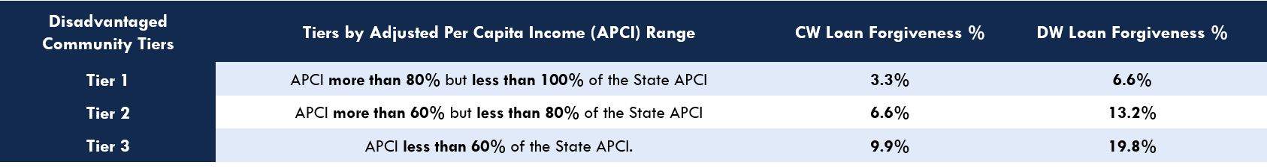
Advantages to Financing through the Trust
Loan Forgiveness for Disadvantaged Communities
The Trust uses a percentage of its annual grant and state funding as additional subsidy each year. This subsidy comes in the form of loan forgiveness to disadvantaged communities.
Eligibility is determined by an annual affordability calculation – which ranks communities into affordability tiers. The amount of loan forgiveness is based on a community’s affordability tier.
The below table is what the Trust has offered over the past number of years but may not be what is offered in future years.

Slide 31


Bipartisan Infrastructure Law Grant Information
President Biden signed into law the $1.2 trillion Infrastructure Investment and Jobs Act of 2021 or the Bipartisan Infrastructure Law (BIL)
Provides an estimated $1 billion to Massachusetts in funding for the Clean Water and Drinking Water State Revolving Funds (SRFs) from 2022 through 2026 – this funding is in addition to the annual SRF capitalization grants
The funding is available to the SRFs in the following grant categories:
Clean Water Grants Supplemental Grant - these funds are available for all eligible projects
49% of the grant must be given away as loan forgiveness to disadvantaged communities
Emerging Contaminants Grant- these funds focus specifically on emerging contaminants such as PFAS
100% of the grant must be given away as loan forgiveness
Drinking Water Grants
Supplemental Grant - these funds are available for all eligible projects
49% of the grant must be given away as loan forgiveness to disadvantaged communities
Emerging Contaminants Grant- these funds focus specifically on emerging contaminants such as PFAS
100% of the grant must be given away as loan forgiveness and 25% of this grant must be directed to disadvantaged communities
Lead Service Line Replacement Grant - these funds will go towards identifying, planning and removing lead service lines
49% of the grant must be given away as loan forgiveness to disadvantaged communities

Slide 32
BIL Investment in Massachusetts
Year | CW Supplemental | CW PFAS | DW Supplemental | DW PFAS | DW Lead | Total
2022 | $60,428,000 | $3,175,000 | $41,750,000 | $17,531,000 | $65,783,000 | $188,667,000
2023 | $70,769,000 | $7,220,000 | $45,206,000 | $16,404,000 | $33,700,000 | $173,299,000
2024 | $77,212,000 | $7,220,000 | $49,350,000 | $16,404,000 | $50,095,000 | $183,886,000
2025* | $91,272,859 | $7,220,000 | $58,336,989 | $16,404,000 | $50,095,000 | $206,933,848
2026* | $91,272,859 | $7,220,000 | $58,336,989 | $16,404,000 | $50,095,000 | $206,933,848
TOTAL | $390,954,718 | $32,055,000 | $252,979,978 | $83,147,000 | $249,768,000 | $1,008,904,696
*Numbers based on preliminary figures from EPA.

Slide 33
Subsidy Programs
0% Interest PFAS Remediation Loans
Per- and polyfluoroalkyl substances (PFAS) are a family of chemicals that are classified as emerging contaminants and are known to cause health issues when found in drinking water
0% Interest Lead Service Line Remediation Construction Loans
The Trust offers 0% interest financing for construction projects that remediate lead, a critical action in mitigating lead exposure and protecting public health
LSL construction loan applications are accepted on a rolling basis
0% Interest Nutrient Enrichment Reduction Loans
Nutrient enrichment is one of America's most widespread, costly and challenging environmental problems, and is caused by excess nitrogen and phosphorus in waterbodies
This loan program is for CWSRF loans that are primarily intended to remediate or prevent nutrient enrichment of a surface water body or water supply which can cause environmental degradation of the surrounding water bodies, provided that certain requirements are met
0% Interest Income-Based Community Septic Management Program (CSMP) Loans
Communities that provide reduced interest rate loans to homeowners based on their annual income as compared to the area median income (AMI) are eligible for the 0% interest rate
Housing Choice Loan Program
Communities that have achieved the “Housing Choice” designation under the Housing Choice Initiative will be eligible for an interest rate reduction up to .50% from the standard below market rate of 2% offered by the Trust

Slide 34
Grant Programs
Lead Service Line (LSL) Planning Grant Program (Currently Paused)
Launched to assist public water suppliers (PWS) with completing planning projects for LSL inventories and developing LSL replacement plans for compliance with the Lead and Copper Rule Revisions
Technical assistance is available for Small Community Water Systems and Non-Transient, Non-Community Systems
Public Water Suppliers Cybersecurity Improvements Grant Program
The DWSRF, in partnership with the MassDEP's Drinking Water Program, is offering grants funds of up to $50,000, to PWSs that have a cybersecurity risk assessment and use operational technology equipment with an identified cybersecurity risk
Asset Management Planning (AMP) Grant Program
The program provides grants up to 60% of the project costs or $150,000, whichever is less
These grants are to assist communities with completing or updating asset management plans for wastewater, drinking water, stormwater utilities, or any combination of the three to ensure the operational integrity of the water utility
Technical Assistance Provided by EPA
EPA has several technical assistance programs, funded by BIL grants, with the goal of ensuring equitable access to water infrastructure funding
For more information, please contact EPA at WaterTA@epa.gov or visit:
Water Technical Assistance Programs | US EPA
Water Technical Assistance (WaterTA) | US EPA
FACT SHEET (epa.gov)

Slide 35
Grant Programs for Lead in Schools
Sampling Program (MassDEP) www.mass.gov/guides/sampling-for-lead-and-copper-at-schools-and-childcare-facilities
First in the nation school drinking water testing program utilizing funds from the Trust to sample public schools across the Commonwealth for lead and copper
Expanded funding from EPA allows MassDEP to expand sampling program to public and private schools, childcare and early education facilities – limited to lead testing
School Water Improvement Grants ‘SWIG’ (Trust) mass.gov/school-water-improvement-grants
The Trust is encouraging private schools K-12, early education facilities and non-residential daycare facilities to apply
The Trust has expanded replacement fixture eligibility to under sink and classroom fountains in facilities serving Pre-K aged children

Slide 36
Loan Terms and Fees
 | Permanent Financing | Interim Financing
Standard Loan Rate | 2% (20 Years) Calculated (30 Years)¹ | 0%
Housing Choice Loan Rate | 1.5% (20 Years)² | 0%
Nutrient Enrichment Reduction, PFAS Remediation, and LSL Construction Rate | 0% | 0%
Maximum Term | 30 Years³ | 3 Years
Administrative Fee | 0.15% | NA
Origination Fee (One Time) | Approx. $5.00/$1,000 | NA
¹ Rate calculated at time of permanent financing, estimated between 2.4-2.9%
² Communities designated as housing choice communities on the 2019-2024 IUPs are eligible for an interest rate discount up to 0.5% for permanent financing, there is no negative interest in any scenario
³ Requires useful life certificate certifying useful life will match or exceed the life of the loan

Slide 37
Trust and MassDEP Contacts
The Trust
Sue Perez | Executive Director
617-367-9333 x816 | sperez@tre.state.ma.us
Nate Keenan | Deputy Director
617-367-9333 x508| nkeenan@tre.state.ma.us
Josh Derouen | Senior Program Associate
617-367-9333 x515 | jderouen@tre.state.ma.us
Kailyn Fellmeth | Program Associate
617-367-9333 x580 | kailyn.n.fellmeth@tre.state.ma.us
MassDEP
Robin McNamara | Deputy Director
857-301-0974 | robin.mcnamara@mass.gov Michele Higgins | Program Manager 857-268-3296 | michele.higgins@mass.gov
Greg Devine | Section Chief Northeastern and Western Regions 617-874-6456 | gregory.d.devine@mass.gov
Lilla Dick | Section Chief Central and Southeastern Regions 857-276-3846 | lilla.dick@mass.gov

Slide 38
For more information
The Massachusetts Clean Water Trust A: 1 Center Plaza, Suite 430 | Boston, MA 02108 E: masswatertrust@tre.state.ma.us | P: (617) 367-9333 x 515 W: mass.gov/orgs/the-Massachusetts-clean-water-trust Follow us on these social media platforms:
LinkedIn: linkedin.com/showcase/Massachusetts-clean-water-trust Twitter/X: twitter.com/MASSCLEANWATER

Slide 39
Direct Pay Overview March 25, 2025
Bob LaRocca, Deputy Director, Federal Funds and Infrastructure Office

Slide 40
What is Direct Pay?
The Inflation Reduction Act (IRA) makes the largest investment in clean energy in United States history, and much of that investment is delivered via tax incentives.
Under the IRA, tax-exempt and governmental entities – such as cities and towns -- that do not owe Federal income taxes are, for the first time, able to receive a payment equal to the full value of tax credits for building qualifying clean energy projects or making qualifying investments. This is called Direct Pay (also known as Elective Pay).
By filing a return and using Direct Pay, these entities can receive a cash refund from the IRS for certain clean energy projects.
Direct pay applies to projects put into service January 1, 2023 through December 31, 2032, creating a decade of tax opportunity to save money on necessary infrastructure replacements and upgrades while reducing energy costs and carbon emissions.
Unlike competitive grant programs, the overall potential of these tax credits to states and municipalities is unlimited.
Note on these credits being “mandatory, not discretionary”

Slide 41
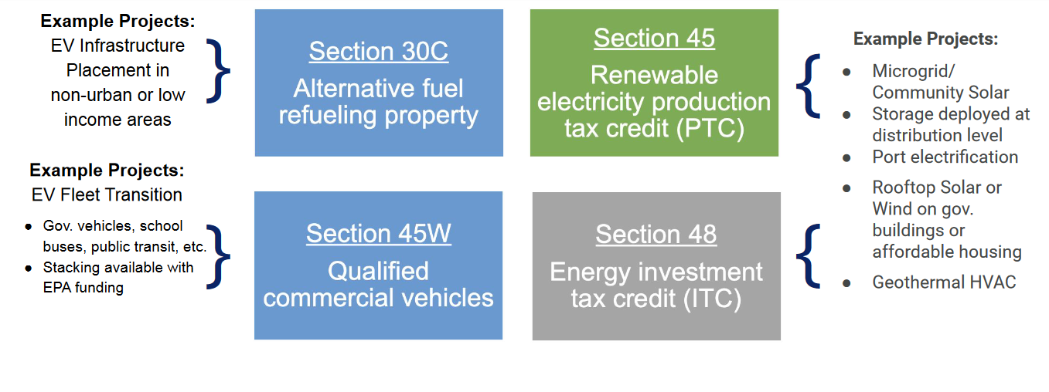
Most relevant tax credits for Massachusetts
v

Slide 42
Some Basics on Bonuses
Please Note: Additional details apply
Low-income Communities
10-20% bonus
… if project is in a low-income community with extra bonus if residential or econ benefit project
Energy Communities
10% bonus
…if project is in historical “energy community” (i.e., closed coal mine, some brownfield sites)
Prevailing Wage and Apprenticeship**
5x bonus
…if reqs for prevailing wages and registered apprentices are met
Domestic Content* **
…if 100% of applicable steel and iron and an applicable share of ‘manufactured products” produced in U.S.
10% bonus
ITC only
Applies to both ITC tax basis and PTC rate
Applies to both ITC tax basis and PTC rate
Applies to both ITC tax basis and PTC rate
* - On December,28, 2023, IRS issued new guidance on this rule for projects beginning in 2024 (see Notice 2024-9)
** - Applicable for projects of a size >1MW

Slide 43
How Direct Pay Credits and Bonuses Affect a $2M Project
Example:
A municipality with brownfield status installs microgrid with solar and energy storage.
Eligible for an ITC (Energy ITC, Sec. 48)
Project cost is $2M
Town recoups 40% of project in tax credits.
$600,000
$120,000

Slide 44
Helpful Resources
FFIO’s Direct Pay Information Page
Elect Pay Overview
CAP webinar on Direct Pay
Lawyers for Good Government Elective Pay resources, including worksheets on:
EV Purchase
EV Infrastructure
Tracking ITC and PTC projects
Slides from a presentation to local governments (but provides overview of Direct Pay for all)
IRS Video Tutorial on pre-registration
IRS Q&A

Slide 45


GrantWell: Simplifying Federal Grant Application Process With AI
AI4Impact x Federal Funds and Infrastructure Office
Jai Surya Kode
Anjith Prakash

Slide 46
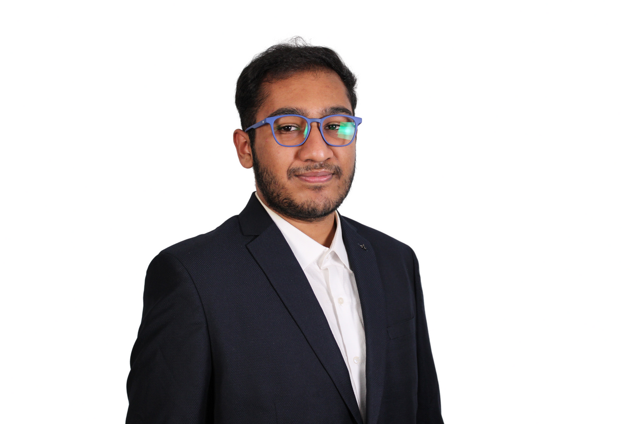


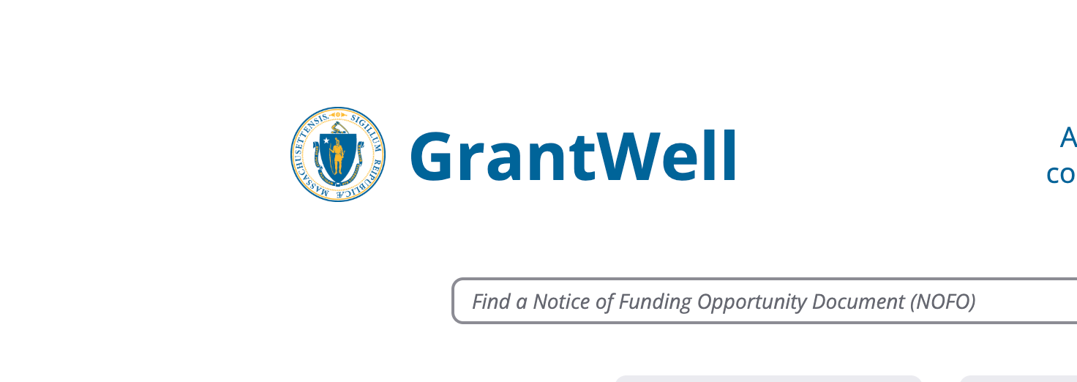
We are student researchers from Northeastern University working on this project as part of AI4Impact program.
AI4Impact partners state agencies and Northeastern University to develop innovative, sustainable, and impactful AI-driven solutions
About us
GrantWell is a free, public AI-enabled grant-writing tool designed to streamline the application process.

Slide 47
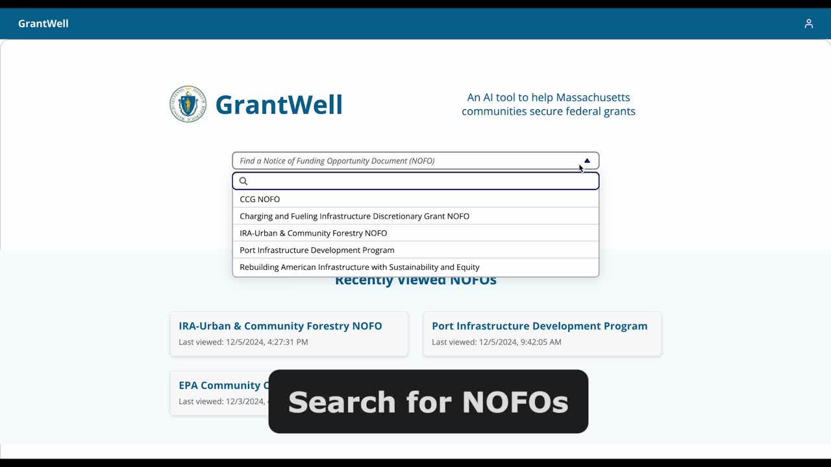


Slide 48
We would like to hear from you!
What challenges do you face when applying for federal grants?
Do you want to help us build GrantWell?
What tools do you use to assist in grant writing?
Jai Surya Kode | Anjith Prakash
www.burnes.northeastern.edu

Slide 49
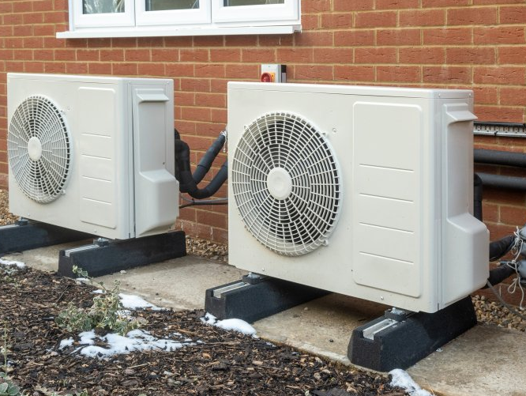
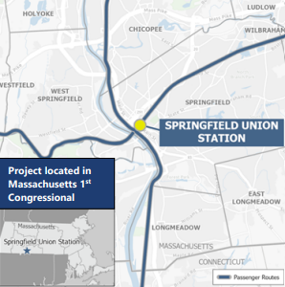
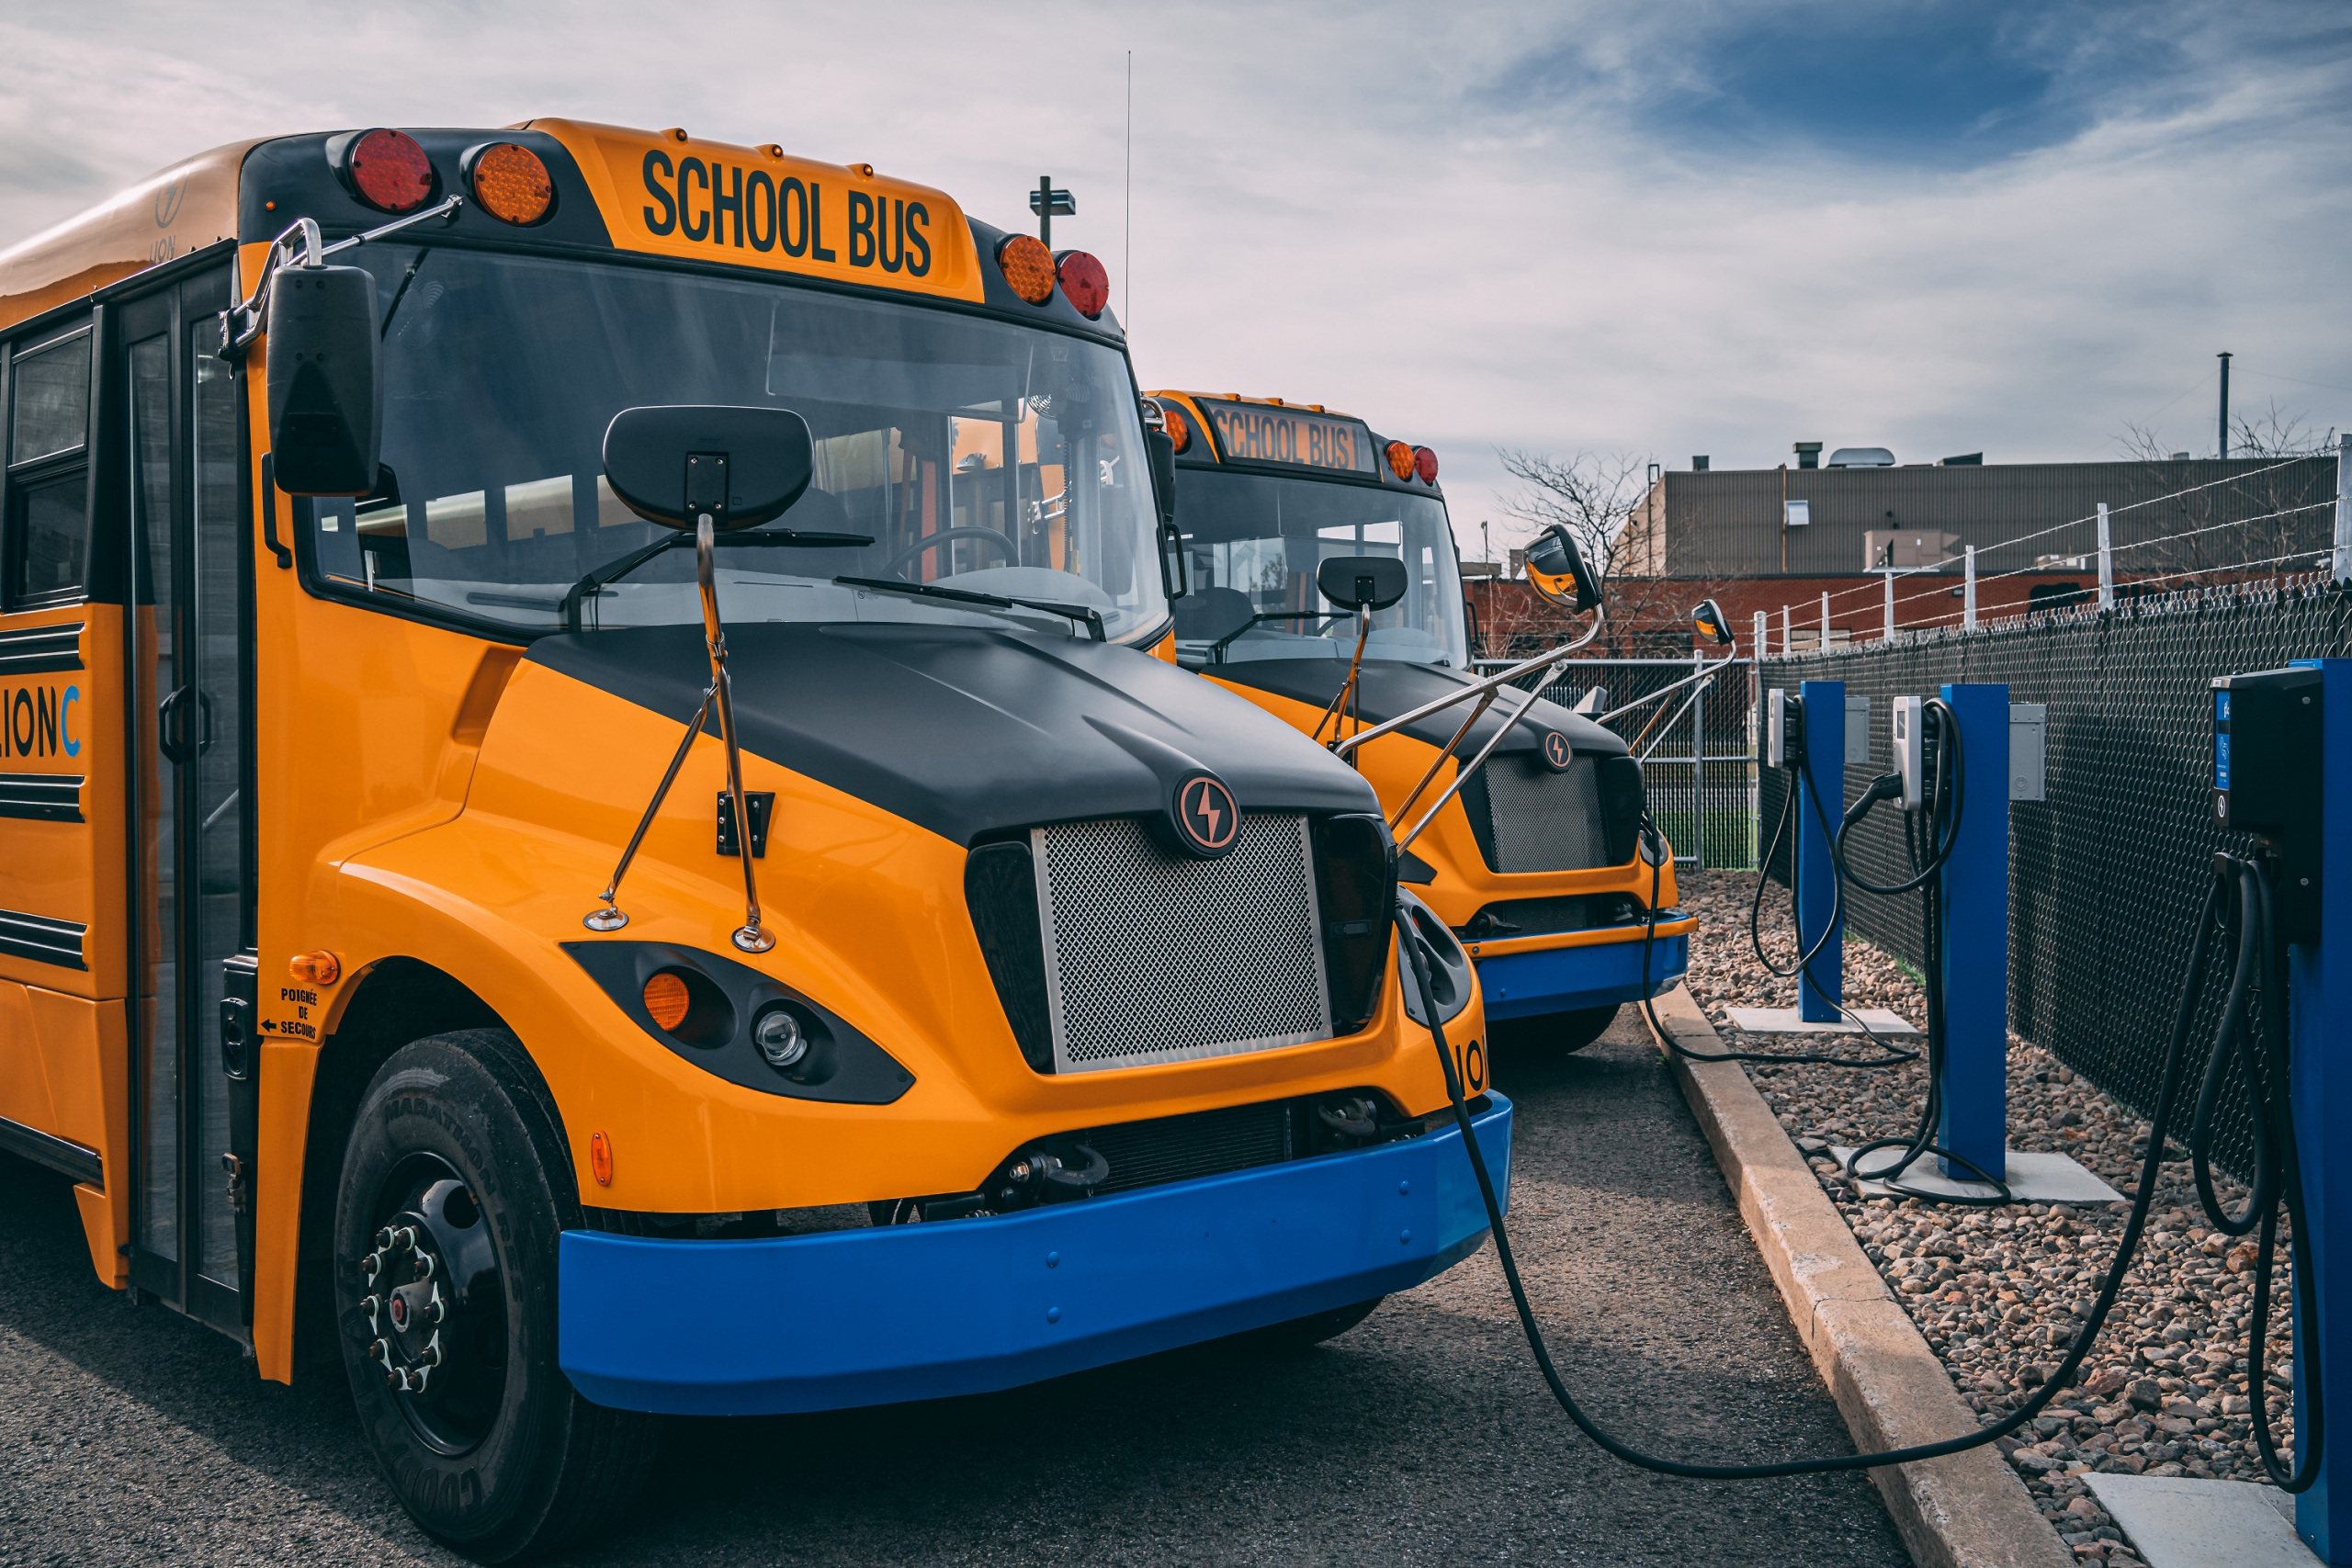
$450 Million Multi-State Award for Heat Pump Adoption
Massachusetts selected as part of a five-state coalition led by Connecticut that proposed a regional heat pump market transformation program called the New England Heat Pump Accelerator, funded under the competitive portion of the EPA’s Climate Pollution Reduction Grants.
Successful Grant Applications
$175 Million for Rail Improvements in MA
MassDOT was awarded $36,800,000 from the DOT-FRA Consolidated Rail infrastructure & Safety Improvements program. Funds will be used to advance West-East Rail, building on the $108,000,000 award from last year. 2 other Massachusetts entities were also awarded over $30,000,000.
Clean School Bus Program
$105 million to Massachusetts entities from the Environmental Protection Agency’s Clean School Bus Program for low and zero emission school buses

Slide 50

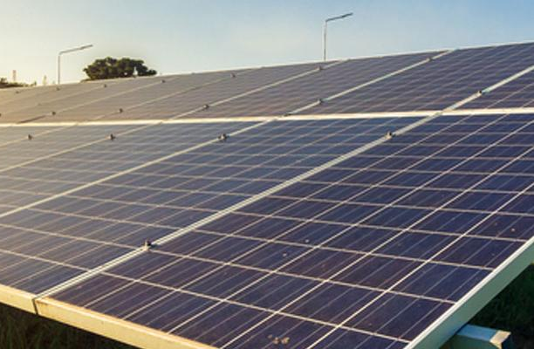
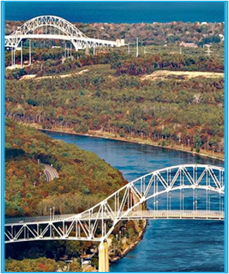
$45 Million for Conservation in Massachusetts
Mass Audubon was awarded $25,000,000 and EEA was awarded $20,835,000 from the USDA Regional Conservation Partnership Program. Funds will be used to protect thousands of acres of land and boost climate resilience in Massachusetts.
Successful Grant Applications
$156 million award through Solar for All program
The Massachusetts Department of Energy Resources (DOER), the Massachusetts Clean Energy Center (MassCEC), MassHousing, and the Boston Housing Authority were awarded $156,120,000 for clean energy investments to up to 31,000 low-income and affordable homes from the EPA’s Greenhouse Gas Reduction Fund.
$993 Million Award for the Cape Cod Bridges
$993 million in funding from the USDOT’s Bridge Investment Program (BIP) towards MassDOT’s replacement of the Cape Cod Bridges. Adds to over $700 million in existing federal funding for the project. Phase 1 of the project will begin with the replacement of the Sagamore Bridge.
Notes:
Do we want to move these slides? Get new wins slides from Partnership or CD or AC meeting

Slide 51
Municipal needs survey
Please take 5 minutes to fill out this form and help us learn more about how our office can support you to best leverage available and upcoming federal funding opportunities!

Slide 52
Discussion and q&a
As a reminder, we can help with:
Helpful information for us:
Looking for grants
Developing application
Advocating for submitted applications
Match grants to projects
Help look for partners/co-applicants (CBOs, other states, state agencies, universities, etc.)
Advice on labor standards, DEI , climate, language.
Review application
Letters of support from the state or congressionals
Calls and in-person advocacy when FFIO is in DC.
Get award dates/application status
-Are there any upcoming grants you are preparing for? Developing applications?
- What kind of technical assistance on these grants would be the most helpful for you?
- Do you have any applications pending or stuck?
-Are you looking for partners/co-applicants?
-Looking for gap financing for projects?
-
Reach us anytime at: FedFundsInfra@mass.gov.

Slide 53




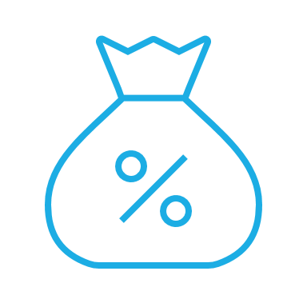

Please join us for our office hours, bring your questions, and discuss priority projects!
Transportation
Climate and Resiliency
General/Water
Office hours
Direct Pay
Priority Projects

