Slide 1
Federal funds & infrastructure office community tour
Gloucester City Hall, Gloucester
May 21, 2025

Slide 2
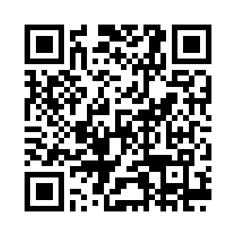
Municipal needs survey
Please take 5 minutes to fill out this form and help us learn more about how our office can support you to best leverage available and upcoming federal funding opportunities!

Slide 3
Agenda
Federal Matching Funds Legislation
New Federal Funding Opportunities
Q&A / Discussion
About FFIO
MassDOT Municipal Grants
Local Government Engagement
Audience Engagement Exercise
Direct Pay
GrantWell: Simplifying Federal Grant Application Processes with AI

Slide 4
About the Federal Funds and Infrastructure Office (FFIO)
Officially created by Executive Order No. 624, and tasked with implementing a whole-of-government to compete for federal funding by:
Leading bi-weekly meetings of the interagency Advisory Council on Federal Funds and Infrastructure
Identifying and tracking key federal funding opportunities and Massachusetts applications through the State Clearinghouse
Implementing the Federal Match legislation (Chapter 214 of the Acts of 2024)
Leading the Massachusetts Federal Funds Partnership and other meetings to support local governments in their applications for federal funding

Slide 5
Local Government Engagement

Slide 6
The Partnership provides key federal funding information to the local governments of MA.
FFIO leads the monthly Massachusetts Federal Funds Partnership meeting. This forum delivers federal funding updates and offers a platform for addressing questions related to the many funding opportunities at the disposal of cities, towns and tribal organizations.
Massachusetts Federal funds partnership
Engagement with RPAs & TrIbes
Next Federal Funds Partnership Meeting Tuesday, May 27th
    MassDOT Presentation on the CIP Process
Previous Monthly Meeting with MARPA + Federally Recognized Tribes Friday, May 2nd
    Key federal funding updates
    Working with RPAs and agencies to identify technical assistance gaps and priority projects.

Slide 7
Below are two external resources related to frozen or at-risk federal awards. Please note that this message does not constitute legal advice. We will stay in contact as we learn more about the availability of federal funds.
Resources for federal grant awardees
Lawyers for Good Government (L4GG), who are running a Fund Protection Clinic to support grantees and sub-awardees of federal programs facing threats to their funding. The intake form for the clinic is here.
The Environmental Protection Network, which maintains a network of hundreds of former EPA staff and appointees and has been providing extensive technical assistance to grantees and sub-awardees. This is the type of resource they are putting out and they are in close communication with many grantees and sub-awardees, including NGOs, municipalities, and Tribal governments. You can sign up for their email list here - they are sending out frequent updates and resources.

Slide 8
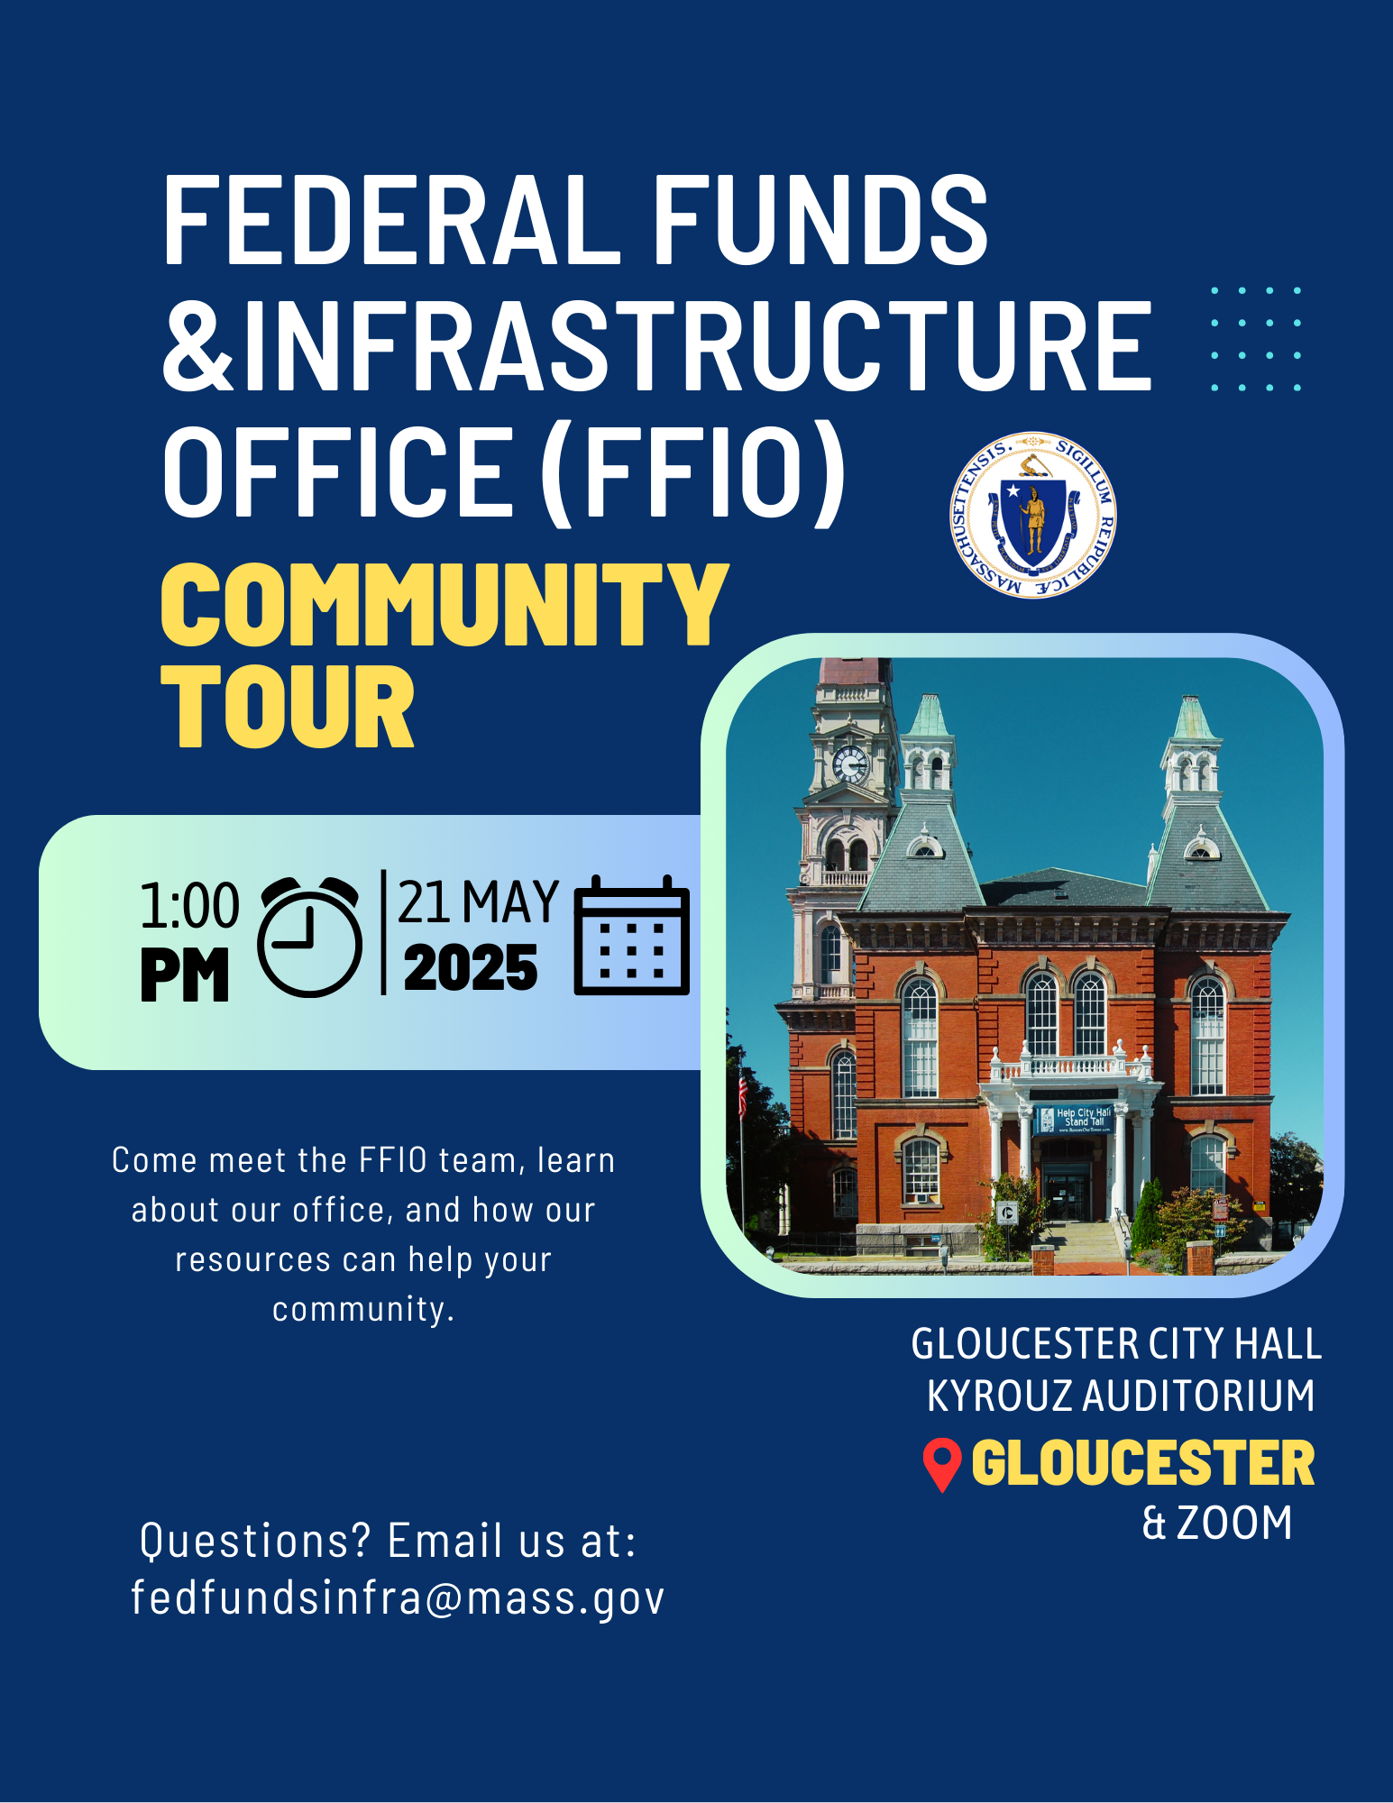


FFIO Community Tour
    INFORMATION SHARING: Provide information on federal grant application resources made available by the new legislation
    UNDERSTAND NEEDS AND PRIORITIES: Seek community input on priority projects seeking federal funding
    GATHER FEEDBACK: Solicit feedback on the Federal Funds Partnership and other FFIO processes
PITTSFIELD
WORCESTER
HAVERHILL
BROCKTON
GLOUCESTER
NEW BEDFORD
BOSTON
BARNSTABLE
SPRINGFIELD

Slide 9
Federal Matching Funds Legislation

Slide 10
Massachusetts Federal match legislation
Matching Funds
Unlocks up to $750M for matching funds for federal programs
Eligible entities, including RPAs can now apply for match via the FFIO Match Request Form
Learn more on the new Massachusetts Matching Funds Website
Other Financial Assistance for Municipalities
Allocates up to $50M in the form of grants, loans, or other financial assistance, which may be directed to municipalities.
Explore providing start-up capital for Direct Pay-eligible projects, etc.
Technical Assistance for Municipalities
Allocates up to $12M for technical support to munis for grant application development and implementation assistance for successful awards
Leverage existing municipal outreach (partnership meetings, upcoming community tour, etc.) to understand municipal needs

Slide 11
Eligible applicants:
State agencies
Independent governmental state or public entities (quasis)
Municipalities (cities and towns)
Tribes
Regional planning agencies (RPAs)
Community development corporations (CDCs)
Other development authorities or agencies
Private entities (under review)
Application process:
Fill out Federal Matching Funds Form
Email supporting materials to fedfundsinfra@mass.gov
Questions on form or materials: reach out to Bob and Sam
If your agency works with munis on a federal program, have the muni who would be award recipient apply for match
Timeline:
Three (3) weeks prior to federal application submission
FFIO and ANF review on a rolling basis (for now)
Still reviewing how to process retroactive requests
Matching funds process
Notes:
Pioneer valley example

Slide 12
New Federal Funding Opportunities

Slide 13
New grants
Grant Name | Eligibility | Max Award | Cost Share | Deadline
Rural and Tribal Assistance Pilot Program (Reapply!) | Rural Local Governments, Tribes | N/A | N/A | TBD
Safe Streets and Roads for All (SS4A) | Local Governments, Tribes, School Districts, Universities | N/A | 20% | 6/26/2025
Ports Infrastructure Development Program (PIDP) (Amended NOFO!) | State, Local Governments, Tribes | $125,000,000 | 20% (exceptions for rural areas and small projects at small ports) | 9/10/2025
Regional Infrastructure Accelerator | All eligible public US based entities | $2,000,000 | N/A | 6/16/2025
FY25 School Violence Prevention Program (DOJ) | State, Local Governments, School Districts, Tribes, Law Enforcement Agencies | $500,000 | N/A | 6/18/2025
Partnership for Fish and Wildlife | State, Local Governments, Tribes, For-Profits, Nonprofits | $750,000 | N/A | 9/30/2025
FY25 COPS Hiring Program | State, Municipalities, Tribes | N/A | N/A | 6/25/2025

Slide 14
New grants: Food grants
Grant Name | Eligibility | Max Award | Cost Share | Deadline
Farmers Market Promotion Program Fiscal Year 2025 | Municipalities, Food Councils, NGOs, Tribes, etc. | $500,000 | 25% | 6/27/2025
Local Food Promotion Program Fiscal Year 2025 | Municipalities, Food Councils, NGOs, Tribes, etc. | $500,000 | 25% | 6/27/2025
Regional Food System Partnerships | State Agencies or Regional Authorities, Philanthropic Corporations, Institutions of Higher Education, Private Corporations, and Commercial, Federal or Farm Credit System Lending Institutions. | $1,000,000 | 25% | 6/27/2025

Slide 15
New grants
Grant Name | Eligibility | Max Award | Cost Share | Deadline
Fire Science Innovations through Research and Education | Unrestricted | N/A | N/A | 6/20/2025
Empower to Grow (E2G) Program Manufacturing | NGOs, Private, Universities | $1,148,658 for 3 awards | N/A | 5/28/2025
NSF - Applied Mathematics | Unrestricted | N/A | N/A | 11/17/2025
FY26 Department of Defense Multidisciplinary Research Program of the University Research Initiative (MURI) | Universities | $4,500,000 | N/A | 9/5/2025
D.4 University Leadership Initiative 2 (ULI2)- NASA | Unrestricted (target: Universities) | N/A | N/A | 6/26/2025
Expanding Opportunity Through Quality Charter Schools Program (CSP)--Grants to State Entities (State Entity Grants) | State | $600,000 | N/A | 6/9/2025

Slide 16
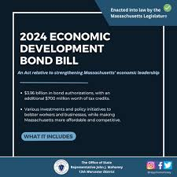
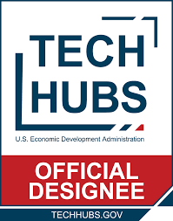






Other opportunities:
DIRECT PAY TAX CREDITS

Slide 17

MassDOT Municipal Grants

Slide 18
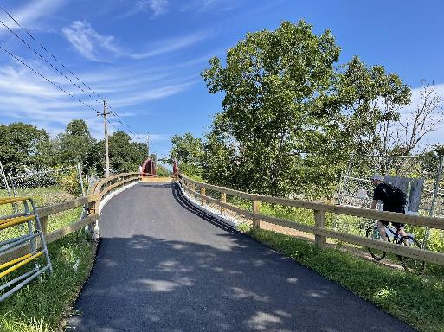
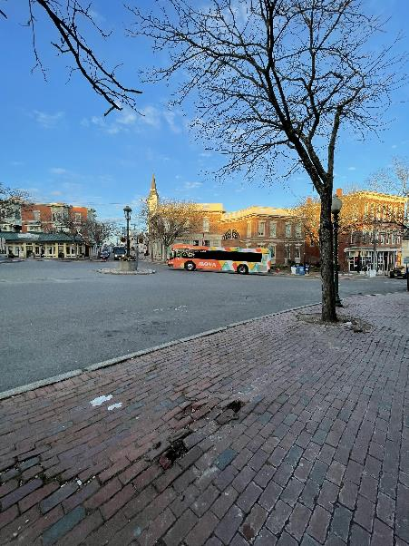
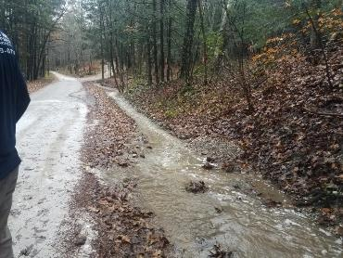
About the Municipal Grants Engagement (MGE) Group
MassDOT’s Municipal Grants Engagement Group’s mission is to connect municipalities with federal funding opportunities to advance local and regional transportation needs.
The group will also provide technical assistance to Massachusetts communities, with a focus on rural areas and Gateway Cities, to prepare projects for the receipt of federal funding, develop discretionary grant applications, and assist with coordination efforts across MassDOT, municipalities, and our partner agencies.

Slide 19
Municipal Grants Engagement Group Resources
Eligibility Guidance / Program “Match Making:” Assisting municipalities in determining eligibility for federal discretionary and formula funding programs and appropriate funding alternatives.
Project Scoping Assistance: Providing technical assistance for early-stage planning activities, including but not limited to: Conceptual Designs/Sketch Plans; Crash Diagrams & Hot Spot Analysis; Road Safety Audits (RSAs); Traffic Impact Studies; Speed Studies; Existing Conditions & Data Collection.
Grant Application Assistance (for Joint State and Municipal Priorities): Providing technical assistance in drafting and reviewing grant applications, including project narratives, budgets, and responses to merit criteria.
Letters of Support: Drafting and issuing MassDOT letters of support for grant applications to demonstrate agency endorsement.
Match Funding Coordination: Advising on strategies to identify and secure local, state, or other match funding for federal grant applications. Coordinating with state funding programs to ensure alignment with grant application requirements.
Post-Award Support: Helping municipalities manage awarded grants, including guidance on reporting, documentation, and financial oversight to ensure compliance with grant terms.

Slide 20
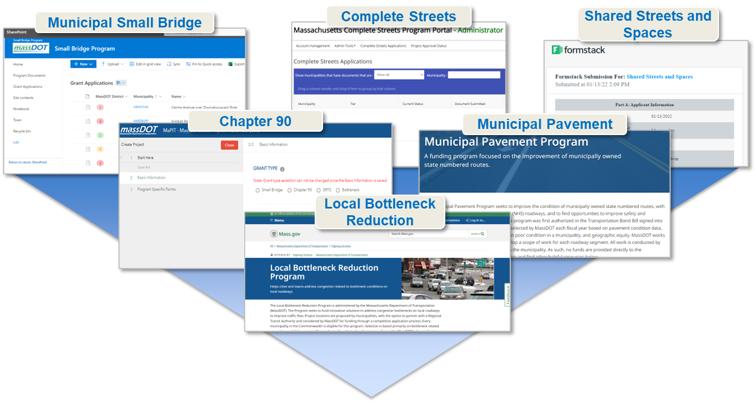
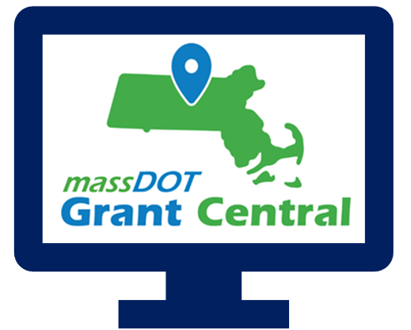
Grant Central
Funding Programs
Grant Central Users
Chapter 90 | Complete Streets | Local Bottleneck Reduction | Municipal Pavement | Municipal Small Bridge | Shared Streets and Spaces
The Public | Municipal Officials | Regional Transit Authorities | MassDOT Staff
636 unique Municipal Users

Slide 21
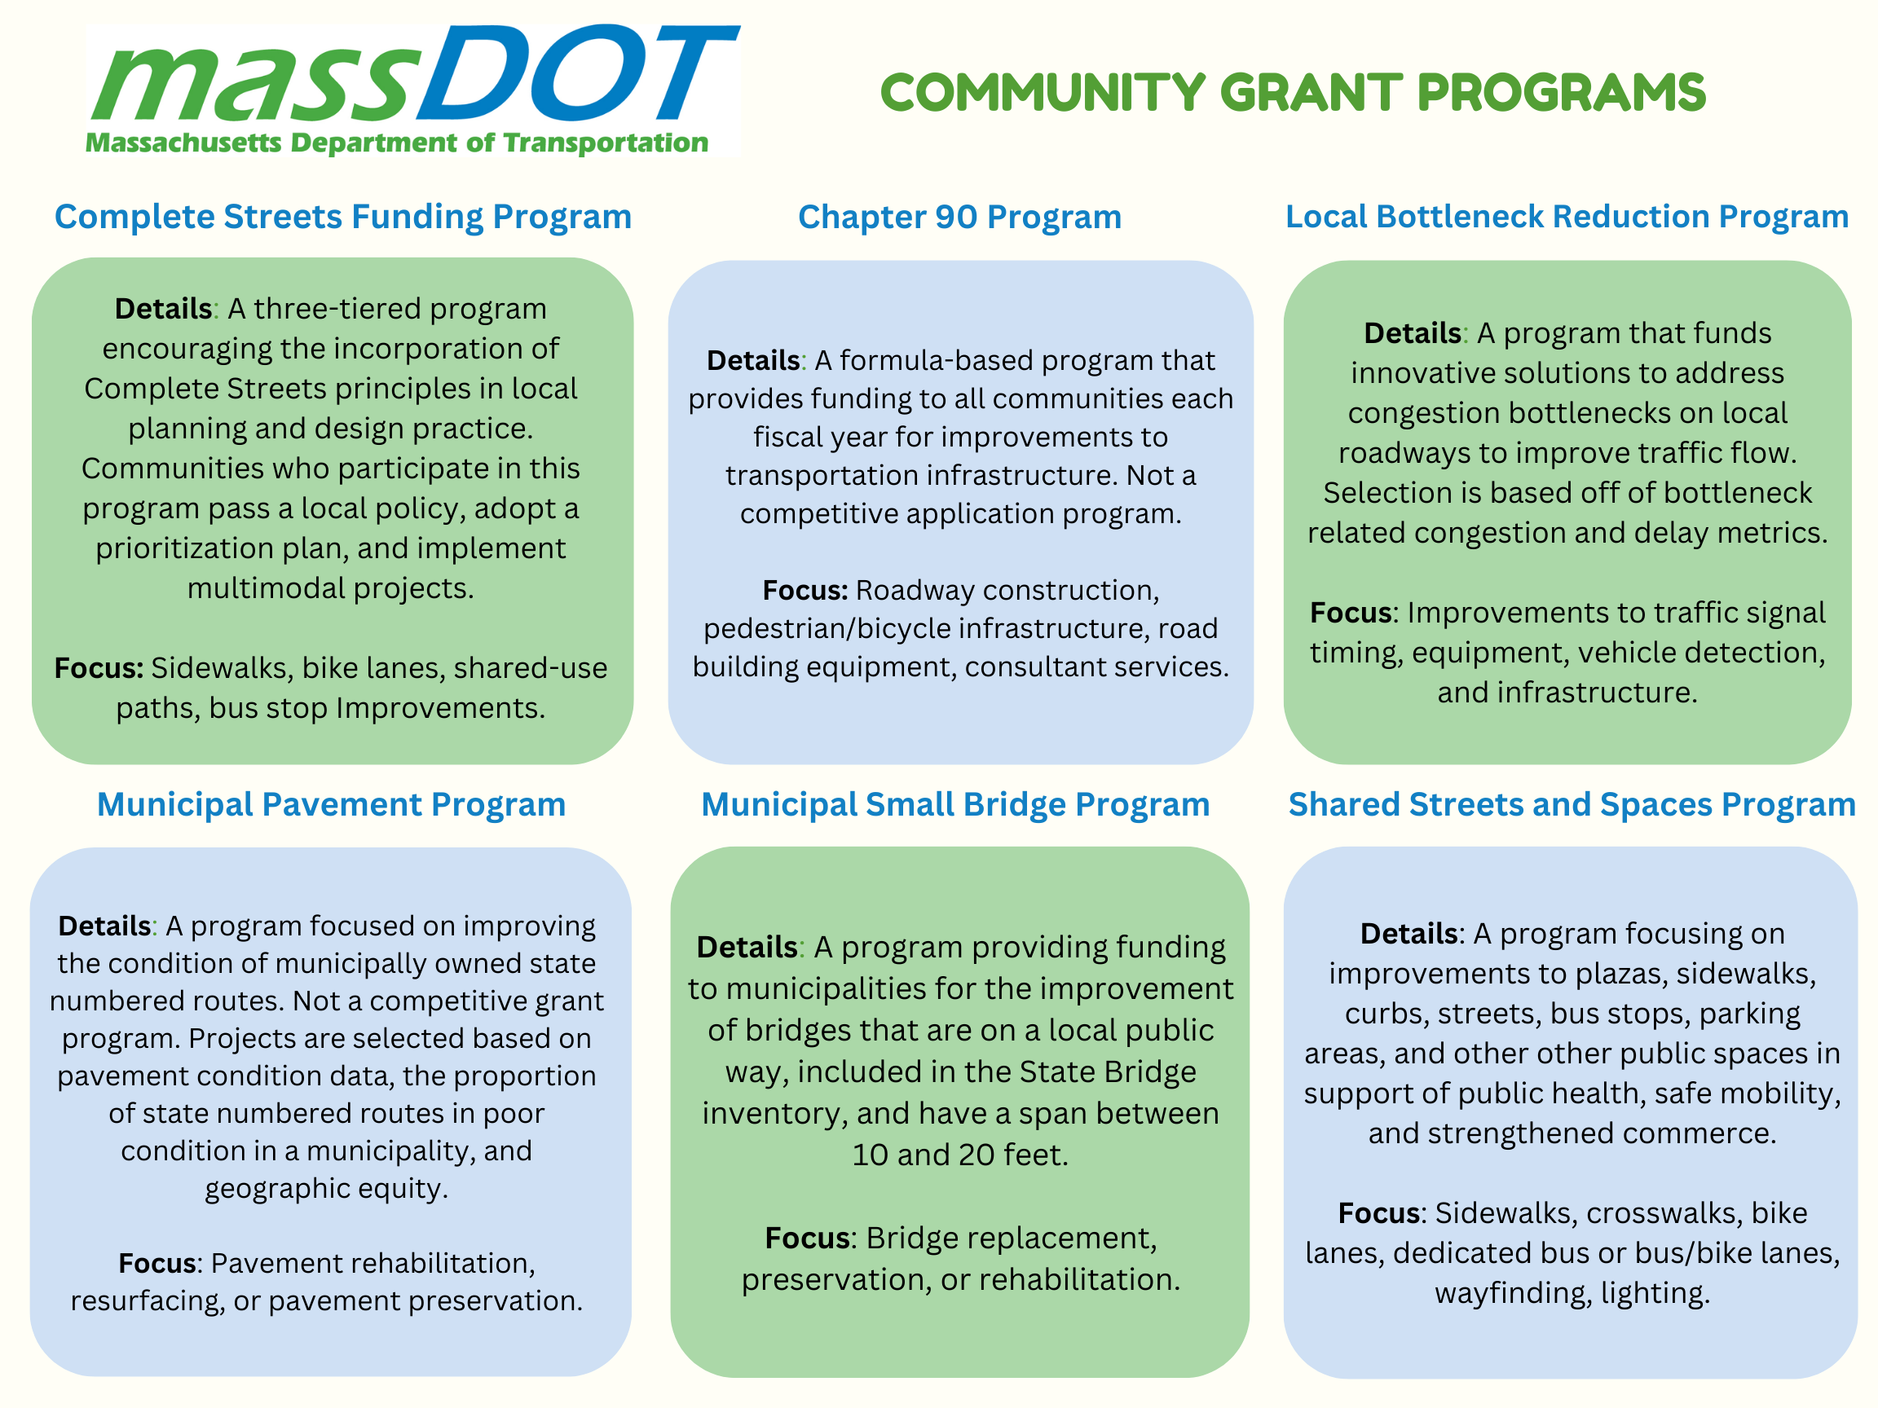

Slide 22
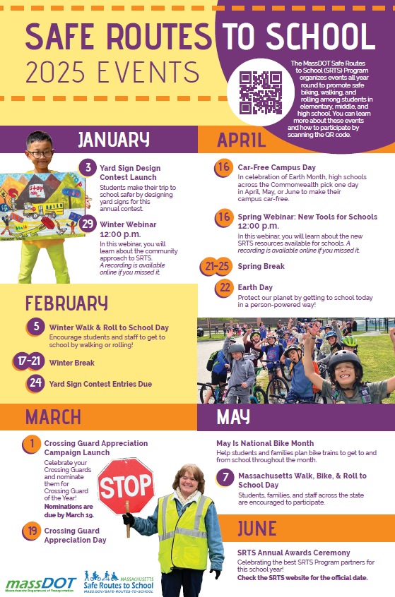
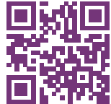
Safe Routes to School (https://www.mass.gov/safe-routes-to-school)
The MassDOT Safe Routes to School (SRTS) Program organizes events all year round to promote safe biking, walking, and rolling among students in
elementary, middle, and high school. You can learn more about these events
and how to participate by scanning the QR code.

Slide 23
Key Dates
Complete Streets: The latest Tier 3 application round closed on May 1, but we are always accepting Tier 1 and Tier 2 submissions!
Shared Streets & Spaces: We anticipate the results of the latest application round to be announced in May 2025.
Municipal Small Bridge Program: The FY25 application round closed on Monday, February 3, 2025. We anticipate the results of this application round to be announced in late May 2025.
Local Bottleneck Reduction Program: MassDOT announced the results of the latest application round in early January have moved on to the initial scoping and design phase.
Safe Routes to School Signs & Lines and Infrastructure Grants: Launching in late August or early September 2025.

Slide 24
Resources and Contact Information
Derek Krevat: Derek.Krevat@dot.state.ma.us
Kristen (Pennucci) Rebelo: Kristen.E.Rebelo@DOT.state.ma.us
Grant Central: MassDOTGrantCenral@DOT.state.ma.us
U.S. DOT Navigator: https://www.transportation.gov/dot-navigator
Grants.gov: https://www.grants.gov/search-grants
MA Federal Funds & Infrastructure Office: https://www.mass.gov/orgs/federal-funds-infrastructure-office

Slide 25
Direct Pay Overview
May 21, 2025
Bob LaRocca, Deputy Director, Federal Funds and Infrastructure Office

Slide 26
What is Direct Pay?
  The Inflation Reduction Act (IRA) makes the largest investment in clean energy in United States history, and much of that investment is delivered via tax incentives.
  Under the IRA, tax-exempt and governmental entities – such as cities and towns -- that do not owe Federal income taxes are, for the first time, able to receive a payment equal to the full value of tax credits for building qualifying clean energy projects or making qualifying investments. This is called Direct Pay (also known as Elective Pay).
  By filing a return and using Direct Pay, these entities can receive a cash refund from the IRS for certain clean energy projects.
  Direct pay applies to projects put into service January 1, 2023 through December 31, 2032, creating a decade of tax opportunity to save money on necessary infrastructure replacements and upgrades while reducing energy costs and carbon emissions.
  Unlike competitive grant programs, the overall potential of these tax credits to states and municipalities is unlimited.
  Note on these credits being “mandatory, not discretionary”

Slide 27
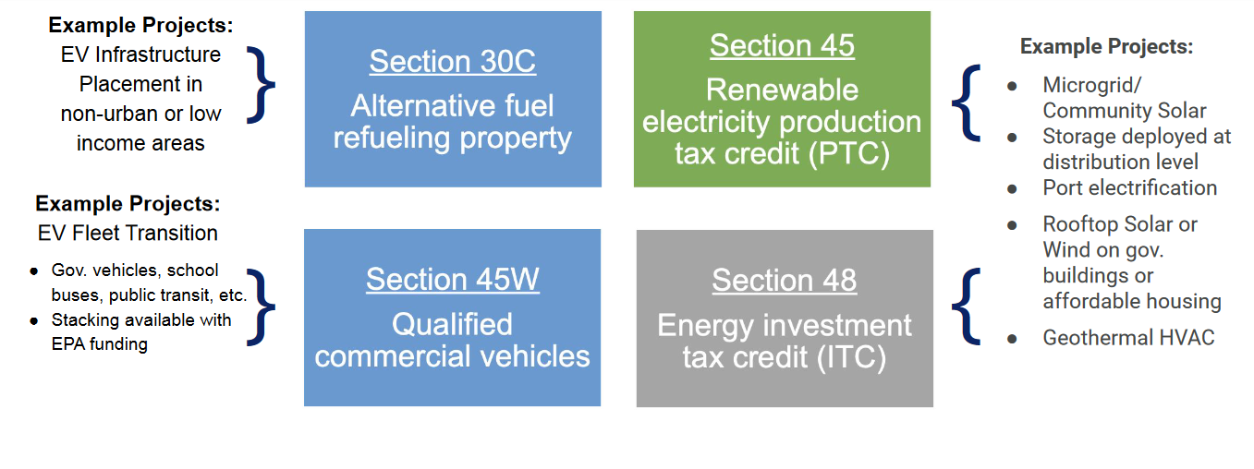
Most relevant tax credits for Massachusetts
v

Slide 28
Some Basics on Bonuses
Please Note: Additional details apply
Low-income Communities
10-20% bonus
… if project is in a low-income community with extra bonus if residential or econ benefit project
Energy Communities
10% bonus
…if project is in historical “energy community” (i.e., closed coal mine, some brownfield sites)
Prevailing Wage and Apprenticeship**
5x bonus
…if reqs for prevailing wages and registered apprentices are met
Domestic Content* **
…if 100% of applicable steel and iron and an applicable share of ‘manufactured products” produced in U.S.
10% bonus
ITC only
Applies to both ITC tax basis and PTC rate
Applies to both ITC tax basis and PTC rate
Applies to both ITC tax basis and PTC rate
* - On December,28, 2023, IRS issued new guidance on this rule for projects beginning in 2024 (see Notice 2024-9)
** - Applicable for projects of a size >1MW

Slide 29
How Direct Pay Credits and Bonuses Affect a $2M Project
Example:
A municipality with brownfield status installs microgrid with solar and energy storage.
Eligible for an ITC (Energy ITC, Sec. 48)
Project cost is $2M
Town recoups 40% of project in tax credits.
$600,000
$120,000

Slide 30
Helpful Resources
FFIO’s Direct Pay Information Page
Elect Pay Overview
CAP webinar on Direct Pay
Lawyers for Good Government Elective Pay resources, including worksheets on:
  EV Purchase
  EV Infrastructure
  Tracking ITC and PTC projects
  Slides from a presentation to local governments (but provides overview of Direct Pay for all)
IRS Video Tutorial on pre-registration
IRS Q&A

Slide 31


GrantWell: Simplifying Federal Grant Application Process With AI
AI4Impact x Federal Funds and Infrastructure Office
Jai Surya Kode
Anjith Prakash

Slide 32
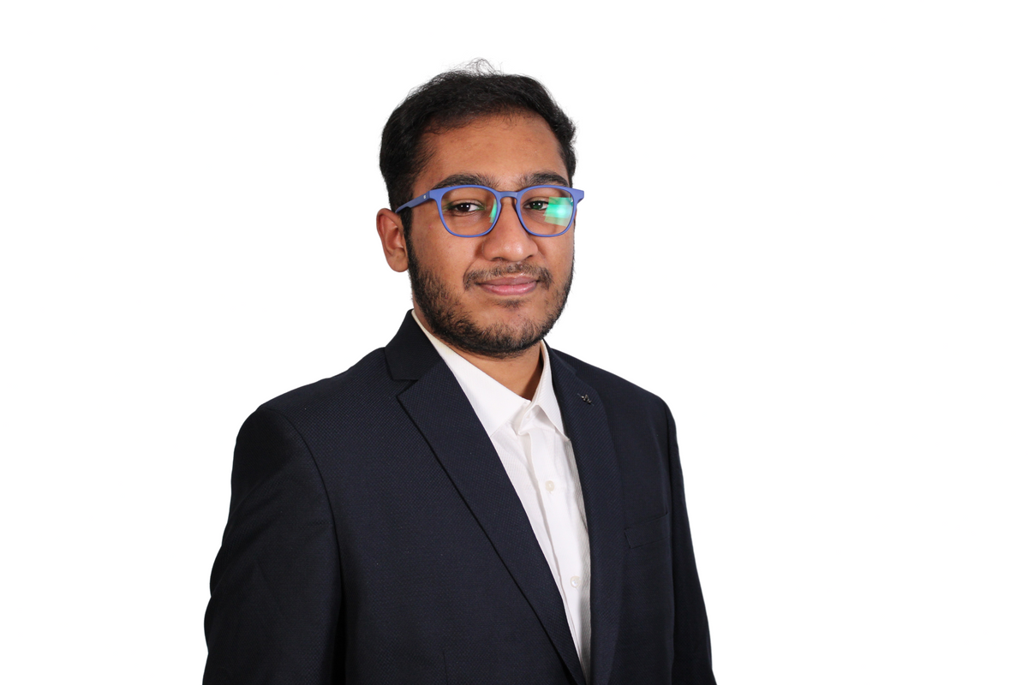


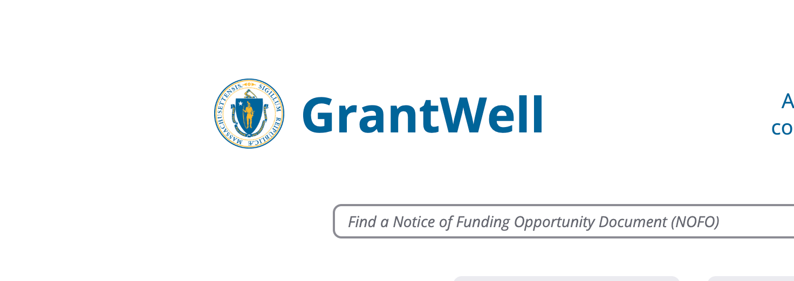
We are student researchers from Northeastern University working on this project as part of AI4Impact program.
AI4Impact partners state agencies and Northeastern University to develop innovative, sustainable, and impactful AI-driven solutions
About us
GrantWell is a free, public AI-enabled grant-writing tool designed to streamline the application process.

Slide 33
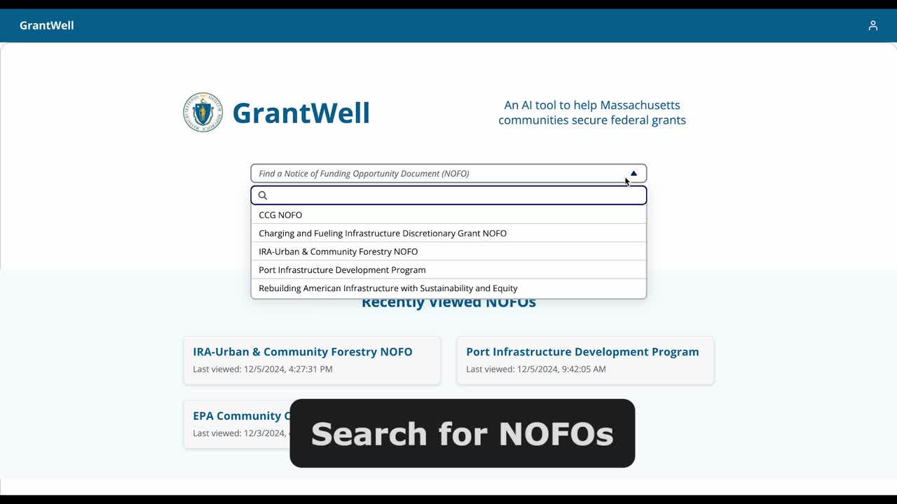


Slide 34
We would like to hear from you!
What challenges do you face when applying for federal grants?
Do you want to help us build GrantWell?
What tools do you use to assist in grant writing?
Jai Surya Kode | Anjith Prakash
www.burnes.northeastern.edu

Slide 35
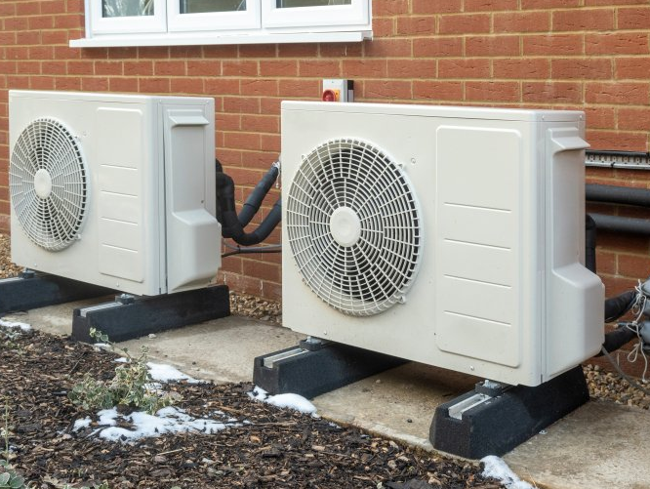
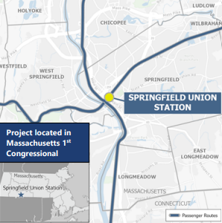
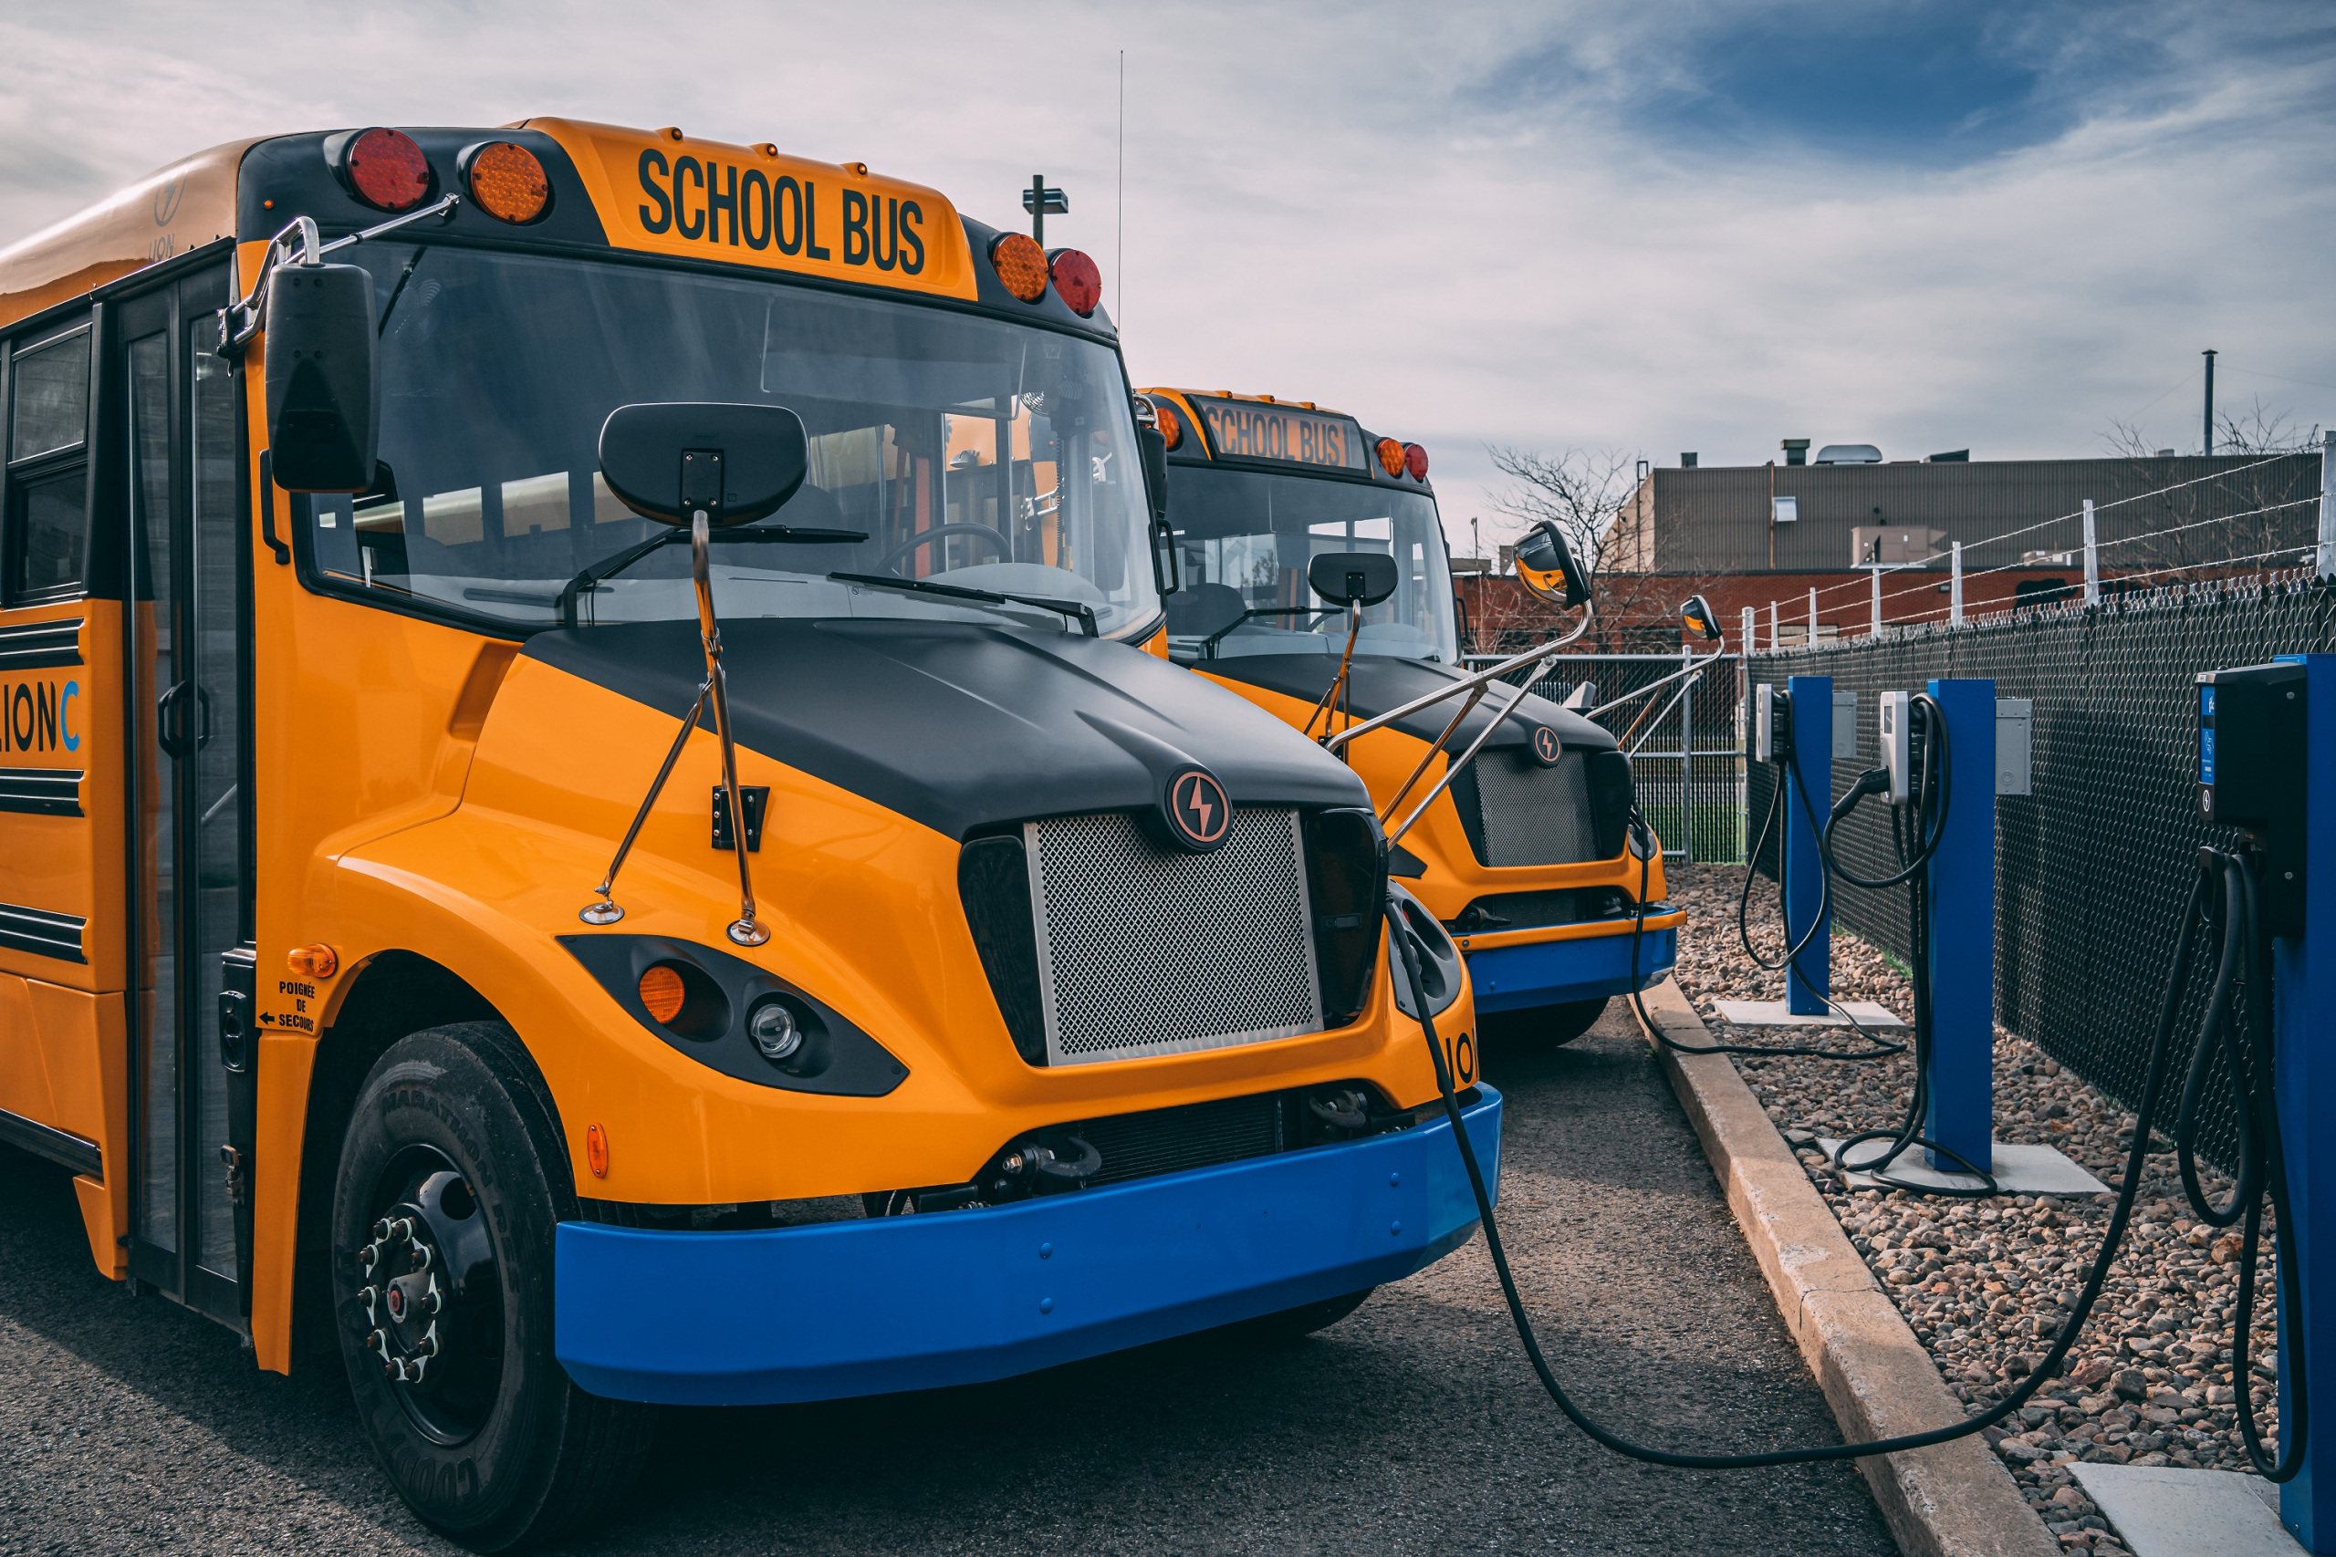
  $450 Million Multi-State Award for Heat Pump Adoption
  Massachusetts selected as part of a five-state coalition led by Connecticut that proposed a regional heat pump market transformation program called the New England Heat Pump Accelerator, funded under the competitive portion of the EPA’s Climate Pollution Reduction Grants.
Successful Grant Applications
  $175 Million for Rail Improvements in MA
  MassDOT was awarded $36,800,000 from the DOT-FRA Consolidated Rail infrastructure & Safety Improvements program. Funds will be used to advance West-East Rail, building on the $108,000,000 award from last year. 2 other Massachusetts entities were also awarded over $30,000,000.
Clean School Bus Program
$105 million to Massachusetts entities from the Environmental Protection Agency’s Clean School Bus Program for low and zero emission school buses

Slide 36


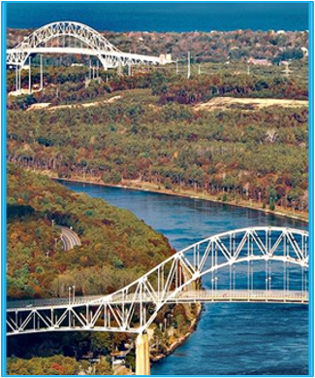
  $45 Million for Conservation in Massachusetts
  Mass Audubon was awarded $25,000,000 and EEA was awarded $20,835,000 from the USDA Regional Conservation Partnership Program. Funds will be used to protect thousands of acres of land and boost climate resilience in Massachusetts.
Successful Grant Applications
  $156 million award through Solar for All program
  The Massachusetts Department of Energy Resources (DOER), the Massachusetts Clean Energy Center (MassCEC), MassHousing, and the Boston Housing Authority were awarded $156,120,000 for clean energy investments to up to 31,000 low-income and affordable homes from the EPA’s Greenhouse Gas Reduction Fund.
  $993 Million Award for the Cape Cod Bridges
  $993 million in funding from the USDOT’s Bridge Investment Program (BIP) towards MassDOT’s replacement of the Cape Cod Bridges. Adds to over $700 million in existing federal funding for the project. Phase 1 of the project will begin with the replacement of the Sagamore Bridge.
Notes:
Do we want to move these slides? Get new wins slides from Partnership or CD or AC meeting

Slide 37
Municipal needs survey
Please take 5 minutes to fill out this form and help us learn more about how our office can support you to best leverage available and upcoming federal funding opportunities!

Slide 38
Discussion and q&a
As a reminder, we can help with:
Helpful information for us:
Looking for grants
Developing application
Advocating for submitted applications
Match grants to projects
Help look for partners/co-applicants (CBOs, other states, state agencies, universities, etc.)
Advice on labor standards, DEI , climate, language.
Review application
Letters of support from the state or congressionals
Calls and in-person advocacy when FFIO is in DC.
Get award dates/application status
-Are there any upcoming grants you are preparing for? Developing applications?
- What kind of technical assistance on these grants would be the most helpful for you?
- Do you have any applications pending or stuck?
-Are you looking for partners/co-applicants?
-Looking for gap financing for projects?
-
Reach us anytime at: FedFundsInfra@mass.gov.

Slide 39



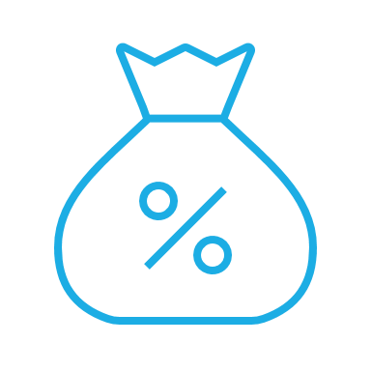


Please join us for our office hours, bring your questions, and discuss priority projects!
Transportation
Climate and Resiliency
Direct Pay
Office hours
GrantWell
Priority Projects

