Slide 1
Federal funds & infrastructure office community tour
Lynn City Hall, City Council Chambers – Lynn
October 15, 2025

Slide 2
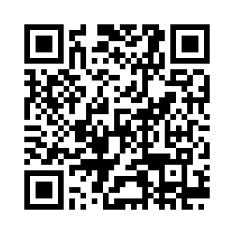
Municipal needs survey
Please take 5 minutes to fill out this form and help us learn more about how our office can support you to best leverage available and upcoming federal funding opportunities!

Slide 3
Agenda
Federal Matching Funds Legislation
Q&A / Discussion
About FFIO
FFIO’s Grant Programs
Local Government Engagement
New Federal Grant Opportunities
Grantwell

Slide 4
About the Federal Funds and Infrastructure Office (FFIO)
Officially created by Executive Order No. 624, and tasked with implementing a whole-of-government to compete for federal funding by:
Leading bi-weekly meetings of the interagency Advisory Council on Federal Funds and Infrastructure
Identifying and tracking key federal funding opportunities and Massachusetts applications through the State Clearinghouse
Implementing the Federal Match legislation (Chapter 214 of the Acts of 2024)
Leading the Massachusetts Federal Funds Partnership and other meetings to support local governments in their applications for federal funding

Slide 5
Local Government Engagement

Slide 6
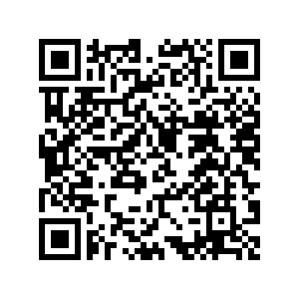
The Partnership provides key federal funding information to the local governments of MA.
FFIO leads the monthly Massachusetts Federal Funds Partnership meeting. This forum delivers federal funding updates and offers a platform for addressing questions related to the many funding opportunities at the disposal of cities, towns and tribal organizations.
Massachusetts Federal funds partnership
Engagement with RPAs & TrIbes
Previous Federal Funds Partnership Meeting Tuesday, September 30th
    FFIO Technical Assistance Programs
    GrantWell
    Scan here to register for Partnership Zoom meetings and FFIO’s newsletter!

Slide 7
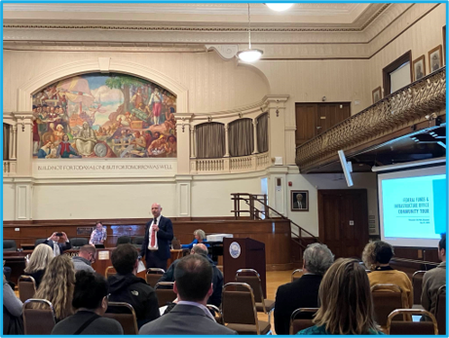


FFIO Community Tour
    INFORMATION SHARING: Provide information on federal grant application resources made available by the new legislation
    UNDERSTAND NEEDS AND PRIORITIES: Seek community input on priority projects seeking federal funding
    GATHER FEEDBACK: Solicit feedback on the Federal Funds Partnership and other FFIO processes
PITTSFIELD
WORCESTER
HAVERHILL
BROCKTON
GLOUCESTER
NEW BEDFORD
BOSTON
BARNSTABLE
GREENFIELD
LYNN (10/15)
LEOMINSTER (10/23)
SPRINGFIELD
MEDFORD

Slide 8
Federal Matching Funds Legislation

Slide 9
Massachusetts Federal match legislation
Matching Funds
Unlocks up to $750M for matching funds for federal programs
Eligible entities, including RPAs can now apply for match via the FFIO Match Request Form
Learn more on the new Massachusetts Matching Funds Website
Other Financial Assistance for Municipalities
Allocates up to $50M in the form of grants, loans, or other financial assistance, which may be directed to municipalities.
Explore providing start-up capital for Direct Pay-eligible projects, etc.
Technical Assistance for Municipalities
Allocates up to $12M for technical support to munis for grant application development and implementation assistance for successful awards
Leverage existing municipal outreach (partnership meetings, upcoming community tour, etc.) to understand municipal needs

Slide 10
Eligible applicants:
State agencies
Independent governmental state or public entities (quasis)
Municipalities (cities and towns)
Tribes
Regional planning agencies (RPAs)
Community development corporations (CDCs)
Other development authorities or agencies
Private entities (under review)
Application process:
Fill out Federal Matching Funds Form
Email supporting materials to fedfundsinfra@mass.gov
Questions on form or materials: reach out to Bob and Sam
If your agency works with munis on a federal program, have the muni who would be award recipient apply for match
Timeline:
Three (3) weeks prior to federal application submission
FFIO and ANF review on a rolling basis (for now)
Still reviewing how to process retroactive requests
Matching funds process

Slide 11
FFIO Grant programs overview

Slide 12
  Grant type: Competitive, direct funding for selected municipalities
  Funding Cap: None; decisions made on a rolling, first-come-first-serve basis (up until a fixed amount per year)
  Covered Services (related to pursuing federal opportunities): Including but not limited to:
      Tax assistance (e.g. for Direct Pay) and legal assistance
      Grant-writing, project scoping and financial analysis
      Planning and feasibility studies,
      Demonstration activities
      Post-award grant management support.
  Administration: In coordination with ANF, FFIO will establish and oversee a process to receive requests for technical assistance services and select successful applicants
  Funding amount: approximately $2,500,000 over 2 years
Municipal and Tribal Technical Assistance Program

Slide 13
  Grant type: Formula-based, direct funding for all 13 RPAs with grant conditions.
  Eligibility: All Massachusetts RPAs.
  Covered Scope of Work (related to pursuing federal opportunities): Including but not limited to: hiring in-house capacity to provide technical assistance, grant application support, project development and implementation support such as project scoping and financial analysis, planning and feasibility studies, cost-benefit analysis.
  Administration: In coordination with ANF and DLS, FFIO will establish and oversee a process to allocate grant funding to RPAs on an opt-in basis. Funding would be tied to specific conditions and reporting requirements:
    (1) Projects pursuing federal funds;
    (2) Regular updates to FFIO, and coordination with FFIO as needed;
    (3) Annual spending reports
  Funding amount: $2,000,000 over 2 years
Technical Assistance Grants for Regional Planning Agencies

Slide 14
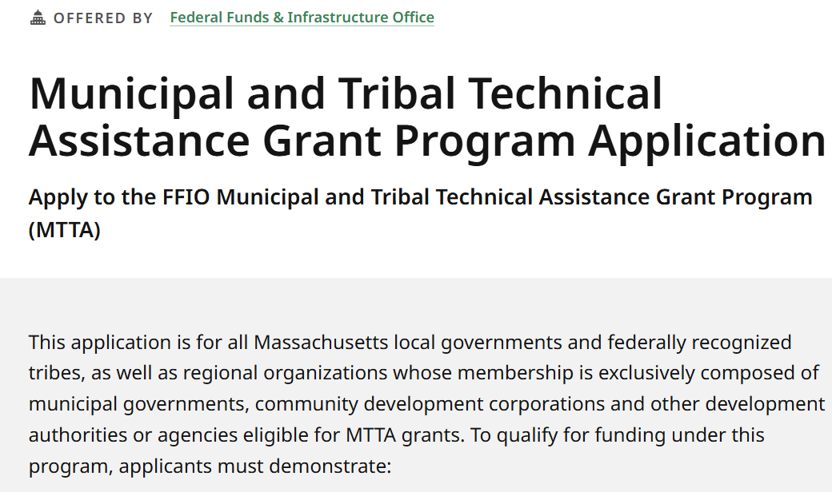
Learn about the technical assistance programs here:
mass.gov/MTTA
mass.gov/TARPA
mass.gov/FFIO-TA

Slide 15
New Federal Funding Opportunities

Slide 16
New grants
Grant Name | Eligibility | Max Award | Cost Share | Deadline
National Fish Passage Program | State, Local Governments, Tribes, NGOs, + | $1,000,000 | No | 11/12/2025
Farm to School Grant Program | State + Tribes. Partnerships of Local Governments, NGOs, agricultural producers, CNP operators | $500,000 | 25% | 12/5/2025
Archival Projects | State, Local Governments, NGOs, Academic Institutions, Federally- or State-recognized Tribes | $150,000 | No | 11/5/2025
If you’ve applied for federal grants – let us know at fedfundsinfra@mass.gov​
Search for federal funding opportunities here: Home | Grants.gov

Slide 17
New grants/Other funding opportunities
Grant Name | Eligibility | Max Award | Cost Share | Deadline
Rural Water and Wastewater Technical Assistance and Training Grant Program | NGOs | N/A | No | 12/31/2025
Solid Waste Management Grant Program | NGOs, Federally- or State-recognized Tribes, Public bodies, Academic Institutions | N/A | No | 12/31/2025
Rural Decentralized Water System Grant Program | NGOs | N/A | 10% | 12/01/2025

Slide 18
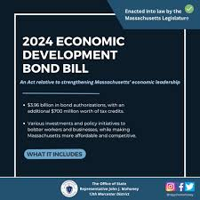


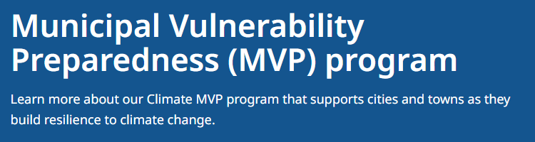
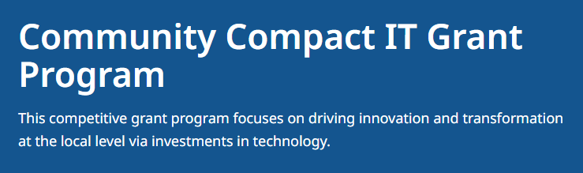
State programs:
Search for state grant programs here: Community Grant Finder | Mass.gov

Slide 19

Direct Pay Tax Credits
Direct Pay Tax Credits allow non-taxable entities to receive tax credits from the IRS for certain qualifying clean energy projects.
The passage of H.R. 1, also known as the One Big Beautiful Bill Act, significantly affects Direct Pay tax credit opportunities and timelines.
Direct Pay still exists as a federal program, but OBBBA now imposes a variety of new restrictions, especially for solar and wind projects, and electric vehicle purchases and charging infrastructure.
However, tax credits remain available for qualifying ground-source heat pump and battery storage projects.
If your community is considering or undergoing these types of projects, please contact FFIO at FedFundsInfra@mass.gov

Slide 20
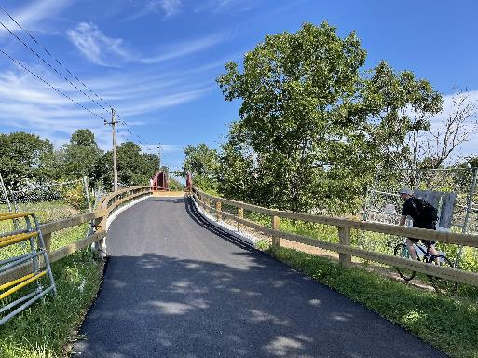
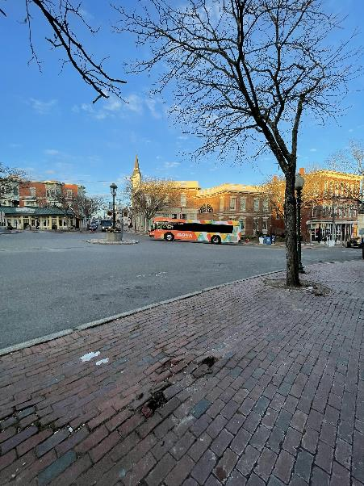
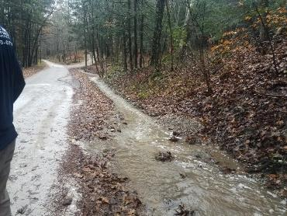
Local Early & Actionable Planning (LEAP) Program
Overview: MassDOT’s Municipal Planning & Support Team has procured consultant support to provide early-stage planning and project development activities for underserved municipalities in Massachusetts.
Cost of Available Services: $1 million is available in State Fiscal Year 2026. Individual tasks will be roughly between $25,000 - $100,000 for the first round.
Eligible Projects: Alternatives Analyses to Inform Project Scope, Conceptual Designs, Safe Streets Network Strategy, Grant Application Development, Safety Analysis, Traffic Analysis, Visual and Mapping Support, Cost Estimation, etc.
Timing: Requests are accepted on a rolling basis but priority deadline was 9/30/2025. MassDOT received 52 total submissions and is reviewing these now.
How to Request Assistance: Form on Grant Central LEAP Page
Contact: Derek Krevat, MassDOT Office of Transportation Planning, Derek.Krevat@dot.state.ma.us

Slide 21


GrantWell
Simplifying Federal Grant Applications
with AI
Jai Surya Kode
Anjith Prakash

Slide 22

Connecting With Communities, Listening and Building Together
The Opportunity
Brockton
Gloucester
Boston
Barnstable
Haverhill
New Bedford
Worcester

Slide 23
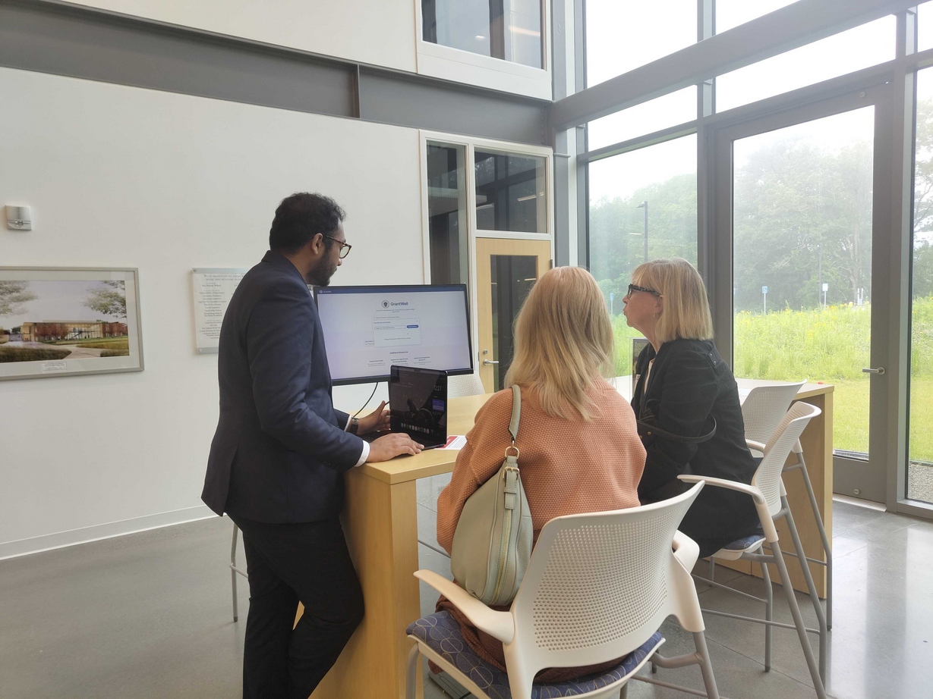
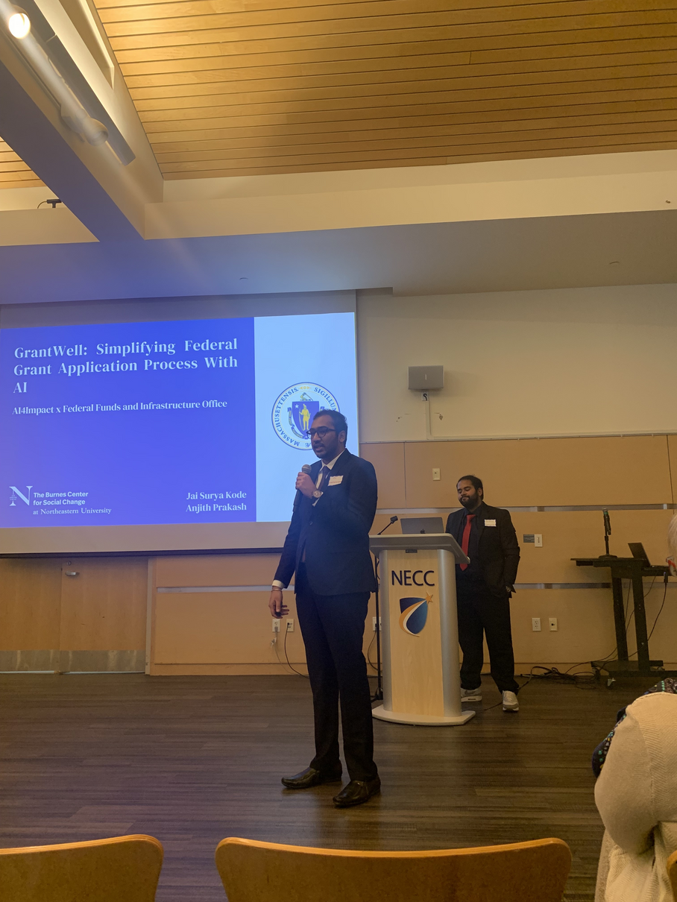
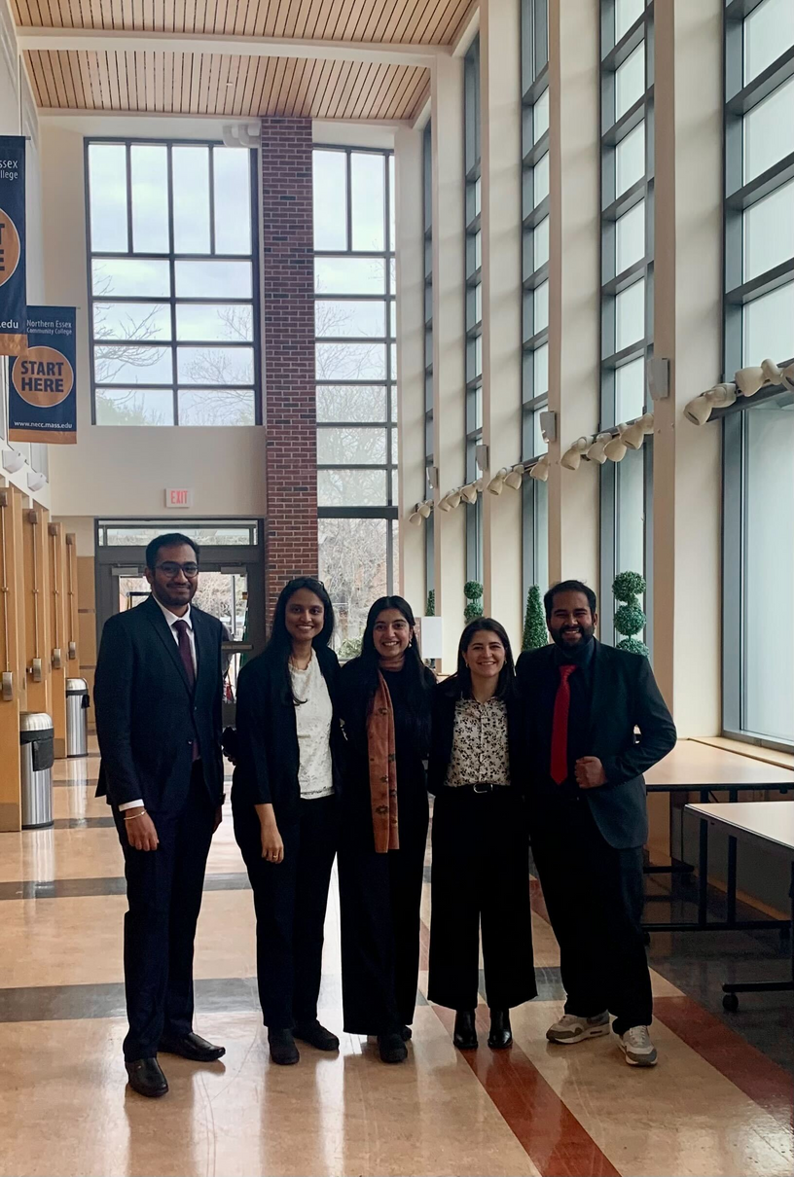
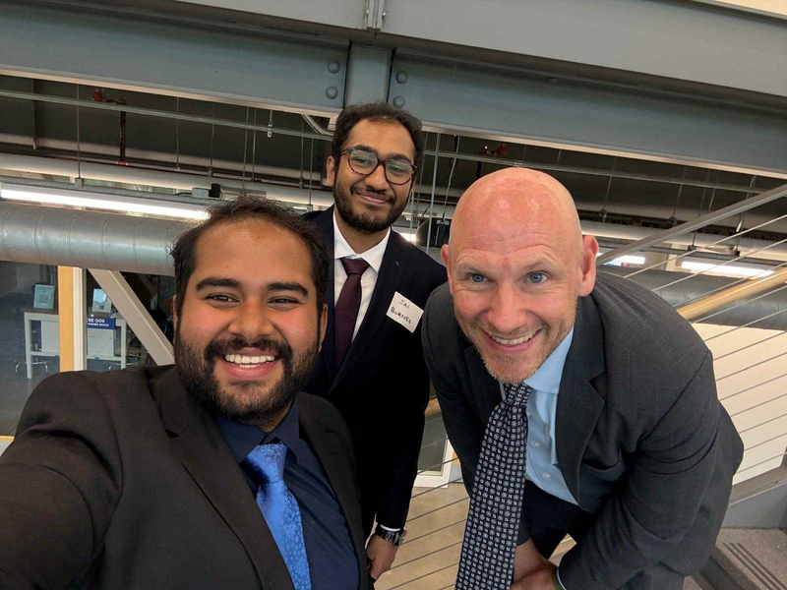
Connecting With Communities, Listening and Building Together
The Opportunity

Slide 24
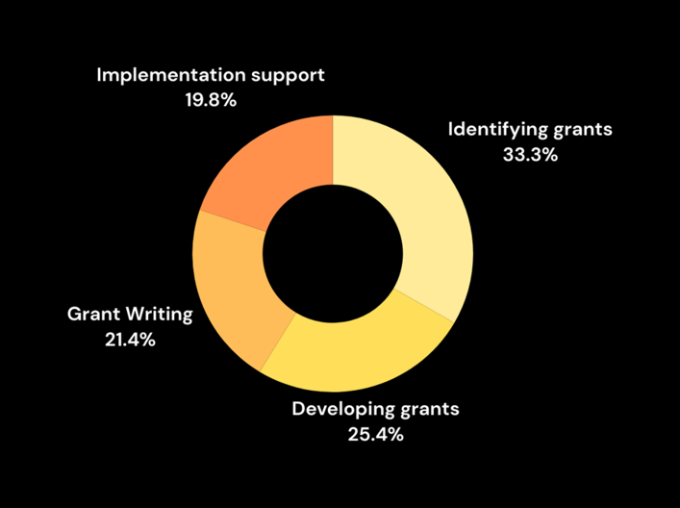
AI bridges the resource gap for Underserved communities
The Necessity

Slide 25
Features
What You Can Do with GrantWell
Grant Recommendation
Finds grants that match with your
community's specific needs
NOFO Summarization
Transforms complex grant documents
into clear summaries​
AI-Guided Grant Writing
Verifies applicant eligibility​ and
provides guidance on application writing​
Context Aware Chatbot
Allows users to ask questions about
requirements, and provides answers​

Slide 26
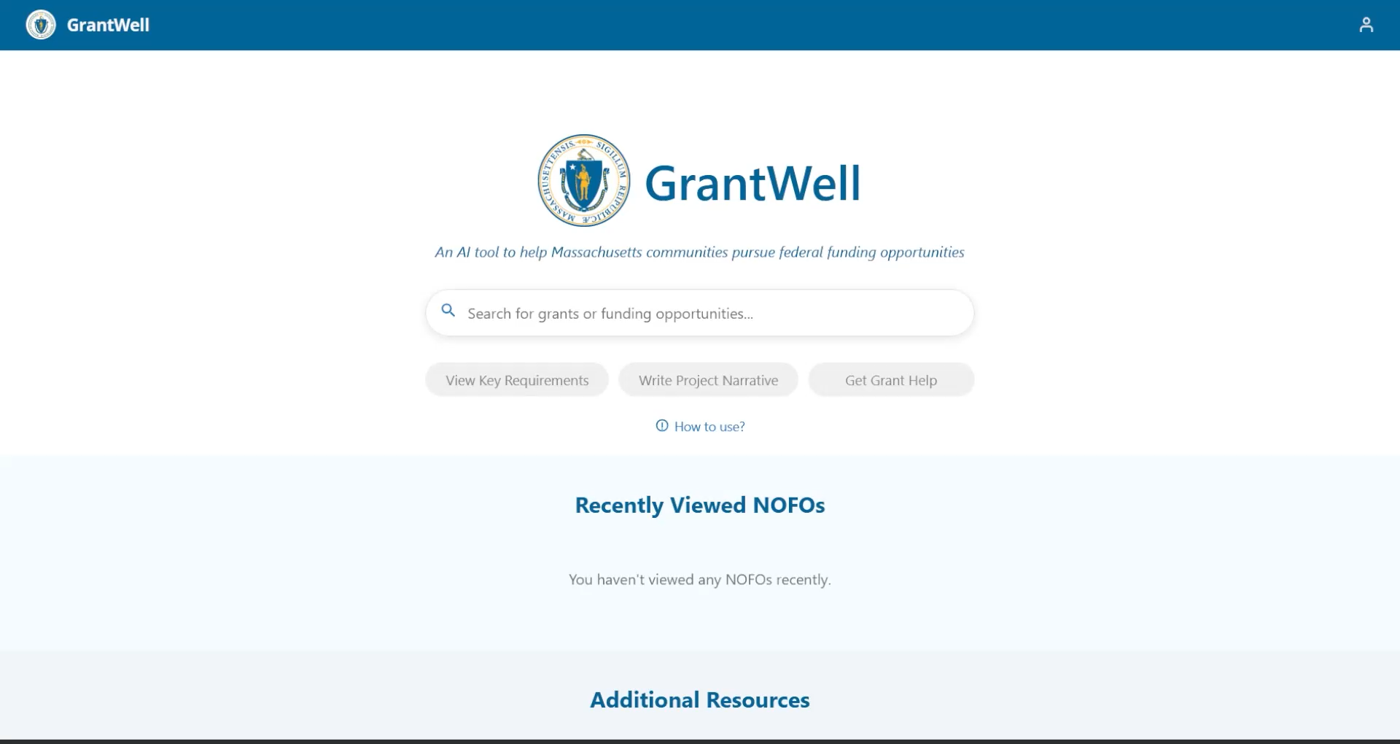

Slide 27
Thank You!

Slide 28
Questions?

Slide 29
Municipal needs survey
Please take 5 minutes to fill out this form and help us learn more about how our office can support you to best leverage available and upcoming federal funding opportunities! You can also click here.

Slide 30




Please join us for our office hours, bring your questions, and discuss priority projects!
FFIO Technical Assistance Programs
GrantWell
Office hours
General Queries/
Priority Projects

