Slide 1
Federal funds & infrastructure office community tour
National Offshore Wind Institute, Bristol Community College New Bedford
June 4, 2025

Slide 2
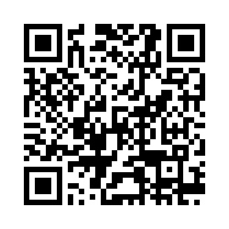
Municipal needs survey
Please take 5 minutes to fill out this form and help us learn more about how our office can support you to best leverage available and upcoming federal funding opportunities!

Slide 3
Agenda
Federal Matching Funds Legislation
Ocean Tech Hub: Advancing Marine Technology Innovation through Regional Partnerships
Q&A / Discussion
About FFIO
New Federal Funding Opportunities
Local Government Engagement
Audience Engagement Exercise
MassDOT Municipal Grants
Direct Pay
New Bedford Port Authority: Leonard’s Wharf
GrantWell: Simplifying Federal Grant Application Processes with AI

Slide 4
About the Federal Funds and Infrastructure Office (FFIO)
Officially created by Executive Order No. 624, and tasked with implementing a whole-of-government to compete for federal funding by:
Leading bi-weekly meetings of the interagency Advisory Council on Federal Funds and Infrastructure
Identifying and tracking key federal funding opportunities and Massachusetts applications through the State Clearinghouse
Implementing the Federal Match legislation (Chapter 214 of the Acts of 2024)
Leading the Massachusetts Federal Funds Partnership and other meetings to support local governments in their applications for federal funding

Slide 5
Local Government Engagement

Slide 6
The Partnership provides key federal funding information to the local governments of MA.
FFIO leads the monthly Massachusetts Federal Funds Partnership meeting. This forum delivers federal funding updates and offers a platform for addressing questions related to the many funding opportunities at the disposal of cities, towns and tribal organizations.
Massachusetts Federal funds partnership
Engagement with RPAs & TrIbes
Next Federal Funds Partnership Meeting Tuesday, June 24th
Previous Monthly Meeting with MARPA + Federally Recognized Tribes Friday, May 2nd
Key federal funding updates
Working with RPAs and agencies to identify technical assistance gaps and priority projects.

Slide 7
Below are two external resources related to frozen or at-risk federal awards. Please note that this message does not constitute legal advice. We will stay in contact as we learn more about the availability of federal funds.
Resources for federal grant awardees
Lawyers for Good Government (L4GG), who are running a Fund Protection Clinic to support grantees and sub-awardees of federal programs facing threats to their funding. The intake form for the clinic is here.
The Environmental Protection Network, which maintains a network of hundreds of former EPA staff and appointees and has been providing extensive technical assistance to grantees and sub-awardees. This is the type of resource they are putting out and they are in close communication with many grantees and sub-awardees, including NGOs, municipalities, and Tribal governments. You can sign up for their email list here - they are sending out frequent updates and resources.

Slide 8
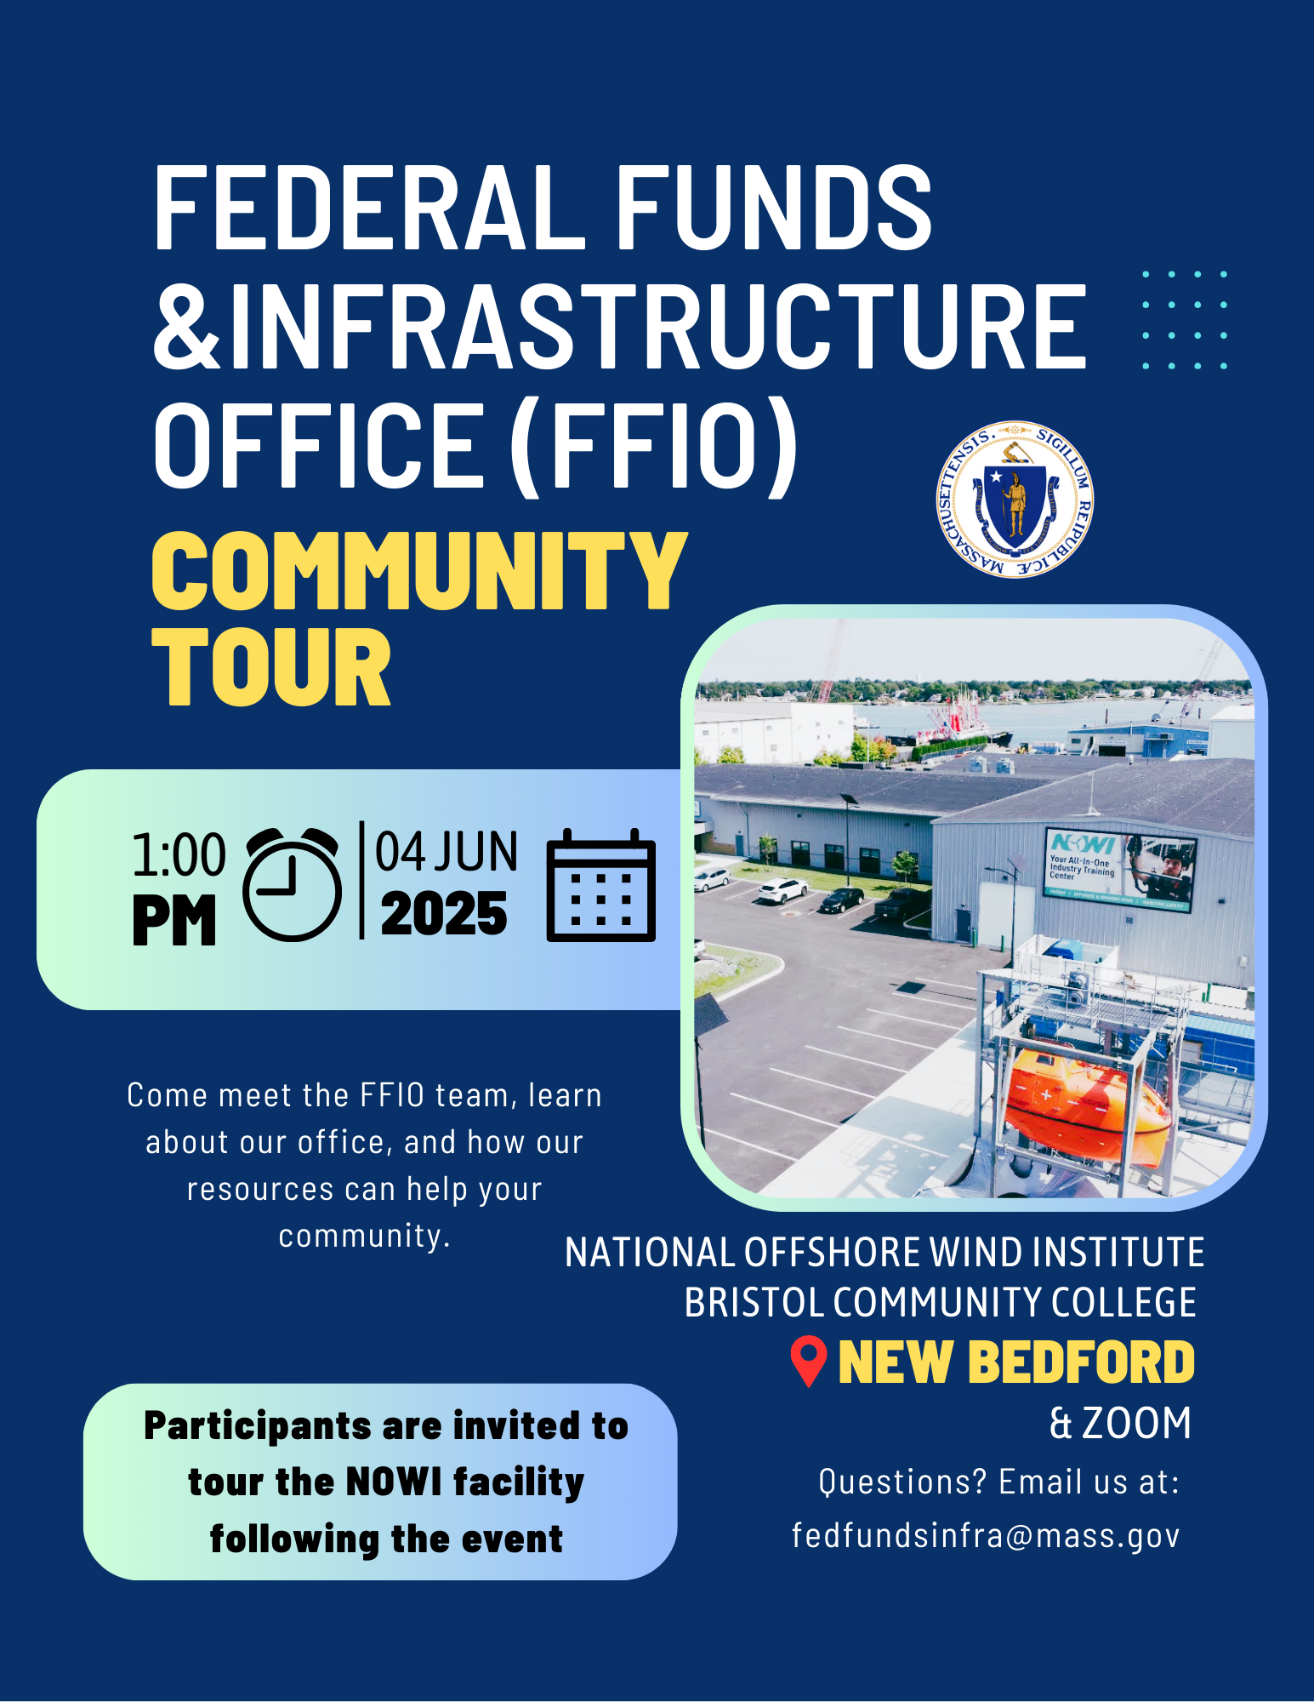
FFIO Community Tour
INFORMATION SHARING: Provide information on federal grant application resources made available by the new legislation
UNDERSTAND NEEDS AND PRIORITIES: Seek community input on priority projects seeking federal funding
GATHER FEEDBACK: Solicit feedback on the Federal Funds Partnership and other FFIO processes
PITTSFIELD
WORCESTER
HAVERHILL
BROCKTON
GLOUCESTER
NEW BEDFORD
BOSTON
BARNSTABLE
SPRINGFIELD

Slide 9
Federal Matching Funds Legislation

Slide 10
Massachusetts Federal match legislation
Matching Funds
Unlocks up to $750M for matching funds for federal programs
Eligible entities, including RPAs can now apply for match via the FFIO Match Request Form
Learn more on the new Massachusetts Matching Funds Website
Other Financial Assistance for Municipalities
Allocates up to $50M in the form of grants, loans, or other financial assistance, which may be directed to municipalities.
Explore providing start-up capital for Direct Pay-eligible projects, etc.
Technical Assistance for Municipalities
Allocates up to $12M for technical support to munis for grant application development and implementation assistance for successful awards
Leverage existing municipal outreach (partnership meetings, upcoming community tour, etc.) to understand municipal needs

Slide 11
Eligible applicants:
State agencies
Independent governmental state or public entities (quasis)
Municipalities (cities and towns)
Tribes
Regional planning agencies (RPAs)
Community development corporations (CDCs)
Other development authorities or agencies
Private entities (under review)
Application process:
Fill out Federal Matching Funds Form
Email supporting materials to fedfundsinfra@mass.gov
Questions on form or materials: reach out to Bob and Sam
If your agency works with munis on a federal program, have the muni who would be award recipient apply for match
Timeline:
Three (3) weeks prior to federal application submission
FFIO and ANF review on a rolling basis (for now)
Still reviewing how to process retroactive requests
Matching funds process

Slide 12
FFIo's work in New Bedford/Southeastern MAss

Slide 13
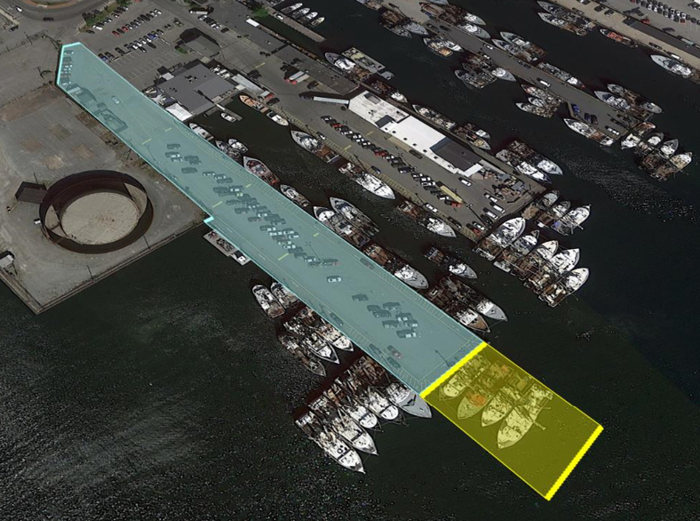
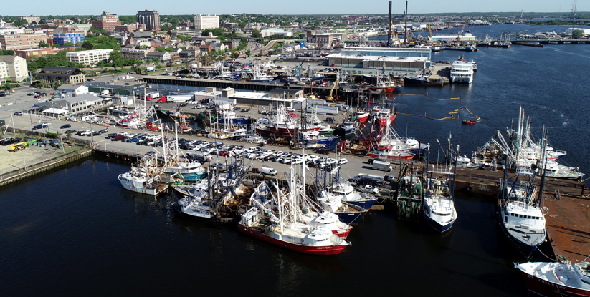
Leonard’s Wharf
Extension and reconstruction project
Construction April 2025-September 2026
Over-sheeting of the 1,065 LF of existing bulkhead
147-foot extension to the harbor line adding 17,000 SF of surface area
Load capacity increased to 1,300 PSF to allow for heavy component transfer by SOVs
Navigational dredging to allow for deep draft berthing
Elevate wharf by two feet to address sea level rise
2023 MARAD PIDP GRANT
Federal grant award: $ 24.4 million (55%)
State match: $ 18.4 million (41.5%)
Local match: $ 1.6 million (3.5%)

Slide 14
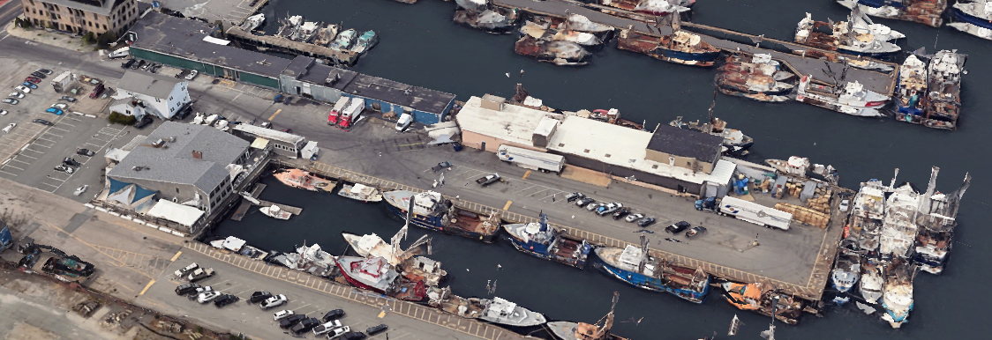
Homer’s Wharf
Similar construction project to Leonard’s Wharf
Over-sheeting and raising – no extension
A bit more complicated with the existing buildings/structures
Estimated at ~ $44 million
Design & Engineering complete
Funded by Seaport Economic Council
Fully permitted through the SER process
PIDP grant submittal Sept. 10, 2025
If successful, project could commence in 2027

Slide 15
ADVANCING MARINE TECHNOLOGY INNOVATION THROUGH REGIONAL PARTNERSHIPS

Slide 16
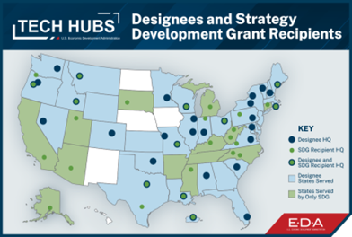
TECH HUBS

Slide 17
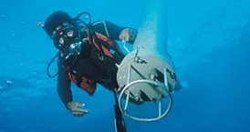
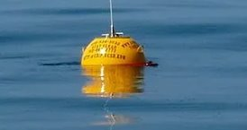
ABOUT THE OCEAN TECH HUB
Accelerates the commercialization of ocean/marine technologies utilizing an integrated hub-and-spoke model
Collaborative initiative that brings together government agencies, academic institutions, nonprofits, early- and mid-stage commercial ventures, and established companies.
Driving growth in key industries, including defense, energy production, transportation, shipping, and aquaculture.
Combines Southeastern New England’s rich legacy of advanced manufacturing with its entrepreneurial expertise and leadership in robotics and advanced materials.

Slide 18
HUB & SPOKE MODEL
INTERCONNECTED NETWORK OF RESOURCES THROUGHOUT SOUTHEASTERN, MA & RHODE ISLAND
Startup Programs
Industry Networks
A Workforce of Over 54,000
Supply Chain of 8,300
7 Deep Water Ports
Hundreds of Miles of Coastline
Established Companies
Successful Startups
VC Network
World- Class Research Institutions
Universities
WHOI
NUWC & War College

Slide 19
OCEAN TECH HUB COMPONENTS
CENTRAL TECH HUB
GROW BLUE BUSINESSES
UNIVERSITY CONSORTIUM
BLUE ROBOTICS LAB
SMART BAY & DIGITAL TWIN
WORKFORCE DEVELOPMENT

Slide 20
GET IN TOUCH
www.oceantechnologyhub.com
LinkedIn: @oceantechhub
Ashley.Medeiros@commerceri.com

Slide 21
New Federal Funding Opportunities

Slide 22
New grants: Transportation
Grant Name | Eligibility | Max Award | Cost Share | Deadline
Rural and Tribal Assistance Pilot Program (Reapply!) | Rural Local Governments, Tribes | N/A | N/A | TBD
Safe Streets and Roads for All (SS4A) | Local Governments, Tribes, School Districts, Universities | N/A | 20% | 6/26/2025
Ports Infrastructure Development Program (PIDP) (Amended NOFO!) | State, Local Governments, Tribes | $125,000,000 | 20% (exceptions for rural areas and small projects at small ports) | 9/10/2025
Regional Infrastructure Accelerator | All eligible public US based entities | $2,000,000 | N/A | 6/16/2025
Low or No Emission Program | State, Local Governments, Tribes | N/A | 20% (with exceptions) | 7/14/2025
Buses and Bus Facilities Program | State, Local Governments, Tribes | $39,810,323 | 20% (with exceptions) | 7/14/2025
High Priority Program-Commercial Motor Vehicle (HP-CMV) | State, Local Governments, Tribes, Universities, Nonprofits | $46,600,000 | N/A | 6/20/2025
Commercial Motor Vehicle Operator Safety Training Program CMVOST | Small business, NGOs, Public Universities, Tribes, State, Local Gov | 200K | No | 6/20/25

Slide 23
New grants: Food grants
Grant Name | Eligibility | Max Award | Cost Share | Deadline
Farmers Market Promotion Program Fiscal Year 2025 | Municipalities, Food Councils, NGOs, Tribes, etc. | $500,000 | 25% | 6/27/2025
Local Food Promotion Program Fiscal Year 2025 | Municipalities, Food Councils, NGOs, Tribes, etc. | $500,000 | 25% | 6/27/2025
Regional Food System Partnerships | State Agencies or Regional Authorities, Philanthropic Corporations, Institutions of Higher Education, Private Corporations, and Commercial, Federal or Farm Credit System Lending Institutions. | $1,000,000 | 25% | 6/27/2025

Slide 24
New grants: Public Safety/other
Grant Name | Eligibility | Max Award | Cost Share | Deadline
Partnership for Fish and Wildlife | State, Local Governments, Tribes, For-Profits, Nonprofits | $750,000 | N/A | 9/30/2025
FY25 COPS Hiring Program | State, Municipalities, Tribes | N/A | N/A | 6/25/2025
EDA Public Works Program (PWEAA) | States, Local Governments, Tribes, Universities, NGOs | $30,000,000 | 20-40% | Rolling
Staffing for Adequate Fire and Emergency Response (SAFER) | Fire Departments, State, Local Governments, Nonprofits | N/A | Varies | 7/3/2025
Fire Prevention and Safety Grant Program | Fire Departments, State, Local Governments, Nonprofits | $600,000 | 5% | 7/3/2025
FY25 School Violence Prevention Program (DOJ) | State, Local Governments, School Districts, Tribes, Law Enforcement Agencies | $500,000 | N/A | 6/18/2025

Slide 25
New grants : Education & Research
Grant Name | Eligibility | Max Award | Cost Share | Deadline
Fire Science Innovations through Research and Education | Unrestricted | N/A | N/A | 6/20/2025
NSF - Applied Mathematics | Unrestricted | N/A | N/A | 11/17/2025
FY26 Department of Defense Multidisciplinary Research Program of the University Research Initiative (MURI) | Universities | $4,500,000 | N/A | 9/5/2025
D.4 University Leadership Initiative 2 (ULI2)- NASA | Unrestricted (target: Universities) | N/A | N/A | 6/26/2025
Expanding Opportunity Through Quality Charter Schools Program (CSP)--Grants to State Entities (State Entity Grants) | State | $600,000 | N/A | 6/9/2025

Slide 26
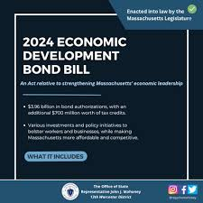
Other opportunities:
DIRECT PAY TAX CREDITS

Slide 27
MassDOT Municipal Grants

Slide 28
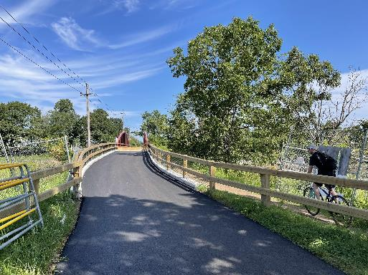
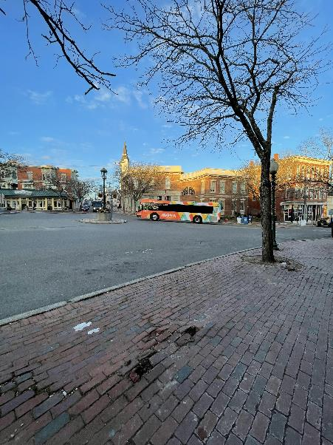
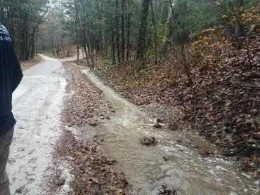
About the Municipal Grants Engagement (MGE) Group
MassDOT’s Municipal Grants Engagement Group’s mission is to connect municipalities with federal funding opportunities to advance local and regional transportation needs.
The group will also provide technical assistance to Massachusetts communities, with a focus on rural areas and Gateway Cities, to prepare projects for the receipt of federal funding, develop discretionary grant applications, and assist with coordination efforts across MassDOT, municipalities, and our partner agencies.

Slide 29
Municipal Grants Engagement Group Resources
Eligibility Guidance / Program “Match Making:” Assisting municipalities in determining eligibility for federal discretionary and formula funding programs and appropriate funding alternatives.
Project Scoping Assistance: Providing technical assistance for early-stage planning activities, including but not limited to: Conceptual Designs/Sketch Plans; Crash Diagrams & Hot Spot Analysis; Road Safety Audits (RSAs); Traffic Impact Studies; Speed Studies; Existing Conditions & Data Collection.
Grant Application Assistance (for Joint State and Municipal Priorities): Providing technical assistance in drafting and reviewing grant applications, including project narratives, budgets, and responses to merit criteria.
Letters of Support: Drafting and issuing MassDOT letters of support for grant applications to demonstrate agency endorsement.
Match Funding Coordination: Advising on strategies to identify and secure local, state, or other match funding for federal grant applications. Coordinating with state funding programs to ensure alignment with grant application requirements.
Post-Award Support: Helping municipalities manage awarded grants, including guidance on reporting, documentation, and financial oversight to ensure compliance with grant terms.

Slide 30
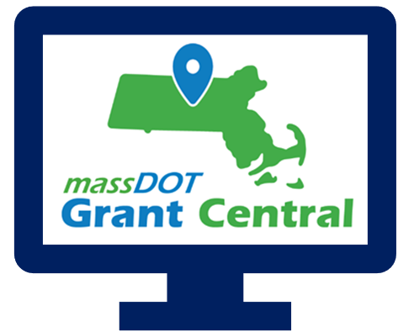
Grant Central
Funding Programs
Grant Central Users
Chapter 90 | Complete Streets | Local Bottleneck Reduction | Municipal Pavement | Municipal Small Bridge | Shared Streets and Spaces
The Public | Municipal Officials | Regional Transit Authorities | MassDOT Staff
775 unique Municipal Users

Slide 32
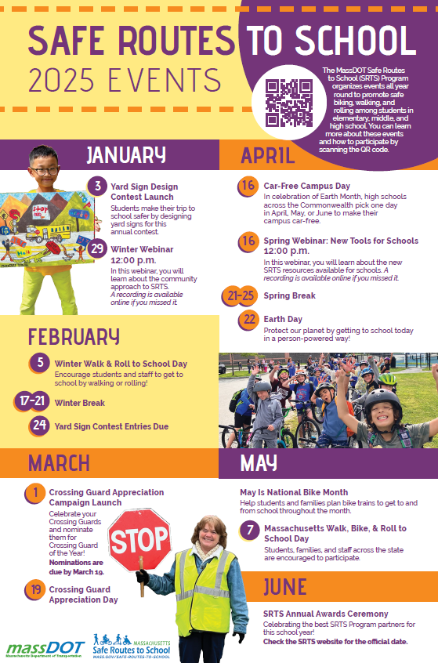
Safe Routes to School (https://www.mass.gov/safe-routes-to-school)
The MassDOT Safe Routes to School (SRTS) Program organizes events all year round to promote safe biking, walking, and rolling among students in
elementary, middle, and high school. You can learn more about these events
and how to participate by scanning the QR code.

Slide 33
Key Dates
Complete Streets: The latest Tier 3 application round closed on May 1, but we are always accepting Tier 1 and Tier 2 submissions!
Shared Streets & Spaces: We anticipate the results of the latest application round to be announced in June 2025.
Municipal Small Bridge Program: The FY25 application round closed on Monday, February 3, 2025. We anticipate the results of this application round to be announced in late June 2025.
Local Bottleneck Reduction Program: Next application round is expected in August of 2025.
Safe Routes to School Signs & Lines and Infrastructure Grants: Launching in late August or early September 2025.

Slide 34
Resources and Contact Information
Derek Krevat: Derek.Krevat@dot.state.ma.us
Kristen (Pennucci) Rebelo: Kristen.E.Rebelo@DOT.state.ma.us
Grant Central: MassDOTGrantCenral@DOT.state.ma.us
U.S. DOT Navigator: https://www.transportation.gov/dot-navigator
Grants.gov: https://www.grants.gov/search-grants
MA Federal Funds & Infrastructure Office: https://www.mass.gov/orgs/federal-funds-infrastructure-office

Slide 35
Direct Pay Overview June 4, 2025
Bob LaRocca, Deputy Director, Federal Funds and Infrastructure Office

Slide 36
What is Direct Pay?
The Inflation Reduction Act (IRA) makes the largest investment in clean energy in United States history, and much of that investment is delivered via tax incentives.
Under the IRA, tax-exempt and governmental entities – such as cities and towns -- that do not owe Federal income taxes are, for the first time, able to receive a payment equal to the full value of tax credits for building qualifying clean energy projects or making qualifying investments. This is called Direct Pay (also known as Elective Pay).
By filing a return and using Direct Pay, these entities can receive a cash refund from the IRS for certain clean energy projects.
Direct pay applies to projects put into service January 1, 2023 through December 31, 2032, creating a decade of tax opportunity to save money on necessary infrastructure replacements and upgrades while reducing energy costs and carbon emissions.
Unlike competitive grant programs, the overall potential of these tax credits to states and municipalities is unlimited.
Note on these credits being “mandatory, not discretionary”

Slide 37
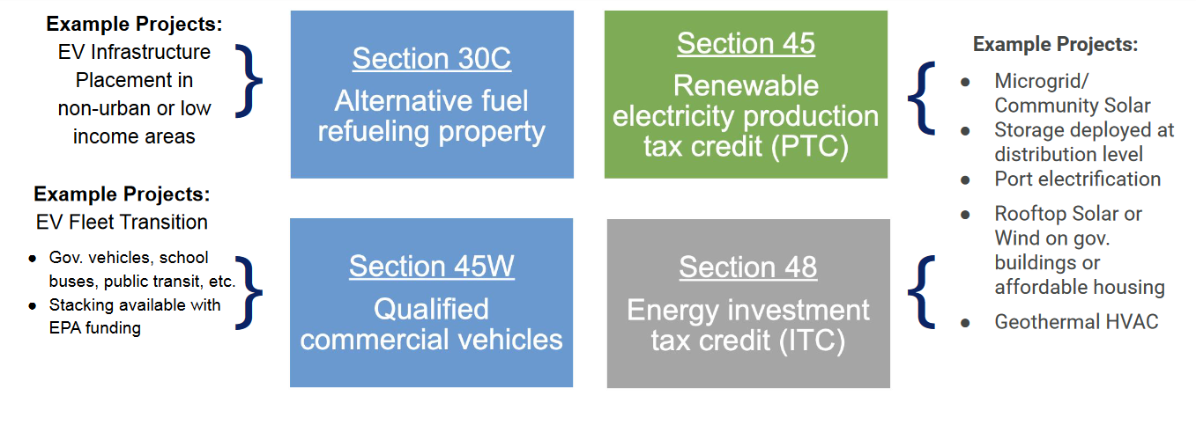
Most relevant tax credits for Massachusetts
v

Slide 38
Some Basics on Bonuses
Please Note: Additional details apply
Low-income Communities
10-20% bonus
… if project is in a low-income community with extra bonus if residential or econ benefit project
Energy Communities
10% bonus
…if project is in historical “energy community” (i.e., closed coal mine, some brownfield sites)
Prevailing Wage and Apprenticeship**
5x bonus
…if reqs for prevailing wages and registered apprentices are met
Domestic Content* **
…if 100% of applicable steel and iron and an applicable share of ‘manufactured products” produced in U.S.
10% bonus
ITC only
Applies to both ITC tax basis and PTC rate
Applies to both ITC tax basis and PTC rate
Applies to both ITC tax basis and PTC rate
* - On December,28, 2023, IRS issued new guidance on this rule for projects beginning in 2024 (see Notice 2024-9)
** - Applicable for projects of a size >1MW

Slide 39
How Direct Pay Credits and Bonuses Affect a $2M Project
Example:
A municipality with brownfield status installs microgrid with solar and energy storage.
Eligible for an ITC (Energy ITC, Sec. 48)
Project cost is $2M
Town recoups 40% of project in tax credits.
$600,000
$120,000

Slide 40
Helpful Resources
FFIO’s Direct Pay Information Page
Elect Pay Overview
CAP webinar on Direct Pay
Lawyers for Good Government Elective Pay resources, including worksheets on:
EV Purchase
EV Infrastructure
Tracking ITC and PTC projects
Slides from a presentation to local governments (but provides overview of Direct Pay for all)
IRS Video Tutorial on pre-registration
IRS Q&A

Slide 41
GrantWell: Simplifying Federal Grant Application Process With AI
AI4Impact x Federal Funds and Infrastructure Office
Jai Surya Kode
Anjith Prakash

Slide 42
We are student researchers from Northeastern University working on this project as part of AI4Impact program.
AI4Impact partners state agencies and Northeastern University to develop innovative, sustainable, and impactful AI-driven solutions
About us
GrantWell is a free, public AI-enabled grant-writing tool designed to streamline the application process.

Slide 44
We would like to hear from you!
What challenges do you face when applying for federal grants?
Do you want to help us build GrantWell?
What tools do you use to assist in grant writing?
Jai Surya Kode | Anjith Prakash
www.burnes.northeastern.edu

Slide 45
Municipal needs survey
Please take 5 minutes to fill out this form and help us learn more about how our office can support you to best leverage available and upcoming federal funding opportunities!

Slide 46
Discussion and q&a
As a reminder, we can help with:
Helpful information for us:
Looking for grants
Developing application
Advocating for submitted applications
Match grants to projects
Help look for partners/co-applicants (CBOs, other states, state agencies, universities, etc.)
Advice on labor standards, DEI , climate, language.
Review application
Letters of support from the state or congressionals
Calls and in-person advocacy when FFIO is in DC.
Get award dates/application status
-Are there any upcoming grants you are preparing for? Developing applications?
- What kind of technical assistance on these grants would be the most helpful for you?
- Do you have any applications pending or stuck?
-Are you looking for partners/co-applicants?
-Looking for gap financing for projects?
-
Reach us anytime at: FedFundsInfra@mass.gov.

Slide 47
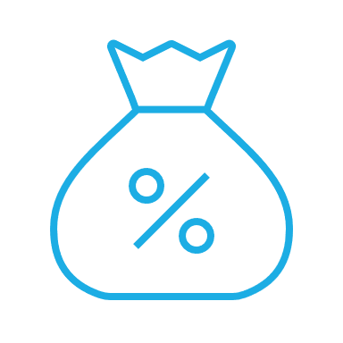
Please join us for our office hours, bring your questions, and discuss priority projects!
Transportation
Climate and Resiliency
Direct Pay
Office hours
GrantWell
Priority Projects

