Slide 1
Federal funds & infrastructure office community tour
Tufts University – Medford
June 17, 2025

Slide 2
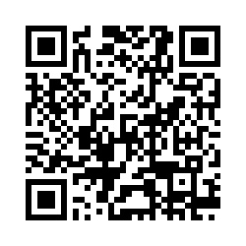
Municipal needs survey
Please take 5 minutes to fill out this form and help us learn more about how our office can support you to best leverage available and upcoming federal funding opportunities!

Slide 3
Agenda
Federal Matching Funds Legislation
Q&A / Discussion
About FFIO
New Federal Funding Opportunities
Local Government Engagement
MassDOT Municipal Grants

Slide 4
About the Federal Funds and Infrastructure Office (FFIO)
Officially created by Executive Order No. 624, and tasked with implementing a whole-of-government to compete for federal funding by:
Leading bi-weekly meetings of the interagency Advisory Council on Federal Funds and Infrastructure
Identifying and tracking key federal funding opportunities and Massachusetts applications through the State Clearinghouse
Implementing the Federal Match legislation (Chapter 214 of the Acts of 2024)
Leading the Massachusetts Federal Funds Partnership and other meetings to support local governments in their applications for federal funding

Slide 5
Local Government Engagement

Slide 6
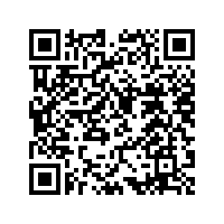
The Partnership provides key federal funding information to the local governments of MA.
FFIO leads the monthly Massachusetts Federal Funds Partnership meeting. This forum delivers federal funding updates and offers a platform for addressing questions related to the many funding opportunities at the disposal of cities, towns and tribal organizations.
Massachusetts Federal funds partnership
Engagement with RPAs & TrIbes
Previous Federal Funds Partnership Meeting Tuesday, May 27th
MassDOT Presentation on the CIP Process
Scan here to register for Partnership Zoom meetings and FFIO’s newsletter!
Previous meeting with MARPA & Tribes, Friday June 6th

Slide 7
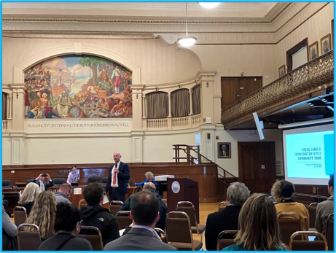
FFIO Community Tour
INFORMATION SHARING: Provide information on federal grant application resources made available by the new legislation
UNDERSTAND NEEDS AND PRIORITIES: Seek community input on priority projects seeking federal funding
GATHER FEEDBACK: Solicit feedback on the Federal Funds Partnership and other FFIO processes
PITTSFIELD
WORCESTER
HAVERHILL
BROCKTON
GLOUCESTER
NEW BEDFORD
BOSTON
BARNSTABLE
SPRINGFIELD
UP NEXT:
MEDFORD (Today!) LYNN (July 8th)
GREENFIELD (6/26) LEOMINSTER (TBA)

Slide 8
Federal Matching Funds Legislation

Slide 9
Massachusetts Federal match legislation
Matching Funds
Unlocks up to $750M for matching funds for federal programs
Eligible entities, including RPAs can now apply for match via the FFIO Match Request Form
Learn more on the new Massachusetts Matching Funds Website
Other Financial Assistance for Municipalities
Allocates up to $50M in the form of grants, loans, or other financial assistance, which may be directed to municipalities.
Explore providing start-up capital for Direct Pay-eligible projects, etc.
Technical Assistance for Municipalities
Allocates up to $12M for technical support to munis for grant application development and implementation assistance for successful awards
Leverage existing municipal outreach (partnership meetings, upcoming community tour, etc.) to understand municipal needs

Slide 10
Eligible applicants:
State agencies
Independent governmental state or public entities (quasis)
Municipalities (cities and towns)
Tribes
Regional planning agencies (RPAs)
Community development corporations (CDCs)
Other development authorities or agencies
Private entities (under review)
Application process:
Fill out Federal Matching Funds Form
Email supporting materials to fedfundsinfra@mass.gov
Questions on form or materials: reach out to Bob and Sam
If your agency works with munis on a federal program, have the muni who would be award recipient apply for match
Timeline:
Three (3) weeks prior to federal application submission
FFIO and ANF review on a rolling basis (for now)
Still reviewing how to process retroactive requests
Matching funds process

Slide 11
New Federal Funding Opportunities

Slide 12
New grants: Transportation
Grant Name | Eligibility | Max Award | Cost Share | Deadline
Rural and Tribal Assistance Pilot Program (Reapply!) | Rural Local Governments, Tribes | N/A | N/A | TBD
Safe Streets and Roads for All (SS4A) | Local Governments, Tribes, School Districts, Universities | N/A | 20% | 6/26/2025
Ports Infrastructure Development Program (PIDP) (Amended NOFO!) | State, Local Governments, Tribes | $125,000,000 | 20% (exceptions for rural areas and small projects at small ports) | 9/10/2025
Low or No Emission Program | State, Local Governments, Tribes | N/A | 20% (with exceptions) | 7/14/2025
Buses and Bus Facilities Program | State, Local Governments, Tribes | $39,810,323 | 20% (with exceptions) | 7/14/2025

Slide 13
New grants: Public Safety/other
Grant Name | Eligibility | Max Award | Cost Share | Deadline
Partnership for Fish and Wildlife | State, Local Governments, Tribes, For-Profits, Nonprofits | $750,000 | N/A | 9/30/2025
EDA Public Works Program (PWEAA) | States, Local Governments, Tribes, Universities, NGOs | $30,000,000 | 20-40% | Rolling
Staffing for Adequate Fire and Emergency Response (SAFER) | Fire Departments, State, Local Governments, Nonprofits | N/A | Varies | 7/3/2025
Fire Prevention and Safety Grant Program | Fire Departments, State, Local Governments, Nonprofits | $600,000 | 5% | 7/3/2025
Search for federal funding opportunities here: Home | Grants.gov

Slide 14
New grants : Education & Research
Grant Name | Eligibility | Max Award | Cost Share | Deadline
NSF - Applied Mathematics | Unrestricted | N/A | N/A | 11/17/2025
FY26 Department of Defense Multidisciplinary Research Program of the University Research Initiative (MURI) | Universities | $4,500,000 | N/A | 9/5/2025

Slide 15
Other Federal Programs:
DIRECT PAY TAX CREDITS

Slide 16
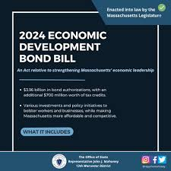
State programs:
Search for state grant programs here: Community Grant Finder | Mass.gov

Slide 17
Direct Pay (IRA Tax Credits)

Slide 18
What is Direct Pay?
The Inflation Reduction Act (IRA) makes the largest investment in clean energy in United States history, and much of that investment is delivered via tax incentives.
Under the IRA, tax-exempt and governmental entities – such as cities and towns -- that do not owe Federal income taxes are, for the first time, able to receive a payment equal to the full value of tax credits for building qualifying clean energy projects or making qualifying investments. This is called Direct Pay (also known as Elective Pay).
By filing a return and using Direct Pay, these entities can receive a cash refund from the IRS for certain clean energy projects.
Direct pay applies to projects put into service January 1, 2023 through December 31, 2032, creating a decade of tax opportunity to save money on necessary infrastructure replacements and upgrades while reducing energy costs and carbon emissions.
Unlike competitive grant programs, the overall potential of these tax credits to states and municipalities is unlimited.
Note on these credits being “mandatory, not discretionary”

Slide 19
Helpful Resources
FFIO’s Direct Pay Information Page
Elect Pay Overview
CAP webinar on Direct Pay
Lawyers for Good Government Elective Pay resources, including worksheets on:
EV Purchase
EV Infrastructure
Tracking ITC and PTC projects
Slides from a presentation to local governments (but provides overview of Direct Pay for all)
IRS Video Tutorial on pre-registration
IRS Q&A

Slide 20
federal funding landscape

Slide 21
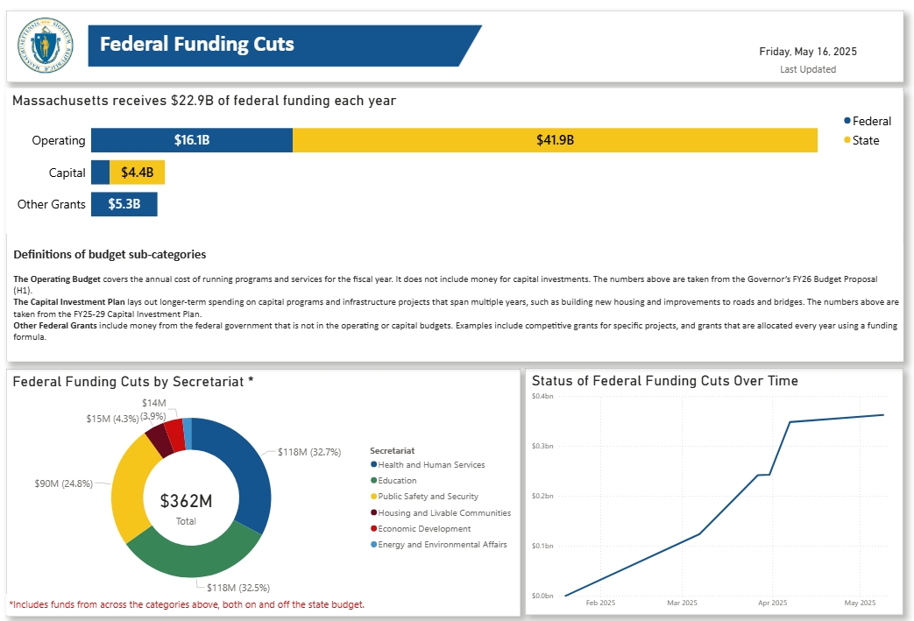
Support for Local Governments
The Governor’s office recently launched a dashboard displaying the total federal funding cuts to the state, along with a form for municipalities and other external entities to report federal funding impacts directly to the state. Visit the website at mass.gov/fedimpact

Slide 22
Below are two external resources related to frozen or at-risk federal awards. Please note that this message does not constitute legal advice. We will stay in contact as we learn more about the availability of federal funds.
Resources for federal grant awardees
Lawyers for Good Government (L4GG), who are running a Fund Protection Clinic to support grantees and sub-awardees of federal programs facing threats to their funding. The intake form for the clinic is here.
The Environmental Protection Network, which maintains a network of hundreds of former EPA staff and appointees and has been providing extensive technical assistance to grantees and sub-awardees. This is the type of resource they are putting out and they are in close communication with many grantees and sub-awardees, including NGOs, municipalities, and Tribal governments. You can sign up for their email list here - they are sending out frequent updates and resources.

Slide 23
MassDOT Municipal Grants

Slide 24
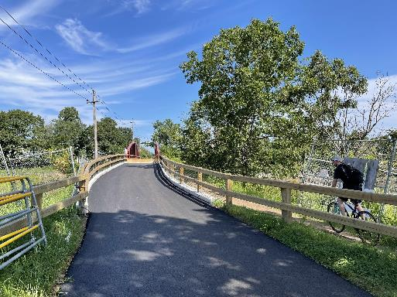
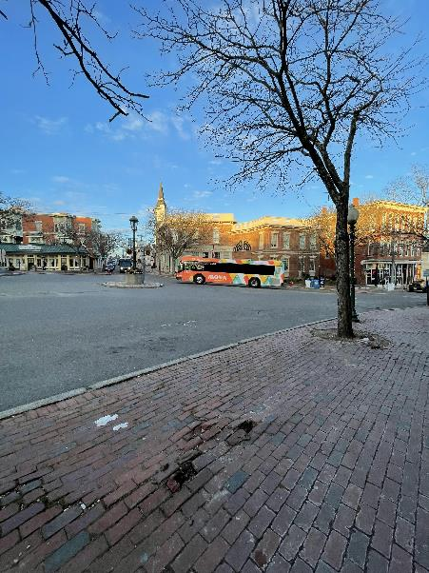
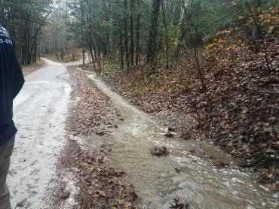
About the Municipal Planning & Support Group
MassDOT’s Municipal Planning & Support Group’s mission is to connect municipalities with federal funding opportunities to advance local and regional transportation needs.
The group will also provide technical assistance to Massachusetts communities, with a focus on rural areas and Gateway Cities, to prepare projects for the receipt of federal funding, develop discretionary grant applications, and assist with coordination efforts across MassDOT, municipalities, and our partner agencies.

Slide 25
Municipal Planning & Support Group Resources
Eligibility Guidance / Program “Match Making:” Assisting municipalities in determining eligibility for federal discretionary and formula funding programs and appropriate funding alternatives.
Project Scoping Assistance: Providing technical assistance for early-stage planning activities, including but not limited to: Conceptual Designs/Sketch Plans; Crash Diagrams & Hot Spot Analysis; Road Safety Audits (RSAs); Traffic Impact Studies; Speed Studies; Existing Conditions & Data Collection.
Grant Application Assistance (for Joint State and Municipal Priorities): Providing technical assistance in drafting and reviewing grant applications, including project narratives, budgets, and responses to merit criteria.
Letters of Support: Drafting and issuing MassDOT letters of support for grant applications to demonstrate agency endorsement.
Match Funding Coordination: Advising on strategies to identify and secure local, state, or other match funding for federal grant applications. Coordinating with state funding programs to ensure alignment with grant application requirements.
Post-Award Support: Helping municipalities manage awarded grants, including guidance on reporting, documentation, and financial oversight to ensure compliance with grant terms.

Slide 26
Contact Us
Northern Middlesex
Merrimack Valley
Franklin
Montachusett
Pioneer Valley
Central Mass
Boston
Berkshire
OCPC
Program Staff by Region
SE Mass
Lily Wallace: lily.n.wallace@dot.state.ma.us ​
Noah Harper: noah.a.harper@dot.state.ma.us ​
Derek Krevat: Derek.Krevat@dot.state.ma.us
Leah Pickett: leah.i.pickett@dot.state.ma.us
Cape Cod
Martha’s Vineyard
Nantucket

Slide 27
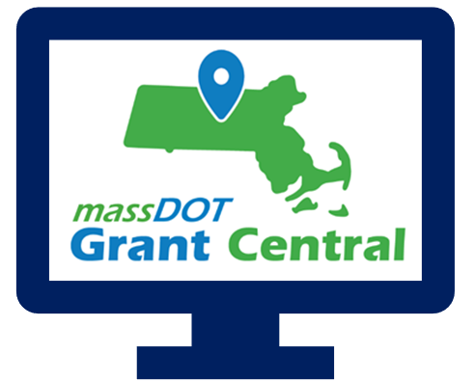
Grant Central
Funding Programs
Grant Central Users
Chapter 90 | Complete Streets | Local Bottleneck Reduction | Municipal Pavement | Municipal Small Bridge | Shared Streets and Spaces
The Public | Municipal Officials | Regional Transit Authorities | MassDOT Staff
775 unique Municipal Users

Slide 29
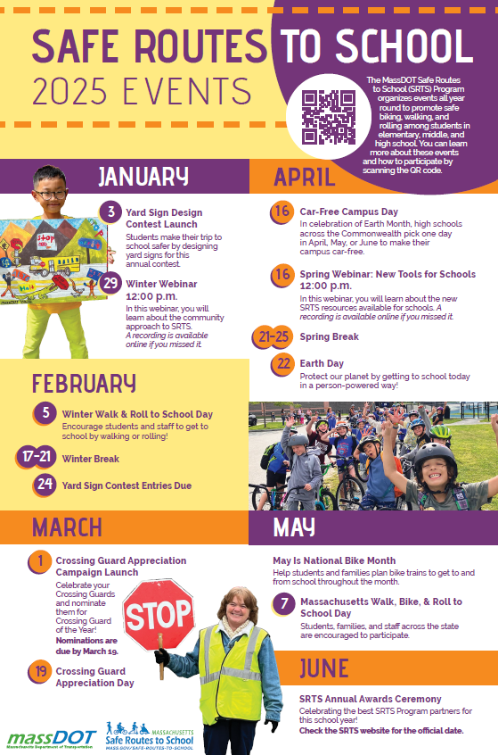
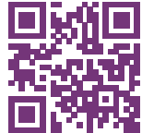
Safe Routes to School (https://www.mass.gov/safe-routes-to-school)
The MassDOT Safe Routes to School (SRTS) Program organizes events all year round to promote safe biking, walking, and rolling among students in
elementary, middle, and high school. You can learn more about these events
and how to participate by scanning the QR code.

Slide 30
Key Dates
Complete Streets: The latest Tier 3 application round closed on May 1, but we are always accepting Tier 1 and Tier 2 submissions!
Shared Streets & Spaces: Announced the latest round last week! Check your inboxes.
Municipal Small Bridge Program: We anticipate the results of this application round to be announced this week!
Local Bottleneck Reduction Program: Next application round is expected in August of 2025.
Safe Routes to School Signs & Lines and Infrastructure Grants: Launching in late August or early September 2025.

Slide 31
Resources and Contact Information
Derek Krevat: Derek.Krevat@dot.state.ma.us
Kristen (Pennucci) Rebelo: Kristen.E.Rebelo@DOT.state.ma.us
Grant Central: MassDOTGrantCenral@DOT.state.ma.us
U.S. DOT Navigator: https://www.transportation.gov/dot-navigator
Grants.gov: https://www.grants.gov/search-grants
MA Federal Funds & Infrastructure Office: https://www.mass.gov/orgs/federal-funds-infrastructure-office

Slide 32
Municipal needs survey
Please take 5 minutes to fill out this form and help us learn more about how our office can support you to best leverage available and upcoming federal funding opportunities! You can also click here.

Slide 33
Discussion and q&a
As a reminder, we can help with:
Helpful information for us:
Looking for grants
Developing application
Advocating for submitted applications
Match grants to projects
Help look for partners/co-applicants (CBOs, other states, state agencies, universities, etc.)
Advice on labor standards, DEI , climate, language.
Review application
Letters of support from the state or congressionals
Calls and in-person advocacy when FFIO is in DC.
Get award dates/application status
-Are there any upcoming grants you are preparing for? Developing applications?
- What kind of technical assistance on these grants would be the most helpful for you?
- Do you have any applications pending or stuck?
-Are you looking for partners/co-applicants?
-Looking for gap financing for projects?
-
Reach us anytime at: FedFundsInfra@mass.gov.

Slide 34
Please join us for our office hours, bring your questions, and discuss priority projects!
Transportation
Climate and Resiliency
Direct Pay
Office hours
GrantWell
Priority Projects

