Slide 1
Federal funds & infrastructure office community tour
UMass Amherst, Henry M. Thomas III Center, Springfield
May 7, 2025

Slide 2
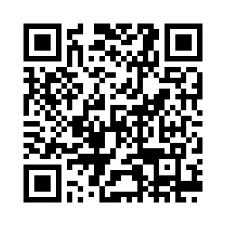
Municipal needs survey
Please take 5 minutes to fill out this form and help us learn more about how our office can support you to best leverage available and upcoming federal funding opportunities!

Slide 3
Agenda
Federal Matching Funds Legislation
New Federal Funding Opportunities
Q&A / Discussion
About FFIO
MassDOT Municipal Grants
Local Government Engagement
Audience Engagement Exercise
Direct Pay
MassTech Innovation Institute: Quantum in MA

Slide 4
About the Federal Funds and Infrastructure Office (FFIO)
Officially created by Executive Order No. 624, and tasked with implementing a whole-of-government to compete for federal funding by:
Leading bi-weekly meetings of the interagency Advisory Council on Federal Funds and Infrastructure
Identifying and tracking key federal funding opportunities and Massachusetts applications through the State Clearinghouse
Implementing the Federal Match legislation (Chapter 214 of the Acts of 2024)
Leading the Massachusetts Federal Funds Partnership and other meetings to support local governments in their applications for federal funding

Slide 5
Local Government Engagement

Slide 6
The Partnership provides key federal funding information to the local governments of MA.
FFIO leads the monthly Massachusetts Federal Funds Partnership meeting. This forum delivers federal funding updates and offers a platform for addressing questions related to the many funding opportunities at the disposal of cities, towns and tribal organizations.
Massachusetts Federal funds partnership
Engagement with RPAs & TrIbes
Next Federal Funds Partnership Meeting Tuesday, May 27th
MassDOT Presentation on the CIP Process
Previous Monthly Meeting with MARPA + Federally Recognized Tribes Friday, May 2nd
Key federal funding updates
Working with RPA’s and agencies to identify technical assistance gaps and priority projects.

Slide 7
Below are two external resources related to frozen or at-risk federal awards. Please note that this message does not constitute legal advice. We will stay in contact as we learn more about the availability of federal funds.
Resources for federal grant awardees
Lawyers for Good Government (L4GG), who are running a Fund Protection Clinic to support grantees and sub-awardees of federal programs facing threats to their funding. The intake form for the clinic is here.
The Environmental Protection Network, which maintains a network of hundreds of former EPA staff and appointees and has been providing extensive technical assistance to grantees and sub-awardees. This is the type of resource they are putting out and they are in close communication with many grantees and sub-awardees, including NGOs, municipalities, and Tribal governments. You can sign up for their email list here - they are sending out frequent updates and resources.

Slide 8
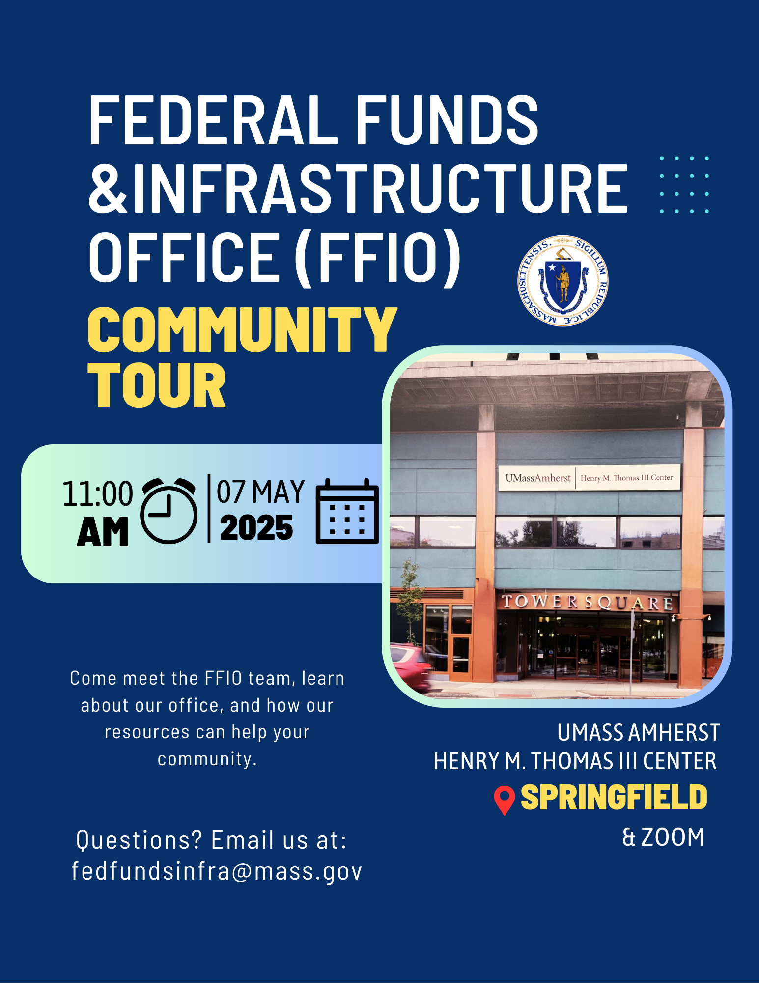


FFIO Community Tour
INFORMATION SHARING: Provide information on federal grant application resources made available by the new legislation
UNDERSTAND NEEDS AND PRIORITIES: Seek community input on priority projects seeking federal funding
GATHER FEEDBACK: Solicit feedback on the Federal Funds Partnership and other FFIO processes
PITTSFIELD
WORCESTER
BOSTON
HAVERHILL
BROCKTON
SPRINGFIELD
GLOUCESTER

Slide 9
Federal Matching Funds Legislation

Slide 10
Matching Funds
Unlocks up to $750M for matching funds for federal programs
Eligible entities, including RPA’s can now apply for match via the FFIO Match Request Form
Learn more on the new Massachusetts Matching Funds Website
Other Financial Assistance for Municipalities
Allocates up to $50M in the form of grants, loans, or other financial assistance, which may be directed to municipalities.
Explore providing start-up capital for Direct Pay-eligible projects, etc.
Technical Assistance for Municipalities
Allocates up to $12M for technical support to munis for grant application development and implementation assistance for successful awards
Leverage existing municipal outreach (partnership meetings, upcoming community tour, etc.) to understand municipal needs
GrantWell: Simplifying Federal Grant Application Processes with AI
Massachusetts Federal match legislation

Slide 11
Eligible applicants:
State agencies
Independent governmental state or public entities (quasis)
Municipalities (cities and towns)
Tribes
Regional planning agencies (RPAs)
Community development corporations (CDCs)
Other development authorities or agencies
Private entities (under review)
Application process:
Fill out Federal Matching Funds Form
Email supporting materials to fedfundsinfra@mass.gov
Questions on form or materials: reach out to Bob and Sam
If your agency works with munis on a federal program, have the muni who would be award recipient apply for match
Timeline:
Three (3) weeks prior to federal application submission
FFIO and ANF review on a rolling basis (for now)
Still reviewing how to process retroactive requests
Matching funds process

Slide 12
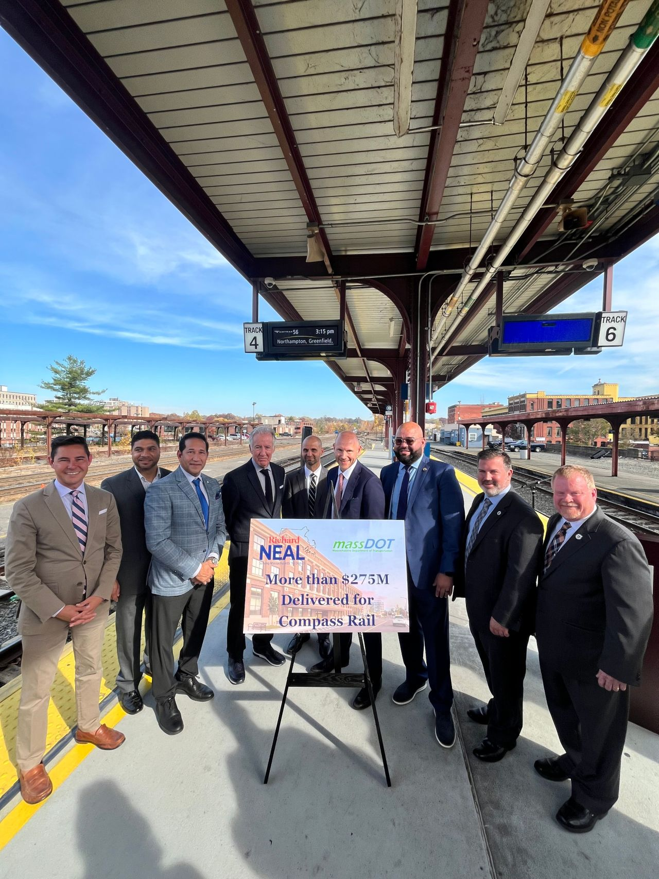
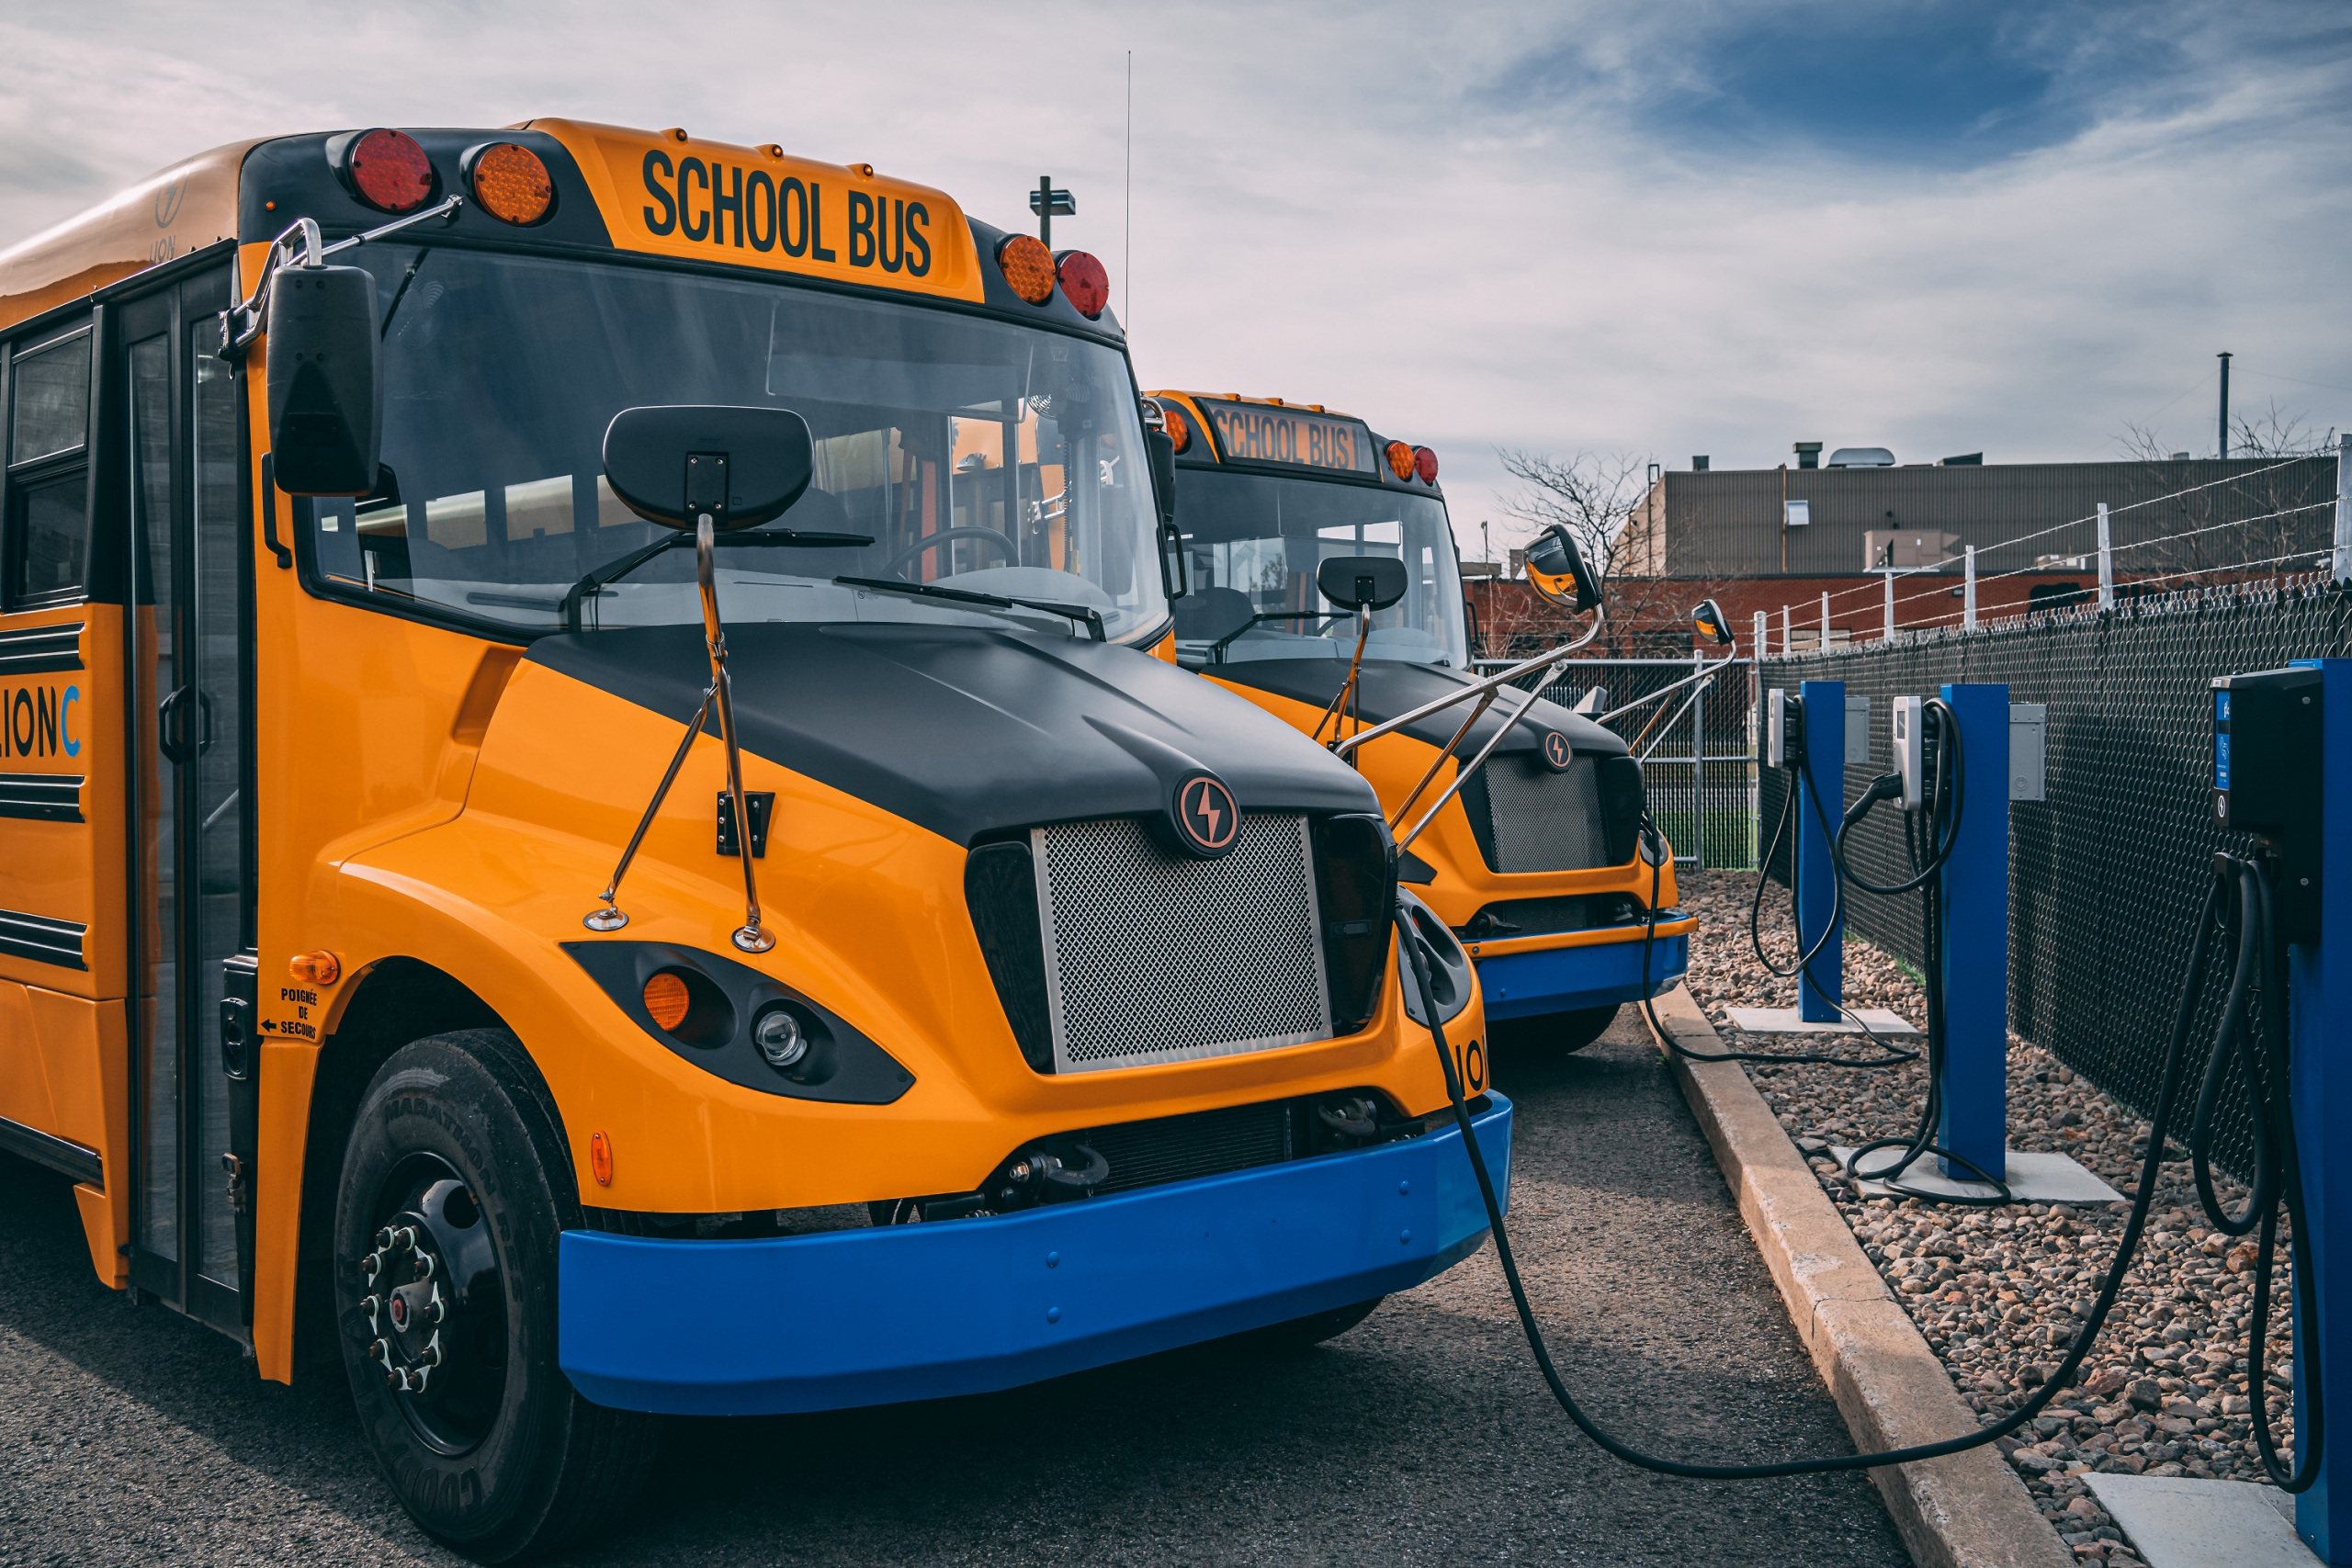
Federal funding: Springfield area WINS
$175 Million to Advance West-East Rail
MassDOT was awarded $36,800,000 from the DOT-FRA Consolidated Rail Infrastructure & Safety Improvements program for improvements to Union Station. Funds will be used to advance West-East Rail, building on the $108,000,000 award from the previous year. 2 other Massachusetts entities were also awarded over $30,000,000.
$9.8 Million for Clean School Buses
$9,875,000 from the Clean School Bus Program to the Lower Pioneer Valley Education Collaborative in West Springfield

Slide 13



$15,012,800 in Safe Streets and Roads for All funding for the City of Springfield citywide safety improvements and $1,000,000 for Pioneer Valley Planning Commission
Federal funding: Springfield area WINS
$6,000,000 in Urban Forestry grants for the City of Springfield
(Statewide) $147 Million for Broadband Massachusetts awarded over $147,000,000 from the National Telecommunications and Information Agency’s Broadband, Equity, Access, and Deployment program to expand high speed internet access in unserved and underserved locations in the state.

Slide 14
Below are two external resources related to frozen or at-risk federal awards. Please note that this message does not constitute legal advice. We will stay in contact as we learn more about the availability of federal funds.
Resources for federal grant awardees
Lawyers for Good Government (L4GG), who are running a Fund Protection Clinic to support grantees and sub-awardees of federal programs facing threats to their funding. The intake form for the clinic is here.
The Environmental Protection Network, which maintains a network of hundreds of former EPA staff and appointees and has been providing extensive technical assistance to grantees and sub-awardees. This is the type of resource they are putting out and they are in close communication with many grantees and sub-awardees, including NGOs, municipalities, and Tribal governments. You can sign up for their email list here - they are sending out frequent updates and resources.

Slide 15
New Federal Funding Opportunities

Slide 16
New grants
Grant Name | Eligibility | Max Award | Cost Share | Deadline
Rural and Tribal Assistance Pilot Program (Reapply!) | Rural local governments, tribes | N/A | N/A | TBD
Safe Streets and Roads for All (SS4A) | Local governments, tribes, school districts, universities | N/A | 20% | 6/26/2025
FY25 School Violence Prevention Program (DOJ) | State and Local Gov., School Districts, Tribes, law enforcement agencies | $500,000 | N/A | 6/18/2025
Partnership for Fish and Wildlife | State, Local Governments, Tribes, For-Profits, Nonprofits | $750,000 | N/A | 9/30/2025

Slide 17
New grants
Grant Name | Eligibility | Max Award | Cost Share | Deadline
Fire Science Innovations through Research and Education | Unrestricted | N/A | N/A | 6/20/2025
Empower to Grow (E2G) Program Manufacturing | NGOs, Private, universities | $1,148,658 for 3 awards | N/A | 5/28/2025
NSF - Applied Mathematics | Unrestricted | N/A | N/A | 11/17/2025
FY26 Department of Defense Multidisciplinary Research Program of the University Research Initiative (MURI) | Universities | $4,500,000 | N/A | 9/5/2025
D.4 University Leadership Initiative 2 (ULI2)- NASA | Unrestricted (target: Universities) | N/A | N/A | 6/26/2025

Slide 18
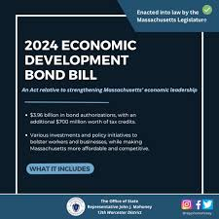







Other opportunities:
DIRECT PAY TAX CREDITS

Slide 19

MassDOT Municipal Grants

Slide 20
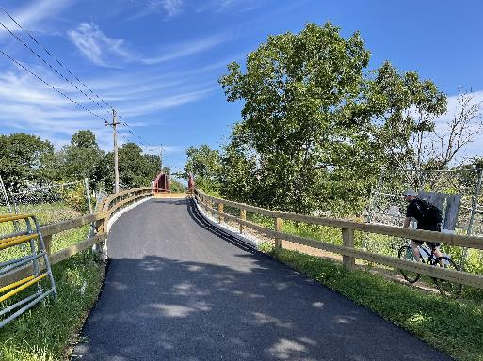
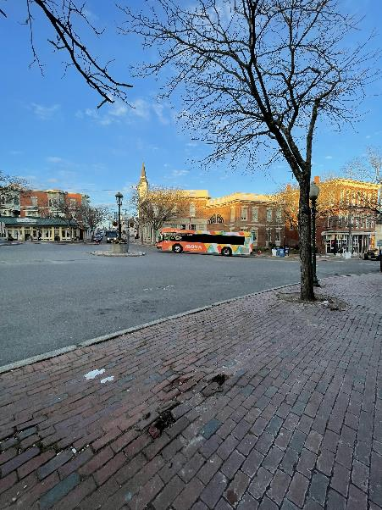
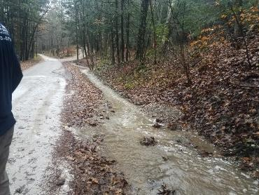
About the Municipal Grants Engagement (MGE) Group
MassDOT’s Municipal Grants Engagement Group’s mission is to connect municipalities with federal funding opportunities to advance local and regional transportation needs.
The group will also provide technical assistance to Massachusetts communities, with a focus on rural areas and Gateway Cities, to prepare projects for the receipt of federal funding, develop discretionary grant applications, and assist with coordination efforts across MassDOT, municipalities, and our partner agencies.

Slide 21
Municipal Grants Engagement Group Resources
Eligibility Guidance / Program “Match Making:” Assisting municipalities in determining eligibility for federal discretionary and formula funding programs and appropriate funding alternatives.
Project Scoping Assistance: Providing technical assistance for early-stage planning activities, including but not limited to: Conceptual Designs/Sketch Plans; Crash Diagrams & Hot Spot Analysis; Road Safety Audits (RSAs); Traffic Impact Studies; Speed Studies; Existing Conditions & Data Collection.
Grant Application Assistance (for Joint State and Municipal Priorities): Providing technical assistance in drafting and reviewing grant applications, including project narratives, budgets, and responses to merit criteria.
Letters of Support: Drafting and issuing MassDOT letters of support for grant applications to demonstrate agency endorsement.
Match Funding Coordination: Advising on strategies to identify and secure local, state, or other match funding for federal grant applications. Coordinating with state funding programs to ensure alignment with grant application requirements.
Post-Award Support: Helping municipalities manage awarded grants, including guidance on reporting, documentation, and financial oversight to ensure compliance with grant terms.

Slide 22
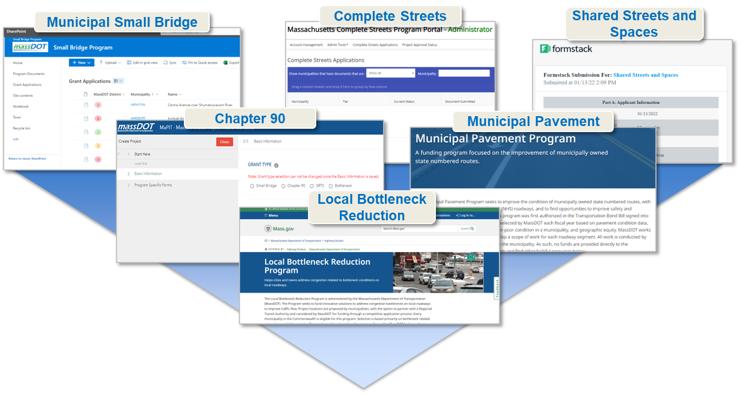
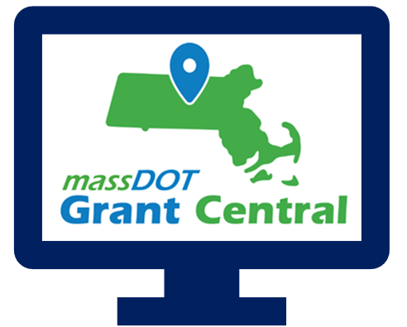
Grant Central
Funding Programs
Grant Central Users
Chapter 90 | Complete Streets | Local Bottleneck Reduction | Municipal Pavement | Municipal Small Bridge | Shared Streets and Spaces
The Public | Municipal Officials | Regional Transit Authorities | MassDOT Staff
636 unique Municipal Users

Slide 23
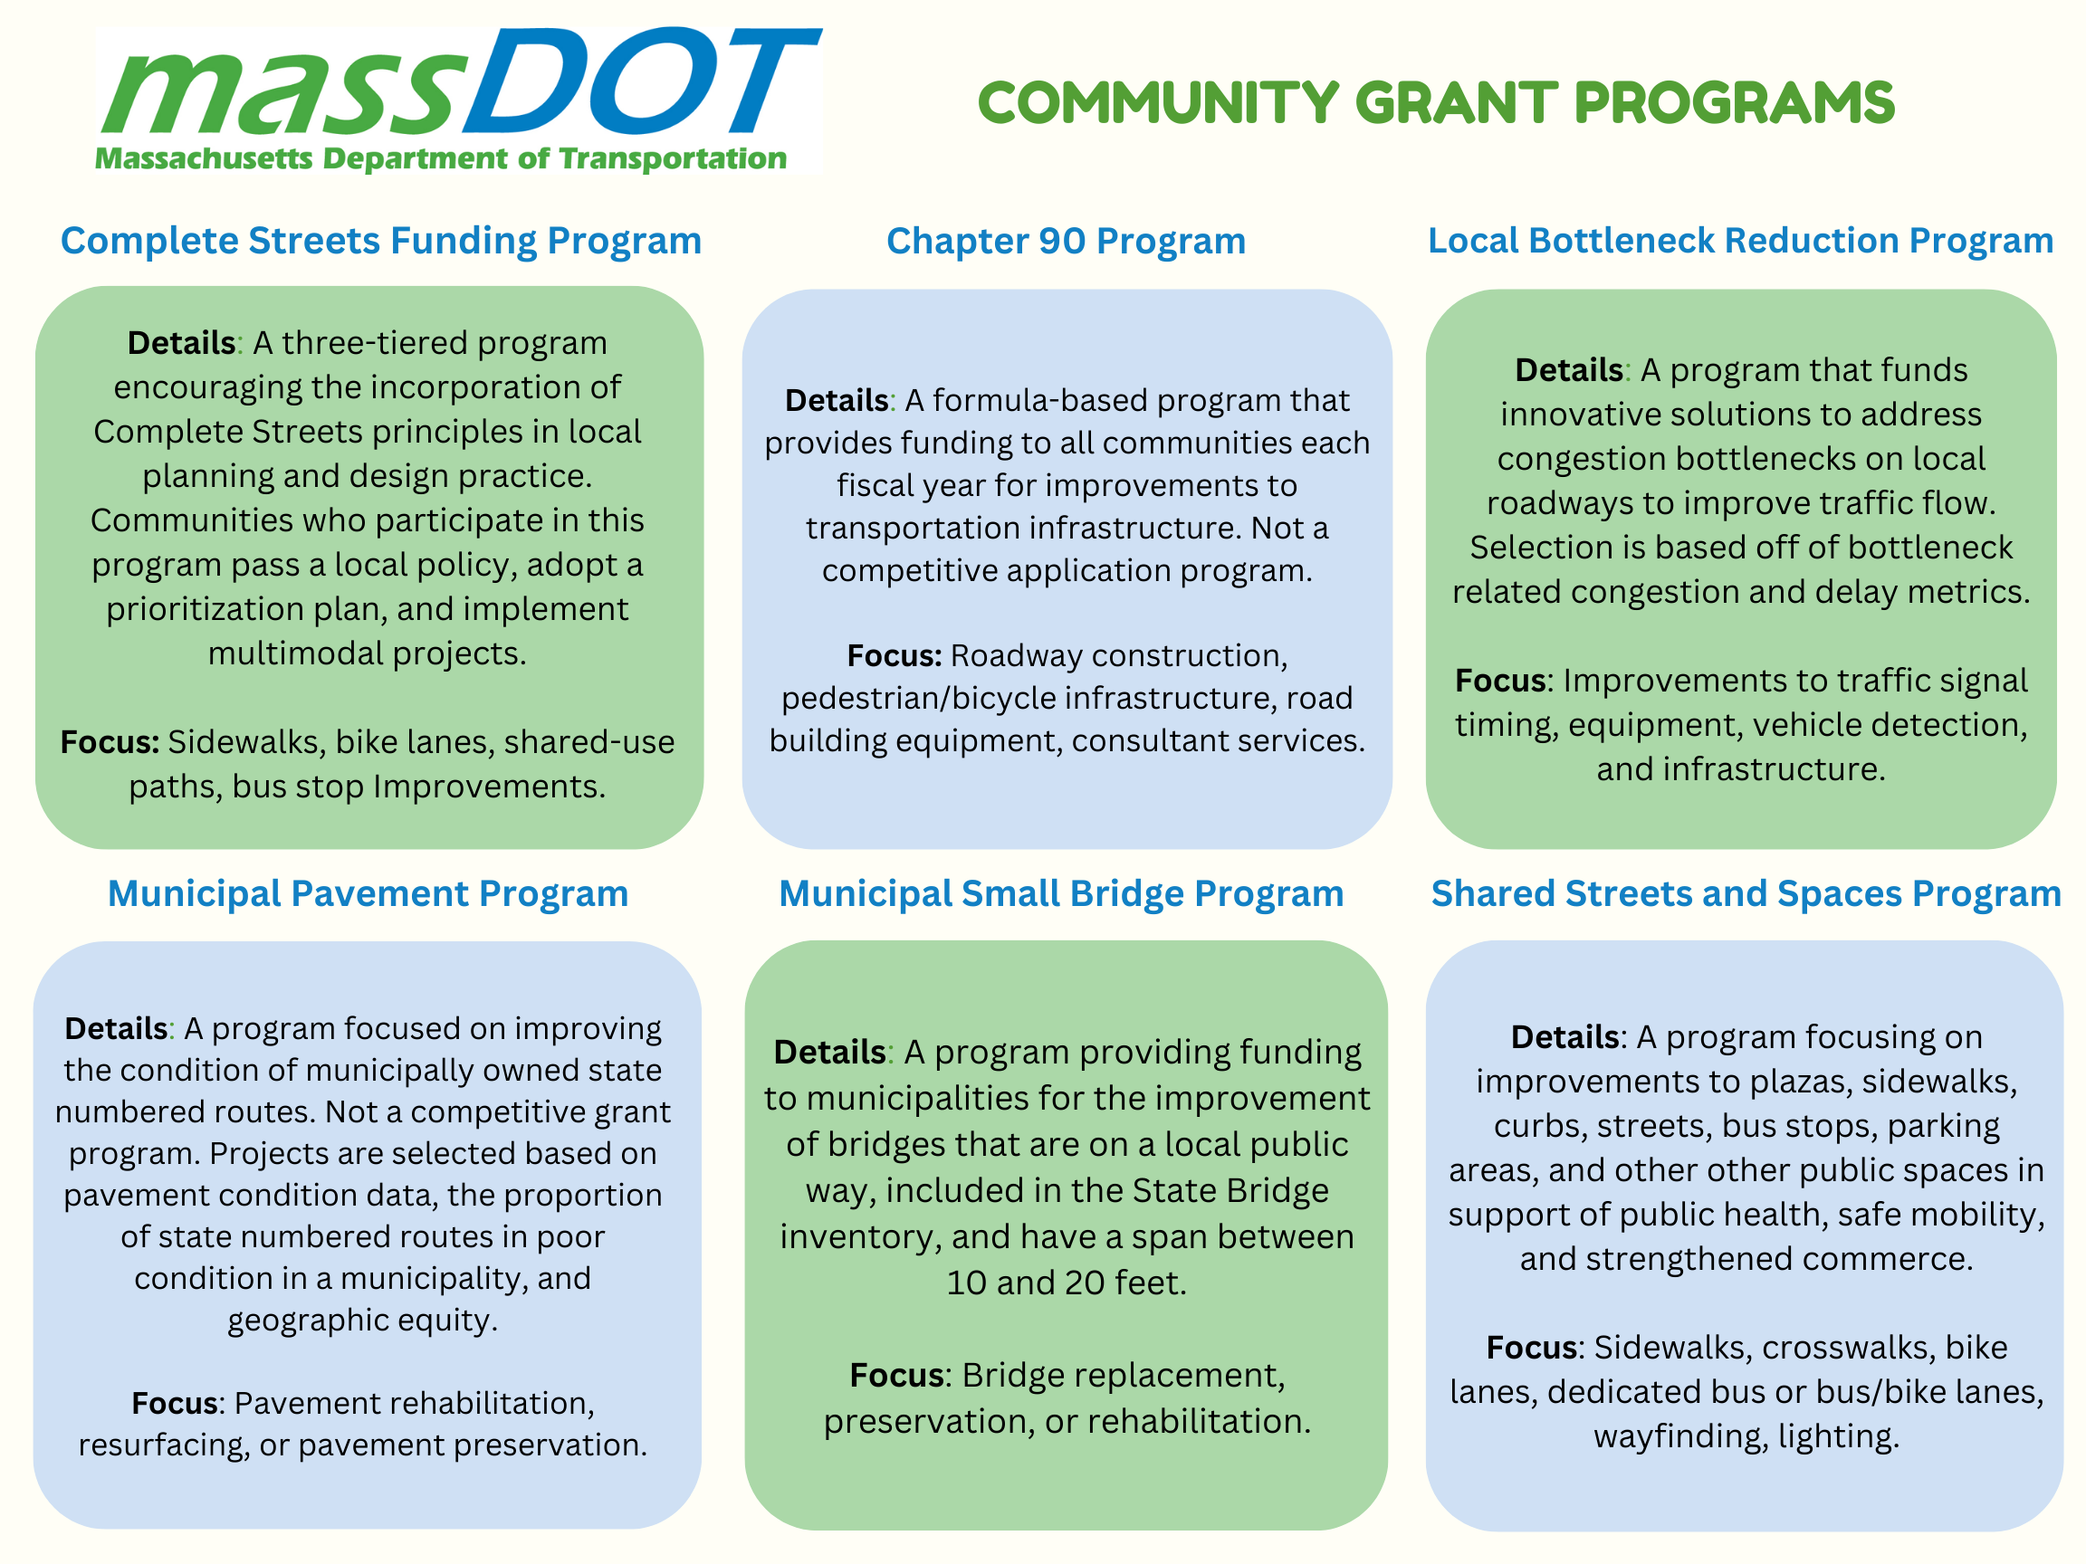

Slide 24
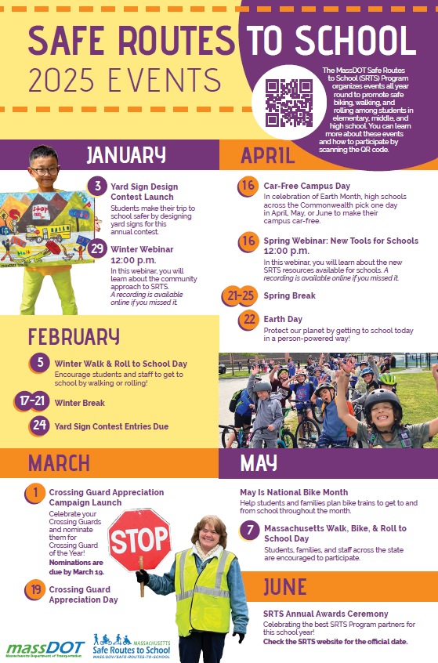
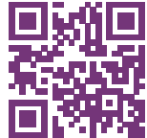
Safe Routes to School (https://www.mass.gov/safe-routes-to-school)
The MassDOT Safe Routes to School (SRTS) Program organizes events all year round to promote safe biking, walking, and rolling among students in
elementary, middle, and high school. You can learn more about these events
and how to participate by scanning the QR code.

Slide 25
Key Dates
Complete Streets: The latest Tier 3 application round closed on May 1, but we are always accepting Tier 1 and Tier 2 submissions!
Shared Streets & Spaces: We anticipate the results of the latest application round to be announced in May 2025.
Municipal Small Bridge Program: The FY25 application round closed on Monday, February 3, 2025. We anticipate the results of this application round to be announced in late May 2025.
Local Bottleneck Reduction Program: MassDOT announced the results of the latest application round in early January have moved on to the initial scoping and design phase.
Safe Routes to School Signs & Lines and Infrastructure Grants: Launching in late August or early September 2025.

Slide 26
Resources and Contact Information
Derek Krevat: Derek.Krevat@dot.state.ma.us
Kristen (Pennucci) Rebelo: Kristen.E.Rebelo@DOT.state.ma.us
Grant Central: MassDOTGrantCenral@DOT.state.ma.us
U.S. DOT Navigator: https://www.transportation.gov/dot-navigator
Grants.gov: https://www.grants.gov/search-grants
MA Federal Funds & Infrastructure Office: https://www.mass.gov/orgs/federal-funds-infrastructure-office

Slide 27
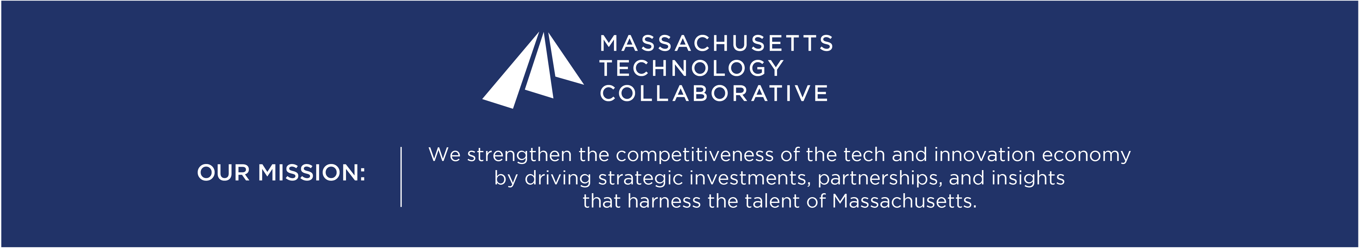





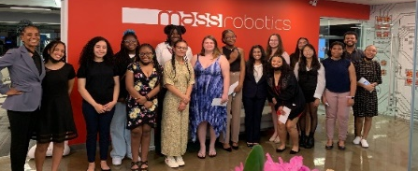
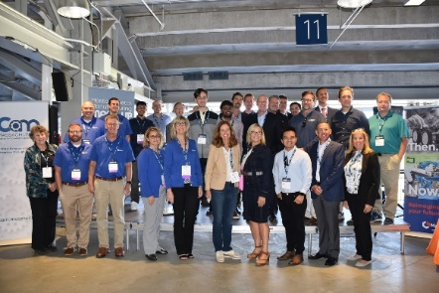
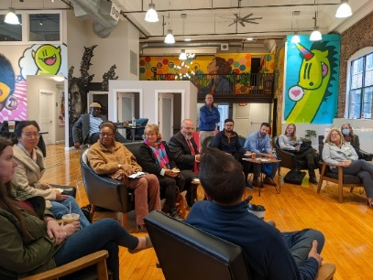
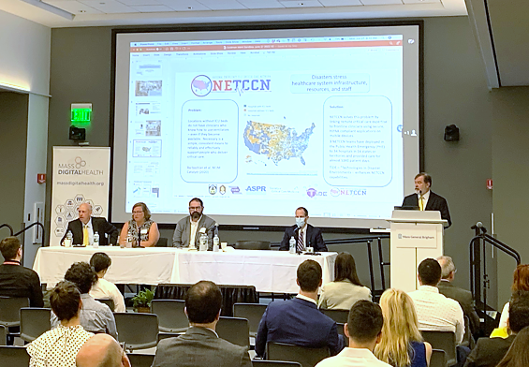
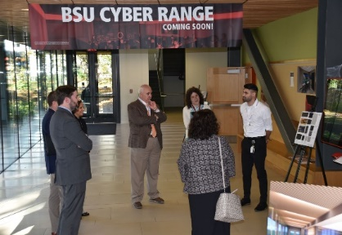
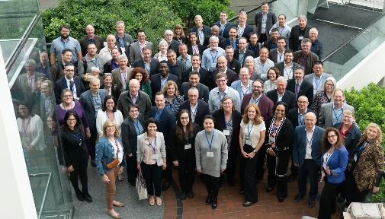
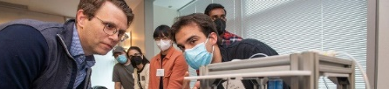
Administering $600M+ in state and federal funds through the next 3 fiscal years.
Established in 1982 by Legislative Statute

Slide 28

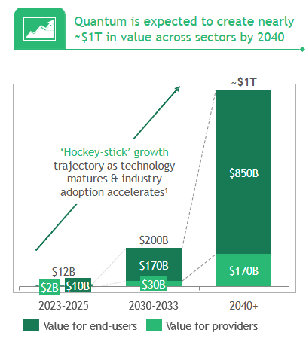
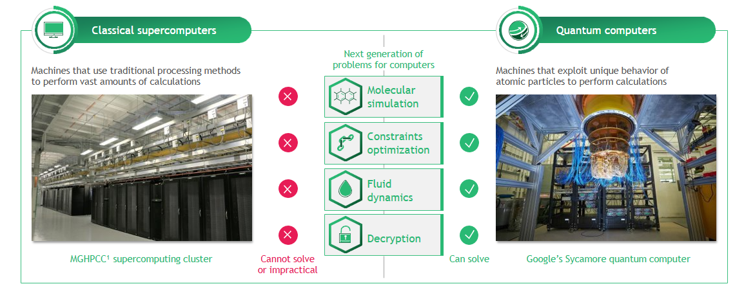

Quantum in Massachusetts
Quantum computers can solve problems that are impossible or impractical for classical computers to handle
Massachusetts is a global quantum hub:
131 academic research groups across 14 universities statewide.
49 dedicated quantum companies, including several global-leaders.
17 investor groups.
12 government entities and research centers focused on quantum.
11 major quantum computing users on the buyer side.

Slide 29
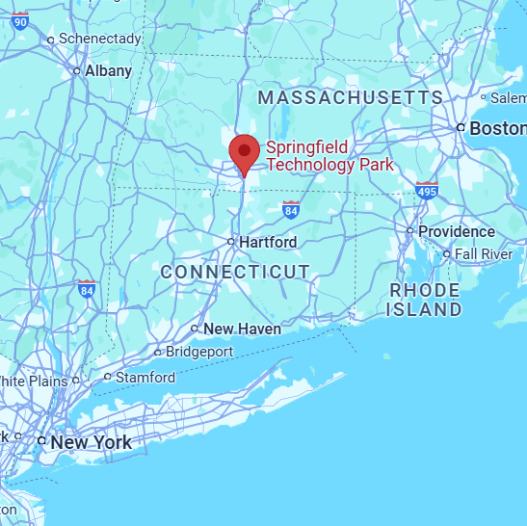
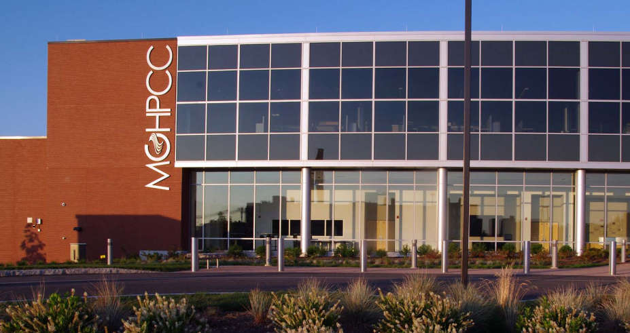

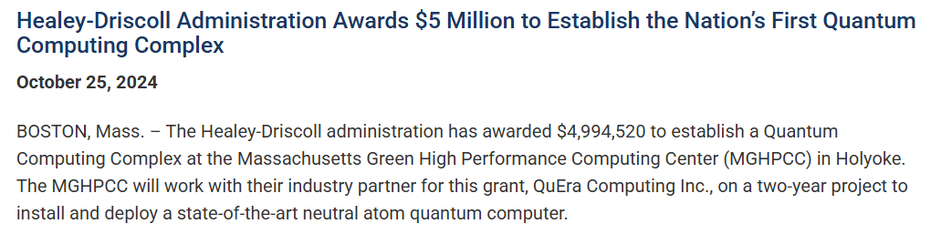



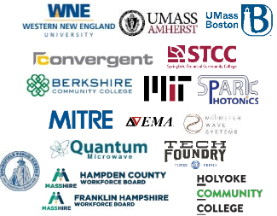

Quantum Massachusetts Strategic Vision
powered by the Pioneer Valley Quantum Innovation Hub (PVQIH) Consortium and Advisory Council
led by MassTech’s Innovation Institute
1. Quantum Computing Complex
2. Quantum Supply Chain Accelerator
Establish a first-of-its-kind Quantum Supply Chain Accelerator
Industry-facing cutting-edge equipment for creating, prototyping,
and commercializing quantum components.
Physical facility to be located in western MA
Fabrication and Packaging
Test and Measurement
3. Quantum Workforce Pathways
Multi-institution cross-regional development
Expand K-12 STEM Pipeline
Enhance/expand community college programs

Slide 30


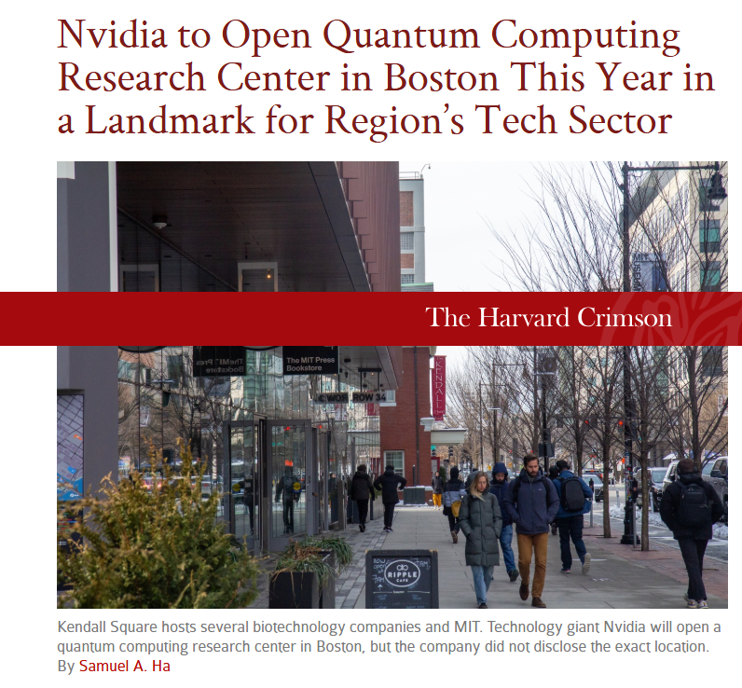
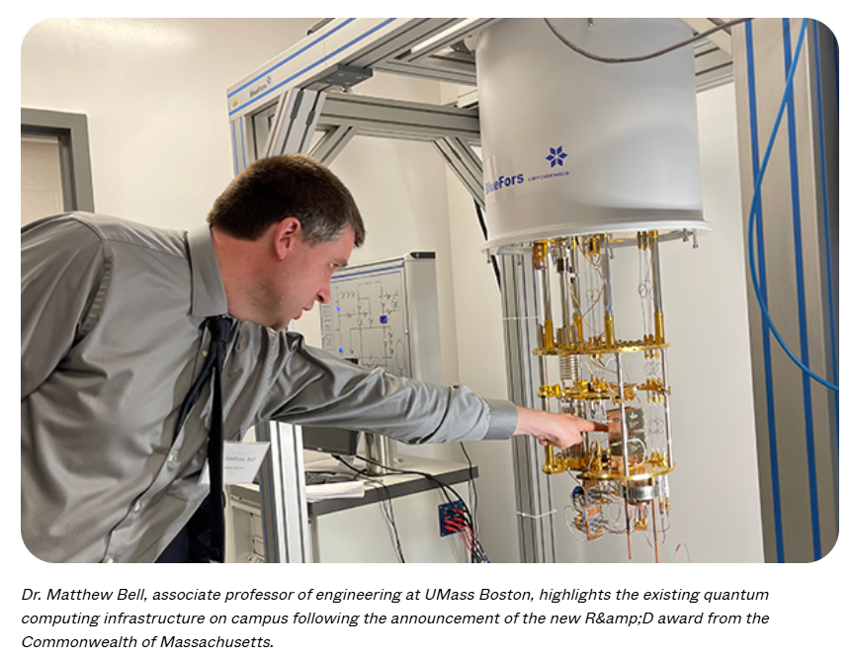
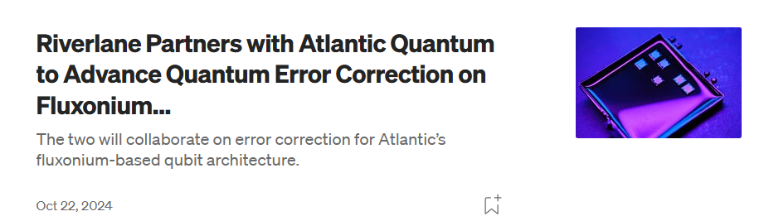

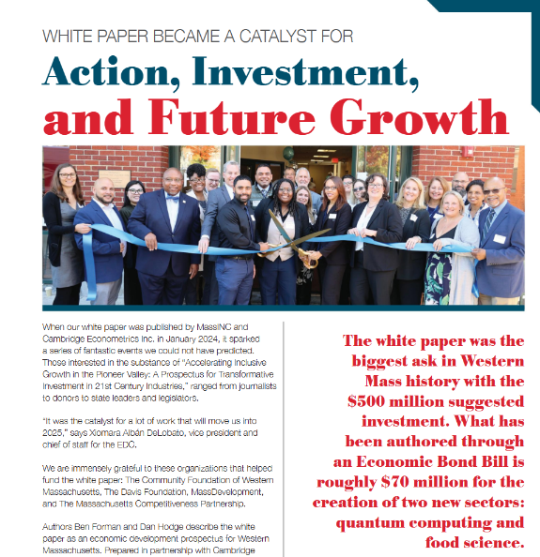
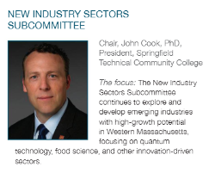
Quantum Massachusetts
Technology, Leadership, Investment
Masstech Quantum Investments
Over $19 Million invested to date
Massachusetts Companies
Quantum Innovation and Investment
$3.5M to Northeastern University for quantum incubator environment(EQUAL)
$1M for a UMass Boston and Western New England University or quantum hardware R&D.
$9.6M through the NEMC Hub to BAE: to reduce the size and cost of quantum systems for DOD applications.
$264k through PROPEL for Millimeter Wave System, Quantum Microwave, and Quantum Network Technologies
Western Massachusetts
Commitment to Quantum Economic Development
$5M to MGHPCC in partnership with QuEra to create Quantum Computing Complex
Mass Leads Act earmark 2024 “not less than $40,000,000 shall be expended for a quantum innovation hub to be located in the Pioneer Valley region of the commonwealth”

Slide 31
Direct Pay Overview May 7, 2025
Bob LaRocca, Deputy Director, Federal Funds and Infrastructure Office

Slide 32
What is Direct Pay?
The Inflation Reduction Act (IRA) makes the largest investment in clean energy in United States history, and much of that investment is delivered via tax incentives.
Under the IRA, tax-exempt and governmental entities – such as cities and towns -- that do not owe Federal income taxes are, for the first time, able to receive a payment equal to the full value of tax credits for building qualifying clean energy projects or making qualifying investments. This is called Direct Pay (also known as Elective Pay).
By filing a return and using Direct Pay, these entities can receive a cash refund from the IRS for certain clean energy projects.
Direct pay applies to projects put into service January 1, 2023 through December 31, 2032, creating a decade of tax opportunity to save money on necessary infrastructure replacements and upgrades while reducing energy costs and carbon emissions.
Unlike competitive grant programs, the overall potential of these tax credits to states and municipalities is unlimited.
Note on these credits being “mandatory, not discretionary”

Slide 33
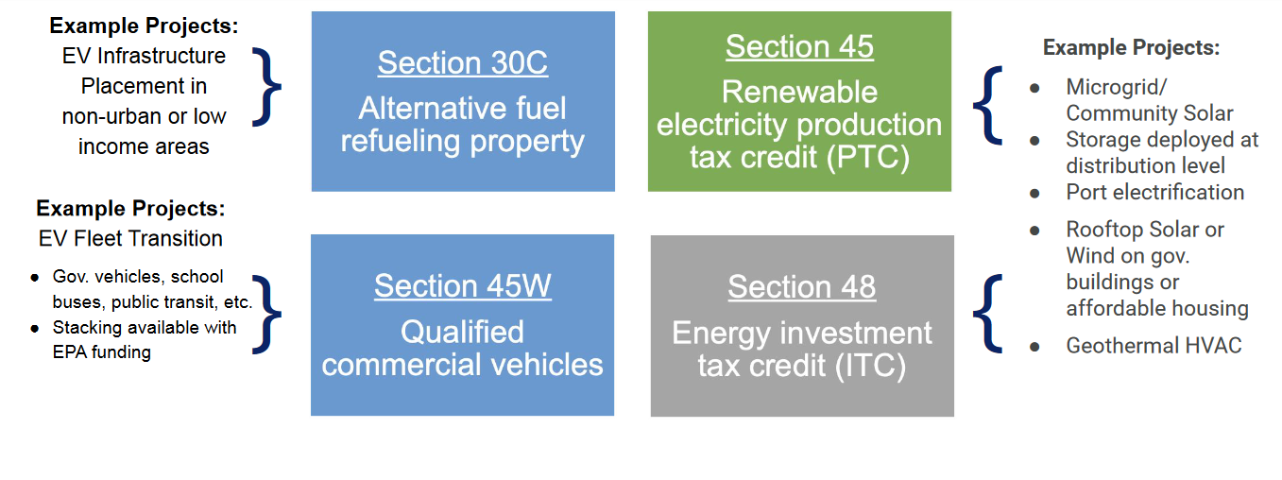
Most relevant tax credits for Massachusetts
v

Slide 34
Some Basics on Bonuses
Please Note: Additional details apply
Low-income Communities
10-20% bonus
… if project is in a low-income community with extra bonus if residential or econ benefit project
Energy Communities
10% bonus
…if project is in historical “energy community” (i.e., closed coal mine, some brownfield sites)
Prevailing Wage and Apprenticeship**
5x bonus
…if reqs for prevailing wages and registered apprentices are met
Domestic Content* **
…if 100% of applicable steel and iron and an applicable share of ‘manufactured products” produced in U.S.
10% bonus
ITC only
Applies to both ITC tax basis and PTC rate
Applies to both ITC tax basis and PTC rate
Applies to both ITC tax basis and PTC rate
* - On December,28, 2023, IRS issued new guidance on this rule for projects beginning in 2024 (see Notice 2024-9)
** - Applicable for projects of a size >1MW

Slide 35
How Direct Pay Credits and Bonuses Affect a $2M Project
Example:
A municipality with brownfield status installs microgrid with solar and energy storage.
Eligible for an ITC (Energy ITC, Sec. 48)
Project cost is $2M
Town recoups 40% of project in tax credits.
$600,000
$120,000

Slide 36
Helpful Resources
FFIO’s Direct Pay Information Page
Elect Pay Overview
CAP webinar on Direct Pay
Lawyers for Good Government Elective Pay resources, including worksheets on:
EV Purchase
EV Infrastructure
Tracking ITC and PTC projects
Slides from a presentation to local governments (but provides overview of Direct Pay for all)
IRS Video Tutorial on pre-registration
IRS Q&A

Slide 37
Discussion and q&a
As a reminder, we can help with:
Helpful information for us:
Looking for grants
Developing application
Advocating for submitted applications
Match grants to projects
Help look for partners/co-applicants (CBOs, other states, state agencies, universities, etc.)
Advice on labor standards, DEI , climate, language.
Review application
Letters of support from the state or congressionals
Calls and in-person advocacy when FFIO is in DC.
Get award dates/application status
-Are there any upcoming grants you are preparing for? Developing applications?
- What kind of technical assistance on these grants would be the most helpful for you?
- Do you have any applications pending or stuck?
-Are you looking for partners/co-applicants?
-Looking for gap financing for projects?
-
Reach us anytime at: FedFundsInfra@mass.gov.

Slide 38





Please join us for our office hours, bring your questions, and discuss priority projects! Feel free to move around tables!
Transportation
Climate
Resiliency
Office hours
Direct Pay
Priority Projects

Slide 39
Municipal needs survey
Please take 5 minutes to fill out this form and help us learn more about how our office can support you to best leverage available and upcoming federal funding opportunities!

