Slide 1
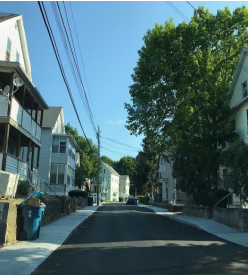
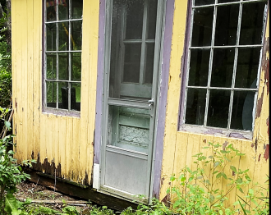
Massachusetts Executive Office of Housing and Livable Communities Community Development Block Grant Program FFY24 CDBG Start-up Training – Day 1 September 24, 2024
Maura T. Healey, Governor
Kimberley Driscoll, Lt. Governor
Edward M. Augustus Jr., Secretary

Slide 2
AGENDA
HUD Opening Remarks – Bob Shumeyko, Region 1, Regional Director, Community Planning and Development
CDBG Awards FFY2024
Contracts & Start-up Procedures
Clearance Documents – A Few Reminders
Single Case Waivers FFY24
Grant Management Reminders
New Grant Management Requirement – Progress Report due May 15th
Section 3 Policy & Reminders
Build America Buy America Act (BABAA)
New Floodplain Rule – Highlights
Addressing Radon – ERR
Updated HUD LMI Numbers (based on ACS 2016-2020)
EOHLC webpage resources https://www.mass.gov/service-details/community-development-block-grant-cdbg

Slide 3
FFY 2024 CDBG Grant Start-Up for:
Community Development Fund
$29,870,416 awarded
30 grants
55 communities
Mini-Entitlements
$9,218,828 awarded
10 grants

Slide 4
Grant Contract: Attachment A – Scope of Services
Specifies Responsibilities of Grantees
City/Town responsible
Incorporates the RFP
Establishes the framework of program implementation
Specifies the implementation period of the grant
7/1/24 – 12/31/25

Slide 5
Contracts and Start-Up Procedures
In order to carry out grant activities: Award Letter and…
A fully executed contract
Special Conditions clearance, if applicable
Professional Services Contract, if applicable
Environmental Release of Funds
City/Town may incur pre-agreement costs – list on settlement and release

Slide 6
Attachment A – Additional Terms & Conditions – Compliance Requirements
Title I of the 1974 HCDA
HUD regulations 24 CFR Part 570
2 CFR 200 – Uniform Administrative Requirements, COST PRINCIPLES, AND AUDIT REQUIREMENTS FOR FEDERAL AWARDS, as applicable
Other federal laws & regulations – Davis Bacon, Section 3,NEPA, Lead Paint, DOL Regs, Arch Barriers Act, the Americans with Disabilities Act…

Slide 7
Attachment A MA CDBG Program Requirements
Activities and Management Plan as submitted in Application - Changes to either require EOHLC approval
Additional Special Conditions - requires EOHLC clearance
Examples: Standard HR and Civil Rights; Citizen Participation Plans (written comments); Revised Management Plans, Budget Explanations; Anti-Speculation (forgiveness 1/15 per year); Public Hearing info, BABA forms
MA CDBG Program Management Manual… revised chapters on EOHLC’s CDBG website
Photographic documentation for construction -
Contractor shall erect a temporary sign and, if applicable, permanent signs, which acknowledge the funding source as follows: The U.S. Department of Housing and Urban Development and the Executive Office of Housing and Livable Communities, Massachusetts CDBG Program.

Slide 8
Attachment A Reporting Requirements
QPRs, Audits, Section 3, Labor Standards
Real property owned or controlled by units of local governments and improved with CDBG funds, may not have its use changed for a period of five years after the closeout of the grant that assisted the property unless the change of use is consistent with 24 CFR 570.489(j). Further, grantees will certify to EOHLC on an annual basis that they are maintaining the original use of the building.

Slide 9
Grant Management
Contractor will implement funded activities in accordance with the management plan
Any substantive change in the management plan requires prior written approval by the Executive Office
The Executive Office reserves the right to review personnel hiring decisions

Slide 10
Clearance Docs. – Reminders
ER – MHC Notification & Checklist Documentation
ER - 58.6 Form for Exempt Activities
ER – for HR Programs – all homes referred for historic review
NOIRRF – name of activity and amount of $
PSC – Method and Schedule of Compensation – new language payments tied to progress
Special Conditions – GMS rating scores summary notes can add context
Special Conditions – don’t resubmit application docs.

Slide 11
FFY2024 Single Case Waivers
Obtain prior EOHLC authorization for:
Projects the cost of which will exceed $60,000 per unit, except in projects involving lead, barrier removal, septic, asbestos, well drilling, historic preservation, for which the prior authorization of the Executive Office will be required when projects exceed $70,000 per unit in cost.

Slide 12
Grant Management Reminders
Initiate Quarterly Reports by the 15th
Quarterly Reports should clearly detail what happened within that quarter
Enter beneficiary data into GMS in timely manner
Claim Guidelines are still applicable
Public Hearings are necessary if substantial change
HR Program – check debarment status

Slide 13
Grant Management Reminders continued…
Ensure adequate onboarding (refer to new EOHLC doc.)
2nd Public Hearing during course of grant
HR – look for best practices/revise guidelines as necessary
Reach out to your Program Reps. with questions!

Slide 14
New Grant Management Requirement – Progress Report & Meeting
Report due on May 15, 2025
Comparison of original goals with actual progress
Detail unforeseen costs/obstacles
Plan to catch up on milestones if behind
One on one meeting with program rep. to discuss
Will release template for report in 2025
Upload to Miscellaneous tab and email rep.

Slide 15
Section 3 Policy
Title 24 CFR Part 75 Economic Opportunities for Low- And Very Low-income Persons, is the statutory repository for HUD’s Section 3 requirements.
§ 75.1 Purpose.
This part establishes the requirements to be followed to ensure the objectives of Section 3 of the Housing and Urban Development Act of 1968 (12 U.S.C. 1701u) (Section 3) are met. The purpose of Section 3 is to ensure that economic opportunities, most importantly employment, generated by certain HUD financial assistance shall be directed to low- and very low-income persons, particularly those who are recipients of government assistance for housing or residents of the community in which the Federal assistance is spent.

Slide 16
Section 3 Reminders
Triggered when: obligate or commit an aggregate amount of $200,000
Housing rehabilitation, housing construction, barrier removal, demolition, other public buildings, facilities, or infrastructure
A recipient must prepare a strategic plan/action plan
Report upon the completion of each activity
Upload Template to the Miscellaneous tab
Nature of Agency Efforts will need to be completed if Safe Harbor Benchmark not met
“Agency” is the municipality

Slide 17
Build America Buy America Act (BABAA)
Language in FFY24 Contracts:
Build America, Buy America Act (BABAA) Requirements under Title IX of the Infrastructure Investment and Jobs Act (“IIJA”), Pub. L. 177-58. Absent a waiver, and provided that total project cost is $250,000 or more from all sources, all iron and steel products, as well as specific construction materials including metals, PVC pipe, lumber and drywall used must be produced in the United States…
Include in all subawards, contracts, and purchase orders for the work performed, or products supplied under the Federal award.
“Infrastructure” is defined broadly under 2 CFR § 184.4(d), and covers any project that includes construction, alteration, maintenance, or repair or infrastructure regardless of whether infrastructure is the primary purpose of the project.

Slide 18
BABAA –cont’d… Examples of CDBG Projects Considered Infrastructure
Examples of CDBG projects that are considered infrastructure projects include: rehabilitation, maintenance, and reconstruction of buildings and real property, including housing, and construction and repair of public facilities and improvements, such as water, sewer, or other utilities, roads, bridges, sidewalks, homeless shelters, or broadband infrastructure.
See the HUD Quick Guide “Build America, Buy America Act: Buy America Preference for CDBG Grantees.” BABA Quick Guide: CDBG (hudexchange.info)
Also recommended: BABA “Beyond the Basics: Implementing the BAP” AT-diffmilk220912Aquiz_gundry-v04-m01-f00-c00 (youtube.com)

Slide 19
New Floodplain Rule Highlights
HUD’s Final Rule to implement the Federal Flood Risk Management Standard (FFRMS) was published on April 23, 2024.
The Final Rule updates 24 CFR Part 55, streamlining floodplain management and wetlands regulations to better address flood risk.
The Final Rule adopts a future flood risk management model that:
Redefines the floodplain of concern
Increases the required elevation for new construction and substantial improvement* activities
Strengthens public notice requirements
* Substantial improvement is any repair or improvement that exceeds 50% market value of the asset or that increases the number of units or peak customers by more than 20% (24 CFR 55.2(b)(12)(i)). Please contact Kathryn McNelis via email at kathryn.mcnelis@mass.gov and Patricia Roushanaei via email at patricia.roushanaei@mass.gov before submitting your ERR/RROF if you believe your project might be a substantial improvement.

Slide 20
New Floodplain Rule Highlights cont’d
HUD grantees, recipients, and applicants must comply with the updated regulations beginning June 24, 2024
Under the Final Rule
Projects within the FFRMS floodplain are required to complete the 8-step process (unless exception exists)
FFRMS floodplain (CISA, 0.2PFA, or FVA) replaces the 100-year floodplain previously used
500-year floodplain can now trigger the 8-step process for non-critical actions
Exceptions are identified at 24 CFR 55.12 or 55.13

Slide 21
New Floodplain Rule Highlights cont’d
For FFY24 CDBG grantees:
As of May 2024, Federal CISA resources have not yet been formally adopted by HUD.
Refer to resources on HUD Exchange, specifically webinar slides: Slides - FFRMS Final Rule Series: Part 55 Overview and Compliance (hudexchange.info)
Demonstrate Compliance Using FEMA Maps – 0.2PFA (see slide 38 on Floodplain training)
If FEMA has not mapped the 500-year floodplain for the project area, use the Freeboard Value Approach (FVA) (slide 23 on Floodplain training)
Flowchart for “Identifying the FFRMS Floodplain” (slide 24 on Floodplain training)

Slide 22
Addressing Radon on ERR
Must address under the toxic sites section on statutory checklist.
Use Scientific Review Method (for this program year)
It is not sufficient to just state “testing not needed”
Detail the exemption if applicable
If no exemption, then need to include map from the CDC National Environmental Public Health Tracking Network showing radon by county
If project is not in an area that has 4.0 or higher pCi/L include this on statutory checklist
If project is in an area that has 4.0 or higher pCi/L (Worcester County) – need to test prior to completing checklist.

Slide 23
Radon Resources
Resources: Visit CDBG website – look under “Environmental Review” for radon guides and flowchart Community Development Block Grant (CDBG) | Mass.gov
There are many resources on the HUD Exchange as well: Radon - HUD Exchange
New Radon Explainer Videos: Radon Explainer Videos - HUD Exchange

Slide 24
Updated HUD LMI Numbers
HUD released new low-and moderate- income summary data (LMISD) based on the 2016-2020 American Community Survey (ACS)`
See Notice: CPD-24-04, Issued June 6, 2024 CPD-24-04.pdf (hud.gov)
Replaces LMISD based on the 2011-2015 ACS
Effective Date August 1, 2024
*** FFY24 CDBG approved activities fall under the transition policy
Impact will be to FFY25 program year and possibly program amendments seeking to qualify under LMI area-wide
Examine numbers for planned multi-phase projects
EOHLC available for virtual meetings if wish to discuss
Link to ACS 2016-2020 All Block Groups: LMISD - All Block Groups, Based on 2016-2020 ACS - HUD Exchange

Slide 25
EOHLC WEBPAGE Resources - https://www.mass.gov/service-details/community-development-block-grant-cdbg
“QPRs, Extensions, Amendments” – the basics
GMS Guidance
Performance Measures/Lead Paint Reporting
SCW procedure
Close-Out
Updated MA CDBG Program Manual chapters
Technical Assistance guides – PSS, ABR, Infrastructure, HR
Environmental Review forms/guidance (*new-radon guidance)

Slide 26
Program Representatives FFY 2024
Nate Delude – Chesterfield, Easthampton. Fairhaven, Millbury, North Brookfield, Orange, Southbridge, Warren, Webster
Anna Whitten – Adams, Chelsea, Edgartown, Greenfield, Hardwick, Lenox, North Adams, Oak Bluffs, Salisbury, Truro, Winchendon
Shelly Chevalier – Agawam, Becket, Everett, Huntington, Mashpee, Wareham
Charles Sanderson – Brewster, Gardner, Great Barrington, Northbridge, Randolph, South Hadley
Emily McLaughlin – Amherst, Athol, Buckland, Chester, Montague, Palmer, Southwick, West Springfield
Contact: firstname.lastname@mass.gov

Slide 27
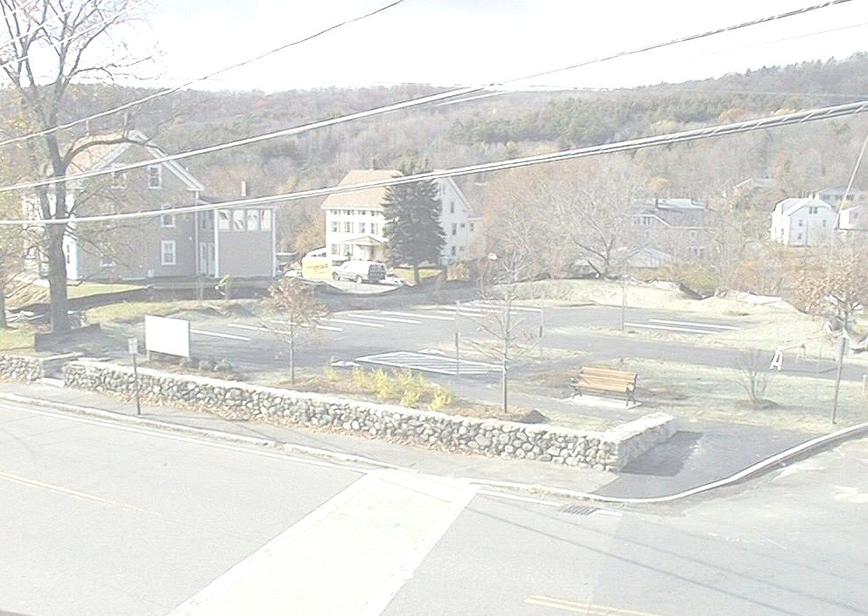
EOHLC
100 Cambridge Street, Suite 300
Boston, MA 02114
Main Phone: 617.573.1400
www.mass.gov/eohlc

