Slide 1

Maura T. Healey, Governor
Kimberley Driscoll, Lt. Governor
Edward M. Augustus, Jr., Secretary

Slide 2
CDBG Application Training FFY 2026
Community Development Fund
Mini-Entitlement Fund

Slide 3
Agenda
Overview
Application Requirements
Activity packets
Evaluation & Scoring
National Objective
On-Line Application
Q and A

Slide 4
Eligible Applicants
Municipalities under 50,000 and
Municipalities that do not receive CDBG funds directly from HUD
Apply only through chief elected official
  Must be authorized to obligate the City or Town

Slide 5
CDF and Mini-Entitlement Applications
Due date
Applications for CDF and Mini-Entitlements due Tuesday, April 21, 2026, at 3:00:00 PM
1 copy of application cover page, joint authorization page(s) with signatures of appropriate CEO due with the application attached in Other Attachments – Do Not Send by Mail
18-month implementation schedule 7/1/2026 – 12/31/27

Slide 6
Grant Award Amounts
Community Development Fund
Category Maximum Grant Award
Single Community $ 950,000
Two Communities (regional) $1,150,000
Three or more Communities $1,350,000
(regional)
Minimum
All (except planning) $ 100,000
Planning or design only $ 10,000

Slide 7
Grant Award Amounts
Mini-Entitlement
Maximum Award is $875,000
Mini-Entitlement communities are eligible for a maximum award of $875,000 based upon prior performance including effective implementation of activities, timely expenditure of funds and performance along with the community’s ability to identify eligible, feasible activities that can be completed in a timely manner
Submit a list of proposed activities to EOHLC within one week after the application availability. Provide the name of the activity, demonstration of eligibility, national objective compliance, a brief description, proposed accomplishments and proposed budget. No later than February 24.
May not participate in joint application.

Slide 8
Mini-Entitlement Program
10 designated communities
Multiple activities – but no more than three in addition to PSS
Required to target except for housing rehabilitation
Demonstrate Community Development Strategy Consistency
CDS is valid for 3 years, beginning with FFY 24 submission

Slide 9
Application Threshold
Timely Expenditure
90% of all grant funds awarded to the municipality for FFY 2022/2023 and earlier FFYs have been fully expended
40% of all grant funds awarded to the municipality for FFY 2024 have been fully expended
if a municipality is less than 75% expended in the FFY21 award, a waiver will not be granted unless good cause and a plan for implementation of funds can be demonstrated

Slide 10
Timely Expenditure Waiver Requests
Due February 27, 2026
Explain and describe the reason(s) for delay
Applying for same activity in FFY 2026?
Provide up-to-date financial information
Provide a revised quarterly commitment/expenditure schedule
Provide a description of how grant(s) will be managed, to meet goals
Are funds being returned to comply with the threshold
History and progress of past Waivers
SIGNED by CEO

Slide 11
On-line Application IGX
A link to the application will be found on the CDBG web page
New Grant Management System
EOHLC will send notice of availability through email lists & COMMBUYS

Slide 12
New to CDBG?
On the log-in page, follow instructions for “New Users”
Contact Mark Southard @ mark.southard@mass.gov for assistance in accessing the system
Questions concerning the application should be directed to program staff, CDU Manager Kathryn.McNelis@mass.gov or Deputy CDU Manager, Patricia.Roushanaei@mass.gov

Slide 13
The Application
Collection of Forms and Links:
Side Bar on the left side of screen
Application Cover Sheet
Plans and Certifications
Thresholds
Components – Project Packets
Administrative Budget – 18 months

Slide 14
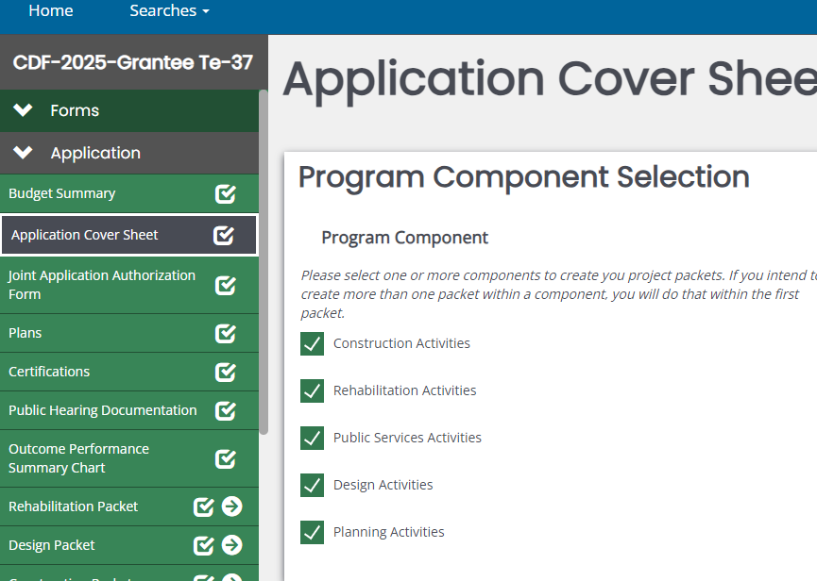
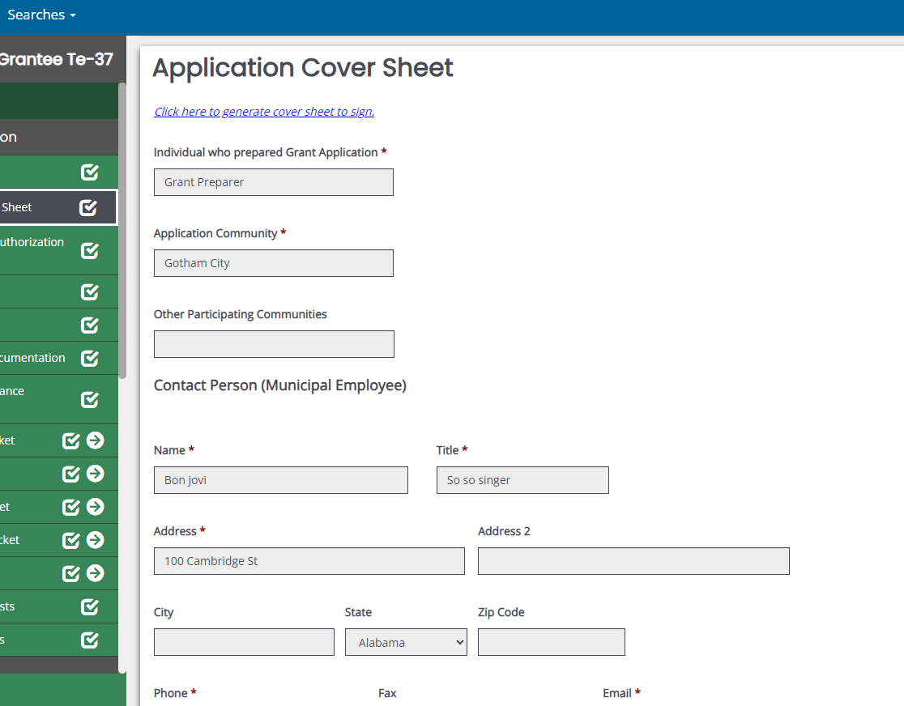

Slide 15
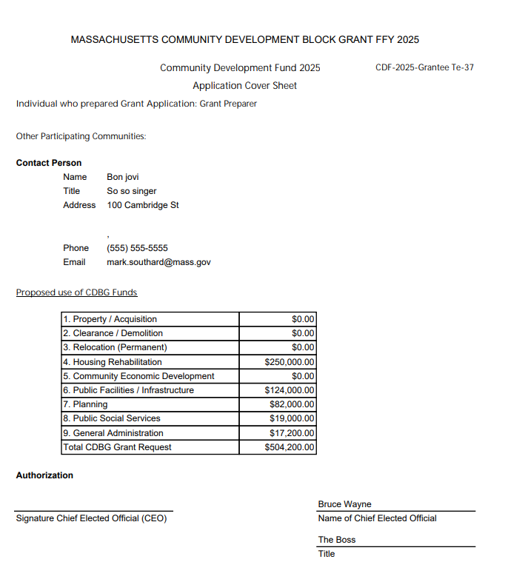

Slide 16
Application Plans and Certifications
Refer to Application Guidance for Instructions
The application requires response to several plans and certifications
Failure to address these could derail your application or result in a special condition attached to the grant which could delay implementation

Slide 17
Application Plans –
1. Anti-Displacement and Relocation Plan – required for all
2. Citizen Participation Plan
3. Grant Management Plan
4. Program Income Plan
5. Anti-Speculation and Recapture Plan
6. Program Contingency Plan

Slide 18
Application Certifications/Requirements
CEO Certification
CFO Certification
Displacement of Non-CDBG Funds
Anti-Displacement & Relocation Assistance
Public Hearing 15-day notice/held 2 weeks before
Outcome Performance Summary

Slide 19
ADA Self Evaluation Survey & Transition Plan
Communities that participated in CDBG applications between FFY 2018 and FFY 2025 have complied
Communities that have not complied with this requirement must submit ADA Self-Evaluation and Transition Plan:
- Attach to Other Attachments on Side Bar
OR
- Attach statement that community does not have one, on letterhead.
Questions?
Director
Massachusetts Office on Disability
(617) 979-7317

Slide 20
Eligible Activities
Title I of Housing & Community Development Act of 1974, as amended – See Appendix A
Housing assistance
Public facilities
Architectural/Engineering Design*
Infrastructure
Planning
Public social services
Economic Development – must contact EOHLC
*Risk of repayment if project construction not complete within five (5) years

Slide 21
Not Eligible per 24 CFR 570.207
Expressly Prohibited:
Buildings used for the conduct of government
General government expenses
Political activities
Generally Ineligible:
Purchase of equipment; Furnishings and personal property;
Operating and maintenance expenses;
New housing construction;
Income Payments

Slide 22
All Activity Thresholds
Eligible Activity - Is the project eligible?
National Objective -Does the project meet a national objective?
Consistent with Sustainable Development principles?

Slide 23
Public Facility Thresholds
Bid-Ready plans and specifications required for public facilities (includes parks/playgrounds) and barrier removal projects with construction costs > $200K
Design development drawings required for those projects and playground/park projects with construction costs of > $25K but < $200K
Infrastructure projects – do not require bid ready docs as a threshold. Note, for this round, points will not be taken off (however must demonstrate completion of docs. built into the 18-month activity timeline)

Slide 24
Special Public Facilities Rule
HUD requires recipients of State CDBG Program grants to retain the use for which CDBG funds were expended on behalf of a public facility project for a minimum of five (5) years after the closeout of the grant.
See Application Guidance for more detail

Slide 25
Senior Center Thresholds
Site control under the Board of Selectmen or Mayor
Bid-ready plans and specifications
  One set of plans as attachment in application
  Letter from Arch/Eng attesting that complete set of specs is prepared and bid-ready
All other financial resources, if necessary, in place at time of application
Elderly persons are presumed by HUD to meet the national objective

Slide 26
Architectural Barrier Removal Project Thresholds
Must submit a copy of ADA Self-Evaluation Survey and Transition Plan
Programmatic removal of barriers must be explored first
ONLY relevant barrier removal work may be funded
Project/Activity must be referenced in ADA Self –Evaluation & Transition Plan

Slide 27
Public Social Services Thresholds
Social service only applications are not allowed
Projects/budget may not exceed 20% of the total grant amount – 20% include delivery and program costs
Must be a New or expanded service
EOHLC encourages PSS that support economic security and self-sufficiency...
No more than 5 public services packets in an application

Slide 28
Housing Rehabilitation Program status update
One page update on past program performance
Uploaded to Other Attachments
Include budget info, reasons for delays, revised timeline
Justify new request

Slide 29
Activity/Project Threshold National Objectives
1. Benefit to low- and moderate- income persons
or
2. Prevention or elimination of slums and blight
or
Urgent need
Identify, describe (document) that you can and how you will meet the national objective

Slide 30
Component Selection - Project Packets
Found @ Top of the Application Cover Sheet
5 component selections – (project packets)- Rehabilitation, Construction, PSS, Planning, Design
1 project per packet
Packet contains:
  Project description - See Application Guidance
  Threshold questions
  Competitive (scored) questions ( Except PSS )
  Budget and related information

Slide 31
Activity Packet Information
Is it eligible? Is it ineligible?
Will it meet a national objective?
Was the need identified through a public process?
Is it feasible? Can it be carried out in a timely manner?
Will it have an impact?
Will it comply with all other federal and state requirements?

Slide 32
Activity Packet Information
Project Description – Tell us about the project
Budget Information – How will the project be funded; how determined; sources
Project Need Response – Competitively scored
Project Feasibility Response – Competitively scored

Slide 33
Competitive Questions
Project Need – 40 points
Define and quantify the need (s) to be addressed. Describe current conditions and the impacted population. Indicate how community input contributed to determining the need (15 pts)
Provide/document relevant and current evidence of the extent of the need/problem – narrative should relate to documentation (10 pts)
Describe how the project will address the need and the impact it will have on the need (5 pts)
LMI Score – to be added by EOHLC – Up to 10 pts

Slide 34
Competitive Questions
Project Feasibility - 25 points
Ready to proceed?
Status of design and project readiness to proceed (10 pts)
Describe project budgets and project oversight – cost reasonableness and internal controls (up to 8 pts: 4 pts budget, 4 pts staffing)
Describe/document ER/permits (3 pts)
Describe/identify milestones and timeframe (4 pts)

Slide 35
Public Service packets
Public Service packets are evaluated for viability and effective operation.
Do not answer the competitive need and feasibility questions as your response.
Project summary – 3-page max
Include detailed budgets that support line-item costs

Slide 36
Public Service packets
Scope of program
Describe need and how identified
Description of service to be provided
Identify Beneficiaries and outcomes
Project Oversight
Allocation of funds per community
Detailed Budget – breakout staff salaries by quantity, rate, hours

Slide 37
CDF Evaluation: Project Packets
65 points
Rehabilitation, Construction and Design, each project packet will be evaluated and scored on the following:
  Project Need (40 points)
  Project Feasibility (25 points)
CDF projects must meet 39 out of 65 points to be considered fundable
Planning activity packets will be scored using Project Need only and must receive at least half the points but will not be included in the application score
Public service packets will be evaluated on information contained in the project description and will be treated as pass/fail – See application guidance. Include detailed budgets

Slide 38
Mini-Entitlement Scoring
Scored to ensure feasibility
Must complete Competitive Questions (both Need + Feasibility)
Activity packets must receive a minimum 50% score for the feasibility question
No more than 3 activity packets in addition to PSS
Upload CDS

Slide 39
Build America Buy America (BABA)
Applicants for infrastructure projects must demonstrate consideration of BABA requirements - Upload BABA form
Factor into Cost Estimate, if applicable
Project Budget from all sources more than $250,000
Infrastructure definition: “any activity related to the construction, alteration, maintenance, or repair of infrastructure in the United States”
Note: this will not likely apply to single family housing rehabilitation programs

Slide 40
BABA
Includes rehabilitation of buildings and real property, construction of public facilities and improvements, utilities, water systems, electrical transmission facilities, broadband and transportation infrastructures
Required to apply the Buy America Preference (BAP) for certain products. These include:
  iron and steel and
  specific construction materials, including metals, PVC pipe, lumber and drywall, not listed construction materials (all other plastic- and polymer-based products, glass, fiber optic cable, optical fiber, engineered wood, and drywall)
All manufacturing processes for iron and steel, as well as construction material must occur in the U.S.
BABA Determination Form will be available on EOHLC’s CDBG web page
Form can be prepared by consultant, but requires municipal sign-off

Slide 41
EOHLC Review Process
Two readers per application
Does application meet threshold requirements
Independent scoring of competitive questions
Meet and discuss, come to consensus –disagreements reviewed with team leader
Team Leader reviews for consistency
Packet scores are averaged
Applications ranked by score and funds allocated until gone

Slide 42
Quick reminders
Read the One Year Plan
One packet per project
Page Limits - 4 pages for scored responses to competitive questions / 2 pages for planning and 3 pages PSS project descriptions – See instructions in the Guidance
Income surveys should not be more than 3 years old
Slum & Blight inventory guidance – don’t create your own criteria
Public Hearing – read instructions!
No changes/additions will be accepted after the application deadline
Barrier Removal - scope limited to barrier removal
Bid-ready plans and specifications for all public facilities and architectural barrier removal projects with construction costs over $200,000

Slide 43
Additional Considerations
Administration – GA 15%; Total 30%
Regional applicants must comply with all requirements as do individual applicants
No single community may receive more than $1.35M in CDF grant funds from FFY 2026 awards
READ THE APPLICATION GUIDANCE!!

Slide 44
Attachments
Attach documents where they belong
Attach documents only where they belong
Attached document names - NO SYMBOLS – Make sure names are consistent
Appendix list if many attachments
Hyper Links – Not recommended
Review attachment requirements in Application Guidance

Slide 45
National Objectives
1. Benefit to low- and moderate- income persons
or
2. Prevention or elimination of slums and blight
or
3. Urgent need
Describe (document) that you can and how you will meet the national objective

Slide 46
LMI National Objective
Statutory requirement that at least 70% of all CDBG Expenditures must benefit LMI persons
EOHLC required to report to HUD annually, if the threshold is not met, HUD can require repayment
HUD LMI limits –
https://www.huduser.gov/portal/datasets/il.html
LMISD - All Block Groups, Based on 2016-2020 ACS - HUD Exchange
eCFR :: 24 CFR 5.609 -- Annual income.

Slide 47
LMI National Objective (project threshold)
Low-and-moderate income benefit
Five ways: depends upon the project
  1. Area-wide low/moderate income
  2. Housing activity
  3. Limited clientele
  4. Job creation or retention
  5. Planning

Slide 48
Area-wide low/moderate income
Service area is determined based on the nature of the activity and who the users will be
For a service area to qualify for National Objective purposes it must be primarily residential, and it must be demonstrated that at least 51% of the residents of the service area are of low-and-moderate income.
Two methods: Survey and Census
Grantee must determine the service area of the activity and provide a written justification/determination/description and
Maps
If Water project, map with flow direction
Data

Slide 49
Area-wide low/moderate income (LMA)
  Two methods to determine compliance with LMA:
  Use of Survey tool or Census Data to show that benefits of project extend generally to all residents of project area. Service area is determined based on the nature of the activity and who the users will be. It must be demonstrated that at least 51% of the residents of the service area are of low-and-moderate income
  Explain methodology for geographic boundaries
  Area must be primarily residential
  Written determination/description
  Maps
  If Water project, map with flow direction
  Survey no older than 3 years
  Survey must be sound methodologically
  Provide blank survey document
  Summary survey results
  Street by street data
  Parcel Map of Service Area including vacant land
  If vacant land, describe future use for 5-7 years

Slide 50
Area-wide low/moderate income (LMA)
Census Data – Use of ACS - Must be pre-approved by EOHLC via submission of form – this includes ME’s
Description of activity; map illustrating the area; block group data.
https://www.mass.gov/doc/lmi-area-wide-block-group-information-documentation-form/download
Submit by 3/21/2026

Slide 51
Project Threshold National Objective (LMI)
Housing activity
Providing or improving permanent residential structures which will be occupied by LMI households when completed
Demonstrate that 51% of the units in a structure are LMI households:
    One unit structure must be occupied by LMI household
    One unit of a 2-unit structure must be occupied by LMI household
    All other housing structures must have at lease 51% of the units occupied by LMI households
Income must be documented and kept on file for all LMI units

Slide 52
Low Mod Housing Benefit (LMH)Documentation
Must have a standard income verification procedure that uses acceptable forms of source documents/third party verification
  Determine income: Part 5 Annual Income
  EOHLC recommends third party verification of gross income; 6-to-8-week period; extended to 12 months
  Source is typically pay stubs; limited situations certified IRS AGI
  Consider seasonal employment and no income claims
  Compare to current income limits

Slide 53
National Objective: Limited Clientele (LMC)
Four options:
  Groups generally presumed to be principally LMI*: elderly (62+), battered spouses, severely disabled adults, persons with AIDS, abused children, homeless persons, illiterate adults, migrant farm workers (presumed beneficiaries)
  Groups of persons already documented as low- and moderate-income
  Groups whose composition is such that it can be concluded that a majority of their clientele will be LMI persons
  Groups that can be documented to be predominantly LMI (at least 51%)
*Unless there is evidence to the contrary

Slide 54
National Objective: Limited Clientele (LMC
Documentation:
  Self-Certification may be used for most activities, except for activities that are providing a subsidy. (Any subsidy requires full income documentation.)
  Clientele certify to family size and income.
    Be sure form is current and updated with income limits
    If self-certification is not used, file must contain information or description to justify that program is used by presumed beneficiary or predominately LM persons

Slide 55
Planning National Objective Compliance
  To satisfy the National Objective, demonstrate that the planning project, if implemented, will meet a LMI National Objective
  Examples:
  - Affordable housing study
  - Study of unmet needs for LMI persons in an area that is 51% or more
  - Study in a S&B area regarding contributing conditions
  - Spot blight study designed to eliminate hazards

Slide 56
National Objective; Slum and Blight
Slums & Blight - Area-wide or Spot
Area-wide basis - application
Submitted no later than 30 days prior to application due date
Once approved by EOHLC, an inventory/ target area is valid for 10 years
Spot blight - only health & safety issues can be addressed

Slide 57
Area-wide Blight
A declaration and description of area or site by local official; Consistent with Chapters 121 A and B
At least 25% of properties experience one or more of the following conditions: See application guidance
  Physical deterioration of buildings or improvements
  Abandonment of properties
  Chronic high occupancy turnover or vacancy rates in industrial/commercial
  Significant declines in property values or abnormally low values relative to others
  Known or suspected environmental contamination
Map delineating target area/Written description
Current parcel inventory of buildings/properties and infrastructure
Appendix J - summary table
Appendix K - EOHLC’s property and infrastructure rating sheets – Do not modify
Any proposed project must address conditions that contribute to the deterioration of the area

Slide 58
Spot Blight
Address specific conditions of blight, physical decay or environmental contamination that threaten public health and welfare
Acquisition*, clearance, historic preservation, remediation, building rehabilitation
Provide description of site – Why is the building or property deteriorated?
Must indicate/document serious health and safety concerns – Why is it a serious concern? Provide evidence to support
Limitations on what can be done under this NO, health and safety hazards.
*Must be a precursor to another eligible activity that addresses S&B

Slide 59
Project Threshold
National Objective – Critical/Urgent Need
Catastrophe, natural disaster – Conditions that pose a serious and immediate threat to the health/welfare of the community
Situation not known prior to 18 months preceding EOHLC approval
Community cannot finance on its own and No other financial resources exist
EOHLC approval necessary before application is submitted
Provide:
Description of the nature and seriousness of condition – include timing of development of condition and photographs
Certification by local government of serious and immediate threat and evidence showing unavailability of other financial resources

