Slide 1
Maura T. Healey, Governor Kimberley Driscoll, Lt. Governor Edward M. Augustus, Jr., Secretary

Slide 2
CDBG Application Training for: FFY 2025
Community Development Fund
Mini-Entitlement Fund

Slide 3
Agenda
Overview
Application Requirements
Activity packets
Evaluation & Scoring
National Objective
Q and A
On-Line Application

Slide 4
Eligible Applicants
Municipalities under 50,000 and
Municipalities that do not receive CDBG funds directly from HUD
Apply only through chief elected official
Must be authorized to obligate the City or Town

Slide 5
Grant Award Amounts
Community Development Fund
Category Maximum Grant Award
Single Community $ 850,000
Two Communities (regional) $1,050,000
Three or more Communities $1,250,000
(regional)
Minimum
All (except planning) $100,000
Planning or design only $ 10,000

Slide 6
Grant Award Amounts Mini-Entitlement
Maximum Award is $950,000
If by 1/17/2025, 100% expended in FFY 2021 and earlier AND
If by 1/17/2025 over 70% expended in FFY 2022-2023 award
Minimum Award is $850,000
Contact Program Representative to determine $
Submit a list of proposed activities to EOHLC within one week after the application availability. Provide the name of the activity, demonstration of eligibility, national objective compliance, a brief description, proposed accomplishments and proposed budget. No later than 2/5/2025.
Meet with EOHLC to discuss this proposed list.
May not participate in joint application

Slide 7
Mass CDBG Program Components – Mini-Entitlements $9,500,000
Mini-Entitlement Program – 10 designated communities
Multiple activities – but no more than three in addition to PSS
Required to target
Demonstrate Community Development Strategy Consistency

Slide 8
Due dates CDF and Mini-Entitlement Applications
Applications for CDF and Mini-Entitlements due Monday, April 14, 2025, at 3:00:00 PM
1 copy of application cover page, joint authorization page(s) with signatures of appropriate CEO due with the application attached in Other Attachments – Do Not Send by Mail

Slide 9
Application Threshold Timely Expenditure
For previous Grantees:
100% of funds from 2021 or earlier
50% of funds from 2022/2023
Procedural clearances complete from 2024
Funds may be returned to meet these requirements
*CDBG includes CDF, Mini-Entitlement, and Reserves, but for the purposes of this calculation excludes Section 108 guarantees. Planning-only grants of $50,000 or less are also excluded from this calculation.
*Greater scrutiny will be applied for 2025 waivers

Slide 10
Timely Expenditure Waiver Requests
Due March 14, 2025
Explain and describe the reason(s) for delay
Applying for same activity in FFY 2025?
Provide up to date financial information
Provide a revised quarterly commitment/expenditure schedule
Provide a description of how grant(s) will be managed, to meet goals
Are funds being returned to comply with the threshold
History and progress of past Waivers
SIGNED by CEO

Slide 11
On-line Application
A link to the application will be found on the CDBG web page
EOHLC will send notice of availability through email lists & COMMBUYS
New Grant Management System

Slide 12
New to CDBG?
On the log-in page, follow instructions for “New Users”
Contact Mark Southard @ mark.southard@mass.gov for assistance in accessing the system
Questions concerning the application should be directed to program staff – contact CDU Manger Kathryn.McNelis@mass.gov or Deputy CDU Manager, Patricia.Roushanaei@mass.gov if you are not already working with staff

Slide 13
The Application
Collection of Forms and Links:
Side Bar on the left side of screen
Application Cover Sheet
Plans and Certifications
Thresholds
Components – Project Packets
Administrative Budget – 18 months

Slide 14
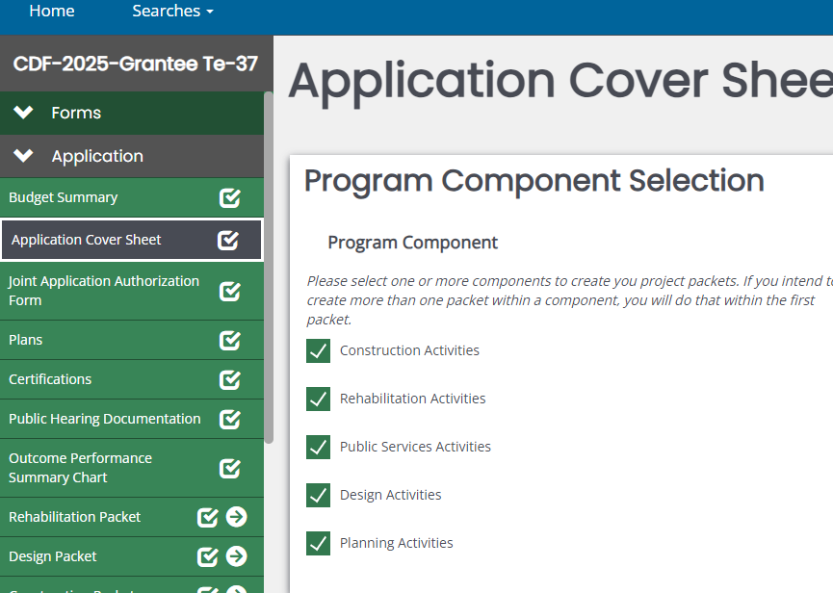
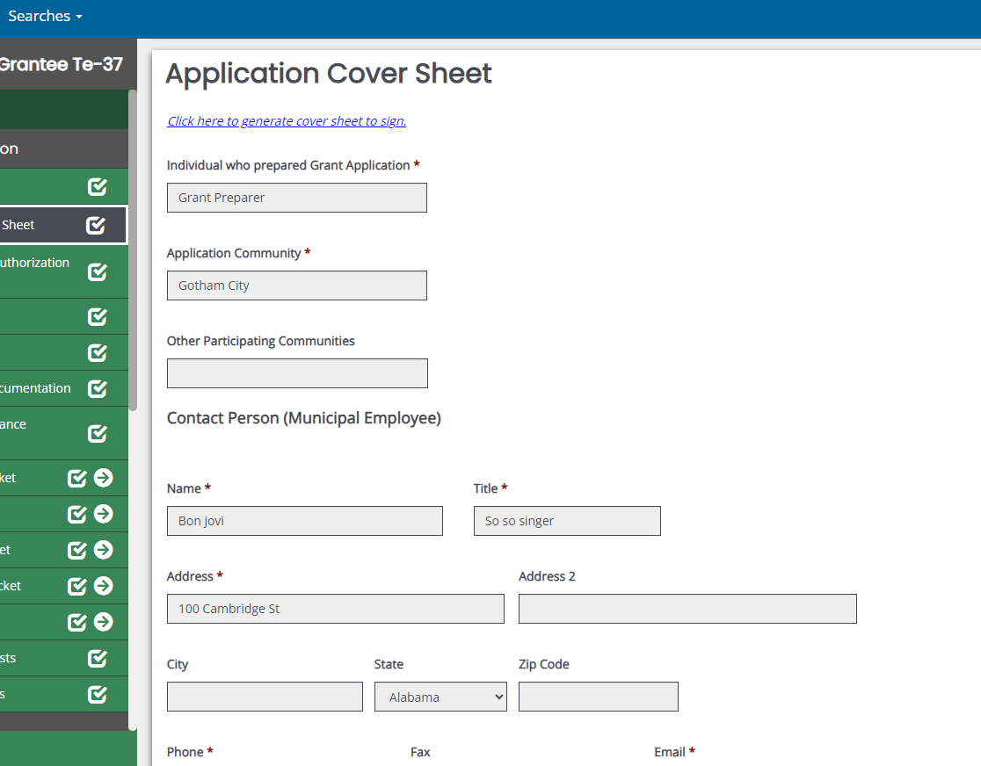

Slide 15
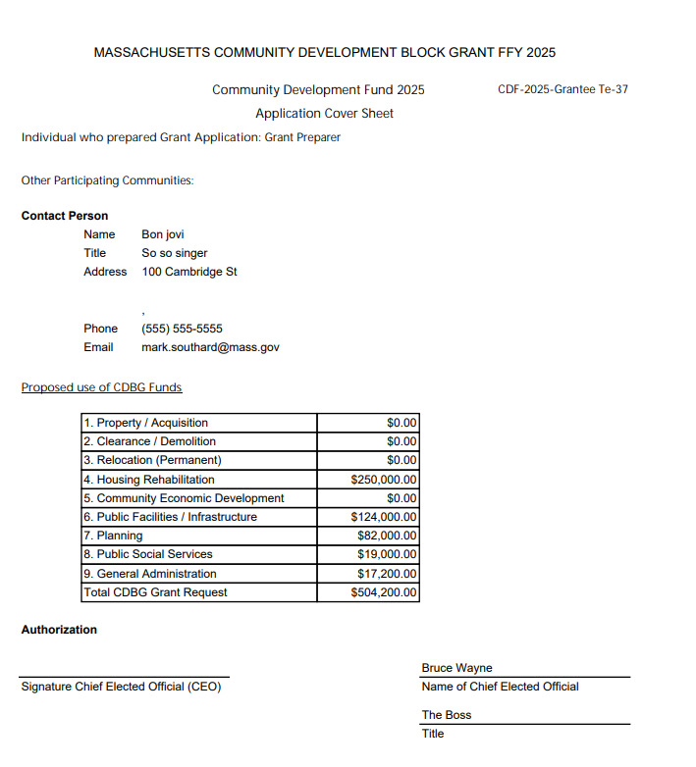

Slide 16
Application Plans and Certifications
The application requires response to several plans and certifications
Failure to address these could derail your application or result in a special condition attached to the grant which could delay implementation

Slide 17
Application Plans – Refer to Application Guidance for Instructions
1. Anti-Displacement and Relocation Plan – required for all
3. Grant Management Plan
4. Program Income Plan
5. Anti-Speculation and Recapture Plan
6. Program Contingency Plan
2. Citizen Participation Plan

Slide 18
Application Certifications/Requirements
CEO Certification
CFO Certification
Displacement of Non-CDBG Funds
Anti-Displacement & Relocation Assistance
Outcome Performance Summary
Public Hearing 15-day notice/held 2 weeks before

Slide 19
Application Requirement – ADA Self Evaluation Survey & Transition Plan
Communities that participated in CDBG applications between FFY 2018 and FFY 2024 have complied
Communities that have not complied with this requirement must submit ADA Self-Evaluation and Transition Plan:
- Attach to Other Attachments on Side Bar
OR
- Attach statement that community does not have one, on letterhead.
Questions?
Director
Massachusetts Office on Disability
(617) 979-7317

Slide 20
Eligible Activities
Title I of Housing & Community Development Act of 1974, as amended – See Appendix A
Housing assistance
Public facilities
Architectural/Engineering Design*
Infrastructure
Planning
Public social services
Economic Development – must contact EOHLC
*Risk of repayment if project construction not complete within five (5) years

Slide 21
What’s Not Eligible
24 CFR 570.207
Expressly Prohibited:
Buildings used for the conduct of government
General government expenses
Political activities
Generally Ineligible:
Purchase of equipment; Furnishings and personal property; Operating and maintenance expenses; New housing construction; Income Payments

Slide 22
Activity Thresholds
Is the project eligible?
Does the project meet a national objective?
Consistent with Sustainable Development principles?
Project specific thresholds: Public Facilities (includes parks), Senior Centers, Barrier Removal
Bid-Ready Plans and Specifications
If you cannot demonstrate that you can meet the thresholds, the application or project cannot move forward!

Slide 23
Project Threshold: Senior Centers
Site control under the Board of Selectmen or Mayor
Bid-ready plans and specifications
One set of plans as attachment in application
Letter from Arch/Eng attesting that complete set of specs is prepared and bid-ready
All other financial resources, if necessary, in place at time of application
Elderly persons are presumed by HUD to meet the national objective

Slide 24
Project Thresholds: Architectural Barrier Removal
Must submit a copy of ADA Self-Evaluation Survey and Transition Plan
Programmatic removal of barriers must be explored first
ONLY relevant barrier removal work may be funded
Project/Activity must be referenced in ADA Eval/Transition Plan

Slide 25
Public Facilities Project Thresholds: Bid-ready Plans and Specifications
Bid-Ready plans and specifications required for public facilities (includes parks/playgrounds) and barrier removal projects with construction costs > $200K
Design development drawings required for those projects and playground/park projects with construction costs of > $25K but < $200K
Infrastructure projects – do not require bid ready docs as a threshold, but readiness will be scored

Slide 26
Special Public Facilities Rule for State CDBG Program Recipients
HUD requires recipients of State CDBG Program grants to retain the use for which CDBG funds were expended on behalf of a public facility project for a minimum of five years after the closeout of the grant.
See Application Guidance for more detail

Slide 27
Project Thresholds: Public Social Services
Social service only applications are not allowed
Projects/budget may not exceed 20% of the total grant amount – 20% include delivery and program costs
Must be
new or expanded service
EOHLC encourages PSS that support economic security and self-sufficiency...
No more than 5 public services packets in an application

Slide 28
Housing Rehabilitation Program Status Update if past recipient
One page update on past program performance
Uploaded to Other Attachments
Include budget info, reasons for delays, revised timeline
Justify new request

Slide 29
Project Threshold National Objectives
1. Benefit to low- and moderate- income persons
or
2. Prevention or elimination of slums and blight
or
3. Urgent need
Identify and describe (document) that you can and how you will meet the national objective

Slide 30
Component Selection – Project Packets
Found @ Top of the Application Cover Sheet
5 component selections – (project packets)- Rehabilitation, Construction, PSS, Planning, Design
1 project per packet
Packet contains:
Project description - See Application Guidance
Threshold questions
Competitive (scored) questions ( Except PSS )
Budget and related information

Slide 31
Activity Packet Information
1. Is it eligible? Is it ineligible?
2. Will it meet a national objective?
3. Was the need identified through a public process?
4. Is it feasible? Can it be carried out in a timely manner?
5. Will it have an impact?
6. Will it comply with all other federal and state requirements?

Slide 32
Packet Information
Project Description – Tell us about the project
Budget Information – How will the project be funded; how determined; sources
Project Need Response – Competitively scored
Project Feasibility Response – Competitively scored

Slide 33
Competitive Questions Project Need – 40 points
Define and quantify the need (s) to be addressed. Describe current conditions and the impacted population. Indicate how community input contributed to determining the need (15 pts)
Provide/document relevant and current evidence of the extent of the need/problem – narrative should relate to documentation (10 pts)
Describe how the project will address the need and the impact it will have on the need (5 pts)
LMI Score – to be added by EOHLC – Up to 10 pts

Slide 34
Competitive Questions Project Feasibility - 25 points Ready to proceed?
Status of design and project readiness to proceed (10 pts)
Describe project budgets and project oversight – cost reasonableness and internal controls (up to 8 pts: 4 pts budget, 4 pts staffing)
Describe/document ER/permits (3 pts)
Describe/identify milestones and timeframe (4 pts)

Slide 35
Public Service packets
Public Service packets are evaluated for viability and effective operation.
Do not answer the competitive need and feasibility questions as your response.
Include detailed budgets

Slide 36
PSS Activity Description Project summary – 3-page max
Scope of program
Describe need and how identified
Description of service to be provided
Identify Beneficiaries and outcomes
Project Oversight
Allocation of funds per community
Detailed Budget – breakout staff salaries by quantity, rate, hours

Slide 37
Evaluation: Project Packets 65 points
For Rehabilitation, Construction and Design, each project packet will be evaluated and scored on the following:
Project Need (40)
Project Feasibility (25)
- CDF projects must meet 39 out of 65 points to be considered fundable
- Planning activity packets will be scored using Project Need only and must receive at least half the points but will not be included in the application score
- Public service packets will be evaluated on information contained in the project description and will be treated as pass/fail – See application guidance. Include detailed budgets

Slide 38
Mini-Entitlement Scoring
Scored to ensure feasibility
Must complete Competitive Questions (both Need + Feasibility)
Activity packets must receive a minimum 50% score for the feasibility question
No more than 3 activity packets in addition to PSS
Upload CDS

Slide 39
Build America Buy America (BABA) for FFY2025 CDBG Applicants – continued
Includes rehabilitation of buildings and real property, construction of public facilities and improvements, utilities, water systems, electrical transmission facilities, broadband and transportation infrastructures
Required to apply the Buy America Preference (BAP) for certain products. These include:
iron and steel
and
specific construction materials, including metals, PVC pipe, lumber and drywall, not listed construction materials (all other plastic- and polymer-based products, glass, fiber optic cable, optical fiber, engineered wood, and drywall)
All manufacturing processes for iron and steel, as well as construction material must occur in the U.S.

Slide 40
Build America Buy America (BABA) for FFY2025 CDBG Applicants
Applicants for infrastructure projects must demonstrate consideration of BABA requirements - Upload BABA form
Factor into Cost Estimate, if applicable
Project Budget from all sources more than $250,000
Infrastructure definition: “any activity related to the construction, alteration, maintenance, or repair of infrastructure in the United States”

Slide 41
Build America Buy America (BABA) for FFY2025 CDBG Applicants – continued
Note: this will not likely apply to single family housing rehabilitation programs
BABA Determination Form will be available on EOHLC’s CDBG web page
Form can be prepared by consultant, but requires municipal sign-off

Slide 42
EOHLC Review Process
Two readers per application
Does application meet threshold requirements
Independent scoring of competitive questions
Meet and discuss, come to consensus –disagreements reviewed with team leader
Team Leader reviews for consistency
Packet scores are averaged
Applications ranked by score and funds allocated until gone

Slide 43
Helpful Hints(and reminders)
Read the One Year Plan
One packet per project
Page Limits - 4 pages for scored responses to competitive questions / 2 pages for planning and 3 pages PSS project descriptions – See instructions in the Guidance
Income surveys should not be more than 3 years old
Slum & Blight inventory guidance – don’t create your own criteria
Public Hearing – read instructions!
No changes/additions will be accepted after the application deadline
Barrier Removal - scope limited to barrier removal
Bid-ready plans and specifications for all public facilities and architectural barrier removal projects with construction costs over $200,000

Slide 44
Additional Considerations
Administration – GA 15%; Total 30%
Regional applicants must comply with all requirements as do individual applicants
No single community may receive more than $1.35M in CDF grant funds from FFY 2025 awards
READ THE APPLICATION GUIDANCE!!

Slide 45
Attachments
Attach documents where they belong
Attach documents only where they belong
Attached document names - NO SYMBOLS – Make sure names are consistent
Appendix list if many attachments
Hyper Links – Not recommended
Review attachment requirements in Application Guidance

Slide 46
National Objectives
1. Benefit to low- and moderate- income persons
or
2. Prevention or elimination of slums and blight
or
3. Urgent need
Describe (document) that you can and how you will meet the national objective

Slide 47
Activity/Project Threshold National Objective (LMI)
Statutory requirement that at least 70% of all CDBG Expenditures must benefit LMI persons
If the threshold is not met, HUD can require repayment
EOHLC required to report to HUD annually

Slide 48
Project Threshold National Objective (LMI)
HUD LMI limits –
https://www.huduser.gov/portal/datasets/il.html
Provides income limits
HUD LMI Block Group - NEW
LMISD - All Block Groups, Based on 2016-2020 ACS - HUD Exchange
24 CFR Part 5.609: Definition of Income
eCFR :: 24 CFR 5.609 -- Annual income.

Slide 49
Project Threshold National Objective (LMI)
Low-and-moderate income benefit
Five ways: depends upon the project
1. Area-wide low/moderate income
2. Housing activity
3. Limited clientele
4. Job creation or retention
5. Planning

Slide 50
Project Threshold National Objective (LMI)
Area-wide low/moderate income (LMI)
Service area must be 51% LMI households
Survey no older than 3 years
Copy of blank survey document
Summary survey results
Street by street data
Parcel Map of Service Area including vacant land
If vacant land, describe future use for 5-7 years
Explain methodology for geographic boundaries
Census Data – ACS

Slide 51
Low Mod Area Benefit Service Area
Grantee must determine the service area of the activity and maintain written documentation on file
Maps
If Water project, map with flow direction
Data
Written determination/description
Service area is determined based on the nature of the activity and who the users will be

Slide 52
Low Mod Area Benefit Service Area
In order for a service area to qualify for National Objective purposes it must be primarily residential
And, it must be demonstrated that at least 51% of the residents of the service area are of low-and-moderate income
Two methods: Survey and Census

Slide 53
Low Mod Area Benefit Service Area
Survey must be sound methodologically
See Appendix C HUD’s survey guidance

Slide 54
Low Mod Area Benefit Service Area
Census Data: Block Groups
Must use HUD’s LMI data –
You must consult with EOHLC and get approval prior to submitting application and use from below
We will want: Description of activity; map illustrating the area; block group data.
https://www.mass.gov/doc/lmi-area-wide-block-group-information-documentation-form/download
Submit by 3/7/2025

Slide 55
Use of 2015 ACS LMISD – considered in special circumstances
Notice CPD-24-04: Low- and Moderate-Income Summary Data Updates - HUD Exchange
Transition Policy: On and after 8/1/2024, in circumstances where the 2015 ACS LMISD demonstrate LMA compliance, but the 2020 ACS LMISD for that same geographic area do not demonstrate LMA compliance, a recipient may use the prior 2015 ACS LMISD to demonstrate area-benefit compliance by meeting the following four-part test. This policy is intended to prevent the disqualification of activities that are already underway.
Notes:
It is HUD’s interpretation and guidance to EOHLC that if there had been an action/investment in a project that met national objective based on the 2015 ACS data, that now did not meet under the 2020 ACS data, that MACDBG could fund it based on the 2015 data based on this language in the Notice below.

Slide 56
The Four-Part Test
To qualify an LMA activity using the prior 2015 ACS LMISD, on and after 8/1/2024 the activity must meet all four of the following criteria.
A documented action must have been made by the grantee before the effective date, 8/1/2024.
the documented action must describe a specific activity,
(3) the documented action must describe a specific funding amount for the specific activity, and
(4) the specific activity must have a clearly defined LMI service area

Slide 57
Project Threshold National Objective (LMI)
2. Housing activity
Providing or improving permanent residential structures which will be occupied by LMI households when completed
Demonstrate that 51% of the units in a structure are LMI households
One unit structure must be occupied by LMI household
One unit of a 2-unit structure must be occupied by LMI household
All other housing structures must have at lease 51% of the units occupied by LMI households
Income must be documented and kept on file for all LMI units

Slide 58
Low Mod Housing Benefit (LMH) Documentation
Must have a standard income verification procedure that uses acceptable forms of source documents/third party verification
Determine income: Part 5 Annual Income
EOHLC recommends third party verification of gross income; 6-to-8-week period; extended to 12 months
Source is typically pay stubs; limited situations certified IRS AGI
Consider seasonal employment and no income claims
Compare to current income limits

Slide 59
Project Threshold National Objective (LMC)
3. Limited clientele (LMC)
Activities that benefit specific groups of persons rather than everyone in an area
Four options:
Groups generally presumed to be principally LMI*: elderly(62+), battered spouses, severely disabled adults, persons with AIDS, abused children, homeless persons, illiterate adults, migrant farm workers (presumed beneficiaries)
Groups of persons already documented as low- and moderate-income
Groups whose composition is such that it can be concluded that a majority of their clientele will be LMI persons
Groups that can be documented to be predominantly LMI (at least 51%)
*Unless there is evidence to the contrary

Slide 60
Low Mod Income Limited Clientele (LMC)
Documentation:
Self-Certification may be used for most activities, except for activities that are providing a subsidy. Clientele certify to family size and income.
Be sure form is current and updated with income limits
If self-certification is not used, file must contain information or description to justify that program is used by presumed beneficiary or predominately LM persons

Slide 61
Project Threshold National Objective (LMI)
4. Job creation or retention
Not applicable to activities currently supported by Massachusetts CDBG Program

Slide 62
Project Threshold National Objective (LMI)
5. Planning
To satisfy the National Objective, demonstrate that the planning project, if implemented, will meet a LMI National Objective
Examples:
- Affordable housing study
- Study of unmet needs for LMI persons in an area that is 51% or more
- Study in a S&B area regarding contributing conditions
- Spot blight study designed to eliminate hazards

Slide 63
Project Threshold National Objective (S&B)
Slums & Blight - Area-wide or Spot
Area-wide basis - application
Submitted no later than 30 days prior to application due date
Once approved by EOHLC, an inventory/ target area is valid for 10 years
Spot blight - only health & safety issues can be addressed

Slide 64
To demonstrate area-wide slums and blight a community needs:
A declaration and description of area or site by local official; Consistent with Chapters 121 A and B
At least 25% of properties experience one or more of the following conditions: See application guidance
Physical deterioration of buildings or improvements
Abandonment of properties
Chronic high occupancy turnover or vacancy rates in industrial/commercial
Significant declines in property values or abnormally low values relative to others
Known or suspected environmental contamination
Map delineating target area/Written description
Current parcel inventory of buildings/properties and infrastructure
Appendix J - summary table
Appendix K - EOHLC’s property and infrastructure rating sheets – Do not modify
Any proposed project must address conditions that contribute to the deterioration of the area

Slide 65
Slums & Blight – Spot basis
Address specific conditions of blight, physical decay or environmental contamination that threaten public health and welfare
Acquisition*, clearance, historic preservation, remediation, building rehabilitation
Provide description of site – Why is the building or property deteriorated?
Must indicate/document serious health and safety concerns – Why is it a serious concern? Provide evidence to support
Limitations on what can be done under this NO, health and safety hazards.
*Must be a precursor to another eligible activity that addresses S&B

Slide 66
Project Threshold National Objective - Critical Need
AKA - Urgent Need
Catastrophe, natural disaster – Conditions that pose a serious and immediate threat to the health/welfare of the community
Situation not known prior to 18 months preceding EOHLC approval
Community cannot finance on its own and No other financial resources exist
EOHLC approval necessary before application is submitted
Provide:
Description of the nature and seriousness of condition – include timing of development of condition and photographs
Certification by local government of serious and immediate threat and evidence showing unavailability of other financial resources

Slide 67
Application (RFP) Training
CDF and ME
application types

Slide 68
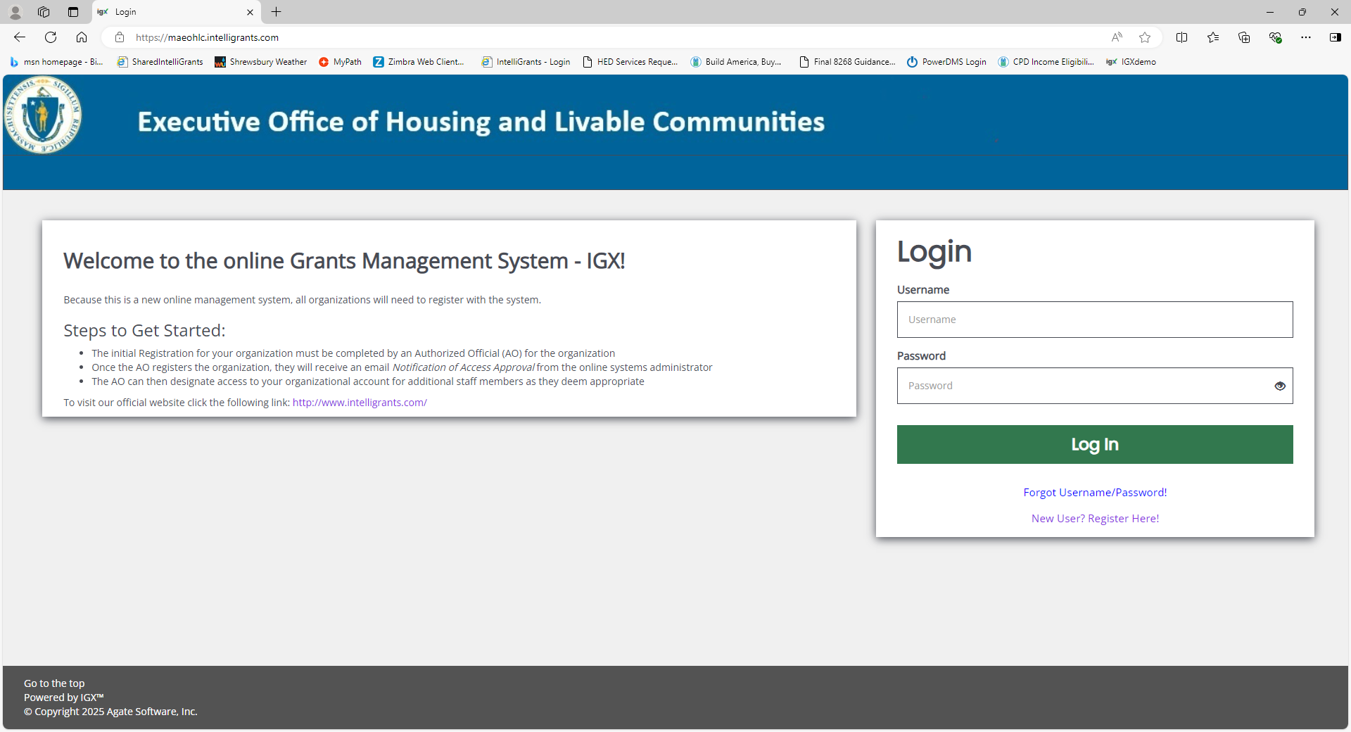
Login Page
Login with your Username and Password.

Slide 69
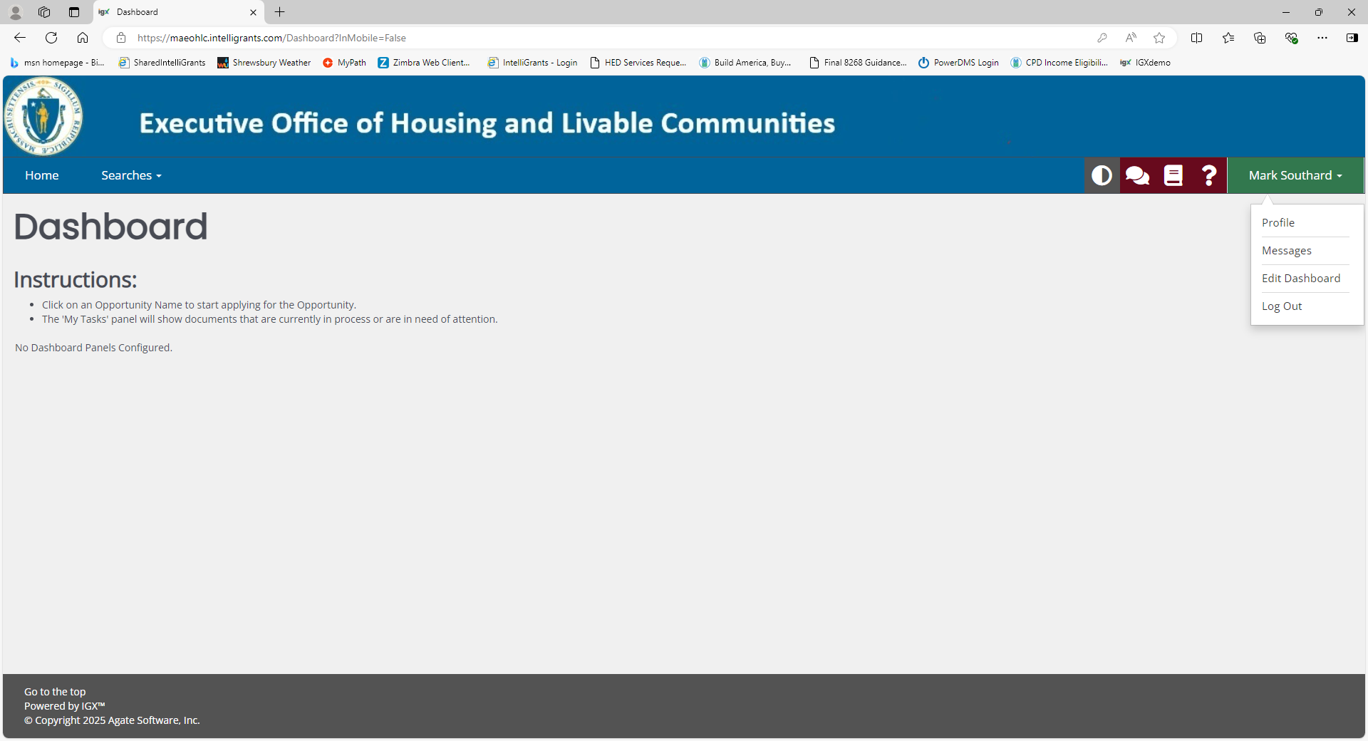
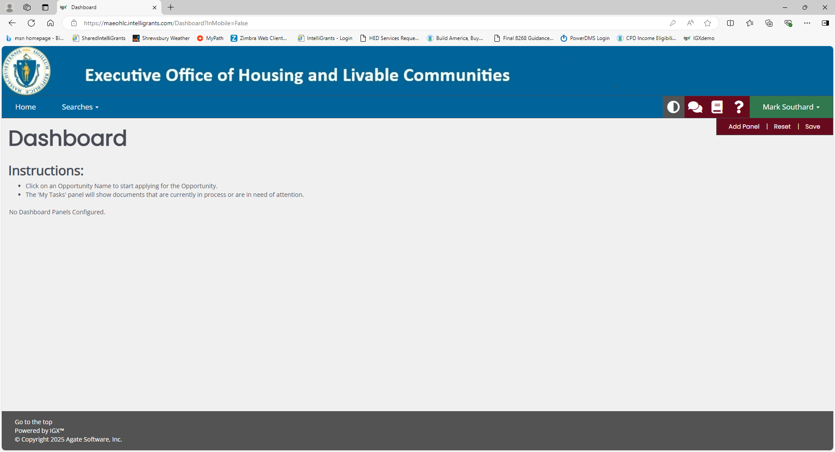
Home Page
Click Edit Dashboard
Click Add Panel

Slide 70
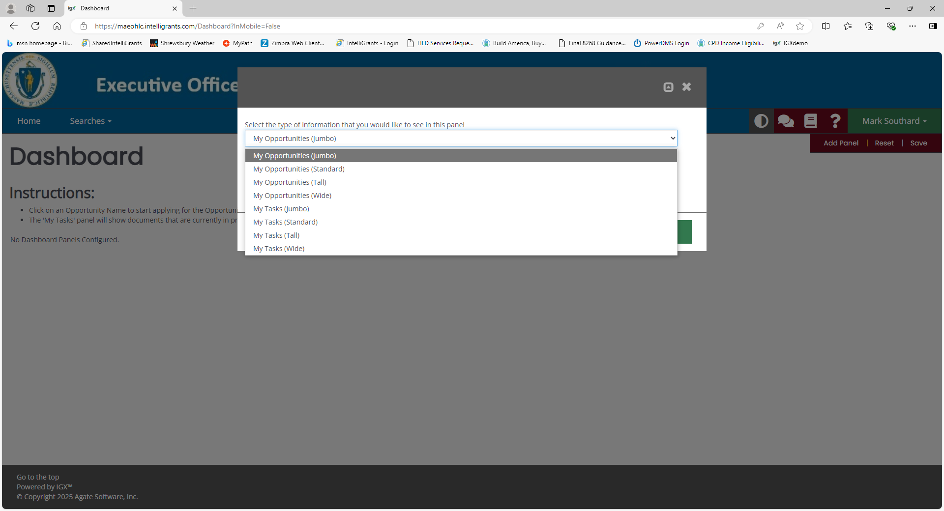
Select My Opportunities, Standard is recommended. Click on the green save button.
Click Add Panel again and select My Tasks. Click on the green save button.
Click the Save button under your name and your Home Page is now set up.

Slide 71
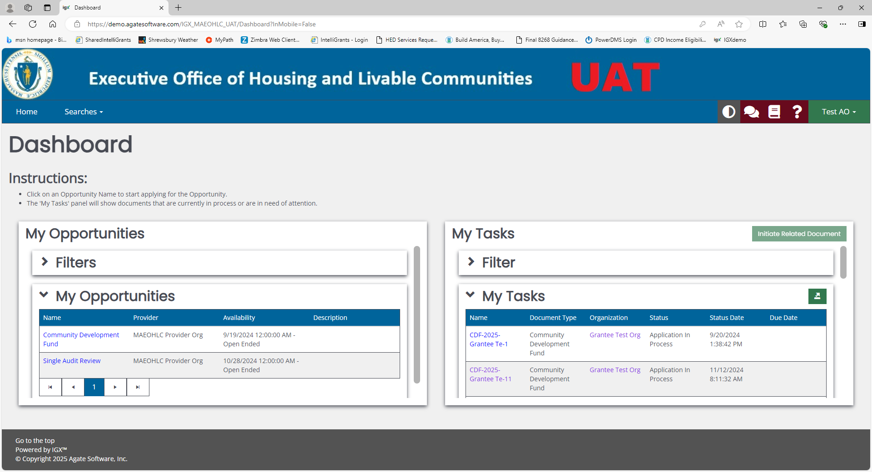
My Opportunities and My Tasks
To apply for an item go to My Opportunities and click on the desired item.
This page will give you a list of all potential applications available.
Follow the Agreement process to create the application.
Once the application has been created the status will be Application in Process and can be found in the My Task box until submitted.

Slide 72
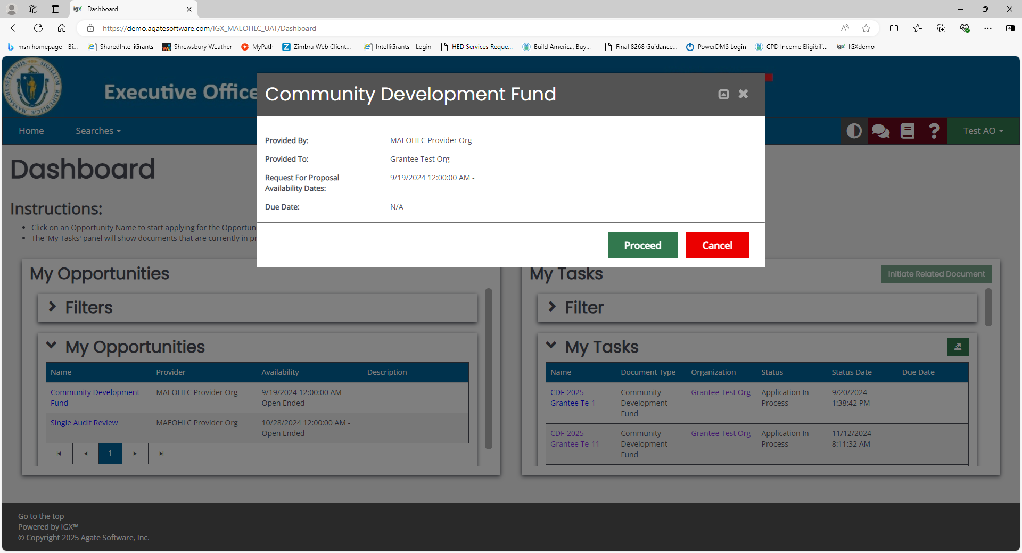
Agreement Process
Click on the green Proceed button.
Clicking Proceed will create the application and load the application Home Page.

Slide 73
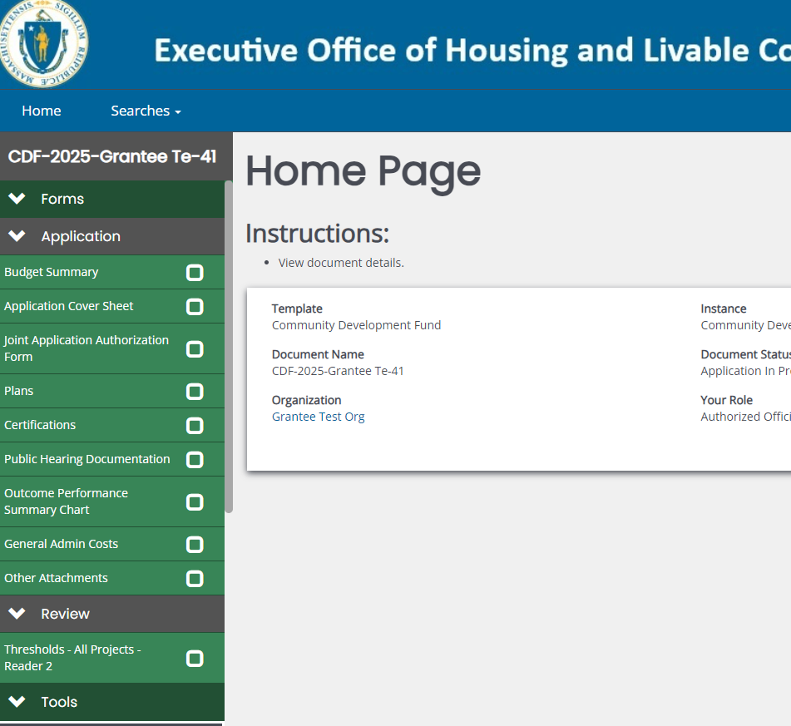
Request for Proposal Menu
1. The application will be built using the Side Bar in green on the left side of the page.
2. Click on an item in white and it will load where the Home Page is. The Side Bar will always be available.
3. You will choose application packets by clicking on the Application Cover Sheet link. Once a packet is created, it will be displayed on the Side Bar.
4. Tools, Status Options, and other Related Items can be found by scrolling down the Side Bar.

Slide 74
Component Selection Click on a component and then save the application cover sheet. The packet will load on the side bar. Click on a packet to complete it.

Slide 75
Document Validation - or are there any errors
Are you ready to submit the application? Click on Document Validation under Tools on the Side Bar.
This will bring up a box that identifies any form or page that has missing information that is required or is incomplete.
Click on the blue form name and it will take you to the page so that you can make the correction(s).
If you forget to check, the system will do the error check when you try to submit.

Slide 76
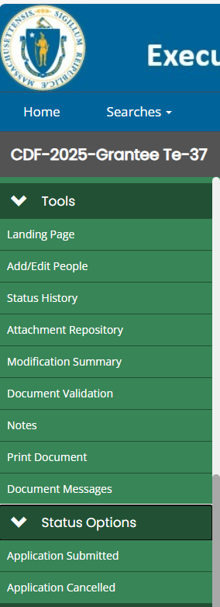
Change the Status
To change the status of the document, select Status Options at the bottom of the Side Bar. Click on Application Submitted.

Slide 77
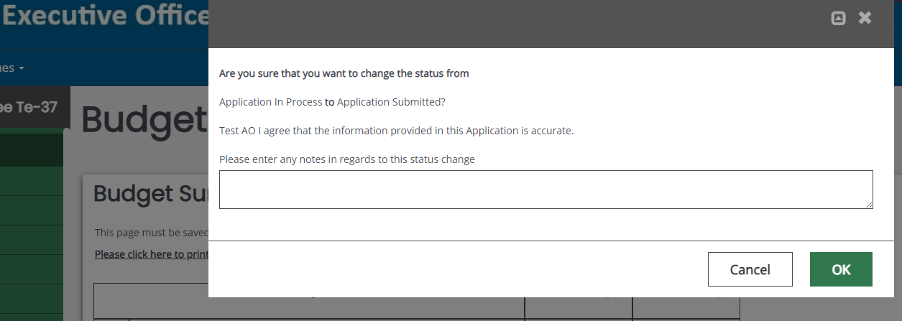
Agreement Page
You will be taken to an Agreement page and asked to verify that you would like to submit the application. Leave a note if you would like. When you are satisfied click on the “OK” button.

Slide 78
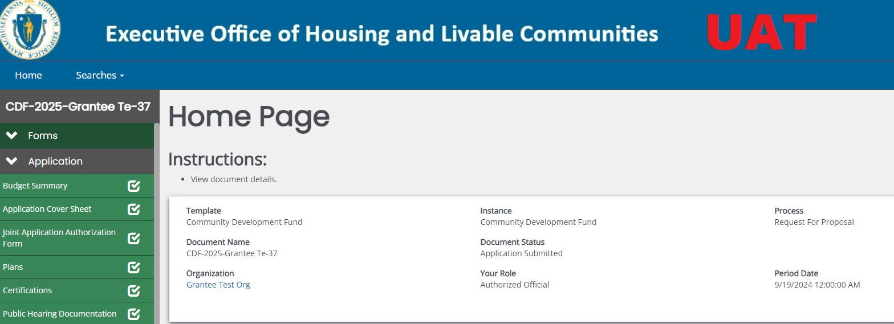
Post Submission
The document’s status will be changed to “Application Submitted”.

Slide 79
Post Submission
It’s Gone!
Please note: That after submitting the document you no longer have the ability to edit or delete pages within.
(The save button will be removed.)

Slide 80
Questions???

Slide 81
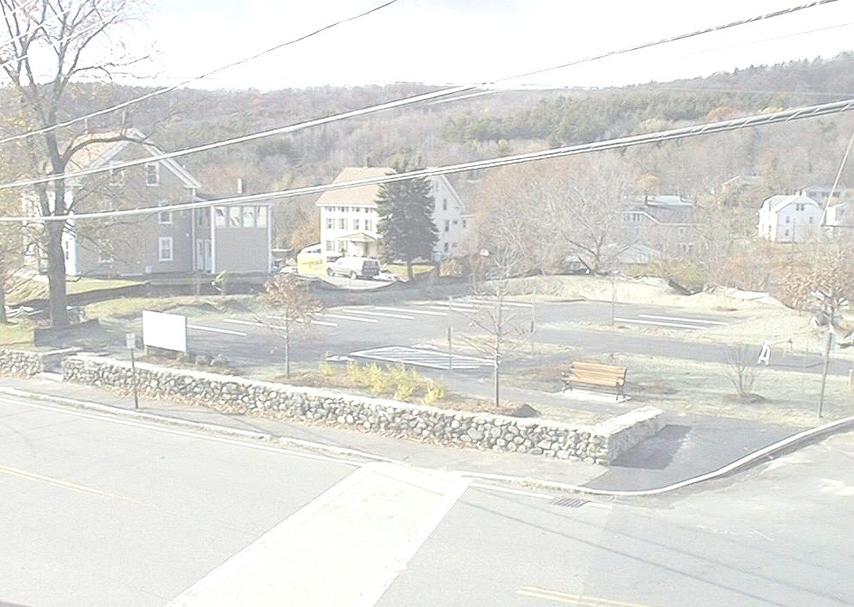
EOHLC
100 Cambridge Street, Suite 300
Boston, MA 02114
Phone: 617.573.1400
www.mass.gov/eohlc/

