Slide 1
Mass Internet Connect
(MIC)
https://www.mass.gov/masshire-career-centers
December 29, 2020

Slide 2
Updates to Training
Program Launch
Customer Self-Attestation
SPOCs, Internet Essentials Code, SharePoint
Question and Answer document
SharePoint: Access to all MIC documents

Slide 3
Mass Internet Connect Launch
Launch date and public announcement TBD
Pre-launch:
Career Centers identify customers who may be eligible for this program
Soft launch
Target soft launch date is December 30th.
Soft launch date is when customers can be contacted and enrolled in the program prior to a public announcement.
Notes:
Must be unemployed AND looking for work
Must be unemployed, in a training program AND looking for work

Slide 4
Mass Internet Connect
Mass Internet Connect (MIC) is a Partnership comprised of Massachusetts Technology Collaborative (MassTech), MassHire Department of Career Services (MDCS) and the MassHire Workforce Development System working together to connect job seekers with the tools, services and internet connections necessary to “get people back to work”.
Notes:
MUST BE UNEMPLOYED AND LOOKING FOR WORK
Partner customers are welcome to work with the career center as long as they meet the criteria.

Slide 5
Economic Recovery Plan
GOAL
“Support internet connectivity across the Commonwealth to facilitate remote work and learning by:
extending and expanding Massachusetts Broadband Institute’s (MBI’s) current hotspot program providing service to disconnected areas of Western MA;
creating a cellular hotspot program; and,
providing subsidized internet access or internet accessible devices to target populations.” -
Subsidized internet access will be available through June 30, 2021

Slide 6
Implementation Overview
LAST MILE TOWN WiFi HOTSPOTS: Extending and expanding Massachusetts Broadband Institute (MBI) current hotspot program
Approximately 24 towns eligible
GATEWAY CITY WiFi HOTSPOTS: WiFi hotspot program in areas other than Last Mile communities
Gateway Cities
Outer Cape Cod
INTERNET and/or DEVICE SUBSIDY: Subsidized CABLE internet access and/or internet accessible devices to target populations
NOTE: Partnering with Comcast and Spectrum covers almost all of the state
CELLULAR HOTSPOT PROGRAM
NOTE: Fallback option if Comcast and Spectrum solutions are not suitable for the eligible individual
Notes:
Gateway Cities are midsize urban centers that anchor regional economies around the state. For generations, these communities were home to industry that offered residents good jobs and a “gateway” to the American Dream.

Slide 7
Identifying Technology Need
Barrier 1: Lacks Internet Connectivity
Solution: Internet subsidy
Comcast, Spectrum, Verizon Wireless (based on location)
Barrier 2: Lacks device
Solution: Chromebook
HiQ
Barrier 3: Digital Literacy
Solution: Skillbase, Career Center programs, or other online resources
Spectrum and Comcast will do their own final verification for eligibility and service availability

Slide 8
Customer Release Form
MassHire Career Centers must obtain release from the customer verbally and record such in MOSES.
EOLWD Legal advised that if we are providing MassTech and carriers only the name, address, email address and phone number of customers who may be eligible for internet access, a subsidy or equipment, the staff person must ask the following to obtain permission from the customer:
“MIC Program: In order for us to get you access to these services, we may need to share some of your personal information (your name, address, email address, and phone number). Is that ok?” Customer Gave Permission MM/DD/YYYY. Or Customer Refused Permission MM/DD/YYYY.
Staff must copy and paste the above language into MOSES Notes and indicate the date that they obtained permission from the customer.

Slide 9
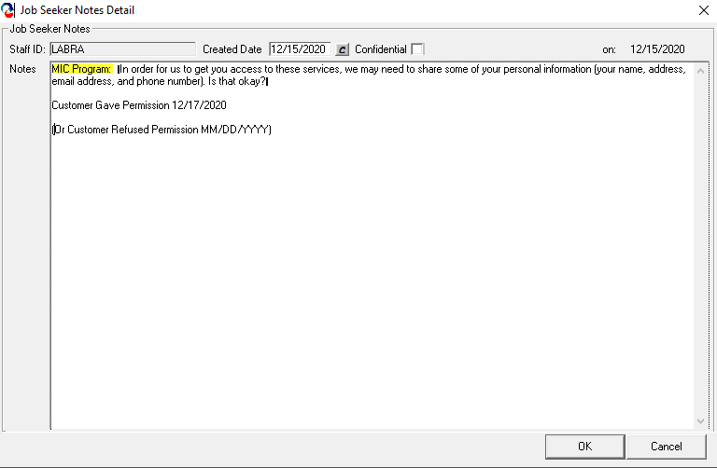
Customer Release MOSES

Slide 10
Customer Self-Attestation - Update
MassHire Career Center customers must self-attest to the following:
They are unemployed AND looking for work OR
They are unemployed, in a training program AND looking for work
If they are going to get a subsidy for Internet service, they must self attest to the following:
They don’t have internet OR
They can’t afford internet OR
Their internet service was canceled
If they are going to get a device from HiQ or Comcast Internet Essentials, they must self attest to the following:
They do not have a device at home that can be used on a regular basis to conduct a job search OR
The only device they have to conduct a job search is a smartphone, tablet, or a child’s computer
By staff determining that the customer is eligible for the program and then entering the referral service into MOSES, self-attestation is confirmed for the customer

Slide 11
Miscellaneous Information
Once enrolled in a program, MassHire customers become customers of the respective carriers, Comcast, Spectrum, Verizon Wireless, and HiQ
Questions regarding equipment, charges or information about the customer’s service should be directed to the respective carrier
Contact information for each carrier is located on the fliers
Remind customers to ask: “what are the all in costs of the monthly service?”
COMCAST: “New customer” may currently have cable or telephone service; but NO internet service as of December 30th
SPECTRUM: “New customer” cannot currently have ANY Spectrum service as of MassHire submittal date
Comcast Internet Essentials Customers and Comcast Subsidy Customers
MUST cancel service prior to June 30, 2021 end date

Slide 12
Barrier 1: Lacks Internet Connectivity Comcast Process – Option 1
Option 1
Client eligible for Internet Essentials
Provide Internet Essentials Code and 800#
Customer should request a refurbished laptop from Comcast, if needed*
Cost to the customer is $150 for a refurbished laptop and they own the laptop
Process ends
If customer is denied, Comcast will contact directly
Federal benefit threshold must be met:
TANF, SNAP, Housing (see other programs below)
New Customers only
Internet Essentials from Comcast. Affordable high-speed Internet. Customers may qualify if they are receiving public assistance programs such as the National School Lunch Program or Head Start, Medicaid, SNAP, TANF, SSI, Low Income Home Energy Assistance Program (LIHEAP), Women, Infants, and Children (WIC) program, Veterans Administration (VA) pension, Tribal assistance
*If customer meets device subsidy requirements and cannot afford or elects not to use the Comcast device voucher, initiate HiQ process.

Slide 13
Comcast Internet Essentials - Updates
The cost of Internet Essentials is $9.95 per month, fully subsidized, customer pays nothing; there is no charge for the modem
“New customer” may have cable service; DOES NOT have internet service as of Dec 30th
When approved, customer receives a voucher from Comcast for a refurbished laptop
Customer must contact Comcast’s vendor partner to redeem the voucher. The cost to the customer for the refurbished laptop is $150. The customer then owns the laptop.
Subsidy goes away June 30, 2021. Customer’s Comcast service will continue and customer must cancel
If they cannot afford $9.95 per month, they must cancel prior to June 30, 2021. Customer should contact Comcast for cancellation requirements
If they choose to keep Internet Essentials Comcast will bill them for service
If customer states that they do not have and cannot afford a device, they must choose between using the Comcast voucher for the $150 refurbished laptop OR a Chromebook from HiQ. Customer cannot get both – they cannot be enrolled in HiQ program unless they say they will not use the voucher for the refurbished laptop from Comcast

Slide 14
Comcast Internet Essentials - SPOCs
Assigning the Internet Essentials Code for the Customer
SPOCs assign the Internet Essentials Code through SharePoint
https://massgov.sharepoint.com/sites/EOL-MDCS/Training%20Material/Forms/AllItems.aspx
Code is matched with job seeker ID# and MassTech pays when code is activated
Internet Essentials Code will be given to the customer and entered into the description box of the support service referral service in MOSES
Important for running reports

Slide 15
Comcast Internet Essentials Code and SharePoint - Update

Slide 16
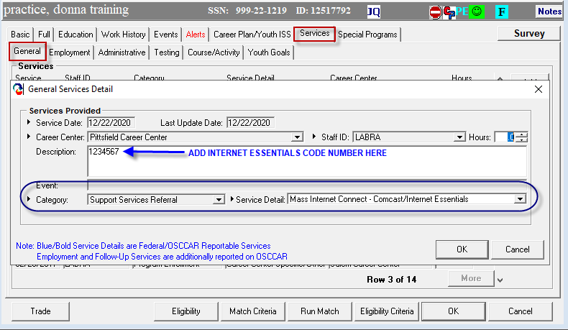
Recording in MOSES: Comcast Internet Essentials – Option 1

Slide 17
Barrier 1: Lacks Internet Connectivity Comcast Process – Option 2
Option 2
If no federal benefit, client may be eligible for subsidy on different Comcast product
New Internet Customers Only
1. MassHire will advise customer to call Comcast
2. Customer must sign up for a Comcast account before MassHire can submit customer for a subsidy
3. Customer will call MassHire back with Comcast account number that MassHire will submit to Comcast through MOSES for discount to appear on customer bill
REMINDER: customer should ask about “all in costs”
4. Process ends
Customers who do not have a federal benefit, and:
Cannot afford full-priced internet
Denied for Internet Essentials
Referred for Option 2
Customers who are denied for a regular account by Comcast OR cannot afford to pay unsubsidized portion of internet service
Referred to Verizon Wireless for a hotspot

Slide 18
Comcast Subsidy Plan
Customer opens account with Comcast and is processed like any other customer
“New customer” may have cable service; DOES NOT have internet service as of Dec 30th
$30 subsidy from MassTech gets discounted from the customer’s bill each month; there is no charge for the modem
Customer is responsible for the balance over the $30
Customer cost will depend on package they choose
Least expensive – internet only package is $55
Ex: $55 month; customer responsible for $25
Subsidy goes away June 30, 2021
Customer’s Comcast service continues and customer must cancel if they cannot afford full cost of service. Customer should contact Comcast for cancellation requirements.
Inform clients to consider selecting a plan that they can afford with the subsidy and signing up for month to month plans unless they are willing to cover the full cost after the subsidy ends.

Slide 19
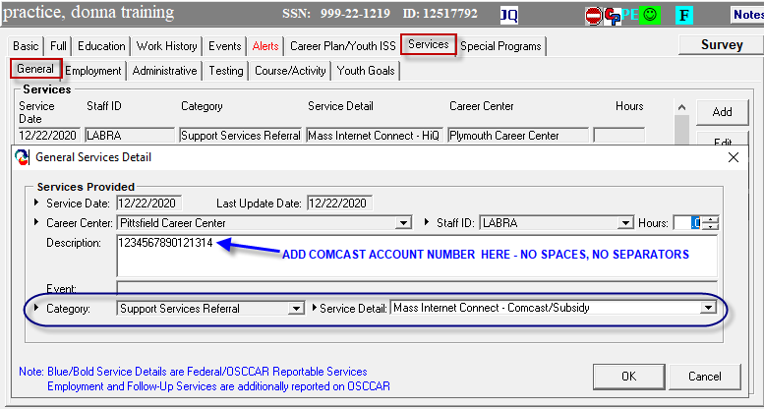
Recording in MOSES Comcast Subsidy – Option 2

Slide 20
Barrier 1: Lacks Internet Connectivity Spectrum Process
Customer information submitted to Spectrum via MOSES
If approved, MassTech pays full cost (no charge for the modem); customer pays nothing
Process ends
New Customers Only
Cannot currently have ANY Spectrum service as of MassHire submittal date
If customer is approved:
Customer does not have to set up an account; master government account
Spectrum notifies customer and sends equipment; no charge for the modem
After program ends on June 30, 2021; service ends and customer returns equipment to Spectrum. Customer must sign up for a new Spectrum account in their name to continue service.
If customer is denied:
MassTech will send the names of those who were denied to Career Centers
Counselor reaches out to the customer and adds customer to MOSES under Verizon eligibility for a hotspot if service is available

Slide 21
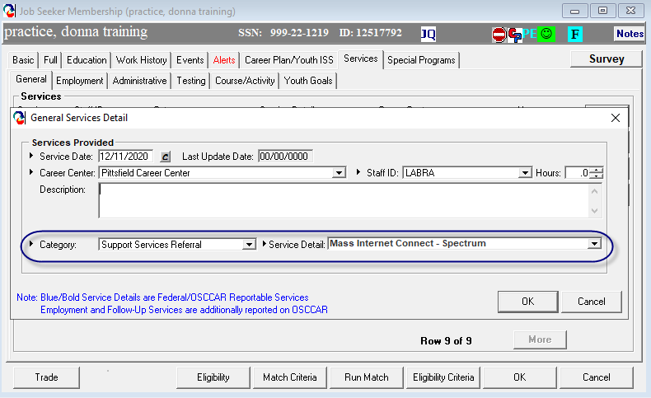
Recording in MOSES Spectrum

Slide 22
Barrier 1: Lacks Internet Connectivity Verizon Wireless
Submit customer information through MOSES to Verizon Wireless for hotspot; jet pack
Process ends
If customer is neither Spectrum nor Comcast eligible or cannot afford regular Comcast service
Customer does not have to set up an account; master government account
Customer gets cellular hotspot / jetpack
A data plan is associated at no charge to customer
After program ends on June 30, 2021; service ends. Customer must sign up for a new Verizon Wireless account in their name to continue service.
No need to return the jetpack at end of program

Slide 23
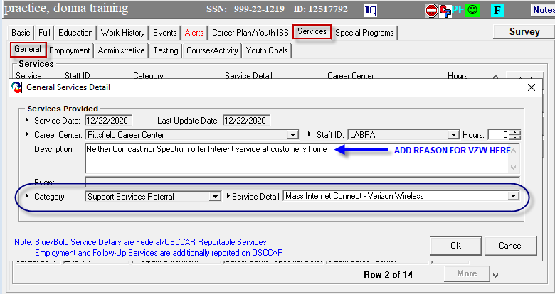
Recording in MOSES Verizon Wireless

Slide 24
Barrier 2: Lacks Device - Update
HiQ - Chromebook
Submit customer information through MOSES to HiQ*
Process ends
HiQ – Chromebook
FAQ gets sent with Chromebook for info on how to use/set-up
Chromebook designed for Google applications but Microsoft Office 365 applications can be used
Due to national shortage, Chromebooks on backlog until mid-end of January
Reminder: Address account timing if customer will be regular Comcast subscriber, paying monthly bill with no device to use
*If customer purchases refurbished laptop under Comcast Internet Essentials, DO NOT refer to HiQ

Slide 25
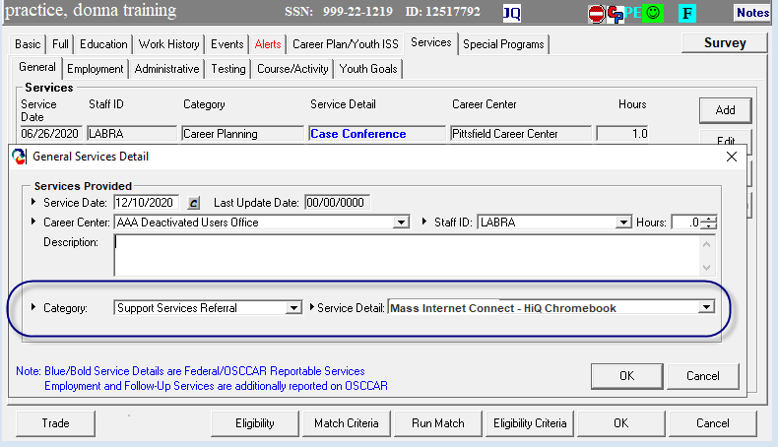
Recording in MOSES HiQ (Chromebook)

Slide 26
Suggested Messaging
No Internet Connectivity:
LISTEN FOR CLUES: I don’t have internet. I can’t afford internet anymore. My internet service was canceled.
Counselor: “Just so I understand, do you have internet access at home today (not including accessing the internet from a Smartphone or tablet)?”
Lacks a Device:
LISTEN FOR CLUES: I don’t have a computer. I can’t do job applications just using my phone. I have to use my kid’s computer.
Counselor: “Just so I understand, do you have a computer (desktop, laptop or Chromebook), that you can use at home on a regular basis? This device should not be a smartphone, tablet or a child’s device that is used for schoolwork.”

Slide 27
Barrier 3: Digital Literacy
Career Center Resources
Online Resources
Skillbase Website, Tech Goes Home
Process Ends
Refer to Resources
Do you need help with any of the following:
accessing the internet,
setting up and using a computer or application,
setting up an email account,
using word processing software to create a resume and cover letter, or
performing specific online tasks, such as searching and applying for a job.”

Slide 28
Recording in MOSES Digital Literacy

Slide 29
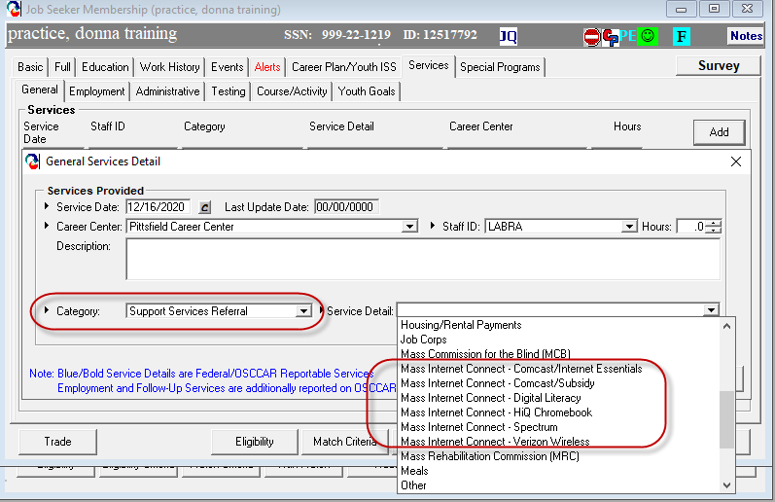
MIC Support Service Referrals

Slide 30
MOSES DATA ENTRY
Some MOSES rules:
Do not backdate the support service referrals service
Do not enter the Comcast Subsidy service until you have the account number
Do not include any spaces or separators of any kind in the Comcast Subsidy account number
Do not use PO Boxes for the Shipping (Mailing) Address

Slide 31
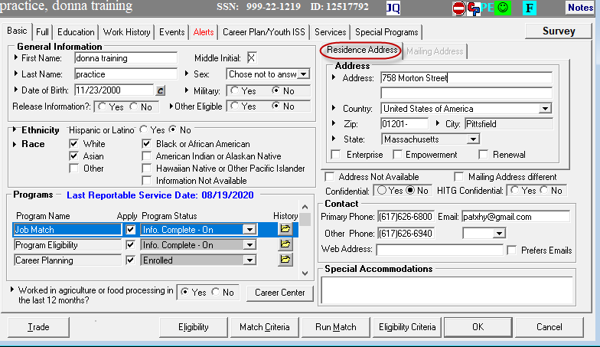
MOSES DATA ENTRY
Residence (or Service) Address:
This is the address where the customer resides and from where they will access the Internet

Slide 32
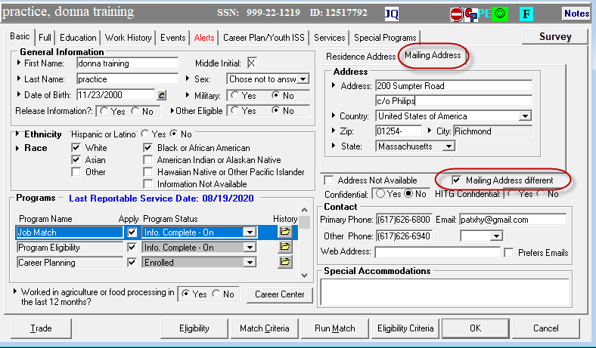
MOSES DATA ENTRY
Mailing (or Shipping) Address:
This is the address where the customer will receive any devices shipped.

Slide 33
CCS Slide – Mass Internet Connect
Please add one slide or an announcement concerning the opportunity of the Mass Internet Connect (MIC) Program to your CCS. Suggested language is below.
Mass Internet Connect is a program for Massachusetts residents that provides subsidized internet access and/or an internet accessible device to eligible unemployed participants, and may assist in connecting job seekers with the tools, services and internet connections necessary to “get back to work”.
Please contact [XXXXXXX] to see if you are eligible for this program. You must be unemployed and working with a MassHire Career Center to search for work. The program ends on June 30, 2021.

Slide 34
Questions & Wrap Up

