Slide 1
Northeast
Regional Planning
Session II
Monday, July 24, 2017

Slide 2
Objectives
Introduction
Confirm regional criteria to select high priority industries and occupations
Confirm regional high priority industries and occupations
Confirm top demographic, labor pool, and talent pipeline considerations impacting workforce skills gaps
Notes:
Bob

Slide 3
Agenda
Introduction
Regional Planning Context
Regional planning timeline
Blueprint structure
Regional Demographic Context
State and Regional Demographics on the Workforce
Framing the Data Process to Identify Priority Industries/Occupations
Region’s Preliminary Criteria
Confirming Industry Priorities
Review Occupational Gap Priorities
Data Tool
Notes:
Bob

Slide 4
I. Regional Planning Context
Notes:
Bob

Slide 5
Why is this important?
Regional Planning Context
Workforce Skills Cabinet
Integrated Planning and Program Alignment
State
Labor Market Blueprints inform State-level planning and program alignment
Local Programs and Partnerships
Pioneer Valley Labor Market Blueprint
Central Mass Labor Market Blueprint
Northeast Labor Market Blueprint
Greater Boston Labor Market Blueprint
Southeast Labor Market Blueprint
Cape Cod and Islands Labor Market Blueprint
Berkshire Labor Market Blueprint
Regional
Local organizations collaborate to create Labor Market Blueprints
Local
Notes:
Bob

Slide 6
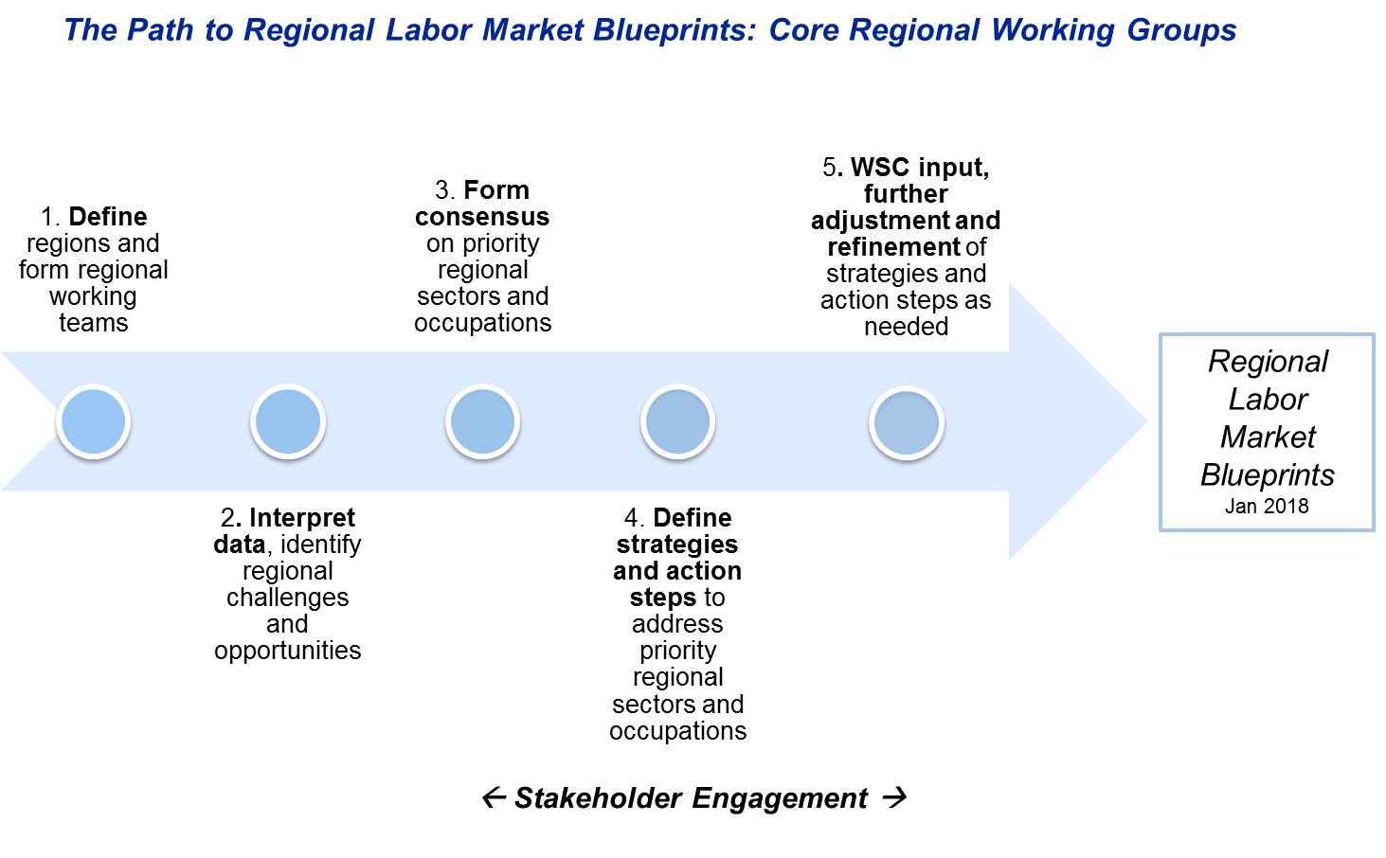
Regional Planning Timeline
Regional Planning Context
Completed
In Progress
November
Aug - Oct
In Progress
Notes:
Bob

Slide 7
Blueprint Review – Identify Strategies for Skill Gaps
Regional Planning Context
Introduction | Describe the process of creating a regional plan.
Where are we now? | Describe the current state of your region, including an analysis of industries, occupations, demographic shifts, and gaps between employer demand and employee supply. Industry Demand Analysis Occupational Demand Analysis Regional Context: Demographic and Industry Trends Workforce Supply
Where do we want to go? | Describe the collectively developed criteria, industry and occupational priorities, vision, mission, and goals for your region. Criteria for Priority Industries and Occupations High Priority Industries High Priority Occupations Assets Vision, Mission, Goals
How do we get there? | Describe the strategies you will jointly employ to align the work of multiple systems around your shared vision, mission, and goals. Shared Strategies Mutually Reinforcing Activities
← Session I
← Session II
← Sessions I-II
← Sessions III-IV
← Sessions III-IV
Notes:
Bob

Slide 8
Framing the conversation: What is a skills gap?
Regional Planning Context
Changes in demand (jobs) or supply (people) can impact the skills gap.
Available number of jobs
Available number of workers
Available number of jobs requiring educational preparation
Available number of workers with educational attainment
Available number of jobs for specific priority occupations, supporting priority industry sectors
Available number of workers with aligned occupational competencies and educational attainment
Notes:
Bob
Worker Gap
Education Gap
Skills Gap
- With that in mind, let’s look at where you left off last time. You were able to narrow down the things that are important to you as a region, and some preliminary industries. Now, we want to make sure that you incorporate this definition of skills gap and information about workforce challenges in your region as you make final determinations.

Slide 9
I. Regional Demographic Context

Slide 10
Projected State Population Growth by Age, 2010-2035
Demographic Deep Dive
The share of older residents is increasing, while the share and number of the working age population is declining.
Census 2010
Population: 6,547,629
Projected 2035 Population: 7,319,469
Census 2010 Working Age
Population: 3,666,672
Projected 2035 Working Age Population: 3,659,734
UMass Donahue Institute, Long-term Population Projections for Massachusetts Regions and Municipalities, March 2015
Notes:
Marina
The total population is projected to increase slightly over time
However, when looking at age brackets, we see that the population is aging
We also see that the number of working age people is decreasing both as a share of the population and in raw numbers
…So I am never getting my social security

Slide 11
Projected Regional Population Growth by Age, 2010-2035
Demographic Deep Dive
In the Northeast, the impact of the age wave is projected to be greater than the state average.
Census 2010
Population: 1,031,733
Projected 2035 Population: 1,118,267
Census 2010 Working Age
Population: 562,684
Projected 2035 Working Age Population: 528,102
UMass Donahue Institute, Long-term Population Projections for Massachusetts Regions and Municipalities, March 2015
Notes:
Marina
The total population is projected to increase slightly over time
However, when looking at age brackets, we see that the population is aging
We also see that the number of working age people is decreasing both as a share of the population and in raw numbers
…So I am never getting my social security

Slide 12
State Trends, Race/Ethnicity and Place of Origin
Demographic Deep Dive
Massachusetts population growth is driven by immigration and growth in diverse populations.
Massachusetts | 2000 | 2012-2014 | Share of Total Population 2012-2014 | Absolute Change | Percent Change | Average Annual Growth Rate
Total Population* | 6,131,752 | 6,447,295 | 100% | 315,543 | 5.1% | 0.4%
Nativity
Native Born | 5,279,860 | 5,326,213 | 83% | 46,353 | 0.9% | 0.1%
Foreign Born** | 851,892 | 1,121,082 | 17% | 269,190 | 31.6% | 2.1%
Race/Ethnicity
White, non-Hispanic | 5,026,398 | 4,817,401 | 75% | -208,997 | -4.2% | -0.3%
Black, non-Hispanic | 300,758 | 407,723 | 6% | 106,965 | 35.6% | 2.4%
Asian, non-Hispanic | 224,242 | 375,130 | 6% | 150,888 | 67.3% | 4.0%
Hispanic | 412,496 | 678,193 | 11% | 265,697 | 64.4% | 3.9%
Other race, non-Hispanic | 167,858 | 168,848 | 3% | 990 | 0.6% | 0.0%
*Civilian non-institutional population
**Foreign born is defined here as those born outside of the 50 states and the District of Columbia, who was not born to American parents abroad, and people born in Puerto Rico and other U.S. territories.
Source: Commonwealth Corporation via 2000 Census, 2012-2014 American Community Survey, PUMS.
Notes:
Marina
Massachusetts population is growing (more slowly than the nation, not shown here), and still relies primarily on immigration for this growth. The Umass Donahue Institute Population Estimates Program recently reported that while immigration still drives our population growth, some net natural increase (births vs. deaths) has also occurred. The race/ethnic mix of our population is also increasingly diverse.
In the future, we’ll plan to base off of 2010 Census or 2008-2010 ACS data here (can’t use previous analysis data due to inconsistencies). The length of the period may overstate the pace of change, and so adding more data points could help us understand more. The Umass Donahue Institute Population Estimates Program recently reported that while immigration still drives our population growth, some net natural increase (births vs. deaths) has also occurred. They report our population is growing more than twice as rapidly as it did on average from 2000 to 2010 (though that doesn’t say a lot, given how slow that was, too). Since 2010, our population has grown by an average of 46,792 persons, or 0.7%, per year.
More: http://www.massbenchmarks.org/statedata/data/UMDI_State_Pop_2015.pdf
And by county: http://pep.donahue-institute.org/countypop2015/MA_CountyPop2015.pdf

Slide 13
Regional Trends, Race/Ethnicity
Demographic Deep Dive
The total population in the Northeast has increased slightly over the past ten years, and the strongest growth has been among minority populations.
Total Population Estimate: 1,049,766
2011-2015 Average
Race
Ethnicity
Source: American Community Survey, Selected Characteristics of the Total and Native Populations of the United States, 5 Year Averages 2011-2015
Notes:
Marina
- Regionally, Pioneer Valley is still heavily white, but we see relatively significant changes in minority populations that mirror those of the state

Slide 14
Regional Trends, Place of Origin
Demographic Deep Dive
About 2/3 of the Northeast was born locally. The share of foreign-born residents has increased by 8%, while out of state migrants have not increased.
Source: American Community Survey, Selected Characteristics of the Total and Native Populations of the United States, 5 Year Averages 2011-2015
Notes:
Marina

Slide 15
Regional Trends, Education
Demographic Deep Dive
Although much of the Northeast is highly educated, a significant portion of residents require language or basic skill remediation.
Total Population Estimate, 25+: 756,507
Total Population Estimate, 18+: 860,885
Source: American Community Survey 5 Year Averages 2011-2015
Notes:
Marina

Slide 16
Regional Commuter Patterns
Demographic Deep Dive
Northeast employers face a net loss of 77,120 employees who leave the region for work.
161,738
Employed in Region but Living Outside
237,933
Living and Employed in Northeast
238,858
Living in Region but Employed Outside
U.S. Census Bureau, OnTheMap Application and LEHD Origin-Destination Employment Statistics (Beginning of Quarter Employment, 2nd Quarter of 2002-2014).
Notes:
Marina
- Pioneer Valley sends more people out of the region to work than attracts people to the region to work

Slide 17
Regional Commuter Patterns
Demographic Deep Dive
The majority of employees commuting outside of the Northeast region work in Massachusetts, specifically in Metro North, Boston, and Metro SW. A small percentage of workers commute to New Hampshire.
Jobs Counts by WIAs - Where Workers are Employed
North Shore WIA | 21.9%
Lower Merrimack Valley WIA | 16.2%
Metro North WIA | 15.8%
Greater Lowell WIA | 11.8%
Boston WIA | 11.5%
Metro South/West WIA | 9.4%
South Shore WIA | 1.6%
Central MA WIA | 1.6%
Salem One-Stop Service Area | 1.4%
Nashua One-Stop Service Area | 1.3%
All Other Locations | 7.6%
U.S. Census Bureau, OnTheMap Application and LEHD Origin-Destination Employment Statistics (Beginning of Quarter Employment, 2nd Quarter 2014).
Notes:
Marina
- Pioneer Valley sends more people out of the region to work than attracts people to the region to work

Slide 18
Takeaways
Demographic Deep Dive
As our State’s population ages, the share of working-age and young people is declining.
The total population in the Northeast has increased slightly over the past ten years, and the strongest growth has been among minority populations.
The Northeast Region loses more workers to outside of the region than the amount of employees that it gains.
Notes:
Marina

Slide 19
II. Framing the Data Process to Identify Priority Industries/Occupations

Slide 20
Preliminary Criteria
Confirming Industry Priorities
Supply gap
Alignment between labor force and employer demand
High demand, high wage Occupations (4 and 5 Stars)
Current demand
Occupations for the workforce of today
Projected demand
Wages (mix of wages)
Supportive employers
Meets regional needs: K-12, ABE, incumbent workers, immigration, different levels of education
Career pathways
Career pathways
Support industry resilience
Emerging industries
Migratory industries
Supporting a stable, recession-proof economy
Aligned with economic development strategies
Accessible to transportation
Notes:
Marina
- Something that we saw across 7 regions

Slide 21
Preliminary Priorities
Confirming Industry Priorities
Industries
Construction
Education Services
Healthcare and Social Services
Manufacturing
Professional and Technical Services (IT)
Transportation and Warehousing
Occupations
1st Line Supervisors
IT & Tech
Engineering
Notes:
Marina
- Biotech captured in two categories: research (P and T) and production (MFD)

Slide 22
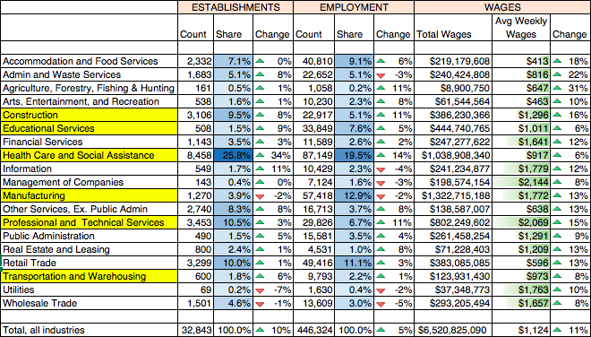
Regional Industry Priorities– Establishments, Employment, Wages
Confirming Industry Priorities
Source: Department of Unemployment Assistance/Bureau of Labor Statistics Quarterly Census of Employment and Wages, Q3 2013 - 2016
Notes:
Marina

Slide 23
Priority Regional Industries by Age
Confirming Industry Priorities
Industry Overview: Age
Manufacturing has the oldest workforce, with 34% over the age of 55. Construction and Healthcare have the youngest workforces, with 33% and 32% under the age of 34, respectively.
Source: US Census Longitudinal Employer-Household Dynamics: Quarterly Workforce Indicators Q2 2016
Notes:
Bob
- Because of the age wave, the bottom blocks are going to be smaller

Slide 24
Priority Regional Industries by Race
Confirming Industry Priorities
Industry Overview: Race and Ethnicity
Manufacturing and Healthcare have the most racially diverse workforces, with nearly one in five workers identifying as non-white.
Source: US Census Longitudinal Employer-Household Dynamics: Quarterly Workforce Indicators Q2 2016
Notes:
Bob

Slide 25
Priority Regional Industries by Ethnicity
Confirming Industry Priorities
Industry Overview: Race and Ethnicity
Healthcare is the most ethnically diverse industry, with 18% Hispanic employees.
Source: US Census Longitudinal Employer-Household Dynamics: Quarterly Workforce Indicators Q2 2016
Notes:
Bob
- In priority industries % hispanic workers exceeds that of population

Slide 26
Priority Regional Industries by Educational Attainment
Confirming Industry Priorities
Industry Overview: Race and Ethnicity
In every identified industry, Bachelor’s degree holders make up less than 50% of the workforce. Professional/ scientific/ technical services has the highest percentage of Bachelor’s degree holders, at 47%, while Construction and Transportation offer the most opportunities for those with a high school diploma or below.
Source: US Census Longitudinal Employer-Household Dynamics: Quarterly Workforce Indicators Q2 2016
Notes:
Bob

Slide 27
Takeaways
Confirming Industry Priorities
Among key industries, Manufacturing is likely to be under the most demographic pressure as the Northeast workforce ages.
Manufacturing and Healthcare have the most racially diverse workforces, with nearly one in five workers identifying as non-white. Professional, Scientific, and Technical services has the lowest representation of Hispanics and Latinos, while healthcare has the highest representation.
In every identified industry, Bachelor’s degree holders make up less than 50% of the workforce. Professional/ scientific/ technical services has the highest percentage of Bachelor’s degree holders, at 47%, while Construction and Transportation offer the most opportunities for those with a high school diploma or below.
Notes:
Bob

Slide 28
Discussion
Confirming Industry Priorities
Does this information support your priority industry selections so far? What other questions do you have?
Notes:
Bob and Marina

Slide 29
III. Confirming Supply Gaps and Occupational Priorities

Slide 30
How do we calculate a supply gap ratio?
Supply Gap Analysis
Supply Gap Ratio = Projected Qualified Individuals Per Opening
Supply Gap Ratio is a proxy measure for understanding what occupations are likely to not have enough talent to meet employer demand.
Supply / Demand = Supply Gap Ratio
100 qualified individuals / 50 potential openings = supply gap ratio of 2
2 qualified individuals per opening (More supply than demand)
6 qualified individuals / 12 potential openings = supply gap ratio of 0.5
0.5 qualified individuals per opening (Less supply than demand)
Notes:
Marina

Slide 31
How do we calculate demand and supply?
Supply Gap Analysis
Demand
How many potential job openings do we expect for a given occupation?
Average of total number of jobs for each occupation across three data sets…
2017 projections from openings and replacement (OES)
2024 projections from openings and replacement (OES)
Help Wanted Online annualized 2016 job postings
Supply
How many qualified individuals do we potentially have available to fill a relevant job opening?
Sum of available workers or graduates related to an occupation from multiple data sets…
Unique UI claims, 2016 (DUA)
Relevant completer data
Voc-Tech completers, 2013-2015 average (DESE), 50% available*
Community College completers, 2013-2015 average (DHE), 90% available
State University completers, 2013-2015 average (DHE), 71% available
Private University completers, 2013-2015 average (iPEDS), 55% available
*All retention figures are statewide, studies cited in Data Tool
**Occupations requiring post-secondary education only
Notes:
Marina
- Only do this for post-high school occupations

Slide 32
More Openings than Qualified: Regional Sub-BA Occupations
Supply Gap Analysis
Among all occupations requiring an Associates or Certificate, computer/IT, healthcare support occupations, engineering and tech, transportation, and a number of installation professions face supply gaps.
4 Star Occupations
3 Star Occupations
Occupations requiring a postsecondary non-degree award, some college, or an Associate’s Degree, 20+ only
Source: OES Projections 2014-2024, OES Projections 2015-2017, HWOL 2016 average, iPEDS, Massachusetts Department of Higher Education, Department of Unemployment Assistance
Notes:
Marina

Slide 33
State Supply Gap Overview: BA Clusters
Supply Gap Analysis
Sales, Healthcare, Management, and Computer and Mathematical Occupations average the lowest ratios of qualified individuals per opening at the BA level.
Under Supply, Ratio >1
Over Supply, Ratio <1
Occupations requiring a Bachelor’s Degree, Demand Index 100+ Only
Source: OES Projections 2014-2024, OES Projections 2015-2017, HWOL 2016 average, iPEDS, Massachusetts Department of Higher Education, Department of Unemployment Assistance
Notes:
Marina

Slide 34
More Openings than Qualified: State BA Occupations
Supply Gap Analysis
A number of 4 and 5 star occupations, largely in STEM fields, are in short supply.
Occupations requiring a Bachelor’s Degree, 4 and 5 stars, Demand Index 100+ only
Source: OES Projections 2014-2024, OES Projections 2015-2017, HWOL 2016 average, iPEDS, Massachusetts Department of Higher Education, Department of Unemployment Assistance
Notes:
Marina

Slide 35
Takeaways
Supply Gap Analysis
Associate’s, Some college, Post-secondary Certificate
In the Northeast Region, a specific set of 3 and 4 star occupations face supply gaps – most notably in healthcare support, computer support/IT, installation, and transportation fields.
Bachelor’s Degree
Across the State, we expect supply gaps in 4 and 5 star occupations primarily in STEM fields, with an emphasis on Healthcare and Computer and Mathematical occupations.
Notes:
Marina

Slide 36
Regional Industry/Occupation Priorities, Sub-BA
Confirming Occupation Priorities
Industry Priorities | Supply Gap, 4-5 Star, Associates/Cert/Some College | Supply Gap, 1-3 Star, Associates/Cert/Some College | High Indexed Demand | 4 and 5 Star Occupations, HS or Below | Career Pathway Entryway | Supportive Employer/Aligned with Econ Dev
1. Construction | Heating, A/C, Refrigeration Mechanics and Installers | Architectural and Civil Drafters |  | Construction Laborers Carpenters Electricians Plumbers | Helpers Carpenters Construction Laborers
2. Educational Services |  | Teacher Assistants Preschool Teachers |  |  | Teacher Assistants
3. Health Care and Social Assistance | Dental Hygienists Physical Therapist Assts LPNs OT Assistants Medical Records and Health Info Techs | Medical Equipment Repairers Nursing Assistants | Social and Human Service Assistants |  | Nursing Assistants Personal Care Aides
4. Manufacturing | Industrial Engineering Technicians Electrical and Electronic Engineering Techs | Mechanical Engineering Techs |  | Industrial Machinery Mechanics Machinists First Line Supervisors of Production/Operating Workers | Team Assemblers
5. Professional and Technical Services (IT) | Web Developers Computer User Support Specialists |  | Computer User Support Specialists |  | Computer User Support Specialists
6. Transportation and Warehousing | Heavy & Tractor-Trailer Truck Drivers Automotive Service Technicians & Mechanics |  | Heavy and Tractor-Trailer Truck Drivers | Light Truck/Delivery Services Drivers First Line Supervisors of Transportation/Machine Vehicle Operators
Notes:
Marina

Slide 37
Reminder
Confirming Occupation Priorities
Workforce Development
Education
Economic Development
Regional Team’s Priorities
Notes:
Marina

Slide 38
Data Tool
Confirming Occupation Priorities
Demo
Notes:
Marina

Slide 39
Group Review
Work Time
Work in mixed groups (workforce, education, economic development groups)
Confirm regional criteria to select high priority industries and occupations
Discuss and confirm regional high priority industries and occupations (slide 34)
Share out upon conclusion of work time
Notes:
Patricia/Dave

Slide 40
Appendix

Slide 41
I. Labor Force and Unemployment Demographics

Slide 42
State and Regional Unemployment Rate
Unemployment Rate Deep Dive
Northeast unemployment rates tend to be on par or slightly above that of the Commonwealth.
Source: Bureau of Labor Statistics, 2005-2017 Seasonally Unadjusted Data

Slide 43
State Labor Force Participation Rate
Unemployment Rate Deep Dive
The labor force participation rate has not recovered to pre-recession levels.
Source: Bureau of Labor Statistics, 2005-2017 Seasonally Unadjusted Data

Slide 44
State Unemployment Rate by Age, 20-64
Unemployment Rate Deep Dive
Cohorts age 16-19, 20-24, and 65+ have demonstrated the most sensitivity to changing labor market conditions. The highest unemployment rates are among young adults 16-19 and 20-24.
Source: BLS Current Population Survey, 12 Month Moving Averages

Slide 45
State Labor Force Participation by Age, 16+
Unemployment Rate Deep Dive
Since the year 2005, labor force participation has declined by 5% for 20-24 year olds and has declined by almost 10% for 16-19 year olds. Labor force participation for seniors has increased since 2005 by approximately 7%.
Source: BLS Current Population Survey, 12 Month Moving Averages

Slide 46
State Unemployment Rate by Race
Unemployment Rate Deep Dive
The white unemployment rate aligns with the state average, whereas Black and Hispanic unemployment rates tend to significantly exceed the trend.
Source: BLS Current Population Survey, 12 Month Moving Averages

Slide 47
State Unemployment Rate by Education, 25+
Unemployment Rate Deep Dive
Higher levels of education tend to correlate with lower unemployment levels and more stability during uncertain economic times.
Source: BLS Current Population Survey, 12 Month Moving Averages

Slide 48
State Labor Force Participation by Education, 25+
Unemployment Rate Deep Dive
Higher education levels are correlated with higher labor force participation rates. However, as the unemployment has declined, labor force participation has also declined in all categories except sub-high school.
Source: BLS Current Population Survey, 12 Month Moving Averages

Slide 49
Takeaways
Unemployment Rate Deep Dive
Labor force participation has not recovered after the recession.
Compared to pre-recession, less young people are in the labor force, and older residents are working longer.
Minority populations experience higher levels of unemployment and less consistent levels of labor force participation.
Compared to pre-recession, less educated workers are in the labor force.

