Slide 1
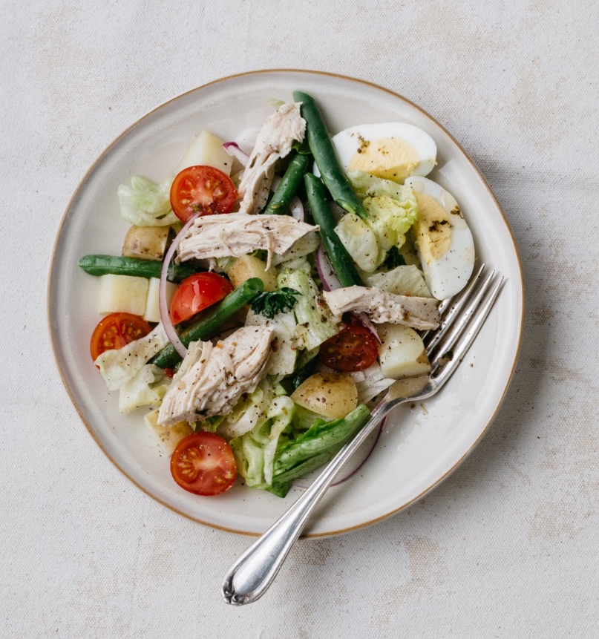
Addressing Chronic Disease, and Reducing Healthcare Costs with Medically Tailored Meals & Nutrition Supports
July 2018
One Care Implementation Council Meeting

Slide 2
Agenda
Our Services to One Care Members
Our Mission and History, and Client Profiles
Meal Interventions and Nutrition Services
Research Demonstrating Impact
Partners and Projects
Requests of the Council
Questions and Discussion

Slide 3
Our Services to One Care Members

Slide 4
Our Healthcare Reimbursement Partners
Organization | Description
Commonwealth Care Alliance | Managed Care Organization serving individuals who qualify for Medicaid and Medicare, due to poverty and disability and/or age; we have served over 300 individuals to date
Neighborhood Health Plan | Managed Care Organization focusing on highest cost, highest needs patients; we have served over 35 individuals since the summer of 2015
Atrius/VNA Care Network; Brigham & Women’s Hospital | Accountable Care Organizations developing a “Medically Home” model of care; beginning in April and June 2017
PACE of Rhode Island | Pilot program serving individuals enrolled in the PACE program of Rhode Island

Slide 5
Who We Serve through One Care
Contract with Commonwealth Care Alliance since 2013
Currently serving 174 individuals
Average duration on meals is 16.3 months
Top cities of residence are Boston, Worcester, and Cambridge
Most common diet selections are diabetic, cardiac, and renal

Slide 6
How do Clients Transition from Our Meal Service?
In addition to home-delivered meals, we offer nutrition counseling and education
In partnership with the Greater Boston Food Bank, we are developing a “step down” program, in which grocery bags with ingredients tailored to individuals with diabetes can be picked up at a food pantry
We also provide clients transitioning from our program with a guide of food and nutrition resources available in the community

Slide 7
“Valerie’s” Story
“Valerie” began receiving Community Servings’ vegetarian meals in July of 2015, and continued through June of 2017. She then started attending our “Farm to Fork” 12-week cooking class series, and attended every class that season. Valerie has joined for the classes again this year. In a note to our Manager of Nutrition Services, who is moving to Washington DC, she wrote, “Thank you for changing my life for the better.”

Slide 8
Community Servings Mission, History, & Client Demographics

Slide 9
Not-for-profit food and nutrition program with a 28-year history of providing medically tailored home-delivered meals and nutrition services to medically vulnerable individuals in poverty.
Today, we prepare and deliver 675,000 wholesome, medically tailored meals weekly to 2,000 chronically ill individuals, 92% of whom live at or below 200% of the federal poverty limit
Community Servings: Mission

Slide 10
Client Profiles
Homebound individuals with limited ability to prepare or receive medically appropriate meals
from caregivers
Multi-morbid chronic diseases (71%) who experience one or more of 35+ chronic conditions including:
Diabetes
Cardiac Disease
Cancer
Renal Failure
HIV/AIDS
Notes:
The most common chronic conditions amongst our clients are diabetes, HIV/AIDS, cardiac disease, kidney disease, cancer, lung disease. Unlike Meals on Wheels, our clients tend to be younger with the average age being 53 years old.
Many of our clients have multiple comorbidities and are also dealing with poverty and food insecurity. As you can imagine, people who are dealing with a chronic illness and food insecurity have a very difficult time following a specific diet recommended by their healthcare team. Imagine trying to control for glucose (diabetes) potassium and fluid intake (kidney disease) and Vitamin K (blood thinners) if you’re struggling to find the resources to pay for your next meal.

Slide 11
Recommended Eligibility Criteria for Community Servings’ Meal Intervention
Medically complex condition(s) with nutritional risk factors
Limited mobility or ability to prepare a medically complex diet
Lack of a caregiver who can prepare medically appropriate meals
Notes:
Examples of medically/nutritionally complex:
Chronic illness diagnoses (or multi-morbid chronic illness)
-Most commonly includes Diabetes, COPD, CHF, cancer, and renal failure
-High risk/high cost
-Recent prolonged hospitalization >5 days
-3 or more ED visits in a 6-month period
-Receiving care management for multi-morbid chronic conditions
-Recent and/or recurring hospitalizatoin
Nutritional risk factors may include food insecurity or malnutrition (significant unintentional weight loss or gain, muscle wasting, poor food intake for 2 weeks or more)

Slide 12
Meal Interventions & Nutrition Services

Slide 13
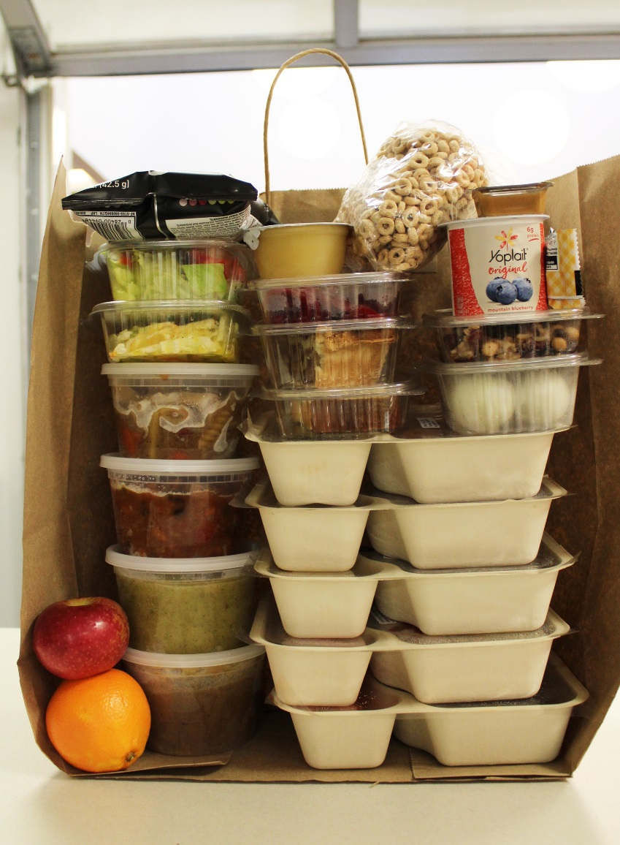
A Weeks’ Food, Delivered in a Bag from Community Servings Includes:
Five days worth of lunches, dinners, and snacks.
In our philanthropic program, we feed the family, not just the medically vulnerable individual, understanding that the majority of our clients are below 200% FPL and would share their food.
Notes:
In our weekly delivery, we provide enough food for lunch, dinner and a snack for 5 days. This includes 5 frozen entrees, 4 frozen soups, 4 salads, 2-3 pieces of fruit, 2-3 yogurts, cereal, a quart of milk and 5 desserts.

Slide 14
Person-Centered Medically Appropriate Diets
Wellness
Diabetic
Cardiac
Renal
Mild (low in spice and acid)
Soft
Low-fiber
No red meat
No Nuts
Low-lactose
No fish
High calorie/protein
Pescetarian (fish & vegetarian)
Vegetarian
Children’s wellness
Clients may combine up to 3 diets from the above. However Renal, Vegetarian and Pescetarian are limited to 2 combinations.
Ex: Renal + No fish
Ex: Cardiac + Soft + No red meat
Limitations: we do not have the capacity to provide Kosher or gluten free meals.
Notes:
We offer 15 medical diets as you can see listed here and a children’s menu for those under 12 years of age. To cater to our clients’ multiple conditions, food allergies, and preferences, we allow a combination of up to 3 diets. So for example, a client could receive a Cardiac, Soft, Vegetarian diet or a Renal, Diabetic and Mild diet.

Slide 15
Research Demonstrating the Impact of Medically Tailored Home-Delivered Meals

Slide 16
AARP/Commonwealth Care Alliance (CCA) Claims-based Study
Published in Health Affairs, April 2, 2018
Examined claims data on healthcare utilization and costs of individuals who received meals from Community Servings for at least six months vs. a matched control group of 1002 individuals who did not receive meals
Examined claims data reflecting healthcare utilization and costs of 624 individuals who received traditional non-medically tailored home-delivered meals for at least six months vs. matched control group of 1318 individuals who did not receive meals

Slide 17
AARP/CCA Evaluation Study Published Results
Medically Tailored Meals Group
vs. Comparison Group Costs
Non-Tailored Meals Group
vs. Comparison Group Costs
COSTS PER PATIENT PER MONTH
COSTS PER PATIENT PER MONTH
$220 per month savings
$10
per month savings
Medical costs
$1,163
Meals cost
Meals cost
Medical costs
$1,007
Medical costs $843
Medical costs $1,413
MTM
Comparison
Group
NTM
Comparison
Group
ED visits, Inpatient admissions and emergency transport services
ED visits and emergency transport services

Slide 18
Requests of the Council

Slide 19
Our Requests of the Council
Request that MassHealth and plans:
Make clear that nutritionally vulnerable and medically complex One Care members may access medically tailored home-delivered meals
Work with Community Servings in developing guidelines on when medically tailored meals should be provided, and a transition plan from the service
Work with Community Servings in developing a plan to teach consumers, PCA’s, and RLC’s how to prepare medically appropriate meals
Receive bi-annual updates on One Care members’ utilization of medically tailored nutrition services

Slide 20
Questions and Discussion
Jean Terranova
Director of Food and Health Policy
JTerranova@servings.org

