Slide 1
From Assessment to Action:
Using Transition Assessment to Guide Postsecondary Planning for Students with Visual Impairments
Kelley Challen, EdM, CAS
Director of Transition Services, NESCA
kchallen@nesca-newton.com
@kelleychallentransitions
Notes:
Time:
2 Minutes
Facilitator’s Notes:
Good Morning – I’m Kelley Challen and I’m a transition specialist and the director of transition services at NESCA, a private practice with offices in Newton, Plainville, and Hingham, Massachusetts and some other states. I conduct and oversee transition assessment, consultation, planning and coaching services. My educational background is in psychology and school counseling, and I have worked in my current capacity as a private transition specialist for about 12 years.
This morning – I’m looking forward to talking with you and spending the day with you. There are certainly a lot of great workshops planned.
Total Presentation Time:
75 Minutes

Slide 2
Objectives
What is transition assessment in the context of the IEP?
Why is assessment essential for students with visual impairments?
What key areas and tools can be utilized for transition assessment?
How does transition assessment connect to the Massachusetts IEP?
What remaining questions do you have about assessment?
Notes:
Time:
1 Minute
Facilitator’s Notes:
In terms of what I am hoping to speak to this morning, these are the questions that we are hoping to answer:
I’m going to walk you through a definition for assessment and how assessment connects to transition services,
I am going to try to give you a sense of the wide variety of common and creative tools that could be part of transition assessment,
and then I will finish by briefly touching on how assessment results fit into the IEP and taking hopefully 15 minutes of questions.

Slide 3
Ground Rules
Brief questions about terminology, acronyms, or clarifying content are encouraged
Tangential questions or questions about content that has not been covered should wait until the end
Keep it general—No personal or overly specific assistance
Notes:
Time:
1 Minute
Facilitator’s Notes:
I’ll be moving quickly through the presentation, so I welcome any clarifying questions about the information or terminology I’m sharing. However, I ask that all other questions be held until the end. Also, when asking questions, please keep them as general as possible so that everyone in the room can benefit from the discussion.

Slide 4
Transition Planning Defined

Slide 5
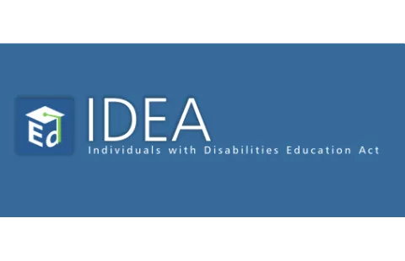
The Individuals with Disabilities Education Act
Law that guarantees students with disabilities an equal opportunity for a free and appropriate public education (FAPE)
Mandates special education and related services be designed to meet a student’s unique needs and prepare them for further education, employment, and independent living
Notes:
Time:
1 Minute
Facilitator’s Notes:
If you are attending today, you are probably familiar with The Individuals with Disabilities Education Act of 2004 (IDEA 2004). IDEA ensures students with disabilities throughout the country have the right to a free appropriate public education (FAPE).
Moreover, IDEA mandates that the purpose of special education and related services is to meet the unique needs of students with disabilities and to “prepare them for further education, employment, and independent living.”
Let me say that again… the purpose of special education is to prepare students for further education, employment, and independent living

Slide 6
IDEA 2004 Requires:
Appropriate measurable postsecondary goals
Based on age-appropriate transition assessments
Transition services to help the student reach those goals
Focused on the student’s strengths, preferences, and interests
Included in the IEP by age 16 (14 in Massachusetts)
Notes:
Time:
1 Minute
Facilitator’s Notes:
One of the main ways special education prepares students with disabilities for life after high school is through transition services.
IDEA requires that students with IEPs have appropriate, measurable postsecondary goals based on age-appropriate transition assessments.
To help students reach these goals, the IEP must include transition services—such as a course of study, instruction, related services, community experiences, employment preparation, and, if needed, a functional vocational evaluation. Transition services build the skills, experiences, and supports students need to progress toward their goals in further education and training, employment, and independent living.
Importantly, these goals and services must be based on the student’s strengths, preferences, and interests—not a one-size-fits-all approach.
By law, transition planning must be included in the IEP by age 16, but some states, including Massachusetts, require it by 14. The law even allows services to begin earlier if needed—something especially important for students with sensory disabilities, as early skill development can be critical.

Slide 7
Transition Planning Involves
Transition Assessment
Measurable Postsecondary Goals
Annual Goals & Transition Services
Notes:
Time:
1 Minute
Facilitator’s Notes:
What I want to emphasize – is that the IEP must have measurable postsecondary goals, and annual goals and transition services that can help the student make effective progress toward achieving those goals
AND that Both the development of appropriate measurable postsecondary goals and the identification of the transition services needed to reach those goals depend on transition assessment
It’s a cycle that starts with transition assessment. We assess, develop long-term goals, determine what short-term goals and services are needed to reach those long-term goals, carry out the IEP, and then re-assess
This process is cyclical and continues until the student exits public education

Slide 8

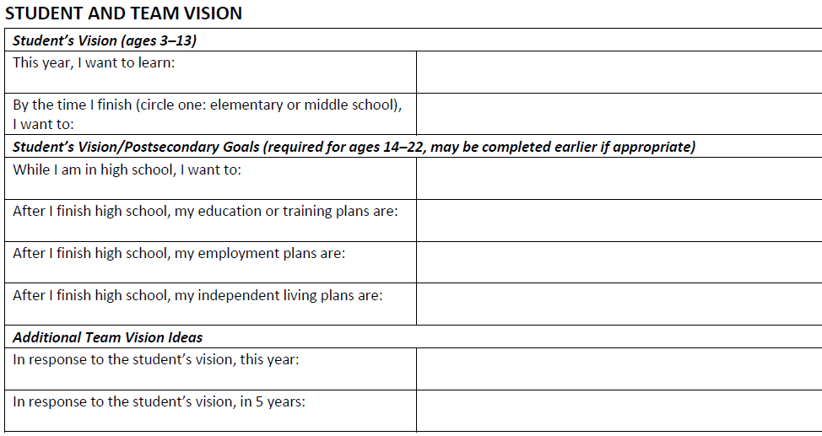



Postsecondary Goals in the IEP
OLD
CURRENT
(New)
Notes:
Time:
2 Minutes
Let’s quickly talk about measurable postsecondary goals since those are an important outcome of age-appropriate transition assessment.
You are likely aware that Massachusetts has a new IEP format and process
Even though this format may seem different from the old form, the law has not changed AT ALL, and the Massachusetts regulations have not changed at all (well except for the uncertainty of current graduation requirements)
But in terms of the requirement to include postsecondary goals, that are based upon age-appropriate transition assessment, in every IEP for students ages 14 and up, that’s not new
What has changed is the inclusion of more space in the IEP for documenting these legally required postsecondary goals
The old IEP was a little confusing because the vision section was used in early years for documenting a short-term vision, and then was supposed to be used during transition planning years for also documenting this long-term vision
The new IEP specifically has three lines to ensure that every student has an education and/or training goal, an employment goal, and an independent living goal – something I don’t love is that there is nowhere in this section to document what age-appropriate transition assessment was used to determine these goals BUT there is room for documenting assessment later in the IEP and I appreciate that it is really hard to do everything required and not create too much redundancy within an process

Slide 9
Transition Assessment Defined
Notes:
So let’s talk about transition assessment

Slide 10

Transition Assessment
An “…ongoing process of collecting data on the individual’s needs, preferences, and interests as they relate to the demands of current and future working, educational, living, and personal and social environments.”⁵
© COPAA (2024) - All Rights Reserved
Notes:
Time:
1 Minute
Facilitator’s Notes:
The most commonly accepted definition of transition assessment comes from the Division on Career Development and Transition (DCDT) of the Council for Exceptional Children (CEC).
Transition assessment is an “…ongoing process of collecting data on the individual’s needs, preferences, and interests as they relate to the demands of current and future working, educational, living, and personal and social environments.”
Research shows that students whose transition plans are based on comprehensive assessments have better postsecondary outcomes in education, employment, and independent living.
Citations:
5. Sitlington, P. L., Neubert, D. A., & Leconte, P. J. (1997). Transition assessment: The position of the Division on Career Development and Transition. Career Development for Exceptional Individuals, 20, 69-79.

Slide 11


Assessment is Ongoing and Collaborative
Students' skills, interests, and support needs change over time
Collaboration ensures a holistic picture of the student
TVIs, O&M specialists, school staff, families, and students all provide essential insights
Data must be collected over time, not just at a single point
Effective transition assessment improves postsecondary success
Notes:
Time:
1 Minute
Facilitator’s Notes:
Since transition assessment is an ongoing process, it’s important to recognize that students’ skills, interests, and support needs change over time.
Research from the National Longitudinal Transition Study-2 (NLTS-2) shows that students who had multiple transition assessments throughout high school were more likely to be employed and living independently by their mid-20s.
Collaboration is definitely key—TVIs, O&M specialists, school staff, families, and students all contribute essential insights.
Effective assessment requires collecting data over time, from multiple responders, not just at a single point, to create a complete picture of a student’s needs and goals. When done well, transition assessment significantly improves postsecondary success.
So, what does this process look like, especially for students with visual impairments? Let’s explore some key considerations.

Slide 12
Formal and Informal Tools
Formal
Informal
Achievement tests
Adaptive behavior scales
Aptitude tests
Functional academic tests
Intelligence tests
Interest inventories
Learning style inventories
Personality scales
Self-determination scales
Quality of life measures
Vocational skills tests
Work readiness tests
PLAN/PSAT/SAT/ACT
Community based assessments
Curriculum based assessments
Direct observations
Medical reports
Questionnaires
Person-centered planning activities
Rating scales
Report Cards/Transcripts
Skill inventories
Structured interviews and surveys
Talking with the student
Task/Environmental Analysis
Trial experiences
Transition planning assessments
Notes:
Time: 2 Minute
When it comes to transition assessment, there are more potential tools available than in almost any other type of student evaluation. These tools fall into two broad categories: formal and informal assessments, and both are essential for a comprehensive evaluation.
Formal assessments are standardized, published tests with specific administration and interpretation procedures. They are norm-referenced, meaning they compare a student’s scores to peers, and they provide reliable and valid data. Every student on an IEP has likely had some formal assessments as part of past evaluations. These are typically administered by trained professionals, but it’s important to note that there isn’t just one specific type of professional who conducts transition assessments. Schools decide who administers assessments based on training and experience with specific tools. For example, a school psychologist may be best equipped to administer adaptive functioning measures, while other professionals with assessment training may be qualified for different tools.
Informal assessment includes everything else—observations, interviews with students, families, and teachers, questionnaires, curriculum-based assessments, and real-world performance evaluations.
These assessments can be inexpensive or even free but require clinical judgment to interpret. Some of the most effective informal assessments include person-centered planning frameworks, such as PATH, MAPS, and Charting the LifeCourse, which gather input from multiple people who know the student well.
Additionally, functional, community-based assessments are critical—because, as transition specialist Terri McLaughlin once said, ‘You can’t take a swim test without a pool.’ We can’t accurately assess a student’s real-world skills like travel, consumer, or employment readiness if we never step outside the classroom.
Ultimately, transition assessment must include both formal and informal measures to meet legal guidelines and to create the most accurate and useful transition plan for students.

Slide 13
If a student is on an IEP, they have had “transition assessment”!
Three-year evaluations
  Cognitive, academic, speech-language, occupational therapy, physical therapy, etc.
Private evaluations
Standardized testing
  Achievement tests, PSAT, PLAN, SAT, ACT
Report Cards/Transcripts/Progress Reports
Counseling activities
  Strengths, learning style, personality type, career interests
Student and Parent Concerns and Vision Statements
Notes:
Time:
1 Minute
Facilitator’s Notes:
If a student is on an IEP, they have already participated in transition assessment—whether they realize it or not.
Most students have undergone school-based evaluations of cognitive, academic, speech and language, motor and sensory, or mobility skills. These assessments all contribute valuable transition data.
Beyond school-based testing, students may have participated in private evaluations or standardized achievement tests, whether state-required or for college placement.
Informal data is also regularly collected through report cards, transcripts, progress reports, and counseling activities—like interviews, resume development, learning style assessments, personality assessments, and career interest surveys. All of these pieces provide information about a student’s strengths, needs, and future goals.

Slide 14

Individual Needs Assessment
What do we already know?
What do we want/need to know?
How can we obtain and measure that information?
Notes:
Time: 1 Minute
Facilitator’s Notes: A needs assessment is a critical first step in planning transition assessment.
It helps answer three key questions:
Who is the student? What are their strengths and needs?
Who does the student want to become? What are their interests and goals?
And how well do the student’s abilities align with the demands of their future educational, employment, and living environments?
We start by reviewing what we already know about the student’s strengths, interests, preferences, and goals. Then, we identify gaps—what do we still need to learn? And finally, what’s the best way to get that missing information? This is where TVIs and COMs can be especially helpful--when the team is thinking about assessment procedures and needing to make sure they are planning accessible testing.
A good needs assessment can prevent unnecessary testing. For example, if parents and school staff both report that a student struggles with mobility in unfamiliar environments—such as navigating through a crowd or crossing a street—an observation may not be needed. But if reports vary, direct assessment becomes more important.
---------------------------------------
IEP GOALS – example, postsecondary writing goal – school doesn’t believe the student needs it based on teacher observation and performance in English class, parent is privately providing tutoring 4 hours per week, student indicates that any writing which requires planning and organizing thoughts is difficult and that it sometimes takes up to 90 minutes to initiate writing – great, let’s request a writing assessment using standardized tools and determine whether the student is able to independently produce grade level writing and is on track to be able to produce college level writing

Slide 15
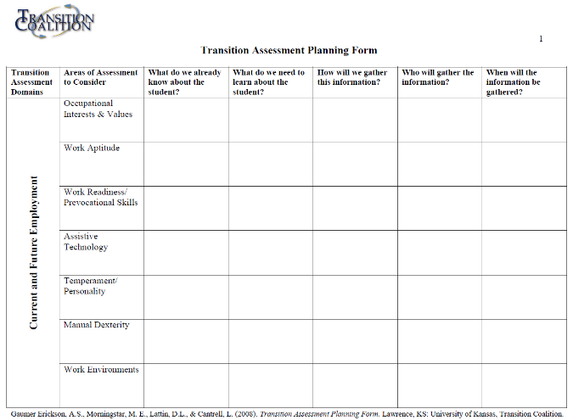
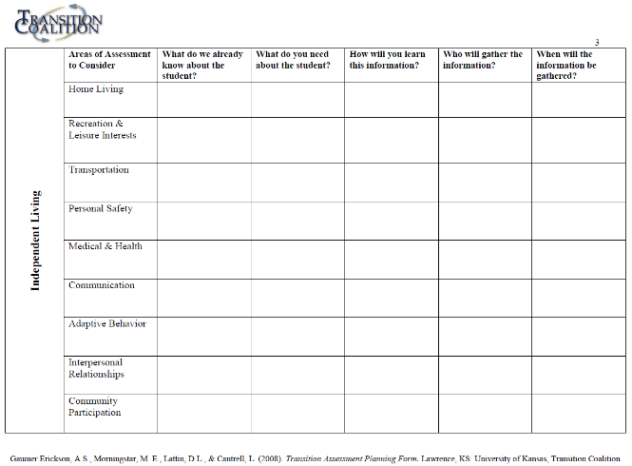
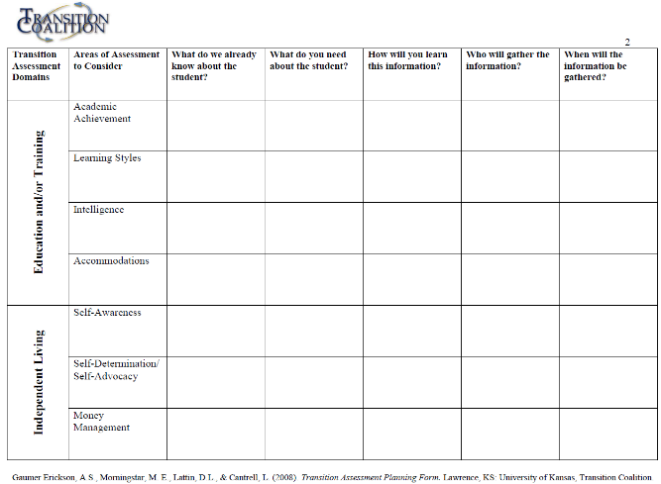
Transition Assessment Planning Form –
Mary Morningstar
Notes:
Time: 1 Minute
This is an example of a form that can help with a needs assessment—the Transition Assessment Planning Tool, developed by Mary Morningstar and colleagues at the University of Kansas. Multiple versions exist, and you can easily find them online. This tool helps teams identify what they already know about a student and what areas still need assessment for a thorough transition plan.
Another way to conduct a needs assessment is by reviewing the IEP. Look at sections where current performance data should be documented—are there gaps in baseline information or details missing about a student’s strengths, interests, and preferences? Identifying these gaps helps ensure transition assessment is comprehensive and meaningful.

Slide 16
Transition Assessment Looks At¹
Cognitive Performance
Academic Achievement/Learning Skills
Learning Style
Compensatory Skills
Accommodation Needs
Self-Determination
  Self-Awareness
  Self-Advocacy
Independent Living Skills/Adaptive Behavior
  Communication
  Daily Living Skills (Self-Care, Domestic, Community)
  Socialization (Interpersonal, Leisure, Coping)
Notes:
Time:
2 Minutes
Facilitator’s Notes:
As you can see, transition assessment covers a lot of territory, and it's important to take a comprehensive approach when planning for a student’s future.
When we think about future learning and training, we must consider:
Cognitive performance, which might include intelligence testing and skills like verbal and nonverbal reasoning, processing speed, and working memory.
Academic achievement is important, along with learning skills such as executive functioning and attention.
Learning preferences and compensatory skills.
Accommodation needs that help students succeed in various environments.
And self-determination, which involves developing self-awareness and self-advocacy skills.
In terms of Independent Living Skills or Adaptive Behavior, the focus expands to:
Communication skills, both spoken and written,
Daily living skills such as self-care, home living, and community engagement—this includes practical things like safety, managing healthcare, handling money, time management, and transportation.
Socialization, which covers skills like coping, building interpersonal relationships, understanding sexual health, maintaining hygiene, engaging in recreation, and addressing maladaptive behaviors.
It’s also essential to include functional evaluations. For example, assessing whether a student can greet others appropriately, not just know they're supposed to. Or whether they can ask a complete stranger for help, rather than relying only on familiar adults in the community.
A key point here is the difference between can and does. For instance, can a student complete a hygiene routine, but more importantly, do they thoroughly bathe, brush their teeth, and maintain a neat appearance throughout the day?

Slide 17
Transition Assessment Looks At – Cont.¹
Vocation
  Interests/Values
  Aptitudes
  Readiness/Prevocational Skills
  Personality/Preferences
  Attitude/Performance
  Environments
  Assistive Technology
  Dexterity, Mobility, and Sensory
Career Exploration Skills
  Academic Planning Skills
  Career Awareness and Planning Skills
Notes:
Time:
1 Minute
Facilitator’s Notes:
With transition assessment, this is often the first time we’re collecting detailed information about a student’s career planning and work readiness skills.
Transition assessment can cover areas like: Vocational Interests & Values, Aptitudes, Readiness & Prevocational skills, Personality & Preferences, Attitude & Performance, Environments, Assistive Technology, Dexterity, Mobility, and Sensory. Career exploration skills, including academic and career planning, are also key.
Many of these areas overlap—for example, interests shape both leisure and career choices, and academics influence education, employment, and community access.
https://www.perkins.org/resource/ecc/

Slide 18
Assessment and Visual Impairment
Transition assessment is required for all, but students with visual impairments have unique needs.
Expanded Core Curriculum (ECC) is essential. Make sure the team doesn’t skip:
  Technology & Assistive Tech
  Compensatory Skills
  Sensory Efficiency
  Orientation & Mobility
Traditional assessments may not fully capture the skills necessary for independence, career readiness, and community participation.
Ongoing, real-world assessment
Notes:
Time:
1 Minute
Facilitator’s Notes:
It’s important to conduct comprehensive transition assessment for students with visual impairments. Not only do we have to consider the core transition planning areas, but we must also ensure we're assessing skills in the Expanded Core Curriculum which all impact transition planning. On the previous two slides, I did bold the nine ECC areas so that you can see how they fit right in with transition assessment.
I made a note to make sure the team doesn’t skip technology, compensatory skills, sensory efficiency, and O&M because those are skillsets that are a little beyond what some traditional transition assessment tools will cover and may need to be specific requests or thoughts during the evalution.
Traditional assessment tools can definitely over or underestimate students skills so its important that ongoing, real-world assessment is part of our transition assessment and planning process.
https://www.perkins.org/resource/ecc/

Slide 19

What is the biggest worry about transitioning to adult life?
Notes:
Time:
1 Minutes
Facilitator’s Notes:
When we do a needs assessment, this is one additional guiding question that I think is important to ask the student, parent, and team: What is the biggest worry about transitioning to adult life?
With so many types of assessment to choose from and areas to focus on, it is really critical that we develop very clear referral questions for conducting transition assessment.
When we ask families this question—and when you think about this question yourself for a student—everyone is more likely to buy into the assessment process and findings. Plus, sometimes assessment results show that something that we thought would be a big worry isn’t actually a concern—and that’s a great outcome!

Slide 20
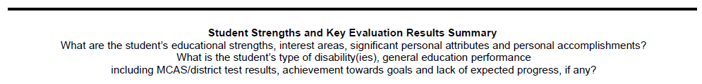
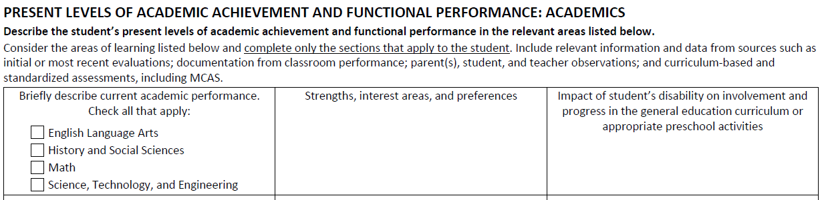
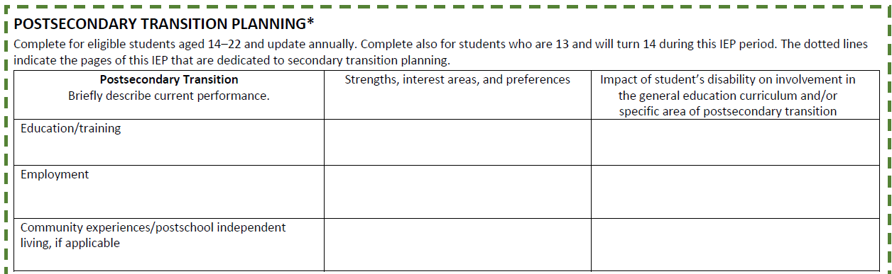







Transition Assessment in the IEP
OLD
AND
Behavior/Social/Emotional
Communication
Additional Areas
CURRENT
(New)
Notes:
Time: 2 Minutes
I just wanted to briefly talk about where transition assessment results can be documented in the IEP
Certainly, the postsecondary goals that we already discussed are one place where assessment results are documented because a students’ postsecondary goals are required to be based on age-appropriate transition assessment
Two other places where most transition assessment results will be documented are in the present levels sections of the new IEP and the postsecondary transition planning section of the IEP
Whereas the previous IEP included a summary of key evaluation results altogether and PLEPS, and the new IEP now calls for much more detailed performance data to be documented across several areas.
For students of all ages, there is a section to describe the student’s current performance related to academics, behavior/social/emotional functioning, communication, and additional areas including activities of daily living or life skills, health, hearing, motor and mobility, sensory, and vision --- this additional areas section is one that we want to bolster with assessment data as early as possible for these students
Then, for students approaching age 14, there is an added section specifically related to postsecondary transition planning which leaves room to document current performance related to future education and training goals, employment, postschool independent living, and community engagement.
So, for example, if a student took a career interest inventory and found out that they had career interests related to the arts, that now has a clear place to be documented in the interest areas section of the employment section here.
Or, if they disliked every single listed employment activity on the interest inventory, we could list in the current performance that they scored 0 out of whatever on the inventory and then indicate over on the right that the student either lacked self-awareness or employment experience and needed to build both for adequate transition planning

Slide 21


Example Assessment Tools:
From Common to Creative
Notes:
Time:
1 Minute
Facilitator’s Notes:
Now, lets talk about some of the assessment tools that you may choose to utilize as part of this process
But I think its very important to offer the caveat that there really are a pretty unlimited number of tools you may use as part of transition assessment. Its possible that I’m going to show you 30 more slides, and you will never use any of the tests I present, and you may be providing students with highly individualized and thorough transition assessment processes – its not likely, but its possible

Slide 22





“Complete” Transition Assessments
Transition Planning Inventory – Third Edition (TPI-3)
Informal Assessments for Transition Planning
Revised Transition Rating Scales (TRS), ages 14-21
Brigance Transition Skills Inventory 2 (TSI 2)
Notes:
Time:
3 Minutes
One type of tool that I want to mention are what we might think of as “complete” or general transition assessments. When we think about 'complete' or general transition assessments, there are several tools that provide a comprehensive snapshot of a student’s strengths, needs, preferences, and interests across key transition areas like employment, postsecondary education, and independent living.
One of the most commonly used tools is the Transition Planning Inventory (TPI-3). It includes 57 items that can be completed by students, parents, or educators, with versions available in multiple languages. The TPI-3 covers a wide range of domains—like daily living, community participation, and self-determination—and includes a student profile to compare different perspectives. A key takeaway is that TPI-2 and TPI-3 are identical, so either version can be used if a school has an older copy.
There are also companion resources, like the Informal Assessments for Transition Planning books, which provide additional sub-competencies and activities to deepen assessment results and help develop IEP goals.
Another option is the Revised Transition Rating Scales, previously known as the Enderle-Severson. This tool ranges from under 50 to nearly 300 questions and can be completed by educators or family members, with different versions for various disability groups. It provides subscale scores but remains a criterion-referenced tool, meaning individual item responses are particularly useful for developing transition services and IEP objectives.
Finally, the Brigance Transition Skills Inventory (TSI-2) stands out as a highly structured, functional assessment. Unlike rating scales, it includes direct skill assessments covering pre-employment, academic, and independent living skills. This tool is excellent for determining a student’s real-world abilities, resolving discrepancies between self-reports and observed skills, and identifying specific areas for instruction. It also has a companion curriculum with lesson plans aligned to assessment results.

Slide 23

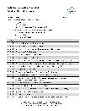

Self-Determination/Advocacy
ARC Self-Determination Scales
AIR Self-Determination Scales, all school ages
ChoiceMaker Self-Determination Curriculum and Assessment
Self-Determination Student Checklist
Person-Centered Planning Activities
Notes:
Time:
2 Minutes
Facilitator’s Notes:
Beyond general transition assessments, self-determination assessments are critical but often overlooked until a student reaches transition age. These tools help evaluate a student’s ability to set goals, make decisions, and take control of their future.
A great starting point is the Arc Self-Determination Scale, a free, norm-referenced self-report tool measuring autonomy, self-regulation, psychological empowerment, and self-realization. It’s powerful because it’s normed on students with IEPs nationwide—so if a highly capable student scores extremely low, we know self-determination may be a major barrier to their success.
Another widely used tool is the AIR Self-Determination Assessment, also free, with versions for students, parents, and educators. It measures both capacity (skills and knowledge) and opportunity (chances to apply those skills at home and school). It’s quick to administer, though the parent perspective feels like a bit of an afterthought compared to student and teacher input.
Other tools include the ChoiceMaker Self-Determination Assessment, which aligns with a curriculum teaching students to set and achieve personal and IEP goals.
The IMDetermined Project offers activities and assessments focused on self-advocacy and IEP involvement like the Self-Determination Checklist.
And for a highly personalized approach, person-centered planning tools like PATH, MAPS, Circles of Support, and Charting a LifeCourse which engage families and stakeholders in the process.
These assessments are invaluable for understanding not just what a student knows, but how prepared they are to take charge of their future.

Slide 24





Life Skills/Adaptive Functioning
Vineland Adaptive Behavior Scales – Third Edition (Vineland-3)
Adaptive Behavior Assessment System, Third Edition (ABAS-3)
Life Skills Inventory (Washington DSHS)
PEATC Life Skills Checklist
Casey Life Skills Toolkit
Assessment of Functional Living Skills
Notes:
Time Allotment:
2 minute
Facilitator’s Notes:
When evaluating life skills and adaptive functioning, it’s essential to use assessments that measure what a student actually does—not just what raters think they can do. We need data on how often students perform independent living behaviors and what support they require, ensuring these skills become automatic and generalizable for life after high school.
Formal assessments like the Vineland-3 and ABAS-3 provide standardized scores on essential life domains, helping to understand a student's developmental level. The Vineland-3 is often interview-based for caregivers, while the ABAS-3 is easier to complete and evaluates multiple adaptive areas.
Beyond these, there are criterion-referenced tools that track skill mastery over time. Free resources like Washington’s Life Skills Inventory, the PEATC Life Skills Checklist, and Casey Life Skills offer structured ways to measure strengths and gaps. With self-report tools like Casey Life Skills, I like to follow up on low scores by asking students how important each skill is to them and when they’d like to learn it.
For students needing in-depth evaluation, The Assessment of Functional Living Skills (AFLS) provides detailed observational assessments across five domains, breaking tasks into micro-skills—for example, getting dressed includes 32 subtasks. While the full AFLS takes time, targeted use can be invaluable.
Ultimately, assessing life skills is critical. Without a baseline evaluation, teams can’t determine whether independent living skills should be addressed in a student's transition plan and we know these skills are essential for students Students who are blind, have low vision, or have cortical visual impairment (CVI).

Slide 25
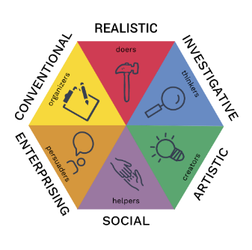
Employment: Career Interests
O*Net Interest Profiler (IP)
Career Decision-Making System-Revised (CDM-R)
Strong Interest Inventory
Picture Interests Career Survey, Third Edition
Reading-Free Vocational Interest Inventory-Third Edition (RFVII-3)
Notes:
Time Allotment: 2 minutes
Facilitator’s Notes:
Alright – we’ve talked about general transition planning tools, self-determination, and life skills, but what about employment?
Career education for students with visual impairments needs to begin as early as possible and include self-awareness and career exploration activities, job seeking skills instruction, information about job keeping, and encourage opportunities for gaining work experience.
If you can remember back to Slide 14, I broke employment up even further into about 10 areas, and there are often multiple tools that could be used to evaluate each of those areas and there are some tools that evaluate multiple areas
Certainly, school counselors and school-to-work counselors are specifically trained in career development and should be accessed
There are also a number of specialists who provide career counseling for individuals with disabilities such as vocational rehabilitation counselors
One of the main types of career assessments that if often used for the first time when a student reaches transition aged is the career interest inventory. These are formal or informal tools that can be word- or picture-based and generally ask individuals to rank how much they think they would like doing a particular job or work task. Results are often displayed as occupational themes or career clusters that help point individuals in the direction of a group of jobs that may align with their tested interests.
Sometimes, these assessments utilize an occupational code, which is a combination of themes, but still points to a particular set of jobs that the tested individual may want to explore further. Examples of career interest assessments include: the ONET, the CDM, the strong interest inventory, the PICS, the RIASEC, and the Reading-Free Vocational Interest Inventory
Importantly, these assessments are only identifying career themes, clusters, or job titles that may match with a student’s interests but not necessarily with their competencies or accommodation needs

Slide 26
Employment – Functional Assessments
Work Aptitudes
  Comprehensive Vocational Evaluation System (CVES)
Situational Vocational Assessment
  Experiential learning in simulated/real work settings
Notes:
Time Allotment:
2 minutes
Facilitator’s Notes:
Any employment decision is about aligning a student’s interests with their skills, preferences, and support needs.
Vocational aptitude tests are similar to intelligence or cognitive assessments but differ in format, activities, and the specific abilities they measure. Some are online or paper-based, while others involve hands-on performance tasks. Most vocational aptitude tests assess a range of abilities, including verbal, numerical, spatial, perceptual, manual dexterity, and general reasoning skills.
These tests are often paired with vocational interest inventories to help identify jobs that align with both a student’s interests and aptitudes. However, most vocational aptitude tests are designed for individuals with average IQs. Students with significant disabilities may struggle to access these assessments, while students with above-average IQs often find that they have the aptitude for nearly anything they set their minds to.
Additionally, most aptitude tests are not designed for individuals with sensory impairments. However, the Comprehensive Vocational Evaluation System (CVES) was specifically developed for individuals who are blind, have low vision, or experience cortical visual impairments. This system is based on the extensively researched McCarron-Dial model and was normed on over 1,000 individuals. It evaluates multiple domains, including cognitive, sensory, motor, emotional-coping, and integration-coping skills. Some of its unique tools include the Cognitive Test for the Blind, the Haptic Sensory Discrimination Test, the McCarron Assessment of Neuromuscular Development, and a Vocational Evaluation Profile Analysis with many other measures.
Beyond aptitude testing, situational vocational assessments—observing students in simulated or real work environments—can be critical for identifying strengths and support needs in practical settings.
We also know that paid employment during high school is a strong predictor of successful transition to both college and the workforce. This is why it’s essential to prioritize real-world work experiences as early as possible in the transition assessment and planning process.

Slide 27
Employment – Readiness, Attitudes, Motivations, Values, and Transferrable Skills
Becker Work Adjustment Profile-Second Edition (BWAP-2)
Work Readiness Inventory
Employability Skills Inventory
Work Motivation Scale
Job Search Attitude Inventory
Transferrable Skills Scale
O*Net Work Importance Locator
Notes:
Time Allotment: 1 minutes
Facilitator’s Notes:
Additional tools can be used to measure a student’s work readiness, work attitudes, motivations, values, and transferrable work skills.
I put up here examples of a work adjustment profile that indicates the level of support a student may need to be able to work, a work readiness inventory, a work motivation scale, a job search attitude inventory, a transferrable skills scale which looks at basic soft skills for employment, and a work importance locator which looks at what preferences are most important to the student when selecting work.

Slide 28


Postsecondary Education
Course of Study: State & Local Requirements, Standardized Testing
Academic Achievement
Executive Functioning & Study Skills
College Planning, Search & Applications
Overnight Experience
Situational Assessment in College Setting
Auditing or Completion of Course at community college or postsecondary institution
Notes:
Time:
2 Minute
Facilitator’s Notes:
Beyond self-determination, there are several key assessment areas that help determine a student’s readiness for postsecondary education or training. These include their course of study and completion of graduation requirements, academic achievement, executive functioning and study skills, and their engagement in the college planning process.
Standardized testing like the MCAS, Accuplacer, SAT, ACT, and even PSAT can provide helpful norm-referenced information about how a student performs on tests in comparison to other college-bound students across the country
For academic achievement, most postsecondary programs expect at least a 5th- to 8th-grade reading level, though many require higher (and medical forms are at 10th grade). It’s also critical to carefully consider course waivers—only exempting subjects like foreign language or lab science when absolutely necessary because those may impact admissions or successful completion of college degree down the line.
Student engagement in the college process is also data related to their readiness and motivation to be successful in college.
Other valuable assessments include overnight experiences—whether at home, through school trips, or summer programs—and situational assessments on college campuses. Even auditing or completing a college course can help students gauge their readiness.
Finally, I’ve linked an OSEP letter on how students may take college courses as part of their IEP transition services at public expense. If the link changes, you can find it by searching ‘Letter to Dude.’

Slide 29

Postsecondary Education – Cont.
High School Checklist for college readiness by skills (Perkins)
A Guide to Assessing College Readiness for Parents of College-Bound Children with Learning Disabilities or ADHD
College Survival and Success Scale (CSSS) – 2nd Edition
Postsecondary Readiness Rubric from New York State Education Department
Students with Asperger Syndrome: A Guide for College Personnel (Wolf, Brown, & Bork)
  Appendix D: Identifying My Academic Strengths and Weaknesses
  Appendix D: My Areas of Difficulty Checklist
  Appendix D: Student Accommodations Needs
Notes:
Time:
1 Minute
Facilitator’s Notes:
There are also specific assessments designed to provide a snapshot of a student’s readiness for postsecondary learning or training. Examples include: high school checklist for college readiness skills from Perkins, a guide to college readiness from landmark college, the college survival and success scale, the postsecondary readiness rubric from NY state ed department, or even informal checklists like the ones in the appendix of the book students with asperger syndrome: a guide for college personnel

Slide 30
Transition Assessment Should include:
A transition planning inventory/assessment
Formal and informal measures
Clear measurements of frequency AND level of support/dependence
Student, parent, and school report through questionnaire and/or interview
Functional measures of student performance
Situational assessments in environments related to postsecondary vision/goals
Notes:
Time Allotment:
2 minute
Facilitators Notes:
What I would like for you to walk away with is a bit of a checklist to be able to think about whether a student has had “enough” or appropriate transition assessment
As a seasoned evaluator, I think it is very important to make sure that a student has been exposed to…
At least one transition planning inventory or assessment so that we have a profile of strengths and needs
Formal and informal measures
Tools that provide information about both the frequency with which the student performs behaviors, and the level of support needed for the student to perform those behaviors
Information coming from the student, a caretaker, and the school
Functional measures of student performance
And situational assessments in environments related to the students’ postsecondary goals
This doesn’t have to be done all at once but if information is missing, there needs to be a plan for how that information will be gathered

Slide 31
Accessibility in Transition Assessments
Common challenges:
  Visual materials that are not adapted
  Testing that assumes print-based literacy or visual scanning
  Career inventories that don’t consider adapted work environments
Possible solutions:
  Use/Make accessible assessment tools (e.g., adapted career inventories, oral interviews)
  Involve TVIs, Certified O&M specialists, and AT specialists in selecting tools
  Ensure assessment environments reflect real-world accessibility needs
  Expand career exploration
Notes:
Time: 3 Minute
Facilitator’s Notes:
Many transition assessment tools are not designed with students with visual impairments in mind. They often rely heavily on visual materials, written formats, or image-based interpretation, which can create misleading results if adaptations are not made.
Here are some common challenges that arise when using standard transition assessments and possible solutions.
One major issue is that career interest inventories often assume a fully sighted workplace. They may recommend fields based on general interests without considering whether the student has access to the necessary accommodations or whether an industry has a track record of accessibility.
For example, a career inventory might suggest a student would enjoy graphic design, but it doesn’t evaluate whether accessible tools like screen readers, tactile graphics, or adapted software would allow the student to work effectively in that field.
Similarly, a situational work assessment might place a student in a retail setting but fail to adapt the environment (e.g., no screen reader for a point-of-sale system, no alternative labeling for inventory). Without these accommodations, the assessment might misrepresent the student’s actual capabilities.
To ensure accurate and meaningful assessment results, we need to:
Use or create accessible tools—such as adapted career inventories, structured interviews, and non-visual assessment methods.
Collaborate with TVIs, COMS, and AT specialists to choose appropriate assessments and ensure the student has access to the tools they would use in the workplace.
Ensure real-world assessment environments reflect actual accessibility needs—for example, evaluating a student’s work readiness in a setting where they can use their assistive technology.
Expanding Career Exploration for Students with Visual Impairments
In addition to making assessments more accessible, we also need to broaden career exploration so students are exposed to fields with a track record of accessibility and success for blind professionals.
Careers in law, teaching, counseling, assistive technology, writing, and advocacy often offer more flexibility than hands-on trades or fields that rely heavily on visual input.
Connecting students with blind professionals– for instance through the LENS program at partners for youth with disabilities- can provide realistic insights into workplace accessibility and strategies for success.
Encouraging job shadowing, mentorships, and workplace experiences in proven-accessible careers can help students develop an informed vision for their future.
Ultimately, if assessments don’t account for accessibility, they risk undervaluing a student’s potential or steering them away from careers where they could thrive with the right supports.

Slide 32
Transition Services and
IEP Development
Notes:
So let’s talk about transition assessment

Slide 33
A Transition-Rich IEP
Present Levels of Academic Achievement and Functional Performance, Postsecondary Transition
Measurable Postsecondary Goals
Measurable
Annual Goals
Annual Activities and Services, including Course of Study
Designated Responsibility
Notes:
Time Allotment:
2 minute
Facilitators Notes:
Certainly The hope is that transition assessment will result in a specific description of the student’s measureable postsecondary goals and specific recommendations regarding transition services the student needs including:
Instruction, related services, community experiences, support or instruction in order to develop employment or postschool living objectives, acquisition of daily living skills, and possibly further evaluation such as functional vocational evaluation
Data from the assessment should certainly be used to update the postsecondary goals in the IEP and to inform well written present levels of academic and functional achievement.
Then, From the assessment information, annual IEP goals, and transition services are developed.
Finally, responsibilities for providing services are designated.
SOMETIMES transition assessment uncovers a need for services that goes beyond what can be completed in one IEP period, if there is a way to capture that and keep a list of what has not been addressed to circle back to in a future IEP period that’s important – the N1 or additional information can be great for this
Also, SOMETIMES transition assessment uncovers skill development that caretakers want to help with or hire private assistance to support – that’s also something that can be discussed – I always tell parents to focus on the skills they absolutely know they cannot help their child to develop and to make sure that gets into this IEP – Transition planning is really the work of a village and requires knowledge of and access of community resources beyond just the school to work best
33

Slide 34
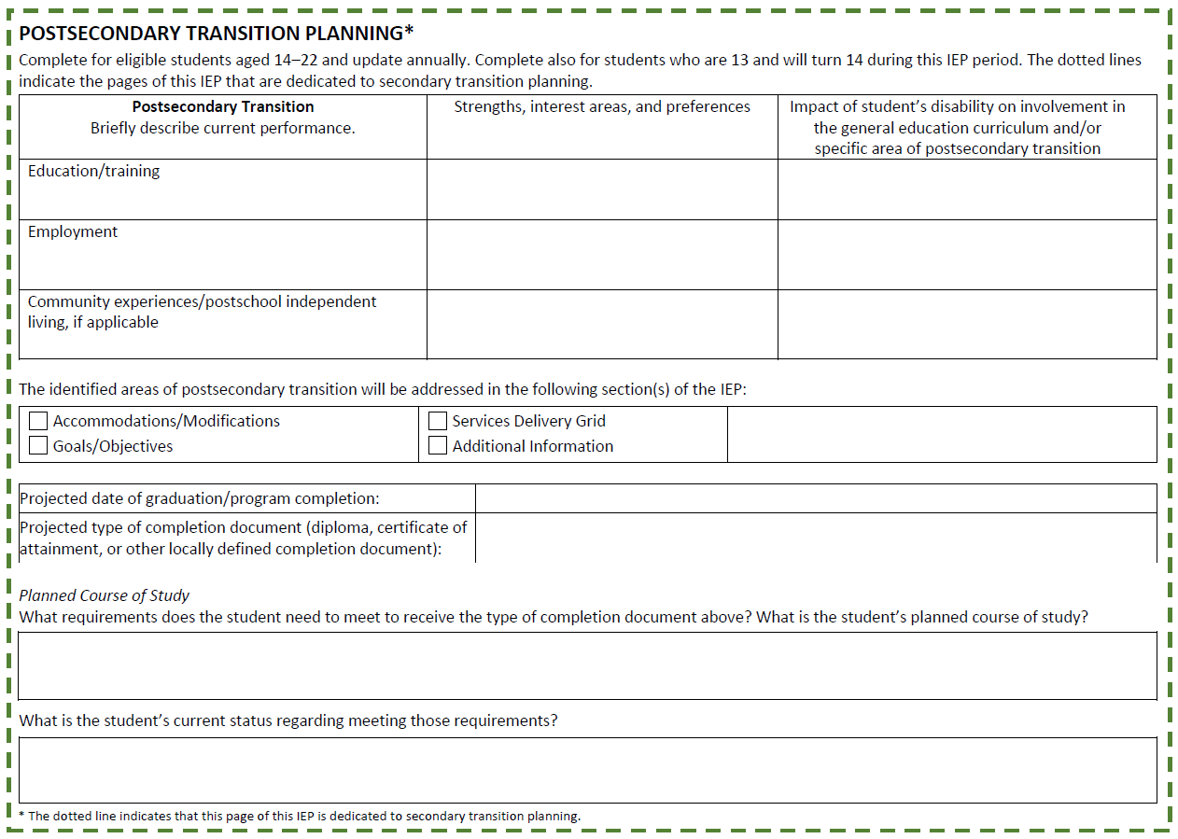










Transition Services in the IEP
CURRENT
(New)
Notes:
Time Allotment: 2 minute
As we talked about the New IEP has the space to document how the student’s disability-related needs impact their ability to make progress toward their postsecondary goals and to identify which sections of the IEP are being used to address these needs: accommodations and modification, annual goals and objectives, service delivery, and additional information.
As an example, a student whose reduced working memory might impact their ability to successfully engage with college lectures might have a note taking accommodation such as using audio recording or note-taking software in class
That same student might have an objective indicating that they will use the software to record lectures or take notes across all school subjects consistently across 5 school days
That same student might have assistive technology consultation to ensure that they know how to use the audio recording or note-taking software
And maybe in the additional information there is a note that indicates that this particular student is going to do a summer program at a college, paid for by their parents, and that they will be able to continue using the school’s subscription to the recording or note-taking software while trying that summer program
It’s more likely that a need might just be addressed in one or two sections, but I wanted to show how the same need might be highlighted anywhere in the IEP
Since we are talking about this section of the IEP – I do want to just run through some of the other transition highlights that you should be discussing at the meeting. Projected graduation date now falls in the transition section of the IEP and needs to be discussed realistically based on the students transition service needs
Planned Course of Study has always been legally required but now has a specific place to be discussed. This is where you would outline what requirements a student needs, and what the student’s status is in meeting those requirements – certainly this would also be where you document courses and electives that the student needs to take to be prepared for their postsecondary goals such as a student who wants to be a programmer taking a computer science class or a student who wants to be a pre-med student taking rigorous science and math classes. If any course requirements are going to be waived, such as foreign language, it would be important to only do that if it is based on a disability-related reason and if it would not impact a student’s progress toward their postsecondary goals.

Slide 35
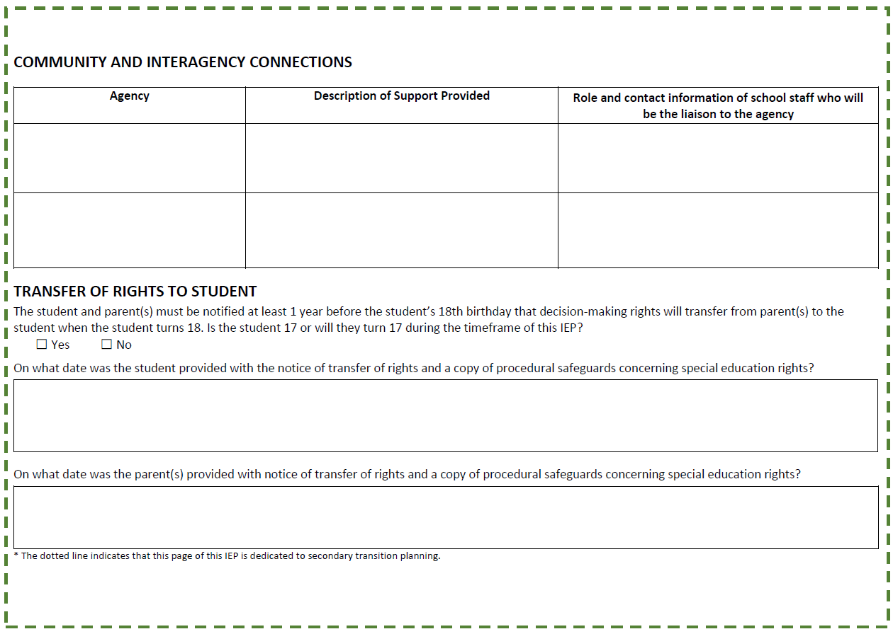
Interagency Connections & Transfer of Rights
CURRENT
(New)
Notes:
Time Allotment:
1 minute
There are also spaces to document community and interagency connections such as Mass Commission for the Blind, department of developmental services, pre-employment transition service providers, local independent living centers and any other community agencies that are connected with the student. We don’t want the students only team to be the school team and this indicates who from the school team is liaising with any outside organizations.
I do also want to point out that Transfer of rights is in the IEP now so that there is a clear discussion about student’s taking ownership of education when they turn 18 and their making a choice about who is going to help or not help with that process
https://www.mass.gov/info-details/pre-employment-transition-services-pre-ets

Slide 36
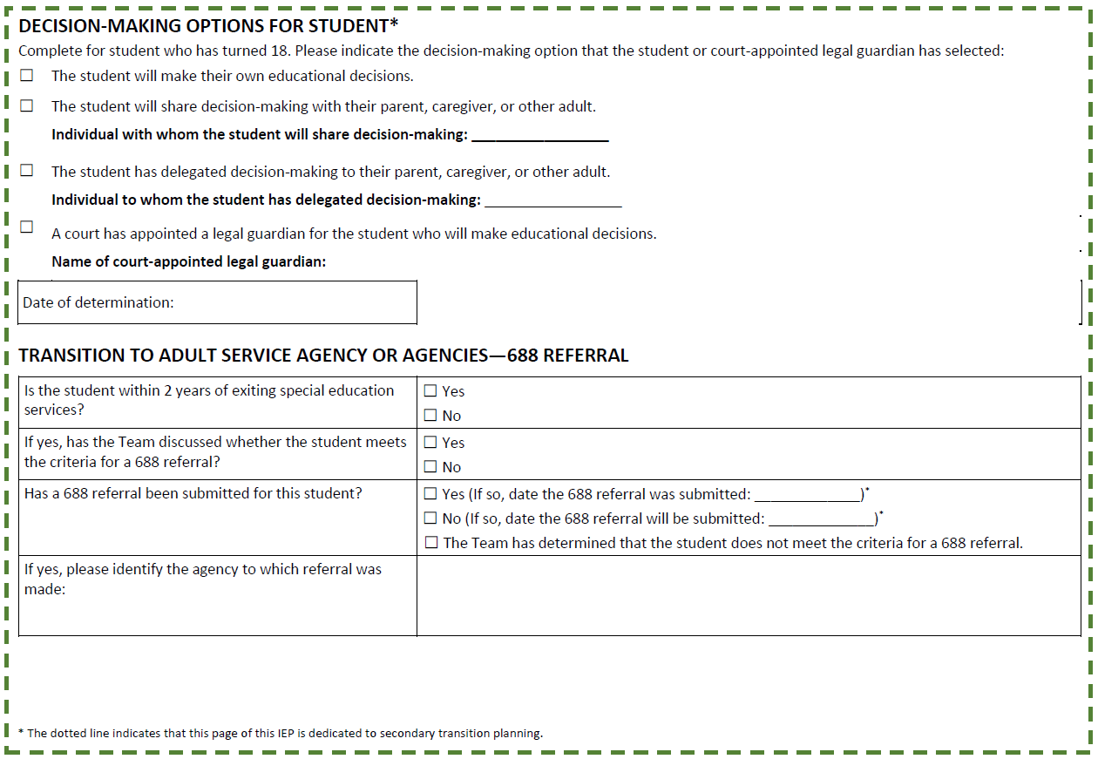
Decision-Making Options and 688 Referral
CURRENT
(New)
Notes:
Time: 1 minute
Facilitator Notes:
Also –
We start to talk about decision making and eventually transfer to adult service agencies
There’s a lot of confusion about what a 688 referral means in Massachusetts – this is NOT the direct referral for adult services to actually work with the student – this is the referral to get a specific adult service agency involved in making a plan for after the student exits public education
For students who are working with MCB, an automatic referral should be made.

Slide 37






Transition Service Questions
What experiences must the student participate in this academic year that are necessary for achieving the identified postsecondary goals?
What services and specific instruction are essential this year for the student to develop skills and knowledge to attain their postsecondary goals?
Do we know enough about this student’s vocational skills to identify an appropriate post-secondary employment goal or design activities to support the identified goal?
Notes:
Time Allotment:
1 minute
So just returning quickly to thinking about the student’s transition service needs:
It’s important to consider: [Read questions to audience]
If you have no idea what transition goals and objectives can look like for a student, I recommend searching for a topic brief on writing transition goals and objectives from Connecticut department of education: https://portal.ct.gov/-/media/SDE/Special-Education/Secondary-Transition/Topic-Brief_Writing-Transition-Goals-and-Objectives-(2017).pdf
We do know that many of the services that make a difference for students who are visually impaired include O&M training, assistive technology training, career counseling and community-based work experiences, life skills, community integration and recreation, self-advocacy and social skills development, and adequate educational support services including consideration of what support needs will be in a postsecondary learning environment
---------------------------------------------------------------------------------------------
Orientation and Mobility Training: Teaching individuals how to navigate their environments safely and independently using techniques such as cane travel or guide dog handling.
Assistive Technology Training: Providing access to and training on the use of assistive technologies such as screen readers, braille displays, and other adaptive tools that facilitate communication and access to information.
Career Counseling and Job Placement: Offering guidance on career options, job search strategies, resume writing, and interview preparation tailored to the needs and strengths of blind individuals.
Independent Living Skills: Teaching daily living skills such as cooking, cleaning, personal finance management, and self-care to promote autonomy.
Self-Advocacy and Social Skills Development: Empowering individuals to advocate for their needs and rights, and helping them develop social skills to interact effectively in various settings.
Educational Support Services: Providing accommodations and support in educational settings, including braille instruction, note-taking assistance, and access to accessible educational materials.
Community Integration and Recreation: Facilitating participation in community activities and recreational programs to enhance social inclusion and quality of life.
Family and Peer Support: Involving family members in the transition process and connecting individuals with peer support groups for shared experiences and advice.

Slide 38

Annual IEP Goals
For each postsecondary goal, there must be an annual goal or goals included in the IEP that will help the student make progress towards the stated postsecondary goals.
Notes:
Time: 1 Minute
Facilitator Notes:
We also need to make sure that there is at least one annual goal or goals in this year’s IEP that will help the student make progress toward their postsecondary goals.
This is where mistakes are sometimes made in transition planning. IF we do have strongly worded measurable postsecondary goals, we still need to do the work to crosswalk between those goals and the annual goals to make sure that there is at least one annual goal, or objective within an annual goal, that is directly aimed at helping the student to make progress toward each of the postsecondary goals the student has: including learning or training, work, and independent living

Slide 39
Annual IEP Goal Questions
What skills and knowledge does the student currently have that support their postsecondary goals?
What skills and knowledge must the student attain this academic year that are necessary for achieving the identified postsecondary goals?
What services and experiences must the student participate in this academic year that are necessary for achieving the identified post-secondary goals?
Notes:
Time Allotment:
1 minute
Facilitators Notes:
So, when determining annual IEP goals, you should ask yourself these questions:
[READ SLIDE]

Slide 40
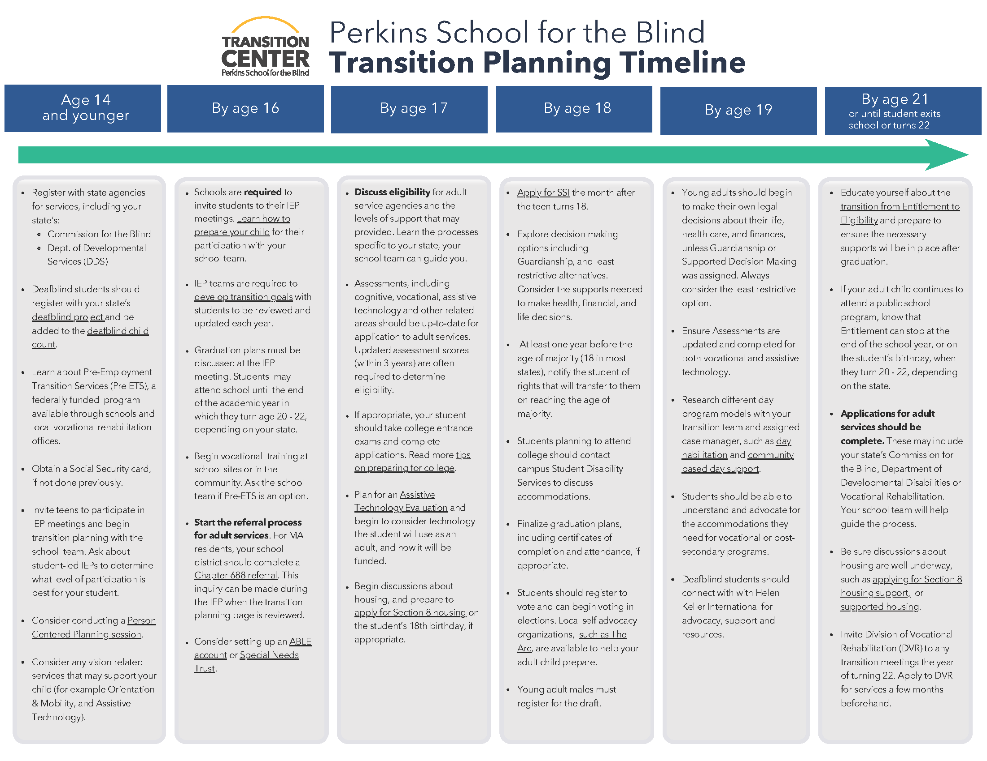
Perkins School for the Blind Transition Planning Timeline
Notes:
Time Allotment:
2 minute
I also wanted to mention that Perkins School for the Blind has a transition planning timeline that is worth consulting.
This by no means covers all of the activities and services that a student needs to participate in for transition planning but there are some critical and time sensitive topics that this timeline addresses including:
Early registration with state supports like Mass Commission for the Blind, Department of Developmental Services, and Pre-Employment Transition Services
It addresses things like making sure students have a social security card although I also think obtaining state identification or a RealID is critical for safety and independence
And for students who may plan to attend college, it mentions taking entrance exams, which is a great transition planning activity and we certainly need to make sure we’ve thought about when to apply for accommodations so that there is enough time to have those in place for testing

Slide 41
References & Resources
Gaumer Erickson, A.S., Morningstar, M. E., Lattin, D.L., & Cantrell, L. (2008). Transition Assessment Planning Form. Lawrence, KS: University of Kansas, Transition Coalition.
Mazzotti, V. L., Rowe, D. A., Kwiatek, S., Voggt, A., Chang, W.-H., Fowler, C. H., Poppen, M., Sinclair, J., & Test, D. W. (2021). Secondary Transition Predictors of Postschool Success: An Update to the Research Base. Career Development and Transition for Exceptional Individuals, 44(1), 47-64. https://doi.org/10.1177/2165143420959793
Mittnacht, M. (2014) Technical Assistance Advisory SPED 2014-4: Transition Assessment in the Secondary Transition Planning Process. Massachusetts Department of Elementary and Secondary Education. Retrieved from https://www.doe.mass.edu/sped/advisories/2014-4ta.html December 4, 2023.
Notes:
Mention NSTTAC – transition assessment toolkit AND presenter’s guide for transition assessment presentation

Slide 42
References & Resources – Cont.
Rowe, D.A., Test, D., and Fowler, C. Using Transition Assessment to Guide IEP Development – 3-hour presentation. [Slideshow] National Secondary Transition Technical Assistance Center, Charlotte, NC, United States. Retrieved from https://www.nsttac.org/content/table-contents-transition-assessment-presenter-guide/ July 24, 2023
Sitlington, P. L., Neubert, D. A., & Leconte, P. J. (1997). Transition assessment: The position of the Division on Career Development and Transition. Career Development for Exceptional Individuals, 20, 69-79.
Wagner, M., Newman, L., & Javitz, J. (2017). Vocational education course taking and post-high school employment of youth with emotional disturbances. Career Development and Transition for Exceptional Individuals. 40, 132–143.
National Technical Assistance Center on Transition (NTACT) - Age-Appropriate Transition Assistance Toolkit - https://transitionta.org/transition-assessment/
Notes:
Mention NSTTAC – transition assessment toolkit AND presenter’s guide for transition assessment presentation

Slide 43

Questions

