Slide 1
Special Commission on Licensing of
Foreign-Trained Medical Professionals
Second Meeting
October 20, 2021

Slide 2
Agenda
Welcome and Introductions
Approval of September 20, 2021 FTMP Commission Minutes (VOTE)
Review of Commission Charge, Timeline and Deliverables
Data Presentations:
  Statutory Barriers to Licensure of FTMPs
    James G. Lavery, Director, Bureau of Health Professions Licensure
  Access to Medical Professionals for the Commonwealth’s Underserved Populations & Practice Barriers for Foreign-Trained Medical Professionals
    Amy Grunder, JD and Dr. Robert Marlin, MD
    Massachusetts Immigrant and Refugee Advocacy Coalition
    Jeff Gross, PhD, World Education Services Global Talent Bridge
Next Steps

Slide 3
Commission Charge
Phase 1: Data
(identify barriers/compare states)
Phase 2: Discussion
(need/strategy/solutions)
Phase 3: Development
(recommendations/legislation)
Phase 4: Drafting
(legislative report)

Slide 4
Commission Timeline
Meeting #1 – September 20, 2021 – Commission introduction
Meeting #2 – October 20, 2021 – Identify barriers
Meeting #3 – December 1, 2021 – Compare other states
Meeting #4 – January 12, 2022 – Discuss strategies
Meeting #5 – February 16, 2022 – Develop recommendations
Meeting #6 – March 16, 2022 – Finalize draft report

Slide 5
Commission Deliverable
Pursuant to section 102 of chapter 41 of the acts 2019 (FY20 Budget)
The commission must submit a report containing its recommendations, including:
  drafts of proposed legislation to carry out its recommendations; and
  guidelines for full and conditional licensing of foreign-trained medical professionals.
The report must be filed with the house and senate clerks and the joint committee on public health no later than April 1, 2022.

Slide 6

Data Presentation
Statutory Barriers to Licensure of Foreign-Trained Medical Professionals
James G. Lavery, Chair
Director, Bureau of Health Professions Licensure
Department of Public Health

Slide 7
Statutory Barriers – Physicians
BORIM licenses foreign trained physicians after a review and determination that their training is “substantially the equivalent.”
Regulations at 243 CMR 2.03 set criteria that, if met, is automatically considered substantially equivalent.
The regulation also provides a mechanism to request consideration by the Board of training that does not meet the standard criteria.
The Board determines substantial equivalency for these alternate scenarios on a case-by-case basis.

Slide 8
Statutory Barriers – Physicians
M.G.L. c. 112, § 2: Registration of Physicians; Alien Applicants
An applicant who has received from a medical school, legally chartered in a sovereign state other than the United States, the commonwealth of Puerto Rico or Canada, a degree of doctor of medicine or its equivalent shall be required to furnish to the board such documentary evidence as the board may require that his education is substantially the equivalent of that of graduates of medical schools in the United States and such other evidence as the board may require as to his qualifications to practice medicine, and shall, unless granted an exemption by the board, be required to present a Standard Certificate granted after examination by the Educational Council for Foreign Medical Graduates; provided, however, that an applicant who shall furnish the board with satisfactory proof that he is eighteen years of age or over and of good moral character, that he has completed two years of premedical studies in a college or university of the United States or Canada shall not be required to possess a certificate by the Educational Council for Foreign Medical Graduates and shall be admitted to the examination for licensure if he has studied medicine in a medical school outside the United States which is recognized by the World Health Organization, has completed all the formal requirements for the degree corresponding to doctor of medicine except internship and social service or internship or social service, has satisfactorily completed one academic year of supervised clinical training sponsored by an approved medical school in the United States or Canada, and has completed one year of graduate medical education in a program approved by the Liaison Committee on Graduate Medical Education of the American Medical Association.

Slide 9
Statutory Barriers – Physicians
M.G.L. c. 112, § 2: Registration of Physicians; Alien Applicants (continued)
An applicant failing to pass an examination satisfactory to the board shall be entitled to two reexaminations within two years at a meeting of the board called for the examination of applicants upon payment of a further fee determined under the aforementioned provision for each reexamination; but two such reexaminations shall exhaust his privilege under his original application.
The board may without examination grant certificates of registration as qualified physicians to such graduates of medical schools: (1) who shall furnish with their applications satisfactory proof that they have the qualifications required in the commonwealth to entitle them to be examined and have been licensed or registered upon a written examination in another state whose standards, in the opinion of the board, are equivalent to those in the commonwealth, or (2) who are diplomates of specialty boards recognized by the American Medical Association or the American Osteopathic Association; provided that any person who has previously attempted unsuccessfully to secure registration in the commonwealth shall be registered under the provisions of this paragraph without examination only at the discretion of the board. The fee for such registration without examination shall be determined under the aforementioned provision.

Slide 10
Statutory Barriers – Physicians
M.G.L. c. 112, § 2: Registration of Physicians; Alien Applicants (continued)
Notwithstanding any other provisions of this chapter the board may without examination grant a certificate of registration as a qualified physician to such person as shall furnish with his application satisfactory evidence that he is: (1) a graduate of a Canadian medical school, or a medical school legally chartered in a sovereign state other than the United States or the commonwealth of Puerto Rico, and is licensed by the Medical Council of Canada and by a provincial licensing authority; or (2) is licensed in the commonwealth of Puerto Rico or in the province of Saskatchewan in Canada upon obtaining a grade of seventy-five per cent or better in the federation licensing examination of the federation of state medical boards of the United States. Any person granted a certificate of registration under the provisions of this paragraph shall pay a fee determined under the aforementioned chapter seven provision.

Slide 11
Statutory Barriers – Physicians
M.G.L. c. 112, § 2: Registration of Physicians; Alien Applicants
Notwithstanding any other provision of this chapter, the board may without examination grant a certificate of registration as a qualified physician to a person who is a graduate of a medical school which is legally chartered in a sovereign state other than the United States, the commonwealth of Puerto Rico or Canada, if such person furnishes proof satisfactory to the board that: (1) he has a full time academic appointment at a legally chartered medical school in the commonwealth; (2) he is qualified and competent in the field of medicine or surgery; and (3) he has been licensed or registered to practice medicine in such other state or country and has held a faculty appointment at a medical school legally chartered in such other state or country. Application for registration as a qualified physician, signed and sworn to by the applicant under the provisions of this section shall be made upon blanks furnished by the board. If satisfied as to the applicant's qualifications, and upon payment of a fee by such applicant, the board may issue to such applicant a certificate of registration as a qualified physician. Such certificate shall be restricted to the specialty in which he holds his academic appointment and shall be valid only so long as he holds a full time academic appointment. In addition to the requirements for renewal of certificates of registration under the provisions of section two, physicians registered under this section shall furnish with their renewal applications evidence satisfactory to the board that they continue to hold the faculty appointment required by this section. The board may adopt, amend and rescind such rules and regulations as it deems necessary to carry out the provisions of this section.

Slide 12
Statutory Barriers – Reputable Dental College
M.G.L. c. 112, § 46: Reputable dental college; definition
A dental college shall be considered reputable which possesses the following qualifications:
First, It shall be incorporated and authorized by its charter to confer degrees of doctor of dental medicine, doctor of dental surgery or doctor of dental science.
Second, It shall have a competent faculty and corps of instructors. The teaching staff shall deliver a comprehensive and satisfactory course of lectures supplemented by adequate clinical and laboratory exercises in all subjects pertaining to modern dentistry.
Third, It shall give a course of not less than four separate academic years to matriculants who are graduates of accredited high schools or who present proof of equivalent training, or a course of not less than three separate academic years to matriculants who present satisfactory proof of having successfully completed two years of appropriate pre-dental training in a college or university authorized to grant degrees. Each academic year shall consist of not less than thirty-two weeks.
The administrative policy of the dental college shall be such as to accomplish the requirements of this section.

Slide 13
Statutory Barriers – Reputable Dental College
This term appears throughout the General Laws, including the enabling statute for the Board of Registration in Dentistry, M.G.L. c. 13, § 46, which makes it a condition of appointment to the Board. Additional references can be found in M.G.L. c. 112, § § 45 (requirements of registration); 45A (limited registration); 45B (temporary registration); and 53 (dentist from another state), and in section 420 of chapter
BHPL has recommended an amendment to this statute for several years, which was most recently included as Outside Sections 39 and 40 in the Governor’s FY19 House 2 but was not adopted as part of the final budget.
    This proposed language would amend M.G.L. c. 112, §45A, and repeal §46 to ensure equal treatment by the Board of Registration in Dentistry (BORD) of equally qualified applicants by allowing BORD to confer a limited license to practice dentistry in a dental school, hospital or dental clinic to foreign educated applicants with dental education in the UK and former British Colonies.
    M.G.L. c. 112, §45A requires an applicant for a limited dental license to possess a diploma from a “reputable dental college”, which is defined in §46 as one that confers a DDS/DMD.
    A DDS/DMD curriculum begins after a student has earned an undergraduate degree.
    These UK educated applicants receive a bachelors in dental science (BDS), which combines the undergraduate education with the dental education curriculum (equal to DDS/DMD curriculum).
    These sections would relieve the burden on these applicants by replacing disparate, specific requirements with BORD expertise to approve dental diplomas.

Slide 14
Statutory Barriers – Reputable Dental College
When we arrive at the recommendations phase of the commission, the chair will recommend the following changes:
Section 45A of chapter 112 of the General Laws, as so appearing, is hereby amended by striking out, in lines 4 and 5, the words "the faculty of a reputable dental college as defined in section forty-six" and inserting place thereof the following words:-
a dental college approved by the board.
Summary: This section and the subsequent section permit the Board of Dentistry to confer a limited license to practice dentistry on a foreign educated applicant who, in addition to satisfying the other statutory requirements, has received a degree from a dental college approved by the Board.
Section 46 of said chapter 112 is hereby repealed.
Summary: This section and the previous section permit the Board of Dentistry to confer a limited license to practice dentistry on a foreign educated applicant who, in addition to satisfying the other statutory requirements, has received a degree from a dental college approved by the Board.

Slide 15
Statutory Barriers - Canadian Nurse Licensure
M.G.L. c. 112, § 76B: Canadian nurse licensure; reciprocity
Any person who has taken and passed the State Board Testing Pool Exam by standards acceptable to the board, and has been registered by a province of Canada in which an examination was taken before August first, nineteen hundred and seventy, and meets the eligibility requirements of clinical and theoretical study as determined by the board, and furnishes to the board satisfactory proof of good moral character and having graduated from a school of nursing approved by the board of nursing in the jurisdiction in which the applicant was originally registered shall be deemed to have met standards substantially the same as those of the commonwealth for the licensing of nurses and shall be licensed in the commonwealth without examination.
Any person who has taken the Canadian Nurses Association Testing Service Exam in English after August first, nineteen hundred and seventy, and has achieved individual scores greater than four hundred in each component of said examination and has been registered by a province of Canada in which an examination was taken, and meets the eligibility requirements of clinical and theoretical study as determined by the board, and furnishes to the board satisfactory proof of good moral character and having graduated from a school of nursing approved by the board of nursing in the jurisdiction in which the applicant was originally registered shall be deemed to have met standards substantially the same as those of the commonwealth for the licensing of nurses and shall be licensed in the commonwealth without examination.

Slide 16
Statutory Barriers - Canadian Nurse Licensure
M.G.L. c. 112, § 76B: Canadian nurse licensure; reciprocity (continued)
Any person who has taken the Canadian Nurses Association Testing Service Comprehensive Exam in English in August of nineteen hundred and eighty or thereafter and achieved a comprehensive score of greater than four hundred and has been registered by a province of Canada in which an examination was taken and meets the eligibility requirements of clinical and theoretical study as determined by the board, and furnishes to the board satisfactory proof of good moral character and having graduated from a school of nursing approved by the board of nursing in the jurisdiction in which the applicant was originally registered shall be deemed to have met standards substantially the same as those of the commonwealth for the licensing of nurses and shall be licensed in the commonwealth without examination.
Any person who has taken the Canadian Nurses Association Testing Service Exam in French after August first, nineteen hundred and seventy, and has achieved individual scores greater than four hundred in each component of said examination and has been registered by a province of Canada in which an examination was taken, and meets the eligibility requirements of clinical and theoretical study as determined by the board, and has attained a score of at least five hundred and fifty on the English Proficiency Examination and furnishes to the board satisfactory proof of good moral character and having graduated from a school of nursing approved by the board of nursing in the jurisdiction in which the applicant was originally registered shall be deemed to have met standards substantially the same as those of the commonwealth for the licensing of nurses and shall be licensed in the commonwealth without examination.

Slide 17
Statutory Barriers - Canadian Nurse Licensure
M.G.L. c. 112, § 76B: Canadian nurse licensure; reciprocity (continued)
Any person who has taken the Canadian Nurses Association Testing Service Comprehensive Exam in French in August of nineteen hundred and eighty or thereafter and achieved a comprehensive score of greater than four hundred and has been registered by a province of Canada in which an examination was taken and meets the eligibility requirements of clinical and theoretical study as determined by the board, and has attained a score of at least five hundred and fifty on the English Proficiency Examination and furnishes to the board satisfactory proof of good moral character and having graduated from a school of nursing approved by the board of nursing in the jurisdiction in which the applicant was originally registered shall be deemed to have met standards substantially the same as those of the commonwealth for the licensing of nurses and shall be licensed in the commonwealth without examination.

Slide 18
Statutory Barriers - Canadian Nurse Licensure
BHPL has recommended an amendment to this statute for several years, which was most recently included as Outside Sections 41 in the Governor’s FY19 House 2 but was not adopted as part of the final budget.
  The proposed language would have amended M.G.L. c. 112, §76B to eliminate references to obsolete licensure examinations that prevent the Board of Registration in Nursing (BORN) from issuing licenses based on reciprocity to otherwise qualified applicants with a Canadian nursing license.
  Currently, nurses registered in Canada cannot practice in Massachusetts through reciprocity unless they have passed named exams that no longer exist.
  This section would relieve the burden on these Canadian applicants for reciprocity by replacing specifically named examinations, which are likely to fall in and out of favor, with BORN expertise to approve currently administered examinations.

Slide 19
Statutory Barriers - Canadian Nurse Licensure
When we arrive at the recommendations phase of the commission, the chair will recommend the following change:
Said chapter 112 is hereby further amended by striking out section 76B, as so appearing, and inserting in place thereof the following section:-
Section 76B. (a) A person who satisfies the following requirements shall be deemed to have met the standards for the licensing of nurses in the commonwealth and shall be licensed in the commonwealth without examination: a person who (i) has taken and passed an examination approved by the board and conducted in the English language; (ii) has been registered by a province of Canada; (iii) meets the eligibility requirements of clinical and theoretical study as determined by the board; (iv) furnishes to the board satisfactory proof of good moral character; and (v) has graduated from a school of nursing approved by the board of nursing in the jurisdiction in which the applicant was originally registered.
(b) A person who has taken and passed an examination approved by the board and conducted in a language other than English who satisfies the following requirements shall be deemed to have met standards for the licensing of nurses in the commonwealth and shall be licensed in the commonwealth without examination: a person who (i) has taken and passed a test of English proficiency approved by the board; (ii) has been registered by a province of Canada; (iii) meets the eligibility requirements of clinical and theoretical study as determined by the board; (iv) furnishes to the board satisfactory proof of good moral character; and (v) has graduated from a school of nursing approved by the board of nursing in the jurisdiction in which the applicant was originally registered.
Summary: This section eliminates an obsolete testing requirement as a prerequisite for nurses certified in Canada to receive a nursing license in the Commonwealth.

Slide 20

Data Presentation
Access to Medical Professionals for the Commonwealth’s Underserved Populations & Practice Barriers for Foreign-Trained Medical Professionals
Amy Grunder, J.D. and Dr. Robert Marlin, M.D., Commission Members
Massachusetts Immigrant and Refugee Advocacy Coalition
Jeff Gross, PhD,
World Education Services Global Talent Bridge

Slide 21
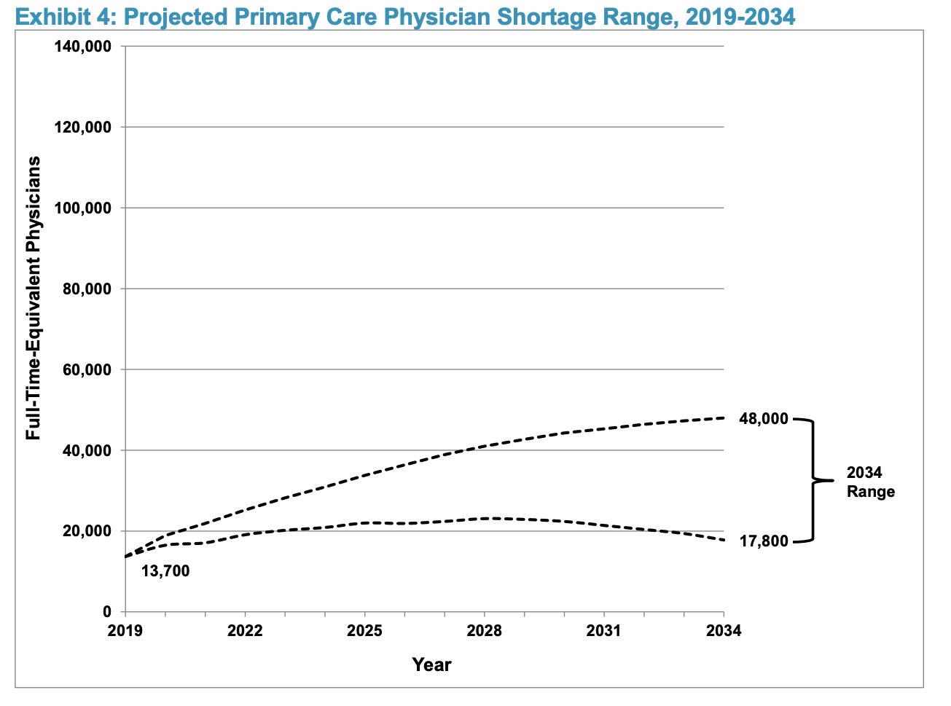
Health Professional Supply and Demand in Rural and Underserved Communities in Massachusetts – Primary Care Physician Supply and Demand Projections
Projected PCP Shortage in the U.S. by 2034
The American Association of Medical Colleges projects PCP demand to exceed supply by between 17,800 and 48,000 PCPs in the U.S. by 2034.
The projections account for various determinants in physician supply (e.g., medical school graduation rates, number of residency slots, rate of retirements), the changing demographics of a growing and aging population, and the expanding role of advanced practice registered nurses (APRNs) and physician assistants (PAs) in meeting primary care needs.
Notes:
Source: AAMC, The Complexities of Physician Supply and Demand: Projections From 2019 to 2034 (June 2021) https://www.aamc.org/media/54681/download?attachment

Slide 22
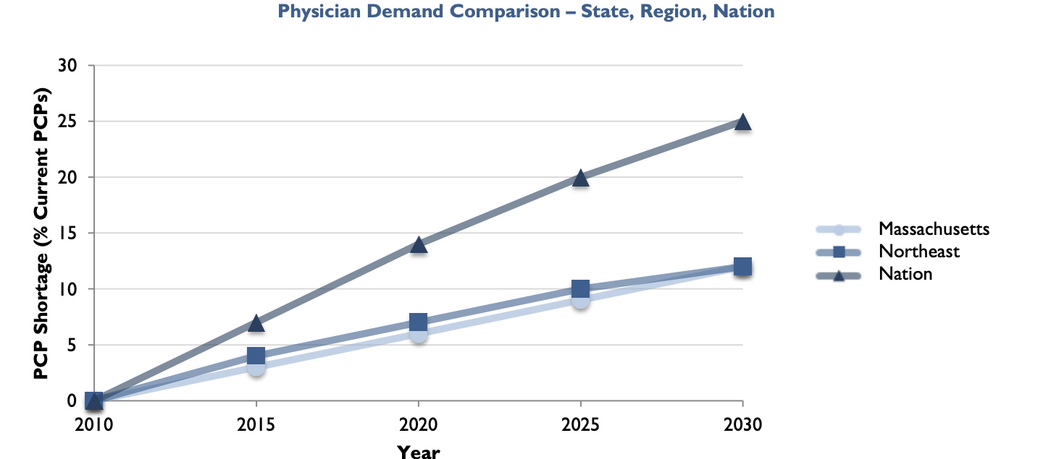
Health Professional Supply and Demand in Rural and Underserved Communities in Massachusetts – Primary Care Physician Supply and Demand Projections
Projected Demand for PCPs in Massachusetts by 2030
These projections indicate that by 2030 the demand for PCPs in Massachusetts is projected to grow by 12% (from 5,807 in 2010 to 6,532 in 2030).
The research modeled the workforce necessary to maintain current primary care utilization rates using a 2010 baseline, accounting for increased demand from an aging population, population growth, and expanded coverage under the Affordable Care Act.
A 2016 study by the U.S. Health Resources and Services Administration projected that by 2025 Massachusetts would be the only U.S. state with a surplus (1,230 PCPs). But the challenge remains the scarcity of providers in underserved areas.
Notes:
Sources:
Robert Graham Center, Massachusetts: Projecting Primary Care Physician Workforce (2013) https://www.graham-center.org/content/dam/rgc/documents/maps-data-tools/state-collections/workforce-projections/Massachusetts.pdf;
U.S. Health Resources and Services Administration, State-Level Projections of Supply and Demand for Primary Care Practitioners: 2013-2025 (2016), https://bhw.hrsa.gov/sites/default/files/bureau-health-workforce/data-research/primary-care-state-projections2013-2025.pdf.

Slide 23

Health Professional Supply and Demand in Rural and Underserved Communities in Massachusetts – Shortage Areas of Physicians and Dentists in Massachusetts
Health Professional Shortage Areas by Population and Percent of Need Met
Even with the highest physician to population ratio in the country, federal data on Health Professional Shortage Areas points to significant gaps across Massachusetts in Primary Care, Dental Health, and Mental Health Care, affecting hundreds of thousands of state residents.
HPSAs may be geographic (a county or service area), population (e.g., low income or Medicaid eligible), or facilities (e.g., a federally qualified health center or a state or federal prison).
Notes:
Sources:
AAMC, 2019 Massachusetts Physician Workforce Profile, https://www.aamc.org/media/37941/download
Bureau of Health Workforce Health Resources and Services Administration (HRSA), Designated Health Professional Shortage Areas Statistics. Fourth Quarter of Fiscal Year 2021 Designated HPSA Quarterly Summary As of September 30, 2021, https://data.hrsa.gov/Default/GenerateHPSAQuarterlyReport

Slide 24
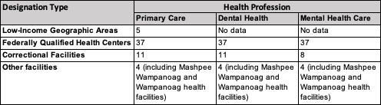
Health Professional Supply and Demand in Rural and Underserved Communities in Massachusetts – Shortage Areas of Physicians and Dentists in Massachusetts
Health Professional Shortage Areas by Designation Type
Low-income geographic areas designated as HPSAs in Massachusetts include Salem/Peabody/Lynn/Beverly, Springfield/Chicopee/Holyoke, and the cities of Worcester, Gloucester and New Bedford.
FQHCs, correctional facilities, and other HPSA facilities are present in all Massachusetts counties except Nantucket. (See Health Resources and Services Administration’s “HPSA Find” tool for more detail: https://data.hrsa.gov/tools/shortage-area/hpsa-find.)
Notes:
Source:
Designated Health Professional Shortage Areas Statistics. Fourth Quarter of Fiscal Year 2021 Designated HPSA Quarterly Summary As of September 30, 2021. Bureau of Health Workforce Health Resources and Services Administration (HRSA), U.S. Department of Health & Human Services https://data.hrsa.gov/Default/GenerateHPSAQuarterlyReport

Slide 25
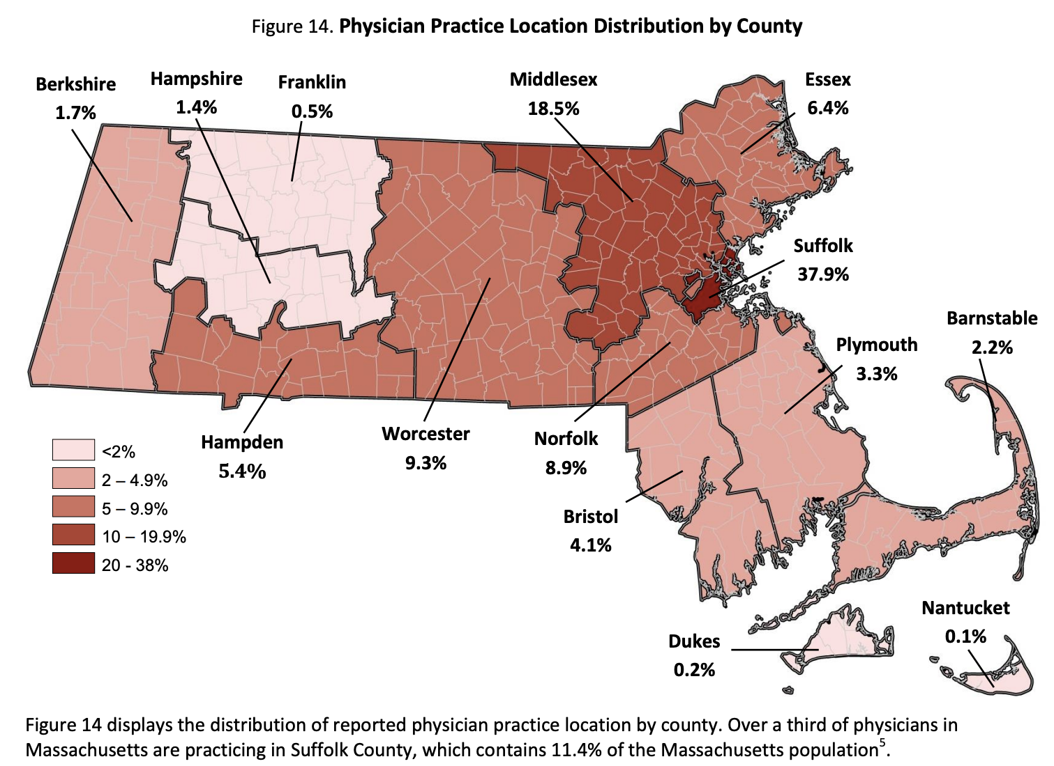
Health Professional Supply and Demand in Rural and Underserved Communities in Massachusetts – Shortage Areas of Physicians and Dentists in Massachusetts
Geographic Distribution of Physicians by County
Based on 2014 data, counties in Western and Southeastern Massachusetts have the lowest concentration of physician practices, including designated rural areas in Franklin, Berkshire, Barnstable, and Dukes counties.
Almost 40% of physicians in Massachusetts are practicing in Suffolk County, which contains just 11.4% of the state’s population.
Notes:
Source:
MA Health Care Workforce Center, Data Brief: Health Professions Data Series – Physicians 2014 (2016) https://www.mass.gov/doc/the-massachusetts-health-professions-data-series-physicians-0/download

Slide 26
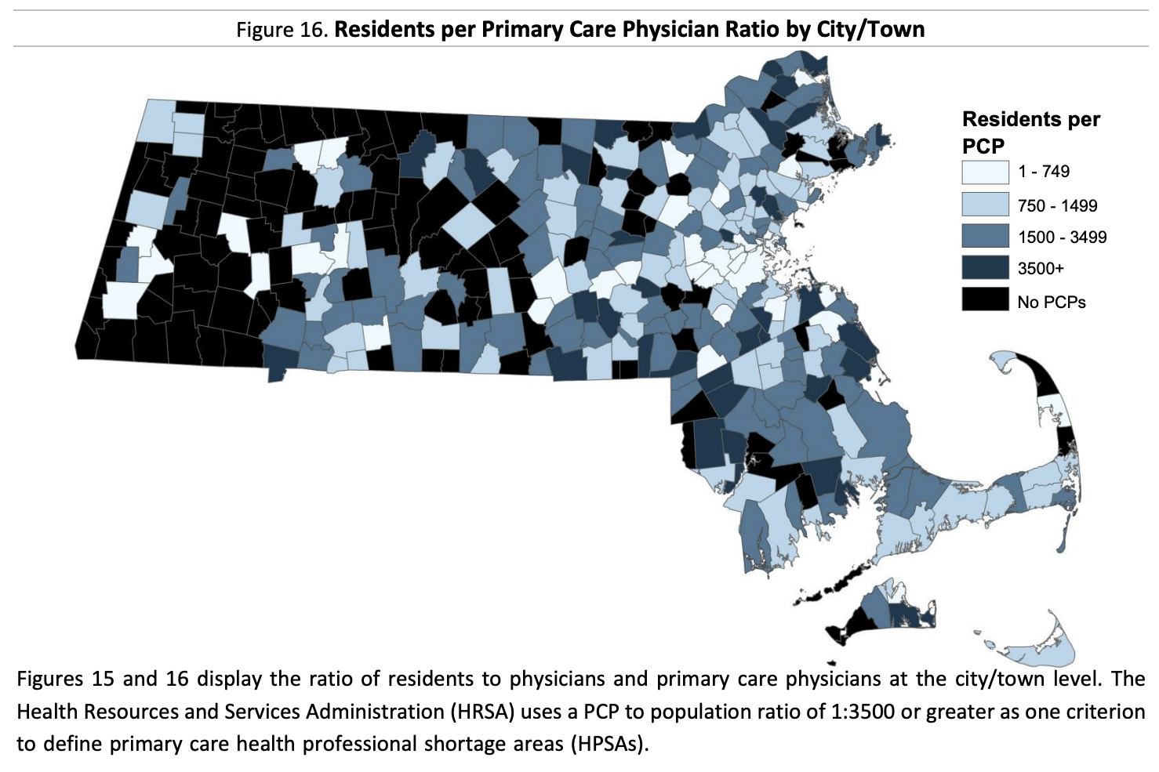
Health Professional Supply and Demand in Rural and Underserved Communities in Massachusetts – Shortage Areas of Physicians and Dentists in Massachusetts
Massachusetts Residents per Primary Care Physician by City/Town
Compared to Greater Boston, a larger number of municipalities in Western and Central MA and in Northeast and Southeast Massachusetts have few or no PCPs, in some cases with none in adjoining towns/cities.
Research shows that the racial and ethnic diversity of the PCP workforce in HPSAs is significantly more diverse than the PCP workforce as a whole. Studies indicate that racial and ethnic minority patients have better health care outcomes with minority providers.
But the overall shortages of PCPs in HPSAs, of whatever background, remain a challenge for those patients. Lower pay and poor working conditions account in part for these shortages of providers in HPSAs.
Notes:
Sources:
MA Health Care Workforce Center, Data Brief: Health Professions Data Series – Physicians 2014 (2016) https://www.mass.gov/doc/the-massachusetts-health-professions-data-series-physicians-0/download
Xiareli and Nivet, “The Racial and Ethnic Composition and Distribution of Primary Care Physicians”, Journal of Health Care for the Poor and Underserved, 2018 29(1) https://www.ncbi.nlm.nih.gov/pmc/articles/PMC5871929
Powe and Cooper, Disparities in Patient Experiences, Health Care Processes, and Outcomes: The Role of Patient-Provider Racial, Ethnic, and Language Concordance (The Commonwealth Fund, 2004) https://www.commonwealthfund.org/publications/fund-reports/2004/jul/disparities-patient-experiences-health-care-processes-and.

Slide 27
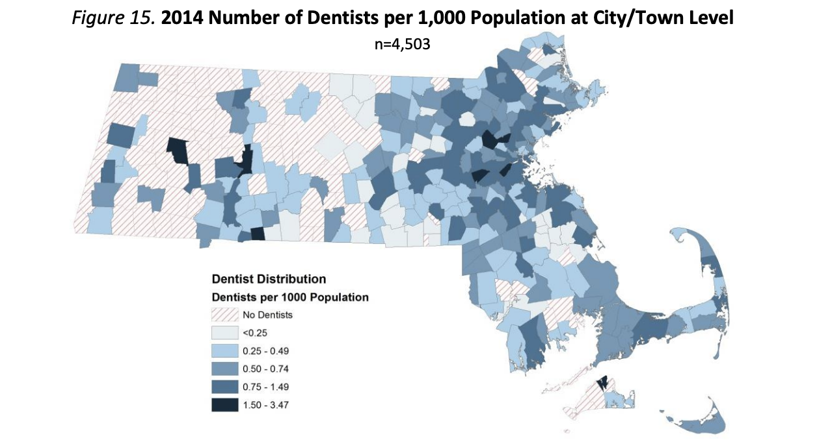
Health Professional Supply and Demand in Rural and Underserved Communities in Massachusetts – Shortage Areas of Physicians and Dentists in Massachusetts
Massachusetts Residents per Dentist by City/Town
As with PCPs, many towns and cities in Western and Central Massachusetts and in Northeast and Southeast Massachusetts have few or no dentists and in some cases none in adjoining towns/cities.
Only 2.6% of dentists in Massachusetts practice in a community health center setting, where the vast majority of patients with MassHealth receive services. (Only 44.3% of dentists working in group practice and 39.4% in solo practice reported treating patients with MassHealth, compared to 97.5% in community health centers).
Only 55.1% of the 668,111 individuals under the age of 21 enrolled in MassHealth in 2015 received any dental or oral health services, meaning nearly 300,000 received no oral health care during this time period.
Notes:
Source:
MA Health Care Workforce Center, Data Brief: Health Professions Data Series – Dentists 2014 (2016) https://www.mass.gov/doc/the-massachusetts-health-professions-data-series-dentists-2014/download

Slide 28
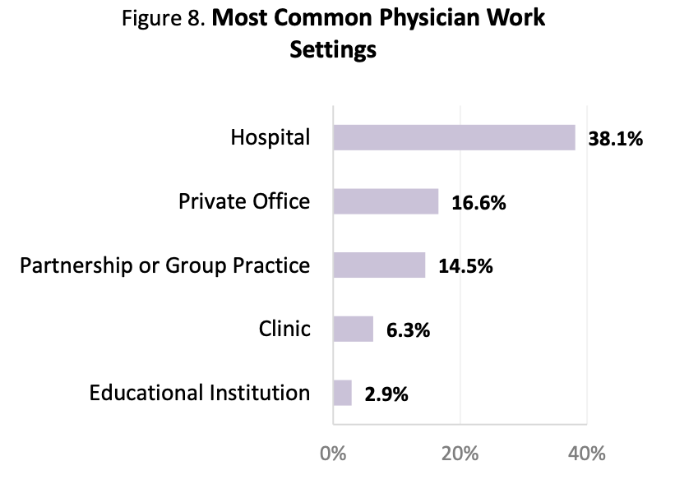
Health Professional Supply and Demand in Rural and Underserved Communities in Massachusetts – Shortage Areas of Physicians and Dentists in Massachusetts
Work Settings for Physicians in Massachusetts
Only 20% of physicians in Massachusetts are PCPs and just 6.3% of physicians work in clinics, which primarily serve under-served populations.
A greater percentage of female physicians (8.5%) work in clinics compared to male physicians (4.8%).
The percentage of physicians in Massachusetts that earned their medical degree from an international medical school (20%) is smaller than the national percentage of 24.2%.
Notes:
Source:
MA Health Care Workforce Center, Data Brief: Health Professions Data Series – Physicians 2014 (2016) https://www.mass.gov/doc/the-massachusetts-health-professions-data-series-physicians-0/download

Slide 29

Health Professional Supply and Demand in Rural and Underserved Communities in Massachusetts – Shortage of Nurses in Massachusetts
Supply and Demand for RNs and LPNs in Massachusetts by 2030
2017 research predicts the supply of RNs in Massachusetts will exceed demand by 2030. A new Harvard study, however, points to recent pandemic-driven shortages of clinical care nurses, as a result of interrupted exams and clinical placements of incoming nurses and the accelerating attrition and retirements of RNs of all ages, posing concerns for the long-term RN pipeline.
The same 2017 study predicted the supply of LPNs in Massachusetts to be significantly below demand by 2030, largely due to rising needs for institutional and home health care for an aging population. As with RNs, the pandemic has created areas of uncertainty and new challenges with regard to the LPN pipeline.
Notes:
Sources:
U.S. Health Resources and Services Administration, Supply and Demand Projections of the Nursing Workforce: 2014-2030 (July 21, 2017)
https://bhw.hrsa.gov/sites/default/files/bureau-health-workforce/data-research/nchwa-hrsa-nursing-report.pdf
Harvard Project on the Workforce, COVID-19 and the Changing Massachusetts Health Care Workforce (September 30, 2021) https://www.pw.hks.harvard.edu/post/ma-healthcare-workforce

Slide 30
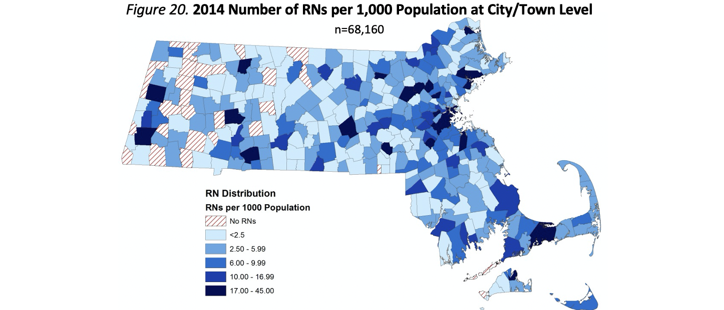
Health Professional Supply and Demand in Rural and Underserved Communities in Massachusetts – Shortage of Nurses in Massachusetts
Number of RNs per 1,000 Population at City/Town Level
2014 data indicate acute shortages of RNs in towns and cities in Western and Central Massachusetts, with many towns with no RNs. Many more locales statewide have only a very small share of RNs relative to their populations (less than 2.5 per 1,000).
These shortages also reflect the smaller presence in these parts of the state of community hospitals, academic medical centers, and hospital-based ambulatory care centers, where the majority of RNs in Massachusetts practice.
Only 2.3% of RNs practice in community health centers that serve primarily low income and other underserved populations.
Notes:
Source:
MA Health Care Workforce Center, Data Brief: Health Professions Data Series – Registered Nurses 2014 (2016) https://www.mass.gov/doc/the-massachusetts-health-professions-data-series-registered-nurses-2014/download

Slide 31
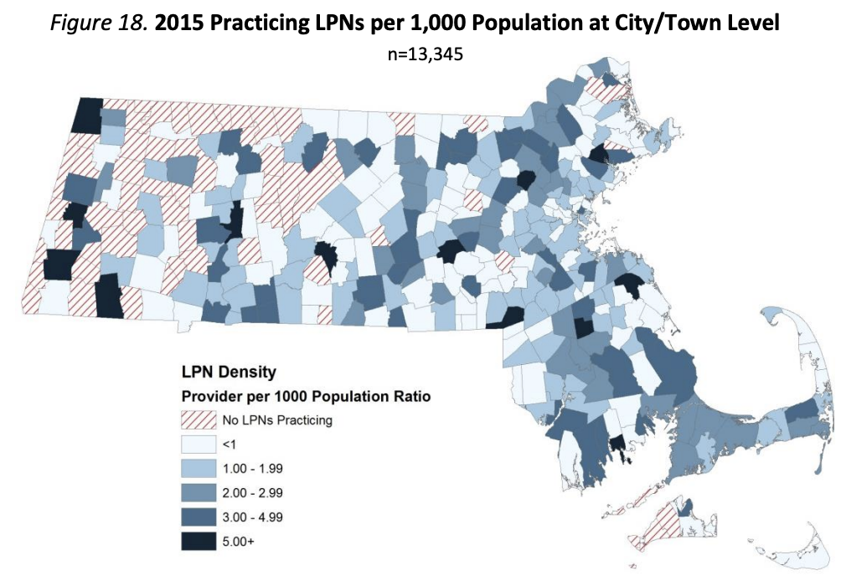
Health Professional Supply and Demand in Rural and Underserved Communities in Massachusetts – Shortage of Nurses in Massachusetts
Number of Practicing LPNs per 1,000 Population at City/Town Level
As with RNs, 2015 data indicate the most acute shortages of LPNs in towns and cities in Western and Central Massachusetts; many more locales statewide have only a very small share of LPNs relative to their populations (less than 1 per 1000).
Unlike RNs, the majority of LPNs work in skilled nursing, home health, chronic care or physician office settings.
Notes:
Source:
MA Health Care Workforce Center, Data Brief: Health Professions Data Series – LIcensed Practical Nurse 2015 (2018) https://www.mass.gov/doc/the-massachusetts-health-professions-data-series-licensed-practical-nurses-2015/download

Slide 32
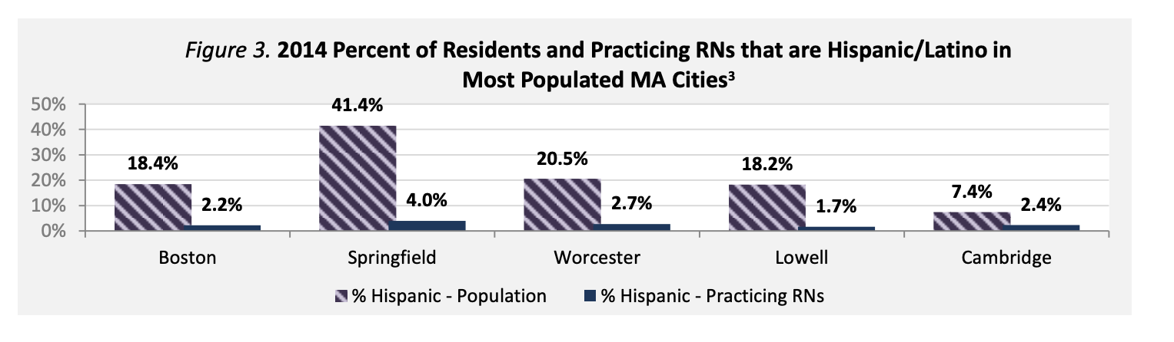
Health Professional Supply and Demand in Rural and Underserved Communities in Massachusetts – Shortage of Nurses in Massachusetts
Percent of Residents and Hispanic/Latino RNs in Most Populated Massachusetts Cities
In all five of the most populous Massachusetts cities, the percentage of Hispanic RNs is 3 to 10 times lower than the percentage of Hispanic residents.
These cities also have a much lower percentage of black, non-Hispanic RNs compared to the percentage of black, non-Hispanic residents.
Notes:
Source:
MA Health Care Workforce Center, Data Brief: Health Professions Data Series – Registered Nurses 2014 (2016) https://www.mass.gov/doc/the-massachusetts-health-professions-data-series-registered-nurses-2014/download

Slide 33
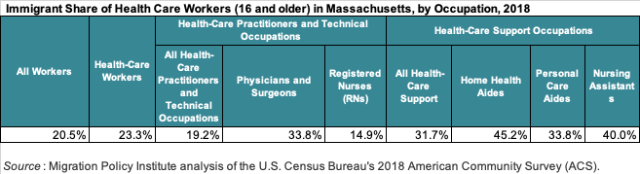
Underemployment of Foreign-trained Health Professionals in U.S. and Massachusetts – Immigrant Health Professionals in MA
Immigrant Share of Heath Care Workers in Massachusetts
With the exception of RNs, the representation of immigrants in the Massachusetts health care workforce is higher than their representation in the state’s workforce as a whole (19.8%).
Immigrants’ presence in healthcare support occupations is higher than their representation in healthcare professions.
Notes:
Sources:
Migration Policy Institute (MPI), Immigrant Healthcare Workers in the United States (2020, based on MPI analysis of 2018 American Community Survey data) https://www.migrationpolicy.org/article/immigrant-health-care-workers-united-states-2018;
MPI, State Immigration Data Profile - Massachusetts https://www.migrationpolicy.org/data/state-profiles/state/workforce/MA

Slide 34
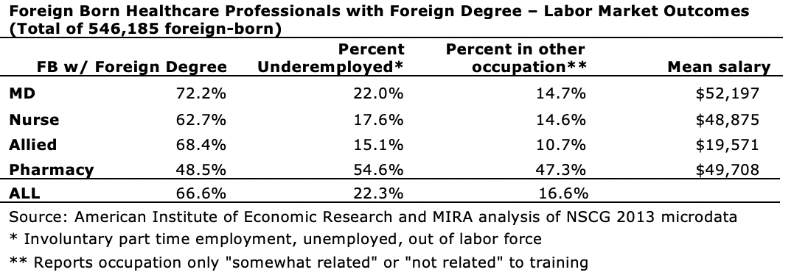
Underemployment of Foreign-trained Health Professionals in U.S. and Massachusetts – Foreign-Trained Health Professional Underemployment
Underemployment of Foreign-trained Immigrant Health Professionals in U.S.
The 2013 National Survey of College Graduates indicates that 22% of foreign-trained immigrant physicians and 17.6% of foreign-trained immigrant RNs in the U.S. are underemployed (i.e., either unemployed, employed part time, or out of the labor force), and 14.7% and 14.6% respectively are working in jobs outside their field of training if not outside of health care altogether, with mean salaries around $50,000.
This compares to 4.6% of U.S.-trained immigrant physicians and 18.1% of U.S.-trained immigrant RNs who are underemployed, and 6.7% and 25.3% respectively who are in another profession, with mean salaries of $92,142 and $62,282.
Notes:
Source:
Governor’s Advisory Council for Refugees and Immigrants (GACRI), Rx for Strengthening Massachusetts’ Economy and Healthcare System (2014, based on analysis of data from the 2013 National Survey of College Graduates) https://www.immigrationresearch.org/system/files/gac_task_force_report-final-12.18.14.compressed.pdf

Slide 35
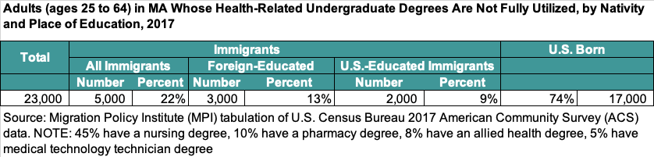
Underemployment of Foreign-trained Health Professionals in U.S. and Massachusetts – Foreign-Trained Health Professional Underemployment
Under-employment of Foreign-trained Immigrant Health Professionals in Massachusetts
13% of Massachusetts immigrants with foreign health-related undergraduate degrees are either unemployed or employed in lower paying, less-skilled jobs, compared to 9% of those with U.S. degrees.
Of these, 45% have a nursing degree, 10% have a pharmacy degree, 8% have a treatment therapy degree, and 5% have a medical technology technician degree.
Notes:
Source:
Migration Policy Institute, As U.S. Health-Care System Buckles under Pandemic, Immigrant & Refugee Professionals Could Represent a Critical Resource (April 2020, based on analysis of 2017 American Community Survey data) https://www.migrationpolicy.org/news/us-health-care-system-coronavirus-immigrant-professionals-untapped-resource

Slide 36
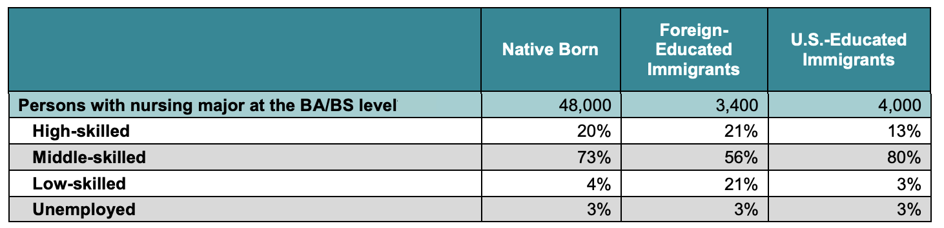
Underemployment of Foreign-trained Health Professionals in U.S. and Massachusetts – Foreign-Trained Health Professional Underemployment
Underemployment of Foreign-trained Immigrant Nurses in MA
In Massachusetts, 24% of foreign-educated nurses are either working in low-skilled jobs or unemployed, compared to just 6% of U.S.-educated immigrants
Notes:
Source:
Migration Policy Institute, Brain Waste in the Massachusetts Workforce (2014, based on analysis of 2010-2012 American Community Survey data) https://www.migrationpolicy.org/sites/default/files/publications/MPI_BrainWaste_MA-FINAL.pdf

Slide 37
Underemployment of Foreign-trained Health Professionals in U.S. and Massachusetts – Foreign-Trained Health Professional Underemployment
Barriers Facing All Foreign-Trained Health Professionals
Complex and unclear licensure requirements: Licensing board websites & resources often do not fully and clearly present the licensure requirements, potential time frames, and costs for internationally-trained applicants
Artificial licensing barriers: Unnecessary and/or potentially discriminatory regulatory barriers including required non-clinical coursework, time limits in completing testing, and rigid English proficiency requirements
Costs of licensure process, including exam and licensure fees and exam prep courses: Estimated costs in MA are $1,250-$5,000 for nurses, $8,000-$32,000 for doctors, and $2,700-$5,300 for pharmacists
Notes:
Sources:
Governor’s Advisory Council for Refugees and Immigrants (GACRI), Rx for Strengthening Massachusetts’ Economy and Healthcare System (2014, based on analysis of data from the 2013 National Survey of College Graduates) https://www.immigrationresearch.org/system/files/gac_task_force_report-final-12.18.14.compressed.pdf
Batalova, Fix & Bachmeir, Untapped Talent: The Costs of Brain Waste among Highly Skilled Immigrants in the United States (Migration Policy Institute, 2016) https://www.migrationpolicy.org/sites/default/files/publications/BrainWaste-FULLREPORT-FINAL.pdf

Slide 38
Underemployment of Foreign-trained Health Professionals in U.S. and Massachusetts – Foreign-Trained Health Professional Underemployment
Barriers Facing All Foreign-Trained Health Professionals (continued)
Limited English proficiency: Shortage in Massachusetts of publicly-funded advanced level English courses; lack of free prep courses for required standardized English exams
Difficulty evaluating foreign credentials: Many refugee or asylee medical professionals face challenges accessing official academic records required for credential evaluations
Shortage of career navigation programs: The one program in Massachusetts specifically for health professionals assists nurses only; no financial assistance is available to help professionals meet licensing-related fees and other costs
Notes:
Sources:
Governor’s Advisory Council for Refugees and Immigrants (GACRI), Rx for Strengthening Massachusetts’ Economy and Healthcare System (2014, based on analysis of data from the 2013 National Survey of College Graduates) https://www.immigrationresearch.org/system/files/gac_task_force_report-final-12.18.14.compressed.pdf
Batalova, Fix & Bachmeir, Untapped Talent: The Costs of Brain Waste among Highly Skilled Immigrants in the United States (Migration Policy Institute, 2016) https://www.migrationpolicy.org/sites/default/files/publications/BrainWaste-FULLREPORT-FINAL.pdf

Slide 39
Underemployment of Foreign-trained Health Professionals in U.S. and Massachusetts – Foreign-Trained Health Professional Underemployment
Barriers Facing Foreign-Trained Immigrant Physicians/International Medical Graduates
Competition for residency spots: While 93% U.S. medical school graduates get into medical residency programs, only 55% of foreign-born IMGs do (2021 match data)
Federal cap on number of residency spots: In 1997 Congress placed a cap on the number of Medicaid-funded residencies, a challenge with increasing numbers of medical graduates competing for a fixed number of slots.
“Catch-22” of recognized clinical experience: Most U.S. residency programs require applicants to have U.S. clinical experience, which normally can’t be obtained outside of a U.S. medical school or residency; “observership” programs offering limited clinical exposure are typically fee-based with erratic value.
Longer residency requirement: IMGs seeking licensure in Massachusetts must complete a minimum of three years of residency/graduate medical education vs. two years for U.S. medical graduates.
Notes:
Sources:
National Resident Matching Program, Results and Data: 2021 Main Residency Match (2021) https://mk0nrmp3oyqui6wqfm.kinstacdn.com/wp-content/uploads/2021/05/MRM-Results_and-Data_2021.pdf
American Association of Medical Colleges, “The Role of GME Funding in Addressing the Physician Shortage,” News & Insights (2021) https://www.aamc.org/news-insights/gme
American Medical Association, Observership Program Listings for International Medical Graduates (ND) https://www.ama-assn.org/education/international-medical-education/observership-program-listings-international-medical
American Medical Association, Initial Licensure of U.S. Medical Graduates and International Medical Graduates (ND) https://www.ama-assn.org/sites/ama-assn.org/files/corp/media-browser/public/img/licensure-comparison-imgs-usmgs_1.pdf

Slide 40
Underemployment of Foreign-trained Health Professionals in U.S. and Massachusetts – Foreign-Trained Health Professional Underemployment
Barriers Facing Foreign-Trained Immigrant Physicians/International Medical Graduates (continued)
Recency of medical school graduation: Most U.S. residency programs consider only recent medical school graduates (within prior 3-5 years), excluding many immigrant physicians with extensive practice experience.
Time limit for completing USMLE exams: Massachusetts requires that USMLE Steps 1, 2 and 3 must be completed within seven years, beginning when the examinee first passes either Step 1 or Step 2.
Complexity and costs of testing and other steps: Foreign-trained physicians often need career assistance in preparing for USMLE exams, completing the complex residency application process, and navigating educational and professional options, as well as help meeting associated costs. Free assistance programs and financial support are rarely available and don’t address structural barriers.
Notes:
Sources:
Task Force on Foreign-Trained Physicians Minnesota Department of Health, Report to the Minnesota Legislature 2015 (January 2015) https://www.house.leg.state.mn.us/comm/docs/4b9e077a-bf0b-4b9e-bc66-83ab8ce2dda2.pdf
Board of Registration in Medicine, Physician Licensing Fees and Eligibility Requirements (ND), https://www.mass.gov/service-details/physician-licensing-fees-and-eligibility-requirements
Governor’s Advisory Council for Refugees and Immigrants (GACRI), Rx for Strengthening Massachusetts’ Economy and Healthcare System (2014) https://www.immigrationresearch.org/system/files/gac_task_force_report-final-12.18.14.compressed.pdf

Slide 41
Next Steps
Next FTMP Commission Meeting
Wednesday, December 1, 2021
12:00pm to 2:00pm
Compare other states’ data (strategies/laws/regulations);
Barriers and successes in other states for potential adoption in Massachusetts.

Slide 42
Adjournment
Thank You

