Slide 1
WORKERS' COMPENSATION ADVISORY COUNCIL
FY'25 ANNUAL REPORT
Report prepared by Executive Director Maureen O'Connell
Voted on by Council Members January 14, 2026
Issued on January 14, 2026

Slide 2
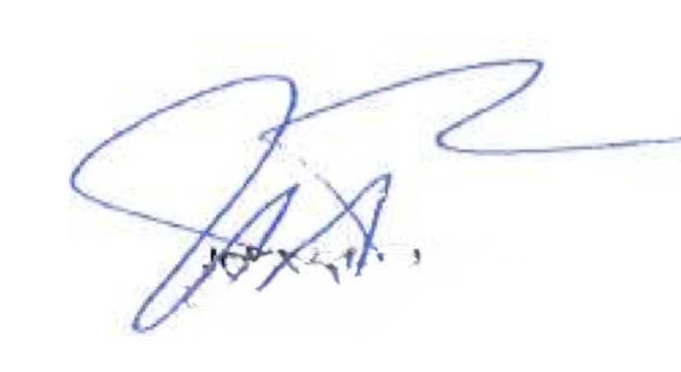
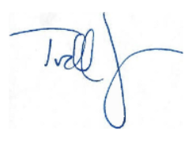
CHAIR WELCOME
The FY'25 Workers' Compensation Advisory Council's Annual report highlights the Department of Industrial Accident's (DIA) performance, accomplishments, and challenges throughout the fiscal year. Despite the challenging economic environment, the organization continued to advance its mission of administering the Commonwealth's workers' compensation system and provide prompt and fair compensation to injured workers.
The Council thanks and acknowledges the leadership of DIA Director Sheri Bowles, Senior Judge Omar Hernández, and the full DIA management team for guiding the agency (including in a hybrid work environment), as well as all DIA employees (including new hires and retirees) for their contributions to supporting injured workers and the mission of the Commonwealth’s workers’ compensation system.
This year the DIA experienced a decrease in staff during 2025 due to several planned retirements. Succession plans were implemented to ensure continuity of operations and knowledge transfer across departments. We thank each one of the employees for your years of service and wish them all the best in your next chapter.
Looking ahead to FY'26, the DIA will focus on stakeholder communications and publications by DIA will be refreshed and improved to better support transparency and engagement for a positive customer experience. The priorities remain centered on safety, the impartial physicians' roster and fee schedule, and the workers' compensation medical reimbursement rate.
The WCAC will continue to collaborate with all stakeholders (workers, employers, insurers, providers) to further enhance the Massachusetts workers’ compensation system, maintaining its high national regard.
John A. Pulgini, Esq
Chair
Todd R. Johnson, JD, AIC, ARM-P, ARM-E
Vice-Chair

Slide 3
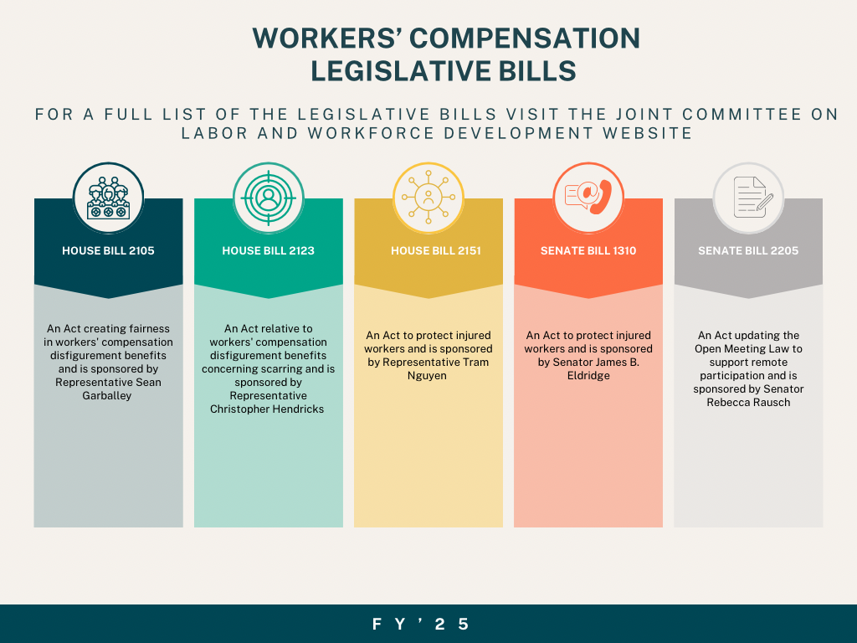
STATUTORY RESPONSIBILITIES
Under MGL Chapter 23E, Section 15 established the Workers' Compensation Advisory Council's (WCAC) membership, appointments, and meeting rules. Additional responsibilities are referenced in MGL Chapter 152, S53A and S65. The WCAC serves as a policy and system oversight body for the Massachusetts workers' compensation system under Chapters 23E and 152. It does not decide on individual claims, but monitors the entire system, conducts research and studies, issues recommendations and reports to the legislature and executive branch and helps to ensure the system operates efficiently and equitably.
The Council is monitoring pending legislative bills related to workers' compensation legislation throughout each legislative session.

Slide 4
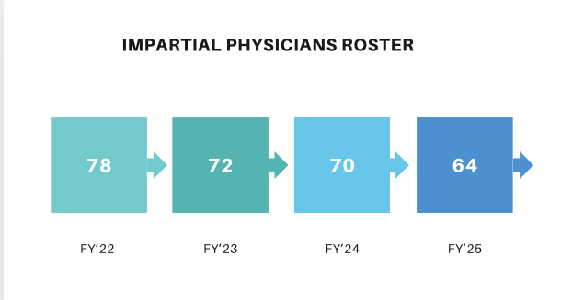
FOCUS AREAS
This year, the Workers' Compensation Advisory Council has concentrated its efforts on two key areas: The Impartial Physician Rate revision and the Workers' Compensation Medical Reimbursement rates.
  The established impartial physician rate covers the full scope of services associated with conducting an impartial medical examination under Section 11A of the workers' compensation system. This includes the review of medical records, performance of the examination, preparation of the written report, and submission of any required documentation. The rate is established and reviewed to ensure fairness, consistency, and alignment with statutory requirements.
  As of March 2025, the impartial physicians' roster is at 64, a decrease from FY'24 (70). The reduction in available impartial physicians may reflect factors such as increased administrative requirements, reimbursement rates that do not keep up with market conditions, or the retirement of long-serving physicians. The DIA continues to explore strategies to strengthen physician participation, including reviewing compensation levels, streamlining administrative processes, and enhancing outreach to qualified medical professionals.
  A listening session was held in October 2025 with the Executive Office of Health and Human Services (EOHHS) to discuss the workers' compensation medical reimbursement rate with stakeholder representation in attendance. The listening session is part of EOHHS's ongoing exploration of potential updates to the workers' compensation medical payment rate system.

Slide 5

DIA DEPARTMENTS
  DIA Offices | Regions | Public Information Unit Page 6
  Office of Claims Administration 7-8
  Office of Dispute Resolution | Reviewing Board 9
  Office of Education and Vocational Rehabilitation 10
  Office of Health Policy | Health Care Services Board 11
  Office of Assessment | Office of Insurance 12
  Office of Investigation 13
  Office of Safety 14-16
  Workers' Compensation Trust Fund 17
  Advisory Council Members 18-19

Slide 6
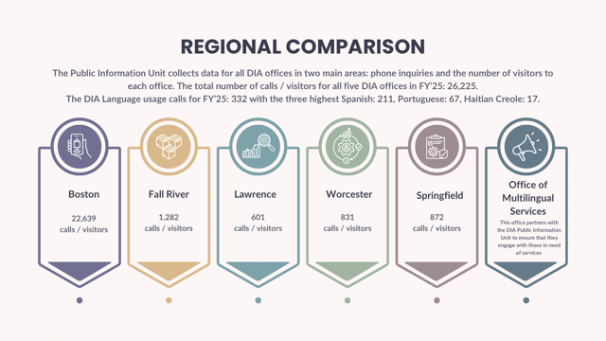
Department of Industrial Accidents
Boston
Lafayette City Center
2 Avenue de Lafayette
Boston, MA 02111
Tel: 617.727.4900
Fall River
1 Father Devalles Boulevard
Fall River, MA 02723
Tel: 508.676.3406
The Department of Industrial Accidents (DIA)oversees and administers the workers' compensation system, ensuring injured workers receive benefits and disputes are resolved. The DIA's Main Office is in Boston with four regional offices throughout the Commonwealth.
Lawrence
354 Merrimack Street #230
Lawrence, MA 01843
Tel: 978.683.6420
Worcester
100 Front Street
Worcester, MA 01608
Tel: 508.753.2072
Springfield
36 Dwight Street Suite 105
Springfield, MA 01103
Tel: 413.784.1133

Slide 7
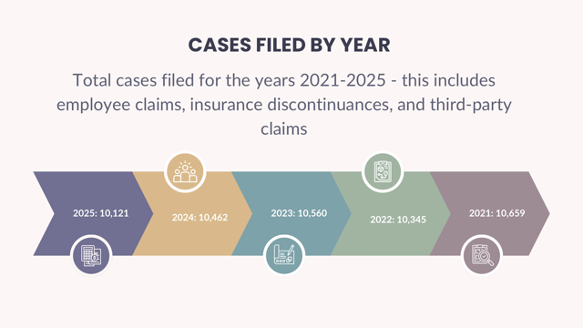
OFFICE OF CLAIMS ADMINISTRATION
The Office of Claims Administration (OCA) is a division within the DIA that acts as the starting point for workers’ compensation case filings in Massachusetts. The OCA is responsible for managing, processing, and overseeing claims filed by injured workers. Its main purpose is to ensure that employees who are injured or become ill due to their jobs receive benefits they are legally entitled to. It handles the receipt and logging of forms and documentation submitted by employers, insurers, attorneys and third-party providers under Massachusetts’ workers’-compensation law (M.G.L. c. 152).
  Benefits may include medical and hospital services, medically necessary equipment and medicine, weekly income replacement during disability, and vocational/rehabilitation services.
  31, 211 First Reports of Injuries filed in FY'25
    Represents 0.85% if the population
  10,121 cases filed by year
    8,235 were employee claims
In Massachusetts, the reduction* in workers’ compensation claims may be driven by a combination of improved safety programs, lower exposure (fewer workers or fewer risky hours), and regulatory/insurance dynamics that reflect lower loss experience. While this is generally good news, it’s important to interpret the drop carefully and not assume it means the risk has disappeared.
*In the 2023/24 rate filings by Workers’ Compensation Rating & Inspection Bureau of Massachusetts (WCRIBMA), they attribute some of the reduction in “lost-time claim counts” to employment levels remaining below pre-pandemic levels in some sectors.

Slide 8
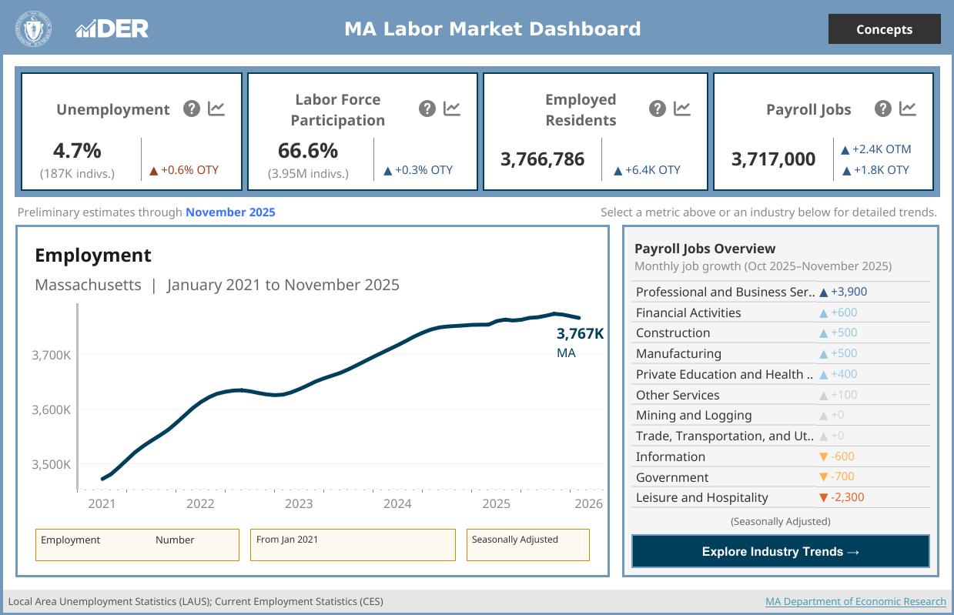
MASSACHUSETTS LABOR FORCE AS OF NOVEMBER 2025
DEPARTMENT OF ECONOMIC RESEARCH
Notes/Disclaimers:
Current month figures are preliminary estimates subject to revision. October 2025 labor force estimates and over-the-month (OTM) comparisons are unavailable due to the federal government shut down. Over-the year (OTY) comparisons reference revised estimates.
The labor force is the sum of the numbers of employed residents and those unemployed, that is, residents not working but actively seeking work in the last four weeks. Estimates may not add up to the total labor force due to rounding. For further information on seasonal adjustment methodology, please refer to the [www.bls.gov] Bureau of Labor Statistics website.

Slide 9
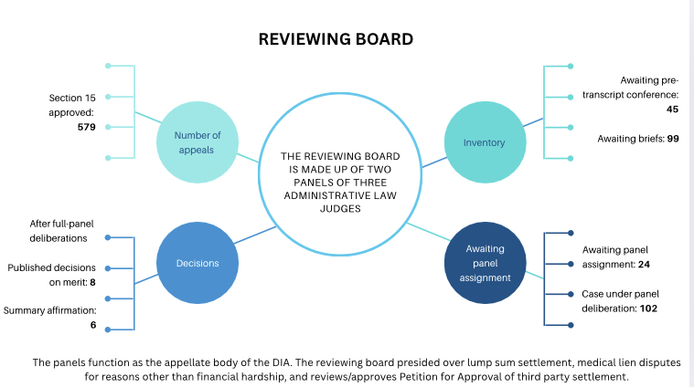
DIVISION OF DISPUTE RESOLUTION
The Division of Dispute Resolution serves as the adjudicatory body (court system) for disputed workers' compensation cases, resolving disagreements between injured workers, insurers, and employers. The mission involves providing a fair and efficient resolution system, while balancing the needs of injured workers, employers, and insurers.
  Departments within the Division of Dispute Resolution: Conciliation Unit, Administrative Judges, Administrative Law Judges, who serve as Reviewing Board members.
    Cases resolved at conciliation for FY'25: 6,077- an average of 506 cases per month (52%)
  The Reviewing Board reviews appeals from decisions made by administrative judges at the hearing level (i.e., when a workers’ compensation case has a hearing decision and a party is aggrieved).
    Reviewing Board Decisions for FY'25: 10

Slide 10
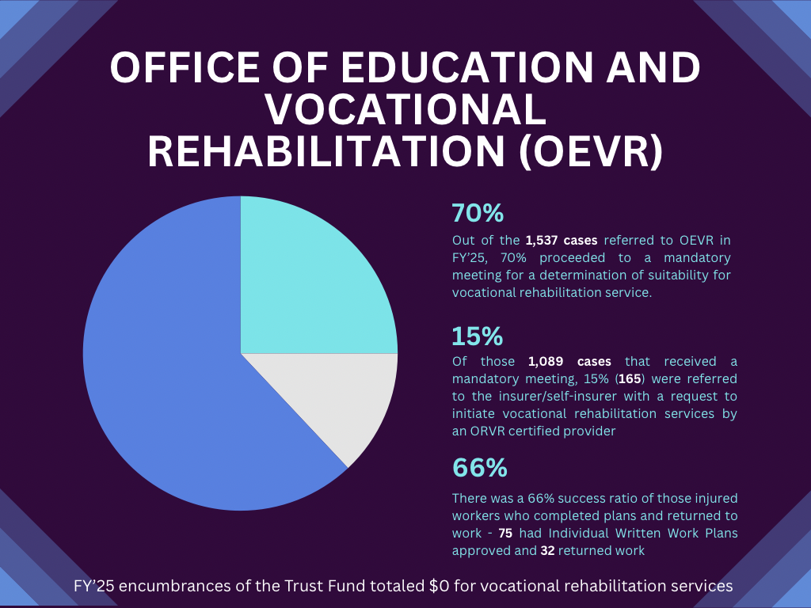
OFFICE OF EDUCATION AND VOCATIONAL REHABILITATION (OEVR)
The Rehabilitation Review Officers remain committed to helping injured workers return to the workforce safely and successfully managed the current caseload despite OEVR's temporary staffing shortages in FY'25.
One injured worker had much success in a training program with the vocational goal of Residential HVAC Technician and employment was secured almost immediately. Their case was ultimately closed several months ahead of schedule and the injured worker received more than their previous wage.
One injured worker with the vocational goal of surgical technician, completed their training program in five months earning $34.66/hour, and has successfully returned to work without any problems.
One injured worker with the vocational goal of becoming a licensed massage therapist secured employment after a year of training earning $65/hour - $1,950.00-$2,080.00 for a 32 hour per week schedule.
With the Rehabilitation Review Officer's tenacity, excellent case management skills, in addition to the injured workers' motivation to return to work, successful outcomes are achieved.
-Erin Muschette, Director | OEVR

Slide 11
OFFICE OF HEALTH POLICY
HEALTH CARE SERVICES BOARD
The Office of Health Policy (OHP) was created pursuant to MGL Chapter 152, Sections 5, 13, and 30. The statute authorizes the Office of Health Policy (OHP) to approve utilization review (UR) agents, thereby allowing them to conduct reviews on Massachusetts workers' compensation claims. The OHP monitors the conduct of agents and workers' compensation utilization review programs to ensure compliance with the requirements of regulation 452 CMR 6.00.
The Health Care Services Board develops and endorses treatment guidelines/ protocols and develops criteria for the DIA Impartial Physicians and investigates complaints against health care providers. Throughout the year there were 3 Health Care Services Board meetings, 8 Health Care Services Board treatment guideline subcommittee meetings, and 3 medical treatment guideline updates.
  Chronic Pain Treatment Guideline, revised October 2024
  Opioid Controlled Substance Protocol, revised October 2024
  Work-Related Asthma Treatment Guideline, revised July 2025
Office of Health Policy
1 complaint analyzed
11 applications reviewed excluding application revisions and updates
Health Care Services Board
3 medical treatment guidelines updated in October 2024 and July 2025
23 utilization review audits

Slide 12
OFFICE OF ASSESSMENTS
OFFICE OF INSURANCE
Office of Assessment
Revenue received for CPA reviews: $31,448
Office of Insurance
No.of self-employers parent-licensed: 63
No.of subsidiaries covered by parent-licenses: 363
Expecting additional: $23,570
Combined total: $55,018
Massachusetts General Laws Chapter 152, Section 65 (as amended by Chapter 572 of the Acts of 1985), established a Workers Compensation Special Fund and a Workers' Compensation Trust Fund.
The Department of Industrial Accidents is required to collect from each employer, through its insurer, an assessment charge that is sent to the Treasurer of the Commonwealth of Massachusetts.
The Department's Office of Insurance maintains a record of the workers' compensation insurer for every employer in the Commonwealth of Massachusetts.
There were no new self-insurance licenses issued in FY'25 and the number of inquiries to the insurance office for historical information from the insurer register: 1,144.
-Aalana Feaster, Director | Office of Assessments, Office of Insurance

Slide 13
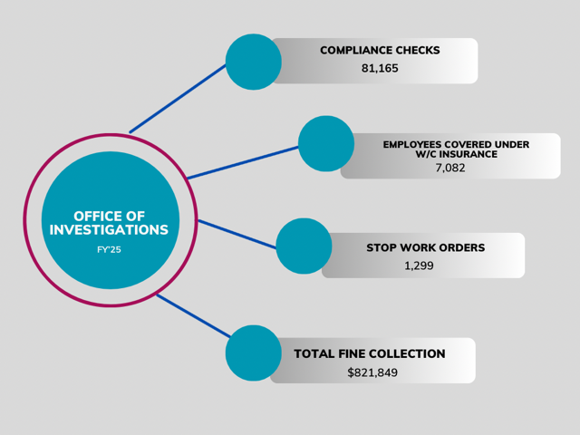
OFFICE OF INVESTIGATIONS
The Office of Investigations monitors businesses and organizations across the Commonwealth to ensure that all employers in Massachusetts maintain workers' compensation insurance. The investigations unit is granted broad authority to bring all operating businesses into compliance with the law.
To fulfill this mission, a team of investigators conduct compliance checks throughout the Commonwealth proactively identifying any business that may be operating without the required workers' compensation coverage. When a business is found in violation, investigators issue a Stop Work Order (SWO), an enforcement action in accordance with state law. Investigators serve as an important educational role taking the time to explain the relevant laws and requirements to employers, helping them achieve compliance quickly, and resolving any outstanding violations. investigators are also responsible for examining claims filed against the Workers’ Compensation Trust Fund by uninsured employees. Working closely with assigned DIA attorneys, investigators gather critical facts, interview witnesses, collect physical evidence, review the roles of all involved parties, and conduct surveillance when necessary.
-Jon Solomon, Director | Office of Investigations

Slide 14
OFFICE OF SAFETY
Total $ Awarded: $800,000
Grants Awarded: 139
Actual Grants Utilizing Funds: 128
Average Cost per $ 120.00
Number of workers Trained: 6,657
The Office of Safety is responsible for promoting safe and healthy working conditions across Massachusetts. Under MGL Chapter 23E Section 3 one off its charged duties is the education and training of employees and employers in the recognition, avoidance and prevention of unsafe or unhealthy working conditions in employment. The Office of Safety administers the Workplace Safety Training Grant Program which funds training and education initiatives aimed at preventing work-related injuries and illnesses.
City Fresh Foods, Inc. is an employee-owned company dedicated to making fresh, healthy and culturally relevant meals accessible to all. Each day, they prepare and deliver more than 20,200 meals to students, seniors and food insecure communities across eastern Massachusetts, By sourcing from local farms, City Fresh not only nourishes some of the region’s most vulnerable residents but also strengthens the local food ecosystem.
Under the tutelage of Stephen St. Laurent, City Fresh, who 200 employees in both English and Spanish in classes that focused on Basic Safety and the Traps we Choose, Kitchen Safety, Burns, Cuts, Slips and Spills, Driver Safety, Ergonomics, Moving, Lifting, Repetitive Motion. Both line and management employees attended.
With a budget of $800,000, the Office of Safety provided training in every Workforce Region and in 12 out of 14 counties. County Map on following page.
-Maryann Falvey, Director | Office of Safety

Slide 15
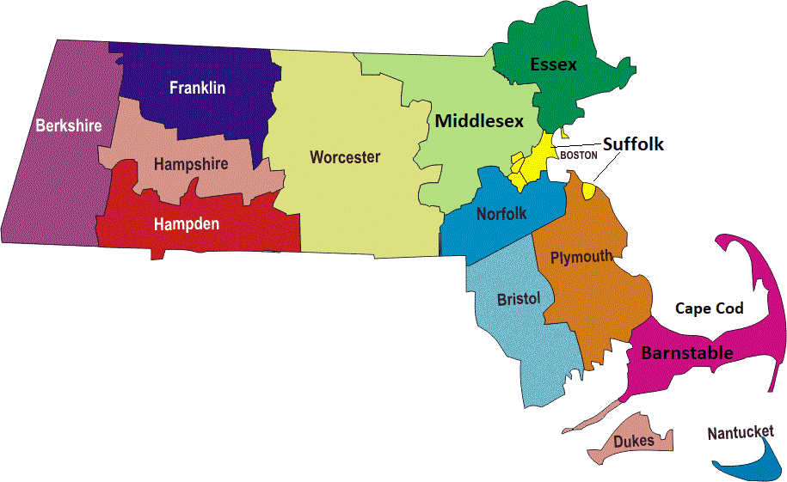
DIA FY 2025 Workplace Safety Grant Year-End Report
3 Grants
251 EEs Trained
28 Grants
1171 EEs Trained
26 Grants
1422 EEs Trained
10 Grants
703 EEs Trained
4 Grants
176 EEs Trained
9 Grants
702 EEs Trained
4 Grants
174 EEs Trained
8 Grants
705 EEs Trained
6 Grants
379 EEs Trained
9 Grants
285 EEs Trained
8 Grants
260 EEs Trained
Grants and Employees
Trained by County
13 Grants
429 EE Trained

Slide 16
NATIONAL SAFETY COUNCIL
The National Safety Council (NSC) is a nonprofit organization dedicated to promoting health and safety in workplaces across the United States. Each year, the NSC publishes reports that analyze economic and human costs of workplace injuries and illnesses , providing valuable insights for employers, policymakers, and safety professionals.
According to the most recent report, the total cost of work-related injuries in the United States exceeded $175 billion in 2023, these costs put a serious strain on small businesses.
The report underscores the importance of proactive safety programs and continuous employee training. By investing in prevention strategies, organizations can not only protect their workers but also reduce financial losses and improve productivity.
103,000,000 days lost from work
$1,080 per worker
$176.5 billion
Source: Work Injury Costs - Injury Facts
https://injuryfacts.nsc.org/work/costs/work-injury-costs/
Source: Real Cost Workplace Injuries
https://www.boston25news.com/news/real-cost-workplace-injuries/BXOBIOLN2NODTCFEQDZPHGJG6M/

Slide 17
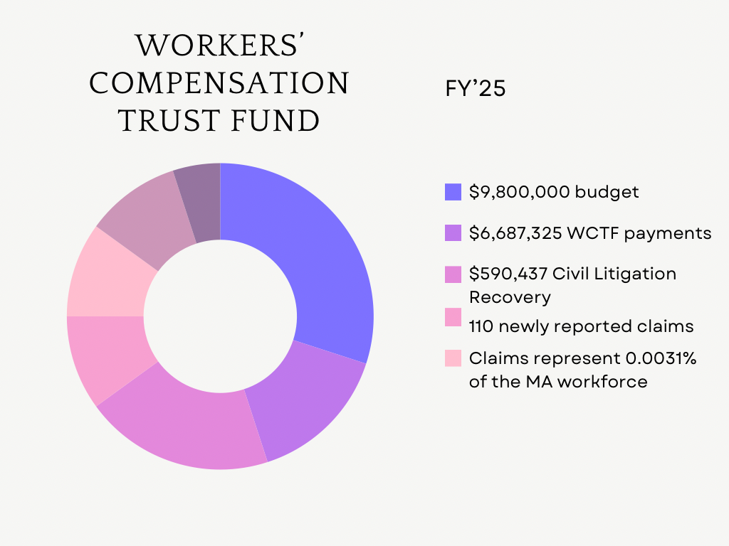
WORKERS' COMPENSATION TRUST FUND
The Workers' Compensation Trust Fund (WCTF) was created under M.G.L. c. 152, § 65 and is a state treasury trust fund managed by the Department of Industrial Accidents (DIA) to cover certain workers’ compensation obligations. The governing regulation: 452 CMR 3.00 sets out scope/authority for the WCTF. The WCTF is funded by assessment on insured employers, and is not subject to appropriation. Insurance companies bill and collect these assessments from employers, then transmit them to the fund. The WCTF becomes involved in two scenarios:​
Uninsured employers: If an injured worker’s employer did not have workers’ compensation insurance (as required under the law), then a claim may be made to the WCTF.
Reimbursements to insurers: Under certain sections of the law (Sections 26, 34B, 35C, 37, 37A of c. 152) insurers or self-insurers who paid out benefits may be reimbursed by the WCTF. ​

Slide 18
ADVISORY COUNCIL MEMBERS
VOTING MEMBERS
LABOR REPRESENTATIVES
  5 SEATS
BUSINESS REPRESENTATIVES
  4 SEATS (ONE VACANCY)
NON-VOTING MEMBERS
  CLAIMANTS BAR
  NSURANCE REPRESENTATIVE
  MEDICAL REPRESENTATIVE
  EX-OFFICIO | EXECUTIVE OFFICE OF LABOR AND WORKFORCE DEVELOPMENT
  EX-OFFICIO | EXECUTIVE OFFICE OF ECONOMIC DEVELOPMENT
  EXECUTIVE DIRECTOR | WORKERS' COMPENSATION ADVISORY COUNCIL

Slide 19
Labor Representatives (Voting Members) | Business Representatives (Voting Members) | Non-Voting Members
John A. Pulgini, Esq (CHAIR) Pulgini & Norton LLP, 10 Forbes Road Suite 240 Braintree, MA 02184 | Todd R. Johnson, Esq (VICE-CHAIR) USI Insurance Services 12 Gill Street, Suite 5500 Woburn, MA 01801 | Bernard Mulholland, Esq Ford Mulholland & Moran P.O. Box 4499 1115 West Chestnut Street Brockton, MA 02303
Stephen P. Falvey The Carpenters Center 750 Dorchester Avenue, Boston, MA 02125 | Teri A. McHugh, Esq Law Office of Teri A. McHugh PLLC PO Box 920677 Needham, MA 02492 | Michael P. Kelley HUB International New England 299 Ballardville Street Wilmington, MA 01887
Michael Hess Iron Workers District Council of New England 161 Granite Avenue Boston, MA 02124 | Kevin M. Snyder A.I.M. Mutual Insurance Companies 54 3rd Avenue Burlington, MA 01803 | Michael Ackland, MD 470 Washington Street, Suite 26 Norwood, MA 02062
Emily Spieler Professor and Dean Emerita Northeastern University School of Law 416 Huntington Avenue, Boston 02115 | James Steenbruggen First Electric Motor Service, Inc. 73 Olympia Avenue Woburn, MA 01801 | Lauren E. Jones, Secretary Executive Office of Labor and Workforce Development
Patrick Walsh Laborer's Local 223 12 Everdean Street, #A Dorchester, MA 02122 | VACANT (Business – Manufacturing | Voting) | Ashley Stolba, Interim Secretary Executive Office of Economic Development
Stephen Joyce Resigned April 2025 North Atlantic States Carpenters Labor Management Program 750 Dorchester Avenue Boston, MA 02125 | VACANT* (Vocational Rehabilitation | Non-Voting) *Nancy L. Segreve began serving in this seat effective July 17, 2025 (FY'26) | Maureen O'Connell Executive Director Workers' Compensation Advisory Council
Voting & Non-Voting Members

