Slide 1
Cooling Corridors Grant Information Session
Division of Conservation Services
January 12th, 2026
Hilary Dimino
Tree Planting Program Manager
Notes:
Intro- Provide name and title, mention DCS

Slide 2


What is the Cooling Corridors Program?
Cooling Corridors is a grant program that provides funding for tree planting projects throughout the Commonwealth.
The program was initiated in 2024, by the Division of Conservation Services, within the Executive Office of Energy & Environmental Affairs.
Notes:
CC funds projects with the primary objective of increasing tree canopy.
Program was started in 2024, this is the 3rd grant round.

Slide 3
Significant Changes in FY 27 Grant round:
Cooling Corridors is now part of the Environment & Climate One Stop | Mass.gov. The EcoOne Stop, is a new, streamlined grant application for climate and environmental resilience projects in Massachusetts. This initiative consolidates multiple EEA grant applications into one application system.
Total maximum grant funding per project is decreased to $75,000.
10% local match required (calculated based on the amount of grant funding requested) Example: If a project is requesting $50k in grant funds, it will need to provide a $5k match.
Piloting use of the Mass EnviroScreen Tool- In collaboration with the EJ Office, the new tool will identify Burdened areas throughout the Commonwealth.
Notes:
Mention EcoOne stop portal- 7 different grants- Dam & Seawall, MVP, CZM Coastal Resilience & Habitat and water, Planning assistance, DER culver replacement
Note that the maximum funding amount per project decreases to $75,000
10% match- can be in kind, can also be used to satisfy watering requirement
MassEnviroscreen tool-new tool, will be used in place of EJ Mapper

Slide 4
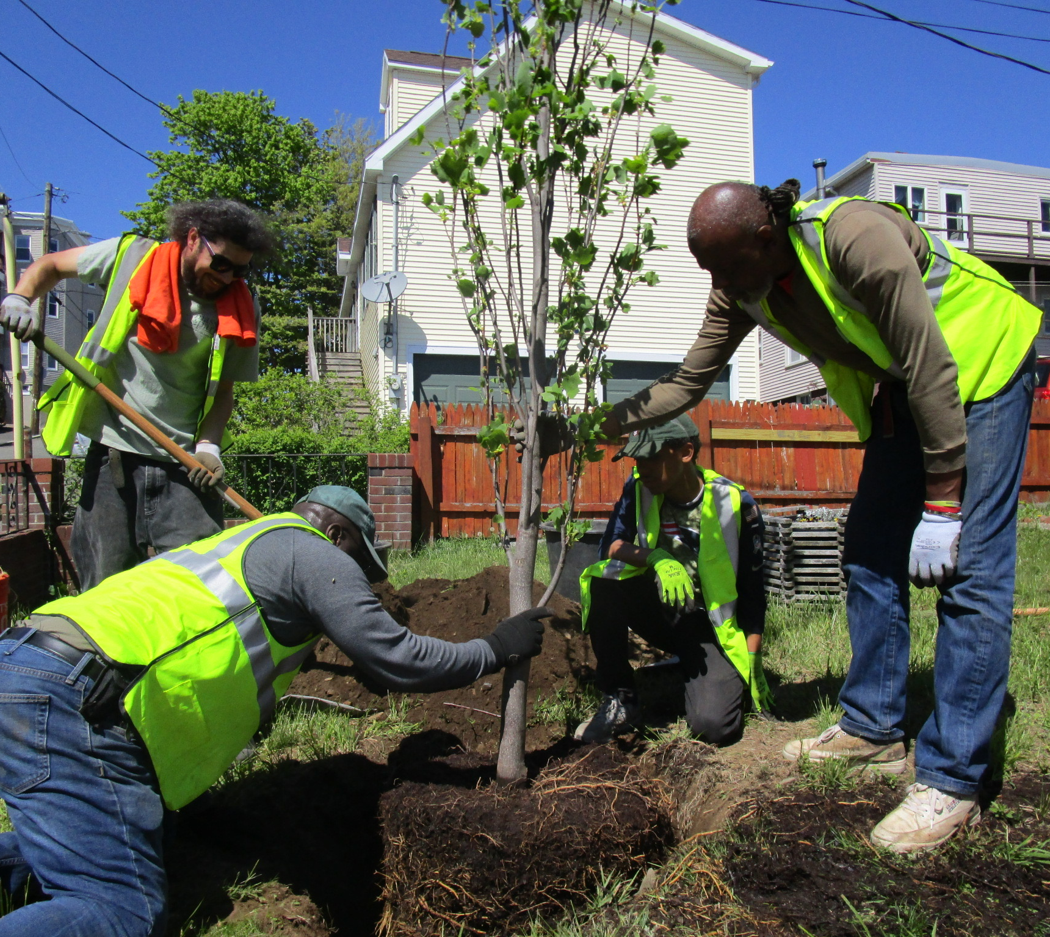
Cooling Corridors Grant Program Priorities
  Targeted tree planting projects
  Extreme Heat Mitigation, specifically within walking routes of vulnerable populations
  Siting trees= Right Tree, Right Place
  Increase tree canopy, focusing on planting shade trees when appropriate
  Proper tree care and maintenance—this is imperative!
  Impervious surface removal, to accelerate tree planting
  Implementation of cooling services, including installation of green infrastructure, painting dark surfaces light colors.
  Increase biodiversity in the urban forest
  Creation of wildlife habitat
Notes:
Focus of grant should be planting trees, increasing tree canopy numbers
Mitigate extreme heat where populations gather and travel
Right tree/right place means sighting trees appropriately

Slide 5
Funding Availability
Eligible Applicants
Maximum grant award is $75,000, to be spent over 2 fiscal years.
A portion of the grant funds must be spent on tree watering and maintenance, over 2 years after planting.
Reimbursement grant program; applicant must be prepared to incur costs up front.
Costs incurred prior to award contract are not eligible for reimbursement.
Municipalities and non-profit 501 (c)(3) organizations, public boards or commissions, tribal governments and/or public & private schools and universities are eligible to apply to this grant program.
Applicants are encouraged to explore partnership opportunities where it will achieve greater impact.
Applicants should have a clear tree planting and watering plan when submitting an application.

Slide 6
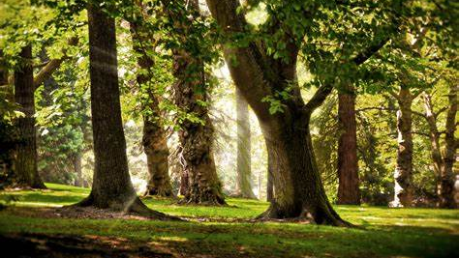
Project Ideas
Community tree planting projects, specifically targeting neighborhoods with documented urban heat islands, hotspots and/or areas that suffer from surges of extreme heat.
Community tree planting projects that create ‘cool corridors’, in environmentally burdened areas and where priority populations reside and travel. Specifically, along walking routes to schools, senior centers, health centers, transit stops and other community gathering areas.
Removal of impervious surfaces to facilitate tree planting (creation of tree belts, restoration of vacant lots, increasing size of tree pits).
Installation of green infrastructure in tandem with tree planting (silva cells, bioswales, flexi-pave)
Implementation of cooling services, in tandem with tree planting. Cooling services can include painting of dark surfaces with a light color and/or installation of light permeable surfaces to reduce heat-energy absorption.

Slide 7
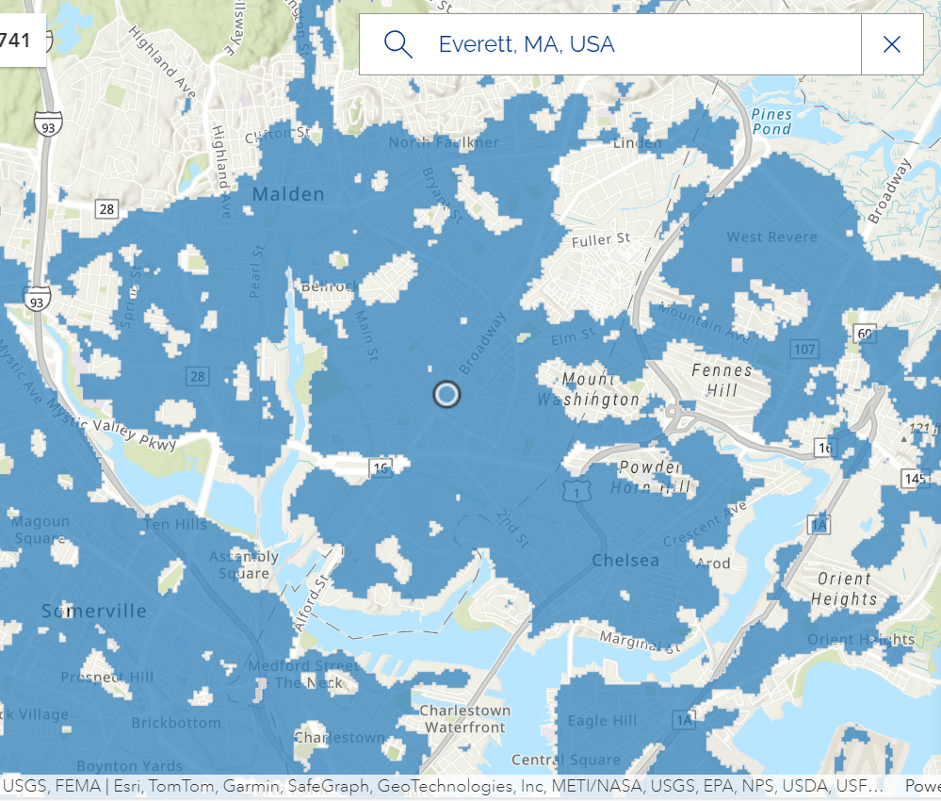
Identifying ‘Hotspots’ within the Project Area
ResilientMass Maps and Data Center (Search for ‘hotspots’ in map layers).
Use this tool to identify ‘hotspots’ within your community to focus tree planting efforts, to maximize heat mitigation.
Notes:
How to identify hotspots in order to identify best locations for tree planting

Slide 8
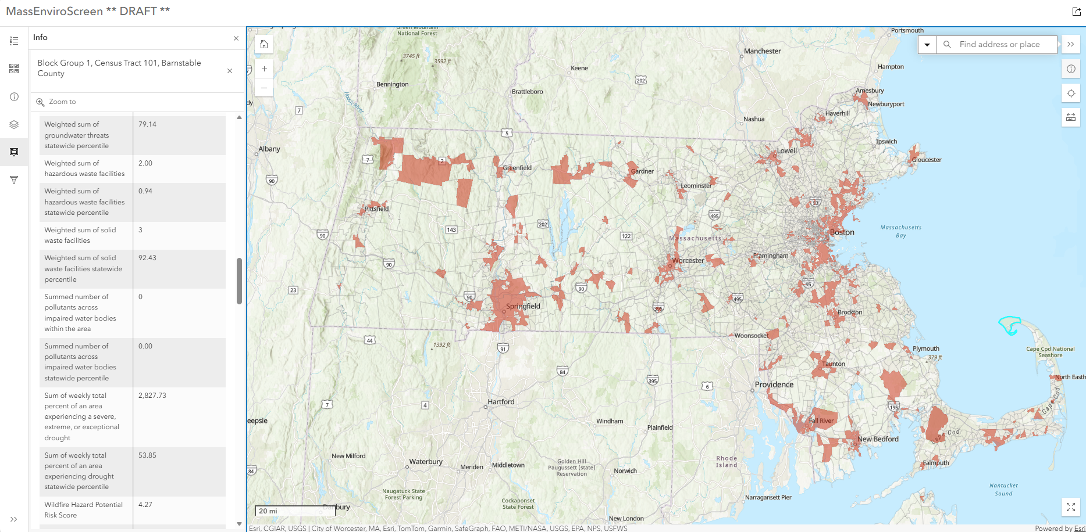
Piloting the MassEnviroscreen Tool
MassEnviroScreen Tool
Notes:
Introduce Kara and Syenna

Slide 9
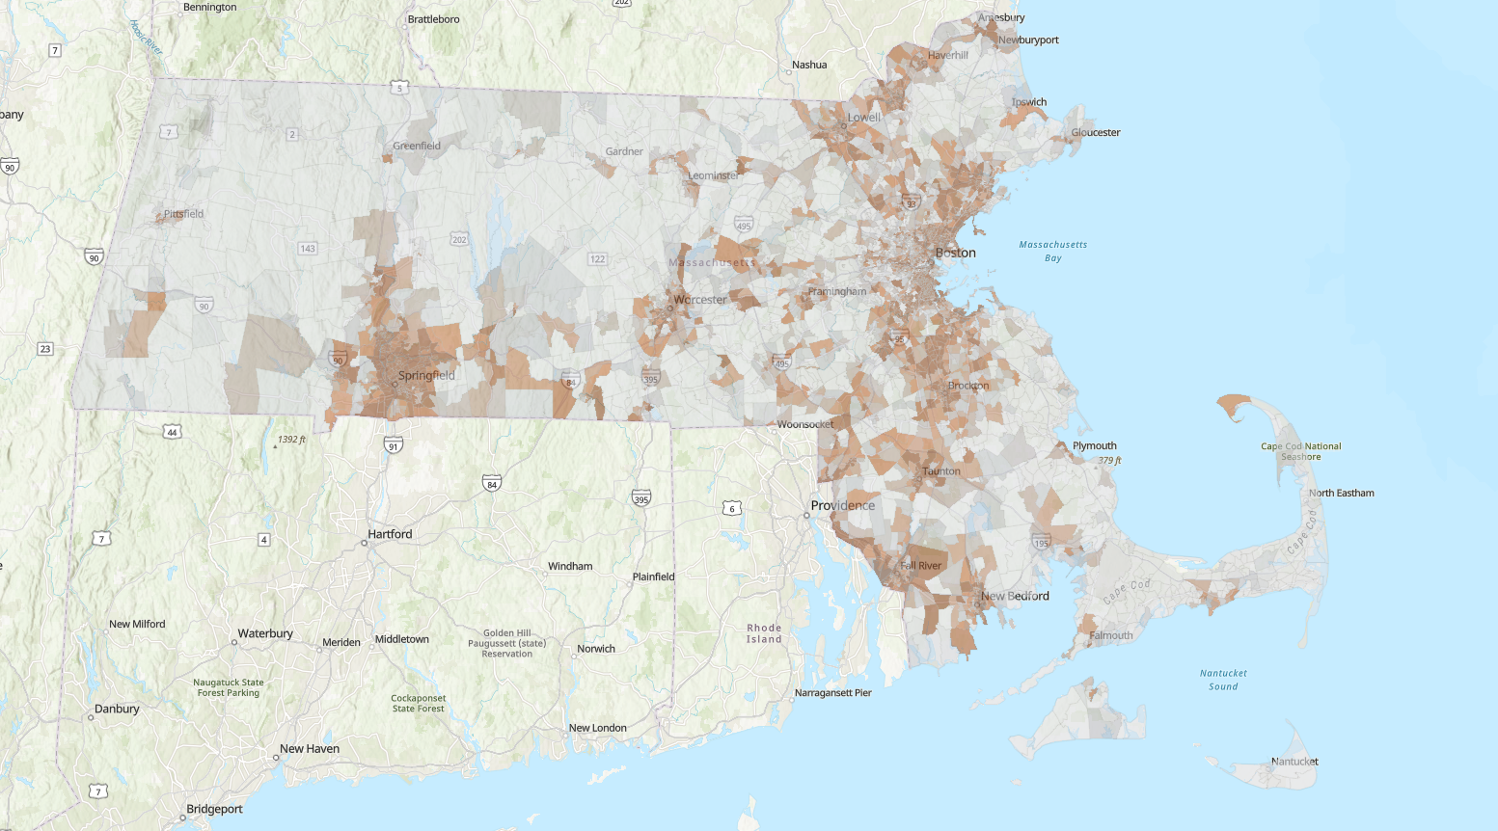
What is MassEnviroScreen?
The MassEnviroScreen (MES) is a statewide environmental justice screening and mapping tool developed by OEJE
Uses statewide data to identify communities facing cumulative environmental, climate, health and socioeconomic stressors
Provides a consistent, transparent baseline for identifying communities that may experience greater cumulative impacts
How communities can use MES:
    Understand local conditions
    Support advocacy and organizing
    Engage more effectively in public processes and community engagement
    Strengthen grant applications

Slide 10
MassEnviroScreen Components
MassEnviroScreen’s 30 indicators fall into five broad components:
Environmental exposure indicators are based on measurements of different types of pollution that people may come into contact with.
Environmental effects indicators are based on the locations of toxic chemicals in or near communities.
Climate risk indicators are based on exposures to climate hazards.
Sensitive populations indicators measure the number of people in a community who may be more severely affected by pollution or climate hazards because of their health.
Socioeconomic factor indicators are conditions that may increase people’s stress or make healthy living difficult and cause them to be more sensitive to pollution’s effects.
These components together provide a comprehensive picture of cumulative impact in the Commonwealth.

Slide 11
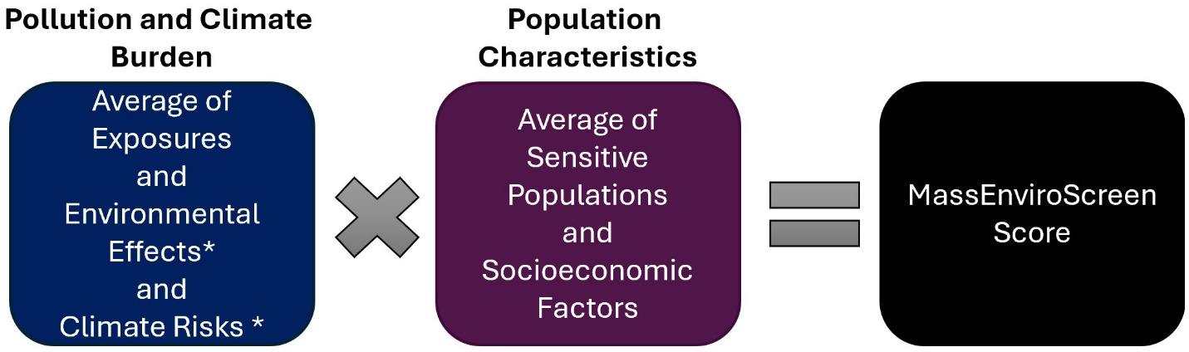
MassEnviroScreen Methodology
Indicators are standardized and combined into component scores
There are two major components:
    Pollution and Climate Burden = Exposures + Environmental Effects + Climate Risks
    Population Characteristics = Sensitive Populations and Socioeconomic Factors
The model follows this conceptual formula:
MassEnviroScreen assigns a cumulative burden score (0 – 100) to every census block group in Massachusetts
The MassEnviroScreen score also represent percentile ranks, which means that a community’s score also indicates the percentage of scores in a group that are equal to or higher than a given score.

Slide 12
Model Output
Higher scores = a combined greater pollution, climate burden and social vulnerability
Communities are designated as Burdened Areas when they meet one or both of the following criteria:
    cumulative burden percentile score (i.e, MassEnviroScore) of 75 or greater, OR
    annual median household income is 65 percent or less of the statewide annual median household income
Importantly, a community not identified as a BA may still exhibit elevated percentile values for individual indicators; in these cases, applicants are encouraged to review MES at the indicator level to better understand localized conditions and explain how their project is benefitting these more vulnerable individuals.
Indicator Percentile Values:
    For each indicator, raw data values are converted into percentiles
    Percentiles show how a community compares to all other communities in Massachusetts
    For each indicator, both the raw value and percentile are available for each community which allows users to identify which indicators are most relevant in each community

Slide 13
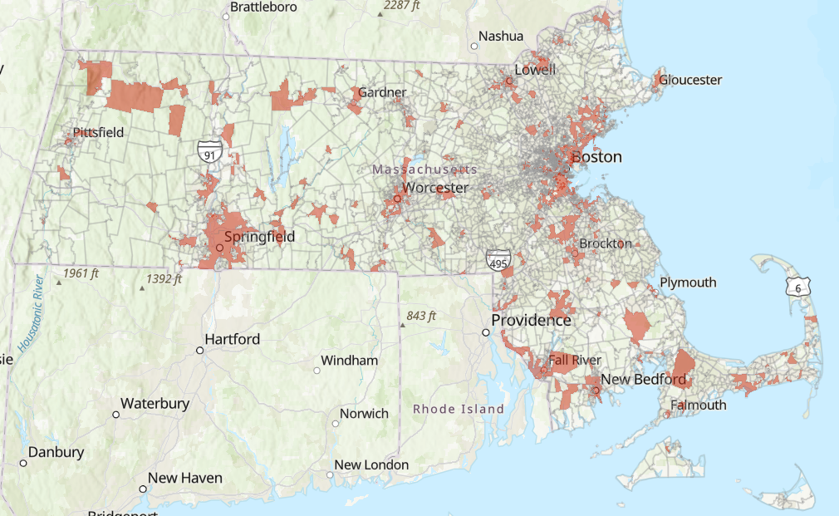
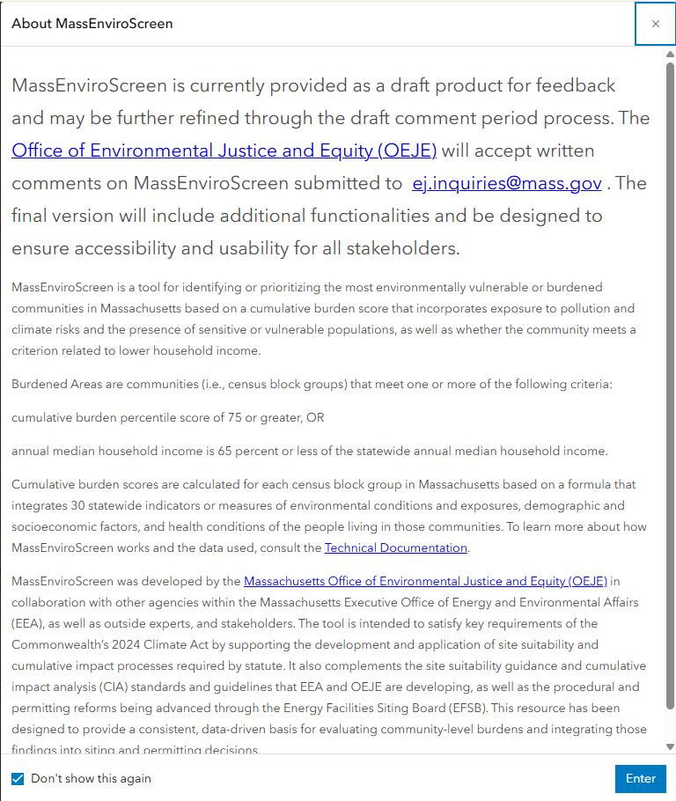
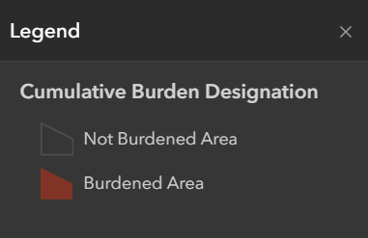
MassEnviroScreen: Map of Burdened Areas

Slide 14
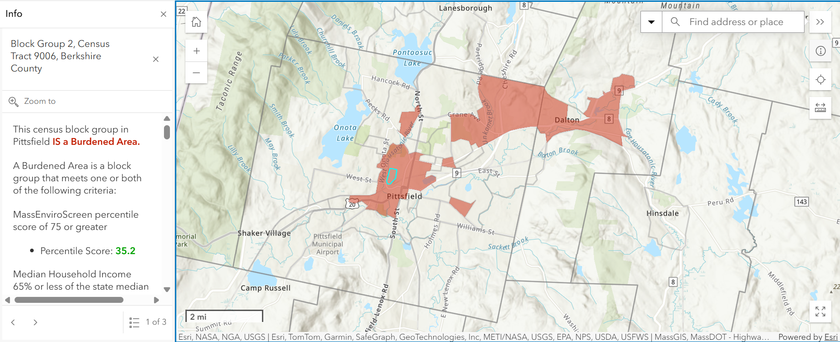
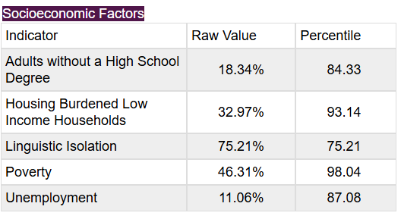
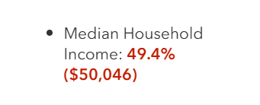
MassEnviroScreen: Pittsfield – Block Group 2, Census Tract 9006

Slide 15
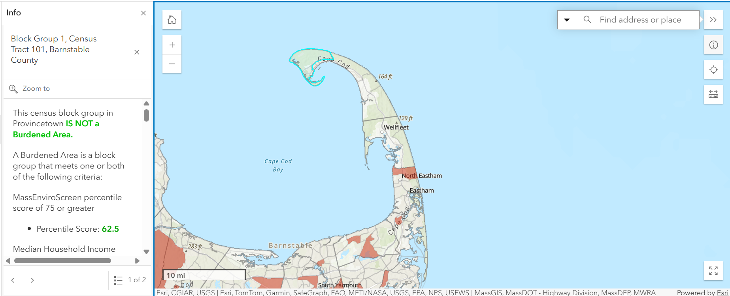
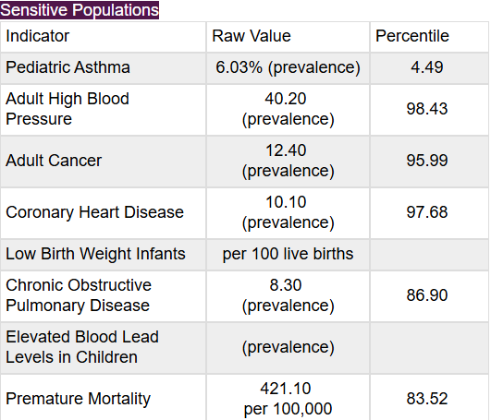
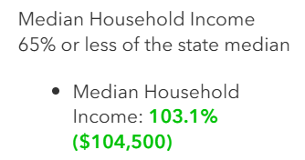
MassEnviroScreen: Provincetown – Block Group 1, Census Tract 101

Slide 16
Contact Information
For any questions related to the draft MassEnviroScreen tool, please contact the Office of Environmental Justice and Equity (OEJE) at ej.inquiries@mass.gov .

Slide 17
Eligible Project Costs
Purchase of trees and associated materials, including clean loam and/or mulch, watering bags, stakes
Costs for watering trees throughout the contract period, including purchase of equipment (water tank, hoses, tree watering bags) needed to water trees. All trees planted utilizing EEA grant funding must be watered for a minimum of two consecutive years after planting. All trees must be watered once a week and be given a minimum of 20 gallons per tree
Tree pit creation, excavation, extension or restoration to facilitate tree planting. Remediation or replacement of soil to increase tree health.
Concrete, asphalt, or other impervious material removal associated with urban heat mitigation and heat sink reduction, in correlation with proposed tree planting projects.
Implementation of cooling services, including painting of dark surfaces with a light color and/or installation of light permeable surfaces to reduce heat-energy absorption, associated with a tree planting project.
Purchase & installation of green infrastructure that accompanies tree planting. Projects must include green infrastructure that allows for larger soil volume, remediates soil compaction and/or facilitates water permeability. Structural soils, silva cell structures, flex pavement, and permeable pavement are all potentially eligible for funding.

Slide 18
Grant Requirements
  Plantings must follow “right tree, right place” principles
        Tree species (or cultivars) prohibited for purchase in MA are not eligible
        Restrictions on host species of Emerald Ash Borer, Beech Leaf Disease and Asian Long-Horned beetle
        Emphasize planting of large shade trees, to increase urban tree canopy
        Plantings in proximity to utility wires must be low-growing species (under 30 ft)
    Grantees may elect to plant trees using their staff, or subcontract tree planting work. Applicants or subcontractors planting trees must have an MCA or ISA certified arborist present on site to manage day-to-day tree plantings.
    For details regarding tree planting and care expectations please review: Tree Planting 101, Selecting Trees for your Urban & Community Forest, Specifications for Tree Planting & Care, Caring for New Trees.
Please read bid document carefully and follow application instructions.

Slide 19
Application Requirements
Project Narrative
      Goals, project deliverables & timeline
      Watering plan and tree stewardship intentions in the first 2 years
Planting Plan
      Identify planting locations and species to be planted
      All trees proposed must be between 1 - 2.5” caliper
      If proposing impervious surface removal, identify locations where materials will be removed to facilitate tree planting.
      Plan should be reviewed with municipal Planning Department.
Project Budget
      Total estimated costs, itemized where possible
      Project costs contributed in-kind or other funding matches (10% match included)
      Please indicate what spending will occur in FY 26 and FY 27
      *Submit Application through EEA’s Grant Management System (GMS)*

Slide 20
Application Requirements, continued
Tree Watering Plan- detailed plan for watering trees planted for two years.
Letter of support from Tree Warden or Tree Commission.
Documentation that planting plan has been reviewed by planning board (if planting is proposed on municipal land).
Letters of endorsement from partners if tree planting is proposed on lands that are not owned by applicant.
Map of proposed project locations.
Site photos.

Slide 21
Project Evaluation Criteria
Project Description (35 pts)
Project Scope (25 pts)
Project Budget (5 pts)
Project Timeline (5 pts)
Burdened Areas (15 pts)
Project located within burdened area (10 pts)
Project benefits populations vulnerable to climate burdens (5 pts)
Project Benefits (50 pts)
Planting within walking routes/residential areas (10 pts)
Planting within hotspots (10 pts)
Tree Watering Plan provided (10 pts)
“Right Tree, Right Place”, Shade trees prioritized (10 pts)
Proposed tree species list emphasizes biodiversity (5 pts)
Cooling services in tandem with tree planting (5 pts)

Slide 22
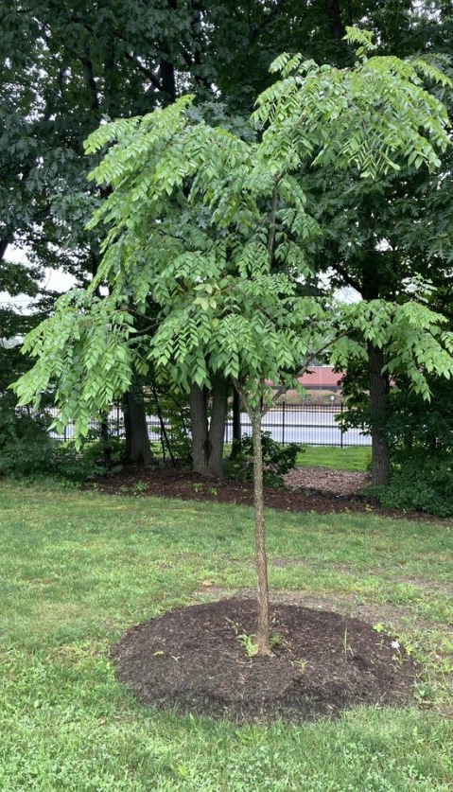
Grant Timeline
January 2026
Post RFR and accepting applications – January 20
RFR and Application Webinar: January 27, 2026, 10:00 AM – 11:00 AM
RFR and Application Webinar: January 28, 2026, 11:00 AM – 12:00 PM
Grant Management System (GMS) How-To Webinar: January 29, 2026, 10:00 AM – 11:00 AM
March 2026
APPLICATION DEADLINE: Friday, March 20th at 11:59pm
  Submit via Grants Management System (GMS) | Mass.gov
June 2026
Awards announced, contracting will commence after award announcement, with the goal of a contract start date of July 1, 2026.
Projects executed: July 1, 2026 through June 30, 2028
Tree watering executed 2 full growing seasons after tree is planted.
EEA Tree Planting Manager will meet with project manager to inspect trees and confirm plantings are acceptable before final reimbursement.

Slide 23
How to Apply
The Commonwealth has launched a grant application portal, the Grants Management System. Applicants applying to the FY 27 Cooling Corridors grant program will need to create a user profile (if they do not have an existing profile) and then submit the application via the portal.
Log in information can be found in the bid documents and will be posted to the Cooling Corridors website.
Applications will not be accepted via email. All applications MUST be submitted via the Grant Management System.
Grants Management System (GMS) | Mass.gov

Slide 24
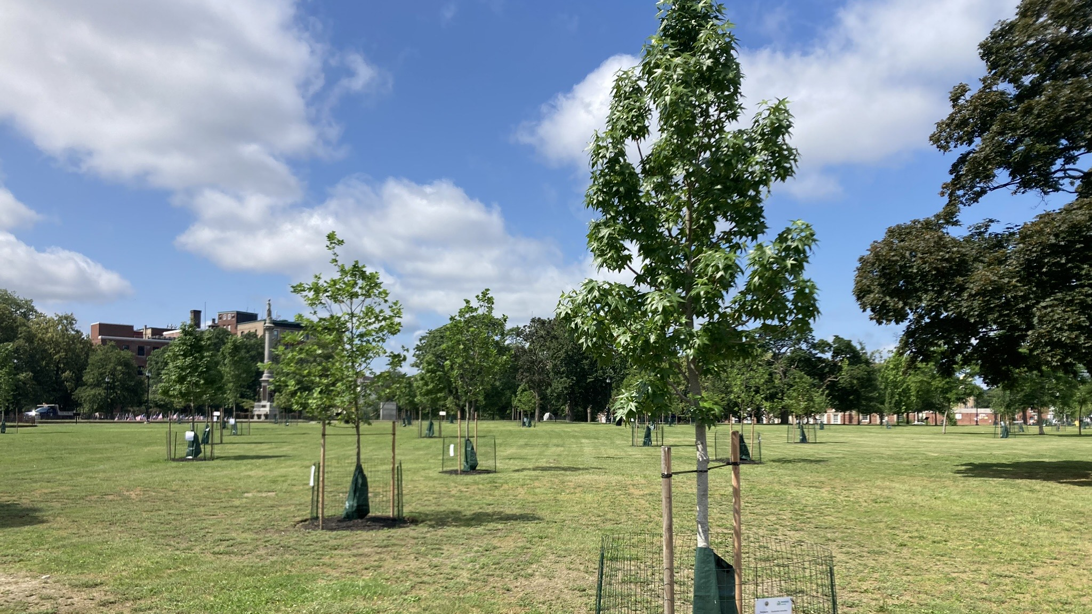
Questions?
Contact Information:
Hilary Dimino
857-207-1912
Hilary.M.Dimino@mass.gov

