Slide 1
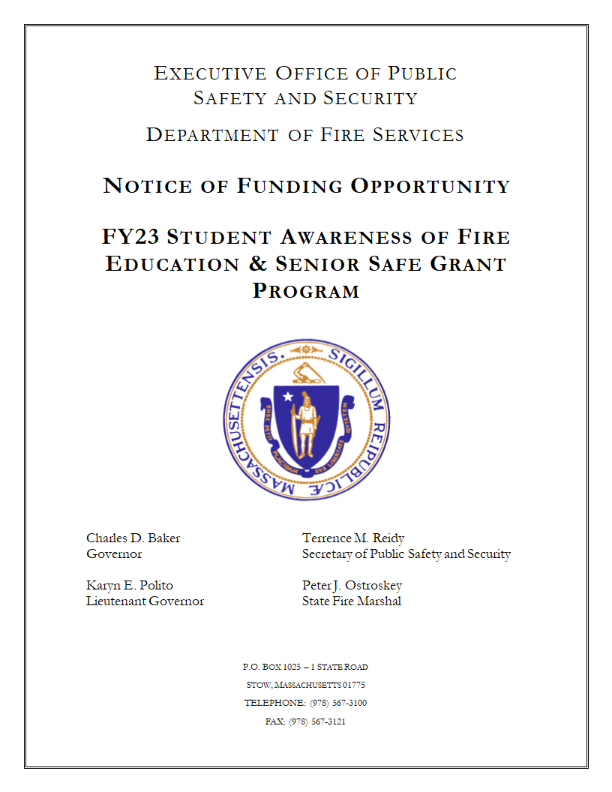
2023 S.A.F.E. Grant Application
Notes:
SAFE Grant Application - applications must be received no later than 5:00 PM on Friday, September 30, 2023.

Slide 2
Application Process
Completeness counts, please be sure to provide all the required information, if you’re not sure contact us.
What you need:
  A completed application
  MFIRS in from January to June 2022
  Completed FY 2022 Year-End Report and all past FY Year-End Reports must also be complete/submitted.
Notes:
It is necessary to be legible, orderly, and neat when filling out any/all applicable parts of the grant application. Completed FY 2022 Year-End Report and all past FY Year-End Reports must also be complete/submitted.

Slide 3
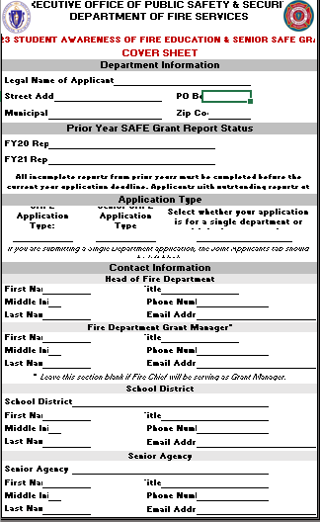
Notes:
1st Box - Department Information – select your departments name from the drop down menu. Enter fire department address information.
2nd Box - Prior Year SAFE Grant Report Status – if we have not received a prior year-end report it will be noted in this category. If any reports are outstanding, they must be completed before the application deadline in order to be considered for funding. If you have outstanding report(s) the link(s) to complete them will appear in blue.
3rd Box – Application Type – select the desired application type for each of the 3 drop down menus. All three fields must be completed.
4th Box – Contact Information – Head of the Fire Department, Fire Department Grant Manager, School Official, and Senior Agency Official (when applicable).
Note: If you are submitting a single departments information then move the Community Information Tab. If you are submitting a Joint Application, move to Joint application tab.

Slide 4
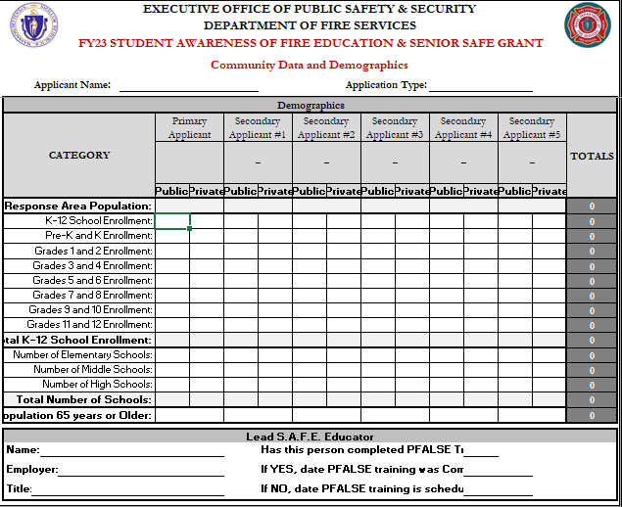
Notes:
Complete all applicable demographic information in the white boxes. Information in the shaded boxes does not need to be filled out and will be totaled up automatically. The next slides tell you how to get these numbers.
Provide all contact information for your communities Lead SAFE Educator who either has or is scheduled to complete PFALSE training.

Slide 5

To find out the school enrollment, go to the https://www.doe.mass.edu/ and click on the three lines located in the upper left hand corner, then locate Educational Options, click on the Public School Districts, and then search District Data listed in alphabetical order.
Notes:
For school enrollment go to the www.doe.mass.edu web site.

Slide 6
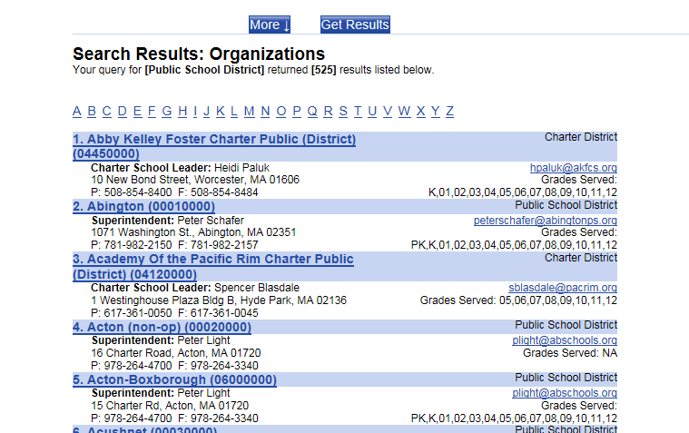
Click on the first letter of your town
Notes:
Select your town or city or (next slide).

Slide 7
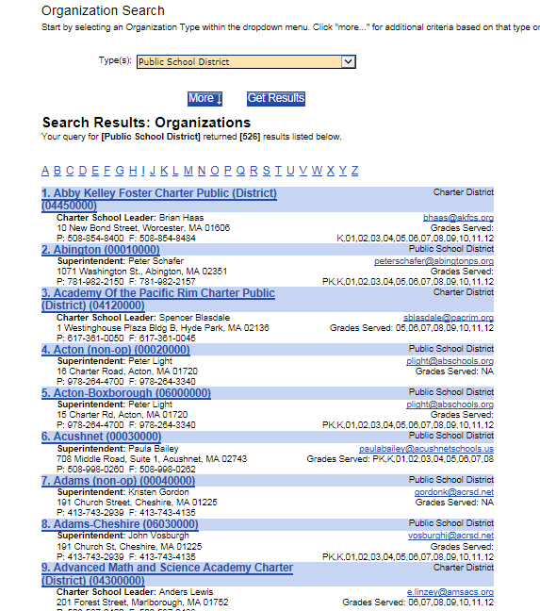
Find your town either by the letter or
alphabetically
Notes:
Look for the letter of the name of your school district or town and click on that letter.

Slide 8
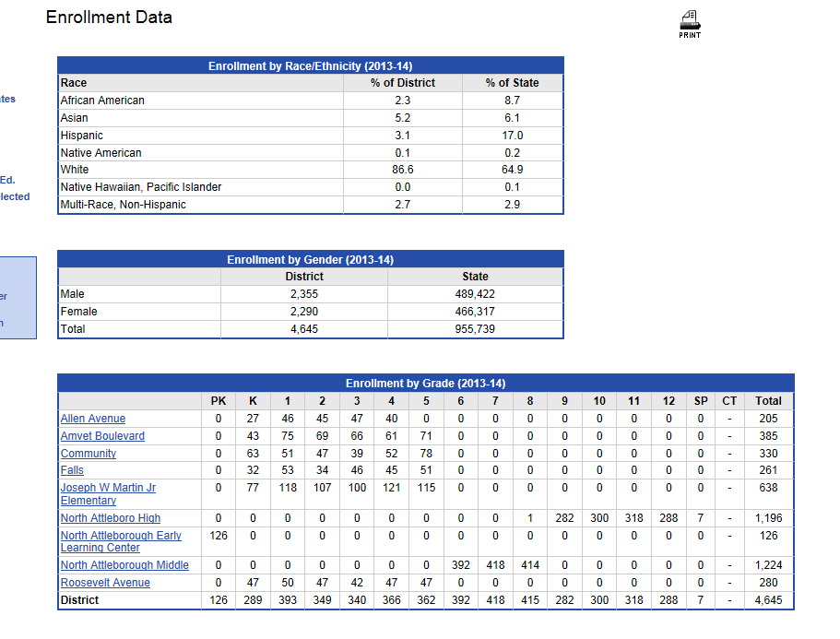
You will find your enrollment numbers
to fill out your school demographics page.
Notes:
Here are the results. You will have to do some adding but see how the grades are broken down? Put this page on your favorites because it will always be refreshed and after October 1 the numbers may change. If you want your private school information repeat the process by returning to slide 7 and looking for the name of the private school.

Slide 9
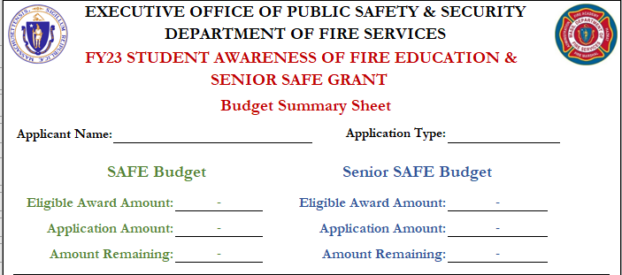
Budget Worksheet
Notes:
Applicant Name and Application Type. Complete the SAFE Budget tables for your SAFE and/or Senior SAFE expenses. Use the green table for SAFE and the Blue table for Senior SAFE.

Slide 10
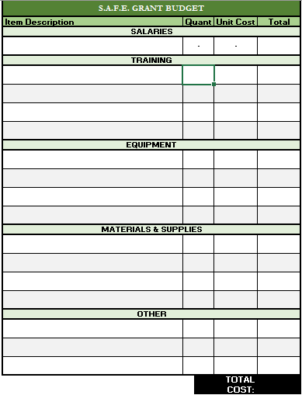
Budget Worksheet
Notes:
SCHOOL-BASED SAFE - provide as much detail as possible in the item description column. Entries into the Equipment and the Materials & Supplies categories are limited to the options in the drop down menus. The total cost will automatically calculate only after the item description, quantity, and unit cost categories are filled in completely. No quantity or unit cost is required for salary expenses. Use the information at the top of the chart to monitor your totals and to make sure that you are not applying for more funding than you are eligible for. If your application exceeds your eligible award amount, you will receive an error message. Your application must be equal to or less than your award amount before it is submitted. The budget indicator lights to the L of the instructions will also indicate whether your budget is under underbudget, over budget, or right on budget. These indicators will turn green when the application amount is correct.

Slide 11
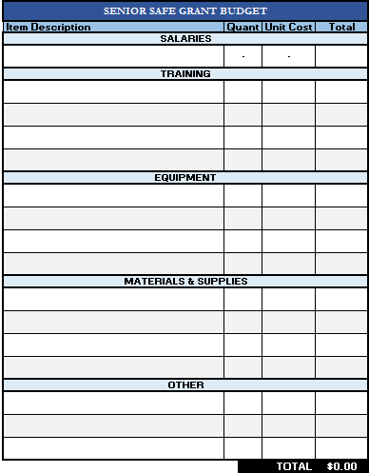
Budget Worksheet
Notes:
SENIOR SAFE - provide as much detail as possible in the item description column. Entries into the Equipment and the Materials & Supplies categories are limited to the options in the drop down menus. The total cost will automatically calculate only after the item description, quantity, and unit cost categories are filled in completely. No quantity or unit cost is required for salary expenses. Use the information at the top of the chart to monitor your totals and to make sure that you are not applying for more funding than you are eligible for. If your application exceeds your eligible award amount, you will receive an error message. Your application must be equal to or less than your award amount before it is submitted. The budget indicator lights to the L of the instructions will also indicate whether your budget is under underbudget, over budget, or right on budget. These indicators will turn green when the application amount is correct.

Slide 12
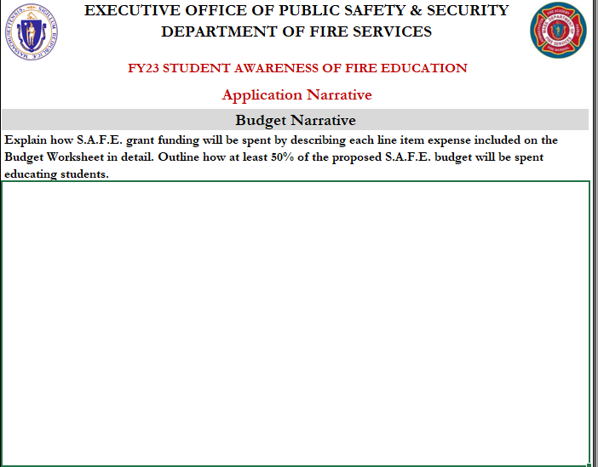
Budget Narrative
Notes:
SCHOOL-BASED SAFE - provide all requested Budget information in as much detail as possible. Review the evaluation criteria in the NOTICE OF FUNDING OPPURTUNITY before drafting this section and ensure that you provide the reviewer with enough information to rate your application.

Slide 13
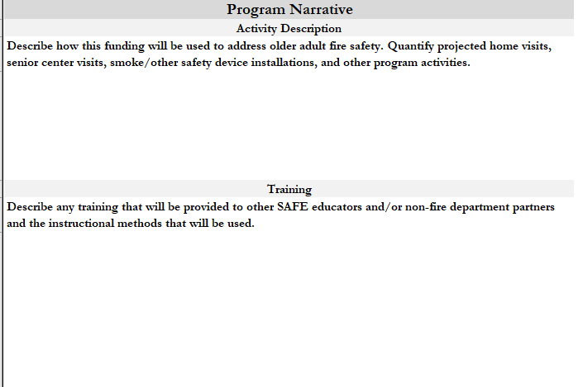
Activity and Training
Notes:
SCHOOL-BASED SAFE - provide all requested Activity Description and Training information in as much detail as possible. Review the evaluation criteria in the NOTICE OF FUNDING OPPURTUNITY before drafting these sections and ensure that you provide the reviewer with enough information to rate your application.

Slide 14
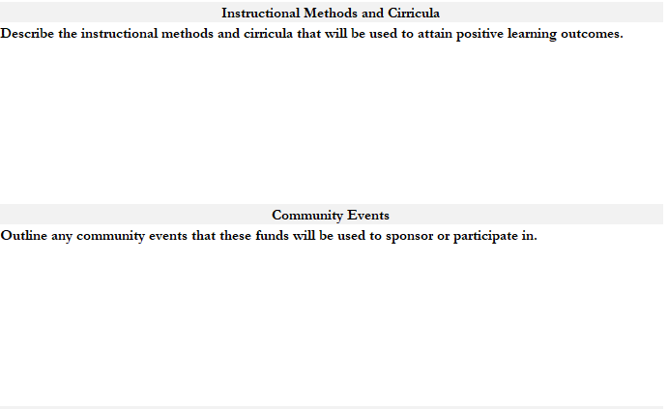
Program and Behaviors
Notes:
SCHOOL-BASED SAFE - provide all requested Instructional Methods and Curricula and Community Events information in as much detail as possible. Review the evaluation criteria in the NOTICE OF FUNDING OPPURTUNITY before drafting these sections and ensure that you provide the reviewer with enough information to rate your application.

Slide 15
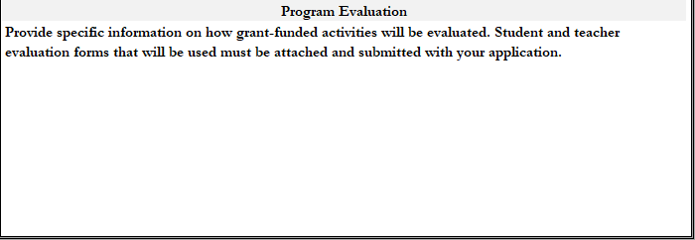
Program Evaluation
Notes:
SCHOOL-BASED SAFE - provide all requested Program Evaluation information in as much detail as possible. Review the evaluation criteria in the NOTICE OF FUNDING OPPURTUNITY before drafting this section and ensure that you provide the reviewer with enough information to rate your application.

Slide 16
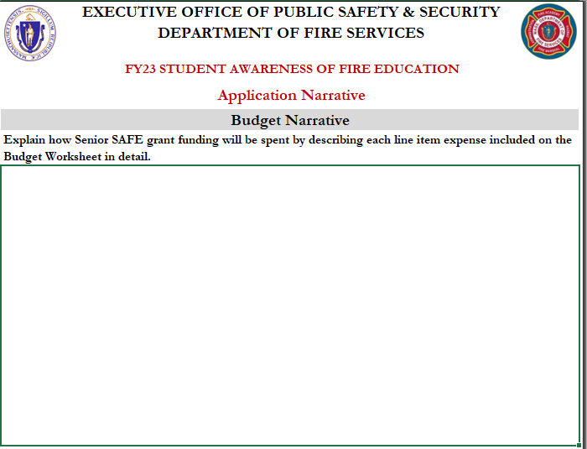
Budget Narrative
Notes:
SENIOR SAFE - provide all requested Budget Narrative information in as much detail as possible. Review the evaluation criteria in the NOTICE OF FUNDING OPPURTUNITY before drafting this section and ensure that you provide the reviewer with enough information to rate your application.

Slide 17
Activity and Training
Notes:
SENIOR SAFE - provide all requested Program Activity and Training information in as much detail as possible. Review the evaluation criteria in the NOTICE OF FUNDING OPPURTUNITY before drafting these sections and ensure that you provide the reviewer with enough information to rate your application.

Slide 18
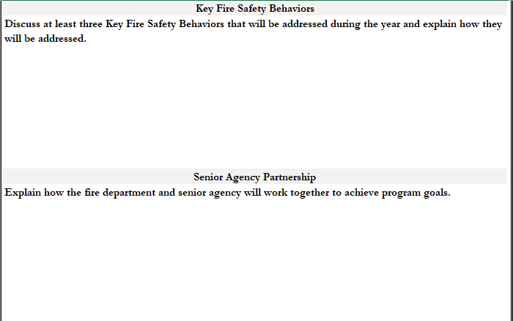
KFS Behaviors and Partnerships
Notes:
SENIOR SAFE - provide all requested Key Fire Safety Behaviors and Senior Agency Partnership(s) information in as much detail as possible. Review the evaluation criteria in the NOTICE OF FUNDING OPPURTUNITY before drafting these sections and ensure that you provide the reviewer with enough information to rate your application.

Slide 19
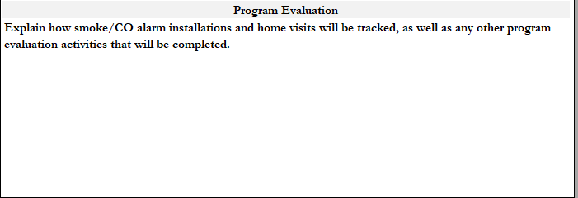
Program Evaluation
Notes:
SENIOR SAFE - provide all requested Program Evaluation information in as much detail as possible. Review the evaluation criteria in the NOTICE OF FUNDING OPPURTUNITY before drafting this section and ensure that you provide the reviewer with enough information to rate your application.

Slide 20
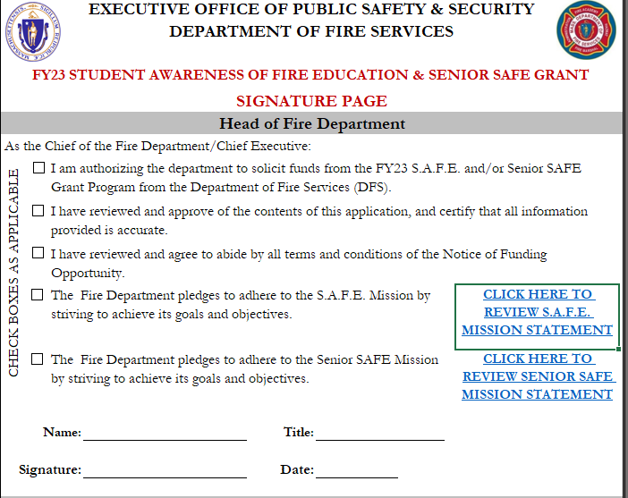
Signatures and Mission Statements
Notes:
Signature by the Head of the Fire Department and School-based SAFE and Senior SAFE Mission statements. The boxes next to each statement must be checked off to acknowledge that the signer has read and understands the statement. Click on the links provided to review the mission statements before signing.

Slide 21
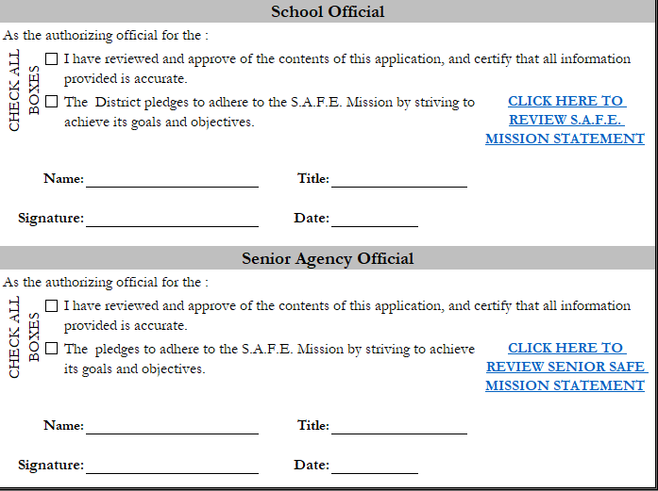
School and Senior Official Signatures
Notes:
Signature by the School Official and Senior Agency Official. The boxes next to each statement must be checked off to acknowledge that the signer has read and understands the statement. Click on the links provided to review the mission statements before signing. Get to know the School Official, staff at the COA, along with the Director of your communities Health Department they are your best allies. In order to advertise the program to Students and Seniors, your partnering agencies may require a discussion of what it is that you are going to teach. They probably have a lot information to offer that you can add to your program.

Slide 22
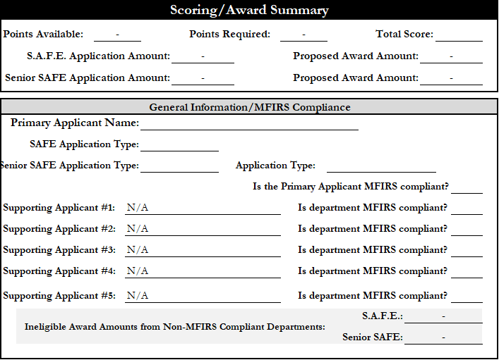
Scoring and Award
Notes:
In the General Information/MFIRS Compliance section, select “Yes” or “No” from the dropdown menu for MFIRS compliance for each department included on the application. Note that if the primary applicant is not compliant with the MFIRS reporting requirement, their Proposed Award Amount will be Ineligible. If a Supporting Applicant on a Joint/Regional Application is not MFIRS compliant, their SAFE and/or Senior SAFE allocations will be automatically removed from the Proposed Award Amount.
The Primary SAFE Educator section is filled out automatically based on the information input by the applicant on the ‘Community Information’ tab. If information is missing from this section or the training date of the individual provided is not within the grant requirements, it will show as 0 points awarded.
Fill out the SAFE Program Scoring and/or Senior SAFE Program Scoring by selecting the appropriate evaluation criteria from the drop down menus in the blank column in the center of the table. Once all relevant sections have been filled out, The Total Score category at the top of the page will auto populate. If the applicant meets the threshold for award, their proposed award amount(s) will be shown. If the application does not have sufficient points for award, the Proposed Award Amount will show as Ineligible.

Slide 23
Curriculum Planning Guidebook
Key Behavior Pages
The title describes the behavior that you want to teach: Understanding and Practicing Match and Lighter Safety (Fire tools) page 3-12.
Under the title is the target group (Ages 3-5 Preschool) and the safety group (Burns).
The box on the right is for quick reference - PRE, meaning preschool and the reference number refers to this particular behavior for this age group.
Notes:
The latest version of the Curriculum Planning Guide Book can be found on the DFS website under Resources for the Fire Service, then select Resources for Fire and Life Safety Educators, then SAFE teaching tools.

Slide 24
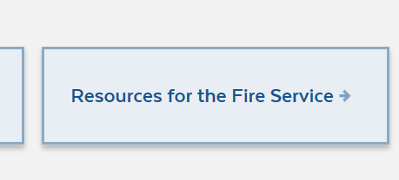
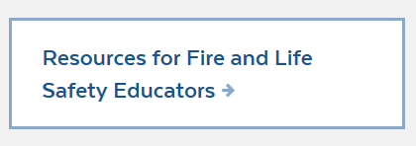
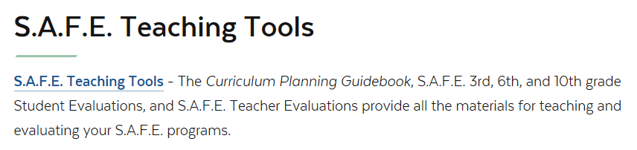
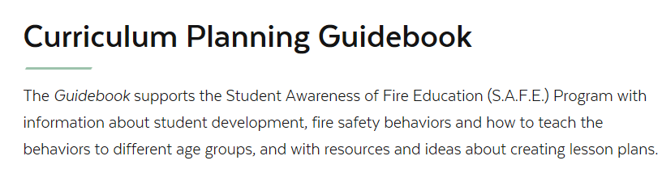
Notes:
Teaching methods with particular attention to the seven methods of learning styles.

Slide 25
Teaching Methods
USFA FEMA Home Escape Plan
Notes:
Teaching methods with particular attention to the seven methods of learning styles.

Slide 26

Evaluation, Evaluation, Evaluation……
Evaluation is one of the most important parts of your program.
Evaluation is more for the program rather than the students or seniors.
Remember evaluation is a requirement and verbal evaluation is not allowed.
Notes:
Discuss both the student and educator evaluation tools and methods.

Slide 27
Evaluation
Submit a copy of your evaluation tool (test, homework assignment, demonstration, etc.)
Grade you evaluated
Number of students you evaluated
Statistics (percentage)
Include Instructor Evaluation
If using the DFS evaluation tool, submit
the front page of the tool.

Slide 28
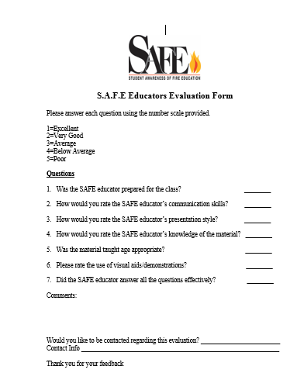
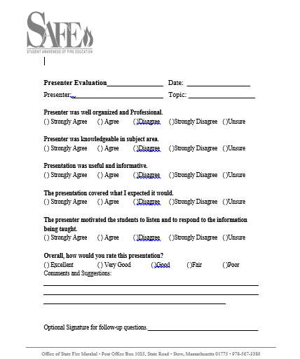
Teacher Evaluation Examples
Notes:
These are two examples of using teacher evaluations. You can put your fire departments’ name on the paper to personalize it.

Slide 29
Budget and Program Narrative for Senior SAFE Grants
Fully explain how you are going to spend your Senior SAFE funds.
What is your plan to address older adult fire safety? (Home visits, senior center visits, installations of smoke alarms or other safety devices) Explain.
We intend on working with the senior center to identify those older adults who need smoke alarms or safety visits.
Describe any training you intend to provide for other SAFE educators and/or non-fire department partners.
We are going to provide older adults and the senior agency workers with the Remembering When program.
What are the Key Fire Safety Behaviors you will address during the year? List at least 3.
Home escape planning
Cooking safety
Fall prevention
Notes:
Ask the students what they are doing for their Senior SAFE Program. What is your data showing about the cause of fires in your elderly population? What can you teach based on the data?

Slide 30
Fully explain how you will work with your partnering agency to deliver fire safety information.
Senior SAFE program Educators from the fire department will work with the staff at the COA to deliver a monthly presentation at the senior center. Each presentation will be followed by a discussion so that the older adults can ask questions and we can follow up with an answer.
What instructional methods will you use?
Lectures, small group discussions and one on one visits
Fully explain your plan to keep track of smoke/CO alarm installations or home visits.
Our department has a data base set up in our fire prevention bureau specifically assigned to documenting the installation of smoke and CO alarms. Follow up will be conducted by the COA.
Notes:
Think about the goals you have for the program and the older adults of the community. How are you going to track smoke alarm/CO alarm installations? This is important information so that we can send this to the legislature and tell them that we are using these awards wisely.

Slide 31
Submission and Deadline Requirements:
Submit your completed application online no later than 5:00 PM on Friday, October 7, 2022 or hand delivery to:
Department of Fire Services
P.O. Box 1025, State Road
Stow, MA 01775
ATTN: 2023 S.A.F.E. Program
No extensions beyond the aforementioned deadline will be granted. Faxed applications are NOT acceptable. Please email all applications to SAFE.FireSafetyDivision@mass.gov

Slide 32

Friendly Reminder:
Please submit application via email to SAFE.FireSafetyDivision@mass.gov
Emailing applications to another email will delay your application

Slide 33


When we receive your grant, we will send a confirmation e-mail. If you do not receive an email within 2 weeks of submitting your application, please contact us.

Slide 34
QUESTIONS?
Matt Brennan
matthew.brennan@mass.gov
Captain David J. DeMarco
david.demarco@mass.gov
Lt. Christie Clement
Christie.Clement@mass.gov
Notes:
DFS SAFE Team contact information.

