Slide 1
FY27 Seasonal Communities Grant Program (SCGP)
Guidance Webinar
June 16, 2026

Slide 2
Agenda
  Welcome and Introductions
  Seasonal Communities Grant Program Overview
  Award Formulas
  Application
  Dates & Deadlines
  Questions/Answers

Slide 3



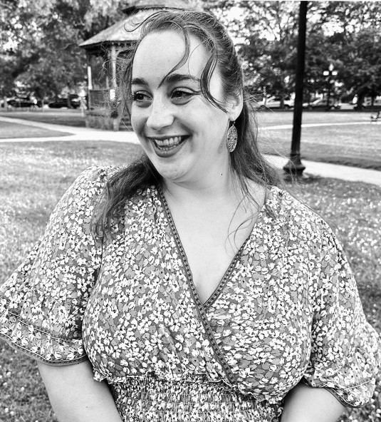
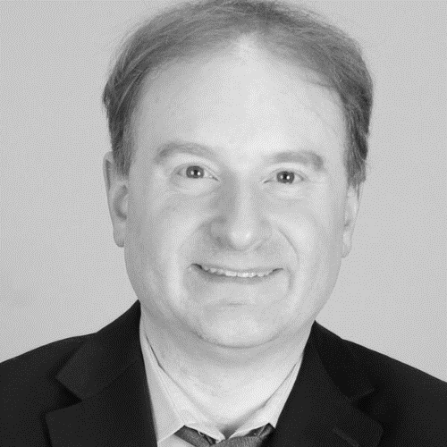
Welcome
Filipe Zamborlini
Community Assistance Unit
Manager
Filipe.Zamborlini@mass.gov
McKenzie Bell
Senior Community
Grants Coordinator
McKenzie.Bell@mass.gov
Victoria Healey
Community Grants
Coordinator
Victoria.J.Healey@mass.gov
Maggie Kenney
Community Grants Coordinator
Margaret.Kenney@mass.gov
Brett Morton
Fiscal Representative
Brett.Morton2@mass.gov

Slide 4
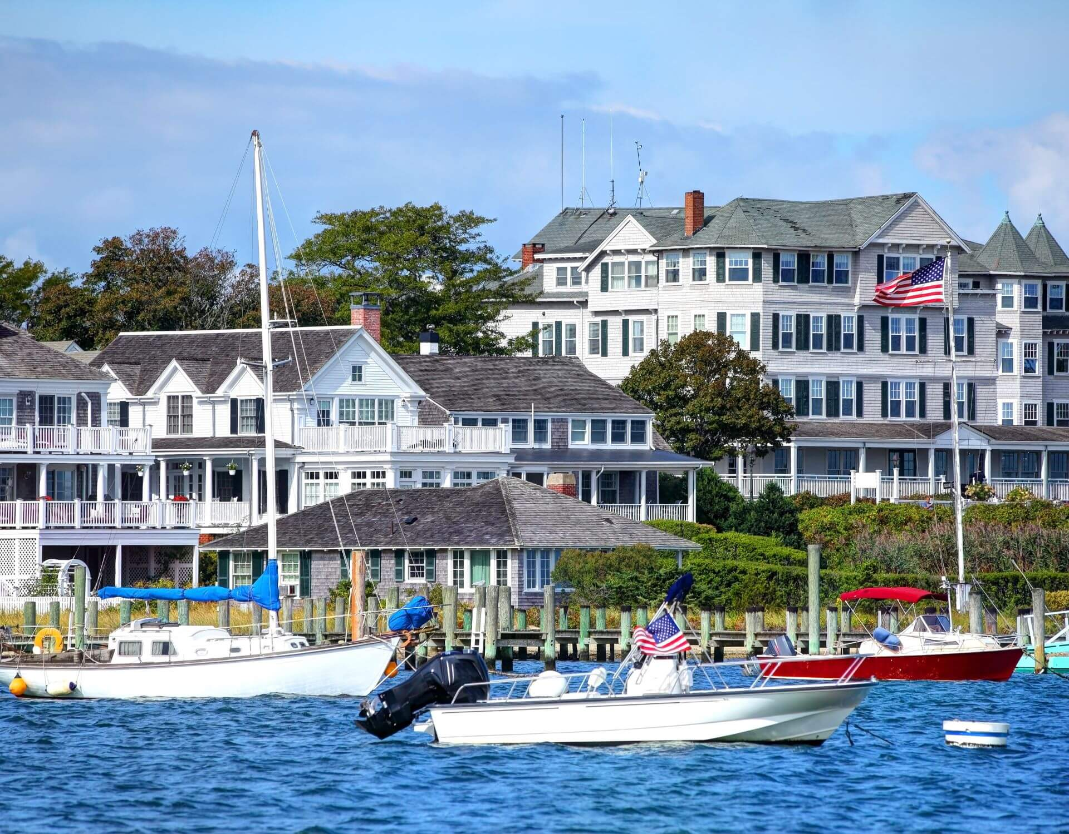
Seasonal Communities Grant Program (SCGP)
Overview
Created as part of the FY26 Five Year Capital Investment Plan as a continuation of the Healey-Driscoll Administration’s commitment to make historic investments in housing production and preservation.
Non-competitive, formula-based grant.
FY27 funds available to Seasonal Communities (SCs) that have accepted the Designation by 7/30/2026.
Notice of Funding Availability (NOFA) published on COMMBUYS.
FY27 Funding: $2M
Highlights:
Funds must be incurred by end of FY27 (6/30/27) and are disbursed on a cost incurred reimbursement basis.
May support phase(s), complete project(s), or portion of ongoing project(s).

Slide 5
FY27 SCGP Award Formula
Seasonal Community | 2020 Census Pop. | Award
Aquinnah | 439 | $56,263
Barnstable (pending vote) | 48,916 | $150,000
Brewster | 10,318 | $84,674
Chatham | 6,594 | $73,964
Chilmark | 1,212 | $58,486
Dennis | 14,674 | $97,202
Eastham | 5,752 | $71,543
Edgartown | 5,168 | $69,863
Egremont | 1,372 | $58,946
Falmouth | 32,517 | $148,518
Gosnold | 70 | $55,201
Great Barrington | 7,172 | $75,626
Monterey | 1,095 | $58,149
Nantucket | 14,255 | $95,997
Oak Bluffs | 5,341 | $70,361
Orleans | 6,307 | $73,139
Provincetown | 3,664 | $65,538
Rockport | 6,992 | $75,109
Sheffield | 3,327 | $64,568
Tisbury | 4,815 | $68,848
Truro | 2,454 | $62,058
Wellfleet | 3,566 | $65,256
West Stockbridge | 1,343 | $58,862
West Tisbury | 3,555 | $65,224
Williamstown | 7,513 | $76,607
Calculation:
Min. award of $55K
Max. award of $150K
Remaining funding distributed to eligible SCs based on 2020 year-round population

Slide 6
FY27 SCGP Uses of Funds
Planning and zoning activities, including, but not limited to:
Planning activities related to housing needs assessments.
Zoning and/or bylaw revisions to implement SC policies.
Planning for housing development.
Ongoing planning efforts.
Local actions for housing development, including but not limited to:
Funding for housing development projects.
Technical Assistance to establish a Year-Round Housing Trust Fund.
Seed funding for Year-Round Housing Trust to support housing development.
Ongoing housing development efforts.
Awarded grants will fund a variety of activities related to implementing the SC law and/or supporting communities’ unique housing and community needs.

Slide 7
FY27 SCGP Uses of Funds Continued
Public horizontal infrastructure projects to leverage housing development, including pre-construction (design/engineering documents) and/or construction related to:
Sewer lines, septic systems, and other sanitary waste disposal systems, water lines, wells, and water treatment systems.
Utility extensions.
Streets, roads, curb cuts, and other transit improvements such as crosswalks and pedestrian and bicycle ways.
Other related horizontal infrastructure work adjacent to planned or imminent housing improvements.
Ongoing infrastructure efforts.
Awarded grants will fund a variety of activities related to implementing the SC law and/or supporting communities’ unique housing and community needs.

Slide 8
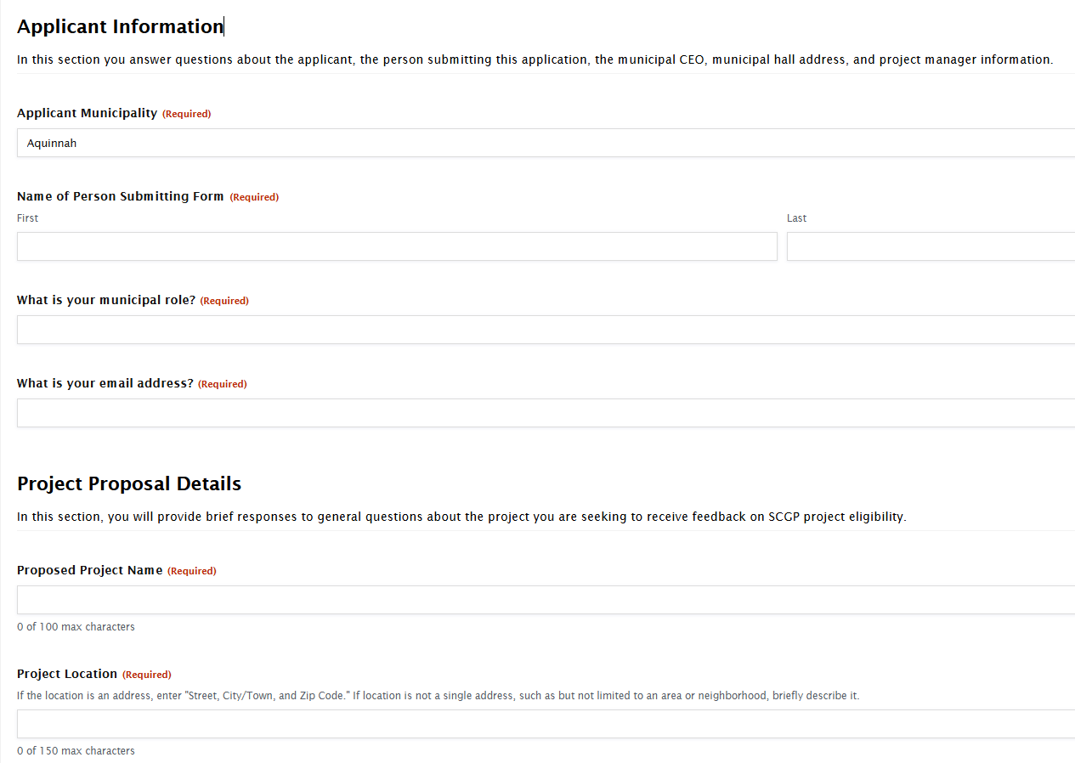
FY27 SCGP Project Eligibility Feedback Form (OPTIONAL)
FY27 SCGP Project Feedback Form
Eligible SCs may request general feedback FY27 project ideas through this optional Feedback Form.
The SCGP eligibility feedback form will open this Wednesday, June 17, and close on August 21, 2026.

Slide 9
FY27 SCGP Project Proposal
SCGP Project Proposal Application
May submit one or more proposals to use award
Application is intended to be simple. Sections include:
  Project Abstract
  Scope of Work – Does proposal align with eligible uses of funds?
  Implementation Timeline – Can requested funds be spent down by 6/30/27?
  Leadership & Ability to Execute – Is leadership in place to successfully execute within this short timeline?
  Anticipated Outcomes
  Grant Request + any local or other match funds
  Cost estimate
  Other attachments, as applicable
Eligible SCs must submit a FY27 SCGP Project Proposal Application form.
The Project Proposal Application will open August 3, 2026, and close by 11:59PM on August 28, 2026.

Slide 10
Guidance & Timeline
Dates | Activity
June 17, 2026 – August 21, 2026 | Available window to submit optional eligibility feedback forms.
August 3, 2026 – August 28, 2026 (by 11:59PM) | Deadline to submit FY27 SCGP Project Proposal Applications.
September/October 2026 | Anticipated awards and contracting.
Available Guidance
Optional Feedback Form
  HLC will provide general feedback on projects through an online form from 6/17/2026 through 8/21/2026.
NOFA
Guidance webinar slide deck
SCGP Project Proposal Application

Slide 11
KEY CONTACTS & QUESTIONS
SCGP Questions
McKenzie Bell, Senior Community Grants Coordinator
McKenzie.Bell@mass.gov
Victoria Healey, Community Grants Coordinator
Victoria.J.Healey@mass.gov
Maggie Kenney, Community Grants Coordinator
Margaret.Kenney@mass.gov
Seasonal Communities
EOHLCSeasonalCommunities@mass.gov

