Slide 1
Massachusetts Human Service Transportation (HST) Brokerage
Orientation Session
May 2021

Slide 2
Accessibility at Today’s Meeting
Interpreters
CART
Use the chat box to contact the hosts for assistance at any time

Slide 3
Today’s Agenda
Welcome
Orientation to HST services, including consumer facing improvements coming July 1
Questions & comments
Submit your questions at any time
Q&A box
Raise your hand during the Questions & Comments section

Slide 4
What stays the same
If you receive HST transportation now, you will continue to receive these rides:
MassHealth through PT-1
Agency-funded trips to a program
Trips arranged through a broker
Working with the same transportation companies

Slide 5
Effective July 1, 2021, GATRA will be the broker for HST Area 3
Rides funded by MassHealth and other state Health & Human Services agencies
MassHealth PT-1
Department of Developmental Services (DDS)
Department of Public Health (DPH)
Massachusetts Rehabilitation Commission (MRC)
Massachusetts Commission for the Blind (MCB)
Department of Mental Health (DMH)
Notes:
Work in Progress:
RB –
Effective July 1, 2021, MART will be responsible as the broker for Human Service Transportation for the newly defined Region 1 & 2 which will include the transportation oversight for the following agencies. (to be read from slide with a brief explanation of how the services are obtained.

Slide 6
HST Regions
MART
MART
GATRA

Slide 7
Timeline
June 17 – brokers ready to start taking your trip requests for July 1 and after
July 1 – new contract goes into effect
Ongoing – HST and brokers welcome feedback and work on additional improvements

Slide 8
What we’re doing to ensure a system that works for everyone

Slide 9
A little background about GATRA
GATRA has been providing safe and reliable service to MassHealth members for more than 20 years
Our Call Center is staffed with 15 Customer Service Representatives, 4 Supervisors, and an Office Manager
Now through June 30: Monday-Friday 8am-5pm
Starting July 1: Monday-Friday 7am-6pm
GATRA is committed to providing efficient service in a courteous and professional manner

Slide 10
Here are some improvements we’re making to improve on-time performance & reliability
Coming July 1
GPS on PT-1 rides
Ability to see location of vehicles in real-time
Consumer smartphone app
Provides an additional way to contact us to schedule rides, etc.
You can still call if you prefer

Slide 11
New and innovative ways to contact us and schedule your transportation
Coming July 1
Consumer Web Portal and a Consumer App for smartphones
Ability to schedule rides
Ability to submit complaints/feedback
You can still call if you prefer

Slide 12
To access the Consumer Web Portal, visit https://cp-gatra.qryde.com
Getting started is simple, just enter the following information and you’re ready to start scheduling trips!
MMIS Number
(The member number located on your MassHealth card)
Your Date of Birth
Your Email address
Your Phone number
Create a password
Call us at 1-800-431-1713 if you need assistance

Slide 13
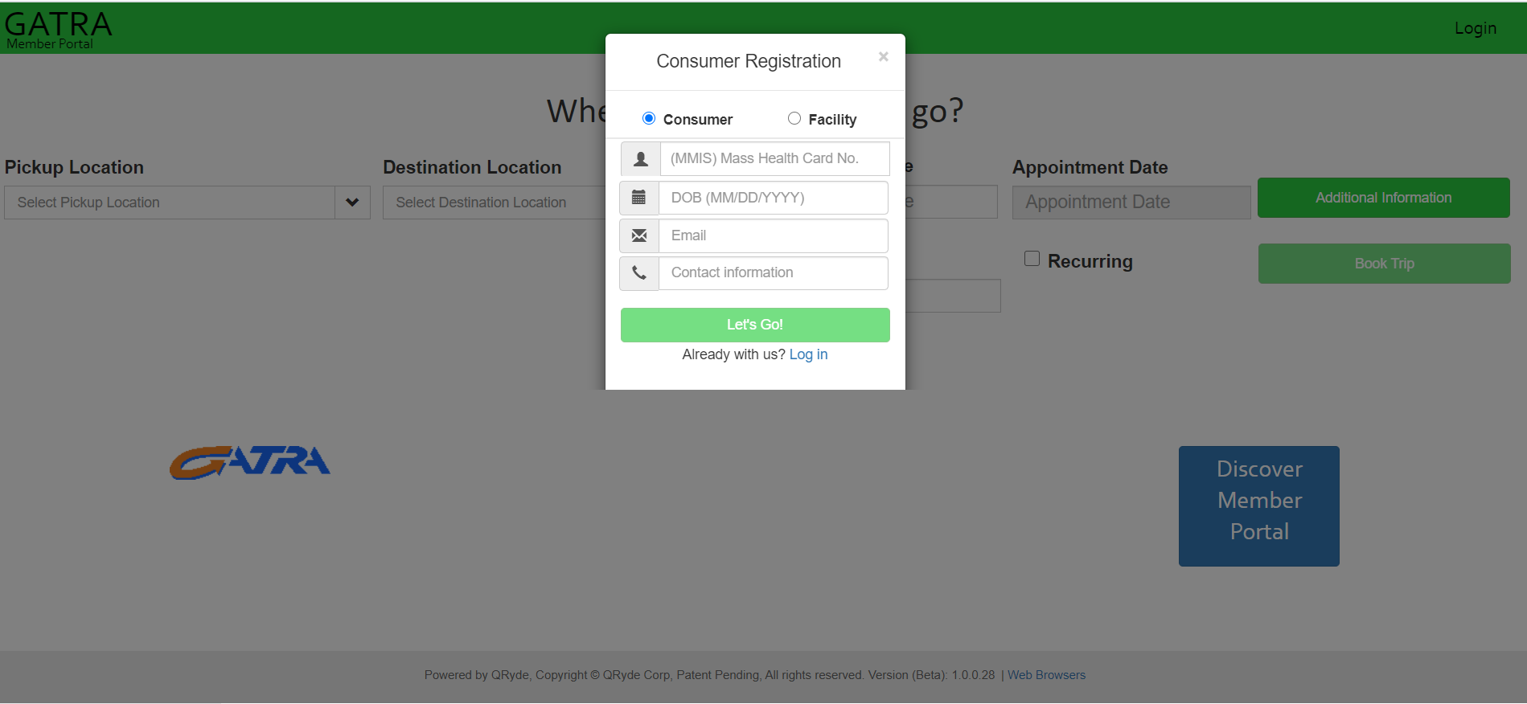
Consumer registration

Slide 14
Scheduling transportation
In order to schedule your transportation, choose the location from which you will be picked up, as well as the address to which you will be transported, choose the time you need to arrive to your appointment.

Slide 15
Then choose the date you need to be transported by choosing from the interactive calendar.

Slide 16
If scheduling a round-trip, click the box indicating that and choose the time you need to be returned from your appointment.

Slide 17
Once all of the required information has been entered, click the “Book Trip” button on the right side of the screen.

Slide 18
Once the trip is booked, you will receive confirmation, which includes the trip ID associated with your scheduled trip.

Slide 19
If you would like to check on all trips you have already scheduled, or to cancel a previously scheduled trip, you can do so by going to the menu located in the upper right corner of the screen and choosing “My Trips”.

Slide 20
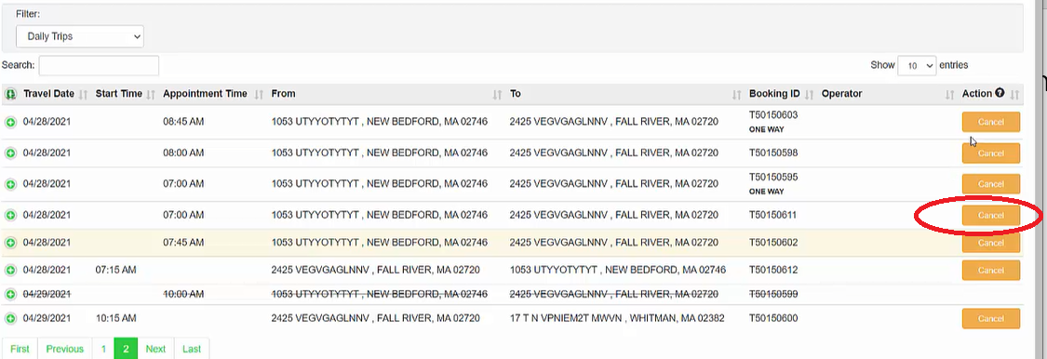
All trips will be displayed and you will have the ability to cancel any previously scheduled trip(s) in real-time.

Slide 21
You can also search for your current active PT-1 forms by going to the same menu and choosing “PT1s” from the dropdown list.

Slide 22
You will then see a list of currently active PT-1 forms. In order to get details, click the green icon next to the PT-1 and it will expand to show you further information about that PT-1.

Slide 23
If you would like to submit feedback, such as a compliment or a complaint about a previous experience with transportation, you can easily do so by accessing your trip history. To do this, choose “My trips from the dropdown list, located in the upper right corner.

Slide 24
To access past trips, choose “Past Trips” from the dropdown list located under the “Filter” section located on the left of the screen.

Slide 25
When viewing the list of past trips, you will have the ability to view additional details by clicking the icon next to the individual trip.

Slide 26
Once the trip information is expanded, you will have the ability to submit a complaint by clicking the “Complain” button.

Slide 27
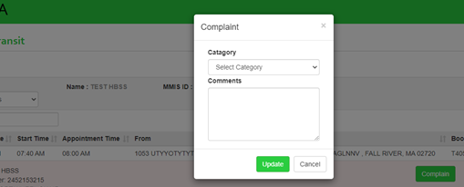
You can then enter the details of your experience within the “Comments” box that is displayed and once finished, click “Update”

Slide 28
GATRA will also have a consumer smartphone app, where you can schedule rides and submit feedback right from the convenience of your mobile device. This is in addition to our Call Center – you can still always reach us by phone.

Slide 29
Mobile Apps
The Mobile apps will be available from the iOS and Android app stores
Consumers will download the “Qryde Rider App’’ and enter the user ID as “MassHealthID” and password as “GATRAMH”
After initial login they will be required to change the password

Slide 30
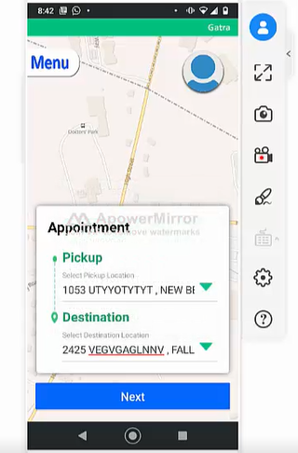
Once logged in, you can schedule your trip(s) by choosing the appropriate pick-up and destination addresses.

Slide 31
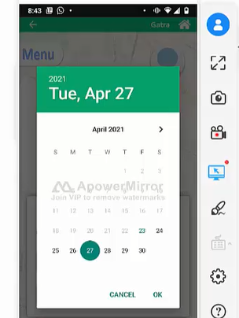
Next, choose the date of the trip you’re scheduling by choosing from the interactive calendar.

Slide 32
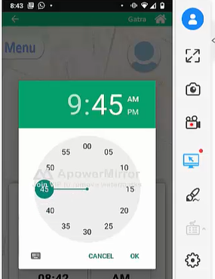
Then choose the time you need to arrive to your appointment, using the interactive clock.

Slide 33
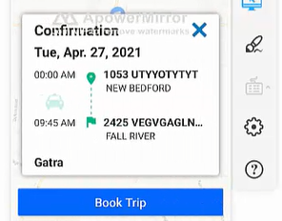
Once all the information for the trip has been entered, tap the “Book Trip” button at the bottom of the screen

Slide 34
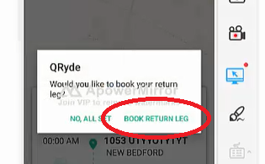
You will then be asked whether or not you need a return trip back. If this is a round trip, click “Book Return Leg”

Slide 35
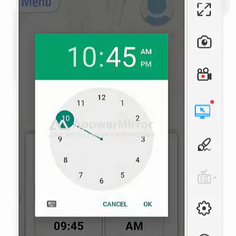
Choose the time you need to be returned home from your appointment, using the interactive clock.

Slide 36
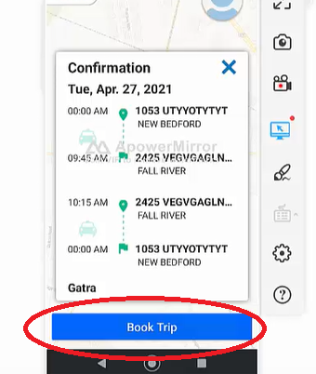
A summary of the trip information you booked will be displayed. Once you confirm accuracy, tap the “Book Trip” button.

Slide 37
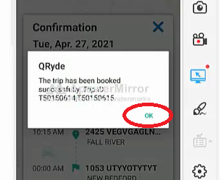
A confirmation of the trip(s) being successfully scheduled will then be displayed. Tap “OK” to move forward.

Slide 38
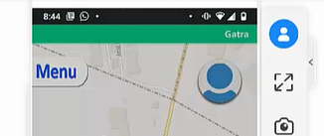
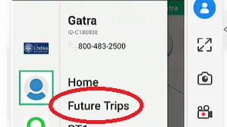
If you would like to view currently scheduled trips, tap the “Menu” option, located in the upper left corner of the screen and choose “future trips”

Slide 39
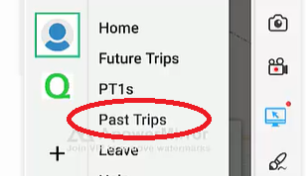
To view a list of trips previously taken, choose “Past Trips” from the list

Slide 40
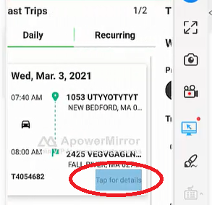
To get more information about a past trip, tap the “Tap for Details” link.

Slide 41
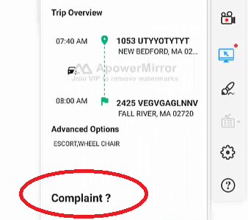
This screen will display an overview of the trip you selected. If you experienced an issue with a particular trip, you can submit a complaint right from the app, without having to call us, simply by tapping the “Complaint” option at the bottom.

Slide 42
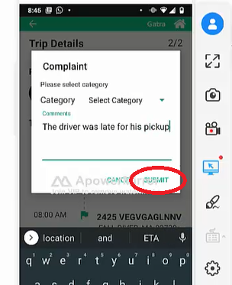
Enter the details of the complaint and then tap the “Submit” option.

Slide 43
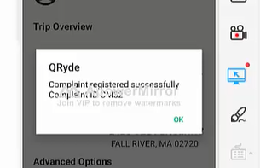
Once submitted, a confirmation will be displayed, indicating your complaint was successfully received by GATRA and we will be diligently working to resolve the issue(s) reported.

Slide 44
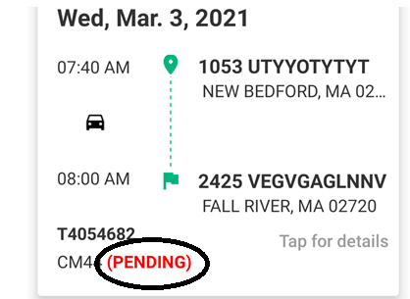
Once you submit your complaint, the status of the complaint will be displayed within the trip details on the consumer app, as well as the web portal.

Slide 45
Notification of submitted complaints
User will receive a text/SMS message, confirming GATRA has received the complaint and is currently investigating
Once the complaint has been resolved, another text/SMS message will be sent to the user, indicating their complaint has been resolved.
Our Call Center remains available for you to contact us by phone.

Slide 46
What we’re working for on future enhancements
Further expansion of GPS Tracking on all vehicles, not just PT-1 rides
Ride-Hail Pilot Program
Potentially utilizing companies such as Uber and Lyft to assist with meeting the growing demand for Non-Emergency Medical Transportation

Slide 47
We welcome your feedback!
Submit a complaint or share your ideas
Call us at (800) 431-1713
More ways to contact us coming July 1

Slide 48
Questions & Comments
Type into the Q&A box
Raise your hand
Click on “Raise Hand”
Use Alt+Y for Windows or Option+Y for Mac
If you are calling in, dial *9

Slide 49
GATRA Orientation Session
The presentation has concluded
You are welcome to log off if you have no more questions or comments
We are available for questions & comments
Type in the Q&A box
Raise your hand
Attend a future session: www.mass.gov/hstnews
Keep in touch
GATRA: (800) 431-1713
HST: hstinfo@mass.gov or (617) 847-3427

