Slide 1

How are you impacted by climate change in Massachusetts?
See the full report at
bit.ly/maclimate
Greater Connecticut River Valley Region
Let’s find out!

Slide 2
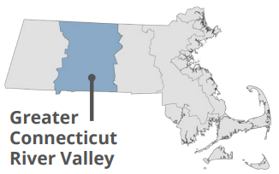
The 2022 Massachusetts Climate Change Assessment evaluated and ranked 37 impacts across 5 sectors for 7 regions throughout the Commonwealth based on:
How big will the impact be from climate change?
How well do current adaptation actions address the impact?
Will populations living in environmental justice areas be disproportionately affected?
The Greater Connecticut River Valley Region is centered around the Connecticut River. This region includes rural towns and urban centers. Many of the most urgent climate impacts are already large concerns in the region (e.g., food security, agriculture, and housing).
The next slides show the most urgent impacts per sector for this region →

Slide 3

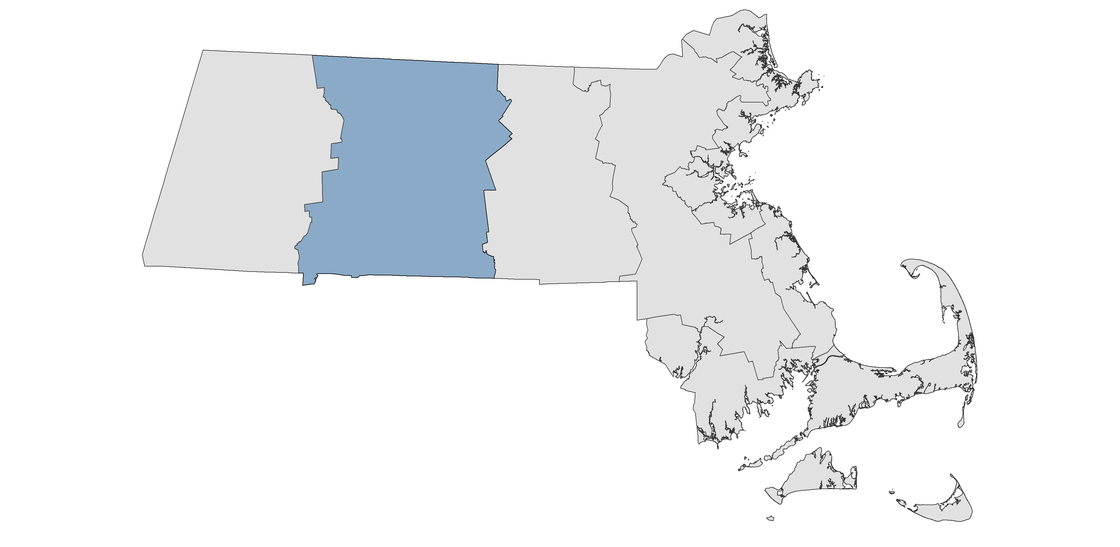
Human Sector
Human Sector
  Top Impacts:
  Reduction in food safety and security due to production and supply chain issues, as well as spoilage during power outages.
  Health effects of extreme storms and power outages, including from injuries, food safety, and medical device failure.
Greater Connecticut River Valley

Slide 4
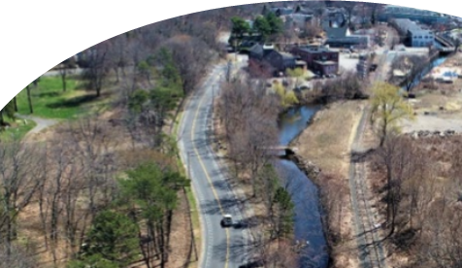
Infrastructure Sector
Infrastructure Sector
  Top Impacts:
  More flooding damage to inland buildings near rivers and when drainage systems are overwhelmed by heavy rainstorms.
  Damage to electric transmission and utility distribution infrastructure associated with heat stress and extreme events.
Greater Connecticut River Valley

Slide 5

Natural Environment
  Top Impacts:
  Shifting distribution of native and invasive species as changing climate conditions favor certain species.
  Freshwater ecosystem degradation due to warming waters, drought, and increased runoff.
  Declining forest health because of warming temperatures, changing precipitation, increasing pest occurrence, more frequent and intense storms, and increased wildfire risk.
Greater Connecticut River Valley

Slide 6
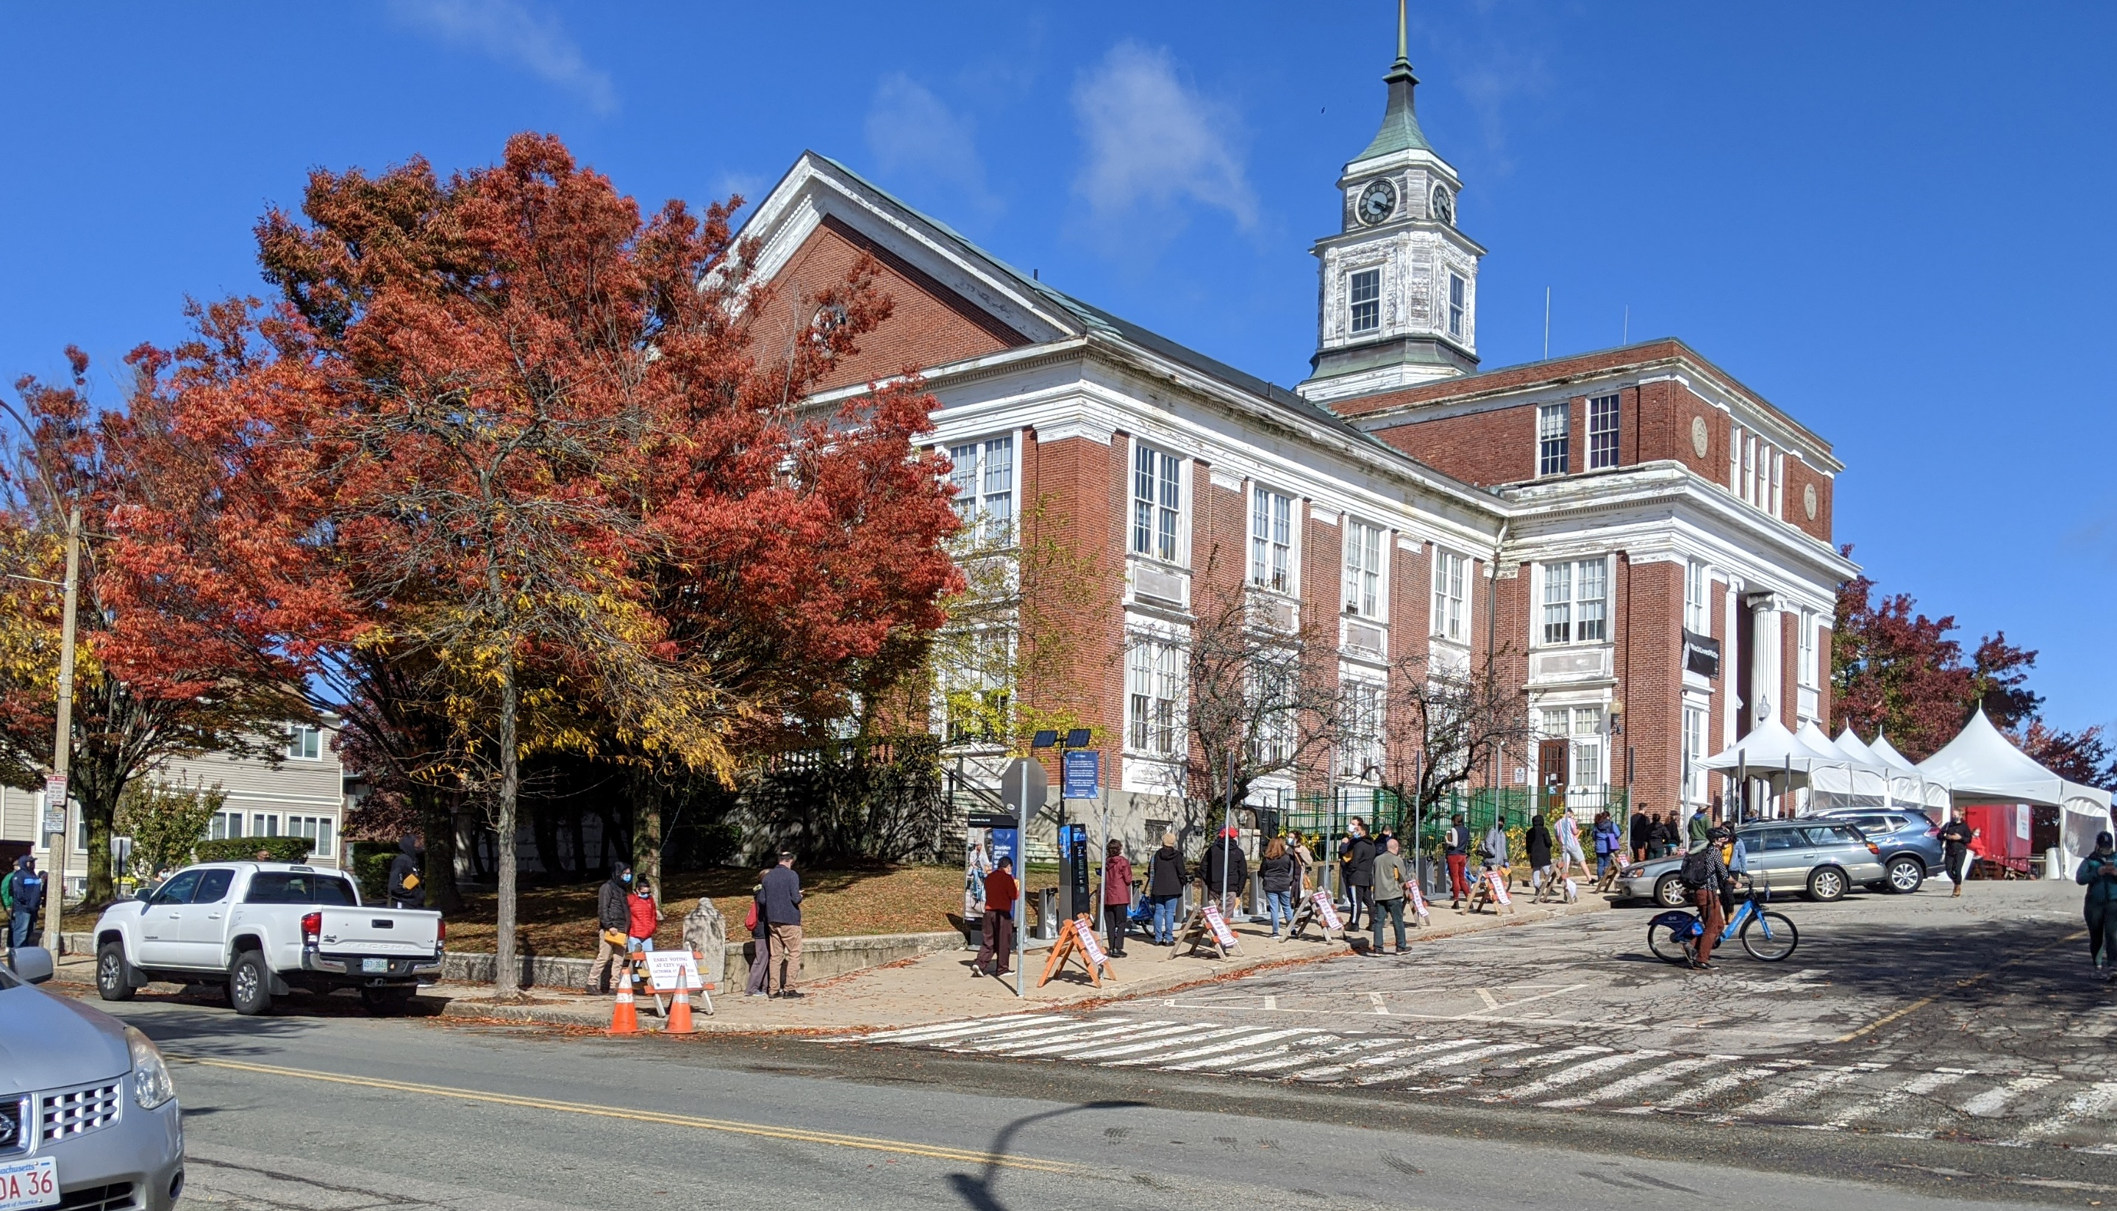
Governance
Sector
Top Impacts:
Increased costs to maintain infrastructure and services during potentially sudden population growth due to climate migration.
Reduction in state and municipal revenues, including a reduced property tax base due to inland flood risk.
Greater Connecticut River Valley

Slide 7
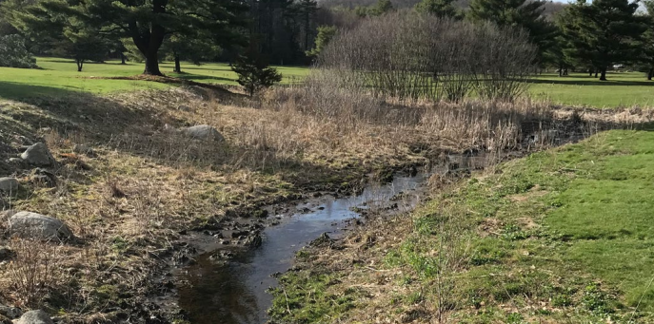
Economic
Sector
Top Impacts:
Decrease in agricultural productivity as crop yields are impacted by precipitation patterns, extreme weather, pests, and other climate factors.
Reduction in the availability of affordably priced housing from direct damage (e.g., flooding) and the scarcity caused by increased demand.
Greater Connecticut River Valley

Slide 8
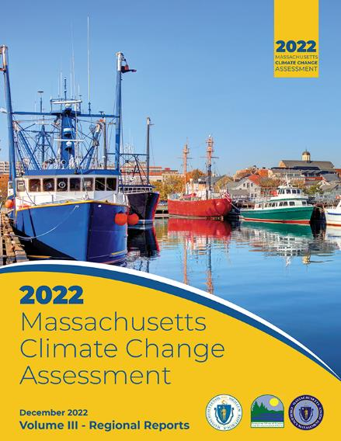
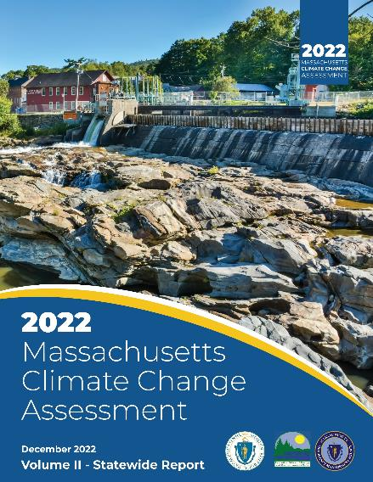
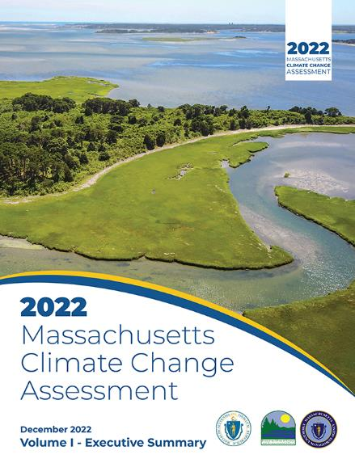

To learn more, check out the full report, available online!
bit.ly/maclimate
Type this link into your browser

