Slide 1
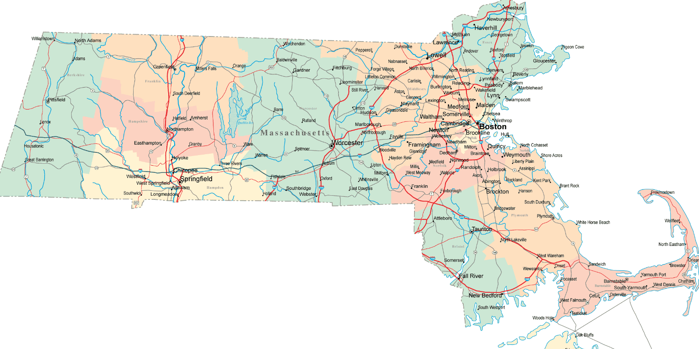
GIC Coordinator Training
Middlesex Community College
Bedford, MA
McCormack State
Office Building
Boston, MA
(Morning)
McCormack State Office Building
Boston, MA
(Afternoon)
Am
UMASS Amherst
Amherst, MA
Massasoit Conference Center Brockton, MA
3/26 – UMass Amherst, Amherst, 10:00 AM – 12:00 PM
3/27 – Middlesex Community College, Bedford, 10:00 AM – 12:00 PM
3/28 – McCormack State Office Building, Boston, 10:00 AM – 12:00 PM
3/28 – McCormack State Office Building, Boston, 1:00 PM – 3:00 PM
3/29 – Massasoit Conference Center, Brockton, 10:00 AM – 12:00 PM

Slide 2
Annual Enrollment
April 4, 2018 - May 2, 2018
GIC Health Fairs
North Shore Community College
Danvers, MA
Berkshire Community College
Pittsfield, MA
UMass Amherst
Amherst, MA
Mount Wachusett Community College Gardner, MA
Middlesex Community College
Bedford, MA
McCormack State Office Building
Boston, MA
State Transportation Building
Boston, MA
Massasoit Conference Center
Brockton, MA
Quinsigamond Community College Worcester, MA
Greenleaf Community Center
Springfield, MA
Hampden County Sheriff’s Dept.
Ludlow, MA
Wrentham Developmental Center
Wrentham, MA
4/11 - Wrentham Developmental Center, Wrentham,11AM-3PM
4/12 – Quinsigamond Community College, Worcester,11AM-3PM
4/13- Berkshire Community College, Pittsfield, 11AM-2PM
4/17- McCormack State Office Building, Boston, 10AM-3PM
4/18- Hampden County Sheriff’s Dept., Ludlow, 11AM-3PM
4/19- UMass Amherst, Amherst, 10AM-3PM
4/20- Massasoit Conference Center, Brockton 1PM-5PM
4/21- North Shore Community College, Danvers, 10AM-2PM
4/23- State Transportation Building, Boston, 11AM-3PM
4/24 -Mount Wachusett Community College, Gardner, 1PM-5PM
4/26- Greenleaf Community Center, Springfield, 3PM-7PM
4/27- Middlesex Community College, Bedford, 1PM-5PM
4/28- Mass Maritime Academy, Buzzards Bay, 10AM-2PM
Mass Maritime Academy
Buzzards Bay, MA

