Slide 1
Eversource’s Climate Change Vulnerability Study
Elli Ntakou, Manager – Reliability and Resilience Planning
July 2023

Slide 2
The History
Mitigation
Offshore wind
DER interconnections
Adaptation
Grid modernization: AMI, telemetry, telecoms
Electrification
Proactive infrastructure replacement: condition-based asset health models
Advanced analytics: LiDAR and satellite imagery data platform
Research on HILL events return periods and multi-layered grid-to-weather modeling
Research on renewables integration & cybersecurity
BESS projects
Climate change vulnerability study
Eversource is committed to providing safe, reliable and resilient service to its Massachusetts, New Hampshire and Connecticut customers, despite worsening climate change and other challenges like rapid electrification, proliferation of DERs and aging electric grid infrastructure.

Slide 3
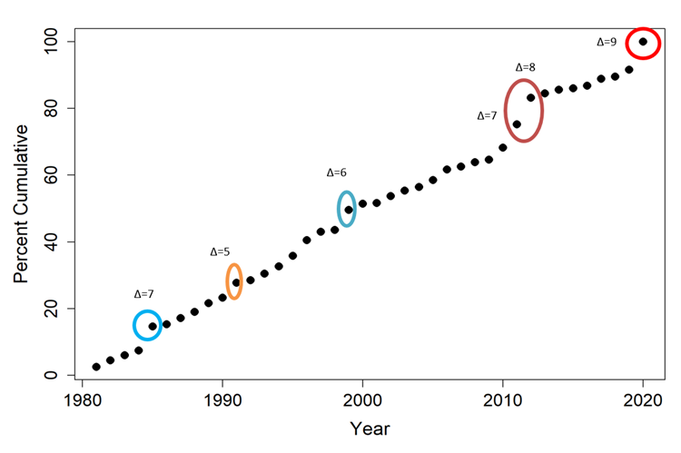
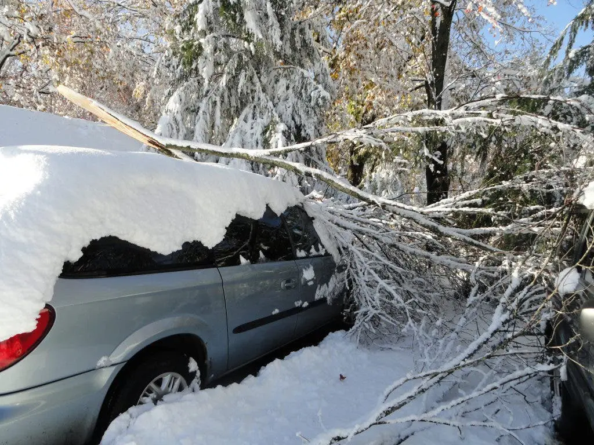
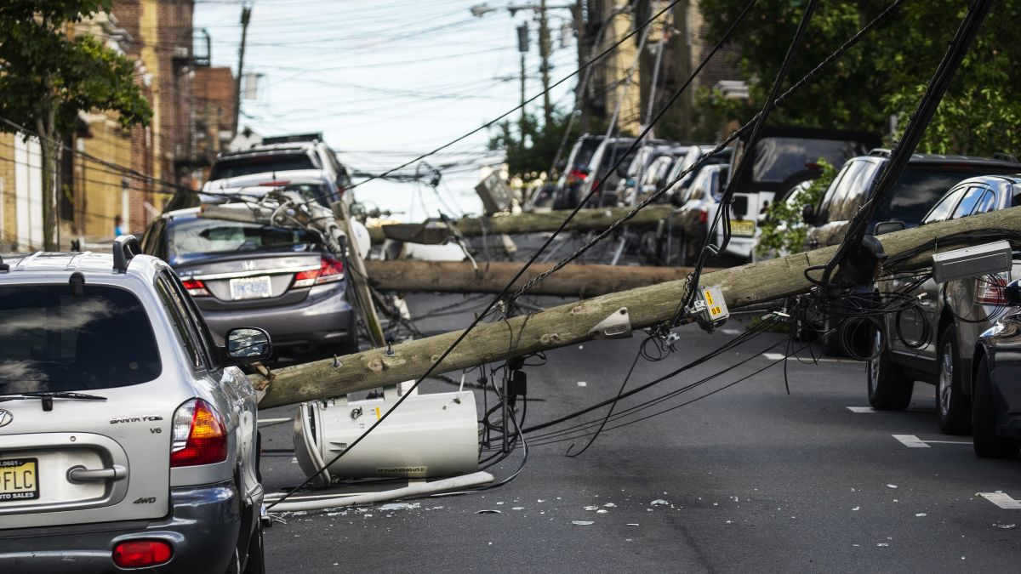
Extreme Weather Events Have Already Become More Frequent And Intense in New England
2011: Storm Alfred
2011: Hurricane Irene
2012: Storm Sandy
2020: Tropical storm Isaias

Slide 4
Eversource’s Climate Change Vulnerability Study- Methods & Approach
Time Horizon
2030, 2040, 2050 and 2080
Scenarios
Shared Socioeconomic Pathway (SSP) 2-4.5 (GHG emissions ↓ by 2050)
SSP5-8.5 (~2C temperature rise; GHG emissions keep increasing)
Other Stats
First EDC to use the new CMIP Phase 6 projections
Climate science variables downscaled to 6kmx6km grid
Variables
Temperature (including impacts to demand)
Sea level rise & coastal flooding
Modelling of a couple of HILL realizations
Wind
Precipitation

Slide 5
Eversource’s Climate Change Vulnerability Study- Scenarios Studied
Low estimate
Higher probability of exceeding
Lower margin of safety/ error
High estimate
Smaller probability of exceeding
Higher margin of safety/ error
90th percentile
The Xth percentile is defined as the value that X percent of the outcomes are ≤ to
High estimate
Upper right tail
50th percentile
Middle range
We show the results of the 90th percentile of the high-emissions scenario, as a worst case, and the 50th percentile of the low-emissions scenario as a middle-of-the-way case.

Slide 6
Eversource’s Climate Change Vulnerability Study- List of Climate Science Variables
Hazard | Climate Variables
Extreme Temperature | Annual 50th, 90th and 95th percentile daily maximum temperature Annual 5th, 10th, 50th, 90th and 95th percentile daily average temperature Number of days above 90th and 95th percentile daily maximum temperature Number of days above 90th and 95th percentile daily average temperature Frequency of two and three consecutive day heat waves with daily maximum temperature over 90th and 95th percentiles Frequency of two and three consecutive day heat waves with daily average temperature over 90th and 95th percentiles Annual longest heat wave duration over 95th percentile daily maximum temperature Annual longest heat wave duration over 95th percentile daily average temperature Number of days below 5th and 10th percentile daily minimum temperature Annual warmest daily maximum temperature Annual coldest daily minimum temperature
Energy Demand | Proxy for May-September Weighted Temperature-Humidity Index (WTHI) October-April Heating Degree Days May-September Cooling Degree Days
Heavy Precipitation | Annual maximum 1- and 5-day precipitation Days per year with precipitation exceeding 1, 2, and 3 inches
Drought | Annual maximum consecutive dry days
Sea Level Rise | Local sea level rise projections under low and high scenarios Sea level rise flooding depth and extent under low and high scenarios
Storm surge | Category 1, 2, and 3 hurricane storm surge depth and extent

Slide 7
Preliminary Results for Massachusetts- Temperature
Warming climate; extreme heat is expected to increase three-fold:
Temperature values
The upper tail of the daily maximum temperature distribution projected to increase by 5.5˚F to 7.0˚F by 2050 in Boston and Hartford
The upper tail of the daily average temperature distribution projected to increase by 6.3˚F to 8.1˚F by 2050 in Boston and Hartford
Heat wave duration
Increasing by 3.7 to 8.0 days by 2050 across the service territory
Heat wave frequency
Increasing by 7.5 to 20.7 heat waves* by 2050 across the service territory
Summer demand will increase significantly
Cooling degree days projected to increase by 200 to 794 degree days* by 2050
Weighted temperature humidity index (WTHI) projected to increase by 3.1 to 6.3* by 2050 in Boston
Cold extremes become less intense and less frequent by 2050

Slide 8
Preliminary Results for Massachusetts- Temperature
Low emissions scenario (SSP2-4.5)
Temperature increase up to 4.7F in the 50th percentile.
High emissions scenario (SSP5-8.5)
Temperature increase up to 7.7F in the 90th percentile.

Slide 9
Preliminary Results for Massachusetts- Temperature
Historically Observed Annual Hottest Daily Temperature
2050 Annual Hottest Daily Temperature- SSP2-4.5 50th percentile
Under the low emissions scenario (SSP2-4.5 50th percentile), daily maximum temperatures are forecasted to be from 80.7-101.5F in 2050 across our service territory.

Slide 10
Preliminary Results for Massachusetts- Temperature
Historically Observed Annual Hottest Daily Temperature
2050 Annual Hottest Daily Temperature- SSP5-8.5 90th percentile
Under the high emissions scenario (SSP5-8.5 90th percentile), daily maximum temperatures are forecasted to be from 84.5-104.8F in 2050 across our service territory.

Slide 11
Preliminary Results for Massachusetts- Temperature
Historically Observed Longest Heat Wave
2050 Annual Longest Heat Wave- SSP2-4.5 50th percentile
Longest heat wave duration is defined as the number of days with temperatures above 95th percentile of daily maximum temperature. Under the low emissions scenario (SSP2-4.5 50th percentile) 7.8-15.0 days in 2050 are forecasted, from the current 4.4-7 days.

Slide 12
Preliminary Results for Massachusetts- Temperature
Historically Observed Longest Heat Wave
2050 Annual Longest Heat Wave- SSP5-8.5 90th percentile
Under the high emissions scenario (SSP5-8.5 90th percentile), drastic changes from baseline and from the low emissions scenario are forecasted, with 11.7-27.7 days in 2050, from the current 4.4-7 days.

Slide 13
Preliminary Results for Massachusetts- Precipitation, Sea Level Rise & Flooding, HILL events
Extreme precipitation projected to increase by 3 - 30.7% by 2050
Coastal areas could see significant inundation due to sea level rise and storm surge.
Extreme events are typically not easily captured by climate science models
Understand probable and impactful combinations of phenomena, leading to concurrent realizations of the values of the climate science variables
Hypothesize a HILL event path, based on the type of event and potentially also informed from historical data
Continue research at Eversource Energy Center to understand HILL events’ return periods

Slide 14
Preliminary Results - Precipitation
Historically Observed Maximum 5-day Precipitation
2050 Maximum 5-day Precipitation- SSP2-4.5 50th percentile
Under the low emissions scenario (SSP2-4.5 50th percentile), a 3.0-14.6% change in maximum 5-day precipitation levels is forecasted in 2050.

Slide 15
Preliminary Results - Precipitation
Historically Observed Maximum 5-day Precipitation
2050 Maximum 5-day Precipitation- SSP5-8.5 90th percentile
Under the high emissions scenario (SSP5-8.5 90th percentile), a 8.7-30.7% change in maximum 5-day precipitation levels is forecasted in 2050.

Slide 16
Preliminary Results - Sea Level Rise
2050 Sea Level Rise- High Scenario
2080 Sea Level Rise- High Scenario
Sea level rise results show flooding impacting coastal areas starting 2050. Sea level rise is creating additional pockets of inland flooding by 2080.

Slide 17
Modeling of HILL events- Simulated realizations’ characteristics
Major ice storm followed by cold snap
Prolonged drought followed by tropical storm
2-day ice storm
0.5-3 inches of snow accumulation in Boston
~1 inch of snow accumulation in the Berkshires
45 mph winds in Springfield
60 mph winds in Boston
At the cold snap’s peak, lowest minimum temperatures
-5°F in Boston
-15°F in Springfield.
Higher elevations of the Berkshires as low as -30°F.
Cape Cod minimum temperatures > 0°F.
<30 inches of rainfall annually for 5 years
Multiple prolonged heat waves
102F at peak, over 95F for 7 consecutive days
Category 3 tropical storm makes landfall in Harford and Western Massachusetts
Source: US drought monitor, as of July 7th, 2023.

Slide 18
Next Steps
Connecting Planning, Standards and Operations to the “new normal” defined by climate change.
Connecting the dots
Between the climate science variable and the type of electrical asset affected
Between the forecasted results and the electrical equipment thresholds
Spatially to locate parts of the grid affected; which variable affects each area
System Planning
Historical all-in metrics
Probabilistic planning inputs
Operations & Engineering
Transformer loading
Vegetation Planning & Ops
Tree health
High heat days
Standards
Pole classes
Conductor types
Danger & hazard trees

