Slide 1
Governor Healey’s Anti-Hunger Task Force Kick-Off Meeting
August 19, 2025

Slide 2
Agenda
Introductions
Background: SNAP Cuts and Impact on Massachusetts
Anti-Hunger Task Force Overview, Structure & Partnership Opportunities
Working Groups Overview
Listening Sessions
Discussion
Next Steps & Proposed Calendar

Slide 3
Supplemental Nutrition Assistance Program (SNAP) at a Glance
Federal nutrition program administered by the Department of Transitional Assistance (DTA) for Massachusetts residents.
Largest anti-hunger program in Massachusetts, serving more than 1 million people (1 in 6 MA residents)
32% of recipients are children (under 18)
24% of recipients are seniors (60 and older)
28% of recipients are people with disabilities
Brings in $2.7 billion federal dollars annually and SNAP benefits have an economic multiplier effect of $1.54 for every $1 spent resulting in economic generation in every community across the Commonwealth
Average SNAP benefit in MA (as of February 2025)
$327/household/month
$10.70/household/day
The Healthy Incentives Program (HIP), a state-funded supplement for purchase of fruits and vegetables at farmer’s markets and community supported agriculture (CSA) farm share programs, increases access to healthy foods and provides direct economic benefit to local farmers.
SNAP brings nearly $3B to over 5500 Massachusetts retailers
Countercyclical - responsive to recessions when unemployment and poverty increase
For every 1 meal provided by a food bank, SNAP provides 9 meals.
826,000 people served monthly by food pantries
1.1 million SNAP participants in MA
557,000 school-age children receiving school meals
125,300
people on WIC
171,000
HIP participants
574,000 school age children enrolled in Sun Bucks (Summer EBT)

Slide 4
Background: Cuts to SNAP and impacted communities in MA
In July 2025, Congress passed a reconciliation bill that made the largest cut to SNAP in the program’s history. These cuts will have adverse impacts on people and communities across the Commonwealth.
Key SNAP Changes:
Expansion of strict work requirements to include older adults and parents of children over age 14 as well removing options waivers options for geographies with high unemployment or few jobs, significantly increasing the number of households at risk of losing benefits.
Elimination of eligibility for certain immigrants including refugees and asylees.
Limitation on utility allowances which will reduce benefits for certain households
Implementation of a benefit cost-share with states tied to payment accuracy measures starting in FFY28, which could result in up to $394M in benefit costs for MA.
Increase in administrative cost share for states for 50% administrative costs to 75% administrative costs starting in FFY27 resulting in $53M in additional costs to MA.
Limitation on increases in the Thrifty Food Plan calculation, the cost basis for SNAP, which will erode the value SNAP benefits over time
Elimination of $9.1M in nutrition education grants.

Slide 5
Data estimates on impact and implementation timeline
Populations, communities, and sectors facing highest potential impacts from cuts to SNAP:
Quantifying the impacts:
Households newly subject to strict work requirements:
Adults 55-65
Households with children over 14
Communities losing geographic waivers exempting households from strict work requirements, including but not limited to:
Western MA
Central MA
Southeastern MA
Cape Cod & Islands
Merrimack Valley - Lowell, Lawrence
North Shore – Revere, Saugus, Lynn, Salem, Gloucester
Immigrants, their families, and communities
Local food economies – farmers, producers, retailers
Emergency food systems (food banks & pantries, grassroots food access organizations, congregate meal sites)
99,000
People newly subject to strict work requirements
9,500
Immigrants at risk of losing eligibility
$447M
Potential costs shifted to Massachusetts for SNAP benefits and administrative costs

Slide 6
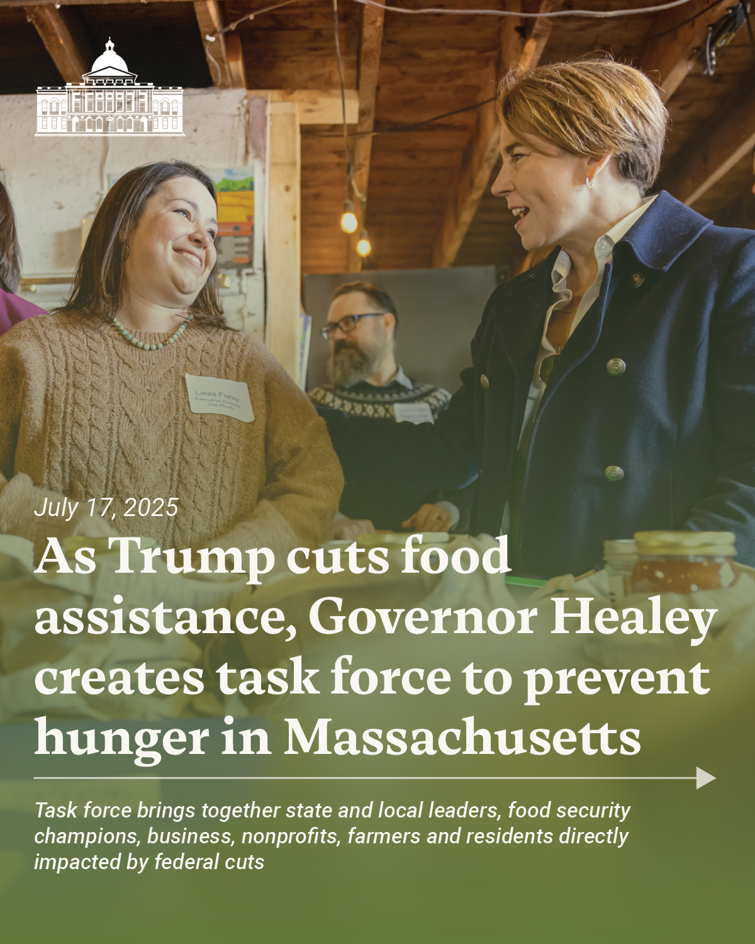
Governor Healey launched Anti-Hunger Task Force to address harmful SNAP cuts
Governor Healey issued an Executive Order in July, forming the Anti-Hunger Task Force to respond to federal cuts and their impact on residents of Massachusetts.
Task Force Objectives:
Provide recommendations for mitigating the direct and indirect impacts of federal SNAP cuts and program changes to Massachusetts;
Initiate and deepen collaboration among public, private, and nonprofit sectors for alleviating hunger and food insecurity, with a specific focus on those communities and populations most impacted by federal action;
Explore opportunities for partnership and collaboration across northeastern states, including New England and New York;
Provide recommendations for long-term, sustainable solutions for mitigating hunger and food insecurity, preserving food systems, and bolstering local economies through cross-cutting initiatives, including public-private partnerships, coordinated state responses, and data-driven reforms to policies and practices.

Slide 7
Building on a strong foundation: A snapshot of some of the Massachusetts anti-hunger initiatives
SNAP Healthy Incentives Program
Statewide supplement to SNAP EBT purchases for fruits and vegetables purchased at farmers’ markets generating revenue for local farmers and bolstering health among residents.
Universal Free School Meals
Statewide funding to provide free breakfast and lunch to every K-12 student in the Commonwealth to reduce food insecurity among families with children and improve childhood outcomes.
Food Security Infrastructure Grants
Grant program that supports projects that improve local food distribution, strengthen the food supply chain, expand food access, and support emergency preparedness
Make Hunger History Campaign
Groundbreaking initiative to end hunger in Massachusetts through cross-sector collaborative of over 300 organizations statewide.
Food banks and food pantries
Place-based resources supporting neighbors in every community with emergency resources through state investment in the Massachusetts Emergency Food Assistance Program.

Slide 8



Working Groups
Working groups provide opportunities for Task Force members and other experts to develop recommendations focused on specific areas impacted by federal SNAP cuts and present to the larger Task Force for consideration.
Increasing access to food assistance for directly impacted populations
Building rural resiliency and sustaining local food systems
Funding opportunities & scaling solutions: Philanthropy & advocacy
Goal: Provide recommendations for initiatives, including but not limited to, supporting residents at risk of losing SNAP with connections to nutrition assistance programs and access to food through partnerships with local food banks, pantries, and food access organizations.
Sub-work groups: Families with children, older adults, people with disabilities
Goal: Provide recommendations that address challenges in rural communities disproportionately impacted by SNAP cuts and identify opportunities to support local food systems.
Goal: Provide recommendations to maximize funding opportunities and support sustainable solutions for ongoing challenges created by SNAP cuts.

Slide 9
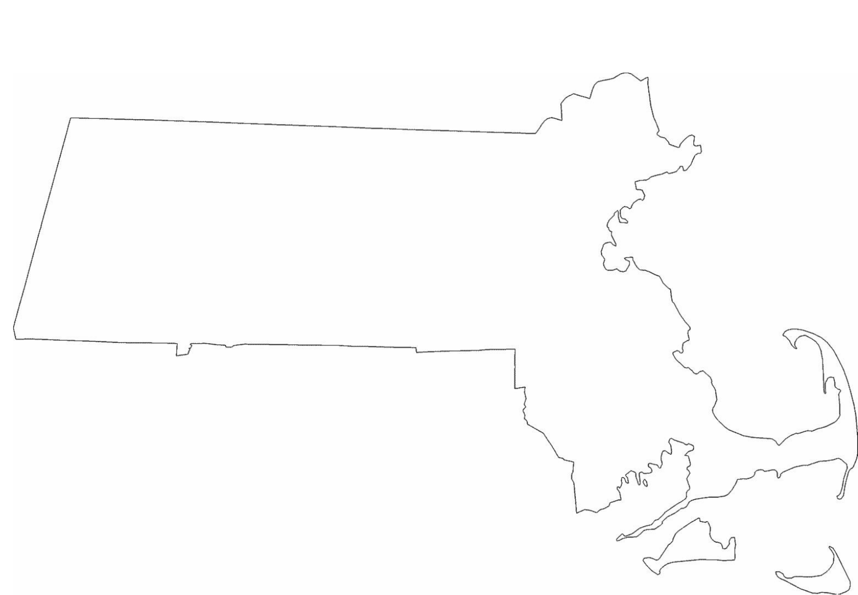
Listening Sessions
Listening sessions across the Commonwealth will provide Task Force and working group members the opportunity to hear from people with lived expertise as well as local organizations and leaders to inform recommendations.
Exact dates and locations to be determined.
In-person listening sessions will focus on the following regions:
Western MA
Central MA
Greater Boston
Cape and the Islands
A virtual listening session will be open to participants from any region of the Commonwealth.

Slide 10
Potential areas of focus for listening sessions:
Impact of cuts:
Access to benefits/benefit navigation
Impacted populations (seniors, working families, immigrants, low-income residents, children)
Emergency food assistance systems
Local food businesses, food system, farms
Schools
Financial impact on resident budgets/ trade-offs
Long-term effects on education, employment, health, and overall well-being
Residents losing both SNAP and Medicaid
Loss of nutrition education
Private fundraising
Access to fresh food, esp in summer months
Capacity of frontline organizations
Western MA, rural, and “gateway” cities
Gig and hourly workforce & economy
Strategies to address:
Cliff effects
Client communications
Barriers to SNAP access
Stabilization of emergency food system
Impact on immigrant communities
Navigation to available resources
Connecting dots in the food system
Measuring impact
Impact on communities in Western MA
Connecting people to state & fed benefits
Engaging farmers
Retaining SNAP customers
Resources for reducing payment error rates
Best practices for working with community leaders and people impacted by cuts
Resources to explore:
Collaboration and engagement opportunities across providers
Community solutions & alternatives for people losing SNAP (mutual aid, pay-what-you-can, alternative economies)
Successful food access partnerships, practical supports & innovative models
Regional coalitions w/ other states
Incentives and resources for residents to grow their own food
Infrastructure grants for local food
Leveraging and increasing HIP accessibility
Creative local solutions to supplement SNAP like food rescue & bulk procurement
Frontline org capacity to provide edu on SNAP cuts
Food system education
Alternative federal nutrition programs filling gaps

Slide 11
Feedback and open discussion
What we have heard from you and working group members thus far:
Importance of grounding this work in data on need, impact, and outcomes on effective ways to reduce food insecurity and identifying new ways to collect and share data including opportunities for frontline service providers
Food is a basic human right
Task Force can play a role in addressing fragmentation of food security sector
Need for a paradigm shift in how we think about the social safety net
Task Force can be a model for bold, inclusive solutions to end hunger
Recommendation to include nutrition security in the discussion
Recommendation to expand rural resiliency focus to include urban, suburban, and per-urban resiliency to focus on food producers across all sizes, scale, and connections
Concerning trends in food insecurity in older adult population and inadequacy of funds

Slide 12
Next Steps and Proposed Calendar
August – Task Force kick-off meeting to initiate work, align on goals, discuss timeline, etc.
September – Working Group meetings
October – Full Task Force meeting to share updates, discuss listening sessions, etc.
November – Working Group meetings
December – Task Force meeting to review draft recommendations and report
January – Submission of report and recommendations to the Governor
* Note: All dates TBD

