Slide 1
COMMONWEALTH OF MASSACHUSETTS
Charles D. Baker, Governor
Karyn E. Polito, Lt. Governor
Kathleen Theoharides, Secretary
Patrick C. Woodcock, Commissioner
FY 2020 Annual Report Overview
9/23/2020
Joanne Bissetta
Deputy Director
Green Communities Division

Slide 2
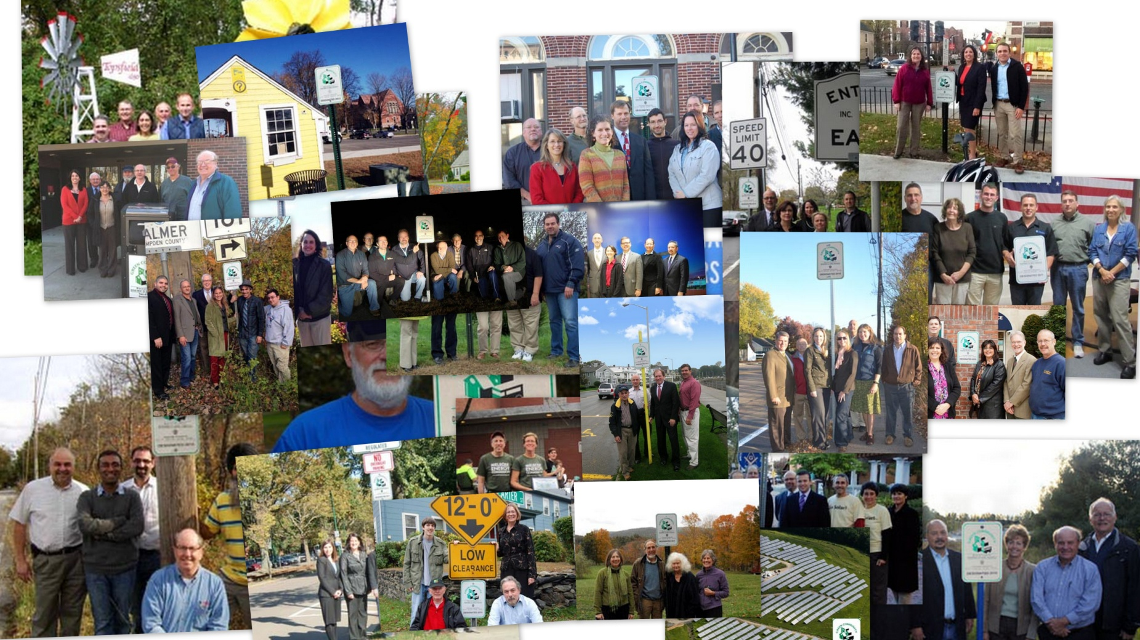
Thanks to all the Green Communities!

Slide 3
Recording & Presentation
    The webinar is being recorded and will be available on our website in approximately 48 hours at:
    www.mass.gov/orgs/green-communities-division-massdoer
    Click on the camera icon top right of your screen to save any slides for future reference
    Use the Q & A icon on your screen to type in questions
    We will pause for questions at the end of each section
Notes:
There will be time for Q&A at end, final answers will also be posted on the website with the webinar.

Slide 4

Upcoming Events
October 1, 9:45 – 12:00: MEI Office Hours for Annual Reports
TBD – RFI on Competitive Grants

Slide 5
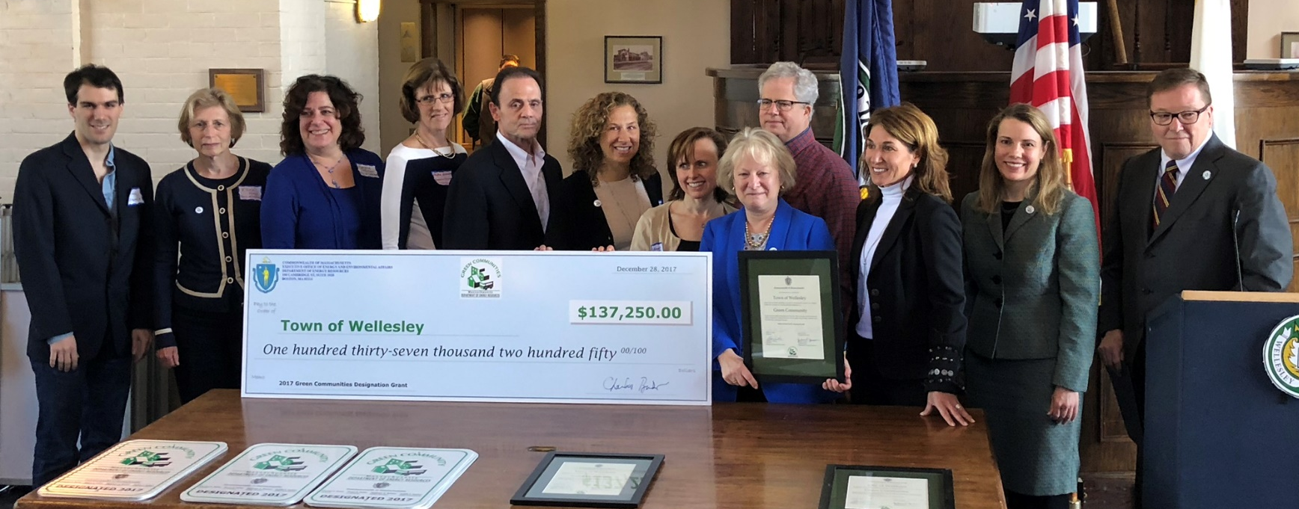
Green Communities 2020-2021
2020-2021 Goals for the GC Division include:
15-20 new GC Designations
Enhanced engagement with Regional School Districts
Assistance for struggling communities
Strategic electrification

Slide 6
Why Annual Reports?
Ensures grant $ awarded to GCs in “good standing”
Mechanism for GCs to “tell their story”
Track progress
ID trends
Inform future program development
Due Friday, November 6

Slide 7
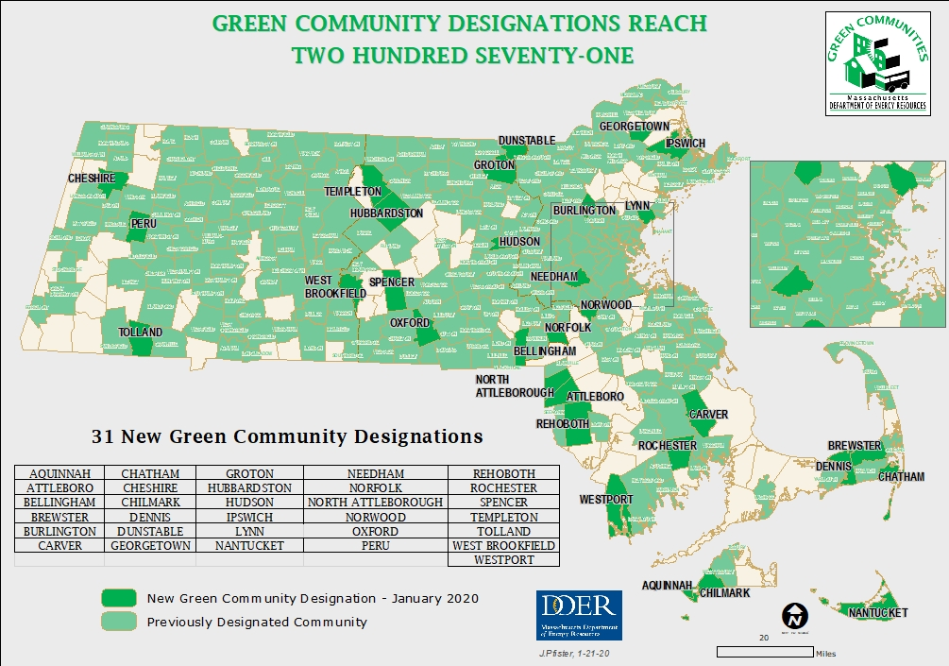

Slide 8
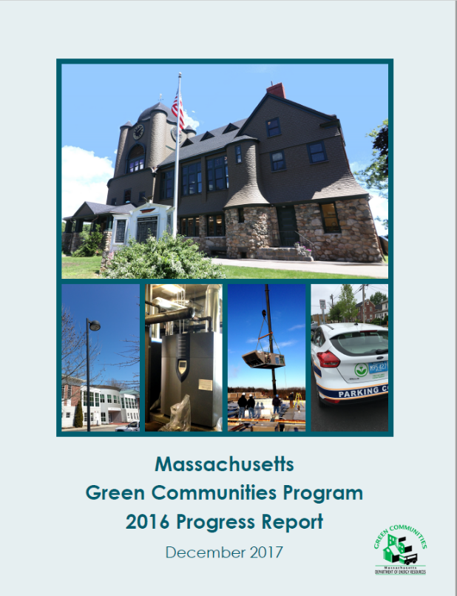
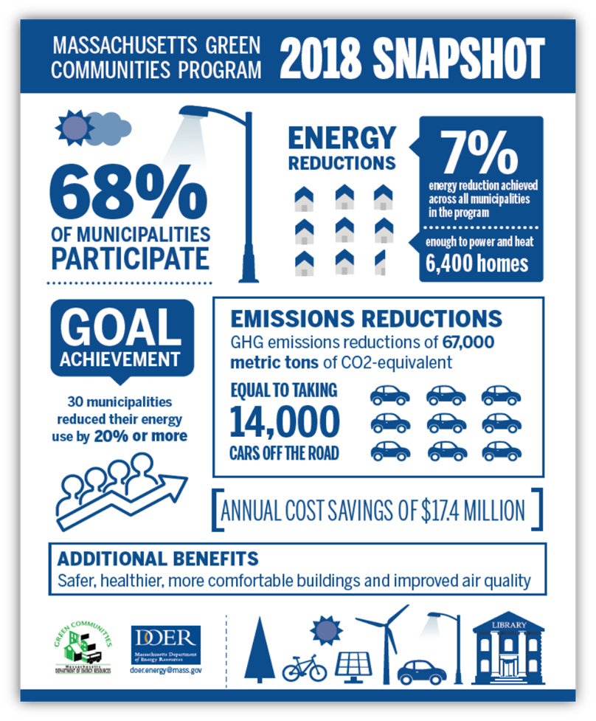
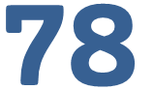
What do we do with the info?
Analyze data
Progress Reports
Verify 20% reduction

Slide 9
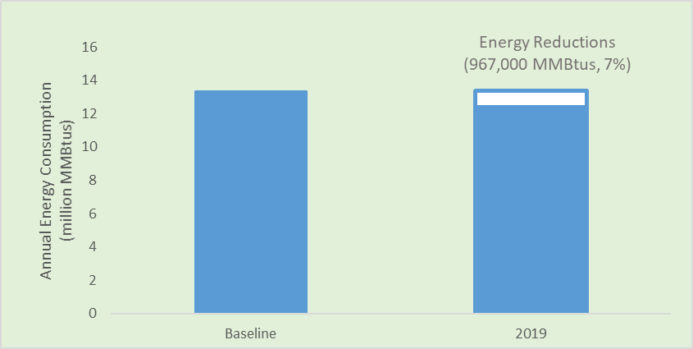
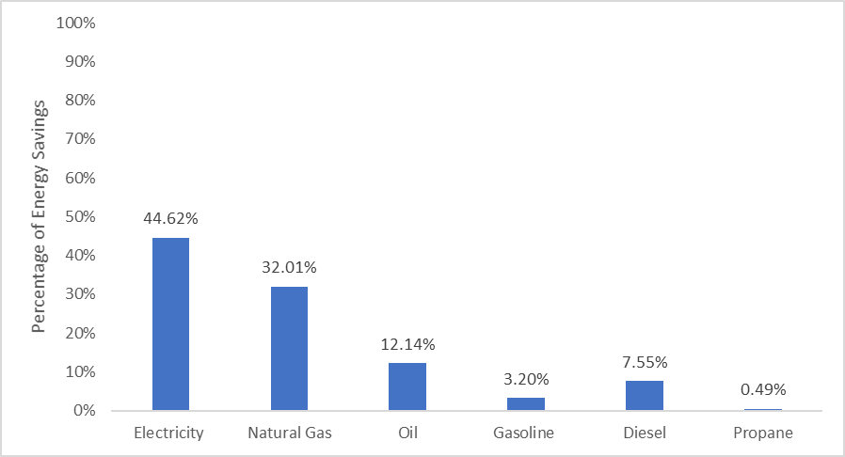
Some Results from 2019
Notes:
The chart on the right shows energy reduction progress for all GCs who reported – some have been in the program since the beginning, others only a couple of years. Total energy reduction is 7 %
The chart on the left shows the proportion of energy reductions by fuel. You can see the electricity accounts for nearly half – a reflection of the many interior lighting upgrades implemented in municipal and school buildings, as well as all the LED streetlight retrofits

Slide 10

FY20 Annual Report Walk-through
WavebreakmediaMicro/dollar photo club
Notes:
We are now going to go through all the tables and forms GCs will need to fill out. For those of you new to annual reports, it consists of an excel workbook with multiple tabs – providing opportunity for GCs to report on activities related to each of the 5 criteria. We will walk through each tab.

Slide 11
Information/Tasks Needed
Information on permitting clean energy projects in by-right zone
Make sure FY20 energy data complete
Delivered fuels (oil, propane, gasoline, diesel, wood)
Obtain changes in municipal fleet
Vehicle acquisitions & retirements
Obtain # occupancy permits issued FY20
New residential & commercial over 100,000 sf

Slide 12
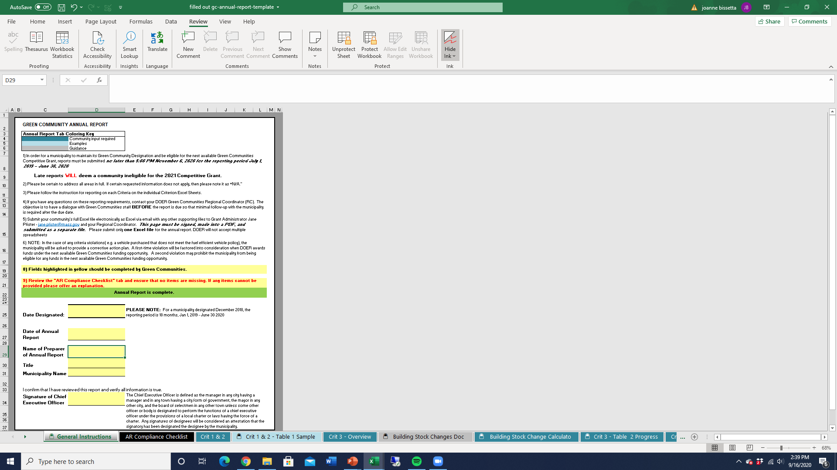
General Instruction/Confirmation Page
Convert the signature page into PDF and submit separately
Make sure CEO signs confirmation
Notes:
This is the first tab – Submittal deadline is Dec. 3 and reports are emailed to our grant administrator Jane Pfister. Please keep the report in excel format (do not make it into a pdf, except for this page)
Areas shaded yellow are places for GCs to provide information
This cover page should be signed by community’s CEO and converted to a pdf and submitted as a separate file.

Slide 13
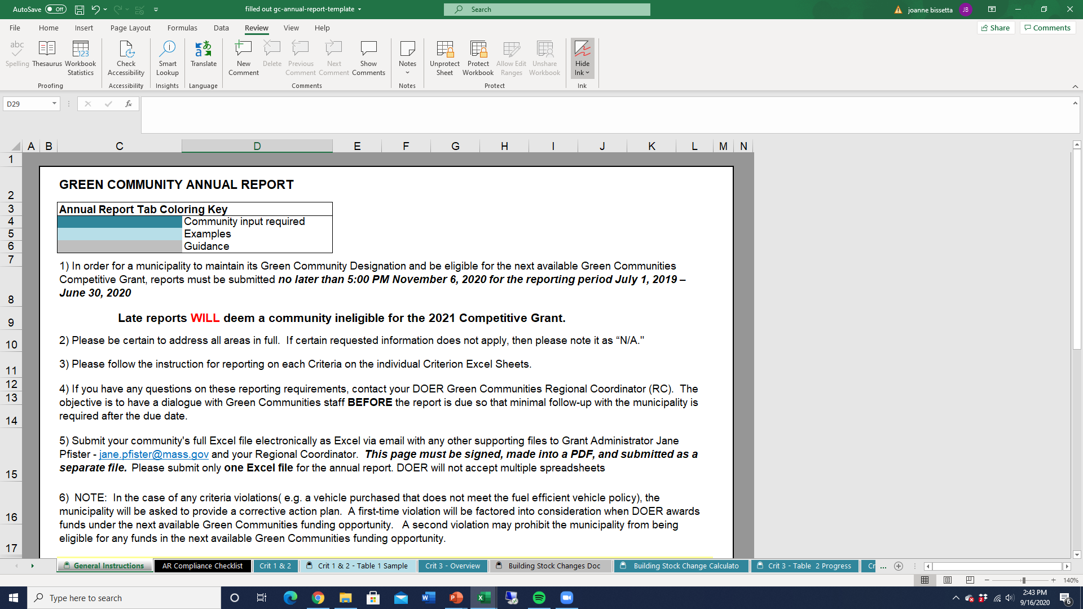
Some Improvements
Notes:
Tabs are color coded – do not be alarmed at workbook size

Slide 14
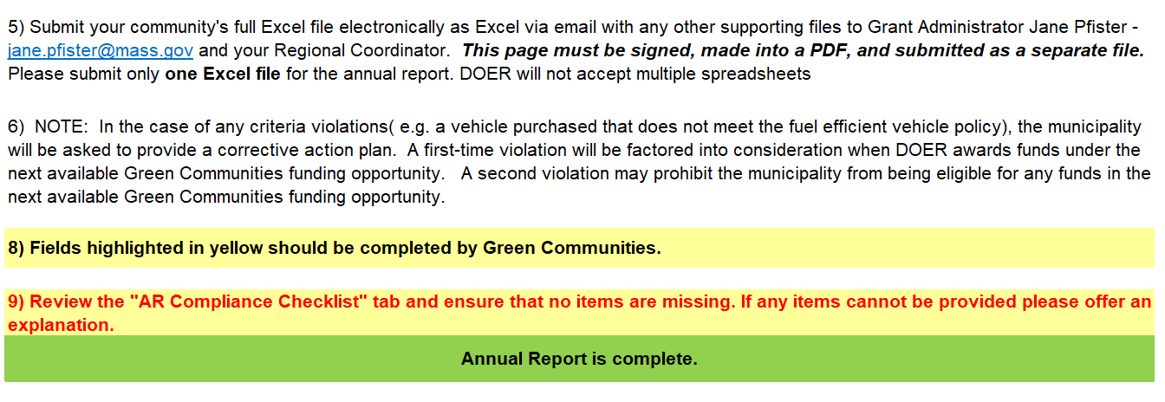

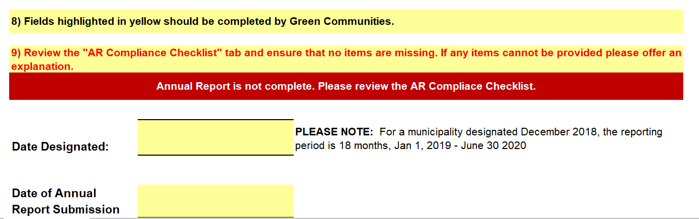

New this Year
Notes:
AR Compliance Checklist -

Slide 15
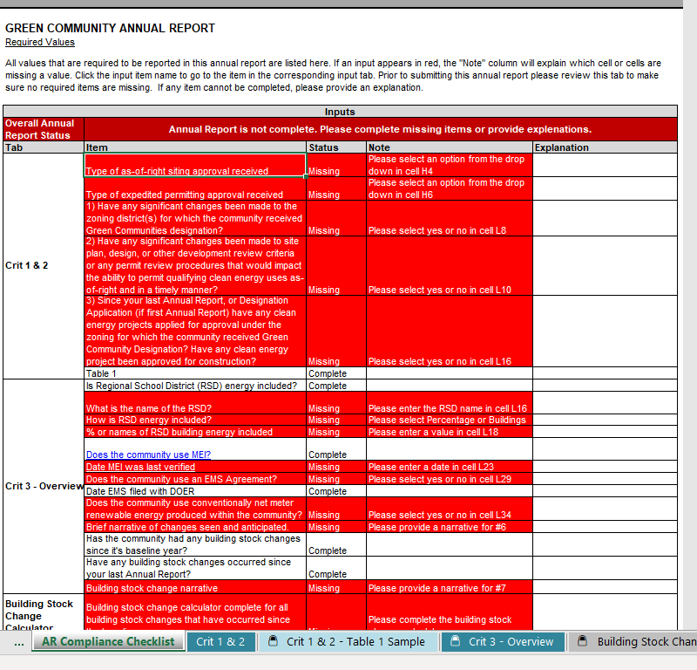
Compliance Checklist

Slide 16
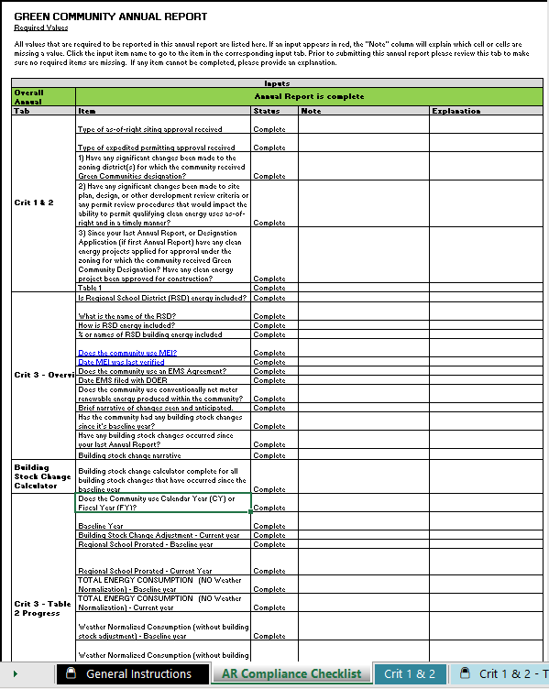
Compliance Checklist

Slide 17
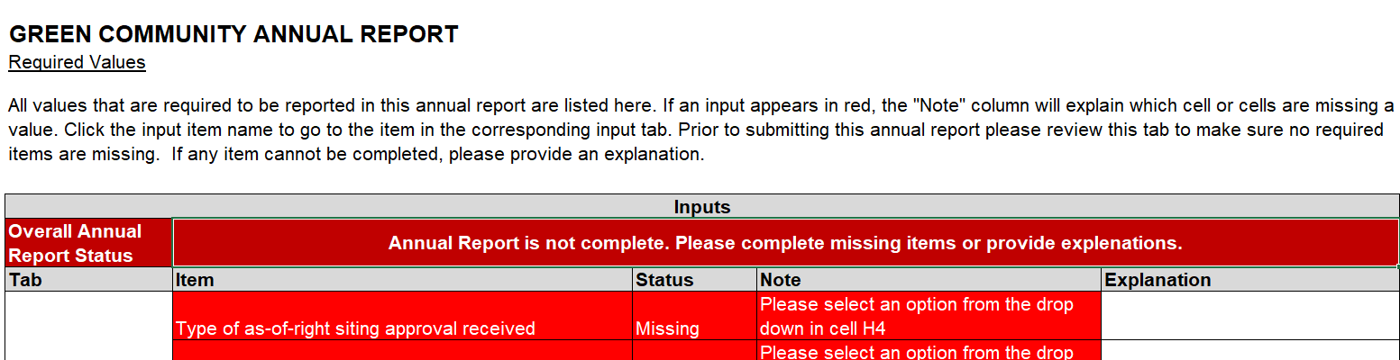
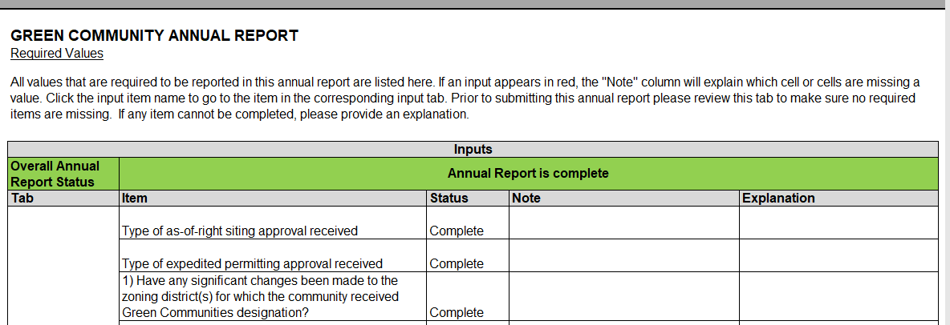
Notes:
The

Slide 18
General Instruction/Confirmation Page
Notes:
Your confirmation page should have the statement “Annual Report is complete” in Green. Please do not submit if it’s red.

Slide 19

Questions on Confirmation Page or Compliance Checklist

Slide 20
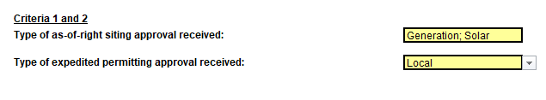
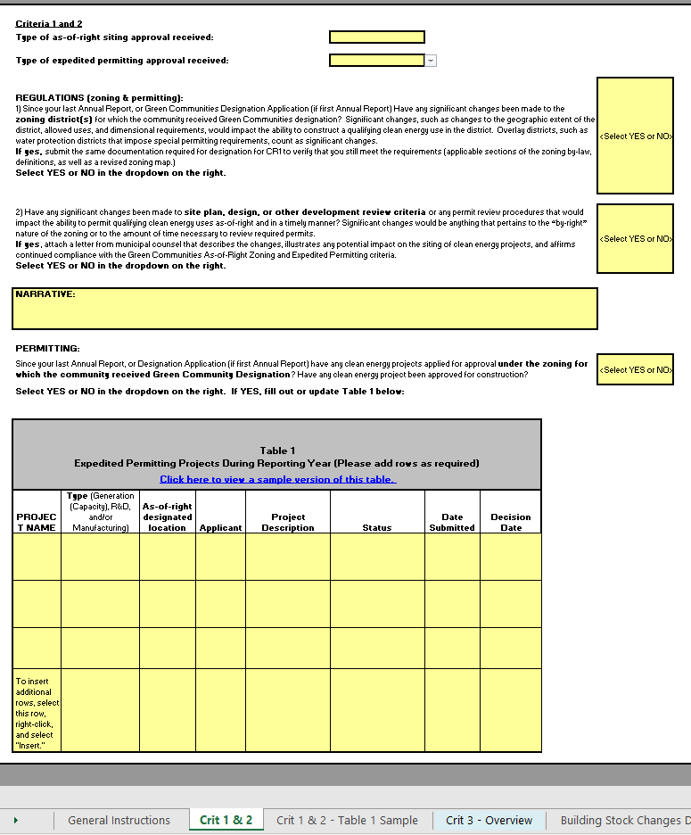
Zoning and Permitting Info
REGULATIONS (zoning & permitting):
1) Since your last Annual Report, or Green Communities Designation Application (if first Annual Report) Have any significant changes been made to the zoning district(s) for which the community received Green Communities designation? Significant changes, such as changes to the geographic extent of
Notes:
Onto Criteria 1 and 2 – zoning an permitting – be sure to select which by-right zoning and expedited permitting applies to your community
NEW this year – we are only asking for updates for 2018. If this is your first annual report, or if you didn’t submit last year or in 2016, we will want updates from then. If you reported to us a zoning change 3 years ago, you don’t need to report it again now.

Slide 21
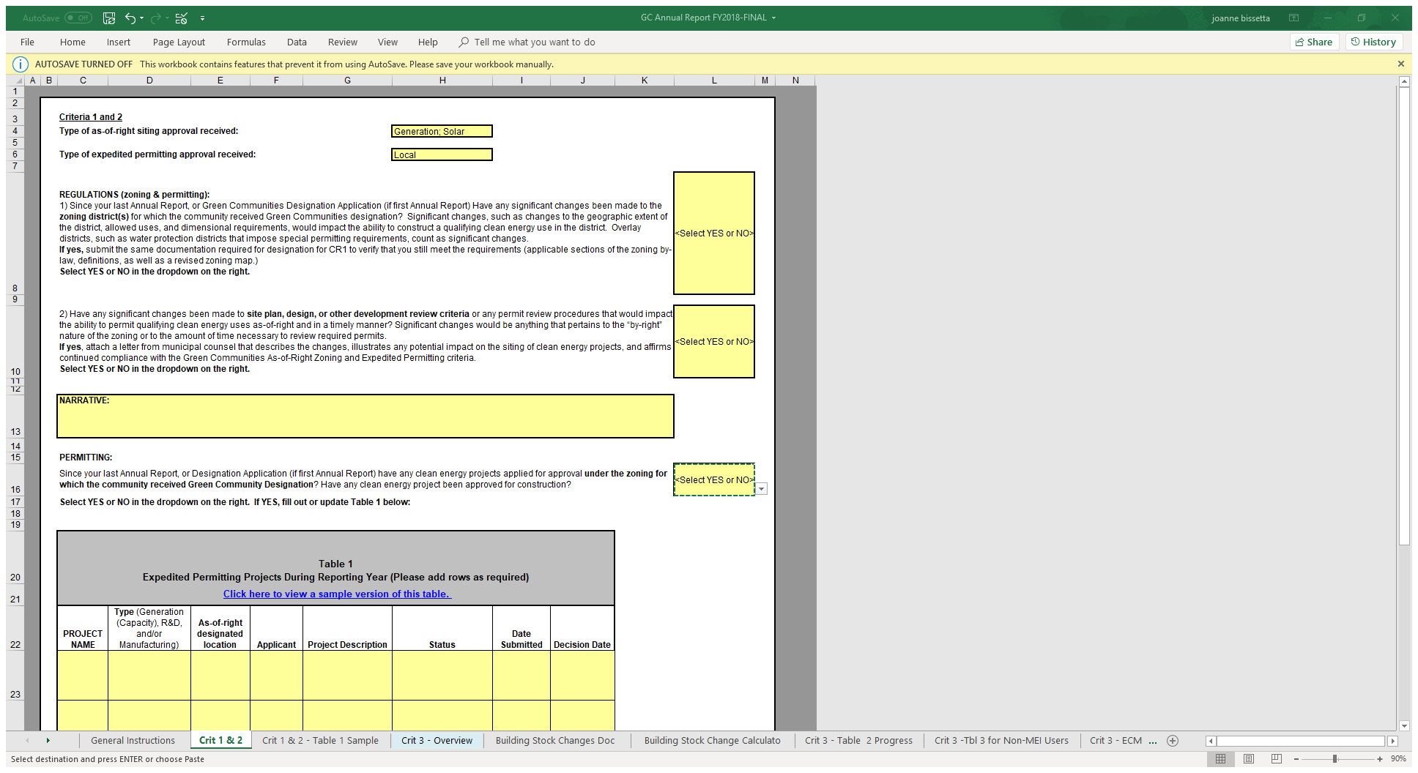
Be sure to select “YES or NO”
Notes:
Please answer all the questions – if you don’t we have to go back and ask you.

Slide 22
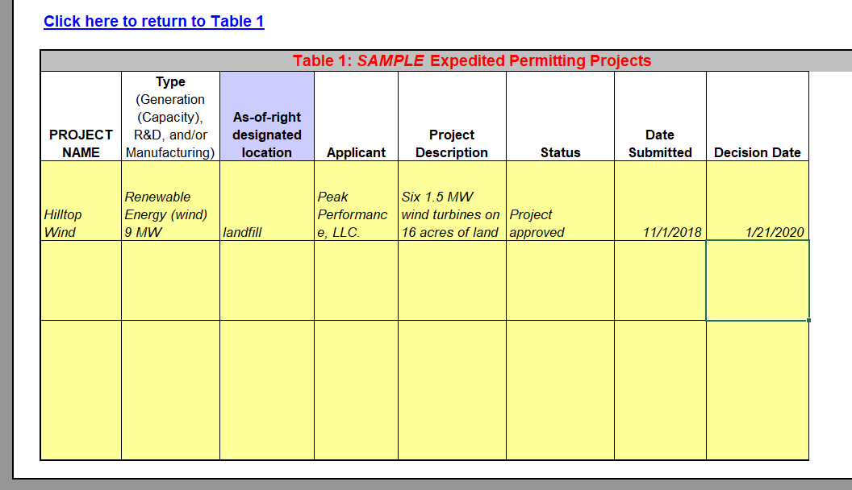
Table 1
Notes:
Here is a sample of table 1 – see that the decision date is during reporting period

Slide 23

Questions on Zoning/Permitting Section

Slide 24
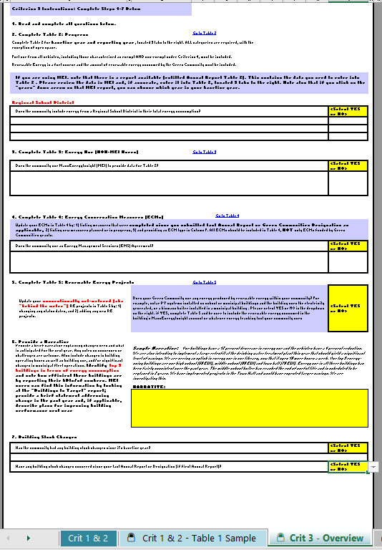

Criterion 3 Overview
This Photo by Unknown Author is licensed under CC BY
Notes:
Criterion 3 addresses your community’s energy use baseline and progress toward the 20% reduction goal. This form may look overwhelming – don’t depair! Much of the AR deals with how to accurately report your community’s energy data and we’ll walk you through it step by step.

Slide 25
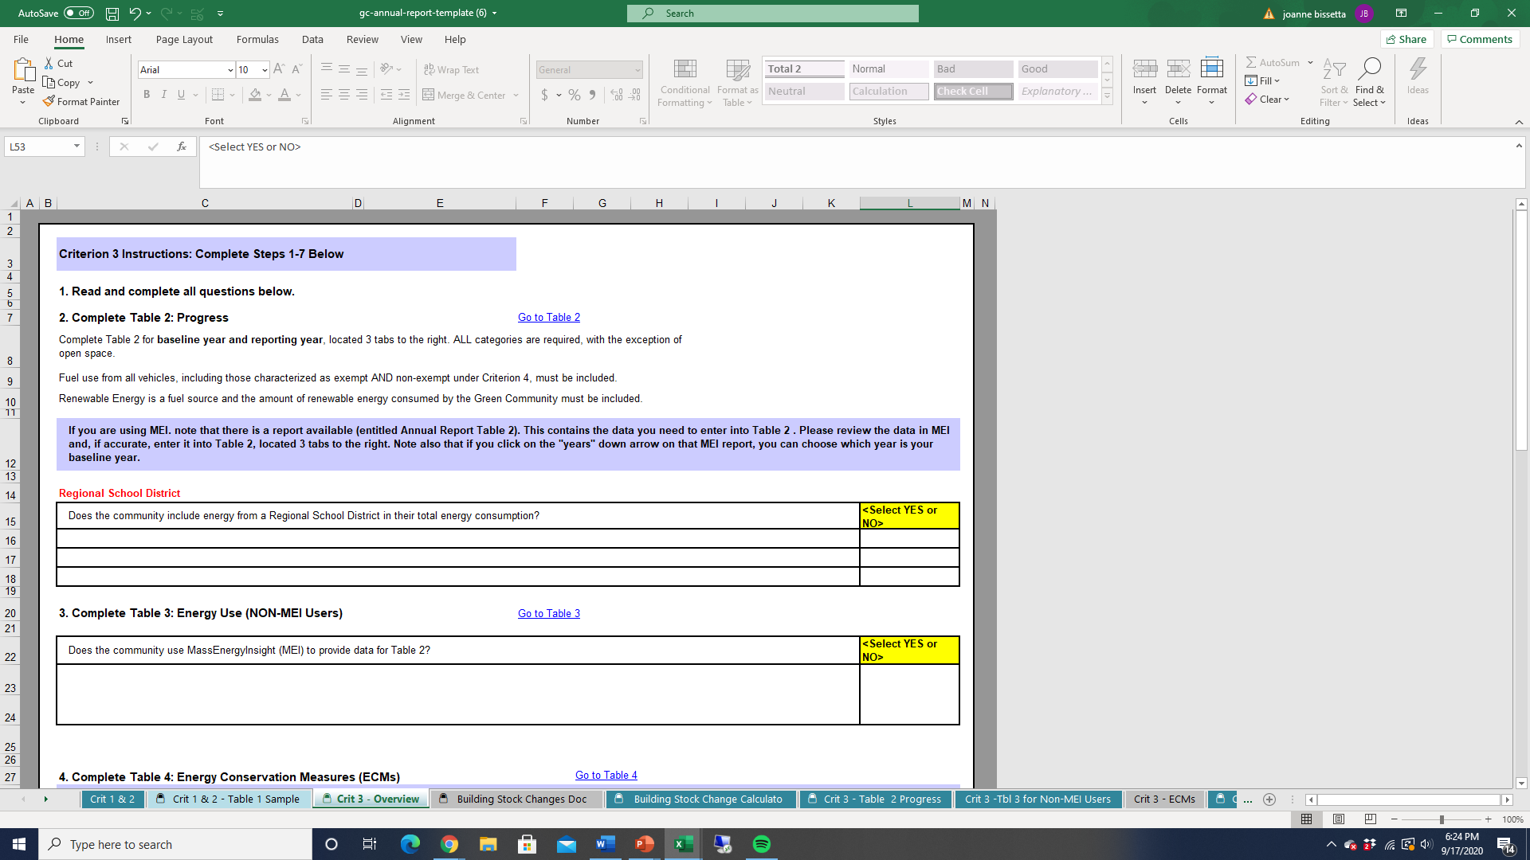
Follow the Steps
11/29/18
Notes:
#1 – Read and complete all questions below
#2 – complete table 2 –
Answer the questions – RSD? – then answer the questions
MEI users – remember to load all delivered fuels and conventionally metered renewable energy.
Fill in the date that you looked at data and confirm it is accurate

Slide 26
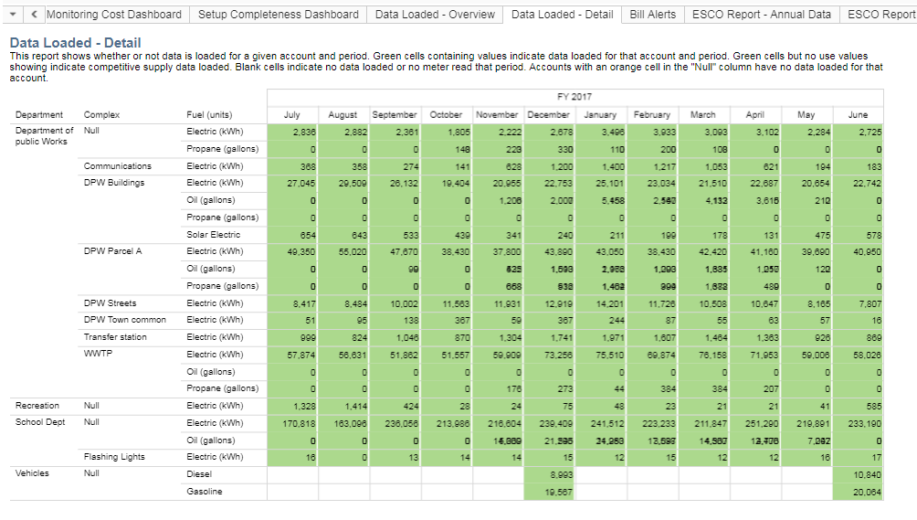
MassEnergyInsight Account Complete?
Solar electric
Notes:
Best way to determine your MEI account is complete is to view “Data Loaded – Detail” report. Our sample town has no gas services, so you see that propane usage has been uploaded.
It also has a solar PV system on the highway garage roof that provides some of the building’s electricity
You can see the town has uploaded gas and diesel

Slide 27
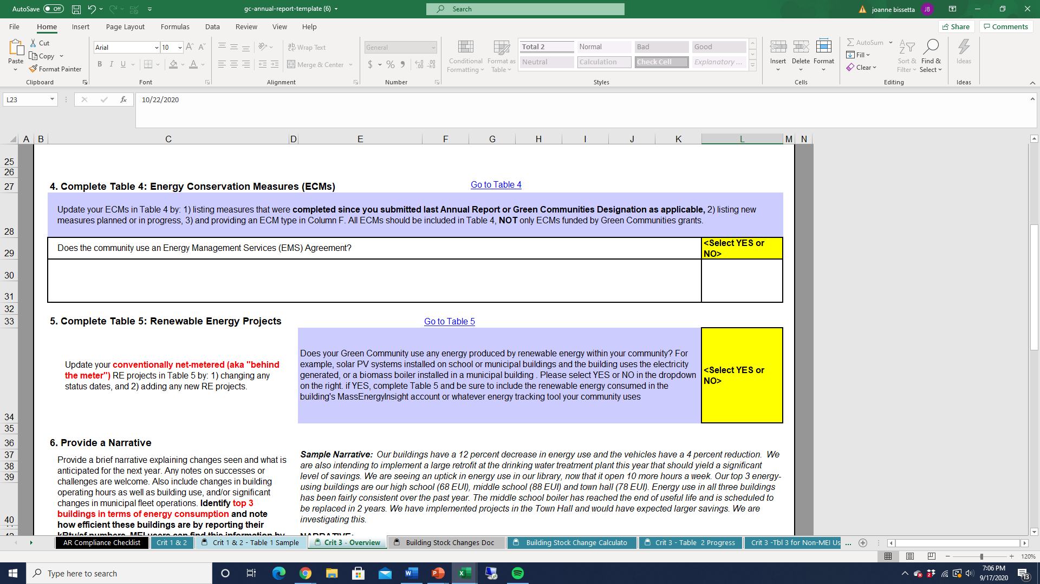
Follow the Steps
Notes:
Back to Criterion 3 Overview, continue to follow the steps. This is where you indicate your town is part of an RSD.
#4 -- provide an update to energy projects on Table 4. If using and Esco, include filing date.
#5 report renewable energy, if applicable

Slide 28
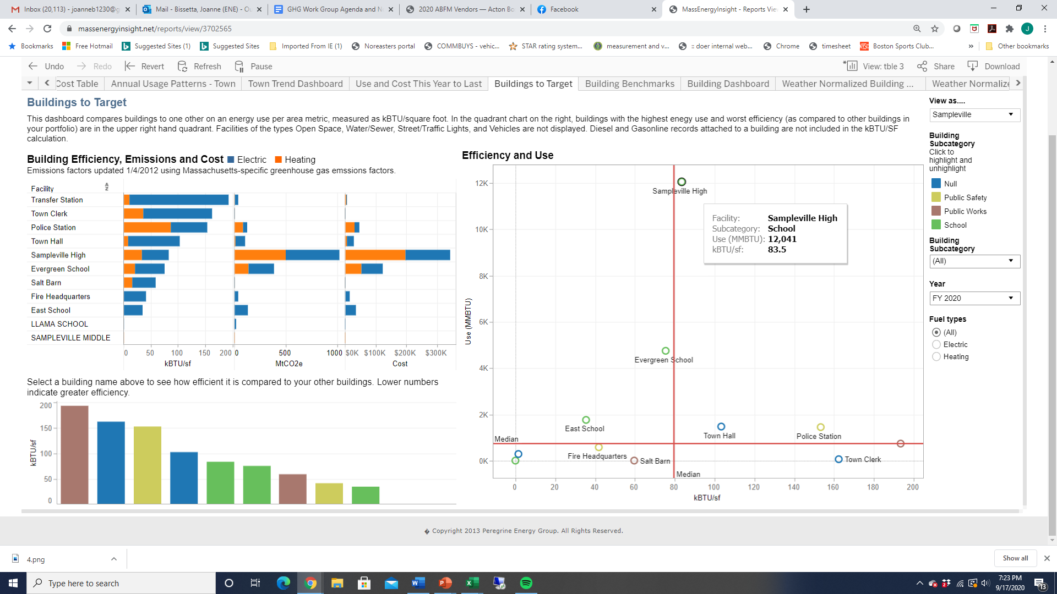
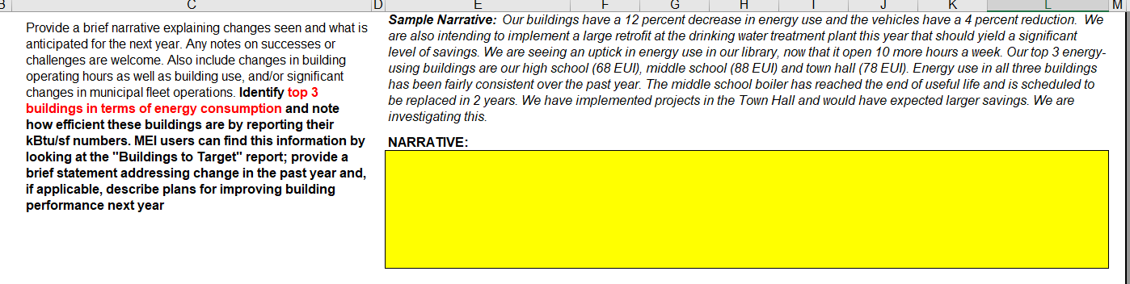
Tell Us More…
Identify top 3 buildings in terms of energy consumption and note how efficient these buildings are by reporting their kBtu/sf numbers. MEI users can find this information by looking at the "Buildings to Target" report; provide a brief statement addressing change in the past year and, if applicable, describe plans for improving building performance next year
Notes:
Last questions on Criteria 3 Overview – tell us what’s going on in your community. This is helpful information for us to consider as we review your information.
#6 – please tell us about your communities largest energy consuming buildings and note their efficiency – MEI’s Buildings to taget is a good tool to use
this is where you include information on building stock changes since baseline year. The instructions say only since last report – Since our town built a new senior center in 2016, it reported on in 2017, so don’t have to add it here unless you want to. But, the DPW addition that came on line in January would be included here. s

Slide 29
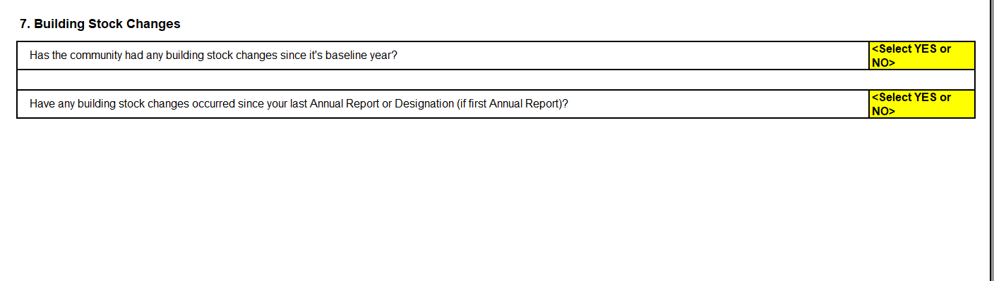

Building Stock Changes
Please describe any building stock changes that have occurred since your last Annual Report or Designation Application (if first Annual Report). Include the year and whether any changes are a replacement, addition, removal or renovation. The adjustments to energy usage should be entered on Table 2, Lines 16 and 20. You may use the Building Stock Changes Calculator provided.
Notes:
Last question #7 – report changes in building stock here. In our sample, we 2 building stock changes – our DPW facility was added on to and opened in January of reporting year – which should be included here. And a couple of years ago we built an addition to our senior center – this was reported in a previous year’s AR but we still need to pro-rate it’s energy use – we will work through the calculator in a few minutes

Slide 30
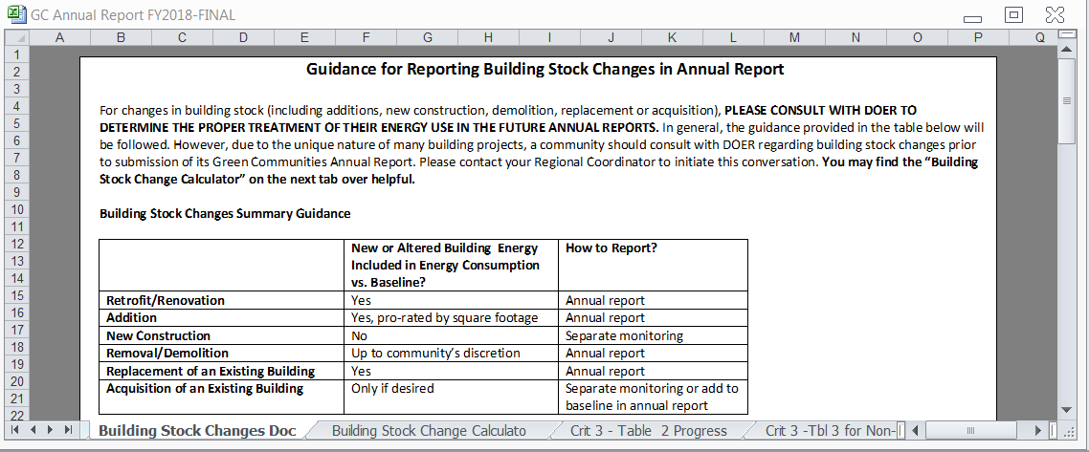
Building Stock Changes Doc

Slide 31

Questions about what to include in Criterion 3 Overview?

Slide 32
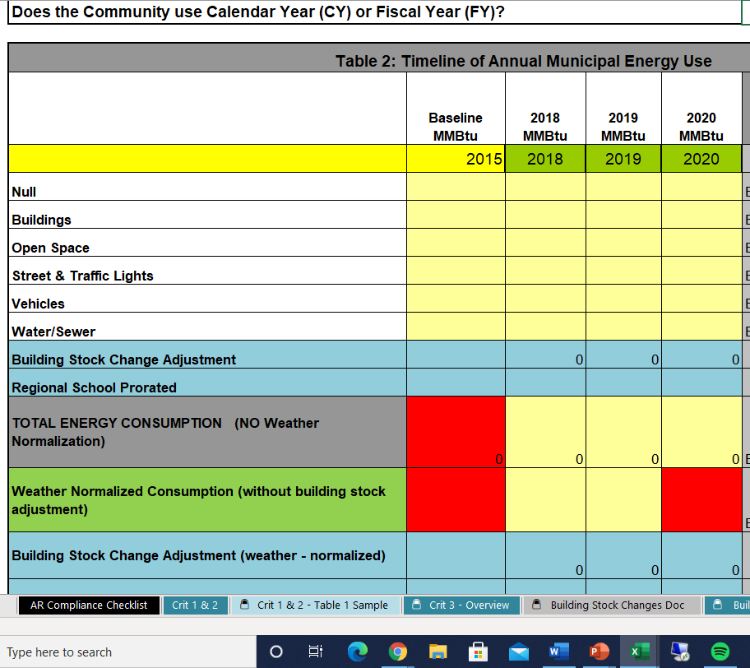
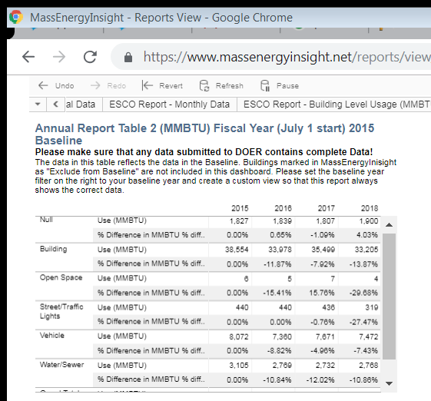
Complete Table 2
Table 2 Instructions:
Enter your community's baseline year (including whether it's a Fiscal Year or Calendar Year);
Enter total MMBtus per category (Rows 11-16) for the baseline year and the current reporting year.
Notes:
MEI Annual Report Table 2 is formatted just like the Table 2 in the annual report. Unless this is your first AR or you didn’t report last year, you only need to report your baseline and reporting year
Please only report on the baseline year and 2020, if you submitted a report last year. We have a few GCs submitting for the first time with a 2017 baseline, so we included subsequent years.

Slide 33
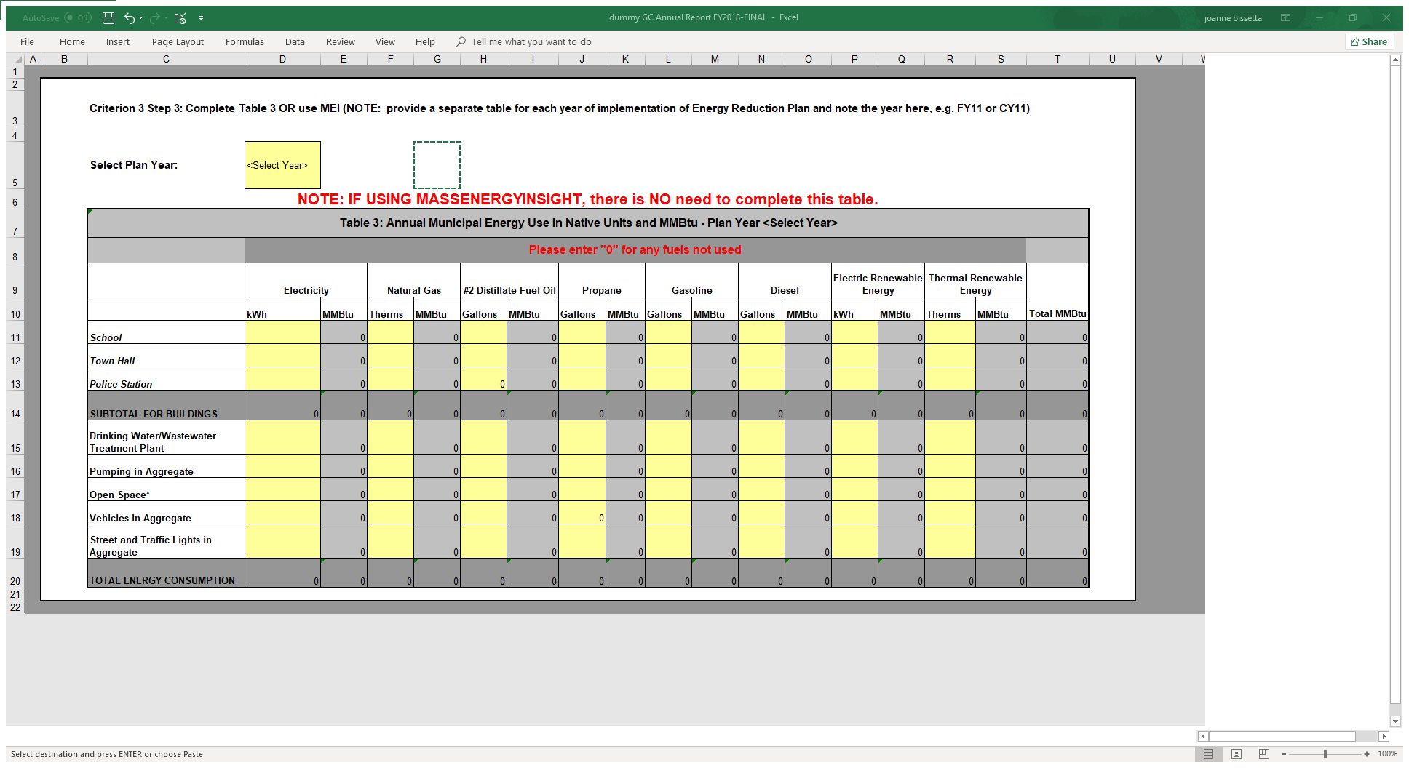
Non-MEI Users
Notes:
For the few communities that don’t use MEI, please fill out this form for the baseline year and 2020. Ignore the instructions that say to complete form for every year.

Slide 34
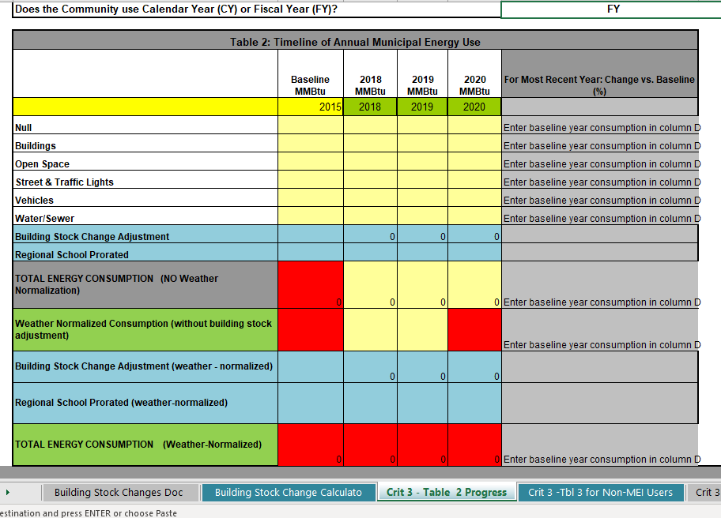
Table 2
-4.0%
13.9%
33.3%
27.5%
7.4%
10.9%
52,004 | 0 | 0 | 45,668 |  | 12.2%
Notes:
So, using the info in MEI Table 2 report, plug in the numbers for each category. Our sample town has a baseline year of 2015.

Slide 35
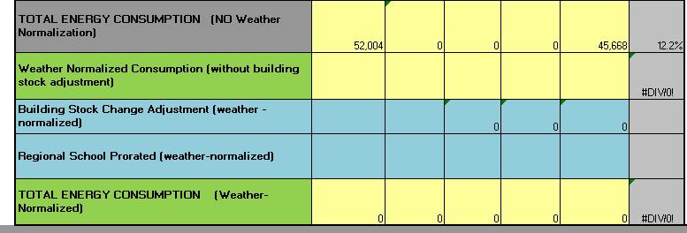
Weather Normalized Data
DOER is encouraging Green Communities to assess their progress using weather-normalized data through a DOER-approved weather normalization methodology. Qualifying methods include use of MassEnergyInsight or Energy Star Portfolio Manager. Please contact your Regional Coordinator for assistance if you use a different energy-tracking tool. Enter weather-normalized total energy consumption in Table 2, Row 19. In MassEnergyInsight, this information is available in the "Annual Report Table 2" report
50,126 |  |  |  | 49,126 | 2.0%
Notes:
And fill in the weather normalized totals for baseline year and 2018.
The weather normalization calculations remain a work in progress. The weather normalization process calculates an annual weather normalized total each month, based on the last 12 bills. The June and December annual totals are used, respectively, for the fiscal and calendar totals in many of the reports, including Table 2. But - stick with me here - if a fuel had no read in a certain month, then there was no bill to trigger the calculation, and no annual total would be created. This particularly impacted delivered fuels, but also could occasionally impact electric and natural gas.
What we've done is for months where there's no June or December read, we look backward a month at a time for up to six months, and grab the last weather normalized annual total energy use calculated, and use it as the total that for that year.
We recognize the issues this raises for weather normalizing baseline year data, when there may be incomplete energy data from the previous year. We would still like communities to report their weather normalized data while this issue is being figured out. We do not expect communities to provide energy data for the year PRIOR to the baseline year.
Contact your regional coordinator if you have additional questions regarding this.

Slide 36
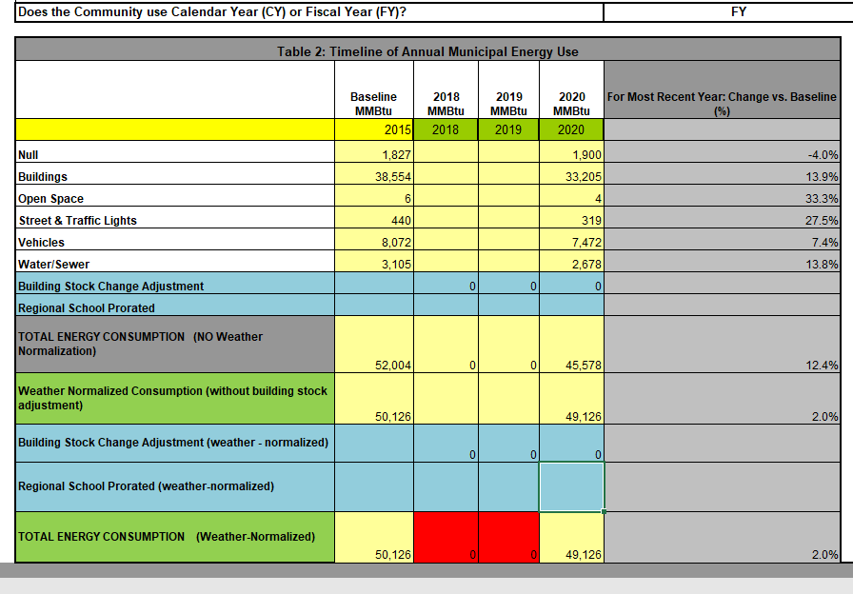
Building Stock Change
Notes:
Our sample town has changes to 2 buildings to report. A new, larger, senior center opened up in 2016 and an addition was added to the DPW building during FY2020. You will need to have the pre and post construction building square footage. Simply plug in the numbers in the yellow fields, and your energy use will be adjusted to account for the new contruction.

Slide 37
Building Stock Change
Example:
New Senior Center
Addition to DPW building that was completed on Jan. 1st
Required Information:
Building square footage (before and after)
Building energy use (weather normalized and non-)
Notes:
Our sample town has changes to 2 buildings to report. A new, larger, senior center opened up in 2016 and an addition was added to the DPW building during FY2018. You will need to have the pre and post construction building square footage. Simply plug in the numbers in the yellow fields, and your energy use will be adjusted to account for the new contruction.

Slide 38
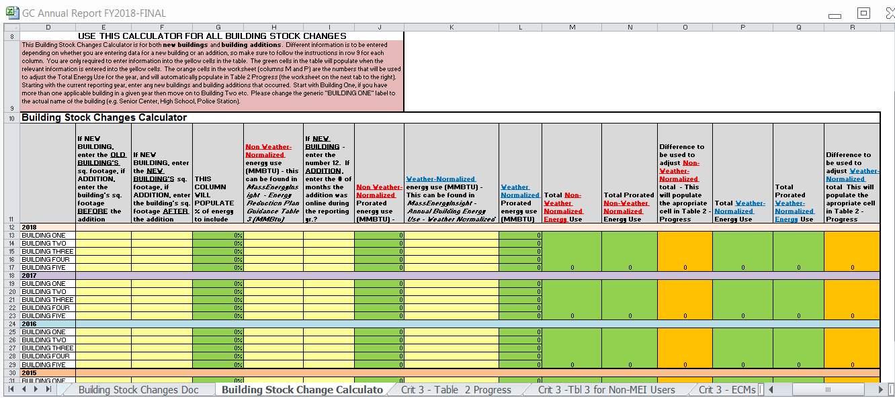
Building Stock Change Calculator

Slide 39
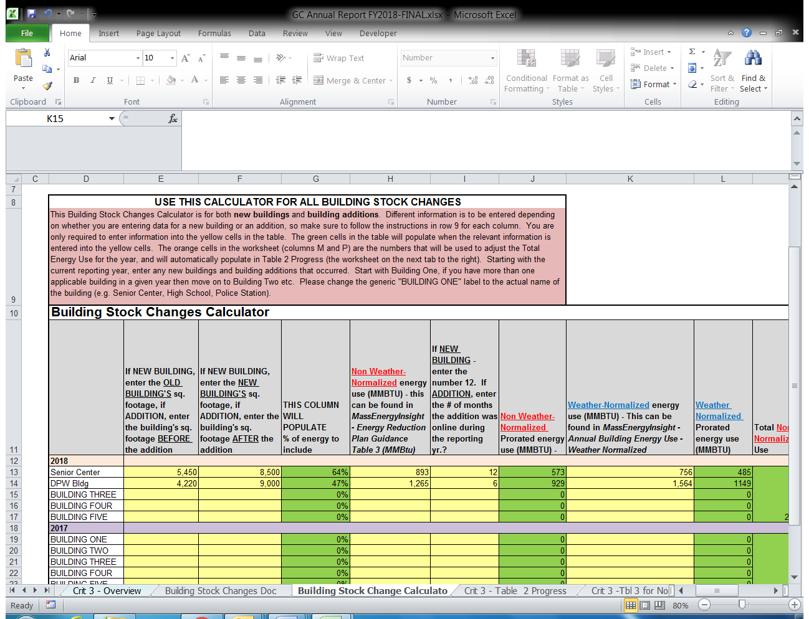
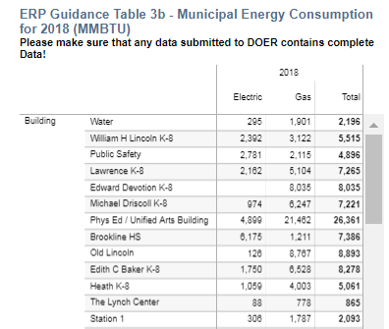
Building Stock Change Calculator
Notes:
Our sample town has changes to 2 buildings to report. A new, larger, senior center opened up in 2016 and an addition was added to the DPW building during FY2018. You will need to have the pre and post construction building square footage. Simply plug in the numbers in the yellow fields, and your energy use will be adjusted to account for the new contruction.

Slide 40
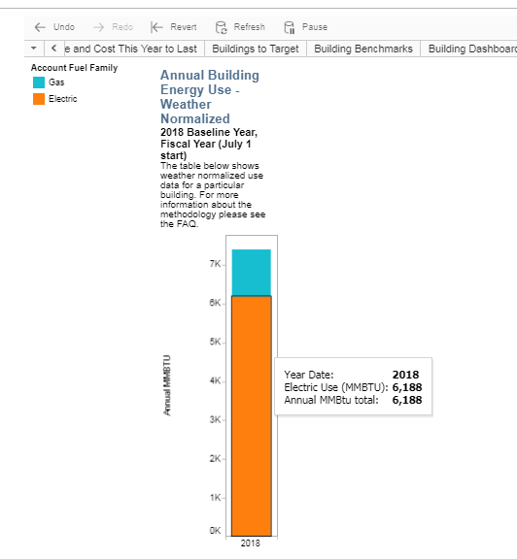
Building Stock Change Calculator
Notes:
Our sample town has changes to 2 buildings to report. A new, larger, senior center opened up in 2016 and an addition was added to the DPW building during FY2018. You will need to have the pre and post construction building square footage. Go to “Annual Building Energy Use – Weather Normalized” report in MEI Simply plug in the numbers in the yellow fields, and your energy use will be adjusted to account for the new contruction.

Slide 41
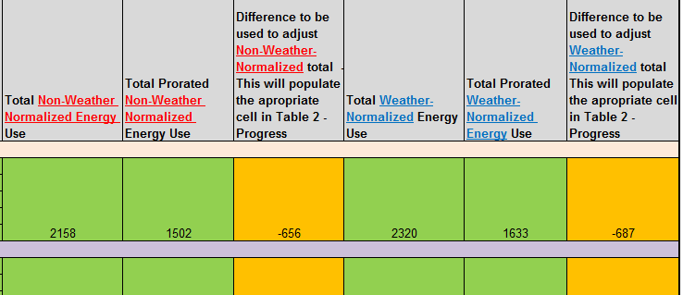
Building Stock Change Calculator
Notes:
Our sample town has changes to 2 buildings to report. A new, larger, senior center opened up in 2016 and an addition was added to the DPW building during FY2018. You will need to have the pre and post construction building square footage. Simply plug in the numbers in the yellow fields, and your energy use will be adjusted to account for the new contruction.

Slide 42
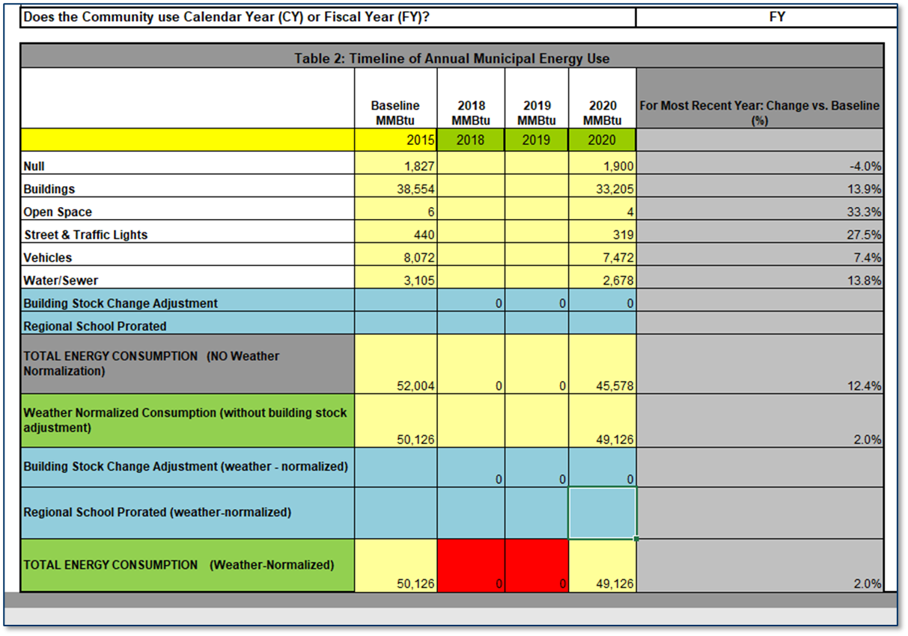
Pro-Rated Use
-656
45,012 | 13.4%
-687
48,439 | 3.4%
Notes:
Going back to our sample town’s Table 2 – you’ll see the adjustment will automatically show up for weather normalized and non-weather normalized.

Slide 43
Pro-rating RSD Energy Data
Table 2 Instructions: 5) If your baseline includes a proportion of energy consumed by a regional school district, provide the pro-rated energy use in Row 18 for non weather-normalized use and Row 22 for weather-normalized use. Attach a worksheet showing the building use energy use and calculations
Non-weather normalized
 | baseline mmbtus | 2020 mmbtus
Total energy Regional School District | 17,551 | 11,284
45% of Regional school district | 7898 | 5078
Weather normalized
 | baseline mmbtus | 2020 mmbtus
Total energy Regional School District | 13,735 | 11,295
45% of Regional school district | 6181 | 5083
Notes:
Our sample town has school facilities in a regional school district that is part of the baseline. The town’s proportion of energy use to “claim” is 45%.
From the RSD’s MEI account, look up their Table 2, take the energy use for the baseline year and 2018 (both weather normalized and non-weather normalized) and multiply by 45%.
This will be added to the municipality’s Table 2

Slide 44
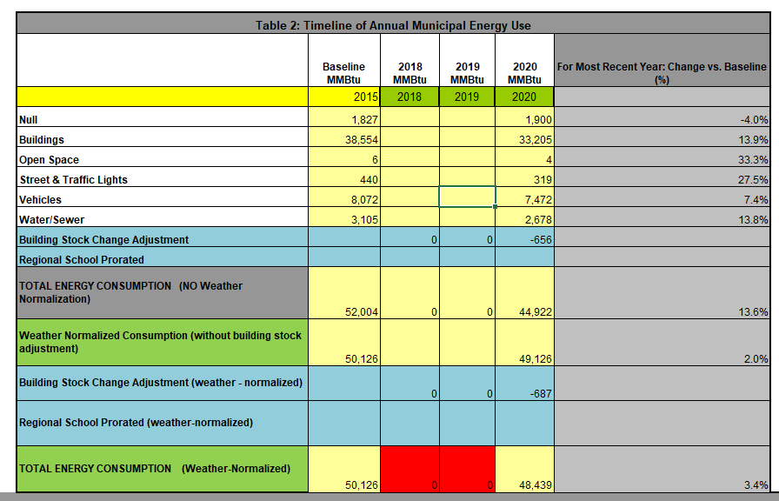
7798
59,802
5078
50,000 | 16.4%
6181 |  |  | 5083
56,307 | 0 | 0 | 53,522 | 4.9%
Notes:
Now, Table 2 is complete. The total weather normalized energy reduction is 4.9%, and non weather-normalized is 16.4%

Slide 45

Questions about Table 2?

Slide 46
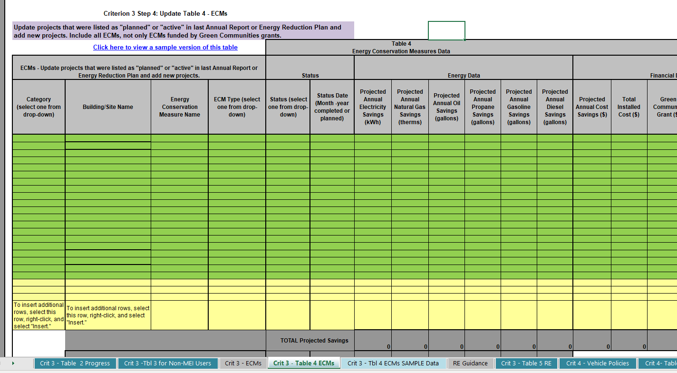
Table 4 - ECMs
Update projects that were listed as "planned" or "active" in last Annual Report or Energy Reduction Plan and add new projects.
Notes:
Only provide updated information –you already reported on the projects you completed in 2013.

Slide 47
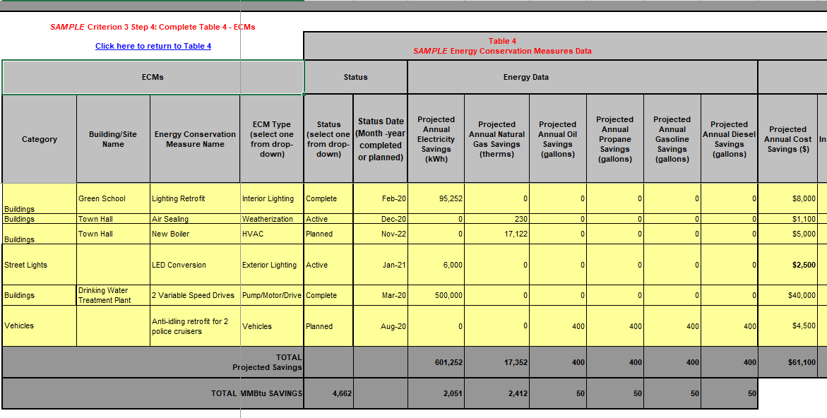
Table 4 Sample

Slide 48
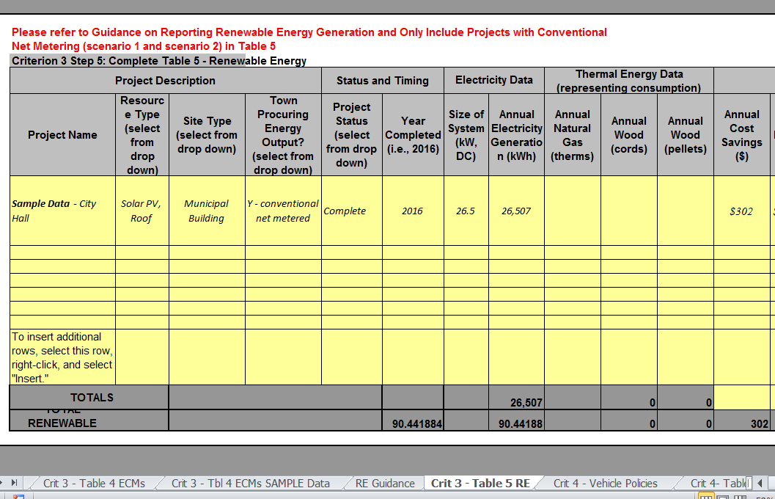
Table 5 – Renewable Energy
Notes:
Table 5 is where you report conventionally net-metered projects (behind the meter)

Slide 49

Questions on Tables 4 and 5?

Slide 50
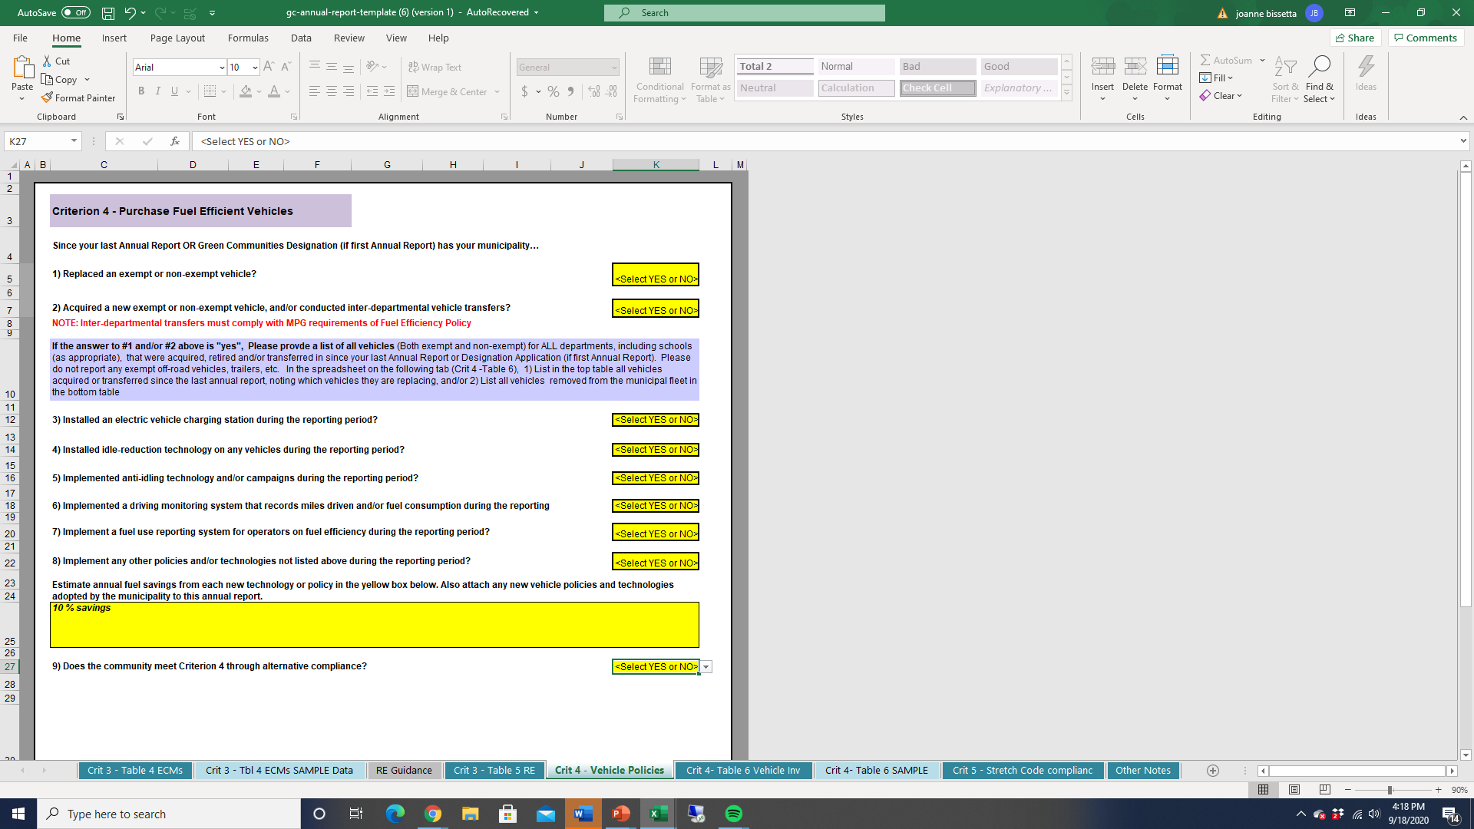
Criterion 4 – Answer the Questions
Since your last Annual Report OR Green Communities Designation (if first Annual Report) has your municipality…
1) Replaced an exempt or non-exempt vehicle?
2) Acquired a new exempt or non-exempt vehicle, and/or conducted inter-departmental vehicle transfers?
Notes:
We are done with Criterion 3! Now onto vehicles.
Please answer all the questions.
Please only report on activities from 2018 (or other years as appropriate)
Towns with alternative compliance policies, remember to report on them in Question 9 and 10.

Slide 51
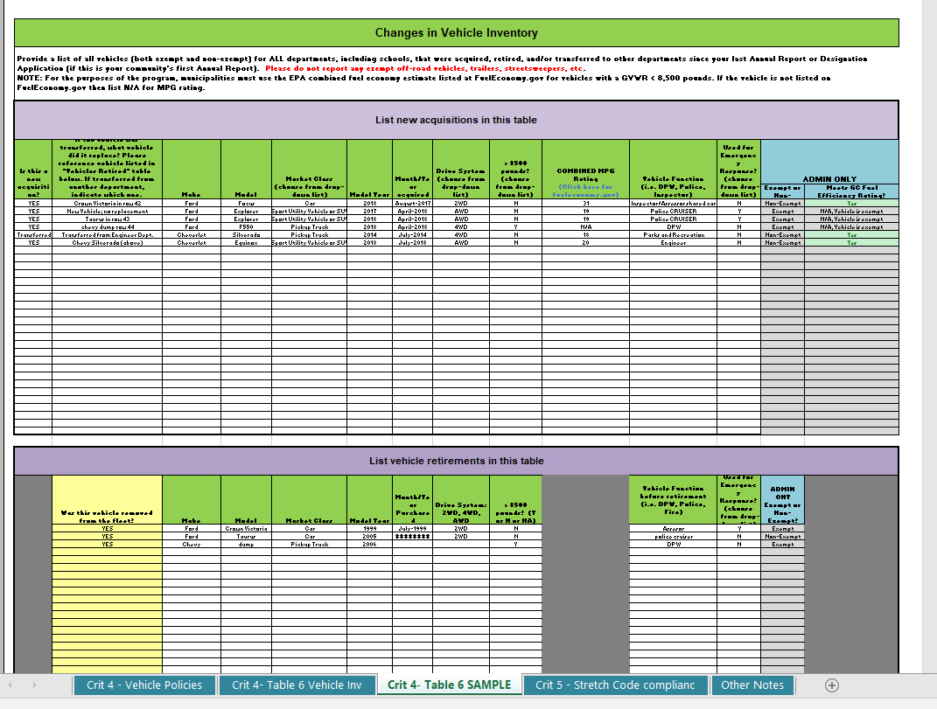


Table 6

Slide 52
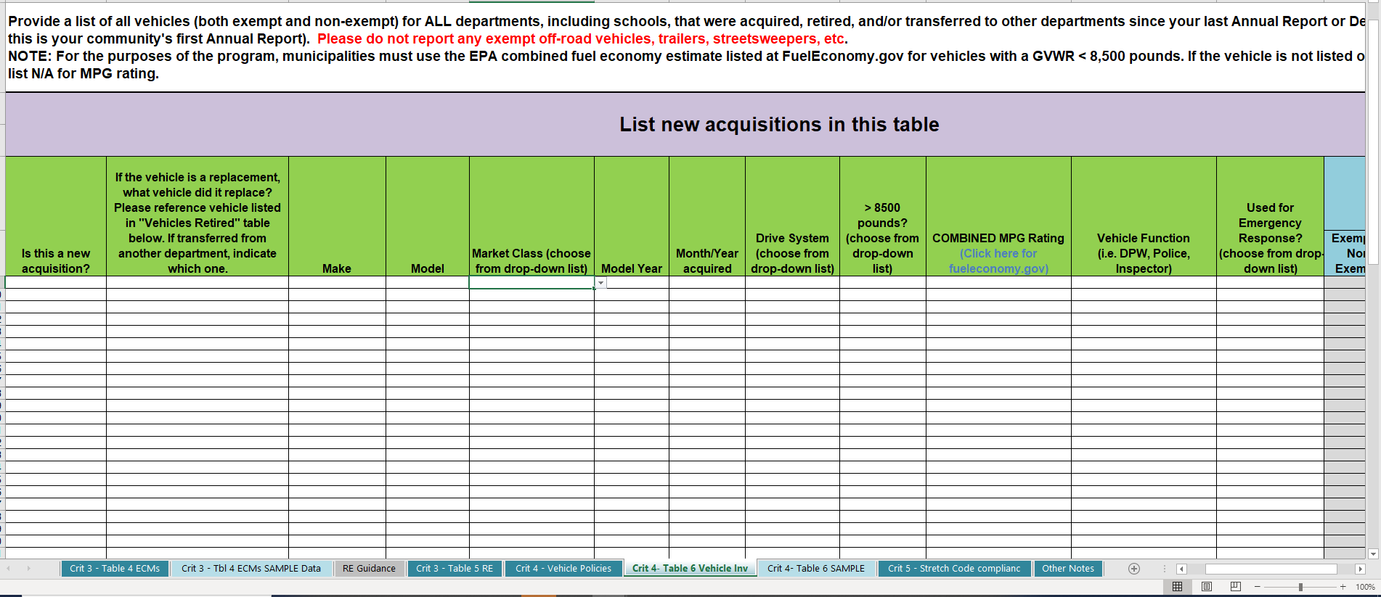
Acquisitions
Provide a list of all vehicles (both exempt and non-exempt) for ALL departments, including schools, that were acquired, retired, and/or transferred to other departments since your last Annual Report or Designation Application (if this is your community's first Annual Report). Please do not report any exempt off-road vehicles, trailers, streetsweepers, etc.
NOTE: For the purposes of the program, municipalities must use the EPA combined fuel economy estimate listed at FuelEconomy.gov for vehicles with a GVWR < 8,500 pounds. If the vehicle is not listed on FuelEconomy.gov then list N/A for MPG rating.

Slide 53
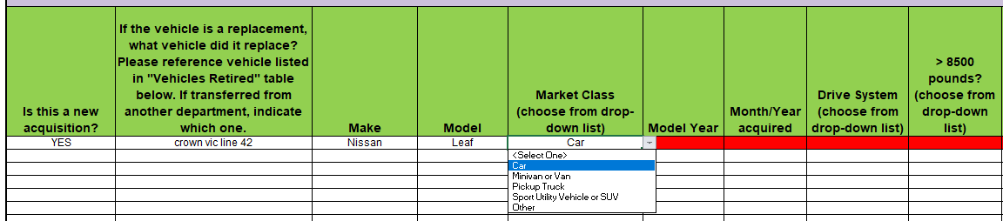
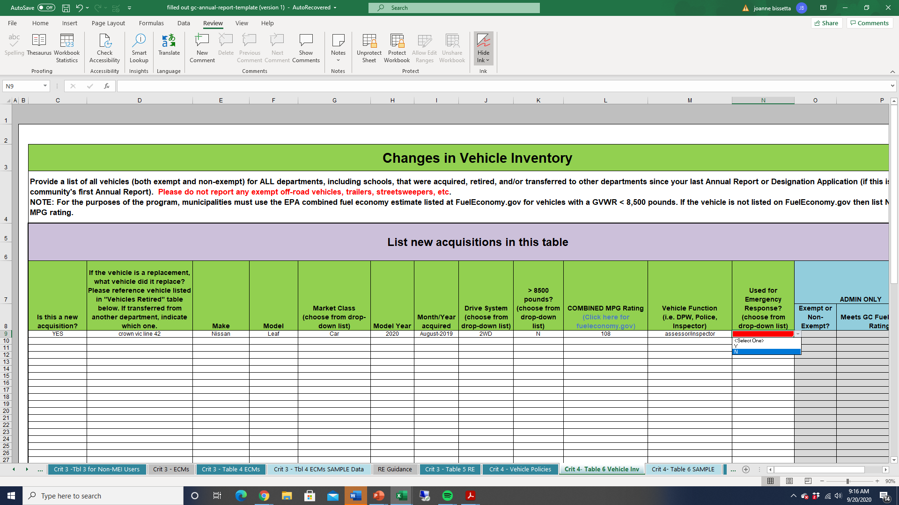

Slide 54
Retirements
Notes:
Bottom half of table 6 is where you report vehicle retirements. Again, just for 2018. {toggle between slide before and this one to show which new vehicles replaced retired vehicles.}

Slide 55
Questions on Fuel Efficient
Vehicle Reporting?

Slide 56
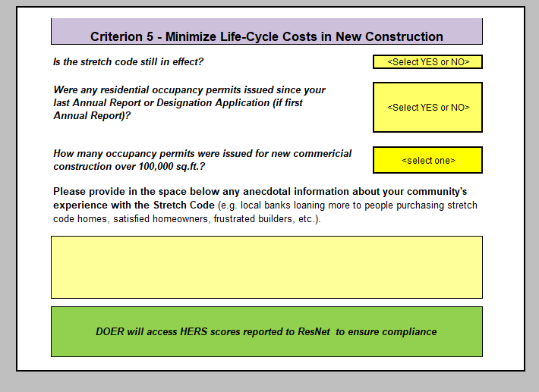
Notes:
And finally – Criterion 5.
Please select and answer.
REMBMER – only want info for 2018 (or since last report/designation)
Just need to know if any new residential occupancy permits were issued; and number of commercial occupancy permits for developments over 100,000 sf.
If more than 12, please note it in the narrative

Slide 57

Notes:
Any other information you wish to convey can go in these space

Slide 58


Almost done…

Slide 59



Slide 60
General Instruction/Confirmation Page
Notes:
Your confirmation page should have the statement “Annual Report is complete” in Green. Please do not submit if it’s red.

Slide 61




Green Communities Regional Coordinators
Regional Coordinators act as direct liaisons with cities and towns on energy efficiency and renewable energy activities
Located at each of the DEP Regional Offices:
WERO – SPRINGFIELD: Mark Rabinsky
Mark.Rabinsky@mass.gov
413-755-2232
NERO – WILMINGTON: Neal Duffy Neal.Duffy@mass.gov
978-694-3315
CERO – WORCESTER: Kelly Brown
Kelly.Brown@mass.gov
508-767-2703
SERO – LAKEVILLE: Lisa Sullivan
Lisa.M.Sullivan@mass.gov
508-946-2822
Notes:
And the Division’s four regional ambassadors in this effort are pictured here…..(INTRODUCE KELLY, NEAL, Lisa AND Mark)
These people are key to the function of the Green Communities program at the local level – Hopefully, you have already connected at some point with your Green Communities regional coordinator. For those who haven’t, please introduce yourself today and make a note of their contact info.

Slide 62
Thank you!
Questions?
Notes:
And – you’re done!

Slide 63
Contact Information
Joanne Bissetta, Deputy Director
Joanne.Bissetta@mass.gov
www.mass.gov/orgs/green-communities-division
  Email updates via listserv – Sign up here:
  https://www.mass.gov/forms/green-communities-updates
Notes:
We want to hear from you!!!!

