Slide 1
MASSACHUSETTS SCHOOL HEALTH SERVICES
​
Karen Robitaille, MSN, MBA, RN, NCSN​
Director of School Health Services​
MDPH Division of Child/Adolescent Health and Reproductive Health

Slide 2
LEARNING OBJECTIVES
Review the structure and scope of service of School Health Services in Massachusetts
Review pertinent Acts, Statutes, and Regulations impacting School Health in Massachusetts
Review regulatory and procedural safeguards and services available to our students with acute and chronic health conditions
Discuss impact of PANDAS/PANS on student experience in school

Slide 3
SCHOOL HEALTH STRUCTURE AND FUNCTIONS
2500 public school nurses and nurse leaders
Unknown ancillary staffing
Unknown non-public school health staff
Estimated 640 non-public schools
399 public school districts, 1827 schools
SCHOOL HEALTH STAFF
NURSES
ANCILLARY STAFF
REGIONAL CONSULTANTS/BU SHIELD
MDPH FUNDED
CONSULTATION AND PROFESSIONAL DEVELOPMENT
SCHOOL HEALTH UNIT
ADHERENCE TO REGULATIONS
GRANT FUNDING
DATA COLLECTION AND ANALYSIS
CONSULTATION
Total FY24 MDPH School Health budget: $26,094,188
Includes: School-based Health Centers $7,040,150
Grant programs: $17,088,496
Director (PHNA II)
Assistant Director (PHNA II)
Medication Program Manager (PHNA I)
Nursing Advisor to Non-Public School (PHNA I)
Operations Coordinator (PC III)
Program Coordinator (PC II)
Epidemiology support (1.5 FTE)
Seven Regional School Nurse Consultants in the 6 EOHHS Regions: West (Hampden/Hampshire & Franklin/Berkshire), Central, Northeast, Boston, Metrowest, Southeast

Slide 4
PERTINENT ACTS, STATUTES & REGULATIONS
1. 105 CMR 210 – The Administration of Prescription Medications in Public and Private Schools
2. 105 CMR 200 - Physical Examination of School Children
3. 105 CMR 201 – Head Injuries and Concussions in Extracurricular Athletic Activities
4. 105 CMR 215: Standards for School Wellness Advisory Committees
5. 105 CMR 220 - Immunization of Students Before Admission to School
6. 105 CMR 225 - Nutrition Standards for Competitive Foods and Beverages in Public Schools
7. 105 CMR 700 - Implementation of M.G.L. C. 94c
8. 105 CMR 460 - Lead Poisoning Prevention and Control (Screening for Schools)
9. 244 CMR 3 – Nurse Practice
10. 244 CMR 9 – Standards of Nursing
11. 603 CMR 7 - Educator Licensure
12. 603 CMR 18 - Program and Safety Standards for Approved Public or Private Day and Residential Special Education School Programs
13. 603 CMR 23 - Student Records
14. 603 CMR 35 - Evaluation of Educators
15. 603 CMR 44 – Educator License (School Nurse and Director/Supervisor)
16. 603 CMR 46 - Prevention of Physical Restraint and Requirements If Used
17. 603 CMR 50 - Educational Collaboratives (Requirements for School Nurses)
18. Health Insurance Portability and Accountability Act (HIPAA)
19. Family Education Rights and Privacy Act (FERPA)
20. Individuals with Disabilities Act (IDEA)
21. Americans with Disabilities Act (ADA)
22. McKinney-Vento Act
23. MGL. c71, s53 - Appointment of one or more school physicians and registered nurses
24. MGL c71 s54B - Administration of Medications in School Setting and Self Administration
25. MGL c71 s54C – AEDs in Schools
26. MGL c71 s96 - School Policies Regarding Substance Use Prevention
27. MGL c71 s97 - SBIRT
28. MGL c94 - Controlled Substances Act
29. MGL c112 s80B – Nurse Practice Act
30. MGL c258 s2 – Tort Claim Act

Slide 5
MEDICATION IN SCHOOLS
Only licensed healthcare providers can administer medication in MA with limited exceptions.
Medication in school settings in MA regulated by 105 CMR 210.
Any medication given by unlicensed staff MUST be given under the delegation model.
ONLY schools/districts registered with MDPH may participate in medication delegation.
The School Nurse is the manager of the medication program.

Slide 6
COMPREHENSIVE SCHOOL HEALTH SERVICES GRANTS
MODEL (57)
AFFILIATE (112) & NON-PUBLIC (19)
Larger awards
MUST provide all basic school health services
MUST implement a case management model and/or a BRYT program
MUST have a 1.0 FTE Nurse Manager free from direct care and on appropriation budget
MUST conduct triannual community needs assessment and annual Continuous Quality Improvement (CQI) project
Provide services that are community-based and culturally and linguistically relevant meaning they address racial inequities and health disparities as appropriate.
Smaller awards
MUST provide all basic school health services; non-publics must be working towards this
Must work towards having a 1.0 FTE Nurse Manager free from direct care and on appropriation budget
MUST conduct triannual community needs assessment
Provide services that are community-based and culturally and linguistically relevant meaning they address racial inequities and health disparities as appropriate.

Slide 7
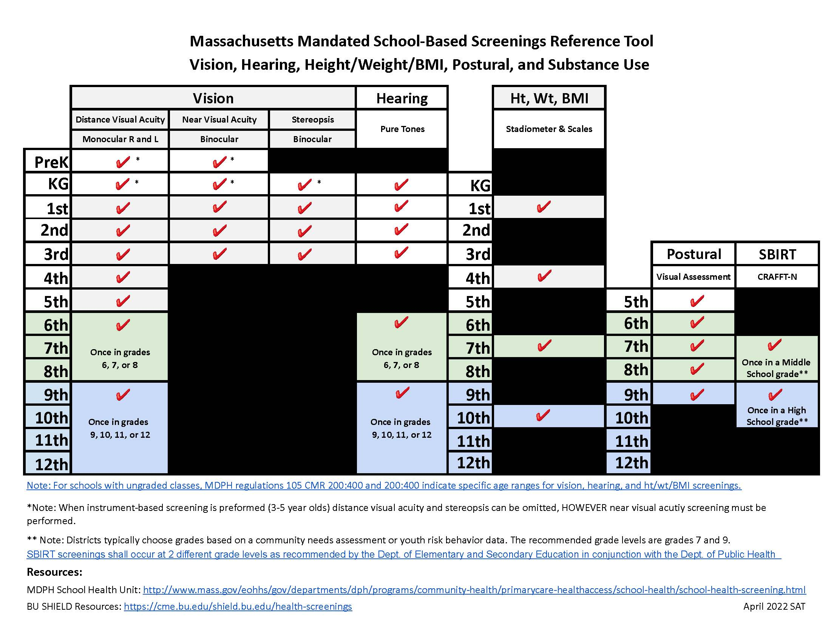
DATA COLLECTION
DATA REQUIRED BY STATUTE/REGULATION
Height, Weight, Body Mass Index (BMI)
Screening, Brief Intervention & Referral to
Treatment (SBIRT)
DATA COLLECTED BY OTHER PROGRAMS (not mandatory)
Asthma/diabetes prevalence in children aged 5-14 years
Immunizations, grades: preK, K, 7 & 11
DATA COLLECTED FROM CSHS GRANTEES ONLY
Monthly reports: office visit data, dispositions, concussions, medications, case management
Annual reports: rates for common chronic illnesses, medical technology & procedures, IHPs/AAPs/504s/DNRs, health services utilization by demographic, health insurance type, screening results, health services staffing, and grant performance measures

Slide 8
PROFESSIONAL DEVELOPMENT FOR SCHOOL HEALTH STAFF
MANDATORY TRAININGS
Foundations of School Nursing Practice(self-paced)
Medication Administration in a School Setting: School Nursing Practice in Massachusetts & Medication Administration in Schools: What School Nurse Managers Need to Know (self-paced & live)
School Health Screening Training (self-paced & live)
LEADERSHIP TRAINING
The Essentials of School Nurse Leadership (self-paced)
RESOURCES
Strengthening Your Leadership Presence and Management Practices (live & self-paced cohort)
SBIRT in Schools (self-paced & live)

Slide 9
CMC-SHARE: JOINT PROJECT OF MDPH (SCHOOL HEALTH AND MASSTART) & BU SHIELD

Slide 10
EXISTING RESOURCES RE PANDAS/PANS FOR SCHOOL HEALTH STAFF
https://pandasnetwork.org/resources/educator-resources/​
https://aspire.care/schools-educators/massachusetts-school-nurse-program-on-pans-pandas/​
https://nepans.org/​
https://neusha.org/resources-handouts/

Slide 11
PANDAS/PAN PREVELANCE
PANDAS at a Glance
1 : 200 Children affected by PANDAS/PANS*
4 – 10 Average age of onset
49% Of patients who had OCD and tics as primary symptoms
81% Of patients who reported infections of streptococcal pharyngitis
*These are estimates of lifetime prevalence. Based on U.S. research of OCD incidence and CDC 2013 national surveillance report of emergency hospitalizations of youth to age 21 with mental health issues related to OCD, Tourettes, & Acute Mood Disorders. (MMWR 2013;62(Suppl; May 15, 2013): 1-35. Percentage of cases based on 2018 PANDAS Network survey 1,400 families and multiple published clinical studies.
https://pandasnetwork.org/
From a "retrospective review for the calendar years 2017–2019 at three different academic medical centers", "in several geographically and socioeconomically diverse primary care populations of children":
"the estimated annual incidence of PANDAS/PANS was 1/11,765 for children between 3 and 12 years with some variation between different geographic areas."
https://www.ncbi.nlm.nih.gov/pmc/articles/PMC10551157/#:~:text=The%20incidence%20of%20PANDAS%20can,%E2%80%934%25%20(6)

