Slide 1
Massachusetts Chapter of the American Academy of Pediatrics
Mary Beth Miotto, MD, MPH, FAAP
Chapter President
March 13, 2024

Slide 2
MCAAP Mission:
The Massachusetts Chapter of the American Academy of Pediatrics is committed to the attainment of optimal physical, mental and social health for all infants, children, adolescents, and young adults. To this end, the members of the academy dedicate their efforts and resources.

Slide 3
Who are We? MCAAP in a Nutshell
1600 members:
Include primary care, pediatric subspecialists, and pediatric surgical specialists
A majority of Chapter members are Fellows of the American Academy of Pediatrics
A full-time Executive Director and one contracted MA Immunization Initiative Program Manager
Funded Principally by MCAAP dues:
Current Policies Preclude Industry Relationships
Limited grant support by National AAP and no other financial support from National AAP
Programs are otherwise implemented by pediatrician and trainee members

Slide 4
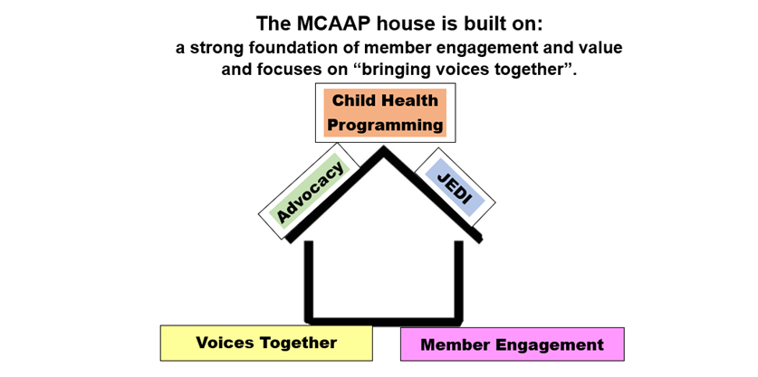
Our Chapter Vision:
The MCAAP is a leading voice for child health advocacy and high-value equitable care for all youth in the Commonwealth of MA
Child Health Programming
Education for Child Health Professionals & Child Advocates
Advocacy
Aligned with National AAP Goals and Tailored to the Commonwealth
JEDI: Justice,Equity, Diversity, Inclusion
Specific Focus on Vulnerable Communities & Children/Youth with Special Health Needs

Slide 5
MCAAP Activities Build on This Foundational Stability:
Child Health Programming
Education for Child Health Professionals and Other Child Advocates
Advocacy
Aligned with National AAP Goals and Tailored to the Commonwealth
JEDI: Justice, Equity, Diversity and Inclusion
Specific Focus on Vulnerable Communities and Children/Youth with Special Health Needs

Slide 6
MCAAP Programming Improves The Quality of Care Families Receive
Immunization Webinars and Conferences
Immunization Initiative Monthly Newsletters
RSV Prevention Webinar (MCAAP/DPH)
RSV Childhood Immunization Roundtable (MCAAP/MMS/MA ACOG/MA AFP)
RSV Prevention/Nirsevimab Resource Packet for Members with monthly updates
Nirsevimab Birthing Hospital Dashboard for Members with monthly updates through shortage
Pediatric Mental Health Gateway with Pediatric Team Diagnostic and Treatment Guidance (website)
Preventive Behavioral Health Visits in Primary Care Co-produced Webinar with MA Health Care for All
MCAAP 2023 Annual Meeting and CME on Increasing Mental Health Competence and Confidence in Primary Care-virtual
Monday Biweekly Lunch and Learn Program “Leveraging Community Services To Support Your Patients’ Learning and Developmental Needs”: Live and on-demand videos and hyperlinked slide decks with resources

Slide 7
MCAAP and Clinical Policy
The Massachusetts Chapter of the American Academy of Pediatrics is not typically a clinical policymaking organization.
The MCAAP Board, officers, and Chapter committees utilize the best evidence and policies published by the national AAP and other national specialty societies to disseminate best practices to Chapter members, nonmember pediatric professionals, child health advocates, and policymakers in the Commonwealth.

