Slide 1
Department of Elementary & Secondary Education
DPH PANDAS/PANS Advisory Council Iraida J. Álvarez, Executive Director, Special Education September 11, 2024

Slide 2
Agenda
Review
Review DESE's Educational Vision, Strategic Objectives and how DESE supports school districts across Massachusetts.
Discuss
Discuss relevant programs, and initiatives that may be relevant to students and families with PANS/PANDAS and the work of the council.
Questions
Respond to questions from the council.

Slide 3
Educational Vision
Learning experiences
Individualized supports
Enable students to excel at grade level and beyond
Are relevant, real-world and interactive
Are known and valued
All students

Slide 4
Educational Vision
All students in Massachusetts, particularly students from historically underserved groups and communities, will have equitable opportunities to excel in all content areas across all grades. Culturally and linguistically sustaining classroom and school practices will support students to thrive by creating affirming environments where students have a sense of belonging, engage in deeper learning, and are held to high expectations with targeted support.

Slide 5
Strategic Objectives
Strategic Objective 2 - "Deeper Learning"
Strategic Objective 3 - "Diverse and Effective Workforce"
Develop and sustain a workforce that is diverse, culturally responsive, well-prepared, and committed to continuous improvement, so that all students have equitable access to effective educators.
Promote deeper learning so that all students engage in grade-level work that is real-world, relevant, and interactive.
Cultivate systems to support the whole student and foster joyful, healthy, and supportive learning environments so that all students feel valued, connected, nourished, and ready to learn.
Strategic Objective 1 - "Whole Student"

Slide 6
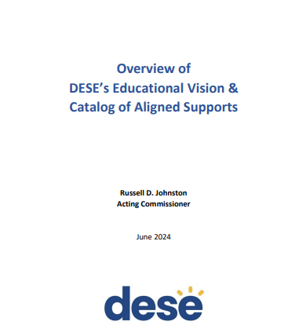
Catalog of Aligned Supports
Describes DESE's Educational Vision, strategic objectives, and core functions
Outlines DESE's priority strategies for each strategic objective and where to find aligned supports in the catalog

Slide 7
Core DESE Functions
Setting expectations including crafting regulations and guidance to implement and explain education laws; specifying what students should know and be able to do by the end of each school year; defining effective teaching and administrative practices; and, where appropriate, establishing criteria for program review and approval.
Promoting and measuring quality and compliance including data collection and reporting; assessment; accountability; monitoring programs and their adherence to state and federal laws and regulations; complaint resolution; research and evaluation; fiscal auditing; and recognizing excellence.
Supporting implementation and catalyzing innovation through grants, aid, and other funding mechanisms; professional learning opportunities; technical and targeted assistance; partnerships and networks; resources, materials, tools, and technology; seeding innovative school and program models; direct service provision; and creating economies of scale.
Communicating and partnering with stakeholders including communications and information sharing; coordination with other state agencies; and engaging with statewide stakeholders.
Spotlight programs and initiatives that align with the goals of the PANDAS/PANS Advisory Council

Slide 8
Office of Student and Family Support (SFS)
The Office of Student and Family Support (SFS) works in partnership with educators, schools, students, families, and other agencies and organizations across the Commonwealth to advance the Center for Educational Options and Department's goals and mission. Our programs and initiatives aim to ensure access to high quality, equity focused, and student-centered pre-K–grade 12 education and strengths-based supports.

Slide 9
Office of Student and Family Support
Bullying Prevention and Intervention
Early Learning
Educational Stability
Mental and Behavioral Health and Wellness Supports
Safe and Supportive Schools
Social and Emotional Learning
Student Attendance
Trauma-Sensitive Schools

Slide 10
New Comprehensive Health and Physical Education Framework (CHPE)

Slide 11
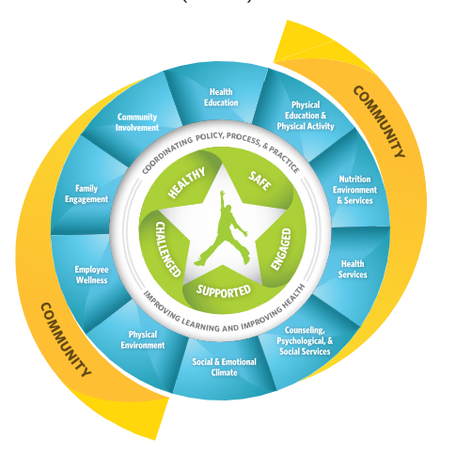
Comprehensive Health and Physical Education (CHPE)
Resources & Advocacy
CDC Healthy Schools works with states, school systems, communities, and national partners to prevent chronic diseases and promote the physical and mental health and well-being of students.
The Whole School, Whole Community, Whole Child (WSCC) model is CDC's framework for improving health in schools. The WSCC model is student-centered and emphasizes the importance of evidence-based policies and practices and the role of the community in supporting schools.

Slide 12
Special Education
As the State Educational Agency, DESE has responsibility for general supervision under Part B of the Individuals with Disabilities Education Act (IDEA). DESE provides technical assistance and monitors local education agencies’ (LEAs) implementation of IDEA and state special education law. General supervision has eight distinct but interconnected components, creating a cohesive system.

Slide 13
The Six Principles of the Individuals with Disabilities Education Act (IDEA)
1. Parent and Student Participation
2. Free and Appropriate Public Education (FAPE)
3. Appropriate Evaluation
4. Individualized Education Program (IEP)
5. Least Restrictive Environment (LRE)
6. Procedural Safeguards

Slide 14
New IEP Project Goals
To improve outcomes for all students with disabilities by providing guidance, technical assistance, and tools on equitable processes to school and district professionals, families, and students so that all students with disabilities have meaningful access to the curriculum frameworks and life of the school.

Slide 15
Areas of Focus for Improved IEP Form
Family and student voice
Form documents process
Least Restrictive Environment
Integrated transition planning
Accessibility of language

Slide 16
Q&A

Slide 17
Resources
DESE Vision
https://www.doe.mass.edu/commissioner/vision/vision-supports.pdf
Office of Student and Family Support (SFS)
https://www.doe.mass.edu/sfs/
Comprehensive Health and Physical Education (CHPE)
https://www.doe.mass.edu/stem/chpe/
Special Education
Special Education - Massachusetts Department of Elementary and Secondary Education

Slide 18
Statutes
State Laws
Massachusetts General Laws Search Page
Massachusetts General Laws: Education (See Chapters 69-78A)
MGL Chapter 71: Public Schools
MGL Chapter 71 § 89: Charter Schools
MGL Chapter 71A: English Language Learners
MGL Chapter 71B: Children with Special Needs
Enabling Laws for the Board and Department of Elementary and Secondary Education
G.L. c. 15, s. 1 (Department of Elementary and Secondary Education)
G.L. c. 15, s. 1E (Board of Education)
G.L. c. 15, s. 1F (Commissioner of Education)
G.L. c. 69, s. 1A (Department/Commissioner of Education - general powers and duties)
G.L. c. 69, s. 1B (Board of Education - general powers and duties)
Other Relevant General Laws Pertaining to the Board and Department of Elementary and Secondary Education
G.L. c. 15, s. 1G (Advisory councils to Board of Education)
G.L. c. 69, s. 1D (statewide educational goals and academic standards)
G.L. c. 69, s. 1E (curriculum frameworks)
G.L. c. 69, s. 1F (vocational-technical education)
G.L. c. 69, s. 1G: (school day/school year)
G.L. c. 69, s. 1H (adult basic education)
G.L. c. 69, s. 1I (performance assessment of students, schools and districts)
G.L. c. 69, s. 1J (underperforming schools)
G.L. c. 69, s. 1K (underperforming districts)
G.L. c. 71, s. 38G (educator certification/licensure)
G.L. c. 71, s. 89 (charter schools)
See also various other provisions of G.L. c. 71; c. 71B (special education); and c. 74 (vocational-technical education)

Slide 19
Regulations
603 CMR 1.00Charter Schools
603 CMR 2.00Accountability and Assistance for School Districts and Schools
603 CMR 4.00Vocational Technical Education
603 CMR 5.00Dispute Resolution Under Parental Notification Law
603 CMR 7.00Educator Licensure and Preparation Program Approval
603 CMR 8.00Kindergartens: Minimum School Age
603 CMR 10.00School Finance and Accountability
603 CMR 14.00Education of English Learners Regulations
603 CMR 17.00Racial Imbalance And Magnet School Programs
603 CMR 18.00Program and Safety Standards for Approved Public or Private Day and Residential Special Education School Programs
603 CMR 23.00Student Records
603 CMR 26.00Access to Equal Educational Opportunity
603 CMR 27.00Student Learning Time
603 CMR 28.00Special Education Regulations
603 CMR 30.00Massachusetts Comprehensive Assessment System And Standards For Competency Determination
603 CMR 31.00Massachusetts Certificate of Mastery
603 CMR 33.00Anti-Hazing Reporting
603 CMR 35.00Evaluation of Educators
603 CMR 41.00Regional School Districts
603 CMR 44.00Educator License Renewal
603 CMR 46.00Prevention of Physical Restraint and Requirements If Used
603 CMR 47.00Licensure of Adult Basic Education Teachers and Preparation
603 CMR 48.00Innovation Schools Regulations
603 CMR 49.00Notification of Bullying and Retaliation
603 CMR 50.00Educational Collaboratives
603 CMR 51.00Criminal History Checks for School Employees
603 CMR 52.00Commonwealth of Massachusetts Virtual Schools
603 CMR 53.00Student Discipline Regulations
603 CMR 54.00Recovery High Schools
603 CMR 55.00Student Opportunity Act Plans
603 CMR 56.00Addressing Regulatory Timelines Due To COVID-19 State of Emergency

Slide 20
Connect with DESE
Massachusetts Department of Elementary & Secondary Education
DESE Newsletters
@maSCHOOLSK12
Website:
Doe.mass.edu / youtube

