Slide 1

Guide to Housing Rehabilitation: how to implement a successful program
Community Development Block Grant
Commonwealth of Massachusetts Executive OFFICE of Housing and Livable Communities

Slide 2
Overview
Massachusetts Overview
Administrative Requirements
The Rehabilitation Process
Procurement and Contracting
Inspections & Payments
Q & A

Slide 3
Massachusetts
$34 m CDBG annually
40 – 50 applicants
Infra/Public Facilities, HR, PSS
50% apply for housing rehab programs
Communities apply on their own or regionally
3- 25-unit goals
351 Municipalities
100 < 5k in pop
170 < 10k in pop
Regionally for more rural communities
Addresses capacity issues
Provides Economies of Scale

Slide 4
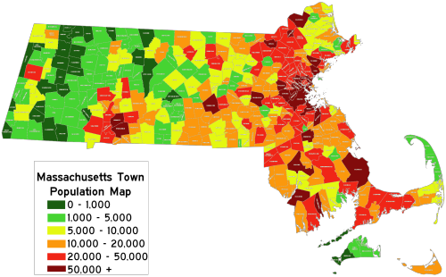

Slide 5
National Objective – hr uNITS
Benefit to low- and moderate- income persons
Minimum unit eligibility:
Single unit structure: household must be income eligible.
Two-unit structure: one of the units must be occupied by an income eligible household.
Three or more units: at least 51% of the units must be occupied by households which are income eligible. Vacant units can be counted as income eligible; owner must agree in writing to affordability requirements. (LMI households & rents subject to affordability requirements)

Slide 6
National Objective
Income Documentation
Benefit to LMI household
Establish standard income verification procedures, including acceptable forms of source documents/third party verification
24 CFR Part 5 Annual Income /IRS Form 1040 Adjusted Gross Income
Current income limits: https://www.hudexchange.info/resource/5334/cdbg-income-limits/
Income determinations are well-documented; and calculations are clear and easy to back-into by a third-party reviewer.
BEST PRACTICE: Use the CPD Income Calculator at:
www.hudexchange.info/incomecalculator

Slide 7
Eligible Activities
Code violations
Incipient violations (those that are not in violation at present but are likely to become a violation if not addressed)
Major Systems in Danger of Failure
Energy efficiency improvements
Must use Energy Star Products
Lead Based Paint evaluation and reduction

Slide 8
Local Program Design
Responsive to local needs (housing characteristics and population)
Written guidelines, and follow standardized practices
Establish guidelines for selecting applicants and marketing plan
Good practice to re-examine annually to ensure that intended outcomes are being addressed

Slide 9
Program Design-
Clear & Consistent
Who is eligible? Waiting List? 1st come; 1st serve? Priority clientele, units?
Units – single/multi family? Owner occupied/Investor? Rentals?
Types of assistance (loans/grants) and amounts specified
Plan for loan servicing and rent monitoring
Refinancing policy

Slide 10
Staffing
Program Manager – intake/oversight, day-to day administration
Rehabilitation Specialists
Risk Assessor
Septic Engineer
(if applicable)

Slide 11





The Rehabilitation Process

Slide 12
The Rehabilitation Process
Environmental Review
Tiered Review (2 steps)
Statutory Check List (determine what’s applicable for site specific)
Complete (sign & date) for each property
MA Historic or PA, Floodplain
Emergencies too!

Slide 13
The Rehabilitation Process
Inspection/Source Documentation
The inspection report details the “conditions”
… What is the deficiency?
Cite the code violation from State Sanitary Code
The inspection report provides source documentation to support the expenditure of funds.

Slide 14
The Rehabilitation Process
Lead Paint 24 CFR Part 35
Federal Use Subpart J - Based on dollar thresholds
Follow relocation plan in application if necessary

Slide 15

The Rehabilitation Process
Work Write-Up
Details the specific code violations and how they will be addressed
Should provide for quality of material and installation methods
Develop Performance Specifications
Signed & Dated by homeowner and rehab specialist
Becomes part of the contract agreements
Projects are required to use energy star building performance standards. Those standards are found at:
www.energystar.gov

Slide 16
The Rehabilitation Process
Cost Estimate
A qualified estimate of reasonable costs that is based on the scope of work and technical specifications in the work write-up – signed and dated

Slide 17


Procurement & Contracting

Slide 18

Procurement - Contractor Selection
    Contractors should be qualified
      Licensed, insured, lead-safe training
      Lead abatement if necessary
      Pre-qualified list – Update every year and as needed
      Solicit Bids
      Check federal and state debarment list:
      https://www.sam.gov/

Slide 19

Contracts
Contract between the property owner
and municipality should include:
Date, name, address of all parties involved
Amount
15-year DPL
Loan closing
Reference to Promissory Note, Affordability restriction, liens and related documents
Anti-speculation & Recapture policy
Forgiveness/Subordination/Refinance Policies
Fair Housing and non-discrimination if applicable
Signed and dated by property owner and municipality

Slide 20
Construction Contract property owner & contractor
Dates, names and addresses of parties involved
Period of Performance - No open-ended contracts
Dollar amount
Final work-write up
Provisions for termination
Provision for Change orders

Slide 21
Provisions for Release of Liens
Warranty provisions
Provision requiring contractor to repair any damage resulting from his/her work at no additional cost to the homeowner
Grievance Procedures and Policies
Signed and dated by contractor & property owner
***Extend contract to cover completion of work if necessary

Slide 22

Inspections Progress Payments
Invoices should be detailed list specific work completed – not percent of job completed !
Rehab Spec ensures work conforms to specs
Contractor’s letterhead
Only issued after inspection by rehab specialist
Retainage 5% - 10%
Checks made out to the contractor and homeowner
No prepayments
Follow a system of Checks and Balances for approvals and signoffs

Slide 23
Final Inspections/Payment
All permits signed off and copy placed in file
Septic signed off by BOH
Statement of Satisfactory Completion/Final Payment
Documentation of Lead Paint Compliance
Contractors Release of Liens

Slide 24
Before

Slide 25
After

Slide 26
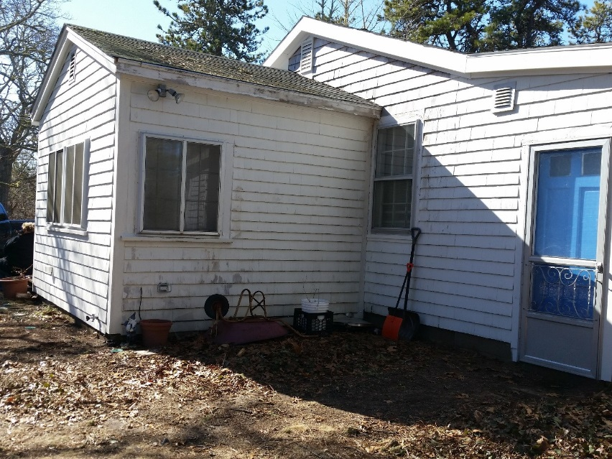
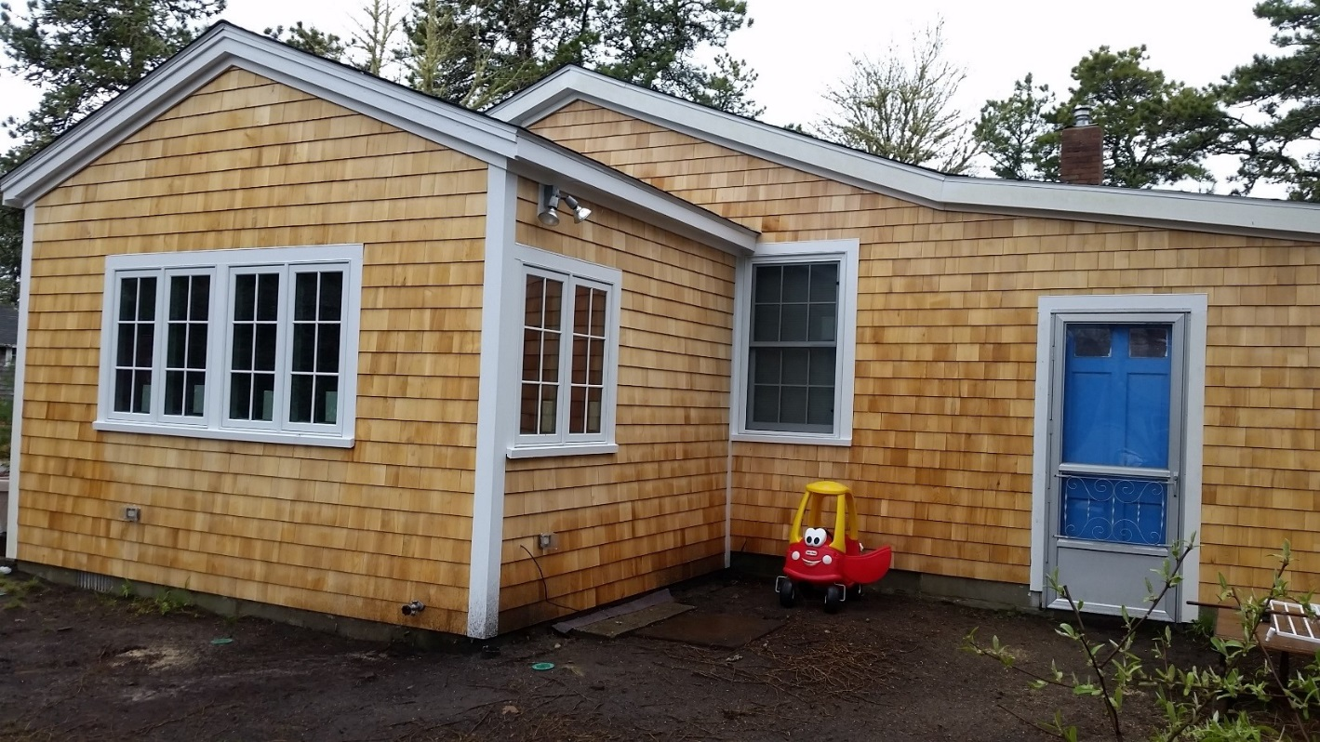
Before and After

Slide 27
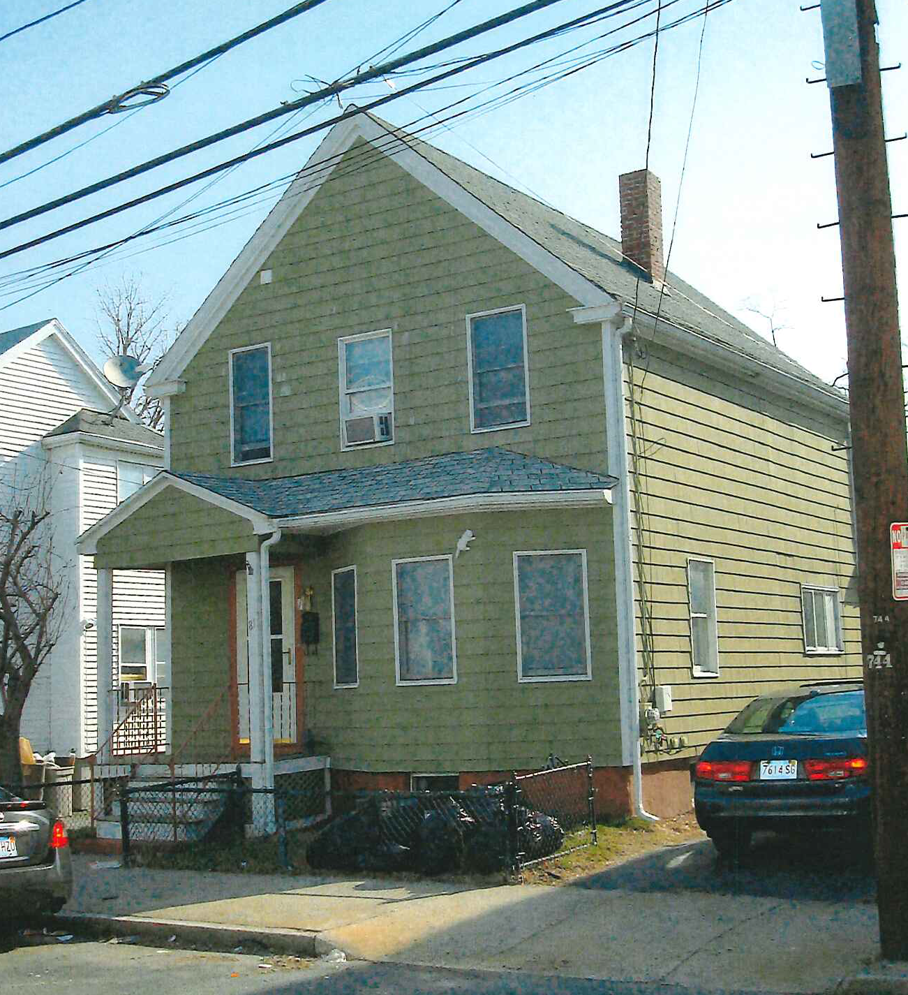
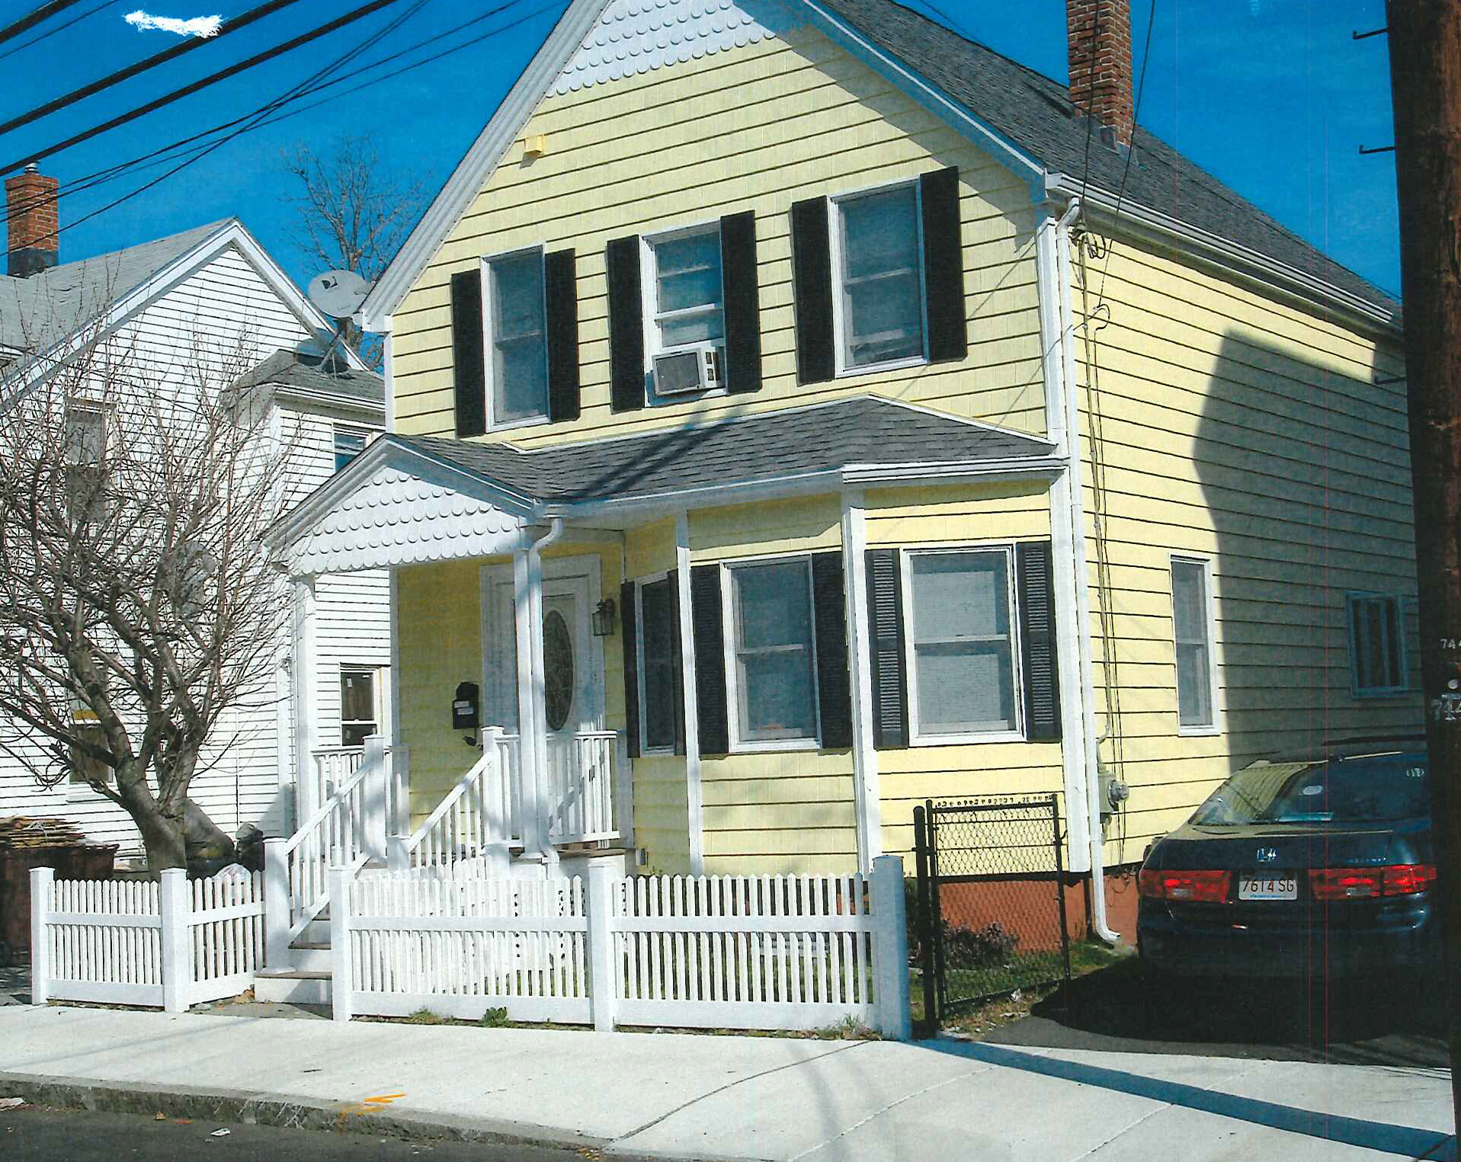
Before and After

Slide 28
Questions?

