Slide 1
Health Care Associated Infections in 2015
Acute Care Hospitals
Alfred DeMaria, M.D.
State Epidemiologist
Bureau of Infectious Disease and Laboratory Sciences
Katherine T. Fillo, Ph.D, RN-BC
Quality Improvement Manager
Bureau of Health Care Safety and Quality
Public Health Council
August 23, 2016

Slide 2
Introduction
The Massachusetts Department of Public Health (DPH) developed this data update as a component of the Statewide Infection Prevention and Control Program created pursuant to Chapter 58 of the Acts of 2006.
  Massachusetts law provides DPH with the legal authority to conduct surveillance, and to investigate and control the spread of communicable and infectious diseases. (MGL c. 111,sections 6 & 7)
  DPH implements this responsibility in hospitals through the hospital licensing regulation. (105 CMR 130.000)
This presentation is the seventh annual Public Health Council update:
It is an important component of larger efforts to reduce preventable infections in health care settings;
It presents an analysis of progress on infection prevention within Massachusetts acute care hospitals; and
It is based upon work supported by state funds and the Centers for Disease Control and Prevention (CDC).

Slide 3
Methods and Measures
This data summary includes the following statewide measures for the 2015 calendar year (January 1, 2015 – December 31, 2015):
Catheter associated urinary tract infections (CAUTI) (NEW);
  Comparisons made to state comparator and national baseline
Central line associated bloodstream infections (CLABSI);
  Comparisons made to state comparator and national baseline
Specific surgical site infections (SSI); and
  Comparison made to the national baseline only (smaller sample size)
Specific facility wide laboratory identified events (LabID) (NEW).
  Comparison made to the national baseline only (smaller sample size)

Slide 4
Measures (Continued)
Standardized Infection Ratio (SIR)*
  When the actual number is equal to the predicted number the SIR = 1.0
Central Line Utilization Ratio
Urinary Catheter Utilization
Actual Number of Infections
Standardized Infection Ratio (SIR) =
Predicted Number of Infections
Central Line Utilization Ratio =
Number of Central Line Days
Number of Patient Days
Urinary Catheter Utilization Ratio =
Number of Urinary Catheter Days
Number of Patient Days
Notes:
4

Slide 5
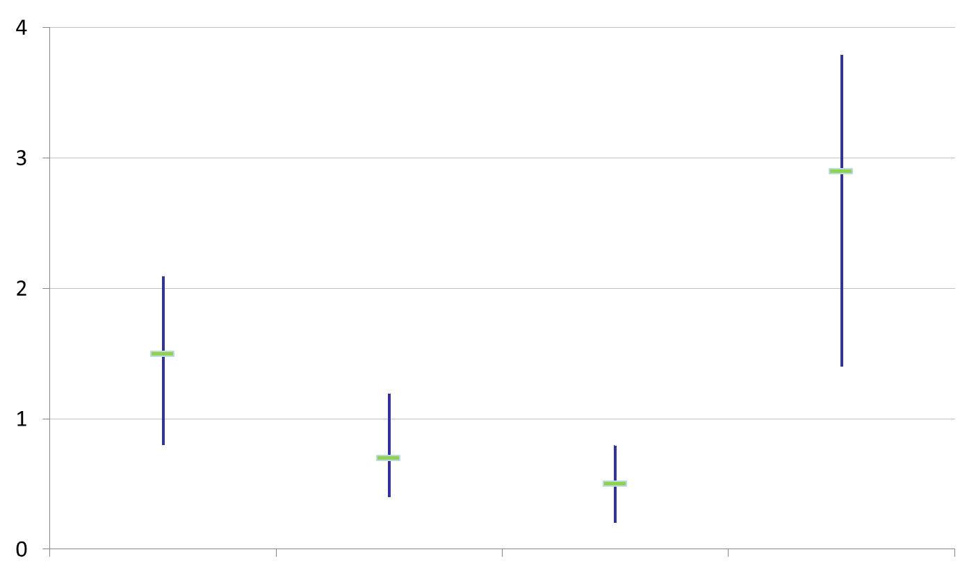
How to Interpret SIRs and 95%
Confidence Intervals (CIs)
Significantly higher than predicted
Not significantly different than predicted
SIR
Significantly lower than predicted
The green horizontal bar represents the SIR, and the blue vertical bar represents the 95% confidence interval (CI). The 95% CI measures the probability that the true SIR falls between the two parameters.
If the blue vertical bar crosses 1.0 (highlighted in orange), then the actual rate is not statistically significantly different from the predicted rate.
If the blue vertical bar is completely above or below 1.0, then the actual is statistically significantly different from the predicted rate.

Slide 6
CAUTI Criteria Definitions
National Healthcare Safety Network (NHSN) groups Catheter Associated Urinary Tract Infections (CAUTIs) into two categories:
  Symptomatic urinary tract infection (SUTI)
    Positive urine culture with no more than two species of organisms
    Signs or symptoms with no other recognized cause
  Asymptomatic bacteremic urinary tract infection (ABUTI) infection
    Positive urine culture with no more than two species of organisms
    Patient has no signs or symptoms of SUTI
    Positive blood culture with at least one matching bacteria to the urine culture or matching organisms in the urine

Slide 7
Massachusetts CAUTI Rates Compared to National Baseline Rate, by ICU Type
January 1, 2015-December 31, 2015
Key Findings
Six ICU types had a significantly lower rate of infection compared to the national baseline:
Medical (T)
Medical (NT)
Medical/Surgical (T)
Pediatric Cardiothoracic
Pediatric Medical/Surgical
Surgical Cardiothoracic
One ICU type had a significantly higher rate of infection compared to the national baseline:
Trauma
There were 40 CAUTIs reported in this ICU type.
NT=Not major teaching
T= Major teaching
SIR Upper and Lower Limit

Slide 8
Massachusetts CAUTI Rates Compared to State Comparator*, by ICU Type
January 1, 2015-December 31, 2015
Key Findings
All but two ICU types (Medical/surgical NT-Small and Neosurgical) had a significantly lower rate of infection compared to the state comparator.
*The state comparator is calculated from data reported by Massachusetts acute care hospitals to NHSN during calendar years 2013-2014.
NT=Not major teaching
T= Major teaching
SIR Upper and Lower Limit

Slide 9
CAUTI Adult & Pediatric ICU Pathogens for 2014 and 2015
Calendar Year 2014
January 1, 2014 – December 31, 2014
n=726
Calendar Year 2015
January 1, 2015 – December 31, 2015
n=379
Notes:
Updated 8/30/16

Slide 10
State CAUTI SIR
Key Findings
In 2015, adult and pediatric ICUs experienced a significantly lower number of infections than expected, as compared to the national baseline data and prior years.
*In 2015, the NHSN definition for UTI was updated, and several criteria and elements were excluded. This may result in a similar, significant decrease in the 2015 CAUTI SIRs than in previous years

Slide 11
State Urinary Catheter Utilization Ratios
Key Findings
Adult ICUs continue to reduce urinary catheter use, reducing the risk of CAUTI.
Urinary catheter utilization in pediatric ICUs has remained relatively low and unchanged since the start of public reporting.

Slide 12
CLABSI Criterion
NHSN groups central line associated bloodstream infections (CLABSIs) into three categories:
  Criterion 1 infection
    Recognized “true” pathogen from one or more blood cultures
    Organism is not related to an infection at another site
  Criterion 2, 3 infection
    Pathogen identified is commonly found on the skin
    Organism causing infection is found in two or more blood cultures drawn on separate occasions
    Patient is symptomatic with blood stream infection
    Criteria 3 applies only to patients who are 1 year of age or younger

Slide 13
Massachusetts Criteria 1, 2, and 3 CLABSI Rates Compared to National Baseline Rate, by ICU Type
January 1, 2015-December 31, 2015
Key Findings
One ICU type had a significantly lower rate of infection compared to the national baseline:
Medical /Surgical (T)
One ICU type had a significantly higher rate of infection compared to the national baseline:
Pediatric Medical
There were 30 CLABSIs reported in this ICU type.
NT=Not major teaching
T= Major teaching
SIR Upper and Lower Limit

Slide 14
Massachusetts Criteria 1, 2 and 3 CLABSI Rates Compared to State Comparator*, by ICU Type
January 1, 2015-December 31, 2015
Key Findings
One ICU type had a significantly higher rate of infection compared to the state comparator:
Pediatric
There were 30 CLABSIs reported in this ICU type.
*The state comparator is calculated from data reported by Massachusetts acute care hospitals to NHSN during calendar years 2013-2014.
NT=Not major teaching
T= Major teaching
SIR Upper and Lower Limit

Slide 15
CLABSI Adult & Pediatric ICU Pathogens for 2014 and 2015
Calendar Year 2014
January 1, 2014 – December 31, 2014
n=172
Calendar Year 2015
January 1, 2015 – December 31, 2015
n=164
Notes:
Updated 8/30/16

Slide 16
Massachusetts Criteria 1, 2, and 3 CLABSI Rates in NICUs compared to National Baseline Rates, by Birth Weight Category
January 1, 2015-December 31, 2015
Key Findings
Infants weighing less than or equal to 750 grams and those weighing 751 grams-1000 grams at birth had a significantly higher rate of infection compared to the national baseline
There were 37 CLABSIs reported in this ICU type.
SIR Upper and Lower Limit
Notes:
≤ 750 grams
751-1,000 grams
1,001-1,500 grams
1,501-2,500 grams
> 2,500 grams

Slide 17
Massachusetts Criteria 1, 2 and 3 CLABSI Rates in NICUs compared to State Comparator*, by Birth Weight Category
January 1, 2015-December 31, 2015
Key Findings
Infants weighing less than or equal to 750 grams and those weighing 751 grams-1000 grams at birth had a significantly higher rate of infection compared to the state comparator
There were 37 CLABSIs reported in this ICU type.
*The state comparator is calculated from data reported by Massachusetts acute care hospitals to NHSN during calendar years 2013-2014
SIR Upper and Lower Limit

Slide 18
State CLABSI SIR
Key Findings
In 2015, pediatric and neonatal ICU types had a significantly higher rate of infection compared to the national baseline.
There were 30 CLABSIs reported in 8 pediatric ICUs and 37 CLABSIs reported in the 10 neonatal ICUs.
DPH and The Neonatal Quality Improvement Collaborative are working to address causal factors.

Slide 19
CLABSI NICU Pathogens for
2014 and 2015
Calendar Year 2014
January 1, 2014– December 31, 2014
n=18
Calendar Year 2015
January 1, 2015– December 31, 2015
n=37
Notes:
UPDATED 8/22/16

Slide 20
State Central Line (CL) Utilization Ratios
Key Findings
Discontinuing unnecessary central lines can reduce the risk for infection.
CL utilization in neonatal ICU types has remained low and relatively unchanged since the start of public reporting.

Slide 21
SSI: Coronary Artery Bypass Graft (CABG) SIR and Colon (COLO) SIR
Key Findings
For the past five years, MA acute care hospitals performing coronary artery bypass graft procedures experienced a significantly lower number of infections than expected, as compared to the national baseline data. There were 31 CABG SSIs reported.
In 2015, Massachusetts hospitals performing colon procedures had an infection rate similar to the national baseline data. There were 223 colon procedure SSIs reported.
CABG
COLO
SIR Upper and Lower Limit

Slide 22
SSI: Knee Prosthesis (KPRO) SIR and Hip Prosthesis (HPRO) SIR
Key Findings
For the past three years, Massachusetts acute care hospitals performing knee and hip prosthesis procedures experienced a significantly lower number of infections than expected, as compared to the national baseline data. There were 57 KPRO and 64 HPRO SSIs reported.
SIR Upper and Lower Limit

Slide 23
SSI: Abdominal Hysterectomy (HYST) SIR and Vaginal Hysterectomy (VHYS) SIR
Key Findings
In 2015, Massachusetts hospitals performing abdominal and vaginal hysterectomy procedures had an infection rate similar to the national baseline data. There were 43 HYST and 11 VHST SSIs reported.
DPH conducted an extensive validation of VHST procedures at MA hospitals over the past year.
HYST
SIR Upper and Lower Limit

Slide 24
SSI Pathogens for 2014-2015
CABG, KPRO, HPRO, HYST, VHYS, COLO
Calendar Year 2014
January 1, 2014– December 31, 2014
n=484
Calendar Year 2015
January 1, 2015 – December 31, 2015
n=429

Slide 25
Statewide SSI Trends by Year
2011-2015
Statistically Higher
than Predicted
Statistically
the Same
as Predicted
Statistically Lower
than Predicted
CABG
KPRO
HPRO
HYST
VHYS
COLO*
*COLO includes data from 2012-2015 only.
Notes:
25

Slide 26
Summary of SSI Results
Significantly Higher than Predicted
The number of infections reported is higher than the number of predicted infections.
HYST
VHYS
COLO
Same as Predicted
The number of infections reported is the same as the number of predicted infections.
CABG
KPRO
HPRO
Significantly Lower than Predicted
The number of infections reported is lower than the number of predicted infections.

Slide 27
LabID: Clostridium difficile (CDI) SIR
Key Findings
In 2015, Massachusetts hospitals reporting CDI events had an infection rate similar to the national baseline data.
There were 2,771 CDI events reported.
SIR Upper and Lower Limit

Slide 28
LabID: Methicillin-resistant Staphylococcus aureus (MRSA) SIR
Key Findings
For the past three years, Massachusetts acute care hospitals reporting MRSA events experienced a significantly lower number of events than expected, as compared to the national baseline data.
There were 180 MRSA events reported.
SIR Upper and Lower Limit

Slide 29
Statewide LabID Trends by Year
2013-2015
Statistically Higher
than Predicted
Statistically
the Same
as Predicted
Statistically Lower
than Predicted
CDI
MRSA
Notes:
29

Slide 30
HAI Prevention Activities
External data validation of surgical site infections (SSIs) following vaginal hysterectomy (VHYS) procedures conducted at 20 hospitals
Hemodialysis infection prevention simulation training initiative for hemodialysis nurses
Clostridium difficile initiative in the long-term care setting
Antimicrobial stewardship across the continuum of care

Slide 31

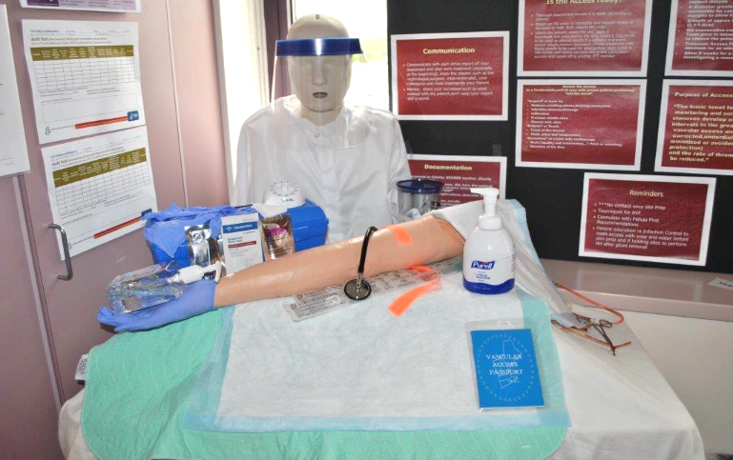
Hemodialysis Prevention Activity
Infection Prevention Best Practices In Hemodialysis
Use of Simulation to Improve Nursing Practice
This one day training for dialysis nurses utilizes simulation as a “hands on” teaching method to provide strategies and skills for the prevention of infections in hemodialysis settings using the Centers for Disease Control and Prevention (CDC) Dialysis Safety guidance and resources.
Describe the CDC Approach to BSI Prevention in Dialysis Facilities
Identify best practices to reduce the risk of healthcare-associated infections in dialysis settings
Review the Centers for Medicare and Medicaid Services (CMS) standards and requirements for End Stage Renal Disease (ESRD) facilities
Provide an opportunity for each participant to practice simulation lab exercises as a teaching method to enhance nursing practice
Nursing CEUs Available

Slide 32
Next Steps
The Department will continue to work with hospitals and additional state and national organizations in a comprehensive effort to address these largely preventable infections.
This update will be available on the MDPH website:
www.mass.gov/dph/dhcq
Please direct any questions to:
Katherine T. Fillo, Ph.D, RN-BC
Quality Improvement Manager
Bureau of Health Care Safety and Quality
katherine.fillo@state.ma.us
617-753-7328

