Slide 1
Health Care Associated Infections in 2016
Acute Care Hospitals
Alfred DeMaria, Jr., M.D.
State Epidemiologist
Bureau of Infectious Disease and Laboratory Sciences
Katherine T. Fillo, Ph.D, RN-BC
Director of Clinical Quality Improvement
Bureau of Health Care Safety & Quality
Eileen McHale, RN, BSN
Healthcare Associated Infection Coordinator
Bureau of Health Care Safety and Quality
Public Health Council
September 13, 2017

Slide 2
Introduction
Healthcare-associated infections (HAIs) are infections that patients acquire during the course of receiving treatment for other conditions within a healthcare setting.
HAIs are among the leading causes of preventable death in the United States, affecting 1 in 25 hospitalized patients, accounting for an estimated 722,000 infections and an associated 75,000 deaths during hospitalization.*
The Massachusetts Department of Public Health (DPH) developed this data update as a component of the Statewide Infection Prevention and Control Program created pursuant to Chapter 58 of the Acts of 2006.
  Massachusetts law provides DPH with the legal authority to conduct surveillance, and to investigate and control the spread of communicable and infectious diseases. (MGL c. 111,sections 6 & 7)
  DPH implements this responsibility in hospitals through the hospital licensing regulation. (105 CMR 130.000)
  Section 51H of chapter 111 of the Massachusetts General Laws authorizes the Department to collect HAI data and disseminate the information publicly to encourage quality improvement. (https://malegislature.gov/Laws/GeneralLaws/PartI/TitleXVI/Chapter111/Section51H)
Magill SS, Edwards JR, Bamberg W, et al. Multistate point-prevalence survey of health care-associated infections.
N Engl J Med. 2014; 370:1198-208.
*

Slide 3
Introduction
This HAI presentation is the eighth annual Public Health Council update:
It is an important component of larger efforts to reduce preventable infections in health care settings;
It presents an analysis of progress on infection prevention within Massachusetts acute care hospitals; and
It is based upon work supported by state funds and the Centers for Disease Control and Prevention (CDC).

Slide 4
Methods
This data summary includes the following statewide measures for the 2016 calendar year (January 1, 2016 – December 31, 2016) as reported to the CDC’s National Healthcare Safety Network (NHSN).
The DPH required measures are consistent with the Centers for Medicare and Medicaid Services quality reporting measures.
Central line associated bloodstream infections (CLABSI) in intensive care units
Catheter associated urinary tract infections (CAUTI) in intensive care units
Specific surgical site infections (SSI); and
Specific facility wide laboratory identified events (LabID)
  *National baseline data for each measure are based on a statistical risk model derived from 2015 national data.
  *All data were extracted from NHSN on August 11, 2017.
Notes:
In addition to the CMS requirements, DPH requires acute care hospitals to report SSIs resulting from VHYS and CABG procedures.

Slide 5
NEW: NHSN Rebaseline
In previous years, DPH has used the CDC’s NHSN 2006-2011 national baseline data as the basis for analysis.
January 2017, CDC completed the process of updating NHSN’s original HAI baselines.
The “rebaseline” was necessary due to multiple factors that have made the original baseline comparator data obsolete:
  Some of the baselines were very old
  NHSN protocols and surveillance definitions have changed over time
Transition to the new 2015 national baseline allows for comparison to more current data, significantly moves the previous values that provided the basis for comparison and creates a higher performance standard.
Notes:
New models: negative binomial regression: CLABSI, CAUTI, MRSA LabID, CDI LabID
New models: logistic regression: SSI
More current baseline includes more current definitions
Per CDC: 2015 baselined SIRs should be measured independent from the previous SIRs: different risk adjustment, different baseline population
The new models will better adjust for differences in patient populations between hospitals, thereby improving intra-facility comparison.
CDC expects that many hospitals’ SIRs will increase following rebaselining.

Slide 6
Measures
Standardized Infection Ratio (SIR)*
  When the actual number is equal to the predicted number the SIR = 1.0
Central Line Utilization Ratio
Urinary Catheter Utilization Ratio
Actual Number of Infections
Standardized Infection Ratio (SIR) =
Predicted Number of Infections
Central Line Utilization Ratio =
Number of Central Line Days
Number of Patient Days
Urinary Catheter Utilization Ratio =
Number of Urinary Catheter Days
Number of Patient Days
Notes:
6

Slide 7
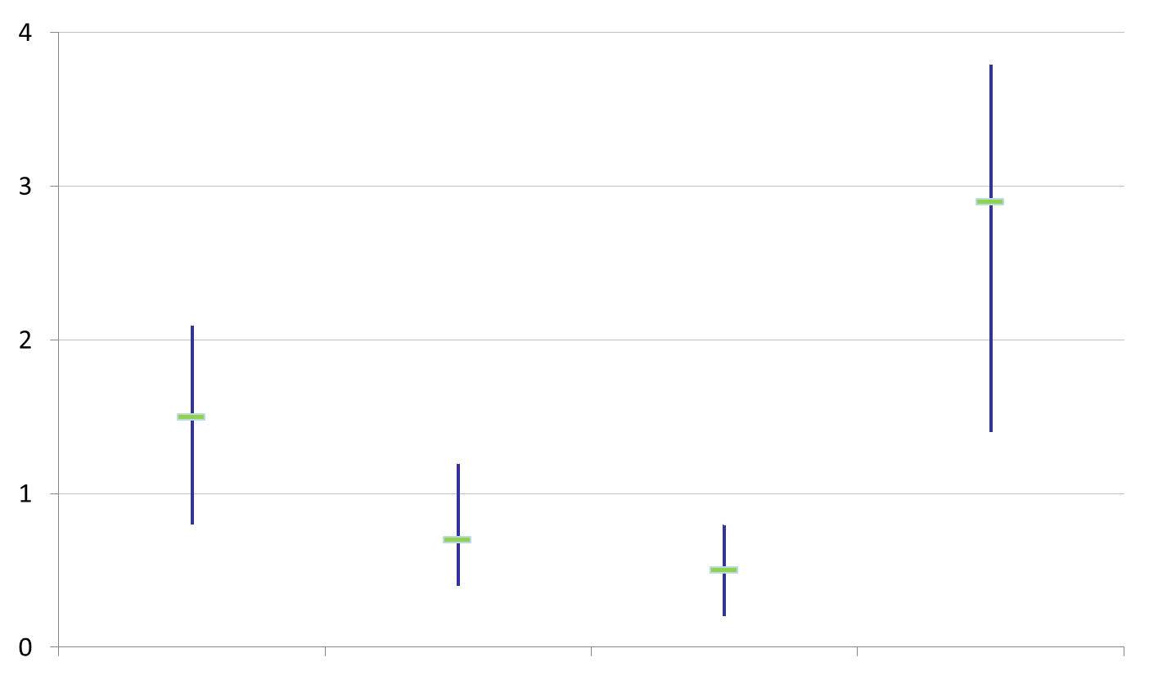
How to Interpret SIRs and 95%
Confidence Intervals (CIs)
Significantly higher than predicted
Not significantly different than predicted
SIR
Significantly lower than predicted
The green horizontal bar represents the SIR, and the blue vertical bar represents the 95% confidence interval (CI). The 95% CI measures the probability that the true SIR falls between the two parameters.
If the blue vertical bar crosses 1.0 (highlighted in orange), then the actual rate is not statistically significantly different from the predicted rate.
If the blue vertical bar is completely above or below 1.0, then the actual is statistically significantly different from the predicted rate.

Slide 8
Massachusetts Central Line-Associated Bloodstream Infection (CLABSI) SIR, by ICU Type
January 1, 2016-December 31, 2016
Key Findings
Two ICU types experienced a significantly lower number of infections than predicted, based on 2015 national aggregate data:
Medical /Surgical (T)
Surgical
One ICU type experienced a significantly higher number of infections than predicted, based on 2015 national aggregate data:
Burn
NT=Not major teaching
T= Major teaching
SIR Upper and Lower Limit
Notes:
2016: Total number of adult and pediatric CLABSI: 176
There are 12 Medical/Surgical teaching ICUs in MA
There are 14 Surgical ICUs in MA
There is one Burn ICU in MA. Data represents 2 infections

Slide 9
CLABSI Adult & Pediatric ICU Pathogens for 2015 and 2016
Calendar Year 2015
January 1, 2015 – December 31, 2015
n=158
Calendar Year 2016
January 1, 2016 – December 31, 2016
n=176
Notes:
DPH monitors data for the emergence of new pathogens or clusters or outbreaks of infections.

Slide 10
Massachusetts CLABSI SIR in NICUs, by Birth Weight Category
January 1, 2016-December 31, 2016
Key Findings
All five birth-weight categories experienced the same number of infections as predicted, based on 2015 national aggregate data.
There were 26 CLABSIs reported in this ICU type.
MA previously reported a higher than expected SIR across NICUs during 2015
SIR Upper and Lower Limit
Notes:
2015 MA reported a higher than expected SIR across NICUs.
DPH worked with the Neonatal Quality Improvement Collaborative of MA (NeoQic) to address the 2015 higher than expected finding in MA NICUs.
≤ 750 grams
751-1,000 grams
1,001-1,500 grams
1,501-2,500 grams
> 2,500 grams

Slide 11
CLABSI NICU Pathogens for
2015 and 2016
Calendar Year 2015
January 1, 2015– December 31, 2015
n=37
Calendar Year 2016
January 1, 2016– December 31, 2016
n=26
Notes:
DPH will continue to monitor data for the emergence of new pathogens and clusters or outbreaks of specific organisms.
2016 Gram negative bacteria represents 5 infections at 3 different hospitals

Slide 12
State CLABSI SIR
Key Findings
For the past two years, adult ICUs experienced a significantly lower number of infections than predicted, based on 2015 national aggregate data.
In 2016, neonatal ICUs experienced the same number of infections than predicted, based on 2015 national aggregate data.
.
Notes:
DPH worked with the Neonatal Quality Improvement Collaborative of MA (NeoQic) to address the 2015 higher than expected finding in MA NICUs.

Slide 13
State Central Line (CL) Utilization Ratios
Key Findings
Discontinuing unnecessary central lines can reduce the risk for infection.
Central line (CL) utilization has remained relatively unchanged between 2015 and 2016.
*The CL utilization ratio is calculated by dividing the number of CL days by the number of patient days.

Slide 14
Massachusetts Catheter-Associated Urinary
Tract infection (CAUTI) SIR, by ICU Type
January 1, 2016-December 31, 2016
Key Findings
All ICU types experienced the same number of infections as predicted, based on 2015 national aggregate data.
No ICU type was an outlier for this measure
There were 290 CAUTIs reported in 2016.
NT=Not major teaching
T= Major teaching
SIR Upper and Lower Limit
Notes:
No ICU type was an outlier for this measure

Slide 15
CAUTI Adult & Pediatric ICU Pathogens for 2015 and 2016
Calendar Year 2015
January 1, 2015 – December 31, 2015
n=391
Calendar Year 2016
January 1, 2016 – December 31, 2016
n=290
Notes:
DPH will continue to monitor data for the emergence of new pathogens and clusters or outbreaks of specific organisms.

Slide 16
State CAUTI SIR
Key Findings
In 2016, all ICU types experienced the same number of infections predicted based on 2015 national aggregate data.
Notes:
Pediatric data: 2015: 3 infections, 7,434 catheter days
Pediatric data: 2016: 9 infections, 7,610 catheter days. Same as predicted. DPH will continue to monitor quarterly Targeted Assessment for Prevention (TAP) reports.

Slide 17
State Urinary Catheter Utilization Ratios
Key Findings
Discontinuing unnecessary urinary catheters can reduce the risk for infection.
Urinary catheter utilization in adult and pediatric ICUs has remained relatively unchanged between 2015 and 2016.
*The urinary catheter utilization ratio is calculated by dividing the number of catheter days by the number of patient days.

Slide 18
Surgical Site Infections (SSI)
Coronary Artery Bypass Graft (CABG) SIR and Colon Procedure (COLO) SIR
Key Findings
For the past two years, MA acute care hospitals performing coronary artery bypass graft procedures (CABG) and colon procedures (COLO) experienced the same number of infections as predicted, based on 2015 national aggregate data.
There were 23 CABG SSIs reported in 2016.
There were 158 COLO SSIs reported in 2016.
SIR Upper and Lower Limit
Notes:
2015: 31 CABG SSIs reported.
2015: 223 colon procedure SSIs reported
2016: 14 hospitals perform, CABG and 60 perform, Colo

Slide 19
Surgical Site Infections (SSI)
Knee Prosthesis (KPRO) SIR and Hip Prosthesis (HPRO) SIR
Key Findings
In 2016, Massachusetts acute care hospitals performing knee prosthesis procedures (KPRO) experienced a significantly higher number of infections than predicted, based on 2015 national aggregate data.
There were 76 KPRO SSIs and 83 HPRO SSIs reported in 2016.
SIR Upper and Lower Limit
Notes:
Important Consideration
NHSN includes only SSIs identified on admission/readmission to a facility where the procedure was performed in their analysis.
MDPH recognizes the importance of SSIs identified through post-discharge surveillance (PDS) or readmission to another facility and does include their occurrence in data analysis.
2016 KPRO and HYST data are not significantly higher than expected when infections identified through PDS or readmission to another facility are removed from the MDPH analysis .
2015 there were 57 KPRO and 64 HPRO SSIs reported.
2016: 60 hospitals perform KPRO and 59 perform HPRO
DPH RESPONSE TO KPRO FINDINGS: 1) OUTREACH TO INDIVIDUAL FACILITIES HAS OCCURRED 2) QUARTERLY DPH TARGETED ASSESSMENT FOR PREVENTION (TAP) REPORTS WILL CONTINUE TO BE MONITORED 3) dph WILL SHARE FINDINGS WITH ITS TECHNICAL ADVISORY GROUP FOR INPUT ON NEXT STEPS

Slide 20
Surgical Site Infections (SSI)
Abdominal Hysterectomy (HYST) SIR and Vaginal Hysterectomy (VHYS) SIR
Key Findings
In 2016, Massachusetts acute care hospitals performing abdominal and vaginal hysterectomy procedures experienced a significantly higher number of infections than predicted, based on 2015 national aggregate data.
There were 46 HYST SSIs and 21 VHYS SSIs reported in 2016.
SIR Upper and Lower Limit
Notes:
Important Consideration
NHSN includes only SSIs identified on admission/readmission to a facility where the procedure was performed in their analysis.
MDPH recognizes the importance of SSIs identified through post-discharge surveillance (PDS) or readmission to another facility and does include their occurrence in data analysis.
2016 KPRO and HYST data are not significantly higher than expected when infections identified through PDS or readmission to another facility are removed from the MDPH analysis .
2015 there were 43 HYST and 11 VHST SSIs reported.
2016: 54 hospitals perform HYST and 51 perform VHYS

Slide 21
SSI Pathogens for 2015-2016
CABG, KPRO, HPRO, HYST, VHYS, COLO
Calendar Year 2015
January 1, 2015– December 31, 2015
n=369
Calendar Year 2016
January 1, 2016 – December 31, 2016
n=407
Notes:
DPH will continue to monitor data for the emergence of new pathogens and clusters or outbreaks of specific organisms.

Slide 22
Statewide SSI Trends by Year
2015-2016
Statistically Higher
than Predicted
Statistically
the Same
as Predicted
Statistically Lower
than Predicted
CABG
KPRO
HPRO
HYST
VHYS
COLO
Notes:
22

Slide 23
Summary of SSI Results
KPRO
HYST
VHYS
Significantly Higher than Predicted
The number of infections reported is higher than the number of predicted infections.
CABG
HPRO
COLO
Same as Predicted
The number of infections reported is the same as the number of predicted infections.
Significantly Lower than Predicted
The number of infections reported is lower than the number of predicted infections.

Slide 24
DPH Response to SSI
DPH has conducted outreach to individual hospitals to determine action taken to address higher than expected SIRs.
Selected examples of hospital actions: conducting root-cause analyses for each infection to identify the cause; re-education to ensure adherence to evidence based practices; observation of OR practices; limiting OR traffic; preoperative chlorhexidine baths and implementation of mandatory “joint class boot camp” for patients having elective surgery.
DPH has consulted with hospitals in the investigation of higher than expected rates of KPRO SSIs.
Notes:
KPRO investigation results: Did not identify one specific issue. Opportunity identified in terminal cleaning. Facility enhanced environmental cleaning and replaced equipment.
VHYS: Outlier contacted; DPH will continue to monitor reported quarterly Targeted Assessment for Prevention (TAP) reports. Improvement has been seen.

Slide 25
Laboratory Identified Events (LabID)
Clostridium difficile (CDI) SIR
Key Findings
In 2016, Massachusetts hospitals reporting CDI events experienced significantly lower number of infections than predicted, based on 2015 national aggregate data.
There were 2,371 CDI events reported in 2016.
SIR Upper and Lower Limit
Notes:
2015 there were 2,771 CDI events reported.

Slide 26
Laboratory Identified Events (LabID)
Methicillin-resistant Staphylococcus aureus (MRSA) SIR
Key Findings
For the past two years, Massachusetts acute care hospitals reporting MRSA events experienced significantly lower number of infections than predicted, based on 2015 national aggregate data.
There were 123 MRSA events reported in 2016.
SIR Upper and Lower Limit
Notes:
2015 there were 180 MRSA events reported.

Slide 27
Statewide LabID Trends by Year
2015-2016
Statistically Higher
than Predicted
Statistically
the Same
as Predicted
Statistically Lower
than Predicted
CDI
MRSA
Notes:
27

Slide 28
Summary of LabID Results
Significantly Higher than Predicted
The number of infections reported is higher than the number of predicted infections.
Same as Predicted
The number of infections reported is the same as the number of predicted infections.
CDI
MRSA
Significantly Lower than Predicted
The number of infections reported is lower than the number of predicted infections.

Slide 29
HAI Prevention Activities
External data validation of catheter-associated urinary tract infections conducted at 20 hospitals
Hemodialysis infection prevention simulation training initiative for hemodialysis nurses was expanded to include dialysis technicians
Clostridium difficile initiative in the long-term care setting
Antimicrobial stewardship across the continuum of care
On-site Infection Control Assessment and Response (ICAR) visits in nursing homes

Slide 30
Next Steps
Hospitals with higher than expected SIRs have been contacted to ensure the need for improvement has been addressed.
DPH will continue to monitor progress by providing quarterly Data Cleaning Reports and Targeted Assessment for Prevention (TAP) Reports for all hospitals to identify areas where focused infection prevention efforts are needed.
DPH will continue to conduct on-site data validation of specific NHSN measures to ensure completeness and accuracy of reported data.
DPH plans to provide educational webinars for hospitals in order that they may effectively use the data obtained from the surveillance system to improve patient and healthcare personnel safety.
DPH will continue to collaborate with state and national organizations to provide educational programs that address multi-drug resistant organisms and antibiotic resistance.
This update will be available on the MDPH website:
www.mass.gov/dph/dhcq
Notes:
A copy of the MA statewide summary is included in the materials for today’s presentation.

