Slide 1
Health Care Associated Infections in 2017
Acute Care Hospitals
Christina Brandeburg, MPH
Epidemiologist
Katherine T. Fillo, Ph.D, RN-BC
Director of Clinical Quality Improvement
Eileen McHale, RN, BSN
Healthcare Associated Infection Coordinator
Public Health Council
July 11, 2018

Slide 2
Introduction
Healthcare-associated infections (HAIs) are infections that patients acquire during the course of receiving treatment for other conditions within a healthcare setting.
HAIs are among the leading causes of preventable death in the United States, affecting 1 in 25 hospitalized patients, accounting for an estimated 722,000 infections and an associated 75,000 deaths during hospitalization.*
The Massachusetts Department of Public Health (DPH) developed this data update as a component of the Statewide Infection Prevention and Control Program created pursuant to Chapter 58 of the Acts of 2006.
  Massachusetts law provides DPH with the legal authority to conduct surveillance, and to investigate and control the spread of communicable and infectious diseases. (MGL c. 111,sections 6 & 7)
  DPH implements this responsibility in hospitals through the hospital licensing regulation. (105 CMR 130.000)
  Section 51H of chapter 111 of the Massachusetts General Laws authorizes the Department to collect HAI data and disseminate the information publicly to encourage quality improvement. (https://malegislature.gov/Laws/GeneralLaws/PartI/TitleXVI/Chapter111/Section51H)
Magill SS, Edwards JR, Bamberg W, et al. Multistate point-prevalence survey of health care-associated infections.
N Engl J Med. 2014; 370:1198-208.
*

Slide 3
Purpose
This HAI presentation is the ninth annual Public Health Council update:
It is an important component of larger efforts to reduce preventable infections in health care settings;
It presents an analysis of progress on infection prevention within Massachusetts acute care hospitals;
It is based upon work supported by state funds and the Centers for Disease Control and Prevention (CDC); and
It provides an overview of antibiotic resistance and stewardship activities.

Slide 4
Methods
This data summary includes the following statewide measures for the 2017 calendar year (January 1, 2017 – December 31, 2017) as reported to the CDC’s National Healthcare Safety Network (NHSN).
The DPH required measures are consistent with the Centers for Medicare and Medicaid Services quality reporting measures.
Central line associated bloodstream infections (CLABSI) in intensive care units
Catheter associated urinary tract infections (CAUTI) in intensive care units
Specific surgical site infections (SSI); and
Specific facility wide laboratory identified events (LabID).
  *National baseline data for each measure are based on a statistical risk model derived from 2015 national data.
  *All data were extracted from NHSN on June 11th, 2018.

Slide 5
Measures
Standardized Infection Ratio (SIR)*
  When the actual number is equal to the predicted number the SIR = 1.0
Central Line Utilization Ratio
Urinary Catheter Utilization Ratio
Actual Number of Infections
Standardized Infection Ratio (SIR) =
Predicted Number of Infections
Central Line Utilization Ratio =
Number of Central Line Days
Number of Patient Days
Urinary Catheter Utilization Ratio =
Number of Urinary Catheter Days
Number of Patient Days
Notes:
5

Slide 6
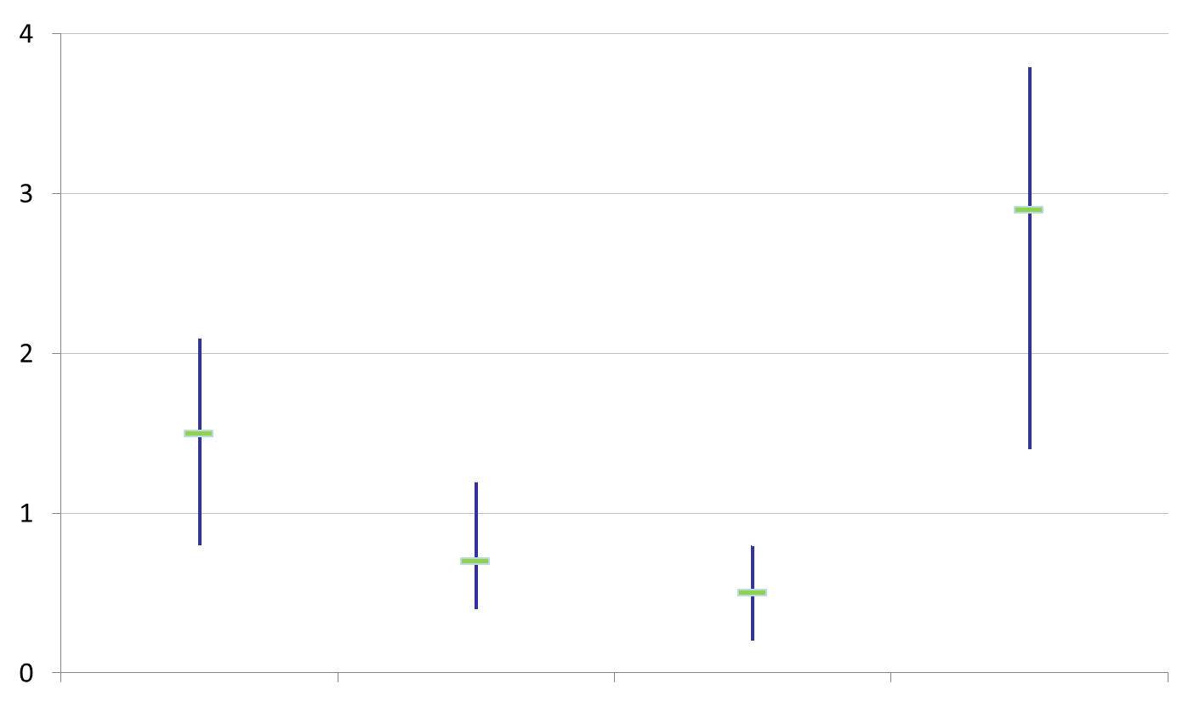
How to Interpret SIRs and
95% Confidence Intervals (CIs)
Significantly higher than predicted
Not significantly different than predicted
SIR
Significantly lower than predicted
The green horizontal bar represents the SIR, and the blue vertical bar represents the 95% confidence interval (CI). The 95% CI measures the probability that the true SIR falls between the two parameters.
If the blue vertical bar crosses 1.0 (highlighted in orange), then the actual rate is not statistically significantly different from the predicted rate.
If the blue vertical bar is completely above or below 1.0, then the actual is statistically significantly different from the predicted rate.

Slide 7
Massachusetts Central Line-Associated Bloodstream Infection (CLABSI) SIR, by ICU Type
January 1, 2017-December 31, 2017
Key Findings
Three ICU types experienced a significantly lower number of infections than predicted, based on 2015 national aggregate data:
Medical (T)
Medical /Surgical (T)
Surgical
One ICU type experienced a significantly higher number of infections than predicted, based on 2015 national aggregate data:
Burn
NT=Not major teaching
T= Major teaching
SIR Upper and Lower Limit

Slide 8
CLABSI Adult & Pediatric ICU Pathogens for 2016 and 2017
Calendar Year 2016
January 1, 2016 – December 31, 2016
n=176
Calendar Year 2017
January 1, 2017 – December 31, 2017
n=165

Slide 9
Massachusetts CLABSI SIR in NICUs, by Birth Weight Category
January 1, 2017-December 31, 2017
Key Findings
Infants weighing 1001 grams-1500 grams at birth experienced a significantly higher number of infections than predicted, based on 2015 national aggregate data.
There were 20 CLABSIs reported in this ICU type.
SIR Upper and Lower Limit

Slide 10
CLABSI NICU Pathogens for
2016 and 2017
Calendar Year 2016
January 1, 2016– December 31, 2016
n=28
Calendar Year 2017
January 1, 2017– December 31, 2017
n=20

Slide 11
State CLABSI SIR
Key Findings
For the past three years, adult ICUs experienced a significantly lower number of infections than predicted, based on 2015 national aggregate data.
Over the past three years, neonatal ICUs have seen a decrease in the number of infections.

Slide 12
State Central Line (CL) Utilization Ratios
Key Findings
Discontinuing unnecessary central lines can reduce the risk for infection.
Central line (CL) utilization has remained relatively unchanged between 2015 and 2017.
*The CL utilization ratio is calculated by dividing the number of CL days by the number of patient days.

Slide 13
Massachusetts Catheter-Associated Urinary
Tract infection (CAUTI) SIR, by ICU Type
January 1, 2017-December 31, 2017
Key Findings
Two ICU types experienced a significantly lower number of infections than predicted, based on 2015 national aggregate data:
Medical /Surgical (T)
Trauma
One ICU type experienced a significantly higher number of infections than predicted, based on 2015 national aggregate data:
Neurosurgical
NT=Not major teaching
T= Major teaching
SIR Upper and Lower Limit

Slide 14
CAUTI Adult & Pediatric ICU Pathogens for 2016 and 2017
Calendar Year 2016
January 1, 2016 – December 31, 2016
n=290
Calendar Year 2017
January 1, 2017 – December 31, 2017
n=305

Slide 15
State CAUTI SIR
Key Findings
Over the past three years, pediatric ICUs have seen an increase in the number of infections but are no different than predicted, based on 2015 national aggregate data.
There were 13 CAUTIs reported by 10 pediatric ICUs.

Slide 16
State Urinary Catheter Utilization Ratios
Key Findings
Discontinuing unnecessary urinary catheters can reduce the risk for infection.
Urinary catheter utilization in adult and pediatric ICUs has remained relatively unchanged between 2015 and 2017.
*The urinary catheter utilization ratio is calculated by dividing the number of catheter days by the number of patient days.

Slide 17
Surgical Site Infections (SSI)
Coronary Artery Bypass Graft (CABG) SIR and Colon Procedure (COLO) SIR
Key Findings
For the past three years, MA acute care hospitals performing coronary artery bypass graft procedures (CABG) and colon procedures (COLO) experienced the same number of infections as predicted, based on 2015 national aggregate data.
There were 33 CABG SSIs reported in 2017.
There were 173 COLO SSIs reported in 2017.
SIR Upper and Lower Limit

Slide 18
Surgical Site Infections (SSI)
Knee Prosthesis (KPRO) SIR and Hip Prosthesis (HPRO) SIR
Key Findings
In 2017, Massachusetts acute care hospitals performing knee prosthesis procedures (KPRO) and hip prosthesis procedures (HPRO) experienced the same number of infections as predicted, based on 2015 national aggregate data.
There were 69 KPRO SSIs and 76 HPRO SSIs reported in 2017.
SIR Upper and Lower Limit

Slide 19
Surgical Site Infections (SSI)
Abdominal Hysterectomy (HYST) SIR and Vaginal Hysterectomy (VHYS) SIR
Key Findings
In 2017, Massachusetts acute care hospitals performing abdominal hysterectomy (HYST) and vaginal hysterectomy (VHYS) procedures experienced the same number of infections as predicted, based on 2015 national aggregate data.
There were 47 HYST SSIs and 10 VHYS SSIs reported in 2017.
SIR Upper and Lower Limit

Slide 20
SSI Pathogens for 2016-2017
CABG, KPRO, HPRO, HYST, VHYS, COLO
Calendar Year 2016
January 1, 2016– December 31, 2016
n=409
Calendar Year 2017
January 1, 2017 – December 31, 2017
n=408

Slide 21
Statewide SSI Trends by Year
2015-2017
Statistically Higher
than Predicted
Statistically
the Same
as Predicted
Statistically Lower
than Predicted
CABG
KPRO
HPRO
HYST
VHYS
COLO
Notes:
21

Slide 22
Summary of SSI Results
Significantly Higher than Predicted
The number of infections reported is higher than the number of predicted infections.
CABG HYST
KPRO VHYS
HPRO COLO
Same as Predicted
The number of infections reported is the same as the number of predicted infections.
Significantly Lower than Predicted
The number of infections reported is lower than the number of predicted infections.

Slide 23
Laboratory Identified Events (LabID)
Clostridium difficile (CDI) SIR
Key Findings
For the past two years, Massachusetts hospitals reporting CDI events experienced significantly lower number of infections than predicted, based on 2015 national aggregate data.
There were 2,186 CDI events reported in 2017.
SIR Upper and Lower Limit

Slide 24
Laboratory Identified Events (LabID)
Methicillin-resistant Staphylococcus aureus (MRSA) SIR
Key Findings
For the past three years, Massachusetts acute care hospitals reporting MRSA events experienced significantly lower number of infections than predicted, based on 2015 national aggregate data.
There were 150 MRSA events reported in 2017.
SIR Upper and Lower Limit

Slide 25
Statewide LabID Trends by Year
2015-2017
Statistically Higher
than Predicted
Statistically
the Same
as Predicted
Statistically Lower
than Predicted
CDI
MRSA
Notes:
25

Slide 26
Summary of LabID Results
Significantly Higher than Predicted
The number of infections reported is higher than the number of predicted infections.
Same as Predicted
The number of infections reported is the same as the number of predicted infections.
CDI
MRSA
Significantly Lower than Predicted
The number of infections reported is lower than the number of predicted infections.

Slide 27
HAI Prevention Activities
External data validation of Clostridium difficile infections conducted at 20 acute care hospitals and 10 long-term care facilities in the fall of 2017 and spring of 2018. DPH plans to conduct data validation of specific NHSN measures to ensure completeness and accuracy of reported data.
Continued enrollment of long-term care facilities into NHSN for Clostridium difficile infection reporting.
Ongoing data sharing with the Neonatal Quality Improvement Collaborative (NeoQIC) to address opportunities for improvement.
Five hemodialysis infection prevention simulation trainings were held for hemodialysis nurses and technicians.
On-site Infection Control Assessment and Response (ICAR) visits expanding from nursing homes to long-term acute care facilities.
DPH monitors progress by providing quarterly Data Cleaning Reports and Targeted Assessment for Prevention (TAP) Reports for all hospitals to identify areas where focused infection prevention efforts are needed.
Outreach to hospitals with higher than expected SIRs to ensure the need for improvement has been addressed.

Slide 28
Antibiotic Resistance: Scope and Significance of the Issue
Antibiotic or antimicrobial resistance occurs when organisms are able to resist the effects of drugs. Bacteria are not killed by the antibiotic and continue to grow.
Some individuals may be at a greater risk for acquiring a drug resistant infection (individuals with co-morbidities, previous hospitalizations, antibiotic exposures, etc.). However, drug-resistant infections can affect anyone.
Infections with resistant organisms can be difficult to treat, are expensive and can have adverse effects.
Inevitably, bacteria are able to adapt to newly developed antibiotics and become resistant.
It is imperative to respond aggressively to prevent resistance and prevent the spread of existing resistant bacteria.

Slide 29
Antibiotic Resistance: Multi-Drug Resistant Organisms (MDROs) in Massachusetts by Organism
MDRO Type | 2016 | 2017 | 2018* | Total
Enterobacter cloacae | 22 | 88 | 71 | 181
Klebsiella oxytoca and pneumoniae | 15 | 78 | 33 | 126
Escherichia coli | 5 | 32 | 40 | 77
Enterobacter aerogenes | 8 | 17 | 5 | 30
Candida auris | 0 | 7 | 0 | 7
Other | 0 | 0 | 1 | 1
Total | 50 | 222 | 150 | 422
*Data are current as of June 30, 2018 and are subject to change.

Slide 30
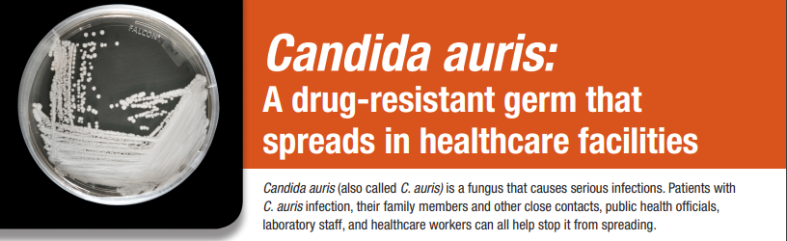
Antibiotic Resistance: MDROs in Massachusetts
Candida auris Example
DPH provides epidemiologic investigation support and guidance when specific MDROs are suspected to mitigate any exposure.
Activities include:
Provide detailed infection control recommendations;
Recommend retrospective and prospective laboratory surveillance
Coordinates colonization screening of close contacts in collaboration with regional laboratory.
 | 2017 | 2018*
Confirmed | 7 | 0
Contact | 75 | 10
Suspect | 0 | 1
* Data are current as of June 30, 2018 and are subject to change.

Slide 31
Antibiotic Stewardship:
What is it?
Studies indicate that between 30-50% of antibiotics prescribed in hospitals and between 40-75% of antibiotics prescribed in nursing homes is unnecessary*.
Improved prescribing practices can help reduce rates of Clostridium difficile and antibiotic resistance.
Appropriate antibiotic prescribing can improve patient outcomes and reduce healthcare costs.
*https://www.cdc.gov/antibiotic-use/healthcare/
https://www.cdc.gov/longtermcare/prevention/antibiotic-stewardship.html

Slide 32
Antibiotic Resistance and Antibiotic Stewardship: MDPH Reporting and Laboratory Testing
Electronic laboratory reporting (ELR) of mandatory MDROs of concern into the Massachusetts Virtual Epidemiologic Network (MAVEN).
Mandatory submission of MDRO isolates to the Massachusetts State Public Health Laboratory
for advanced testing;
  Identify novel resistance mechanisms;
  Identify Candida auris.

Slide 33
Antibiotic Resistance and Antibiotic Stewardship: Prevention and Educational Activities
NEW - Nine part webinar series for long-term care and long-term acute care facilities, “Navigating Infection Control and Antibiotic Stewardship in Long-term Care” with three “ask the experts” calls.
NEW - Collection, monitoring and reporting of facility-level antibiotic use data in long-term care facilities (n=45).
NEW - “Bug of the Month” webinar series targeting MDROs of concern for all facility types.
Publication of annual statewide antibiogram.
  Provides bug-drug combinations of interest for benchmarking purposes (https://www.mass.gov/service-details/massachusetts-antibiograms)
Engagement with subject matter experts and stakeholders during quarterly statewide HAI/AR Technical Advisory Group (TAG) meetings.

Slide 34
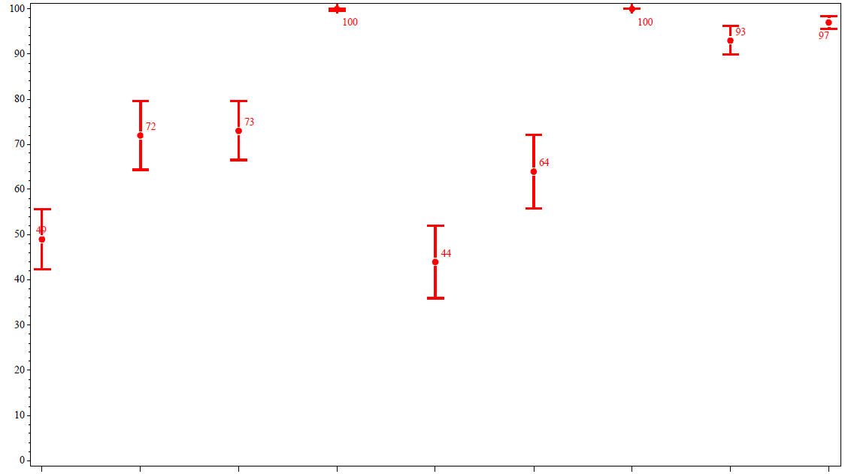
Antibiotic Resistance and Antibiotic Stewardship: Antibiograms
Staphylococcus aureus Susceptibility Rates – 2017
Statewide
% Susceptibility
Azithromycin
Ciprofloxacin
Clindamycin
Daptomycin
Erythromycin
Oxacillin
Quin/Dal
Tetracycline
TMS
Antibiotic

Slide 35
Antibiotic Resistance and Antibiotic Stewardship:
Next Steps
Awarded competitive funding from the Council of State and Territorial Epidemiologists (CSTE) to modify the infection control assessment and response (ICAR) tool for use in long-term acute care hospitals (LTACHs) and to conduct enhanced education for managing and containing MDROs.
Plan to collect and analyze NHSN antibiotic use (AU) data from a sample of acute care facilities to better understand trends in antibiotic use and monitor stewardship activities.
Support and collaborate with two national Leadership in Epidemiology, Antimicrobial Stewardship and Public Health (LEAP) fellows, selected to improve the utility of the statewide antibiogram data and to enhance AS activities in long-term care facilities.
Engage additional infection preventionists in use of MAVEN system for ease in response and containment of MDROs.

Slide 36
Contact Information
Thank you for the opportunity to present this information today.
Please direct any questions to:
Eileen McHale, RN, BSN
Healthcare Associated Infection Coordinator
Bureau of Health Care Safety and Quality
Eileen.mchale@state.ma.us

