Slide 1
2020 Health Care Associated Infections: Acute Care Hospitals
Public Health Council
October 13, 2021
Christina Brandeburg, MPH, Epidemiologist
Katherine T. Fillo, Ph.D, MPH, RN-BC, Director of Clinical Quality Improvement
Eileen McHale, RN, BSN, Healthcare Associated Infection Coordinator

Slide 2
Introduction
Healthcare-associated infections (HAIs) are infections that patients acquire during the course of receiving treatment for other conditions within a healthcare setting.
HAIs are among the leading causes of preventable death in the United States, affecting 1 in 17 hospitalized patients, accounting for an estimated 1.7 million infections and an associated 98,000 deaths.*
The Massachusetts Department of Public Health (DPH) developed this data update as a component of the Statewide Infection Prevention and Control Program created pursuant to Chapter 58 of the Acts of 2006.
Massachusetts law provides DPH with the legal authority to conduct surveillance, and to investigate and control the spread of communicable and infectious diseases. (MGL c. 111,sections 6 & 7)
DPH implements this responsibility in hospitals through the hospital licensing regulation. (105 CMR 130.000)
Section 51H of chapter 111 of the Massachusetts General Laws authorizes the Department to collect HAI data and disseminate the information publicly to encourage quality improvement. (https://malegislature.gov/Laws/GeneralLaws/PartI/TitleXVI/Chapter111/Section51H)
*Haque M, Sartelli M, McKimm J, Abu Bakar M. Healthcare-associated Infections - an Overview. Infect Drug Resist. 2018;11:2321–2333.

Slide 3
Purpose
This HAI presentation is the 12th annual Public Health Council update:
It is an important component of larger efforts to reduce preventable infections in health care settings
It presents an analysis of progress on infection prevention within Massachusetts acute care hospitals
It is based upon work supported by state funds and the Centers for Disease Control and Prevention (CDC)
It provides an overview of antibiotic resistance and stewardship activities
It considers the impact of COVID-19 on Massachusetts acute care hospitals

Slide 4
Methods
This data summary includes the following statewide measures for the 2020 calendar year (January 1, 2020 – December 31, 2020) as reported to the CDC’s National Healthcare Safety Network (NHSN).
DPH required measures are consistent with the Centers for Medicare and Medicaid Services (CMS) quality reporting measures.
Central line associated bloodstream infections (CLABSI) in intensive care units and wards
Catheter associated urinary tract infections (CAUTI) in intensive care units and wards
Specific surgical site infections (SSI)
Specific facility wide laboratory identified events (LabID)
* National baseline data for each measure are based on a statistical risk model derived from 2015 national data
^ All data were extracted from NHSN on August 9, 2021

Slide 5
Measures
Standardized Infection Ratio (SIR)
Actual Number of Infections
Standardized Infection Ratio (SIR) =
Predicted Number of Infections
Standard Utilization Ratio (SUR)
Standard Utilization Ratio=
Number of Device Days
Predicted Number of Device Days
If the SIR/SUR > 1.0, then more infections/device days were reported than predicted
If the SIR/SUR = 1.0, then the number of infections/number of device days is equal to the predicted number
If the SIR/SUR < 1.0, then fewer infections/device days were reported than predicted
Notes:
5

Slide 6
How to Interpret SIRs and 95% Confidence Intervals (CIs)
Significantly higher than predicted
Not significantly different than predicted
SIR
Significantly lower than predicted
The green horizontal bar represents the SIR, and the blue vertical bar represents the 95% confidence interval (CI). The 95% CI measures the probability that the true SIR falls between the two parameters.
If the blue vertical bar crosses 1.0 (highlighted in orange), then the actual rate is not statistically significantly different from the predicted rate.
If the blue vertical bar is completely above or below 1.0, then the actual is statistically significantly different from the predicted rate.

Slide 7
Central Line-Associated Bloodstream Infections (CLABSI): Standard Infection Ratio in Adult and Pediatric ICUs and Wards
ICU
Ward
T= Major teaching hospital
NT=Not major teaching hospital
SIR Upper and Lower Limit
Key Findings
Three unit types experienced a significantly lower number of infections than predicted, based on 2015 national aggregate data.
*SIRs and CIs are currently not calculated when the number of predicted infections is less than 0.5.
Cardiothoracic ICU
Medical/Surgical (NT) Ward
Surgical Ward

Slide 8
Central Line-Associated Bloodstream Infections (CLABSI): Standard Utilization Ratio in Adult and Pediatric ICUs and Wards
ICU
Ward
T= Major teaching hospital
NT=Not major teaching hospital
SIR Upper and Lower Limit
Key Findings
Seven unit types experienced a significantly lower number of device days
than predicted, based on 2015 national aggregate data.
Medical (NT) ICU
Neurologic ICU
Medical (T and NT) Ward
Medical/Surgical (T and NT) Ward
Surgical Ward

Slide 9
CLABSI Adult & Pediatric Pathogens for 2019 and 2020
ICU Pathogens
N=155
N=241
N=138
N=144
Ward Pathogens

Slide 10
Central Line-Associated Bloodstream Infections (CLABSI): Standard Infection Ratio in Neonatal ICUs
Key Findings
There were no birthweight categories experiencing a significantly higher or lower number of infections than predicted, based on 2015 national aggregate data.
There were 15 CLABSIs reported in Neonatal ICUs in 2020.
SIR Upper and Lower Limit
Notes:
≤ 750 grams
751-1,000 grams
1,001-1,500 grams
1,501-2,500 grams
> 2,500 grams

Slide 11
Central Line-Associated Bloodstream Infections (CLABSI): Standard Utilization Ratio in Neonatal ICUs
Key Findings
All five birthweight categories experienced a significantly lower number of device days than predicted, based on 2015 national aggregate data.
SIR Upper and Lower Limit
Notes:
≤ 750 grams
751-1,000 grams
1,001-1,500 grams
1,501-2,500 grams
> 2,500 grams

Slide 12
CLABSI NICU Pathogens for 2019 and 2020
Calendar Year 2019
January 1, 2019 – December 31, 2019
N=18
Calendar Year 2020
January 1, 2020 – December 31, 2020
N=15

Slide 13
State CLABSI SIR in ICU and Wards
Key Findings
In 2020, adult ICUs experienced the same number of infections as predicted, based on 2015 national aggregate data.
Between 2015-2020, adult Wards experienced a significantly lower number of infections than predicted, based on 2015 national aggregate data.
ICU
Ward
Notes:
Between 2016-2019, pediatric ICUs saw a decrease in the number of infections.

Slide 14
State CLABSI SUR in ICU and Wards
Key Findings
In 2020 adult ICU’s, experienced a significantly higher number of device days than predicted, based on 2015 national aggregate data.
Between 2015-2020, pediatric Wards experienced a significantly higher number of device days than predicted, based on 2015 national aggregate data
ICU
Ward
Notes:
Between 2017-2019, pediatric ICUs saw a decrease in the number of device days.

Slide 15
Catheter-Associated Urinary Tract Infections (CAUTI): Standard Infection Ratio in Adult and Pediatric ICUs and Wards
ICU
Ward
T= Major teaching hospitals
NT=Not major teaching hospitals
SIR Upper and Lower Limit
Key Findings
Two unit types experienced a significantly higher number of infections than predicted, based on 2015 national aggregate data.
Medical (NT) ICU
Medical/Surgical (NT) Ward

Slide 16
Catheter-Associated Urinary Tract Infections (CAUTI): Standard Utilization Ratio in Adult and Pediatric ICUs and Wards
ICU
Ward
T= Major teaching hospital
NT=Not major teaching hospital
SIR Upper and Lower Limit
Key Findings
Seven unit types experienced a significantly lower number of device days
than predicted, based on 2015 national aggregate data.
Medical (NT) ICU
Neurologic ICU
Medical (T and NT) Ward
Medical/Surgical (T and NT) Ward
Surgical Ward
Notes:
All other unit types experienced a significantly lower number of device days than predicted

Slide 17
CAUTI Adult & Pediatric Pathogens for 2019 and 2020
ICU Pathogens
N=223
N=228
N=205
N=198
Ward Pathogens

Slide 18
State CAUTI SIR in ICU and Wards
Key Findings
In 2020, adult and pediatric ICUs experienced a significantly lower number of infections than predicted, based on 2015 national aggregate data.
In 2020, adult and pediatric wards experienced the same number of infections than predicted, based on 2015 national aggregate data.
ICU
Ward
Notes:
Pediatric ICUs saw an increase in the number of infections between 2018 and 2019.

Slide 19
State CAUTI SUR in ICU and Wards
Key Findings
In 2020, adult and pediatric ICUs experienced a significantly higher number of device days than predicted, based on 2015 national aggregate data.
For the past six years, adult Wards experienced a significantly lower number of device days than predicted, based on 2015 national aggregate data.
ICU
Ward
Notes:
Over the past five years, pediatric ICUs saw a decrease in the number of device days.

Slide 20
Surgical Site Infections (SSI) Coronary Artery Bypass Graft (CABG) SIR and Colon Procedure (COLO) SIR
Key Findings
In 2020, MA acute care hospitals performing colon surgeries (COLO) experienced a lower number of infections than predicted, based on 2015 national aggregate data.
There were 25 CABG SSIs reported in 2020.
There were 161 COLO SSIs reported in 2020.
SIR Upper and Lower Limit

Slide 21
Surgical Site Infections (SSI) Knee Prosthesis (KPRO) SIR and Hip Prosthesis (HPRO) SIR
Key Findings
For the past three years, Massachusetts acute care hospitals performing knee prosthesis procedures (KPRO) experienced significantly higher number of infections than predicted, based on 2015 national aggregate data.
There were 54 KPRO SSIs reported in 2020.
There were 52 HPRO SSIs reported in 2020.
SIR Upper and Lower Limit

Slide 22
Surgical Site Infections (SSI) Abdominal Hysterectomy (HYST) SIR and Vaginal Hysterectomy (VHYS) SIR
Key Findings
In 2020, Massachusetts acute care hospitals performing abdominal hysterectomy (HYST) procedures experienced significantly higher number of infections than predicted, based on 2015 national aggregate data.
There were 46 HYST SSIs reported in 2020.
There were 5 VHYS SSIs reported in 2020.
SIR Upper and Lower Limit
Notes:
VHYS procedures performed in 2019: 786

Slide 23
SSI Pathogens for 2019-2020 CABG, KPRO, HPRO, HYST, VHYS, COLO
Calendar Year 2019
January 1, 2019 – December 31, 2019
N=439
Calendar Year 2020
January 1, 2020 – December 31, 2020
N=343

Slide 24
Statewide SSI Trends by Year 2015-2020
Statistically Higher
than Predicted
Statistically
the Same
as Predicted
Statistically Lower
than Predicted
CABG
KPRO
HPRO
HYST
VHYS
COLO
Notes:
24

Slide 25
Laboratory Identified Events (LabID) Clostridioides difficile (CDI) SIR
Key Findings
For the past four years, Massachusetts hospitals reporting CDI events experienced significantly lower number of infections than predicted, based on 2015 national aggregate data.
There were 1,400 CDI events reported in 2020.
SIR Upper and Lower Limit

Slide 26
Laboratory Identified Events (LabID) Methicillin-resistant Staphylococcus aureus (MRSA) SIR
Key Findings
For the past six years, Massachusetts acute care hospitals reporting MRSA events experienced significantly lower number of infections than predicted, based on 2015 national aggregate data.
There were 189 MRSA events reported in 2020.
SIR Upper and Lower Limit

Slide 27
Statewide LabID Trends by Year 2015-2019
Statistically Higher
than Predicted
Statistically
the Same
as Predicted
Statistically Lower
than Predicted
CDI
MRSA
Notes:
27

Slide 28
DPH HAI COVID-19 Activities
DPH Epidemiologists are assigned to each long-term care facility with a COVID-positive resident and/or healthcare personnel to effectively manage outbreak responses and control measures.
Epidemiologists are also assigned to COVID-19 clusters in other high risk patient settings including hospitals, assisted living residences, dialysis centers, inpatient psychiatric units, substance use disorder facilities, prisons, jails and homeless shelters.
Comprehensive on-site Infection Control Assessment and Response (ICAR) visits are conducted at licensed nursing homes. During these visits an epidemiologist and public health nurse:
Discuss facility infection prevention and control policies and practices;
Observe of screening areas, hand hygiene, PPE use, environmental cleaning, breakrooms, testing, vaccine storage, and designated COVID-19 care areas; and
Provide feedback and coaching to the facility staff.
Daily statewide long-term care facility and weekly facility-level case counts were published on the COVID-19 Interactive Data Dashboard. Internal review of healthcare associated COVID-19 data collected through DPH’s surveillance system continues to be monitored routinely.
Weekly analysis of nursing home data submitted to the LTCF COVID-19 Module in NHSN to monitor trends over time and to identify facilities with staffing or PPE shortages and those with lower resident and/or staff vaccination rates.
Promote CDC’s National Training Collaborative, Project Firstline, and develop MA-specific infection control training content and learning programs for frontline healthcare workers in partnership with the Population Health Exchange (PHX) at Boston University.

Slide 29
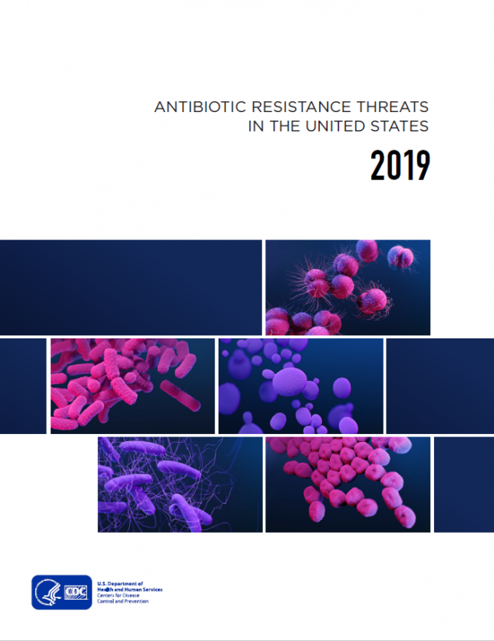
Antibiotic Resistance: Urgent Threats in MA
CDC 2019 AR Threats Report
More than 2.8 million antibiotic-resistant infections occur in the U.S. each year, and more than 35,000 people die as a result.
Dedicated prevention and infection control efforts are working to reduce the number of infections and deaths caused by antibiotic-resistant germs, but the number of people facing antibiotic resistance is still too high.
Urgent threats targeted in MA through surveillance, detection
and containment
Carbapenem-resistant Acinetobacter
Candida auris
Clostridioides difficile
Carbapenem-resistant Enterobacterales

Slide 30
Antibiotic Resistance: Targeting Carbapenemase-producing Organisms (CPO) in MA
Carbapenems are a class of antibiotics often considered a “last resort” to treat infections caused by Enterobacterales, Pseudomonas and Acinetobacter
One way these organisms are resistant to carbapenems is by producing carbapenemases
A carbapanemase is an enzyme that can break down (and thus resist) many classes of antibiotics, including carbapenems, making infections with these organisms harder to treat
Genes that program the organism to produce a carbapenemase can be shared between bacteria
Carbapenemase gene targets: KPC, NDM, VIM, OXA and IMP
KPC
NDM
VIM
OXA
IMP

Slide 31
Antibiotic Resistance Surveillance:
Reporting and Laboratory Testing
Electronic laboratory reporting (ELR) of mandatory MDROs of concern into the Massachusetts Virtual Epidemiologic Network (MAVEN)
Mandatory submission of selected MDRO isolates to the Massachusetts State Public Health Laboratory (MA SPHL) for advanced testing here and at our partner ARLN laboratory, The Wadsworth Center in New York:
Identify novel resistance mechanisms such as genes that code for carbapenemase production or colistin resistance
Identify Candida auris
Test swabs to identify colonization with target organisms to detect transmission within a healthcare facility
Conduct whole-genome sequencing to determine relatedness of organisms to identify transmission pathways within and across healthcare facilities
Notes:
Carbapenem-resistant Enterobacteriaceae (CRE), including carbapenemase-producing CRE
Candida auris
Organisms containing the mcr gene, conferring mobilized resistance to colistin, a last-resort antibiotic used for treating resistant infections
Isolates are sent to the regional Antibiotic Resistance Laboratory Network (ARLN) – NY Wadsworth Laboratory for testing

Slide 32
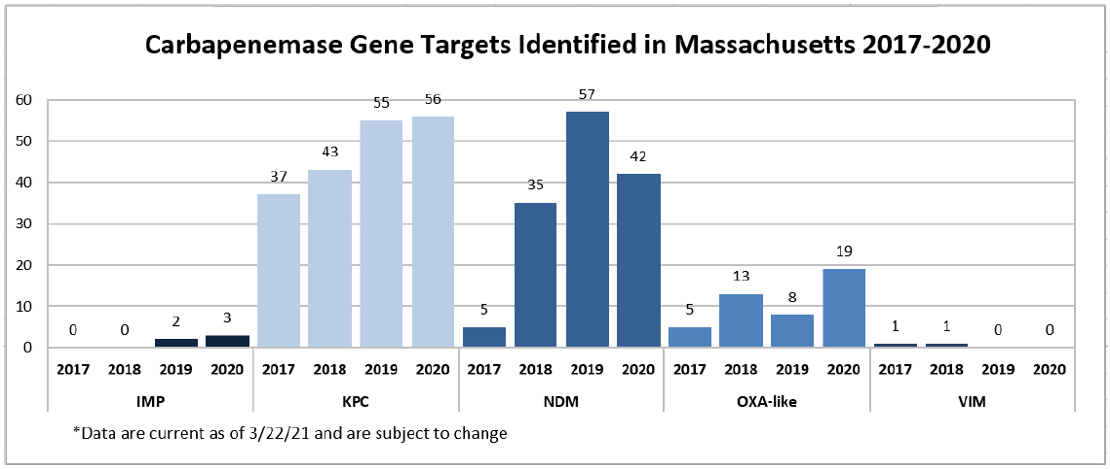
Antibiotic Resistance Surveillance: Carbapenemase-producing Organisms (CPOs) in MA

Slide 33
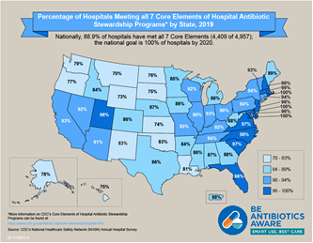
Antibiotic Stewardship
Studies indicate that between 30-50% of antibiotics prescribed in hospitals and between 40-75% of antibiotics prescribed in nursing homes are unnecessary*
Improved prescribing practices can help reduce rates of Clostridioides difficile and antibiotic resistance
Appropriate antibiotic prescribing can improve patient outcomes and reduce healthcare costs
*https://www.cdc.gov/antibiotic-use/healthcare/
https://www.cdc.gov/longtermcare/prevention/antibiotic-stewardship.html
Notes:
28% of MA acute care hospitals reporting at least one month of data to NHSN’s Antimicrobial Use Option as of October 2020
NY has 39% and VA is highest with 64%

Slide 34
Antibiotic Stewardship: Prevention and Educational Activities
NEW: 34 acute care hospitals participating in NHSN antibiotic use (AU) module to better understand trends in antibiotic use and to monitor stewardship activities- will soon have access to antibiotic prescribing data for 50% of all acute-care facilities in MA
Collection, monitoring, and benchmarking of facility-level antibiotic use data in long-term care facilities (106 facilities reported at least one month of data in 2020, average of 58 participating facilities each month)
NEW: Renewed collaboration with antibiotic stewardship (AS) experts from Tufts Medical Center to enhance AS support and activities in our long-term care facilities
Held a statewide webinar for long-term care facilities on MDROs and Infection Control (n=150 participants) in February, 2020
Publication of 10-year trends in MA Hospital Antibiograms : https://doi.org/10.1017/ice.2020.395
Engagement with subject matter experts and stakeholders during quarterly statewide HAI/AR Technical Advisory Group (TAG) meetings with formation of Antibiotic Use Subcommittee

Slide 35
Contact Information
Thank you for the opportunity to present this information today.
Please direct any questions to:
Eileen McHale, RN, BSN
Healthcare Associated Infection Coordinator
Bureau of Health Care Safety and Quality
eileen.mchale@state.ma.us

