Slide 1
2021 Health Care Associated Infections:
Acute Care Hospitals
Christina Brandeburg, MPH, Epidemiologist
Katherine T. Fillo, PhD, MPH, RN-BC, Director of Clinical Quality Improvement
Jessica Leaf, MPH, Epidemiologist
Eileen McHale, RN, BSN, Healthcare Associated Infection Coordinator

Slide 2
Introduction
Healthcare-associated infections (HAIs) are infections that patients acquire during the course of receiving treatment for other conditions within a healthcare setting.
HAIs are among the leading causes of preventable death in the United States, affecting 1 in 17 hospitalized patients, accounting for an estimated 1.7 million infections and an associated 98,000 deaths.*
The Massachusetts Department of Public Health (DPH) developed this data update as a component of the Statewide Infection Prevention and Control Program created pursuant to Chapter 58 of the Acts of 2006.
Massachusetts law provides DPH with the legal authority to conduct surveillance, and to investigate and control the spread of communicable and infectious diseases. (MGL c. 111,sections 6 & 7)
DPH implements this responsibility in hospitals through the hospital licensing regulation. (105 CMR 130.000)
Section 51H of chapter 111 of the Massachusetts General Laws authorizes the Department to collect HAI data and disseminate the information publicly to encourage quality improvement. (https://malegislature.gov/Laws/GeneralLaws/PartI/TitleXVI/Chapter111/Section51H)
Haque M, Sartelli M, McKimm J, Abu Bakar M. Healthcare-associated Infections - an Overview. Infect Drug Resist. 2018;11:2321–2333.

Slide 3
Purpose
This HAI presentation is the 13th annual Public Health Council update:
An important component of larger efforts to reduce preventable infections in health care settings
Presents an analysis of progress on infection prevention within Massachusetts acute care hospitals
Based upon work supported by state funds and the Centers for Disease Control and Prevention (CDC)
Provides an overview of antibiotic resistance and stewardship activities
Considers the impact of COVID-19 on Massachusetts acute care hospitals

Slide 4
Methods
This data summary includes the following statewide measures for the 2021 calendar year (January 1, 2021 – December 31, 2021) as reported to the CDC’s National Healthcare Safety Network (NHSN).
DPH required measures are consistent with the Centers for Medicare and Medicaid Services (CMS) quality reporting measures.
Central line associated bloodstream infections (CLABSI) in intensive care units and wards
Catheter associated urinary tract infections (CAUTI) in intensive care units and wards
Specific surgical site infections (SSI)
Specific facility wide laboratory identified events (LabID)
National baseline data for each measure are based on a statistical risk model derived from 2015 national data
^ All data were extracted from NHSN on August 15, 2022

Slide 5
Measures
Standardized Infection Ratio (SIR)
Actual Number of Infections
Standardized Infection Ratio (SIR) =
Predicted Number of Infections
Standard Utilization Ratio (SUR)
Standard Utilization Ratio=
Number of Device Days
Predicted Number of Device Days
If the SIR/SUR > 1.0, more infections/device days were reported than predicted
If the SIR/SUR = 1.0, the number of infections/number of device days is equal to the predicted number
If the SIR/SUR < 1.0, fewer infections/device days were reported than predicted
Notes:
5

Slide 6
How to Interpret SIRs and 95% Confidence Intervals (CIs)
Significantly higher than predicted
SIR
Not significantly different than predicted
Significantly lower than predicted
The green horizontal bar represents the SIR, and the blue vertical bar represents the 95% confidence interval (CI). The 95% CI measures the probability that the true SIR falls between the two parameters.
If the blue vertical bar crosses 1.0 (highlighted in orange), then the actual rate is not statistically significantly different from the predicted rate.
If the blue vertical bar is completely above or below 1.0, then the actual is statistically significantly different from the predicted rate.

Slide 7
Central Line-Associated Bloodstream Infections (CLABSI): Standard Infection Ratio in Adult and Pediatric ICUs and Wards
ICU
Ward
T= Major teaching hospital
NT=Not major teaching hospital
SIR Upper and Lower Limit
Key Findings
Six unit types experienced a significantly lower number of infections than predicted, based on 2015 national aggregate data.
*SIRs and CIs are currently not calculated when the number of predicted infections is less than 0.5.
Cardiothoracic ICU
Medical (T) Ward
Medical/Surgical (T & NT) Ward
Pediatric Ward
Surgical Ward

Slide 8
Central Line-Associated Bloodstream Infections (CLABSI): Standard Utilization Ratio in Adult and Pediatric ICUs and Wards
ICU
Ward
T= Major teaching hospital
NT=Not major teaching hospital
SIR Upper and Lower Limit
Key Findings
Nine unit types experienced a significantly lower number of device days
than predicted, based on 2015 national aggregate data.
Medical (NT) ICU
Neurologic ICU
Neurosurgical ICU
Trauma ICU
Medical (T and NT) Ward
Medical/Surgical (T and NT) Ward
Surgical Ward

Slide 9
CLABSI Adult & Pediatric Pathogens for 2020 and 2021
ICU Pathogens
N=241
N=241
N=145
N=123
Ward Pathogens

Slide 10
Central Line-Associated Bloodstream Infections (CLABSI): Standard Infection Ratio in Neonatal ICUs
Key Findings
There were no birthweight categories experiencing a significantly higher or lower number of infections than predicted, based on 2015 national aggregate data.
There were 19 CLABSIs reported in Neonatal ICUs in 2021.
SIR Upper and Lower Limit
Notes:
≤ 750 grams
751-1,000 grams
1,001-1,500 grams
1,501-2,500 grams
> 2,500 grams

Slide 11
Central Line-Associated Bloodstream Infections (CLABSI): Standard Utilization Ratio in Neonatal ICUs
Key Findings
Four birthweight categories experienced a significantly lower number of device days than predicted, based on 2015 national aggregate data.
SIR Upper and Lower Limit
Notes:
≤ 750 grams
751-1,000 grams
1,001-1,500 grams
1,501-2,500 grams
> 2,500 grams

Slide 12
CLABSI NICU Pathogens for 2020 and 2021
Calendar Year 2020
January 1, 2020 – December 31, 2020
N=15
Calendar Year 2021
January 1, 2021 – December 31, 2021
N=19

Slide 13
State CLABSI SIR in ICU and Wards
Key Findings
In 2021, adult, pediatric, and Neonatal ICUs experienced the same number of infections than predicted, based on 2015 national aggregate data.
Between 2015-2021, adult Wards experienced a significantly lower number of infections than predicted, based on 2015 national aggregate data.
ICU
Ward

Slide 14
State CLABSI SUR in ICU and Wards
Key Findings
In 2021, adult ICUs and pediatric Wards experienced a significantly higher number of device days than predicted, based on 2015 national aggregate data.
Between 2015-2021, Neonatal ICUs and adult Wards experienced a significantly lower number of device days than predicted, based on 2015 national aggregate data
ICU
Ward

Slide 15
Catheter-Associated Urinary Tract Infections (CAUTI): Standard Infection Ratio in Adult and Pediatric ICUs and Wards
ICU
Ward
T= Major teaching hospitals
NT=Not major teaching hospitals
SIR Upper and Lower Limit
Key Findings
Four unit types experienced a significantly lower number of infections than predicted, based on 2015 national aggregate data.
Cardiothoracic ICU
Neurologic ICU
Surgical ICU
Trauma ICU

Slide 16
Catheter-Associated Urinary Tract Infections (CAUTI): Standard Utilization Ratio in Adult and Pediatric ICUs and Wards
ICU
Ward
T= Major teaching hospitals
NT=Not major teaching hospitals
SIR Upper and Lower Limit
Key Findings
Eight unit types experienced a significantly lower number of device days
than predicted, based on 2015 national aggregate data.
Medical (NT) ICU
Medical/Surgical (T) ICU
Neurologic ICU
Medical (T and NT) Ward
Medical/Surgical (T and NT) Ward
Surgical Ward

Slide 17
CAUTI Adult & Pediatric Pathogens for 2020 and 2021
ICU Pathogens
N=229
N=274
N=198
N=230
Ward Pathogens

Slide 18
State CAUTI SIR in ICU and Wards
Key Findings
In 2021, adult ICUs experienced a significantly lower number of infections than predicted, based on 2015 national aggregate data.
In 2021, adult and pediatric wards experienced the same number of infections than predicted, based on 2015 national aggregate data.
ICU
Ward

Slide 19
State CAUTI SUR in ICU and Wards
Key Findings
In 2021, pediatric ICUs and Wards experienced a significantly higher number of device days than predicted, based on 2015 national aggregate data.
For the past seven years, adult Wards experienced a significantly lower number of device days than predicted, based on 2015 national aggregate data.
ICU
Ward

Slide 20
Surgical Site Infections (SSI) Coronary Artery Bypass Graft (CABG) SIR and Colon Procedure (COLO) SIR
Key Findings
In 2021, MA acute care hospitals performing coronary artery bypass graft (CABG) and colon (COLO) surgeries experienced the same number of infections as predicted, based on 2015 national aggregate data.
There were 36 CABG SSIs reported in 2021.
There were 193 COLO SSIs reported in 2021.
SIR Upper and Lower Limit

Slide 21
Surgical Site Infections (SSI) Knee Prosthesis (KPRO) SIR and Hip Prosthesis (HPRO) SIR
Key Findings
In 2021, MA acute care hospitals performing knee (KPRO) and hip (HPRO) prosthesis procedures experienced the same number of infections as predicted, based on 2015 national aggregate data.
There were 41 KPRO SSIs reported in 2021, with one facility accounting for 20% of the reported events.
There were 71 HPRO SSIs reported in 2021.
SIR Upper and Lower Limit

Slide 22
Surgical Site Infections (SSI) Abdominal Hysterectomy (HYST) SIR and Vaginal Hysterectomy (VHYS) SIR
Key Findings
In 2021, Massachusetts acute care hospitals performing abdominal hysterectomy (HYST) procedures experienced significantly higher number of infections than predicted, based on 2015 national aggregate data.
There were 45 HYST SSIs reported in 2021.
There were 3 VHYS SSIs reported in 2021.
SIR Upper and Lower Limit

Slide 23
SSI Pathogens for 2020-2021 CABG, KPRO, HPRO, HYST, VHYS, COLO
Calendar Year 2020
January 1, 2020 – December 31, 2020
N=347
Calendar Year 2021
January 1, 2021 – December 31, 2021
N=389

Slide 24
Statewide SSI Trends by Year 2015-2021
Statistically Higher
than Predicted
Statistically
Same
as Predicted
Statistically Lower
than Predicted
CABG
KPRO
HPRO
HYST
VHYS
COLO
Notes:
24

Slide 25
Laboratory Identified Events (LabID) Clostridioides difficile (CDI) SIR
Key Findings
For the past five years, Massachusetts hospitals reporting CDI events experienced significantly lower number of infections than predicted, based on 2015 national aggregate data.
There were 1,444 CDI events reported in 2021.
SIR Upper and Lower Limit

Slide 26
Laboratory Identified Events (LabID) Methicillin-resistant Staphylococcus aureus (MRSA) SIR
Key Findings
For the past seven years, Massachusetts acute care hospitals reporting MRSA events experienced significantly lower number of infections than predicted, based on 2015 national aggregate data.
There were 220 MRSA events reported in 2021.
SIR Upper and Lower Limit

Slide 27
Statewide LabID Trends by Year 2015-2021
Statistically Higher
than Predicted
Statistically
Same
as Predicted
Statistically Lower
than Predicted
CDI
MRSA
Notes:
27

Slide 28
DPH HAI COVID-19 Activities
In 2021, DPH Epidemiologists were assigned to each long-term care facility (LTCF) with a COVID-positive resident and/or staff to effectively manage outbreak responses and control measures. Other high risk patient settings including hospitals, assisted living residences (ALR), dialysis centers, inpatient psychiatric units, substance use disorder facilities, prisons, jails and homeless shelters also had assigned epidemiologists.
Comprehensive on-site Infection Control Assessment and Response (ICAR) visits are conducted at licensed nursing homes, ALRs, rest homes and other healthcare facilities. During these visits an epidemiologist and public health nurse:
Discuss facility infection prevention and control policies and practices;
Observe screening areas, hand hygiene, PPE use, environmental cleaning and disinfection, testing, vaccine storage, etc. and provide feedback and coaching to the facility staff.
Daily statewide LTCF and weekly facility-level case counts continued to be published on the COVID-19 Interactive Data Dashboard.
Weekly analysis of nursing home data submitted to the LTCF COVID-19 Module in NHSN to monitor trends over time and to identify facilities with outbreaks, staffing or PPE shortages and those with lower resident and/or staff vaccination rates.
Promote CDC’s National Training Collaborative, Project Firstline, and developed MA-specific infection control training content and learning programs for frontline healthcare workers in partnership with the Population Health Exchange (PHX) at Boston University.

Slide 29
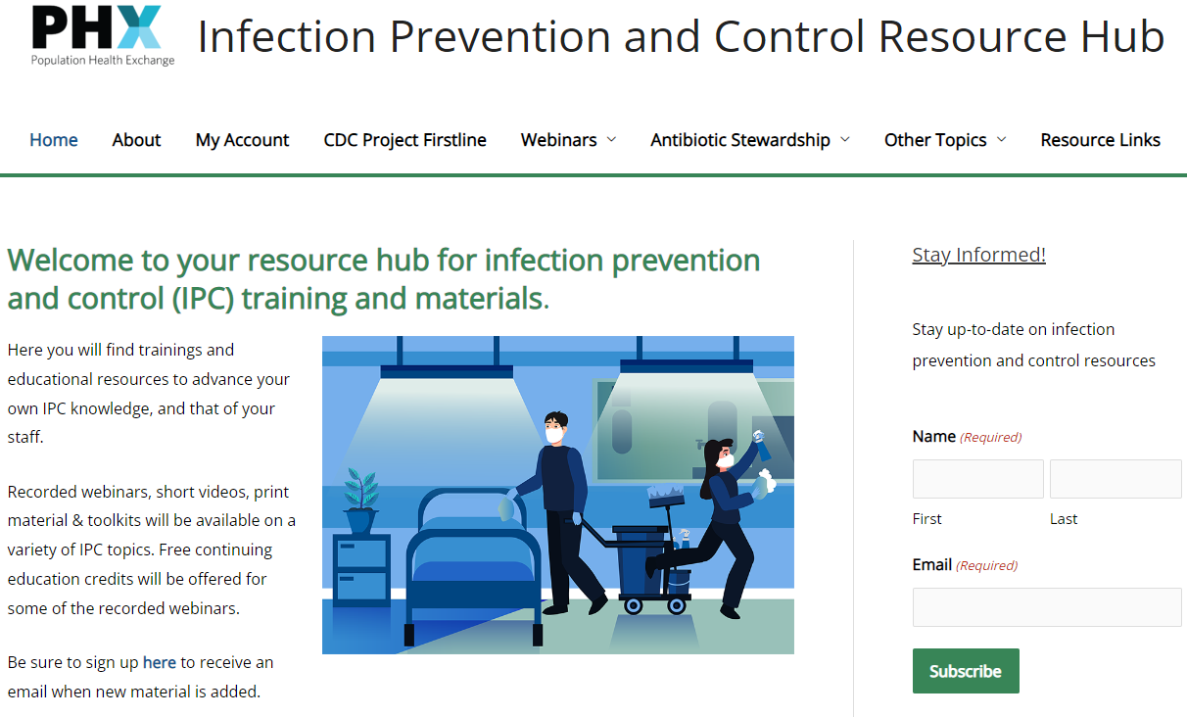
New Activities
Collaboration with Boston University Public Health Exchange (BU PHX) to promote infection prevention and control (IPC) training and education for all healthcare personnel (https://mainfectioncontrol.populationhealthexchange.org/)
Promote CDC’s Project Firstline: https://www.cdc.gov/infectioncontrol/projectfirstline/index.html
Provide additional IPC education and training
Cleaning and disinfection in healthcare settings
Ventilation tips and strategies
Developing resilience in challenging times
Water management including sinks and drains
Promote antimicrobial stewardship/combat antibiotic resistance
Developing data cleaning reports to share summary statistics with dialysis providers and non-acute hospitals on a quarterly basis before the end of 2022

Slide 30
U.S. Impact on Antibiotic Resistance: CDC 2022 Special Report
In July 2022, CDC released a new report finding that much of the progress made in the United States in previous years combating antimicrobial resistance (AR) was lost, in large part, due to the effects of the COVID-19 pandemic.
COVID-19: U.S. Impact on Antimicrobial Resistance, Special Report 2022, concludes that the threat of antimicrobial-resistant infections has worsened—with resistant hospital-onset infections and deaths both increasing at least 15% during the first year of the pandemic.

Slide 31
U.S. Impact on Antibiotic Resistance: CDC 2022 Special Report
Resistant hospital-onset infections and deaths both increased at least 15% during the first year of the pandemic. In a 2021 analysis, CDC also reported that, after years of steady reductions in healthcare-associated infections (HAIs), U.S. hospitals saw significantly higher rates for four out of six types of HAIs in 2020. Many of these HAIs are resistant to antibiotics or antifungals.
There were more and sicker patients during the pandemic who required more frequent and longer use of catheters and ventilators. This may have increased risk of HAIs and spread of pathogens, especially when combined with personal protective equipment and lab supply challenges, reduced staff, and longer lengths of stay.
Acute care hospitals also saw more Candida auris cases, including in COVID-19 units. C. auris has previously been a threat in post-acute care facilities (e.g., long-term care). The increased spread in hospitals could be a result of staffing and supply shortages and changes in infection prevention and control practices.

Slide 32
Antibiotic Resistance: Targeting Carbapenemase-producing Organisms (CPO) in MA
Carbapenems are a class of antibiotics often considered a “last resort” to treat infections caused by Enterobacterales, Pseudomonas and Acinetobacter
One way these organisms are resistant to carbapenems is by producing carbapenemases
A carbapanemase is an enzyme that can break down (and thus resist) many classes of antibiotics, including carbapenems, making infections with these organisms harder to treat
Genes that program the organism to produce a carbapenemase can be shared between bacteria
Carbapenemase gene targets: KPC, NDM, VIM, OXA and IMP
KPC
NDM
VIM
OXA
IMP

Slide 33
Antibiotic Resistance Surveillance:
Reporting and Laboratory Testing Methods
Electronic laboratory reporting (ELR) of mandatory MDROs of concern into the Massachusetts Virtual Epidemiologic Network (MAVEN)
Mandatory submission of selected MDRO isolates to the Massachusetts State Public Health Laboratory (MA SPHL) for advanced testing at MA SPHL and at our regional Antimicrobial Resistant Laboratory Network (ARLN), the Wadsworth Center in New York:
Identify novel resistance mechanisms such as genes that code for carbapenemase production or colistin resistance
Identify Candida auris
Test swabs to identify colonization with target organisms to detect transmission within a healthcare facility
Conduct whole-genome sequencing to determine relatedness of organisms to identify transmission pathways within and across healthcare facilities

Slide 34
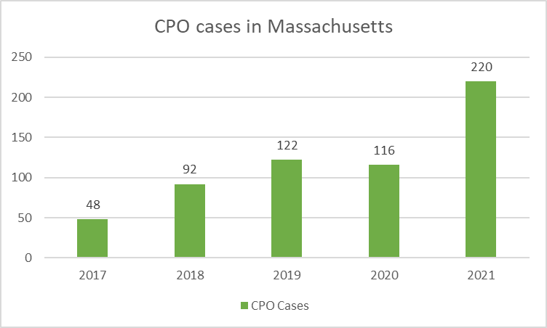
Antibiotic Resistance Surveillance: Increasing Candida auris and Carbapenemase-producing Organism (CPO) Cases in MA

Slide 35
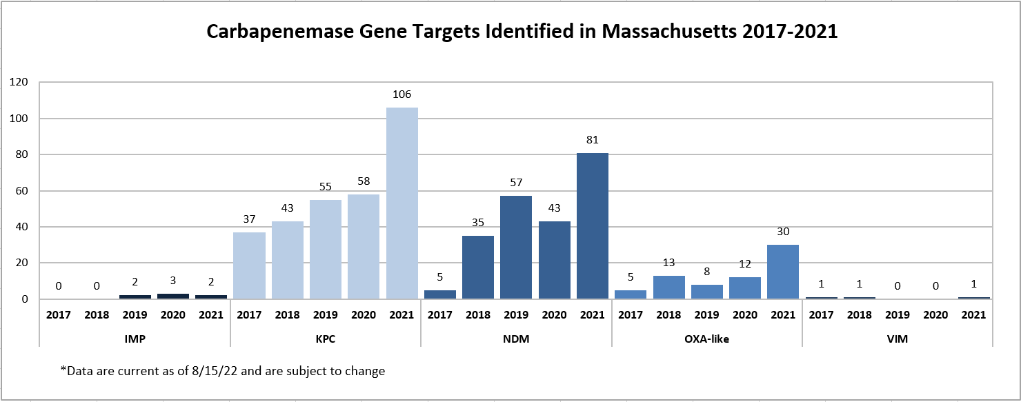
Antibiotic Resistance Surveillance: Carbapenemase-producing Organisms (CPOs) in MA

Slide 36
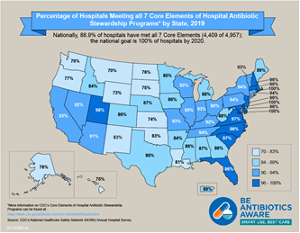
Antibiotic Stewardship
Studies indicate that between 30-50% of antibiotics prescribed in hospitals and between 40-75% of antibiotics prescribed in nursing homes are unnecessary*
Improved prescribing practices can help reduce rates of Clostridioides difficile and antibiotic resistance
Appropriate antibiotic prescribing can improve patient outcomes and reduce healthcare costs
https://www.cdc.gov/antibiotic-use/healthcare/
https://www.cdc.gov/longtermcare/prevention/antibiotic-stewardship.html

Slide 37
Antibiotic Stewardship: Prevention and Educational Activities
Collection, monitoring, and benchmarking of facility-level antibiotic use data in long-term care facilities (86 facilities reported at least one month of data in 2021, averaging of 46 participating facilities each month) with continued expansion of this program
Ongoing collaboration with antibiotic stewardship (AS) experts from Tufts Medical Center to enhance AS support and activities in our long-term care facilities including monthly office hours for long term care facilities (LTCF) and a new AS Honor Roll to highlight facilities with consistent participation: https://mainfectioncontrol.populationhealthexchange.org/ltcf-as/antibiotic-stewardship-honor-roll/
Collaboration with CDC and several mid-Atlantic states on a six-part webinar series (CEUs offered) covering prevention and control of MDROs, Enhanced Barrier Precautions, cleaning and disinfection, hand hygiene, and water management including sink hygiene. Several hundred MA healthcare providers have participated in this series.
Thirty-four acute care hospitals currently participate in the NHSN antibiotic use (AU) module to better understand trends in antibiotic use and to monitor stewardship activities- we continue to leverage this data and engage remaining acute care hospitals in reporting to have a comprehensive, statewide picture of antibiotic use in the acute care setting.

Slide 38
Thank you for the opportunity to present this information today.
Please direct any questions to:
Eileen McHale, RN, BSN
Healthcare Associated Infection Coordinator
Bureau of Health Care Safety and Quality
eileen.mchale@state.ma.us

