Slide 1
2022 Health Care Associated Infections:
Acute Care Hospitals
Non-Acute Care Hospitals
Dialysis
Christina Brandeburg, MPH, CIC, Senior HAI/AR Epidemiologist and Analytic Coordinator
Katherine T. Fillo, PhD, MPH, RN-BC, Deputy Bureau Director of Clinical & Health Care Systems Quality
Jessica Leaf, MPH, CIC, Senior HAI/AR Epidemiologist and MDRO Coordinator
Eileen McHale, RN, BSN, Healthcare Associated Infection Coordinator

Slide 2
Introduction
Healthcare-associated infections (HAIs) are infections that patients acquire during the course of receiving treatment for other conditions within a healthcare setting.
  HAIs are among the leading causes of preventable death in the United States, affecting 1 in 17 hospitalized patients, accounting for an estimated 1.7 million infections and an associated 98,000 deaths.*
The Massachusetts Department of Public Health (DPH) developed this data update as a component of the Statewide Infection Prevention and Control Program created pursuant to Chapter 58 of the Acts of 2006.
  Massachusetts law provides DPH with the legal authority to conduct surveillance, and to investigate and control the spread of communicable and infectious diseases. (MGL c. 111,sections 6 & 7)
  DPH implements this responsibility in hospitals through the hospital licensing regulation. (105 CMR 130.000)
  DPH implements this responsibility in dialysis centers through the out-of-hospital dialysis regulation (105 CMR 145.000)
  Section 51H of chapter 111 of the Massachusetts General Laws authorizes the Department to collect HAI data and disseminate the information publicly to encourage quality improvement. (https://malegislature.gov/Laws/GeneralLaws/PartI/TitleXVI/Chapter111/Section51H)
Haque M, Sartelli M, McKimm J, Abu Bakar M. Healthcare-associated Infections - an Overview. Infect Drug Resist. 2018;11:2321–2333.

Slide 3
Purpose
This HAI presentation is the 14th annual Public Health Council update:
An important component of larger efforts to reduce preventable infections in healthcare settings
Presents an analysis of progress in infection prevention within Massachusetts' healthcare facilities
Provides an overview of infection prevention and control, antibiotic resistance and stewardship activities
Considers the impact of COVID-19 in Massachusetts healthcare settings
Based upon work supported by funding from both the state and the Centers for Disease Control and Prevention (CDC)

Slide 4
Methods
The acute care hospital data summary includes the following statewide measures for the 2022 calendar year (January 1, 2022– December 31, 2022) as reported to the CDC’s National Healthcare Safety Network (NHSN).
DPH-required measures are consistent with the Centers for Medicare and Medicaid Services (CMS) quality reporting measures.
Central line-associated bloodstream infections (CLABSI) in intensive care units and wards
Catheter-associated urinary tract infections (CAUTI) in intensive care units and wards
Specific surgical site infections (SSI)
Specific facility-wide laboratory identified events (LabID)
National baseline data for each measure are based on a statistical risk model derived from 2015 national data
^ All data were extracted from NHSN on August 1, 2023

Slide 5
Measures
Standardized Infection Ratio (SIR)
Actual Number of Infections
Standardized Infection Ratio (SIR) =
Predicted Number of Infections
Standard Utilization Ratio (SUR)
Standard Utilization Ratio=
Number of Device Days
Predicted Number of Device Days
If the SIR/SUR > 1.0, more infections/device days were reported than predicted
If the SIR/SUR = 1.0, the number of infections/number of device days is equal to the predicted number
If the SIR/SUR < 1.0, fewer infections/device days were reported than predicted

Slide 6
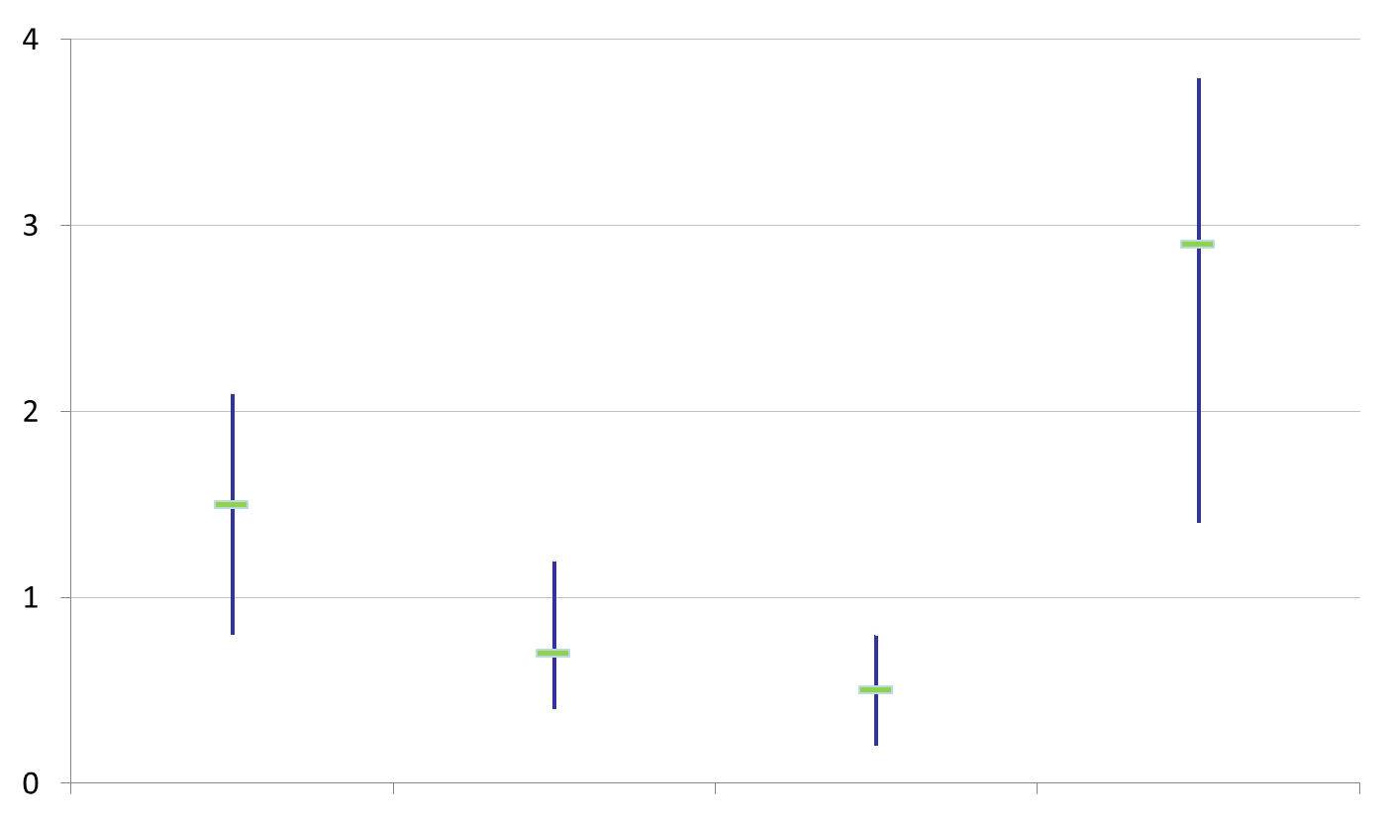
How to Interpret SIRs/SURs and 95% Confidence Intervals (CIs)
Significantly higher than predicted
SIR/SUR
Not significantly different than predicted
Significantly lower than predicted
The green horizontal bar represents the SIR/SUR, and the blue vertical bar represents the 95% confidence interval (CI). The 95% CI measures the probability that the true SIR/SUR falls between the two parameters.
If the blue vertical bar crosses 1.0 (highlighted in orange), then the actual rate is not statistically significantly different from the predicted rate.
If the blue vertical bar is completely above or below 1.0, then the actual is statistically significantly different from the predicted rate.

Slide 7
Central Line-Associated Bloodstream Infections (CLABSI):
Standard Infection Ratio in Adult and Pediatric ICUs and Wards
ICU
Ward
⬇
⬇
⬇
⬇
T= Major teaching hospital
NT=Not major teaching hospital
SIR Upper and Lower Limit
Key Findings
Four unit types experienced a significantly lower number of infections than predicted, based on 2015 national aggregate data.
There were no unit types that experienced a significantly higher number of infections than predicted, based on 2015 national aggregate data.
7

Slide 8
Central Line-Associated Bloodstream Infections (CLABSI):
Standard Utilization Ratio in Adult and Pediatric ICUs and Wards
ICU
Ward
⬆
⬆
⬆
⬇
⬇
⬆
⬆
⬇
⬇
⬆
⬆
⬇
⬇
⬇
⬇
⬇
⬆
⬇
T= Major teaching hospital
NT=Not major teaching hospital
SUR Upper and Lower Limit
Key Findings
Ten unit types experienced a significantly lower number of device days than predicted, based on 2015 national aggregate data.
Eight unit types experienced a significantly higher number of device days than predicted, based on 2015 national aggregate data.

Slide 9
CLABSI Adult and Pediatric Pathogens for 2021 and 2022
ICU Pathogens
N=240
N=198
N=123
N=179
Ward Pathogens

Slide 10
State CLABSI SIR and SUR in ICU and Wards
Key Findings
In 2022, adult ICUs and wards experienced a significantly lower number of infections than predicted, based on 2015 national aggregate data.
In 2022, adult ICUs, pediatric ICUs, and pediatric Wards experienced a significantly higher number of device days than predicted, based on 2015 national aggregate data.
ICU
Ward
10

Slide 11
Central Line-Associated Bloodstream Infections (CLABSI):
Neonatal ICUs by Birth Weight Category
⬇
⬇
⬇
⬇
⬆
SIR Upper and Lower Limit
SUR Upper and Lower Limit
Key Findings
There were 17 CLABSIs reported in Neonatal ICUs in 2022.
There were no birthweight categories experiencing a significantly higher or lower number of infections than predicted, based on 2015
national aggregate data.
Four birthweight categories experienced a significantly lower number of device days than predicted, based on 2015 national aggregate data.

Slide 12
CLABSI NICU Pathogens for 2021 and 2022
Calendar Year 2021
January 1, 2021 – December 31, 2021
N=19
Calendar Year 2022
January 1, 2022 – December 31, 2022
N=17
12

Slide 13
Catheter-Associated Urinary Tract Infections (CAUTI):
Standard Infection Ratio in Adult and Pediatric ICUs and Wards
ICU
Ward
⬇
⬇
⬇
⬇
⬆
T= Major teaching hospital
NT=Not major teaching hospital
SIR Upper and Lower Limit
Key Findings
Four unit types experienced a significantly lower number of infections than predicted, based on 2015 national aggregate data.
One unit type experienced a significantly higher number of infections than predicted, based on 2015 national aggregate data.
13
13

Slide 14
Catheter-Associated Urinary Tract Infections (CAUTI):
Standard Utilization Ratio in Adult and Pediatric ICUs and Wards
ICU
Ward
⬆
⬆
⬆
⬇
⬇
⬇
⬇
⬇
⬆
⬆
⬆
⬆
⬇
⬇
⬇
⬇
⬇
T= Major teaching hospital
NT=Not major teaching hospital
SUR Upper and Lower Limit
Key Findings
Ten unit types experienced a significantly lower number of device days than predicted, based on 2015 national aggregate data.
Seven unit types experienced a significantly higher number of device days than predicted, based on 2015 national aggregate data.
14
14
14

Slide 15
CAUTI Adult and Pediatric Pathogens for 2021 and 2022
ICU Pathogens
N=276
N=200
N=230
N=269
Ward Pathogens

Slide 16
State CAUTI SIR and SUR in ICU and Wards
Key Findings
In 2022, adult ICUs experienced a significantly lower number of infections and adult Wards experience a significantly higher number of infections than predicted, based on 2015 national aggregate data.
In 2022, pediatric ICUs experienced a significantly higher number of device days than predicted, based on 2015 national aggregate data.
ICU
Ward
16

Slide 17
Surgical Site Infections (SSI)
Coronary Artery Bypass Graft (CABG) SIR and Colon Procedure (COLO) SIR
Key Findings
In 2022, MA acute care hospitals performing coronary artery bypass graft (CABG) and colon (COLO) surgeries experienced the same number of infections as predicted, based on 2015 national aggregate data.
There were 40 CABG SSIs reported in 2022.
There were 195 COLO SSIs reported in 2022.
SIR Upper and Lower Limit

Slide 18
Surgical Site Infections (SSI)
Knee Prosthesis (KPRO) SIR and Hip Prosthesis (HPRO) SIR
Key Findings
In 2022, MA acute care hospitals performing knee (KPRO) and hip (HPRO) prosthesis procedures experienced the same number of infections as predicted, based on 2015 national aggregate data.
There were 45 KPRO SSIs reported in 2022, with one facility accounting for over 20% of the reported events.
There were 65 HPRO SSIs reported in 2022.
SIR Upper and Lower Limit
18

Slide 19
Surgical Site Infections (SSI)
Abdominal Hysterectomy (HYST) SIR and Vaginal Hysterectomy (VHYS) SIR
Key Findings
In 2022, MA acute care hospitals performing abdominal hysterectomy (HYST) procedures experienced a significantly lower number of infections than predicted, based on 2015 national aggregate data.
There were 14 HYST SSIs reported in 2022.
There was 1 VHYS SSI reported in 2022.
SIR Upper and Lower Limit
19

Slide 20
SSI Pathogens for 2021-2022
CABG, KPRO, HPRO, HYST, VHYS, COLO
Calendar Year 2021
January 1, 2021 – December 31, 2021
N=388
Calendar Year 2022
January 1, 2022 – December 31, 2022
N=360
20
20

Slide 21
Statewide SSI Trends by Year
2015-2022
CABG
KPRO
HPRO
Statistically Higher
than Predicted
Statistically Same
as Predicted
Statistically Lower
than Predicted
HYST
VHYS
COLO
Statistically Higher
than Predicted
Statistically Same
as Predicted
Statistically Lower
than Predicted
21
21
21

Slide 22
Laboratory Identified Events (LabID)
Clostridioides difficile (CDI) SIR and Methicillin-resistant Staphylococcus aureus (MRSA) SIR
Key Findings
For the past six years, MA hospitals reporting CDI and MRSA events experienced significantly lower number of infections than predicted, based on 2015 national aggregate data.
There were 1,423 CDI events reported in 2022.
There were 177 MRSA events reported in 2022.
SIR Upper and Lower Limit
22
22
22
22

Slide 23
Statewide LabID Trends by Year
2015-2022
Statistically Higher
than Predicted
Statistically
Same
as Predicted
Statistically Lower
than Predicted
CDI
MRSA
23
23
23

Slide 24
Non-Acute Care Hospitals
State CLABSI and CAUTI SIR and SUR
Key Findings
In 2022, Long-Term Acute Care (LTAC) Hospital ICUs and Wards experienced a significantly lower number of central line days than predicted, based on 2015 national aggregate data.
In 2022, Long-Term Acute Care Hospital ICUs experienced a significantly higher number of catheter-associated infections and Inpatient Rehab Facilities (IRFs) experienced a significantly higher number of catheter days than predicted, based on 2015 national
aggregate data.
CLABSI
CAUTI
Data were extracted from NHSN on August 1, 2023
24
24
24
24

Slide 25
Non-Acute Care Hospitals
Clostridioides difficile (CDI) SIR and Methicillin-resistant Staphylococcus aureus (MRSA) SIR
Key Findings
For the past four years, MA non-acute care hospitals reporting CDI and MRSA events experienced significantly lower number of infections than predicted, based on 2015 national aggregate data.
There were 128 CDI events reported in 2022.
There were 10 MRSA events reported in 2022.
Data were extracted from NHSN on August 1, 2023
SIR Upper and Lower Limit
25
25
25
25
25

Slide 26
Dialysis Bloodstream Infections (BSI):
Standard Infection Ratio by Year and Access Type
Key Findings
For the past three years, all access types of access for hemodialysis (central venous catheters (CVC), arteriovenous fistulas and arteriovenous grafts, experienced a significantly lower number of infections than predicted, based on 2014 national aggregate data.
Data were extracted from NHSN on May 24, 2023
26
26
26
26
26
26

Slide 27
Dialysis Antibiotic Start Rates by Year and Access Type
2017-2022
Key Findings
Antibiotic and vancomycin start rates are highest in those with any kind of central venous catheter.
All Antibiotics
Vancomycin
Data were extracted from NHSN on May 24, 2023
27
27
27
27
27
27

Slide 28
DPH HAI Prevention and Response Activities
Comprehensive proactive and responsive on-site Infection Control Assessment and Response (ICAR) visits are conducted at a variety of healthcare facilities. During these visits, an epidemiologist and public health nurse:
  Discuss facility infection prevention and control policies and practices;
  Observe hand hygiene, PPE use, environmental cleaning and disinfection, wound care, point of care blood glucose testing, vaccine storage, and provide feedback and coaching to the facility staff;
  A comprehensive report is provided to facility leadership with resources and recommendations for improvement.
Conducted webinars for nursing home staff on topics such as:
  Enhanced barrier precautions to protect at-risk residents
  Invasive group A streptococcus due to an increase in cases and clusters
Promote CDC’s National Training Collaborative, Project Firstline, and develop MA-specific infection control training content and learning programs for frontline healthcare workers.
Conducted three in-person simulation trainings for dialysis nurses, technicians and infection preventionists on CDC's dialysis evidence-based best practice recommendations.
  Program content and materials shared with multiple state health departments to promote dialysis training nationwide.
NEW Developed and distributed quarterly dialysis and non-acute hospital data cleaning reports sharing summary statistics using data submitted to NHSN.

Slide 29
Antibiotic Resistance:
Targeting Carbapenemase-producing Organisms (CPO) in MA
Carbapenems are a class of antibiotics often considered a “last resort” to treat infections caused by Enterobacterales, Pseudomonas, and Acinetobacter
One way these organisms are resistant to carbapenems is by
producing carbapenemases
A carbapenemase is an enzyme that can break down (and thus resist)
many classes of antibiotics, including carbapenems, making infections
with these organisms harder to treat
Genes that program the organism to produce a carbapenemase
can be shared between bacteria
Carbapenemase gene targets: KPC, NDM, VIM, OXA and IMP
CDC’s July 2022 COVID-19: U.S. Impact on Antimicrobial Resistance, Special Report,
concluded that the threat of antimicrobial-resistant infections worsened—with resistant
hospital-onset infections and deaths both increasing at least 15% during the first year of
the COVID-19 pandemic.
KPC
NDM
VIM
OXA
IMP

Slide 30
Antibiotic Resistance Surveillance:
Reporting and Laboratory Testing Methods
Electronic laboratory reporting (ELR) of multidrug-resistant organisms (MDROs) of concern into the Massachusetts Virtual Epidemiologic Network (MAVEN) is mandatory for clinical laboratories
Mandatory submission of selected MDRO isolates to the Massachusetts State Public Health Laboratory (MA SPHL) for advanced testing at MA SPHL and at our regional Antimicrobial Resistant Laboratory Network (ARLN), the Wadsworth Center in New York:
  Identify novel resistance mechanisms such as genes that code for carbapenemase production or
  colistin resistance
  Identify Candida auris
  Test swabs to identify colonization with target organisms to detect transmission within a healthcare facility
  Conduct whole-genome sequencing to determine relatedness of organisms to identify transmission pathways within and across healthcare facilities

Slide 31
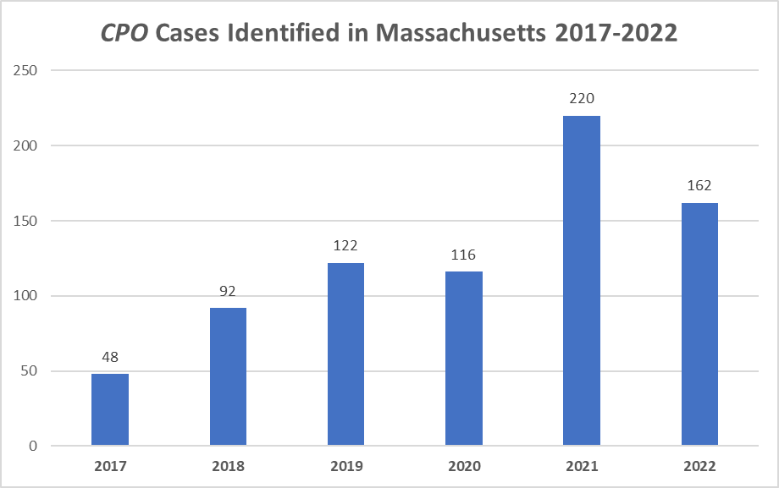
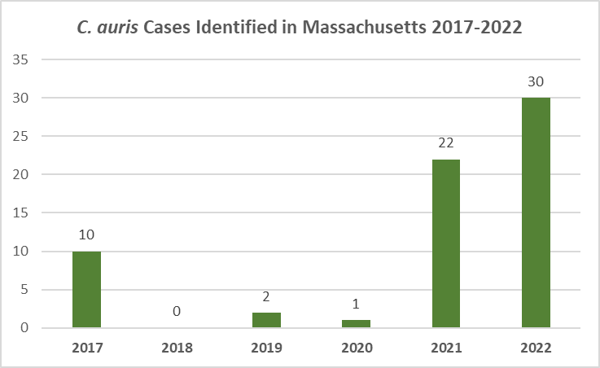
Antibiotic Resistance Surveillance: Increasing Candida auris and Carbapenemase-producing Organism (CPO) Cases in MA

Slide 32
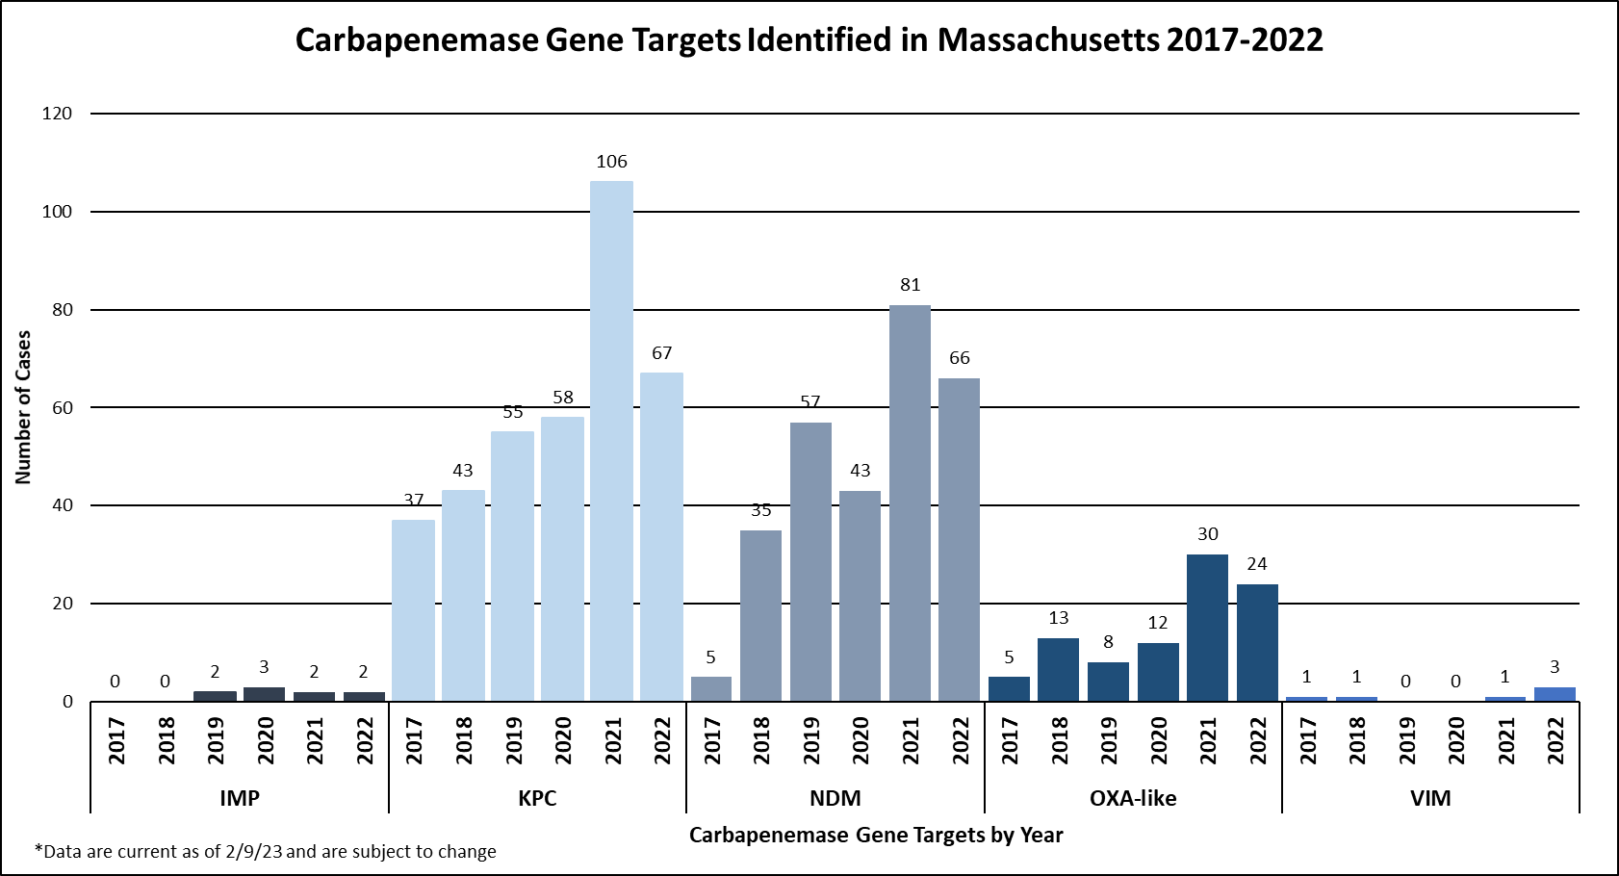
Antibiotic Resistance Surveillance:
Carbapenemase-producing Organisms (CPOs) in MA

Slide 33
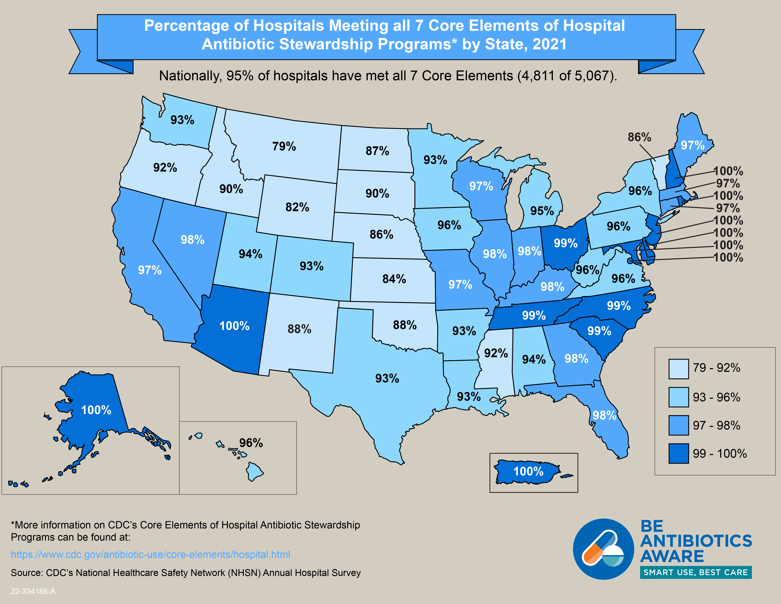
Antibiotic Stewardship
Studies indicate that between 30-50% of
antibiotics prescribed in hospitals and
between 40-75% of antibiotics prescribed
in nursing homes are unnecessary*
Improved prescribing practices can help
reduce rates of Clostridioides difficile and
antibiotic resistance
Appropriate antibiotic prescribing can
improve patient outcomes and reduce
healthcare costs
https://www.cdc.gov/antibiotic-use/healthcare/
https://www.cdc.gov/longtermcare/prevention/antibiotic-stewardship.html

Slide 34
Antibiotic Stewardship: Prevention and Educational Activities
This year, DPH is host health department to one of four IDSA/SHEA Leadership in Epidemiology, Antimicrobial Stewardship, and Public Health Fellows.
  In addition to collaborating with the health department, Dr. Kap Sum Foong of Tufts Medical Center will pilot a program to remove unnecessary antibiotic allergy labels in long term care facilities.
Continued collection and analysis of facility-level antibiotic use data voluntarily submitted by long-term care facilities.
  76 facilities reported at least one month of data in 2022, on average 43 facilities reported each month.
  Updated AS Honor Roll highlighting facilities with consistent participation: https://mainfectioncontrol.populationhealthexchange.org/ltcf-as/antibiotic-stewardship-honor-roll/
Ongoing collaboration with antibiotic stewardship (AS) experts from Tufts Medical Center to enhance AS support and activities in long-term care facilities, including monthly office hours.
Re-established the Antimicrobial Use (AU) Subcommittee of the statewide HAI/AR Technical Advisory Group to provide guidance on how to best leverage NHSN AU module data for understanding trends in antibiotic use, monitoring stewardship activities, and obtaining a comprehensive, statewide picture of antibiotic use in the acute care setting.
  Currently, DPH has access to NHSN AU data for 34 acute care hospitals.
  Hospitals participating in the CMS Promoting Interoperability (PI) Program must begin reporting AUR Surveillance data in calendar year 2024.

Slide 35
Eileen McHale, RN, BSN
Healthcare Associated Infection Coordinator
Bureau of Health Care Safety and Quality
eileen.mchale@state.ma.us

