Slide 1
Health Care Associated Infections
Calendar Year 2023:
Acute Care Hospitals
Non-Acute Care Hospitals
Dialysis Centers
Christina Brandeburg, MPH, CIC, Senior HAI/AR Epidemiologist and Analytic Coordinator
Katherine T. Fillo, PhD, MPH, RN-BC, Director of Health Care Strategy & Planning
Jessica Leaf, MPH, CIC, Senior HAI/AR Epidemiologist and MDRO Coordinator
Eileen McHale, RN, BSN, Healthcare Associated Infection Coordinator

Slide 2
Introduction
Healthcare-associated infections (HAIs) are infections that patients acquire during the course of receiving treatment for other conditions within a healthcare setting.
HAIs are among the leading causes of preventable death in the United States, affecting 1 in 17 hospitalized patients, accounting for an estimated 1.7 million infections and an associated 98,000 deaths.*
The Massachusetts Department of Public Health (DPH) developed this data update as a component of the Statewide Infection Prevention and Control Program created pursuant to Chapter 58 of the Acts of 2006.
Massachusetts law provides DPH with the legal authority to conduct surveillance, and to investigate and control the spread of communicable and infectious diseases. (MGL c. 111,sections 6 & 7)
DPH implements this responsibility in hospitals through the hospital licensing regulation. (105 CMR 130.000)
DPH implements this responsibility in dialysis centers through the out-of-hospital dialysis regulation. (105 CMR 145.000)
Section 51H of chapter 111 of the Massachusetts General Laws authorizes the Department to collect HAI data and disseminate the information publicly to encourage quality improvement. (https://malegislature.gov/Laws/GeneralLaws/PartI/TitleXVI/Chapter111/Section51H)
Haque M, Sartelli M, McKimm J, Abu Bakar M. Healthcare-associated Infections - an Overview. Infect Drug Resist. 2018;11:2321–2333.

Slide 3
Methods
The healthcare data summary includes the following statewide measures for the 2023 calendar year (January 1, 2023– December 31, 2023) as reported to the CDC’s National Healthcare Safety Network (NHSN).
DPH required measures are consistent with the Centers for Medicare and Medicaid Services (CMS) quality reporting measures.
National baseline data for each measure are based on a statistical risk model derived from national data
^ All data were extracted from NHSN on August 21, 2024
Acute Care Hospitals (ACH) | Non-acute Care Hospitals | Dialysis Facilities
Central line-associated bloodstream infections (CLABSI) in intensive care units and wards Catheter-associated urinary tract infections (CAUTI) in intensive care units and wards Specific surgical site infections (SSI) Specific facility-wide laboratory identified events (LabID) | Central line-associated bloodstream infections (CLABSI) in intensive care units and wards Catheter-associated urinary tract infections (CAUTI) in intensive care units and wards Specific facility-wide laboratory identified events (LabID) | Positive blood cultures IV antimicrobial starts Pus, redness or increased swelling at vascular access site

Slide 4
Measures
Standardized Infection Ratio (SIR)
Actual Number of Infections
Standardized Infection Ratio (SIR) =
Predicted Number of Infections
Standard Utilization Ratio (SUR)
Standard Utilization Ratio (SUR) =
Number of Device Days
Predicted Number of Device Days
If the SIR/SUR > 1.0, more infections/device days were reported than predicted
If the SIR/SUR = 1.0, the number of infections/number of device days is equal to the predicted number
If the SIR/SUR < 1.0, fewer infections/device days were reported than predicted

Slide 5
How to Interpret SIRs/SURs and 95% Confidence Intervals (CIs)
Significantly higher than predicted
SIR/SUR
Not significantly different than predicted
Significantly lower than predicted
The green horizontal bar represents the SIR/SUR, and the blue vertical bar represents the 95% confidence interval (CI). The 95% CI measures the probability that the true SIR/SUR falls between the two parameters.
If the blue vertical bar crosses 1.0 (highlighted in orange), then the actual rate is not statistically significantly different from the predicted rate.
If the blue vertical bar is completely above or below 1.0, then the actual is statistically significantly different from the predicted rate.

Slide 6
2023 Central Line-Associated Bloodstream Infections (CLABSI): Standard Infection Ratio in Adult and Pediatric ICUs and Wards
ICU
Ward
⬇
⬇
⬇
⬇
⬇
T= Major teaching hospital
NT=Not major teaching hospital
SIR Upper and Lower Limit
2023 Key Findings
Five unit types experienced a significantly lower number of infections than predicted, based on 2015 national aggregate data.
There were no unit types that experienced a significantly higher number of infections than predicted, based on 2015 national aggregate data.
6

Slide 7
2023 Central Line: Standard Utilization Ratio in Adult and Pediatric ICUs and Wards
ICU
Ward
⬆
⬆
⬆
⬇
⬇
⬇
⬇
⬇
⬇
⬇
⬆
⬇
⬇
⬇
⬇
⬇
⬆
⬇
T= Major teaching hospital
NT=Not major teaching hospital
SUR Upper and Lower Limit
2023 Key Findings
Thirteen unit types experienced a significantly lower number of device days than predicted, based on 2015 national aggregate data.
Five unit types experienced a significantly higher number of device days than predicted, based on 2015 national aggregate data.

Slide 8
CLABSI Acute Care Hospital Adult and Pediatric Pathogens for 2022 and 2023
ICU Pathogens
N=198
N=168
N=180
N=170
Ward Pathogens

Slide 9
2023 Central Line-Associated Bloodstream Infections (CLABSI): Neonatal ICUs by Birth Weight Category
⬇
⬇
⬇
⬇
⬆
SIR Upper and Lower Limit
SUR Upper and Lower Limit
2023 Key Findings
There were 12 CLABSIs reported in Neonatal ICUs.
There were no birthweight categories experiencing a significantly higher or lower number of infections than predicted, based on 2015
national aggregate data.
Four birthweight categories experienced a significantly lower number of device days than predicted, based on 2015 national aggregate data.

Slide 10
CLABSI NICU Pathogens for 2022 and 2023
Calendar Year 2022
January 1, 2022 – December 31, 2022
N=17
Calendar Year 2023
January 1, 2023 – December 31, 2023
N=12
10

Slide 11
2023 Catheter-Associated Urinary Tract Infections (CAUTI): Standard Infection Ratio in Adult and Pediatric ICUs and Wards
ICU
Ward
⬇
⬇
⬇
⬇
⬇
⬇
⬇
T= Major teaching hospital
NT=Not major teaching hospital
SIR Upper and Lower Limit
2023 Key Findings
Eight unit types experienced a significantly lower number of infections than predicted, based on 2015 national aggregate data.
There were no unit types that experienced a significantly higher number of infections than predicted, based on 2015 national aggregate data.
11
11

Slide 12
2023 Catheter: Standard Utilization Ratio in Adult and Pediatric ICUs and Wards
ICU
Ward
⬆
⬆
⬇
⬇
⬇
⬇
⬇
⬇
⬇
⬇
⬇
⬆
⬇
⬇
⬇
⬇
⬆
⬇
T= Major teaching hospital
NT=Not major teaching hospital
SUR Upper and Lower Limit
2023 Key Findings
Fourteen unit types experienced a significantly lower number of device days than predicted, based on 2015 national aggregate data.
Four unit types experienced a significantly higher number of device days than predicted, based on 2015 national aggregate data.
12
12
12

Slide 13
CAUTI Acute Care Hospital Adult and Pediatric Pathogens for 2022 and 2023
ICU Pathogens
N=200
N=149
N=269
N=220
Ward Pathogens

Slide 14
Acute Care Hospital Surgical Site Infections (SSI) Coronary Artery Bypass Graft (CABG) SIR and Colon Procedure (COLO) SIR
Key Findings
In 2023, MA acute care hospitals performing coronary artery bypass graft (CABG) surgeries experienced a significantly higher number of infections than predicted, based on 2015 national aggregate data.
There were 43 CABG SSIs reported in 2023.
There were 201 COLO SSIs reported in 2023.
SIR Upper and Lower Limit

Slide 15
Acute Care Hospital Surgical Site Infections (SSI) Knee Prosthesis (KPRO) SIR and Hip Prosthesis (HPRO) SIR
Key Findings
In 2023, MA acute care hospitals performing knee (KPRO) prosthesis procedures experienced a significantly higher number of infections than predicted, based on 2015 national aggregate data.
There were 53 KPRO SSIs reported in 2023.
There were 79 HPRO SSIs reported in 2023.
SIR Upper and Lower Limit
15

Slide 16
Acute Care Hospital Surgical Site Infections (SSI) Abdominal Hysterectomy (HYST) SIR and Vaginal Hysterectomy (VHYS) SIR
Key Findings
In 2023, MA acute care hospitals performing vaginal hysterectomy (VHYS) procedures experienced a significantly higher number of infections than predicted, based on 2015 national aggregate data.
There were 32 HYST SSIs reported in 2023.
There was 7 VHYS SSI reported in 2023.
SIR Upper and Lower Limit
16

Slide 17
Acute Care Hospital SSI Pathogens for 2022-2023 CABG, KPRO, HPRO, HYST, VHYS, COLO
Calendar Year 2022
January 1, 2022 – December 31, 2022
N=360
Calendar Year 2023
January 1, 2023 – December 31, 2023
N=415
17
17

Slide 18
Acute Care Hospital Laboratory Identified Events (LabID) Clostridioides difficile (CDI) SIR and Methicillin-resistant Staphylococcus aureus (MRSA) SIR
Key Findings
For the past seven years, MA hospitals reporting CDI and MRSA events experienced significantly lower number of infections than predicted, based on 2015 national aggregate data.
There were 1,251 CDI events reported in 2023.
There were 192 MRSA events reported in 2023.
SIR Upper and Lower Limit
18
18
18
18

Slide 19
Long-Term Acute Care Hospitals (LTAC) and Inpatient Rehabilitation Facilities (IRF) 2023 Central Line-Associated Bloodstream Infections (CLABSI) and Catheter-Associated Urinary Tract Infections (CAUTI): Standard Infection Ratio (SIR)
Key Findings
In 2023, LTACs experienced a significantly lower number of catheter-associated urinary tract infections (CAUTI) than predicted, based on 2015 national aggregate data.
SIR Upper and Lower Limit
19
19
19
19

Slide 20
Long-Term Acute Care Hospitals (LTAC) and Inpatient Rehabilitation Facilities (IRF) 2023 Central Line and Catheter: Standard Utilization Ratio (SUR)
Key Findings
In 2023, LTACs and IRFs experienced a significantly lower number of central line days than predicted, based on 2015 national aggregate data.
In 2023, LTACs experienced a significantly lower number of urinary catheter days and IRFs experienced a significantly higher number of urinary catheter days than predicted, based on 2015 national aggregate data.
SUR Upper and Lower Limit

Slide 21
Long-Term Acute Care Hospitals (LTAC) and Inpatient Rehabilitation Facilities (IRF) 2023 Clostridioides difficile (CDI) SIR and Methicillin-resistant Staphylococcus aureus (MRSA) SIR
Key Findings
In 2023, LTACs and IRFs experienced a significantly lower number of CDI infections than predicted, based on 2015 national aggregate data.
In 2023, LTACs experienced a significantly lower number of MRSA infections than predicted, based on 2015 national aggregate data.
SIR Upper and Lower Limit
21
21
21
21

Slide 22
Dialysis Center Bloodstream Infections (BSI): Standard Infection Ratio by Access Type
Key Findings
For the past four years, all hemodialysis access types (central venous catheters (CVC), arteriovenous fistulas and arteriovenous grafts) experienced a significantly lower number of infections than predicted, based on 2014 national aggregate data.
SIR Upper and Lower Limit

Slide 23
Dialysis Antimicrobial Start Rates by Year and Access Type 2017-2023
Key Findings
Antimicrobial and vancomycin start rates are highest in those with any kind of central venous catheter.
All Antimicrobial
Vancomycin
23
23
23
23
23
23

Slide 24
DPH HAI Prevention and Response Activities
Comprehensive proactive and responsive on-site Infection Control Assessment and Response (ICAR) visits are conducted at a variety of healthcare facilities. During these visits, an epidemiologist and public health nurse:
Discuss facility infection prevention and control (IPC) policies and practices.
Observe hand hygiene, PPE use, environmental cleaning and disinfection, wound care, point of care, blood glucose testing, and vaccine storage, and provide feedback and coaching to the facility staff.
Provide a comprehensive report to facility leadership with resources and recommendations for improvement.
Glo Germ kits are distributed for teaching hand hygiene and environmental cleaning and disinfection.
NEW IPC priority checklist for facility leadership and a staff IPC Bingo Card were developed and co-branded by CDC.
Conducted webinars for nursing home staff on topics such as:
IPC in Wound Care: A Guide for the Clinician ○ IPC in Skilled Nursing Facilities
Enhanced Barrier Precautions for Skilled Nursing Facilities ○ Respiratory Viral Illness

Slide 25
DPH HAI Prevention and Response Activities (Cont.)
Promote CDC’s National Training Collaborative, Project Firstline, and develop MA-specific infection control training content and learning programs for frontline healthcare workers.
Conducted three in-person simulation trainings for dialysis nurses, technicians and infection preventionists on CDC's dialysis evidence-based best practice recommendations.
Program content and materials shared with multiple state health departments to promote dialysis training nationwide.
NEW Developed public-facing interactive maps for dialysis and non-acute hospital HAI data.

Slide 26
Antibiotic Resistance: Targeting Carbapenemase-producing Organisms (CPO) in MA
Carbapenems are a class of antibiotics often considered a “last resort” to treat infections caused by Enterobacterales, Pseudomonas, and Acinetobacter
One way these organisms are resistant to carbapenems is by producing carbapenemases
A carbapenemase is an enzyme that can break down (and thus resist) many classes of antibiotics, including carbapenems, making infections with these organisms harder to treat
Genes that program the organism to produce a carbapenemase can be shared between bacteria
Carbapenemase gene targets: KPC, NDM, VIM, OXA and IMP
KPC
NDM
VIM
OXA
IMP

Slide 27
Antibiotic Resistance Surveillance: Reporting and Laboratory Testing Methods
Electronic laboratory reporting (ELR) of multidrug-resistant organisms (MDROs) of concern into the Massachusetts Virtual Epidemiologic Network (MAVEN) is mandatory for clinical laboratories
Mandatory submission of selected MDRO isolates to the Massachusetts State Public Health Laboratory (MA SPHL) for advanced testing at MA SPHL and at our regional Antimicrobial Resistant Laboratory Network (ARLN), the Wadsworth Center in New York:
Identify novel resistance mechanisms such as genes that code for carbapenemase production or colistin resistance
Identify Candida auris
Test swabs to identify colonization with target organisms to detect transmission within a healthcare facility
Conduct whole-genome sequencing to determine relatedness of organisms to identify transmission pathways within and across healthcare facilities

Slide 28
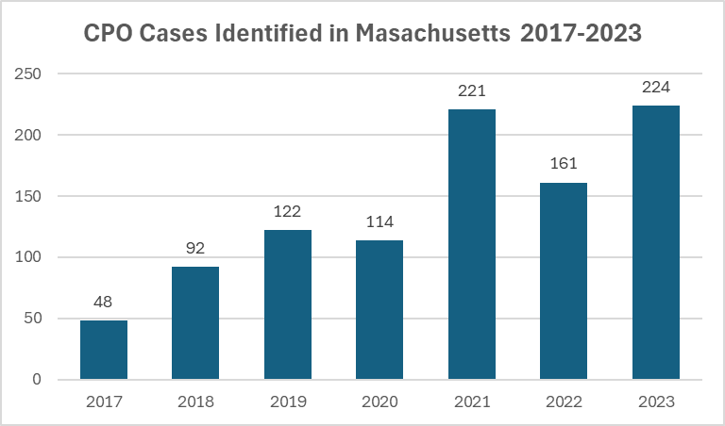
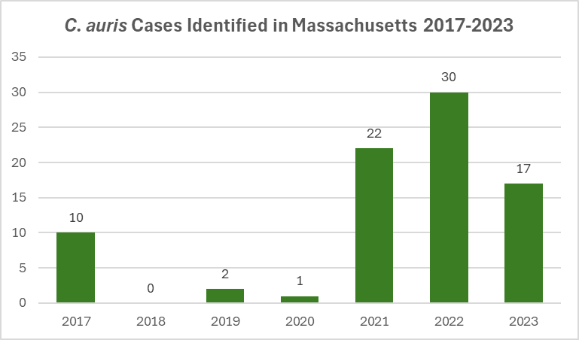
Antibiotic Resistance Surveillance: Candida auris and Carbapenemase-producing Organism (CPO) Cases in MA
*Data are current as of 8/15/24 and are subject to change

Slide 29
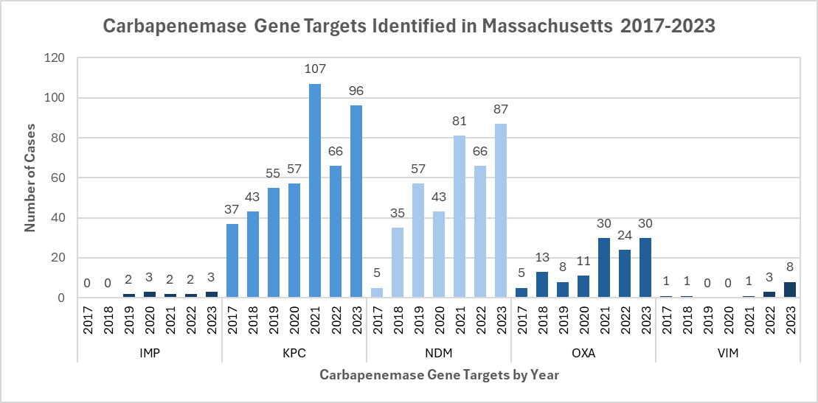
Antibiotic Resistance Surveillance: Carbapenemase-producing Organisms (CPOs) in MA
*Data are current as of 8/15/24 and are subject to change

Slide 30
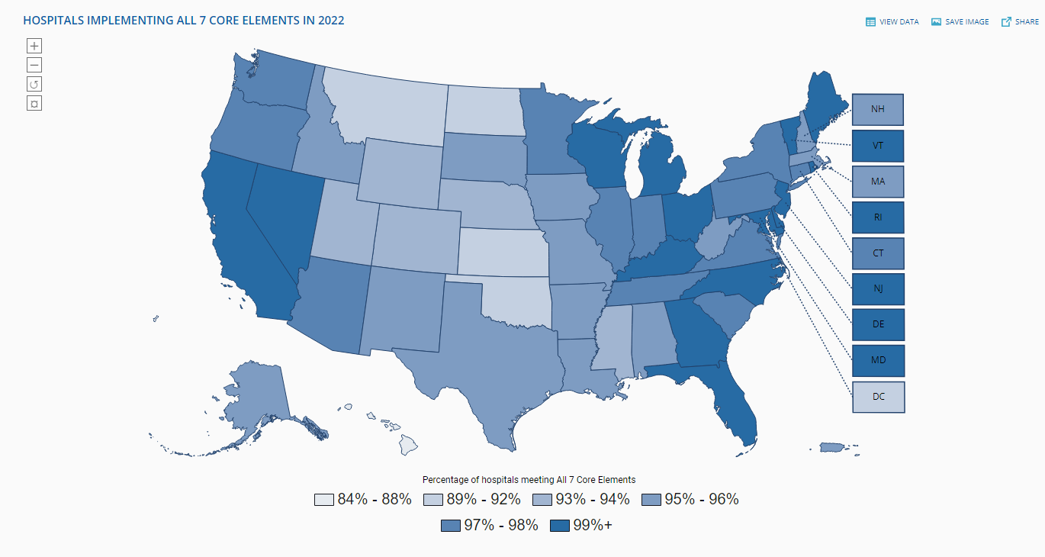
Antibiotic Stewardship
Studies indicate that about 30% of all antibiotics prescribed in hospitals and between 40-75% of antibiotics prescribed in nursing homes are unnecessary*
Improved prescribing practices can help reduce rates of Clostridioides difficile and antibiotic resistance
Appropriate antibiotic prescribing can improve patient outcomes and reduce healthcare costs
*Core Elements of Hospital Antibiotic Stewardship Programs | Antibiotic Prescribing and Use | CDC
Core Elements of Antibiotic Stewardship for Nursing Homes | Antibiotic Prescribing and Use | CDC
Hospital Antibiotic Stewardship | A.R. & Patient Safety Portal (cdc.gov)

Slide 31
Antibiotic Stewardship: Prevention and Educational Activities
From July 2023-June 2024, DPH was a host health department to one of four IDSA/SHEA Leadership in Epidemiology, Antimicrobial Stewardship, and Public Health Fellows.
In addition to collaborating with the health department, Dr. Kap Sum Foong of Tufts Medical Center piloted a program to remove unnecessary antibiotic allergy labels in long term care facilities.
Continued collection and analysis of facility-level antibiotic use data voluntarily submitted by long-term care facilities.
86 facilities reported at least one month of data in 2023, on average 59 facilities reported each month.
Updated AS Honor Roll highlighting facilities with consistent participation: https://infectioncontrolma.org/antibiotic-stewardship-long-term-care-honor-roll.php

Slide 32
Antibiotic Stewardship: Prevention and Educational Activities Continued
Ongoing collaboration with antibiotic stewardship (AS) experts from Tufts Medical Center to enhance AS support and activities in long-term care facilities, including monthly office hours.
Re-established the Antimicrobial Use (AU) Subcommittee of the statewide HAI/AR Technical Advisory Group to provide guidance on how to best leverage NHSN AU module data for understanding trends in antibiotic use, monitoring stewardship activities, and obtaining a comprehensive, statewide picture of antibiotic use in the acute care setting.
Currently, DPH has access to NHSN AU data for 47 acute care hospitals.
Hospitals participating in the CMS Promoting Interoperability (PI) Program must begin reporting AUR Surveillance data in calendar year 2024.

Slide 33
Eileen McHale, RN, BSN
Healthcare Associated Infection Coordinator
Office of Health Care Strategy & Planning
eileen.mchale@state.ma.us

