Slide 1
Harnessing Your Potential: Introduction to Guide Dog Travel
Presented by Allyson Bull, M.Ed., COMS, TVI
April 25, 2025

Slide 2
What is Orientation & Mobility (O&M)?
A specialized field of instruction for individuals who are blind or have low vision
Focuses on teaching safe, efficient, and independent travel skills
MCB offers community-based O&M services
Common tools include the white cane and GPS mobile apps
O&M training is a prerequisite for obtaining a guide dog

Slide 3
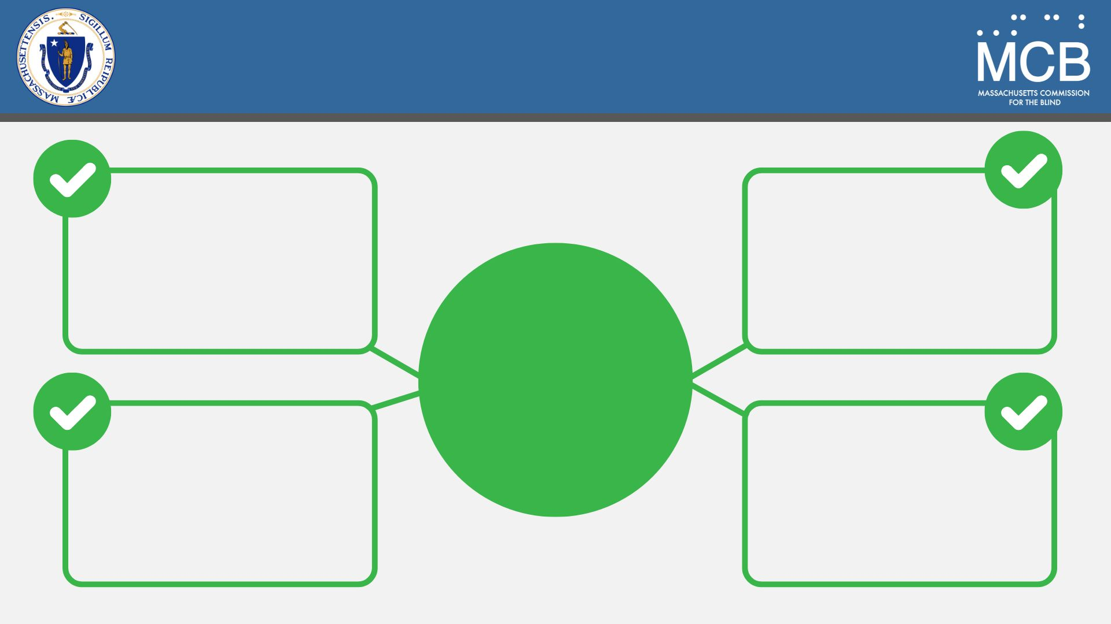
Our Role in the Application Process
Background information on application requirements
Resources on different guide dog schools
How our O&M Specialists can help you prepare
References to support your guide dog application
O&M services to get you ready

Slide 4
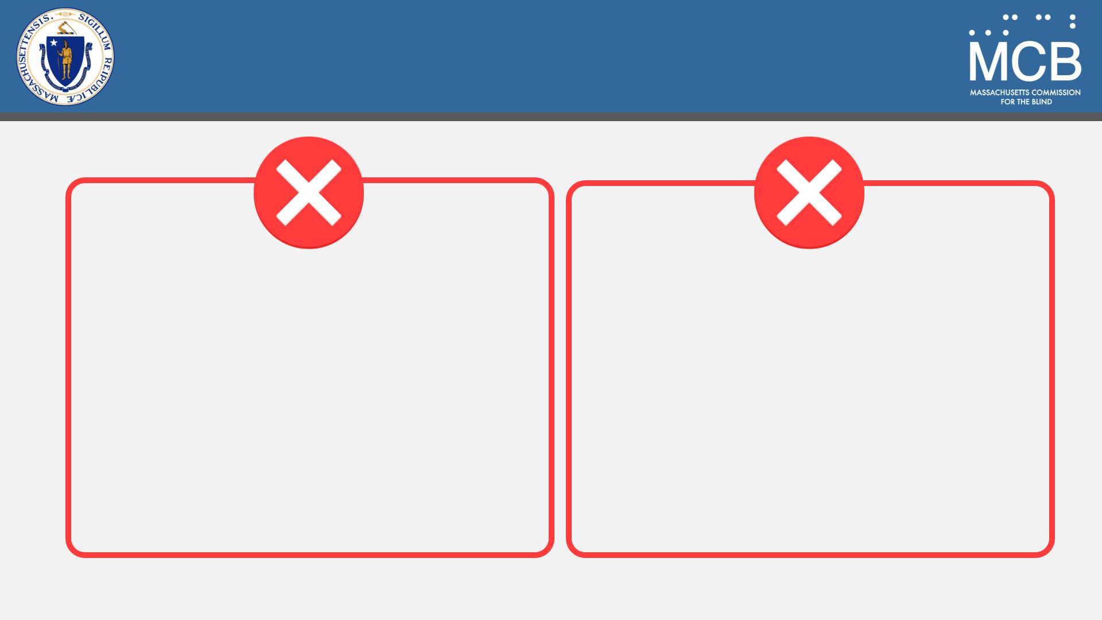
Our Role in the Application Process (2)
MCB staff do not determine guide dog program acceptance
MCB does not provide guide dogs

Slide 5
Our Role After Receiving a Guide Dog
Many individuals benefit from follow-up O&M services after bringing their new guide dog home
Contact your MCB counselor to request a referral to connect with an O&M Specialist
What an O&M Specialist can provide:
Route training tailored to your new dog
Environmental familiarization with your dog

Slide 6
White Cane vs. Guide Dog
A white cane provides direct contact with the environment
Relies on tactile clues, such as landmarks, surface changes, and obstacle detection
A guide dog avoids obstacles before contact occurs
Guide dogs are trained in intelligent disobedience to keep handlers safe

