Slide 1


Medicaid for Violence Prevention
Kyle Fischer, MD, MPH
Policy Director
October 25, 2024

Slide 2
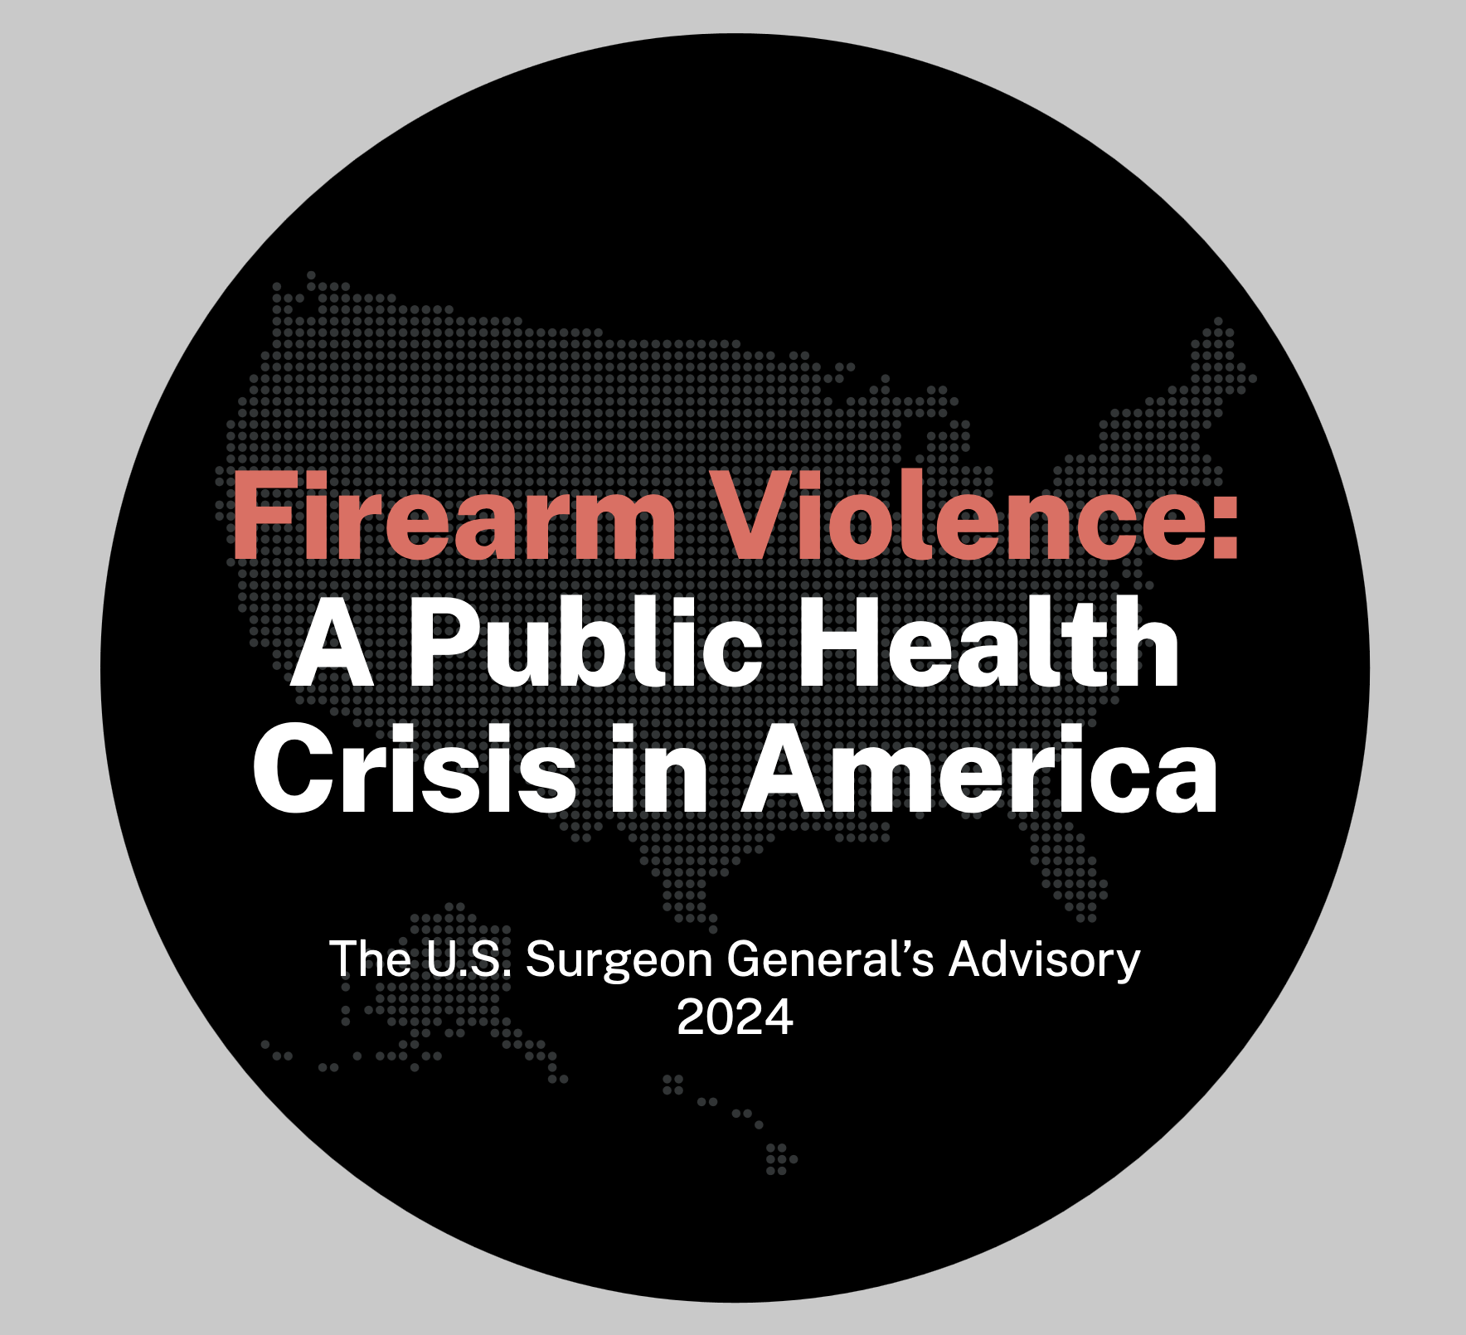
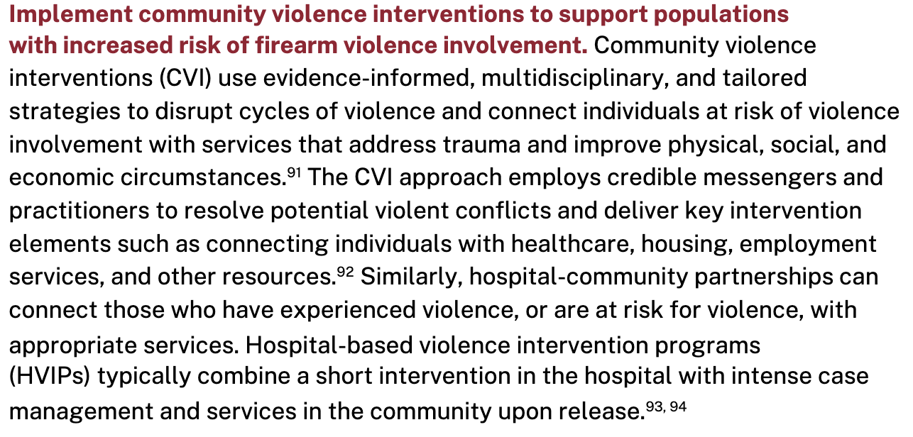
Firearm Violence: A Public Health Crisis

Slide 3
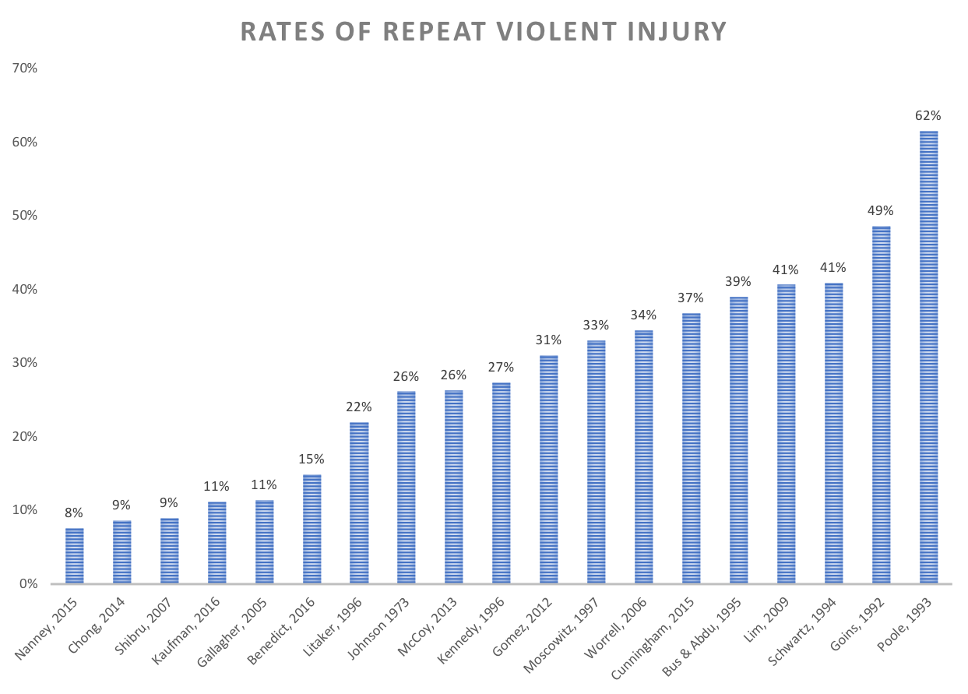
Rates of reinjury have wide variations, but estimates around 30-40%
DATA ADAPTED FROM GREENE, 2016

Slide 4
Survivors of community violence face significant physical, psychological, and social consequences.

Slide 5
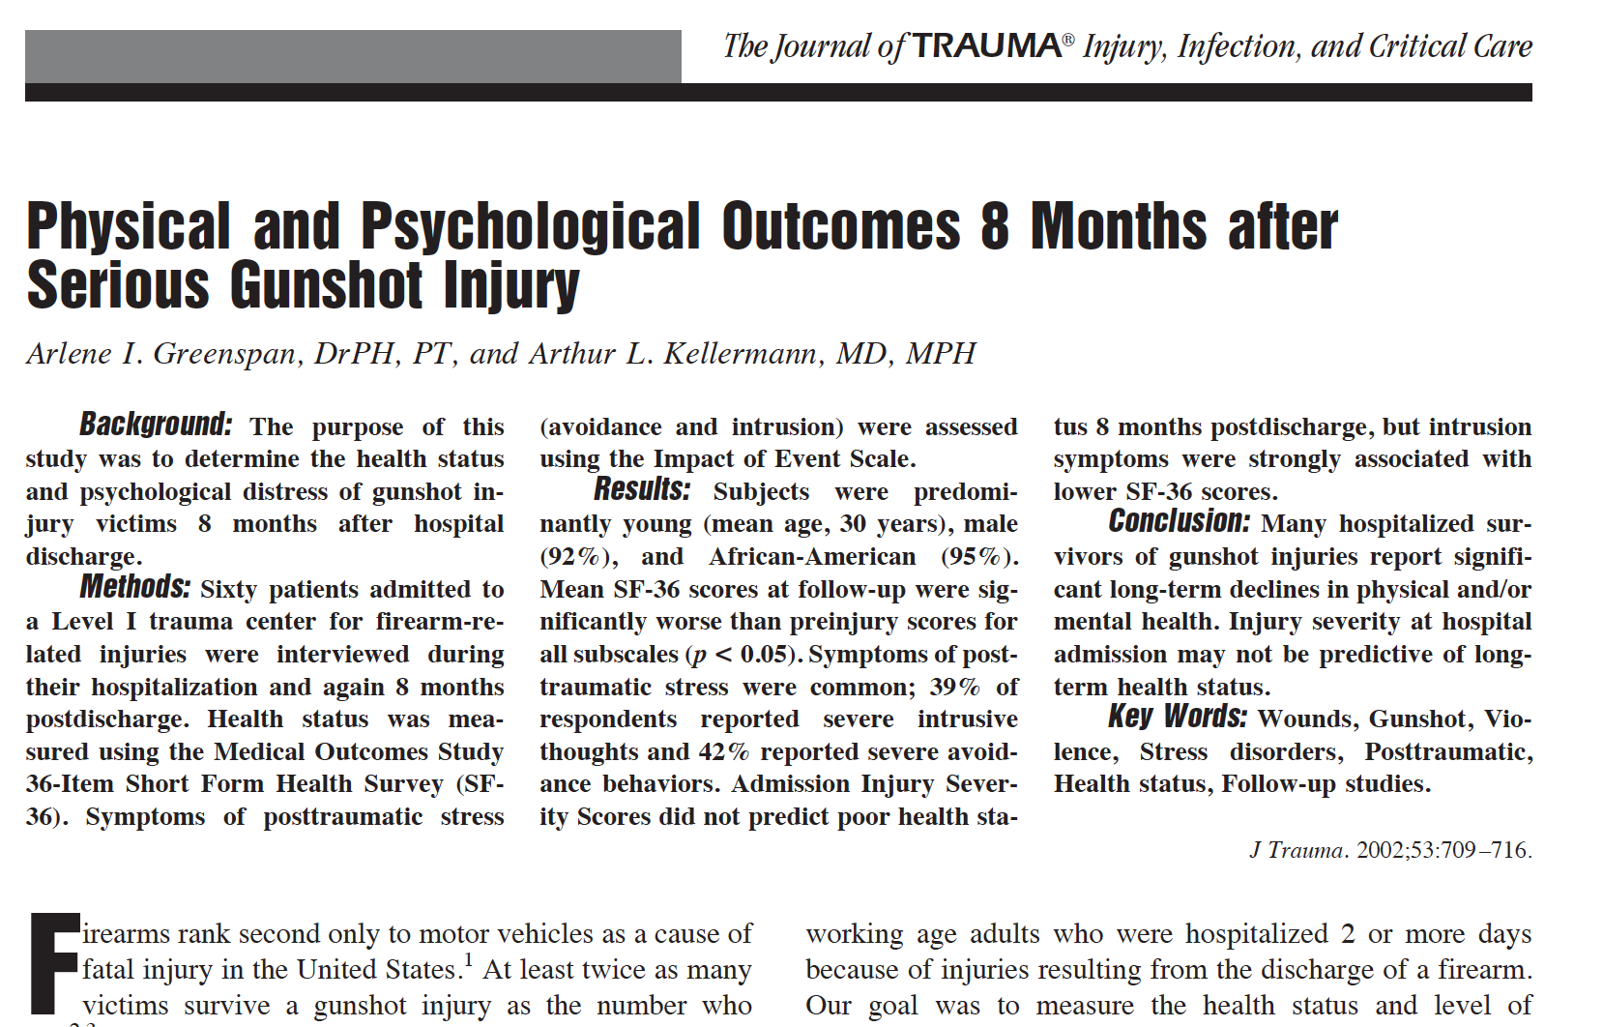

Slide 6
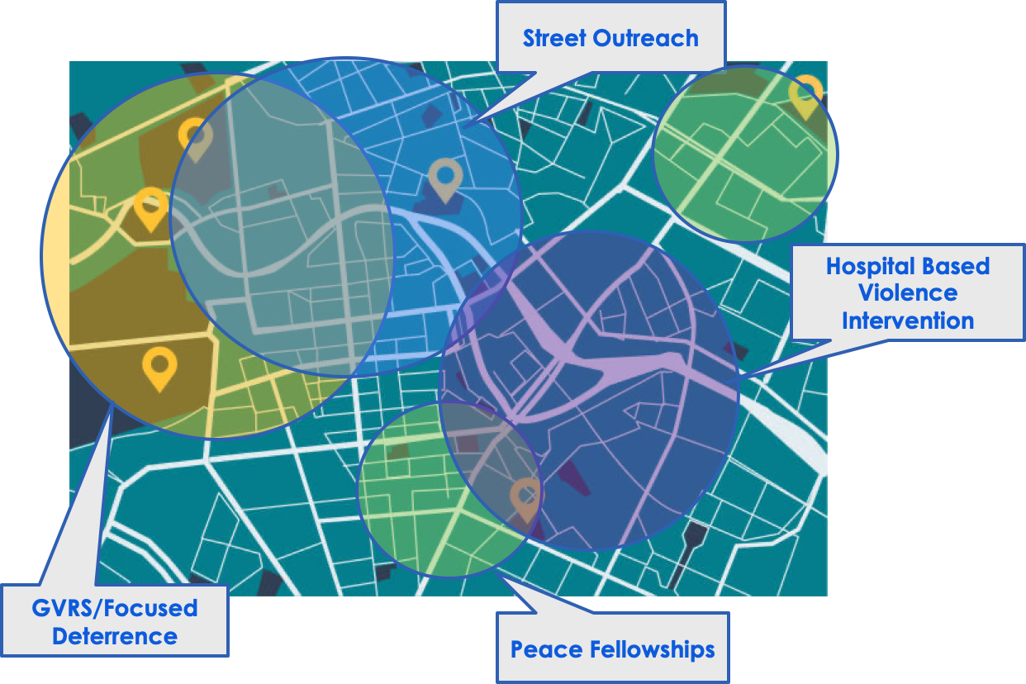
Several evidence-based program models exist

Slide 7
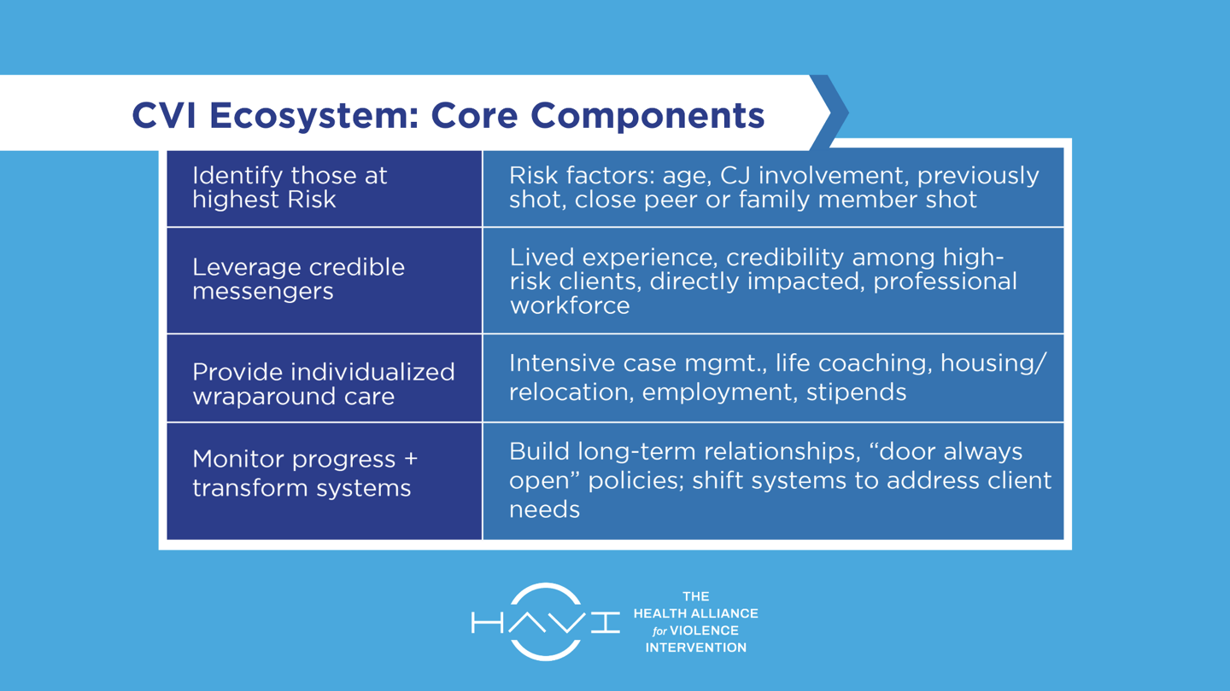

Slide 8
Community Violence Intervention (CVI) Programs
Deliver Significant Health Equity Impacts
Targeted engagement with patients disconnected and skeptical of traditional health institutions
Deliver trauma-informed care and mental health services in mental health and trauma deserts
Addresses the leading cause of death for young Black and Brown men

Slide 9
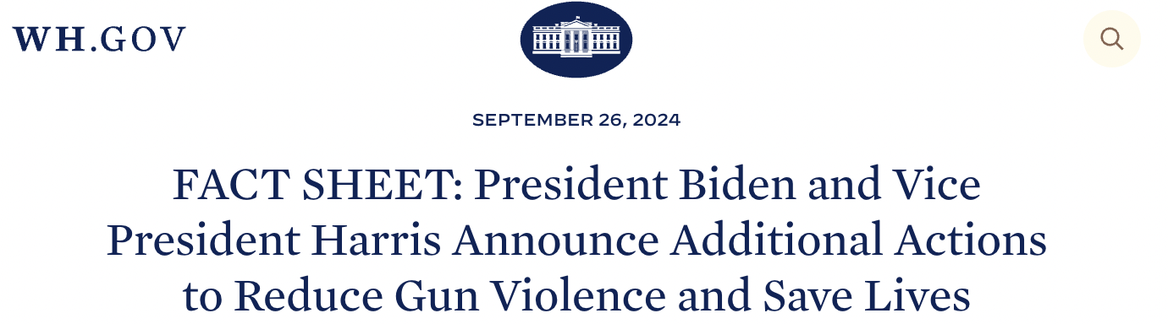
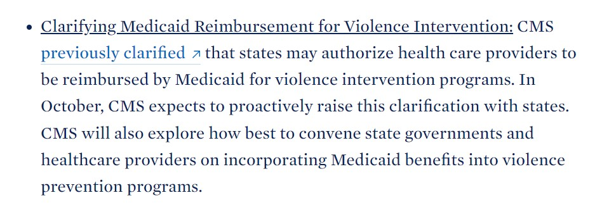
Medicaid and CVI
2021: The Centers for Medicare and Medicaid Services (CMS) announced that Medicaid could be used to reimburse CVI programs. The agency then provided various pathways for states to take advantage of this benefit.
September 2024: The Biden-Harris Administration announces new Executive Order to reduce gun violence and save lives.
As of October 2024:
Eight states—Connecticut, Illinois, California, Oregon, Colorado, Maryland, North Carolina, and New York—have chosen to use Medicaid to support CVI programming.
CMS held a meeting on 10/23/24 to discuss how the Biden-Harris Administration’s recently announced executive actions impact violence intervention programs.

Slide 10
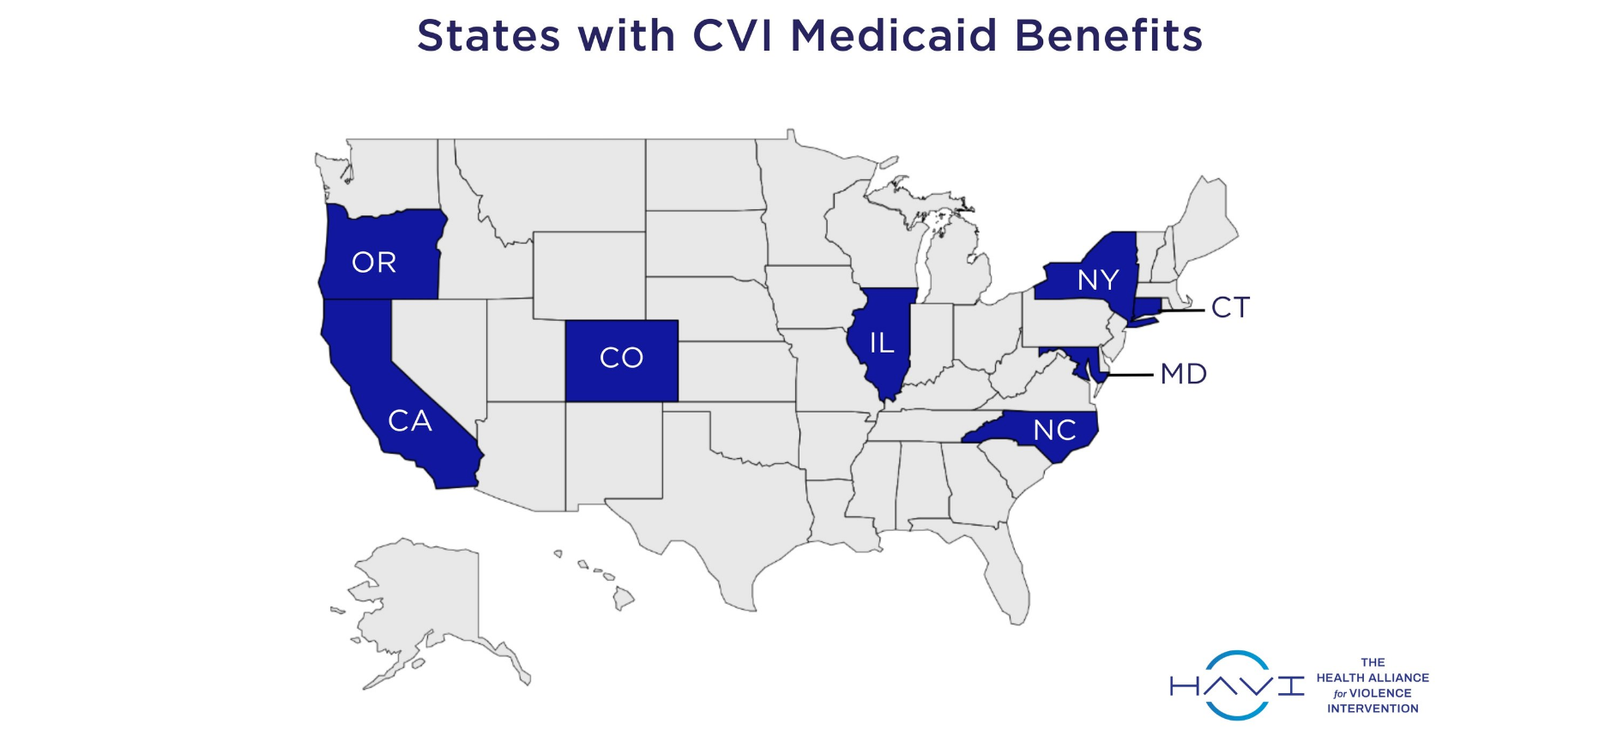

Slide 11
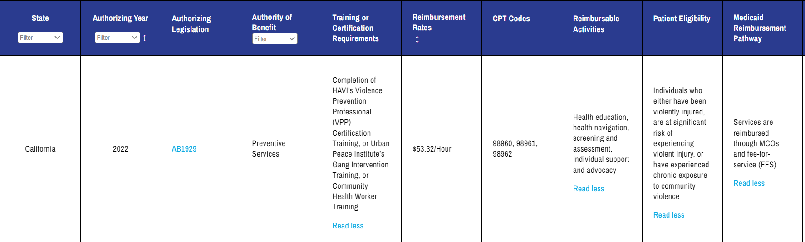
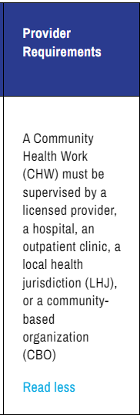
Medicaid Benefit Example: California

Slide 12
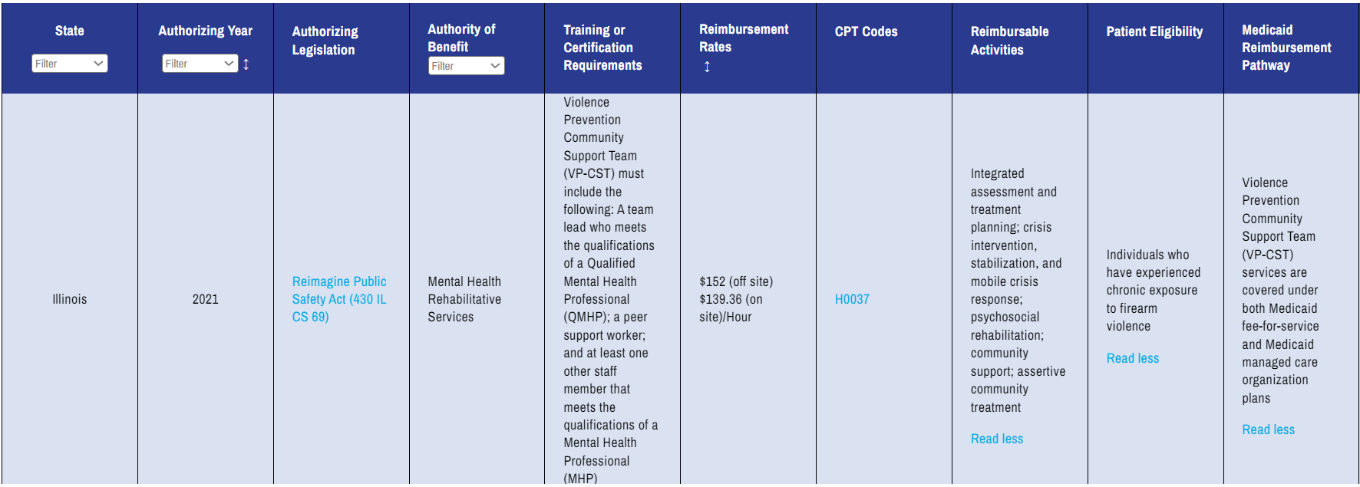
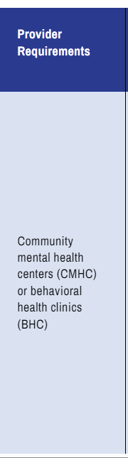
Medicaid Benefit Example: Illinois

Slide 13
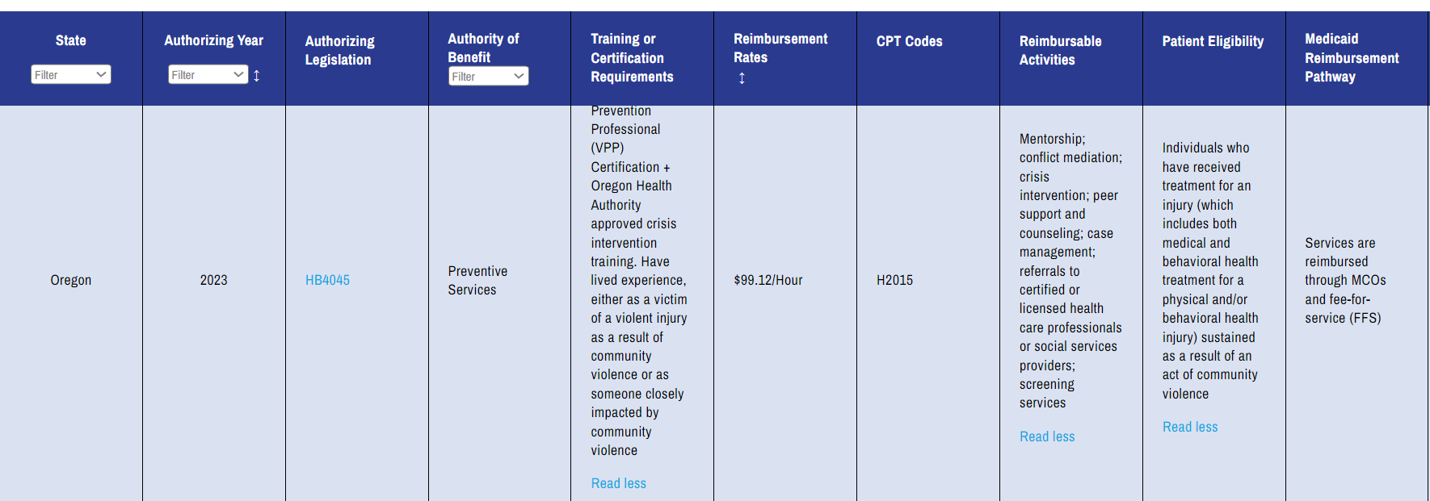
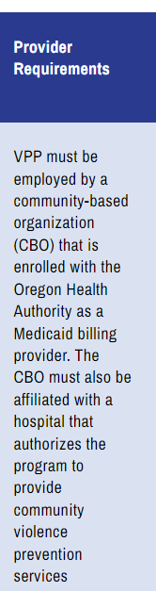
Medicaid Benefit Example: Oregon

Slide 14
Current State of States
Strengths
Stakeholder Engagement: States like Connecticut and Oregon had strong stakeholder involvement during the program's launch or benefit design process, which helped shape the programs.
Technical Assistance: Oregon included a technical assistance fund to support program billing preparations and offset startup costs.
Program Enrollment Progress: Some states, such as California and Oregon, have programs actively working towards or preparing for Medicaid billing.
Innovative Approaches: California set up a CBO hub for Medicaid enrollment, and Illinois used a team-based model through community mental health centers.
Challenges
Low Reimbursement Rates: A common issue across several states (e.g., California, Connecticut, New York) is that reimbursement rates are below the cost of providing services. To date, states have not received substantial reimbursement from Medicaid.
Complex Requirements: Illinois imposed significant mental health requirements, creating barriers for programs.
Limited Eligibility Criteria: Connecticut restricted billing eligibility to hospital-affiliated programs, which excluded some community-based organizations.
Lack of Communication and Coordination: In New York, poor communication between the state health department and local departments has hindered program enrollment.

Slide 15
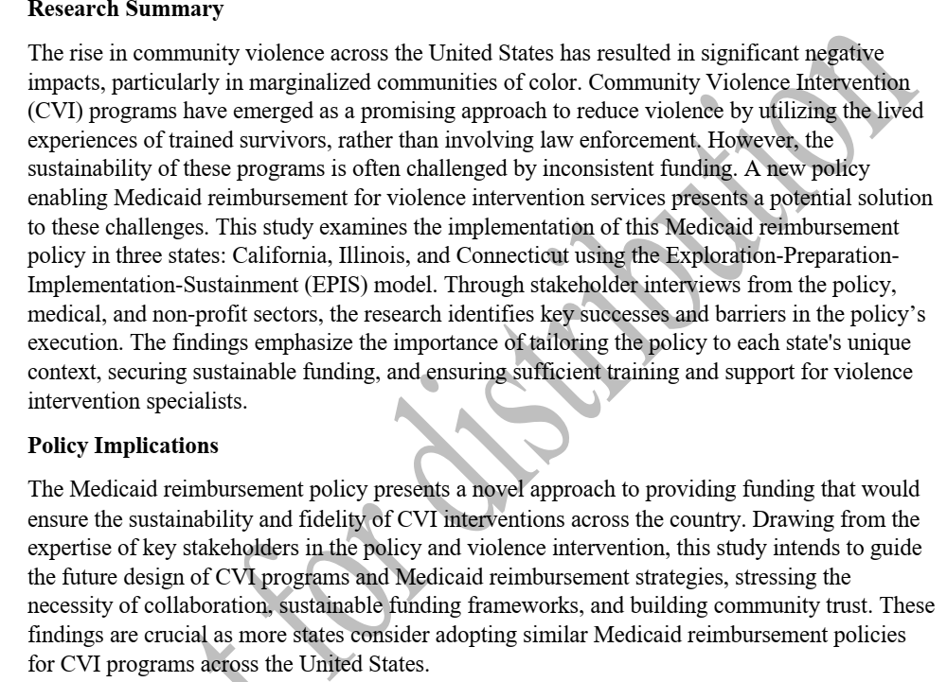
Case Study Implementation Findings

Slide 16
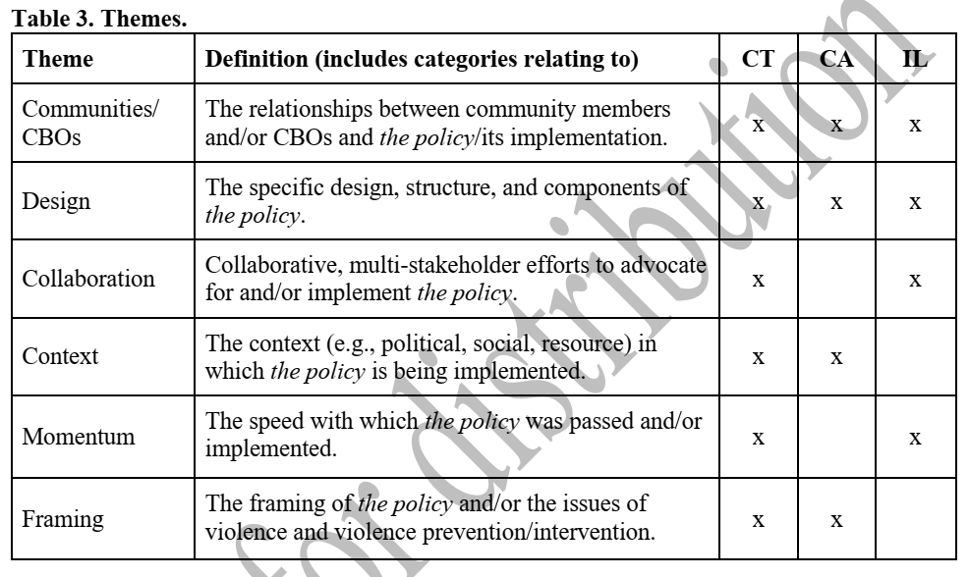
Case Study Implementation Findings

Slide 17
Key Takeaways for Implementation
Involve stakeholders during the benefit design process
Create a technical assistance fund to help programs develop their capacity for billing
Ensure that reimbursement rates are adequate

Slide 18
Thank you!
Questions? KyleF@TheHAVI.org

