Slide 1
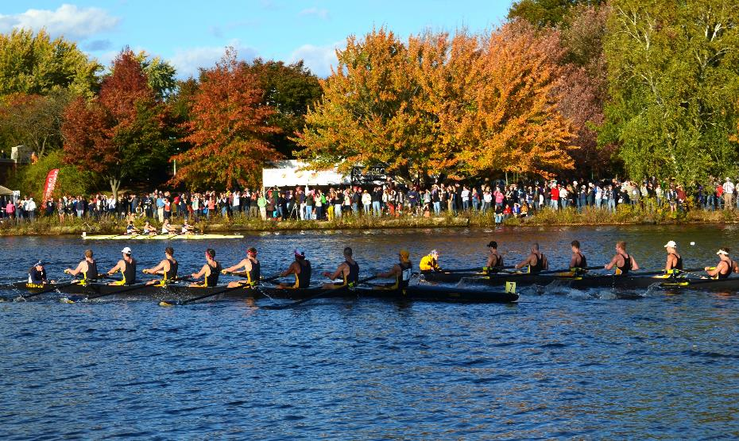




Introduction to Project
Head of the
Charles Regatta Strategic Plan
Public Meeting #2
July 30th, 2025

Slide 2
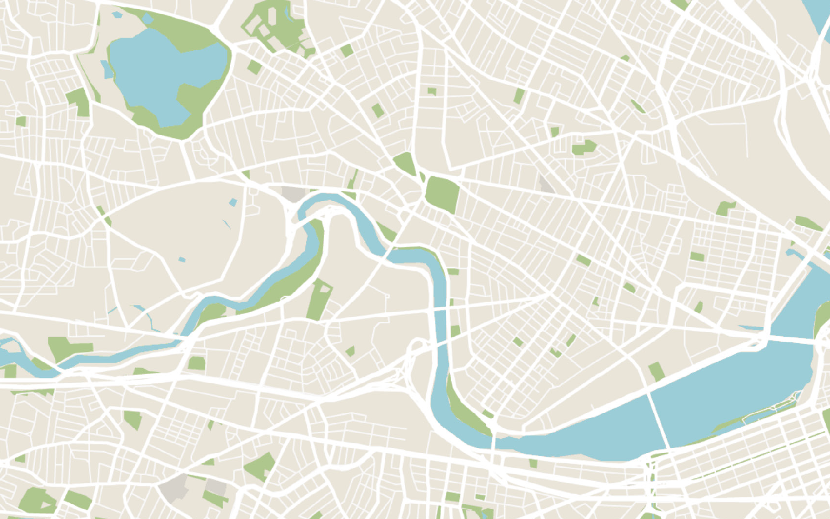

Acknowledgements
Commonwealth of Massachusetts
Governor
Maura Healey
Lieutenant Governor
Kim Driscoll
Energy and Environmental Secretary
Rebecca Tepper
Department of Conservation and Recreation Commissioner
Nicole LaChapelle

Slide 3
DCR MISSION
DCR MISSION
To protect, promote and enhance our
common wealth of natural, cultural
and recreational resources
for the well-being of all.

Slide 4
Agenda
6:00 - 6:05 Meeting Logistics
6:05 - 6:15 Welcome, Recap and Project Overview & Goals
6:15 - 6:45 Strategic Plan / Vision Plan
• Landscape & Conservation
• Events & Use
• Partners & Process
6:45 – 8:00 Discussion

Slide 5
Meeting Logistics
  Please provide feedback after the presentation
    You will find information on how to give feedback at the end of the presentation
  Q&A function is open for comments during the presentation
  Cameras + microphones
    Your camera is on/off
    We will enable your microphone only when you are speaking after the presentation
Please note that this public meeting will be recorded, and the recording will be posted online shortly after.

Slide 6

Meeting Logistics, part 1
  We will take comments in the order hands are raised
  If calling in, dial *9 to raise your hand and *6 to unmute
  In order to allow everyone to speak, please try to limit your time to 1 minute
  Approximately every 15 minutes, we will provide responses to Q/A
  The meeting is scheduled to end at 8:00 PM

Slide 7
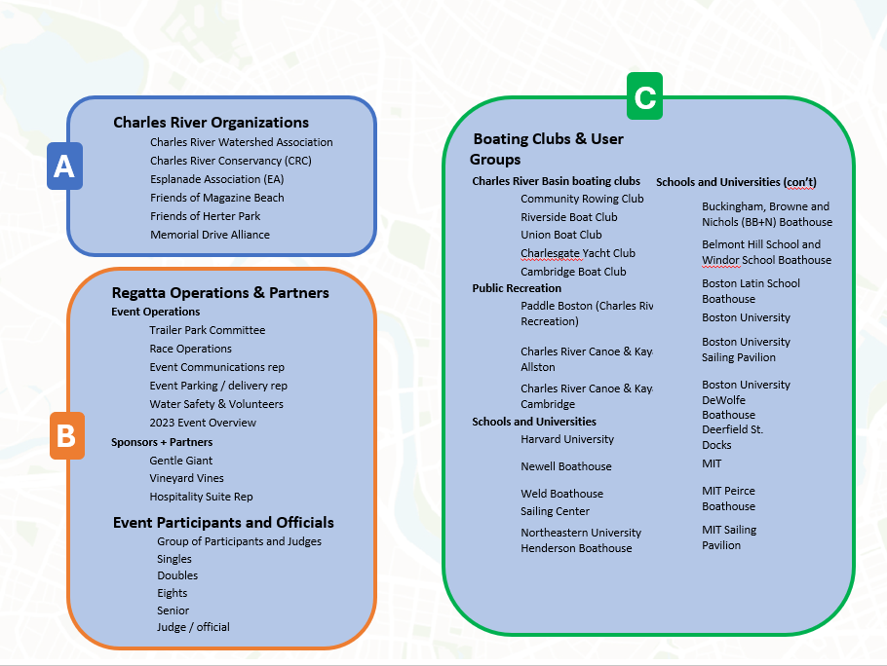
Stakeholder Groups

Slide 8
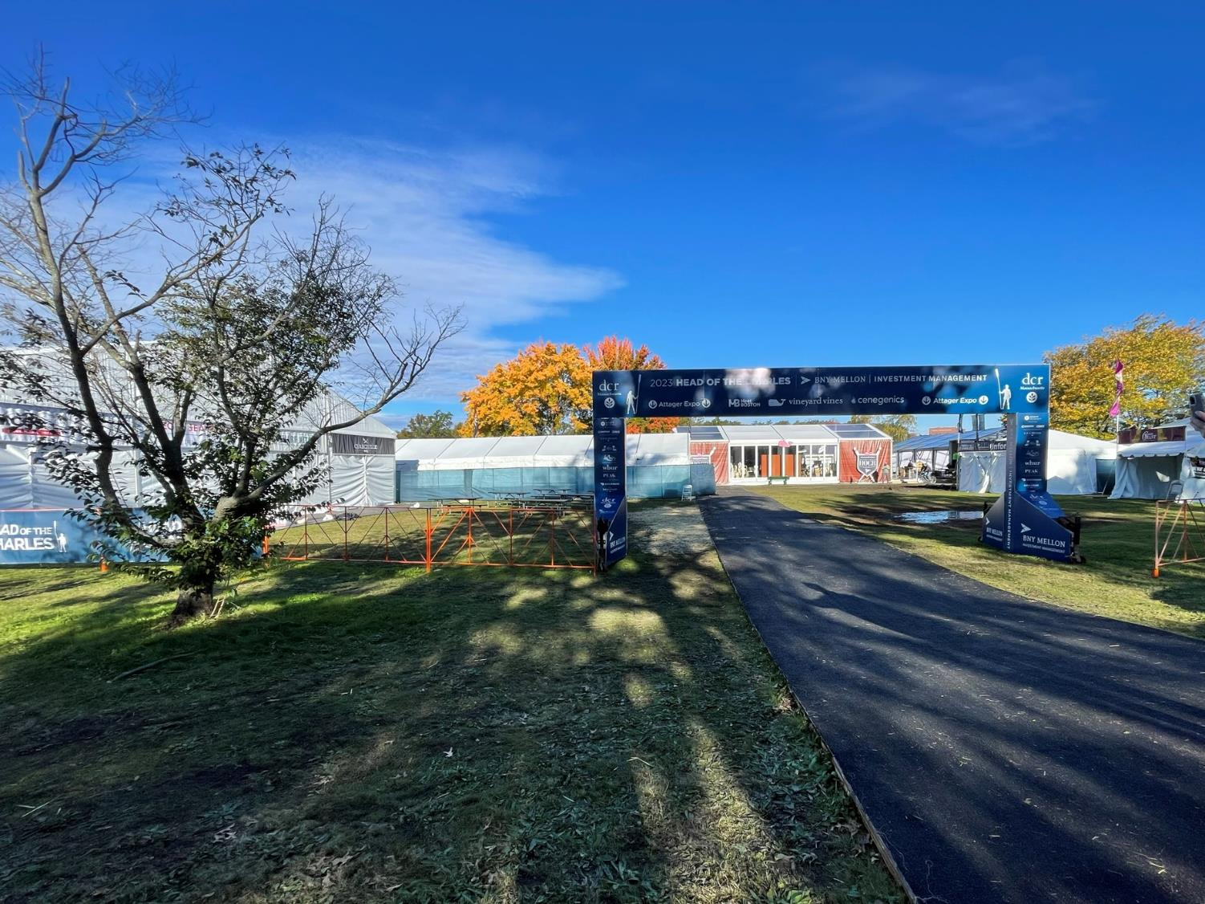



Project Goals
OBSERVE AND IDENTIFY IMPACTS
DEVELOP SUSTAINABLE DESIGN AND OPERATIONAL STANDARDS
PROMOTE A LONG-TERM PARTNERSHIPS & LAND STEWARDSHIP
thoroughly assess the existing operations of the Head of the Charles Regatta (HOCR) and understand the full scope of activities
identify both direct and indirect impacts of the Regatta on the Charles River and the surrounding Reservation parkland.
review of current permit requirements to ensure that all event-related activities comply with environmental regulations and best practices
develop design recommendations and operational improvements that enhance sustainability, circulation, accessibility, and safety.
Enhance the quality of the river and landscape through vegetation and stormwater management improvements
highlight the cultural and educational value of the Charles River by identifying and promoting stewardship opportunities
responding to the annual and evolving requirements of the HOCR Regatta, and tailor solutions to meet both short-term logistical challenges and long-term environmental goals

Slide 9

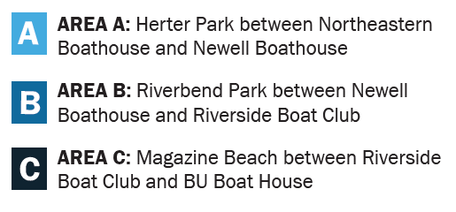
Study Area
A
B
C
Cambridge
Boat Club
A
Eliot Bridge
MOUNT AUBURN CEMETERY
Weld
Boathouse
FINISH
Newell
Boathouse
Weeks Footbridge
B
HERTER PARK
KENDALL SQUARE
Western Avenue Bridge
MASSACHUSETTS INSTITUTE OF TECHNOLOGY
Arsenal Street Bridge
Northeastern
Boathouse
Longfellow Bridge
CRI
Community Rowing, Inc
River Street Bridge
Riverside
Boat Club
MIT
Boathouse
MAGAZINE BEACH
BU
Boathouse
Harvard Bridge
C
BU Bridge
START
BACK BAY EAST
BOSTON UNIVERSITY

Slide 10
Pipeline Projects
Soldiers Field Road
Lighting Improvements
Eliot Bridge Project
Memorial Drive Phase III
Cambridge
Boat Club
MOUNT AUBURN CEMETERY
Eliot Bridge
Weld
Boathouse
Artesani Parking Lot
Magazine Beach Improvements
FINISH
Newell
Boathouse
Weeks Footbridge
HERTER PARK
KENDALL SQUARE
Western Avenue Bridge
MASSACHUSETTS INSTITUTE OF TECHNOLOGY
Arsenal Street Bridge
Northeastern
Boathouse
Longfellow Bridge
CRI
Community Rowing, Inc
River Street Bridge
Riverside
Boat Club
MIT
Boathouse
Telford Street
Pedestrian Bridge
MAGAZINE BEACH
BU
Boathouse
Harvard Bridge
BU Bridge
START
BACK BAY EAST
Everett Street Intersection
I-90 Allston Shoreline: Riverfront Park
(on hold)
BOSTON UNIVERSITY

Slide 11
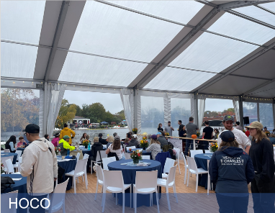
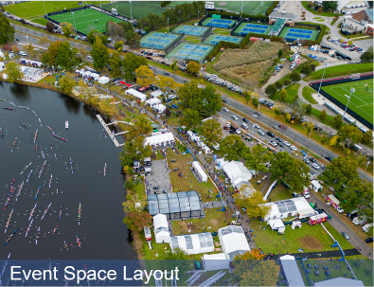
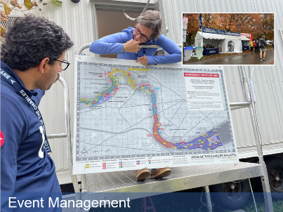
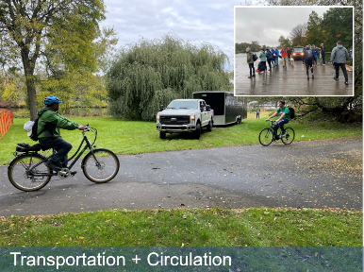
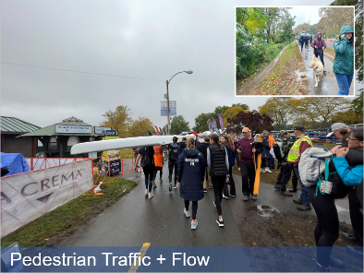
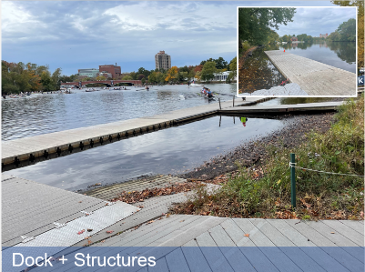
Recap: Existing Operations & Conditions

Slide 12
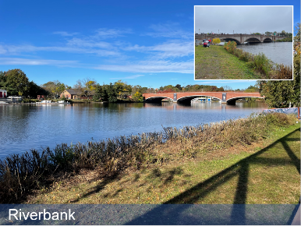
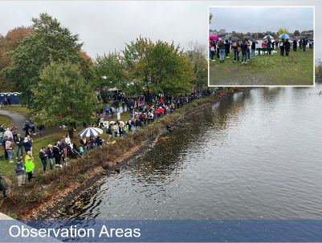
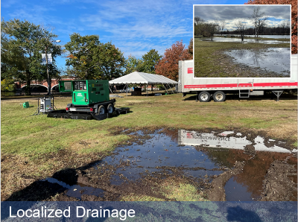
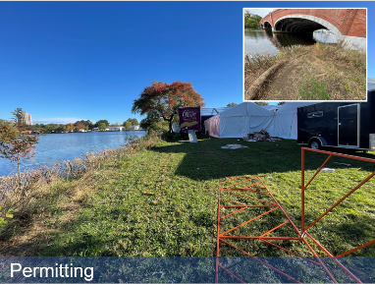
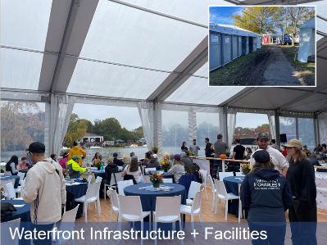
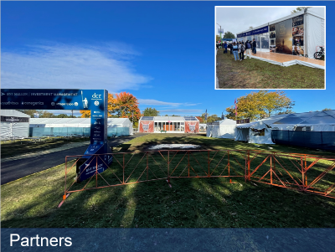
Recap: Existing Operations & Conditions, prt. 2

Slide 13




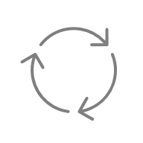

What is the Strategic Plan?
  Strengthen Landscape & Infrastructure
  Address wear on paths, docks, drainage, and other physical assets.
Long-Term Planning & Implementation
Coordinate with internal and external partners to deliver short- and long-term projects
EVENT & USE
PARTNERS & PROCESS LANDSCAPE & CONSERVATION
Enhance the Performance of the Landscape
Promote adoption of landscape typologies that will reduce erosion, protect vegetation, and improve waste and water management.
Foster Stakeholder Collaboration
Engage agencies, sponsors, community members, and the public.
Ensure Compliance and Accessibility
Meet permitting standards and improve equitable access.
Improve Event Logistics
Enhance circulation, access, safety, and staging for participants and spectators.
Balance Event Use with Everyday Park Life
Ensure the Regatta coexists sustainably with year-round public park use.

Slide 14
Landscape Plan
  Strengthen Landscape & Infrastructure
  Address wear on paths, docks, drainage, and other physical assets.
EVENT & USE
PARTNERS & PROCESS LANDSCAPE & CONSERVATION
Enhance the Performance of the Landscape
Promote adoption of landscape typologies that will reduce erosion, protect vegetation, and improve waste and water management.

Slide 15
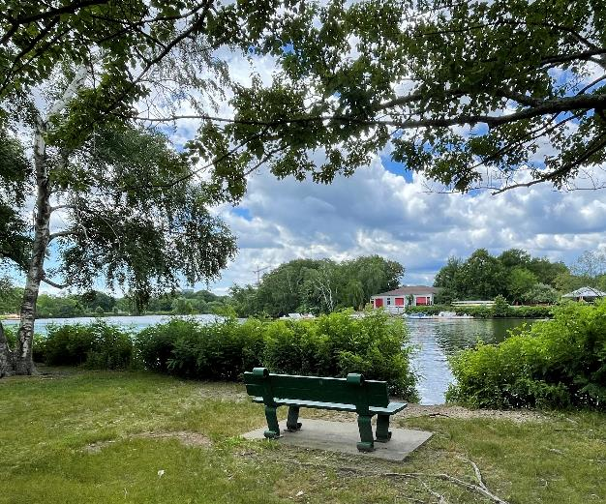
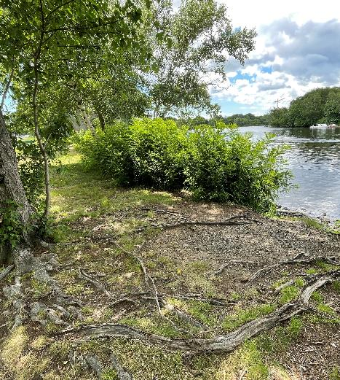
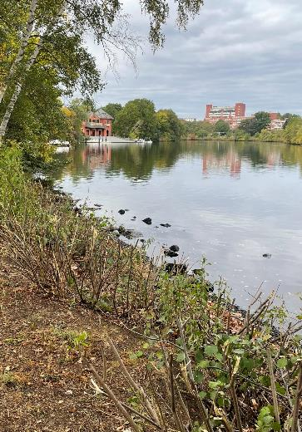


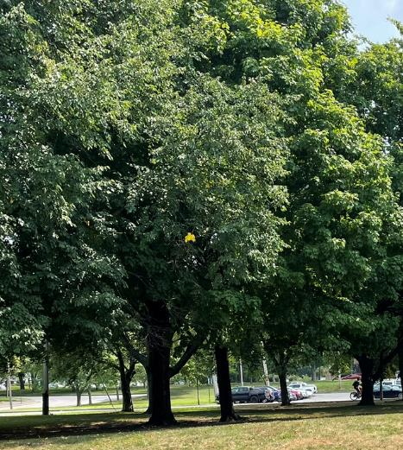
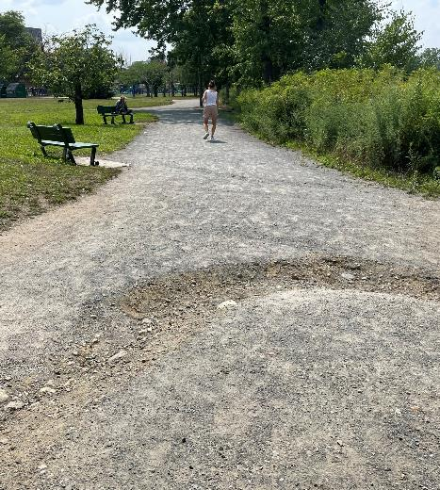
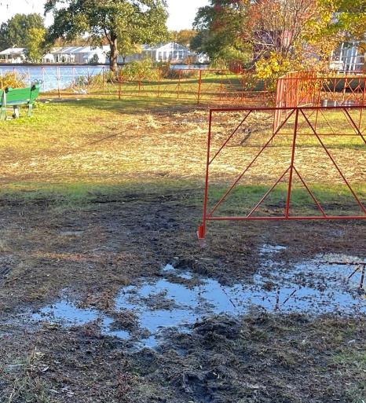



Landscape Assessments
  Soil Assessment
  evaluate soil conditions and nutrient levels, & guide landscape improvements
  Routine Site Maintenance Invasive Species Control
  Evaluating year-round care and event-specific invasive control
  Tree Preservation & Care
  Evaluating tree condition for long-term health and safety
  Assess Wear & Tear on Pathways
  Extends pathway lifespan and ensures visitor safety
  Evaluate Drainage and Flooded Areas Restores recreational areas and enhances accessibility

Slide 16
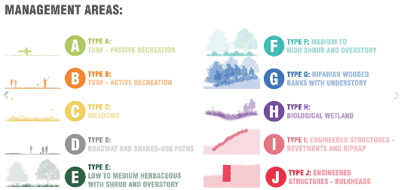
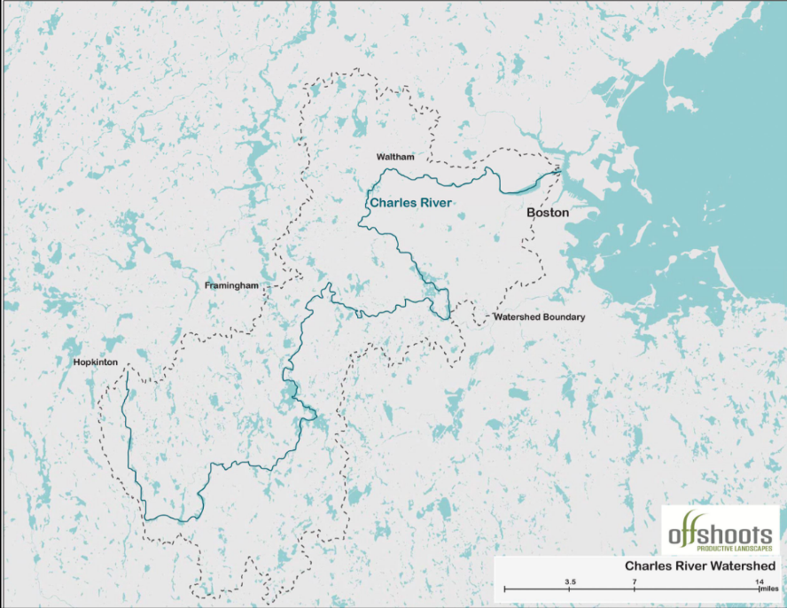
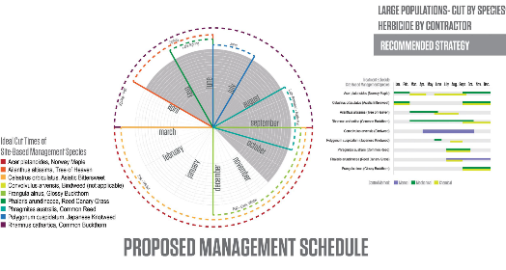
Charles River Shoreline Vegetation Management Plan (CRVMP)

Slide 17
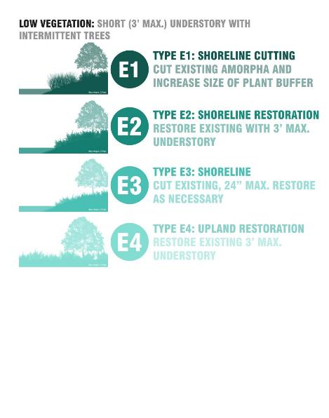
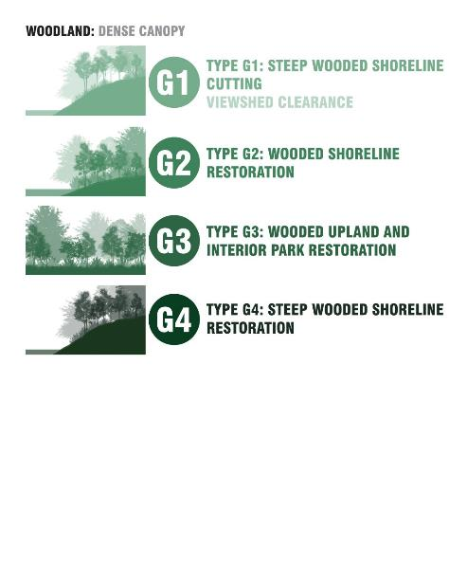
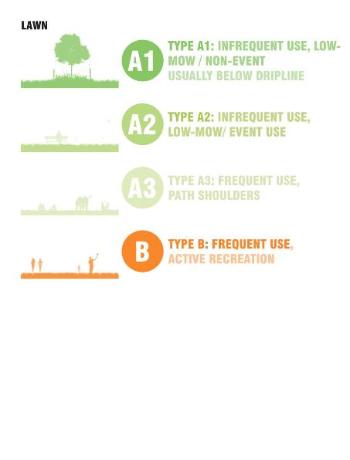
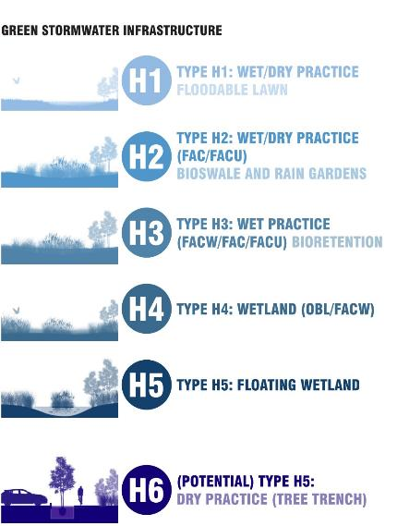
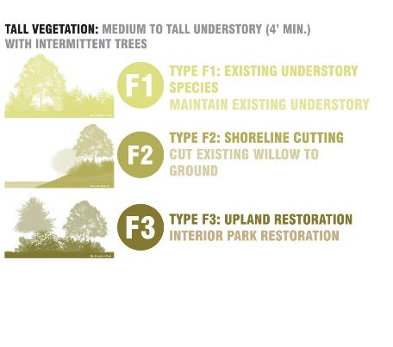
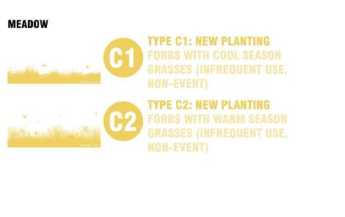

Landscape Typologies Expanded: Charles River Strategic Plan

Slide 18
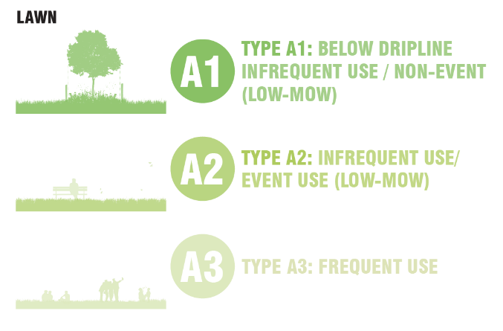
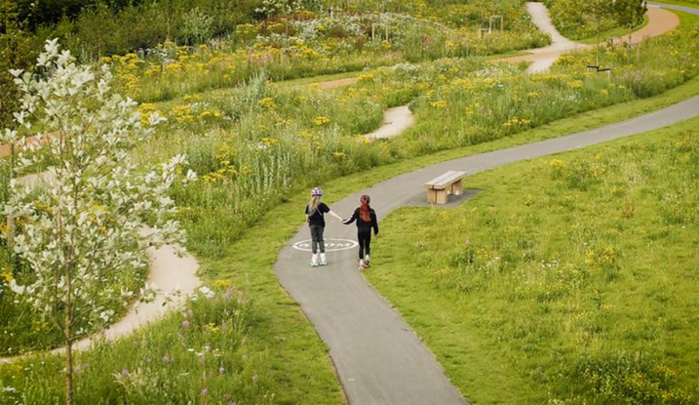
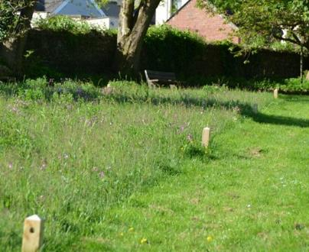
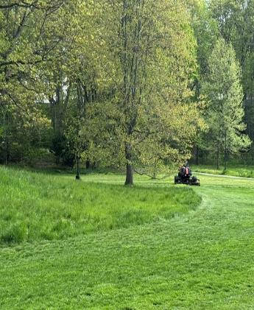
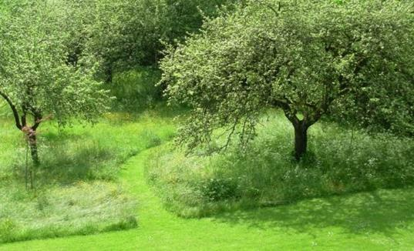
Landscape Typologies: Lawn
Example Images of Managed Lawns

Slide 19
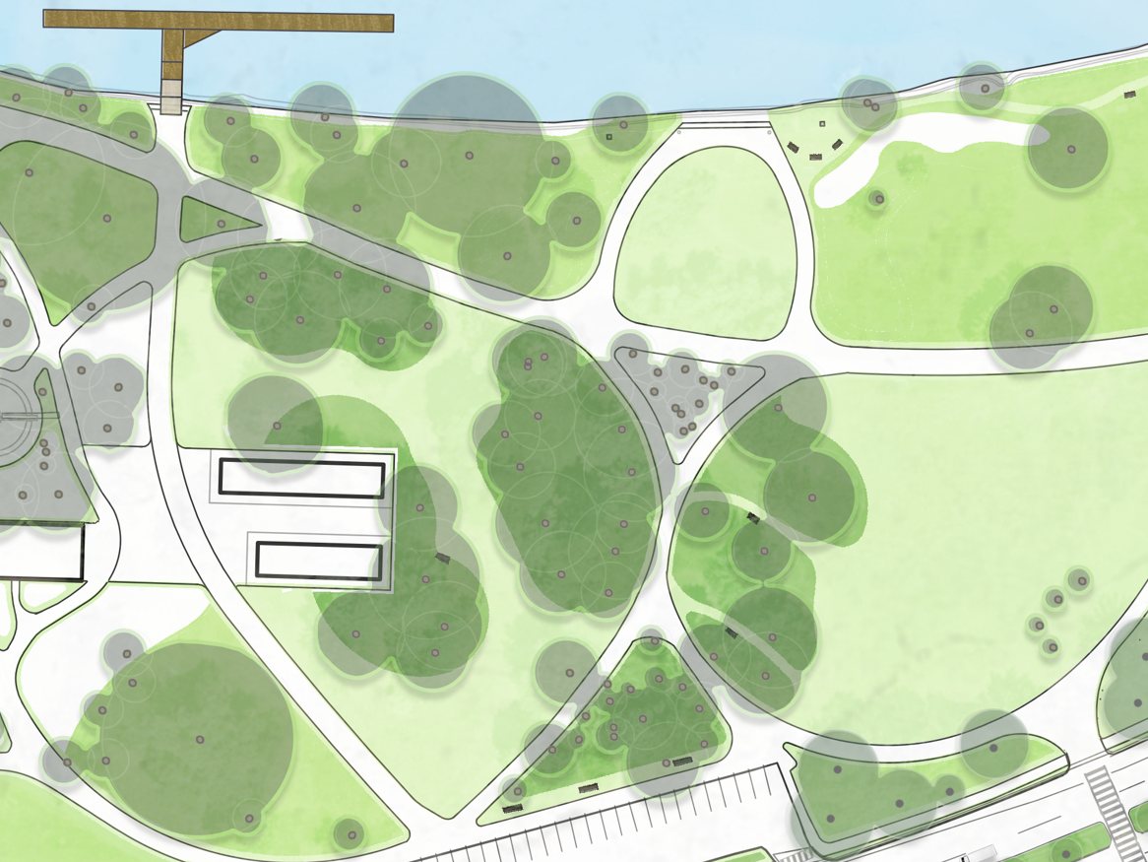
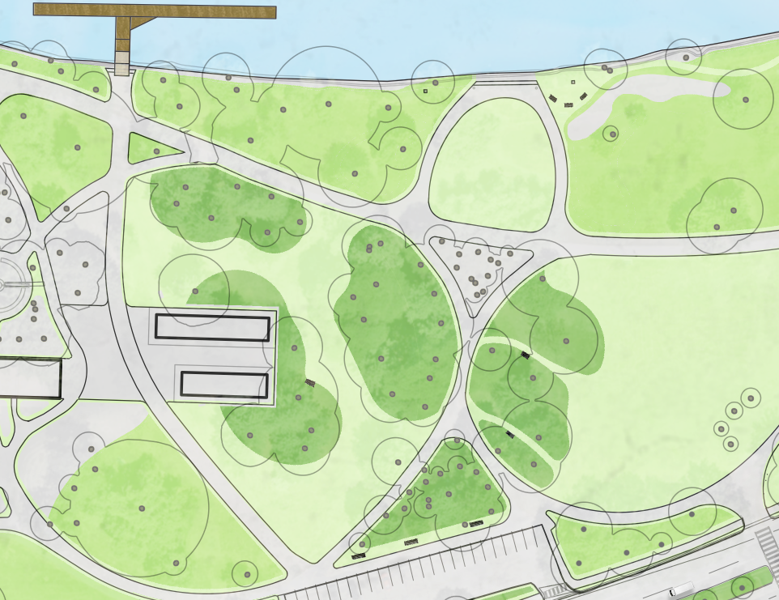
Sample Area
East of Herter Park Amphitheater
NEW HARVARD DOCK
A2
INFREQUENT USE
Lawn Maintenance Types (A1, A2, A3) range from low to high maintenance
3’ buffer along stone dust pathways
Mow high-use paths within lawn areas, under tree dripline and along the riverfront.
A1
BELOW DRIPLINE
A3
FREQUENT USE
3 FT
BUFFER ON PATHS

Slide 20
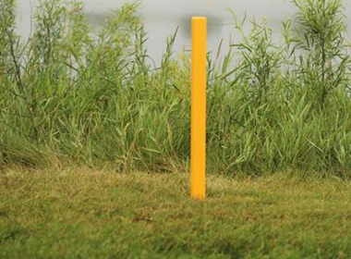
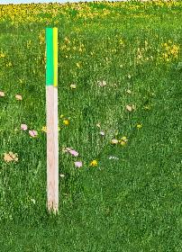
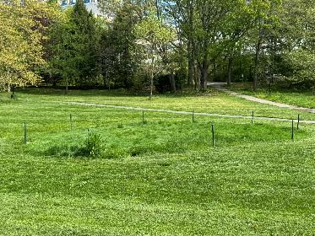
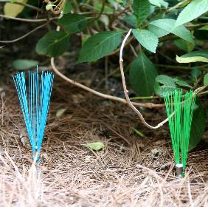
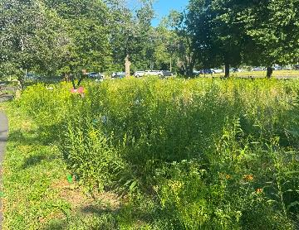
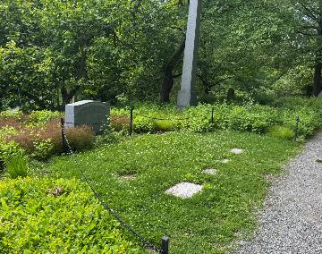
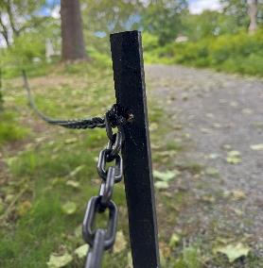
Landscape Typologies: Lawn Delineation
Stakes
Brush Markers
Chains

Slide 21
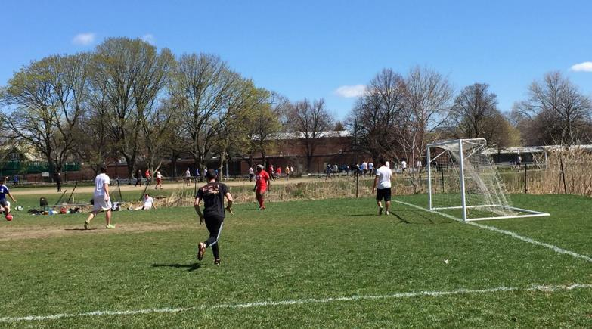

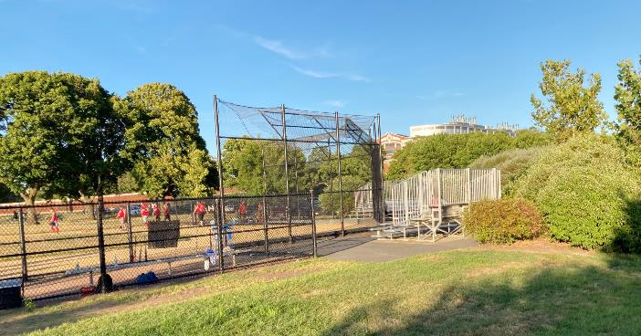
Landscape Typologies: Lawn (Turf)
Magazine Beach Soccer Field
Magazine Beach Softball Field

Slide 22
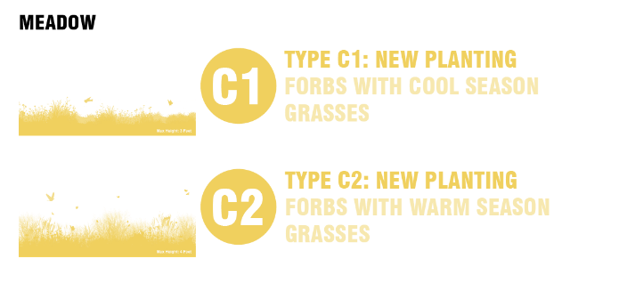




Landscape Typologies: Meadow
Example Images of Managed Meadows

Slide 23





Landscape Typologies: Low Vegetation
Weld Boat House: Invasive False indigo
Shoreline Restoration
Amorpha cutting

Slide 24




Landscape Typologies: Tall Vegetation (Thicket)
Existing Thicket in Herter Park
Example Images of Managed Thicket

Slide 25



Landscape Typologies: Dense Canopy
Existing Wooded Upland in Herter Park
Existing Wooded Shoreline in Watertown

Slide 26





Landscape Typologies: Green Stormwater Infrastructure
Existing drainage issues by Kayak Kiosk in Herter Park
Henderson Boathouse GSI
Floodable Lawn
Existing Charles River Wetland

Slide 27



Future Landscape Vision
Area A | Before & After
Key plan
Today
Future

Slide 28
Future Landscape Vision
Area A | Improved Circulation & River Access
Key plan
P
P
P
Today
P
P
P
P
Future
P

Slide 29























Future Landscape Vision, Area A Typologies
WEST AREA
CENTRAL AREA
EAST AREA
West Woodland & Boathouse
Playground
Main Arrival
Herter Center & Amphitheater
East Lawn
North Lawn
Woodland & lawn maintenance
Low shoreline vegetation, & lawn maintenance
Rain garden, low shoreline vegetation, meadow & lawn maintenance
Woodland, thicket, low shoreline vegetation, & lawn maintenance
Floodable lawn, thicket, low shoreline vegetation, & lawn maintenance
Low shoreline vegetation, & lawn maintenance

Slide 30




Herter Park Master Plan, 2022
Cambridge Boathouse
Eliot Bend Park
Outlook
Eliot Bridge
Lawn Delineation & Walkways
Renovated Event Lawn
Floodable Lawn & Habitat Restoration
Outlook
Greenough Blv
Event Lawn
Lawn Delineation & Walkways
Parking Lot
Northeastern
Boat House
Outlook
Expand Existing Boardwalk
New Permanent Canoe & Kayak Launch
Outlook
Harvard Dock (New Design)
Lawn Delineation & Walkways
Event Lawn
Outlook
Outlook
Event Lawn
Outlook
Event Lawn
Community Garden
Herter Center & Harvard Boat Storage
Herter Park Amphitheater & Museum
Parking Lot
Artesani Playground
Renovated Event Lawn
Artesani Parking Lot
(New Design)
Soldier's Field Road
Parking Lot

Slide 31



Future Landscape Vision
Area B | Before & After
Key plan
Today
Future

Slide 32
Future Landscape Vision
Area B | Improved Circulation & River Access
Key plan
Today
Future

Slide 33

Future Landscape Vision, Area B: Typologies
WEST AREA
CENTRAL AREA
EAST AREA
Riverwalk & Boathouse
Parklet
Linear Park & Boathouse
East Weeks Bridge
Low shoreline vegetation, & lawn maintenance
Low shoreline vegetation, & lawn maintenance
Low shoreline vegetation, & lawn maintenance
Low shoreline vegetation, & lawn maintenance

Slide 34


Overview of Riverbend Rendered Plan
Event Lawn
Event Lawn
Memorial Dr
Event Lawn
Outlook & Dock
Event Lawn
Shoreline Restoration & Invasive Species Management
Weeks Footbridge
Shoreline Restoration & Invasive Species Management
Event Lawn
Weld Boat House
Shoreline Restoration & Invasive Species Management
Anderson Memorial Bridge
Event Lawn
Newell Boat House
Soldiers Field Rd

Slide 35



Future Landscape Vision
Area C | Before & After
P
Key plan
P
Today
P
SOCCER FIELD
BASEBALL
FIELD
P
Future

Slide 36
Future Landscape Vision
Area C | Improved Circulation & River Access
P
Key plan
P
Today
P
SOCCER FIELD
BASEBALL
FIELD
P
Future

Slide 37






Future Landscape Vision, Area C: Typologies
WEST AREA
CENTRAL AREA
EAST AREA
Boathouse
Pool, Drop off & Historic Features
Recreation Outlook, & Boat Launch
Municipal Building & Wooded Parklet
Wooded Shoreline and Boathouse
Low shoreline vegetation, & lawn maintenance
Wetland, woodland, low shoreline vegetation, & turf & lawn maintenance
Woodland, & lawn maintenance
Shoreline Woodland
P
SOCCER FIELD
BASEBALL
FIELD
P
Future

Slide 38



Overview of Magazine Beach
Riverside Boat Club
BU Boathouse
Veterans Memorial Pool
Memorial Dr
Outlook
(Magazine Beach Restoration Project)
SOCCER FIELD
MWRA Cottage Farm (Sewage Treatment Facility)
Outlook
(Magazine Beach Restoration Project)
BASEBALL
FIELD
BU Bridge
Expanded Magazine Patio
(Magazine Beach Restoration Project)
Magazine Beach Cartop Launch
Proposed Outlook
Solders Field Rd

Slide 39
Events and Year-around Use
EVENT & USE
PARTNERS & PROCESS LANDSCAPE & CONSERVATION
Ensure Compliance and Accessibility
Meet permitting standards and improve equitable access.
Improve Event Logistics
Enhance circulation, access, safety, and staging for participants and spectators.
Balance Event Use with Everyday Park Life
Ensure the Regatta coexists sustainably with year-round public park use.

Slide 40

Shaping the Regatta Experience
Herter Park Area

Slide 41

Shaping the Regatta Experience
Sense of Arrival
Sense of arrival / access to the waterfront

Slide 42

Shaping the Regatta Experience
Rooms & Lawns Along the Water’s Edge
Rooms and lawns along the water’s edge

Slide 43

Shaping the Regatta Experience
Reinforcing the Pedestrian Spine
Reinforcing the pedestrian spine

Slide 44

Shaping the Regatta Experience
Expanding Areas for Trailer Capacity
Expanding areas for trailer capacity and planning for implementation and construction

Slide 45

Shaping the Regatta Experience
Integrating Greenough Boulevard
Integrating Greenough Boulevard – trailer storage and dock

Slide 46
Partnership
Long-Term Planning & Implementation
Coordinate with internal and external partners to deliver short- and long-term projects
EVENT & USE
PARTNERS & PROCESS LANDSCAPE & CONSERVATION
Foster Stakeholder Collaboration
Engage agencies, sponsors, community members, and the public.

Slide 47







Benefits for People & Place
Enhanced Visitor Experience through more beautiful, accessible, and welcoming park spaces
Greater Sense of Safety and Comfort with improved paths, lighting, and wayfinding
Stronger Community Connection to the river and event through shared spaces and gathering areas
Improved Ecological Awareness from visible efforts in tree health, native planting, and erosion control
More Opportunities to Engage in stewardship, volunteering, and educational programming
Year-Round Enjoyment of landscapes designed to support both daily use and special events

Slide 48
Stakeholder Groups Participation

Slide 49





















Positive Contributions to the Charles River today
Meet a beekeeper!
sewage pollution action
Charles River Environmental Watch (CREW)
“CREW Stewards” collect data to track invasive plants on river
EARTH DAY
Bittersweet removal
Aquatic invasives
LEARN & DISCOVER

Slide 50









Citizen science initiatives
Where could we take it further?
Stewardship Opportunities
➤ How can the community, partners, and volunteers be more involved in caring for the Charles River and surrounding parklands?
Community volunteer programs
Youth engagement & education
Public stewardship campaigns
Corporate & Institutional partnerships
Interpretive signage & self guided tours
Skill building workshops & trainings
Stewardship ambassador “adopt a spot” programs
Notes:
1. Community Volunteer Programs
Expand recurring events for litter cleanups, invasive species removal, native plantings, and trail maintenance.
2. Youth Engagement & Education
Partner with schools, summer camps, and youth organizations to offer stewardship-focused education and hands-on activities.
3. Citizen Science Initiatives
Encourage public participation in monitoring efforts such as water quality testing, wildlife sightings, and tree health assessments.
4. Public Stewardship Campaigns
Launch seasonal or thematic awareness campaigns (e.g., "Leave No Trace," “Protect Pollinators”) using signage, social media, and local media.
5. Corporate & Institutional Partnerships
Create stewardship opportunities for businesses, universities, and institutions through service days or co-sponsored conservation projects.
6. Interpretive Signage & Self-Guided Tools
Install educational signage and develop mobile-friendly self-guided tours that highlight ecological features and ways the public can help.
7. Skill-Building Workshops & Trainings
Host public workshops on trail building, pruning, invasive plant ID, or composting to build stewardship knowledge and capacity.
8. Stewardship Ambassador or “Adopt-a-Spot” Programs
Develop a program that allows individuals or groups to “adopt” trails, park sections, or planting beds and maintain them over time.

Slide 51





Enhance pre- and post-event management with new tools
Most Activities Permitted
Activities Allowed with Precautions
Primarily in critical root zone areas and poor drainage areas
High Impact Activities Restricted to ensure sensitive vegetation along riverfront and park woodlands is protected
Roadway & Mobility
Circulation recommendations & parking guidelines

Slide 52

Enhance pre- and post-event management with new tools: Herter Park Example

Slide 53

Testing the Ideas: Dock 5 Pilot Project

Slide 54




Testing the Ideas: Dock 5 Pilot Project
Site Assessment

Slide 55




Testing the Ideas: Dock 5 Pilot Project
Dock 5 During HOCR

Slide 56

Testing the Ideas: Existing Conditions Year-Around

Slide 57

Testing the Ideas: Existing Conditions HOCR

Slide 58

Testing the Ideas: Proposed Redesign Year-Around

Slide 59

Testing the Ideas: Proposed Redesign During Event

Slide 60


Dock 5 Pilot Project Site: Rendering & Design Development

Slide 61





Discussion: 10-15 mins per each topic area
Landscape Design & Circulation Improvements
➤ How can we improve the flow of people and enhance the landscape experience during the Regatta and throughout the year?
Operational Event Management
➤ What aspects of event setup, transportation, or public access should be improved to better support the Regatta and daily park users?
Environmental Impact
➤ Where do you see the greatest opportunities to reduce environmental stress caused by the event and protect natural resources?
Stewardship Opportunities
➤ How can the community, partners, and volunteers be more involved in caring for the Charles River and surrounding parklands?
Investment Priorities
➤ What areas of the Basin—physical, ecological, or operational—do you believe should be prioritized for future investment?

Slide 62
Additional Information
  Recording and slide deck will be available at:
  www.mass.gov/dcr/past-public-meetings
  If you have comments on this project, please use the link below. The public comment period will be open for 2 weeks:
  Submit online: www.mass.gov/dcr/public-comment
  Please note: the contents of comments submitted to DCR, including your name, town and zip code, will be posted on DCR’s website. Additional contact information provided, notably email address, will only be used for outreach on future updates to the subject project or property.
If you wish to subscribe to a DCR general information or project-related listserv: contact DCR’s Office of Community Relations via email at mass.parks@mass.gov

