Slide 1
Department of Public Health
COVID-19 Health Equity Advisory Group
Recommendations
06/19/20

Slide 2
Table of Contents
DPH Health Equity Framework
Health Equity Advisory Group Overview
Draft Recommendations
COVID-19 Health Equity Data

Slide 3
health equity framework
3

Slide 4
Notes:
AA

Slide 5
Office of Health Equity
Mission:
Leverage public and private partnerships to collect, use and disseminate high quality data and documentation and inform and influence policies, programs, practices, prevention strategies and resource allocation that address inequities in the social determinants of health. The Office of Health Equity was established at DPH in the 1980s and was expanded in 2018 through an Interagency Services Agreement from the Executive Office of Health & Human Services.
DPH Office of Population Health
Office of Data Management and Outcomes Assessment
Office of Health Equity
Special Analytic Projects
Registry of Vital Records and Statistics

Slide 6
A working framework for DPH’s equity activities
Strategic Vision
DPH “House” and Mission as principles guiding the road to eliminating health inequities
Culture
Racial Equity trainings, Diversity Council, Racial Equity Initiatives in Bureaus (e.g. Racial Equity Leadership Team)
Data Infrastructure
Public Health Data Warehouse, Population Health Information Tool, Refining and Defining Population Data Standards
Capacity Building
Data Day, Epi Conference, Equity Labs and Reframes, DPH policies & practices (e.g. procurement and hiring)

Slide 7
Definition of Terms
What is health equality?
Everyone is given the same health intervention without consideration of underlying needs.
What are health disparities?
Disparities are significant differences in health outcomes between populations.
What are health inequities?
Inequities are the unjust distribution of resources and power between populations which manifests in disparities.
What is health equity?
Everyone has what they need to attain their highest level of health.

Slide 8
What Makes Us Healthy?
SOURCE: ADAPTED FROM R TARLOV, A. (1999). PUBLIC POLICY FRAMEWORKS FOR IMPROVING POPULATION HEALTH. ANNALS OF THE NEW YORK ACADEMY OF SCIENCES. 896. 281-93.

Slide 9
CDC Health Impact Pyramid

Slide 10
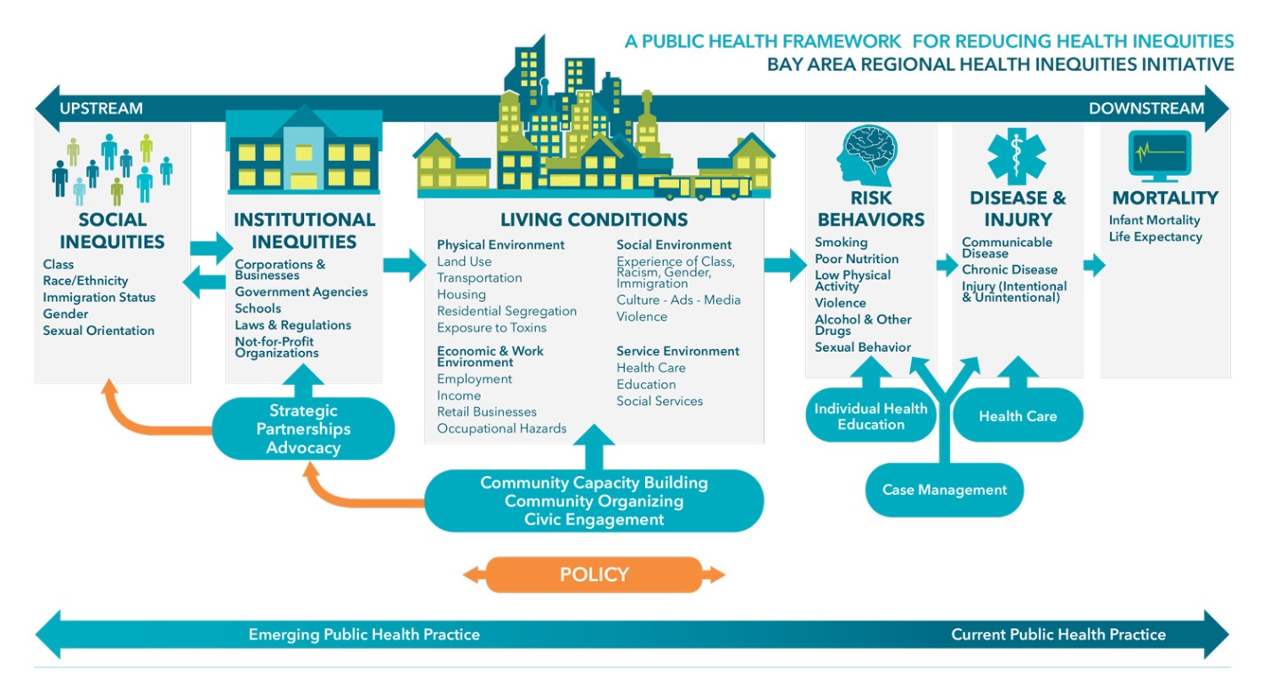
Poor conditions prevent people from practicing healthy behaviors and achieving good health.

Slide 11
COVID-19 HEALTH EQUITY ADVISORY GROUP

Slide 12
The DPH COVID-19 Health Equity Advisory Group
The Commissioner convened the Health Equity Advisory Group to advise DPH on the needs of communities and populations disproportionately impacted by the COVID-19 pandemic.
The 26 Health Equity Advisory Group members represent a cross-sector of community leaders and health and racial equity experts.
The group met twice weekly throughout the month of May. The group organized its effort into four subcommittees chosen by the members to create a set of recommendations.
Group members provided reading materials and feedback in between meetings as well.

Slide 13
The DPH COVID-19 Health Equity Advisory Group
Members selected four areas to address:
Data and Metrics
COVID-19 Mitigation
Community Engagement and
Social Determinants of Health
Each subcommittee was led by volunteer co-chairs who were members of the advisory group. Logistical support and note-taking was provided by DPH staff.
In total the group met 8 times, 5 times as a full group and 3 times in the subgroups.

Slide 14
The DPH COVID-19 Health Equity Advisory Group
The primary function of the advisory group was to generate a series of recommendations for the Commissioner of the Massachusetts Department of Public Health on how the COVID-19 pandemic response could be informed by a health equity lens to ensure equitable access to resources and services, and prevent inequities and disproportionate negative outcomes.

Slide 15
Members of COVID-19 Health Equity Advisory Group
Monica Bharel, MD, MPH, Commissioner, Massachusetts Department of Public Health (CHAIR)
Dolores Acevedo-Garcia, Ph.D., Director, Institute for Child, Youth and Family Policy, Heller School for Social Policy and Management, Brandeis University
Madeline Aviles-Hernandez, Psy.D., Director of Outpatient and Recovery Services, Gandara Center
Mary Bassett, MD, MPH, Director, FXB Center for Health and Human Rights, Harvard University; FXB Professor of the Practice of Health and Human Rights, Harvard School of Public Health
Bithiah Carter, President and CEO, New England Blacks in Philanthropy
Elisa Choi, MD, FACP, FIDSA, Governor, American College of Physicians, Massachusetts Chapter
Yvette Cozier, DSc, Assistant Dean for Diversity and Inclusion, BUSPH
Michael Curry, Deputy CEO and General Council, Mass League of Community Health Centers
Denise De Las Nueces, MD, MPH, Medical Director, Boston Health Care for the Homeless Program’s Barbara McInnis House
Deb Enos, Independent Consultant, Governor’s Black Advisory Commission Chair
Isabel Gonzalez-Webster, Director, Worcester Interfaith
Raquel Halsey, Executive Director, North American Indian Center of Boston
Rev. Dr. Conley Hughes, Sr. Pastor, Concord Baptist Church of Boston
Helena DaSilva Hughes, Executive Director, Immigrants Assistance Center

Slide 16
Members of COVID-19 Health Equity Advisory Group, continued
Claude A. Jacob, Chief Public Health Officer, Cambridge Public Health Department
Thea James, MD, Vice President of Mission and Associate Chief Medical Officer, Emergency Medicine, Boston Medical Center
Collin Killick, Executive Director, Disability Policy Consortium
Jennifer Kimball, Principal Planner, Berkshire Public Health Alliance / Berkshire Planning Commission
Alden Landry, MD, MPH, Emergency Medicine, physician, BIDMC; Director of Health Equity Education, Harvard Medical School
Jennifer Lee, Chair, Massachusetts Statewide Independent Living Council
Juan Lopera, Vice President of Business Diversity, Tufts Health Plan
Eva Millona, Executive Director, MIRA
Vanessa Otero, Director, Urban Education Initiative, Smith College
Claire Pierre, MD, Chief Medical Officer, Harbor Health Services, Inc, Internal Medicine Physician, Board Certified in Clinical Informatics
Maria Belen Power, Associate Executive Director, GreenRoots, Inc. (Chelsea)
Tanisha Sullivan, Esq., President, NAACP Boston Branch​
Simone Wildes, MD, Infectious Disease, South Shore Health; Chair, Committee on Diversity in Medicine and Vice-Chair, Committee on Public Health, Mass Medical Society

Slide 17
Recommendations
17

Slide 18
Principles Underlying Recommendations
As part of the development of these recommendations, the Health Equity Advisory Group Social Determinants of Health Subcommittee developed the following principles:
Acknowledging the fundamental role of racism, xenophobia and lack of economic opportunity as causes of inequitable outcomes;
acknowledging the role of root causes even if addressing a more immediate and urgent need; at a minimum, ensuring that immediate mitigations are implemented in a way that does not perpetuate inequities and does more than provide a service that alone does not work to change the condition leading to the inequity;
identifying actions that can have measurable impact and/or where we can demonstrate what success looks like;
these actions are intended to challenge existing systems that are not working.

Slide 19
Model of How Social Determinants Interact
Education
Economic Mobility
Health
Healthy Food Access
Stable Housing

Slide 20
1. Data and Metrics
 | Recommendations
Public Health COVID-19 Indicators | Report indicators disaggregated across vulnerable and marginalized populations to ensure resource distribution is equitable and culturally/ linguistically appropriate
‘Safer at Home’ advisory | Track ability to work from home across vulnerable and marginalized populations to ensure resources ($, PPE, testing, etc) are geared towards these populations
Caring for Children | Track childcare providers re-opening by diverse ownership to ensure equal opportunity for minority-owned businesses and increased support to meet safety protocols Track access to childcare across vulnerable and marginalized populations to ensure equitable childcare access for workers required to return
Transit | Track ridership in “hot spot” transit areas to ensure vulnerable and marginalized communities are not subject to increased exposure due to crowded transit
Reopening Massachusetts Plan Details: https://www.mass.gov/info-details/reopening-massachusetts

Slide 21
2. COVID-19 Mitigation
 | Recommendations
Access to PPE | Ensure equitable distribution of personal protective equipment (PPE) to essential workers, residents in professions most at-risk, and communities with high rates of infection
Housing Stability | Understand housing instability in response to needs raised by COVID-19 Implement policies that increase housing stability
Culturally Appropriate Workforce | Create strategic guidance to intentionally recruit diverse, culturally intelligent workforce, including for contact tracing, tracking cases, and other workforce needs
Access to Care | Work to ensure all populations have equitable access to culturally appropriate and needed therapies, vaccines, trials, and other necessary medical care Develop pathways for foreign-trained medical professionals to practice
System Coordination | Create coordinated effort across healthcare providers and other relevant stakeholders to streamline efforts regarding mitigation and surge
Community Safety | Monitor enforcement of COVID-19 guidance to avoid over-policing in disenfranchised communities and increasing inequities

Slide 22
3. Community Engagement & Support
 | Recommendations
Messaging | Prioritize investment in multilingual outreach to communities most critically impacted by COVID-19 regarding testing, protection at home and workplace, and how to access state assistance programs and resources available
Engaging the Community | Plan and implement strategy for the active engagement and representation of existing anchor organizations in the communities in decision-making processes related to COVID-19 response and recovery
Partnership | Develop and expand public and private partnerships with community health centers, local governments, other state agencies, quasi-state agencies (e.g. MBTA) and philanthropic organizations
Economic Mobility | Develop pathways to financial freedom to prevent further disparities and that support economic mobility

Slide 23
4. Additional Domains of Expertise
The expertise and advice of advisory group members extends beyond the scope of public health and the specific recommendations to DPH.
Members elevated recommendations of other stakeholder groups and looked for opportunities to align these recommendations and priorities in the context of equity work across the state.
This document focuses on the recommendations most pertinent to DPH, and also acknowledges the discussion of longer term solutions and equity concerns in domains beyond DPH’s immediate purview.
The additional expertise and advice of work group members included domains such as Educational Equity, Bridging the Digital Divide, Transportation Access, Childcare Access, Housing Stability, and Workforce & Economics.

Slide 24
COVID-19 Health Equity Data
Population denominators for rate calculations provided by UMass Donahue Inst. based on Strate S, et al. Small Area Population Estimates for 2011 through 2020, published March 2020 (original report published Oct 2016)
24

Slide 25
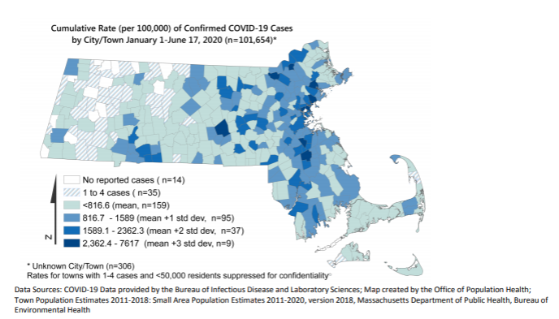
The Communities with Highest Case Rates are Primarily in High Density Population Areas
The ten communities with the highest cumulative rates of COVID-19 cases per 100,000 residents were: Chelsea, Brockton, Lawrence, Everett, Lynn, Revere, Randolph, Worcester, Danvers, and Lowell.

Slide 26
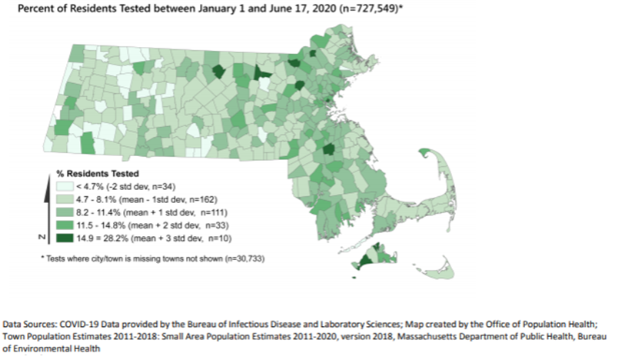
Testing Rates are Highest in Communities with Highest Case Rates
The overall testing rate in MA is 10.4%. Five cities/towns with the highest case rates also have testing rates above the state average (from 15 % to 28%). These include Chelsea, Brockton, Lawrence, and Lowell.
Four towns have high testing rates, but are not among the highest case rate communities: Ayer, Bedford, Gardner, Shirley, Chilmark, and Tisbury.

Slide 27
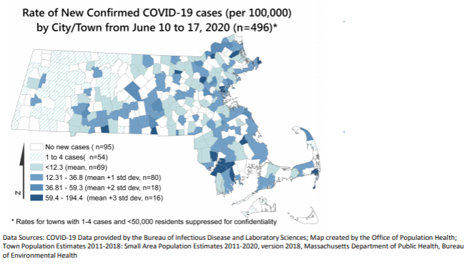
Communities with New Cases Are Those with High Cumulative Case Rates
From May 27th to June 17th cities/towns with high cumulative case rates reported above state average rate of new cases, these include Chelsea and Lawrence.
New communities with high weekly new case rates compared to the average new case rate are Chatham, Rowley, Hampden, Fall River, Freetown, and Webster.

Slide 28
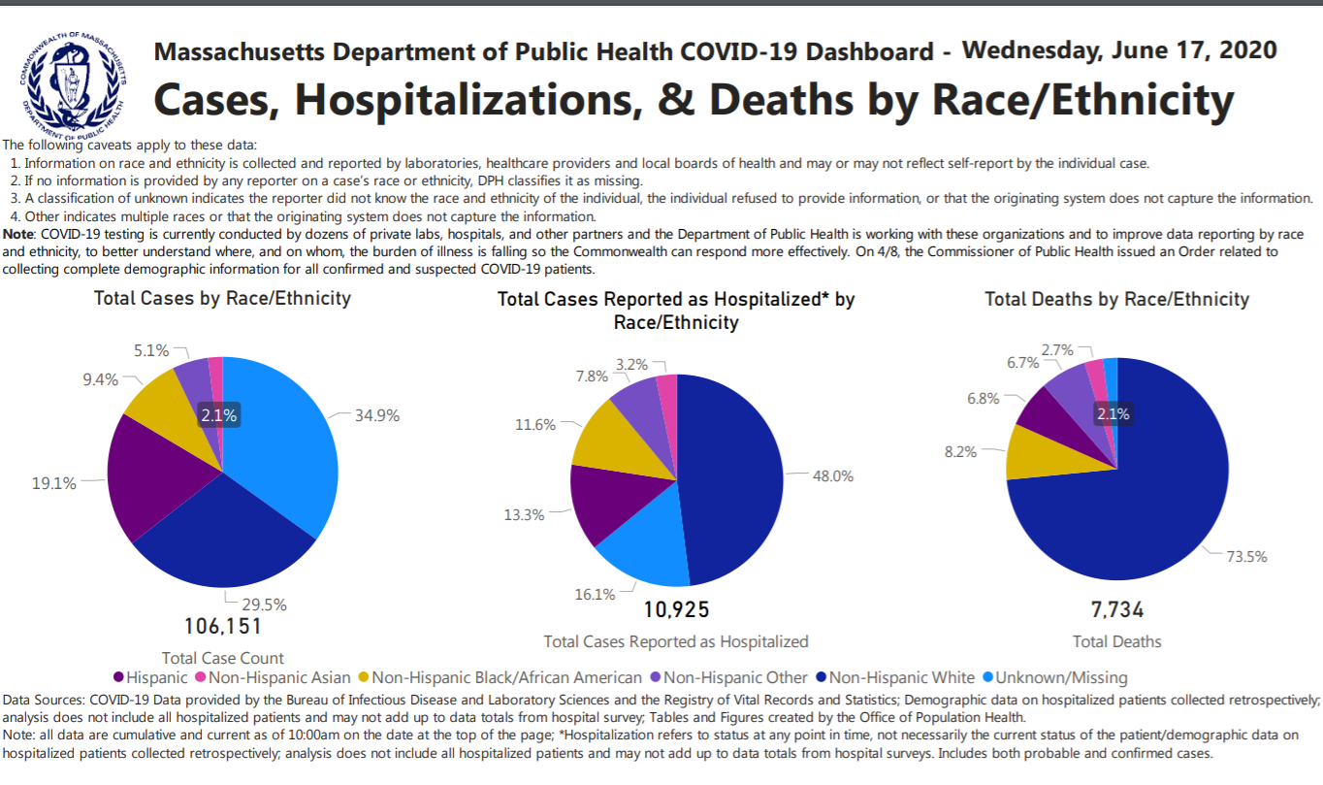
https://www.mass.gov/info-details/covid-19-response-reporting#covid-19-daily-dashboard-

Slide 29
Following the Executive Order on April 8th, race/ethnicity data reporting has improved for cases, deaths, and hospitalizations

Slide 30
The Rate of Positive Cases is Highest for Black and Hispanic Residents
Black non-Hispanics represent 7.2% of the MA population but double that proportion of cases at 14.4% of cases
Hispanics represent 12.2% of the MA population but more than twice that proportion of cases at 29.3% of cases
The highest rates of positive cases are among Black non-Hispanics and Hispanics which are more than 3x higher than the rate for White non-Hispanics
Data as of 06/17/2020
Population denominators for rate calculations provided by UMass Donahue Inst. based on Strate S, et al. Small Area Population Estimates for 2011 through 2020, published March 2020 (original report published Oct 2016)

Slide 31
Cities with the Highest Rates of COVID-19 are Primarily Communities of Color
The ten communities with the highest rates of COVID-19 are shown below. The overall rate in MA of COVID-19 Cases is 1,459.1 per 100,000 people as of 06/17/2020. Almost all of these communities have high (>50%) percentage of residents who are people of color (shaded blue)
MA State Average Rate
Town | Chelsea | Brockton | Lawrence | Everett | Lynn | Revere | Randolph | Worcester | Danvers | Lowell
Case Count | 2885 | 4172 | 3443 | 1724 | 3548 | 1733 | 938 | 5112 | 719 | 2807
Percent of Residents who are People of Color | 80% | 68% | 87% | 61% | 66% | 52% | 75% | 51% | 7.6% | 55%
Population denominators for rate calculations provided by UMass Donahue Inst. based on Strate S, et al. Small Area Population Estimates for 2011 through 2020, published March 2020 (original report published Oct 2016)
State and Town-level COVID-19 data from 06/17

Slide 32
The Rate of Hospitalizations is Highest for Black and Hispanic Residents
White non-Hispanics represent 71.5% of the population but only 57.2% of the hospitalizations, whereas the percentages of Black Non-Hispanic and Hispanics who are hospitalized are greater than their proportions in the population.
The rate of hospitalizations for Black non-Hispanics and Hispanics is 2.4x and 1.6x higher (respectively) than for White non-Hispanics.
Data as of 06/17/2020
Population denominators for rate calculations provided by UMass Donahue Inst. based on Strate S, et al. Small Area Population Estimates for 2011 through 2020, published March 2020 (original report published Oct 2016)

Slide 33
Age-Specific Death Rates by Race/Ethnicity Reveal Inequities
Age-specific death rates reveal that Hispanic, Black Non-Hispanic and Other Non-Hispanic residents have higher rates of death in every age group compared to White and Asian Non-Hispanic. This is most pronounced for age groups under 70. (Caveat: Some of the smaller counts can be unstable.)
 | White Non-Hispanic |  | Hispanic |  | Black Non-Hispanic |  | Asian Non-Hispanic |  | Other² Non-Hispanic |  | Unknown
Age Group | Count | Rate | Count | Rate | Count | Rate | Count | Rate | Count | Rate | Count
0-19 years | 0 | 0 | 0 | 0 | 0 | 0 | 0 | 0 | 0 | 0 | 0
20-29 years | <5 |  | 6 | 3.66 | <5 |  | <5 |  | <5 |  | <5
30-39 years | * |  | 10 | 7.59 | * |  | 0 | 0 | <5 |  | <5
40-49 years | 26 | 4.38 | 21 | 20.03 | 19 | 29.80 | <5 |  | <5 |  | <5
50-59 years | 136 | 17.77 | 61 | 77.41 | 45 | 72.35 | 10 | 19.79 | 21 | 225.47 | 10
60-69 years | 483 | 69.64 | 95 | 207.01 | 137 | 314.23 | 24 | 68.13 | 58 | 895.83 | 19
70-79 years | 1232 | 297.11 | 128 | 576.45 | 161 | 759.55 | 49 | 270.61 | 110 | 3410.21 | 41
80+ years | 3855 | 1491.99 | 214 | 2111.97 | 268 | 2388.50 | 118 | 1252.00 | 329 | 21361.62 | 78
1Data are current as of 6/19/2020 and are subject to change. 2Other includes individuals that identify as Native Hawaiian/Pacific Islander, American Indian/Alaskan Native, Multi-Race, and Other. *Case counts are suppressed to prevent back calculations. For populations <50,000 case counts, <5 cases are reported as such or are suppressed for confidentiality purposes. Rates are not calculated for suppressed counts. Population denominators for rate calculations provided by UMass Donahue Inst. based on Strate S, et al. Small Area Population Estimates for 2011 through 2020, published March 2020 (original report published Oct 2016)
Data as of 06/19/2020
Rates are per 100,000 population. Age-adjusted to the 2000 US standard population. See weights used at: https://www.cdc.gov/nchs/data/statnt/statnt20.pdf
Count and Rate (per 100,000) of Reported Deaths among COVID-19 Confirmed and Probable Cases by Race and Ethnicity and Age Group in MA¹ (N=7800)

Slide 34
Age-Adjusted Death Rates by Race/Ethnicity Reveal Inequities
The age-adjusted death rate is highest for Black residents, at 161.4 deaths/100,000
Age-adjusted death rates are recommended for comparisons among race groups given differences in the underlying age distribution of the MA population by race, and differences in COVID-19 death trends by age
Data as of 06/19/2020
Population denominators for rate calculations provided by UMass Donahue Inst. based on Strate S, et al. Small Area Population Estimates for 2011 through 2020, published March 2020 (original report published Oct 2016)
Rates are per 100,000 population. Age-adjusted to the 2000 US standard population. See weights used at: https://www.cdc.gov/nchs/data/statnt/statnt20.pdf
Count and Rate (per 100,000) of Reported Deaths among COVID-19 Confirmed and Probable Cases by Race and Ethnicity and Age Group in MA (N=7800). Data are current as of 6/19/2020 and are subject to change.

