Slide 1
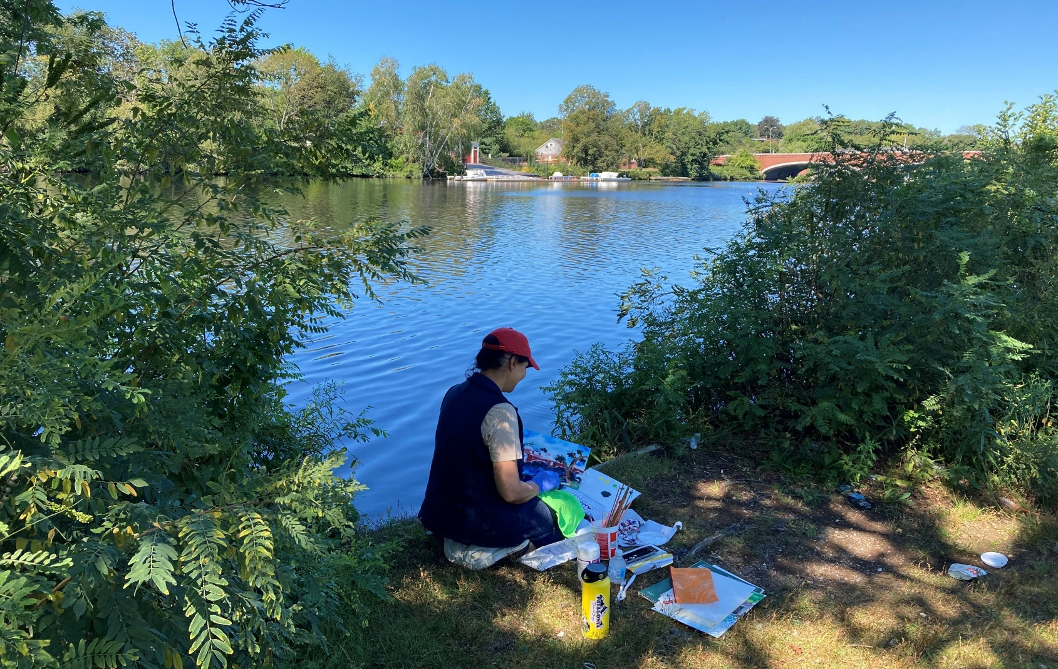
Public Review of Concept Proposals
September 29, 2021
Review of Concept Proposals
Christian A. Herter Park Master Plan

Slide 2
Commonwealth of Massachusetts
Governor
Charles D. Baker
Lieutenant Governor
Karyn E. Polito
Energy and Environmental Secretary
Kathleen A. Theoharides
Department of Conservation and Recreation Commissioner
Jim Montgomery

Slide 3
Meeting Logistics
Our speakers will go through the presentation, asking everyone else to be muted.
You will have the opportunity to submit comments over the course of the next two weeks at ^{DCR Public Comments:​}
https://www.mass.gov/forms/dcr-public-comments
Two ways to ask questions during the meeting.
^{Raise your hand Zoom function}
^{Use the chat function}
Tonight's meeting will be recorded.
The recording and slide deck will be available shortly after the meeting at:
www.mass.gov/dcr/past-public-meetings

Slide 4
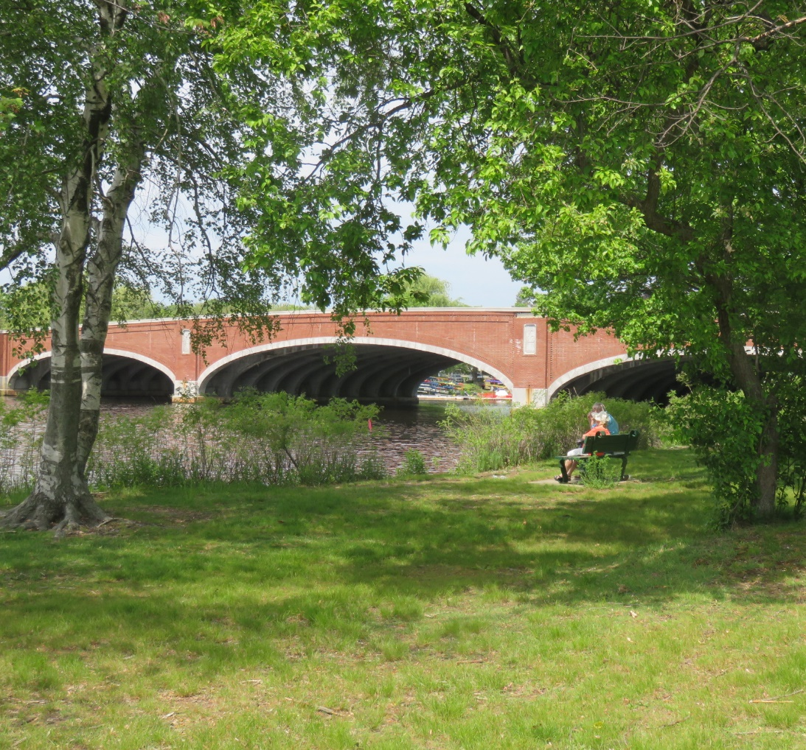
DCR Mission
To protect, promote and enhance our common wealth of natural, cultural and recreational resources for the well-being of all.

Slide 5
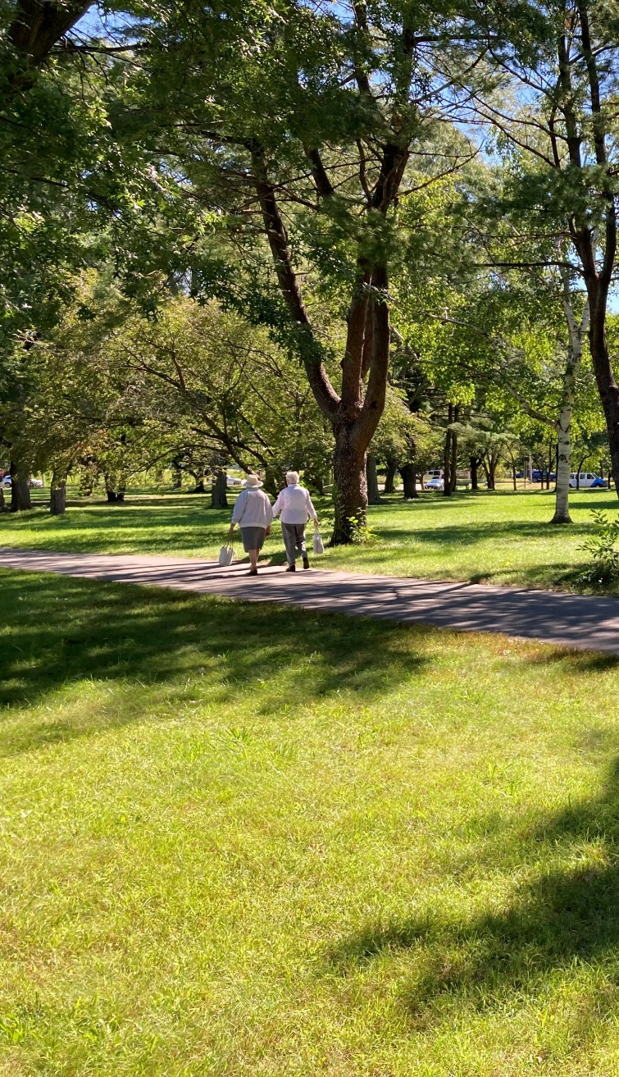
Agenda
Re-Introductions
Purpose of the Meeting
Concepts for Review and Comment:
Vehicular Circulation: SFR Road Diet
SFR Crosswalk Locations
Proposed Road Diet
Eliot Bridge Approach Intersection
Herter Center Adaptive Reuse: High School Rowing
Community Garden Consolidation
Park Concepts: Enlarged Plans
Discussion and Feedback
Master Plan Schedule and Next Steps
Review of Concept Proposals
Christian A. Herter Park Master Plan

Slide 6
Purpose of the Meeting
Purpose of the meeting is to solicit your feedback on some visionary concepts to achieve project goals, including:
Public Access and Circulation: Provide accessible, safe, and efficient circulation to and within the park.
Programming: Propose vital programs for Herter Park signature facilities.
Visitor Experience: Improve views, wayfinding, interpretive signage.
Review of Concept Proposals
Christian A. Herter Park Master Plan

Slide 7
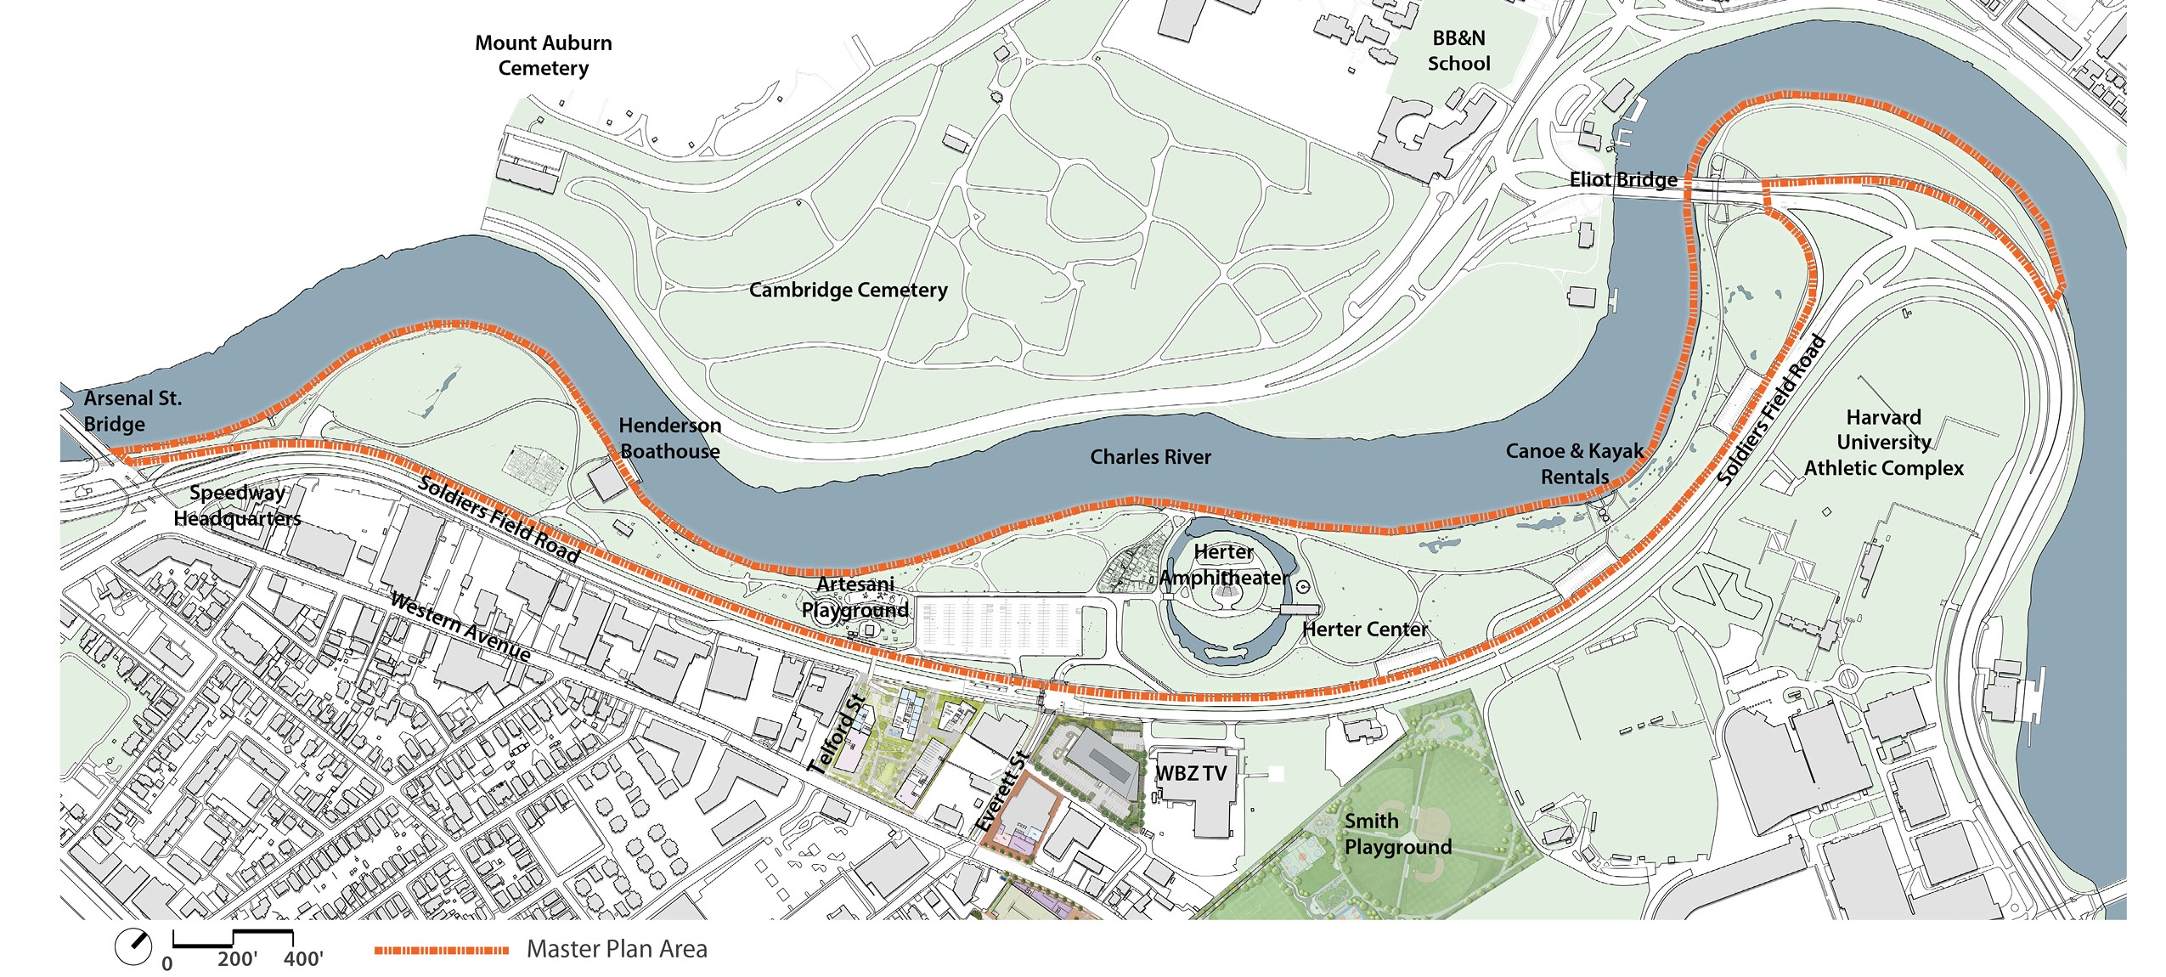
Existing Conditions Plan
Vehicular Circulation
Christian A. Herter Park Master Plan

Slide 8
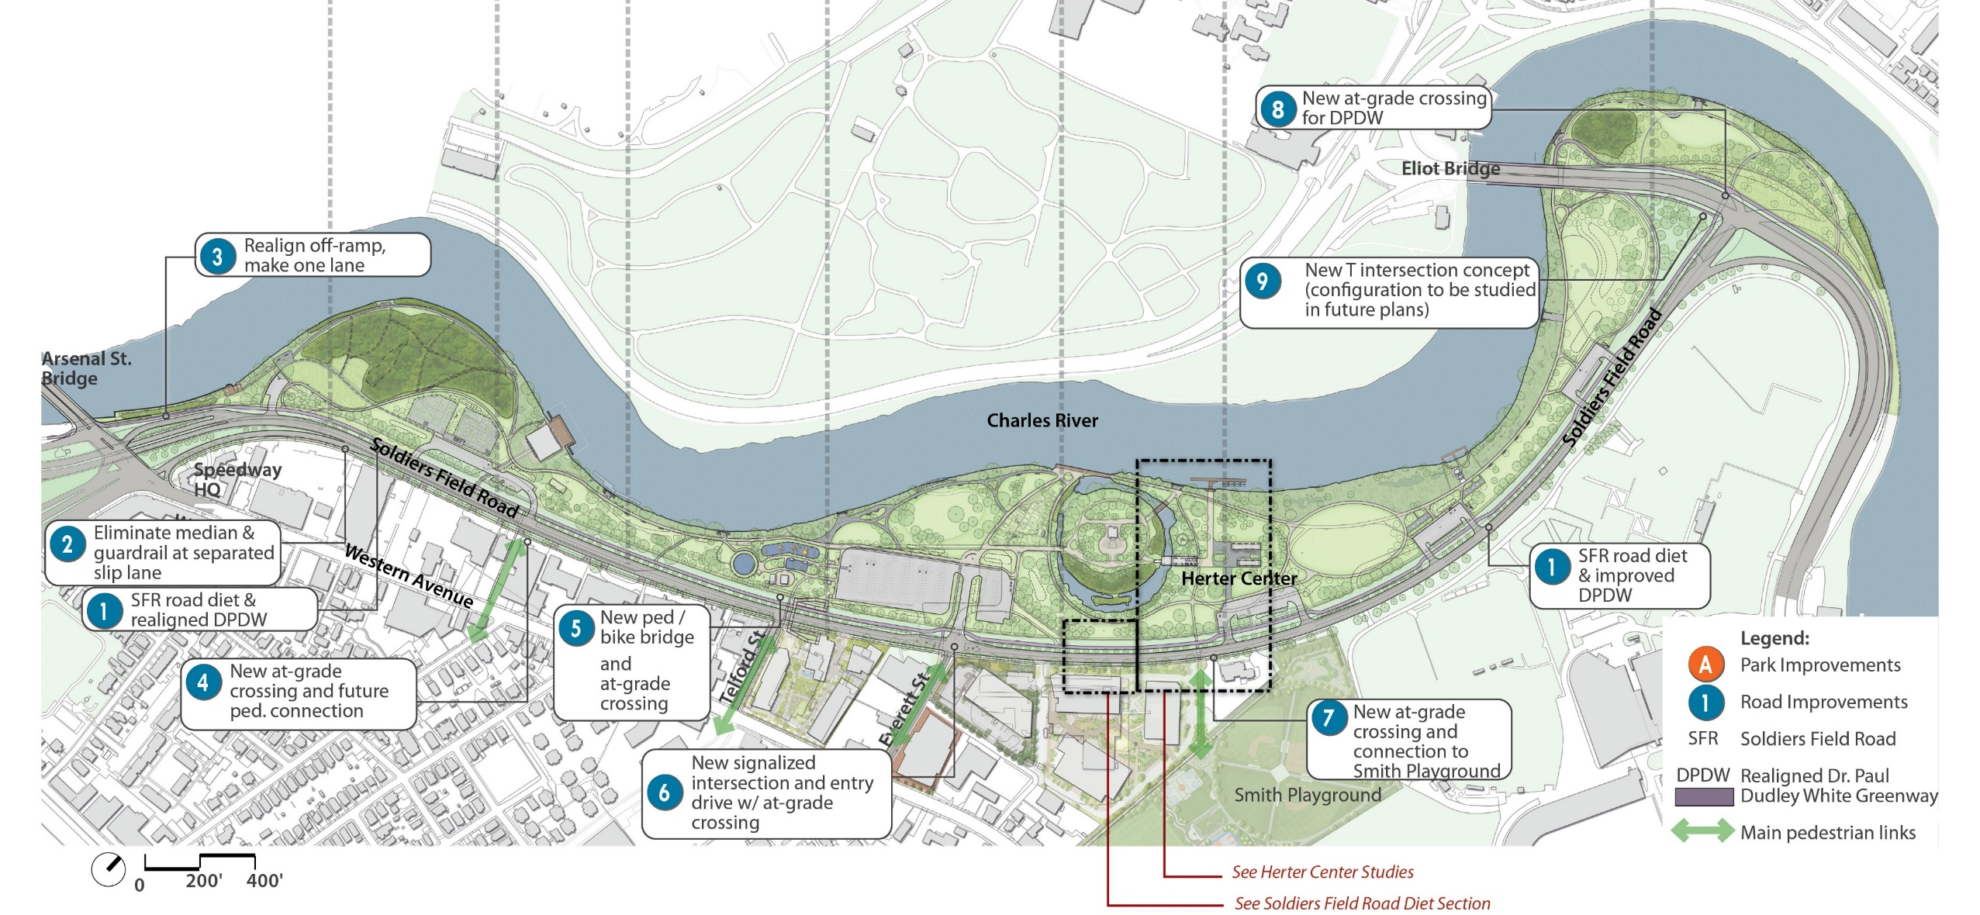
Soldiers Field Road: Road Diet Concept
Vehicular Circulation
Christian A. Herter Park Master Plan

Slide 9
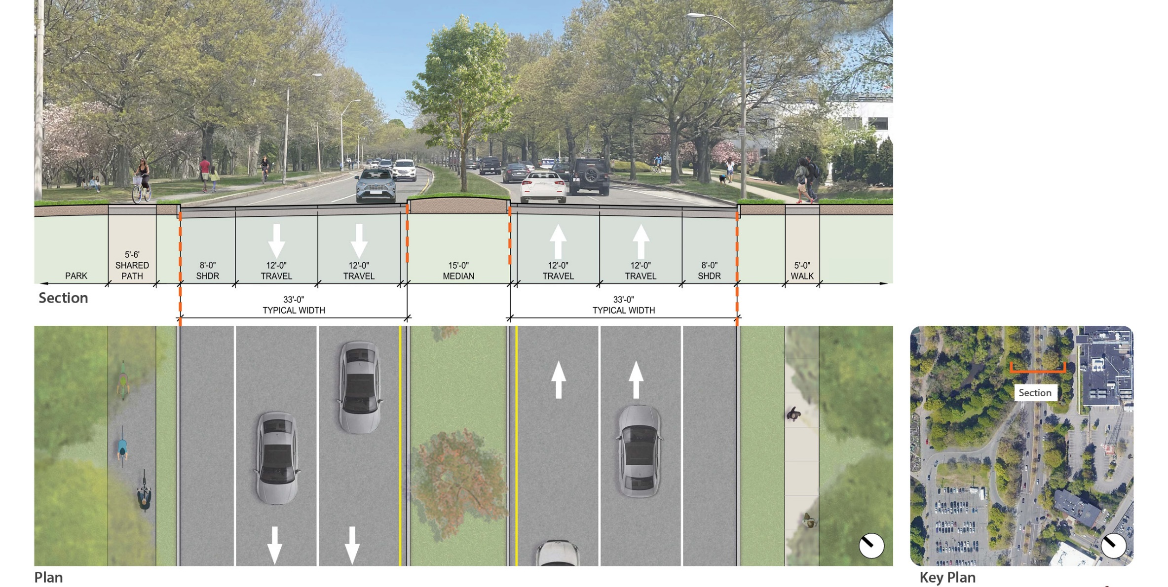
Soldiers Field Road: Existing Conditions
Vehicular Circulation
Christian A. Herter Park Master Plan

Slide 10
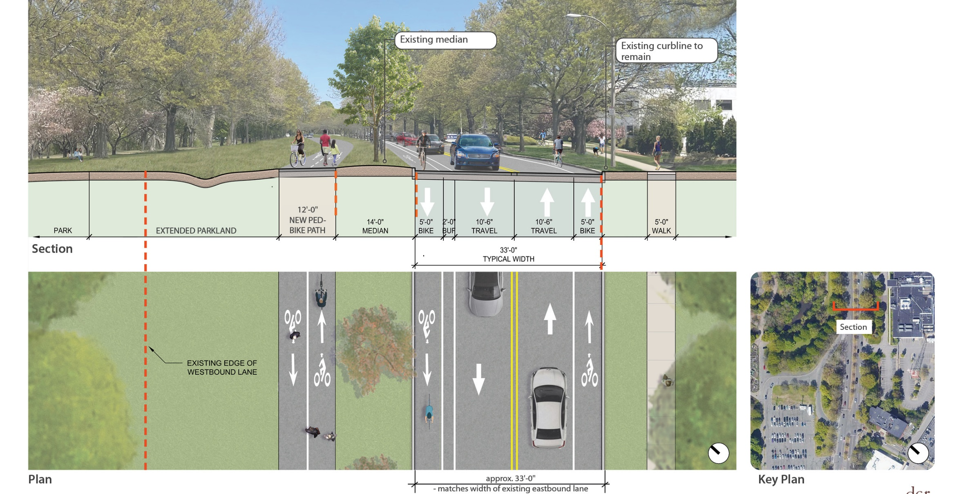
Soldiers Field Road: Road Diet Concept
Vehicular Circulation
Christian A. Herter Park Master Plan

Slide 11
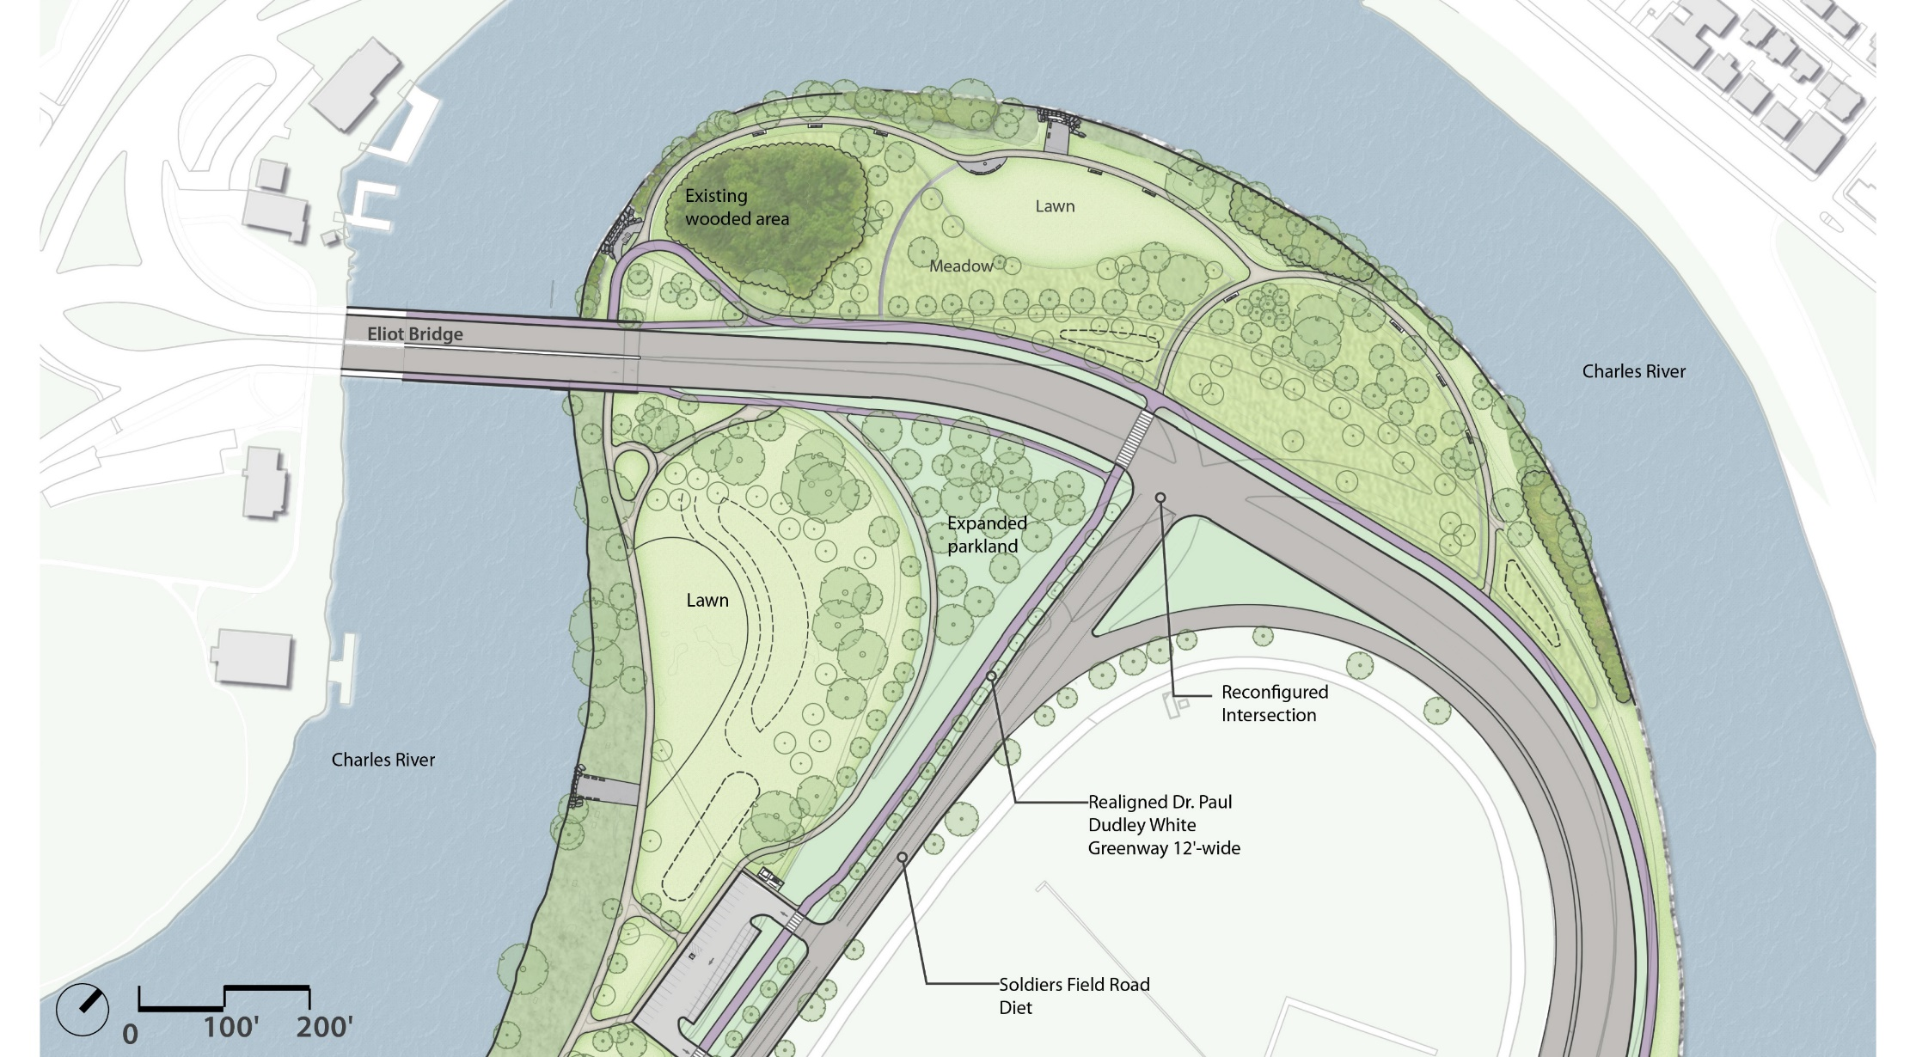
Soldiers Field Road: Concept for Eliot Bridge Approach Intersection
Vehicular Circulation
Christian A. Herter Park Master Plan

Slide 12
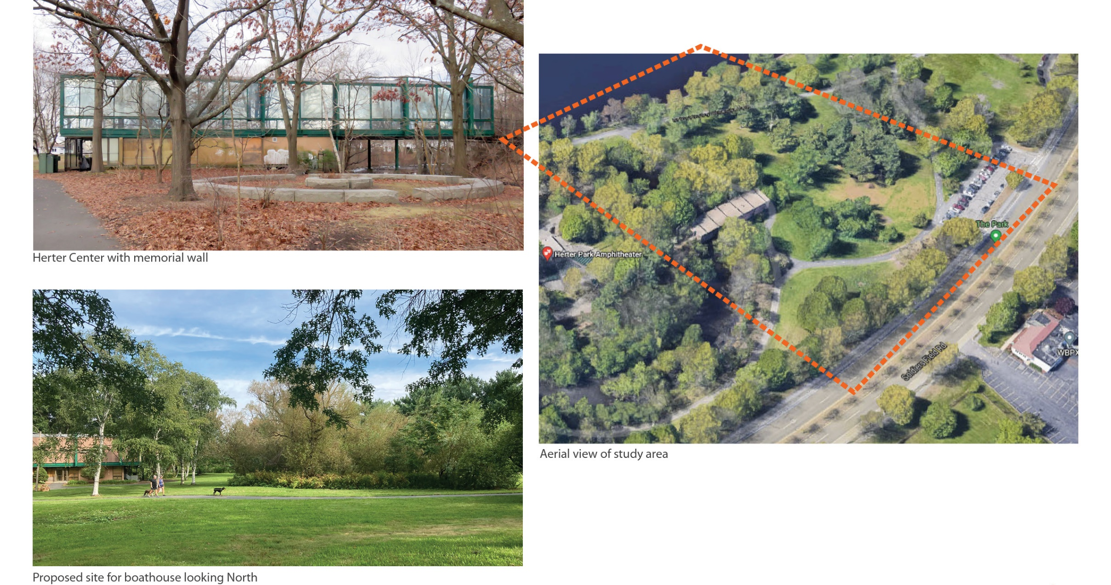
Herter Center: Existing Conditions
Herter Center Adaptive Reuse: High School Rowing
Christian A. Herter Park Master Plan

Slide 13
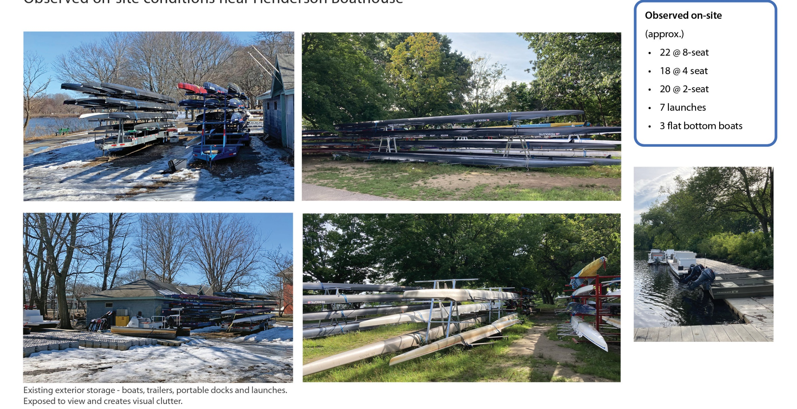
Current Facility: Existing Conditions
Herter Center Adaptive Reuse: High School Rowing
Christian A. Herter Park Master Plan

Slide 14
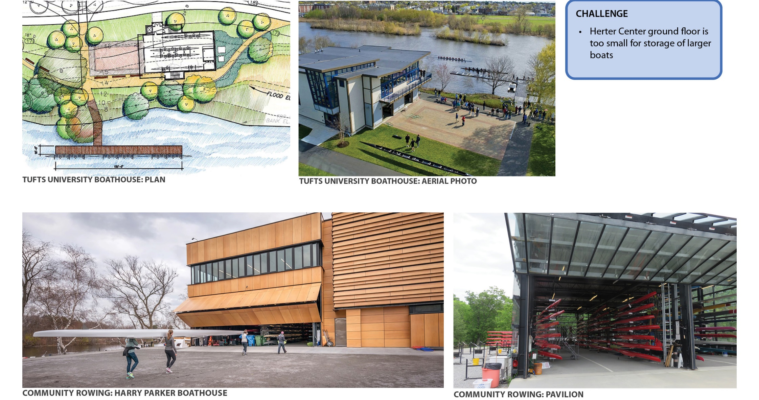
Boat Storage Precedents
Herter Center Adaptive Reuse: High School Rowing
Christian A. Herter Park Master Plan

Slide 15
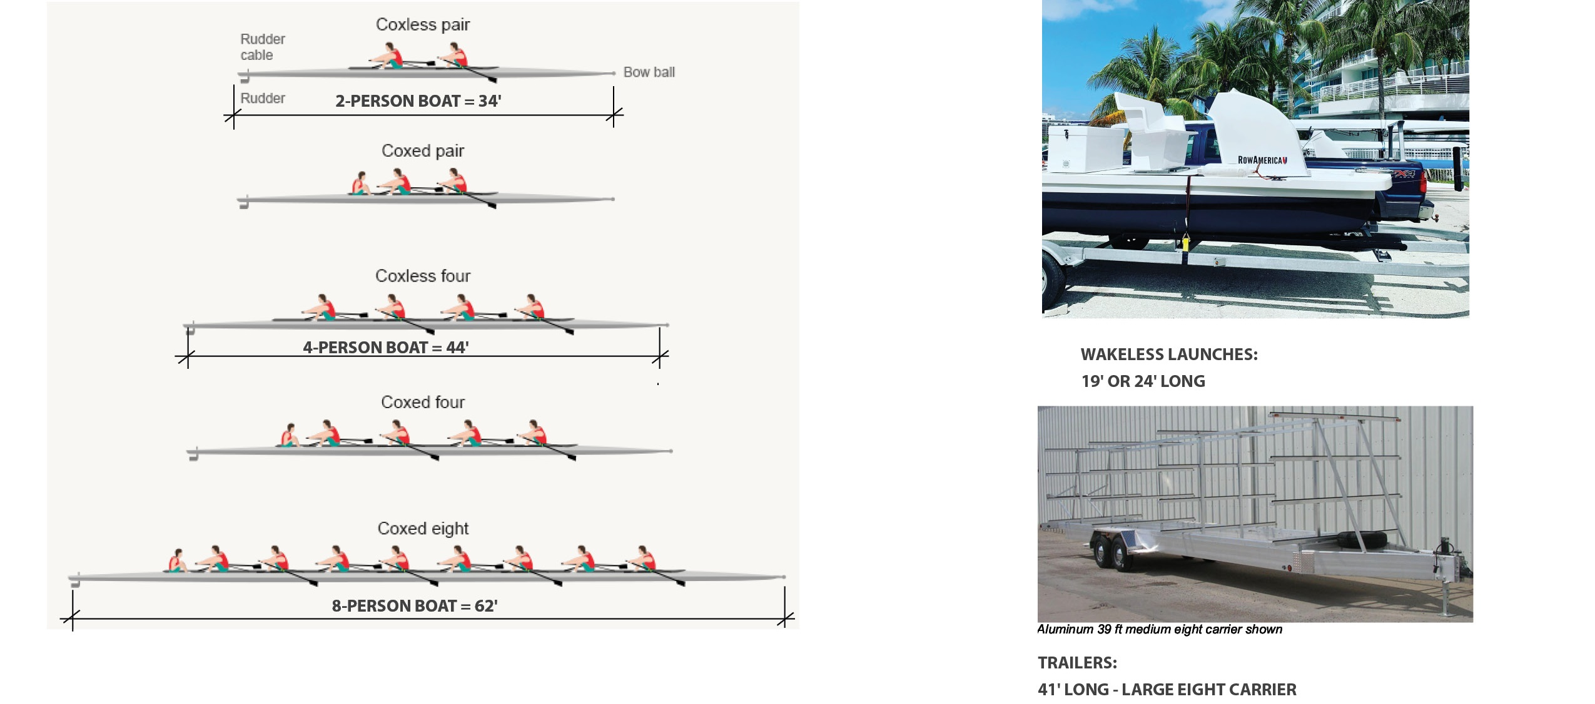
Boat Sizes
Herter Center Adaptive Reuse: High School Rowing
Christian A. Herter Park Master Plan

Slide 16
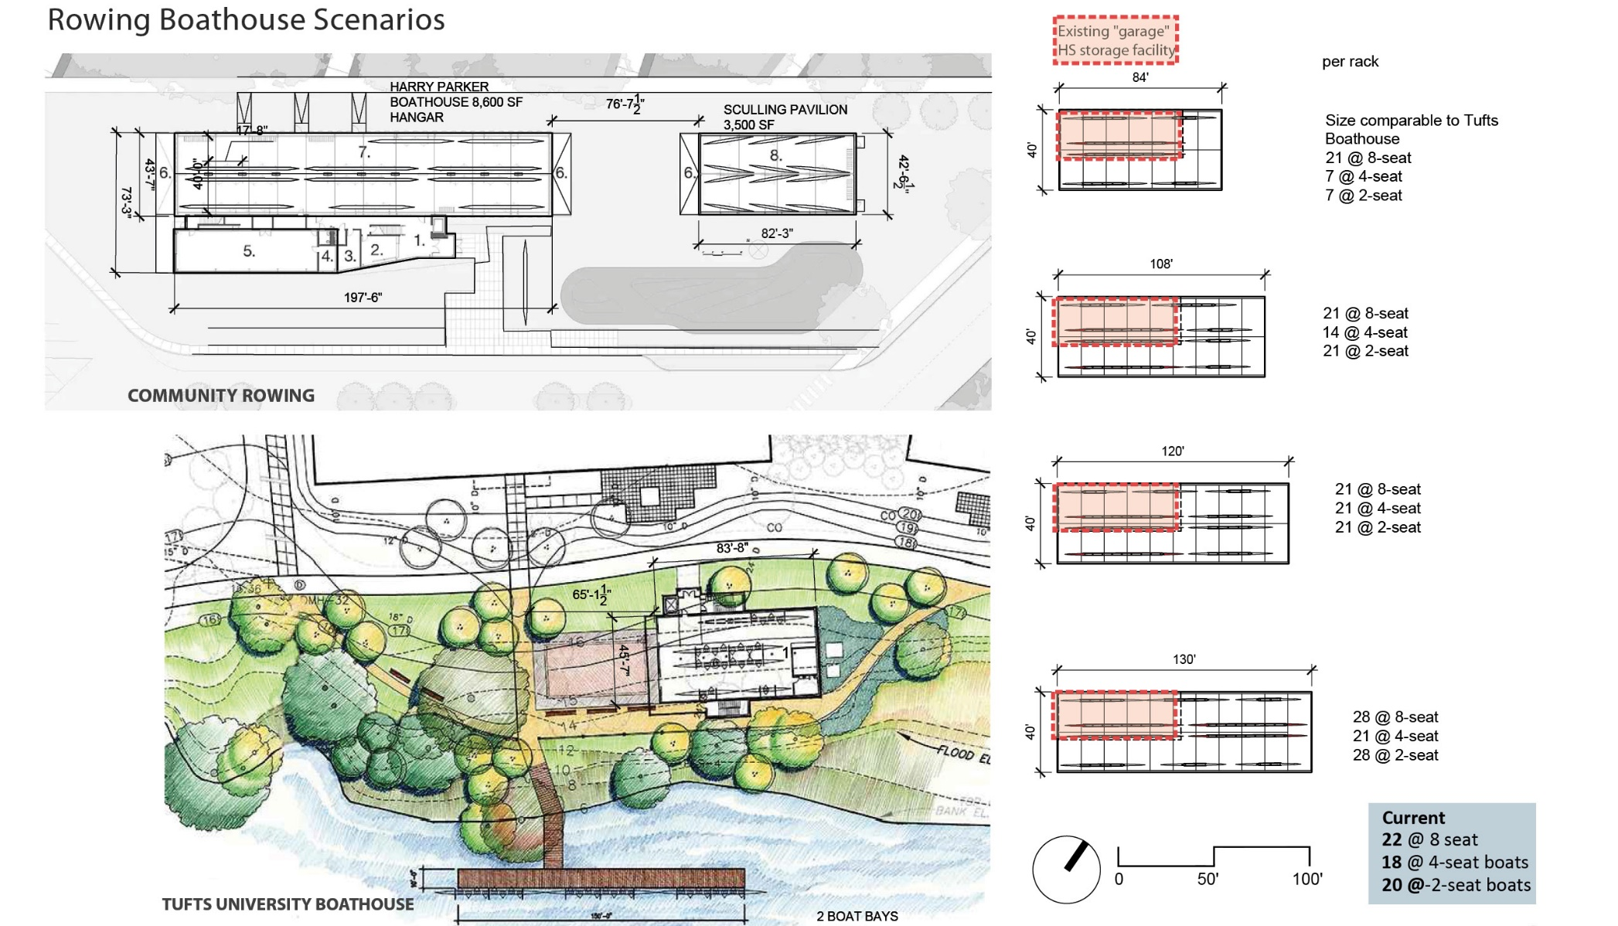
Boat Storage Precedents
Herter Center Adaptive Reuse: High School Rowing
Christian A. Herter Park Master Plan

Slide 17
Herter Center Floor Plan Concept: Rowing Center and Amphitheater Support
Upper Floor Plan
Ground Floor Plan
Herter Center Adaptive Reuse: High School Rowing
Christian A. Herter Park Master Plan

Slide 18
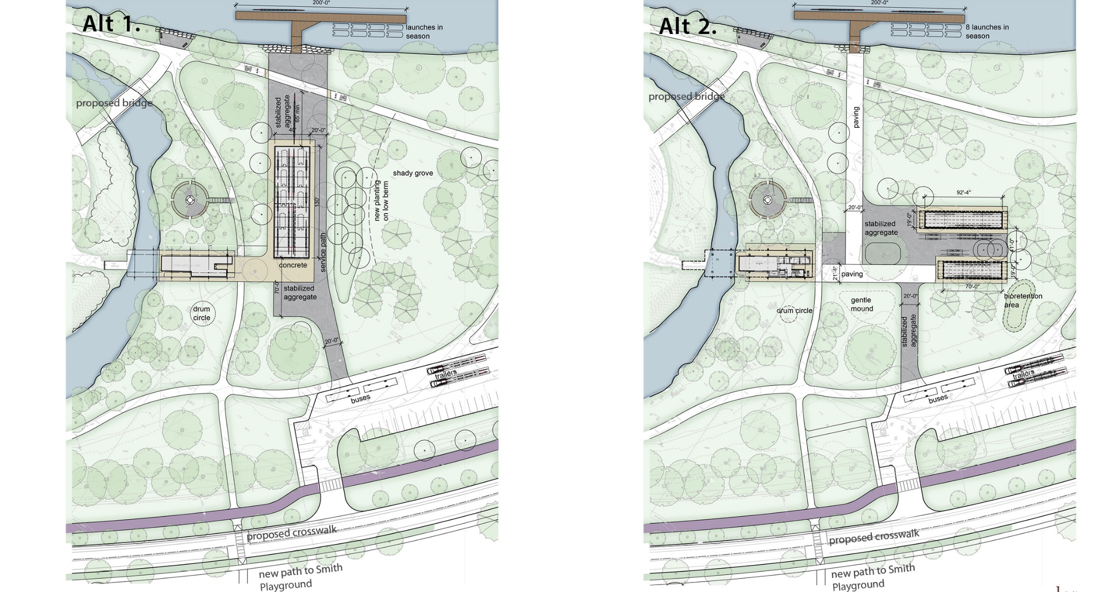
Herter Center Site Plan Concepts: Alternatives 1 and 2
Herter Center Adaptive Reuse: High School Rowing
Christian A. Herter Park Master Plan

Slide 19
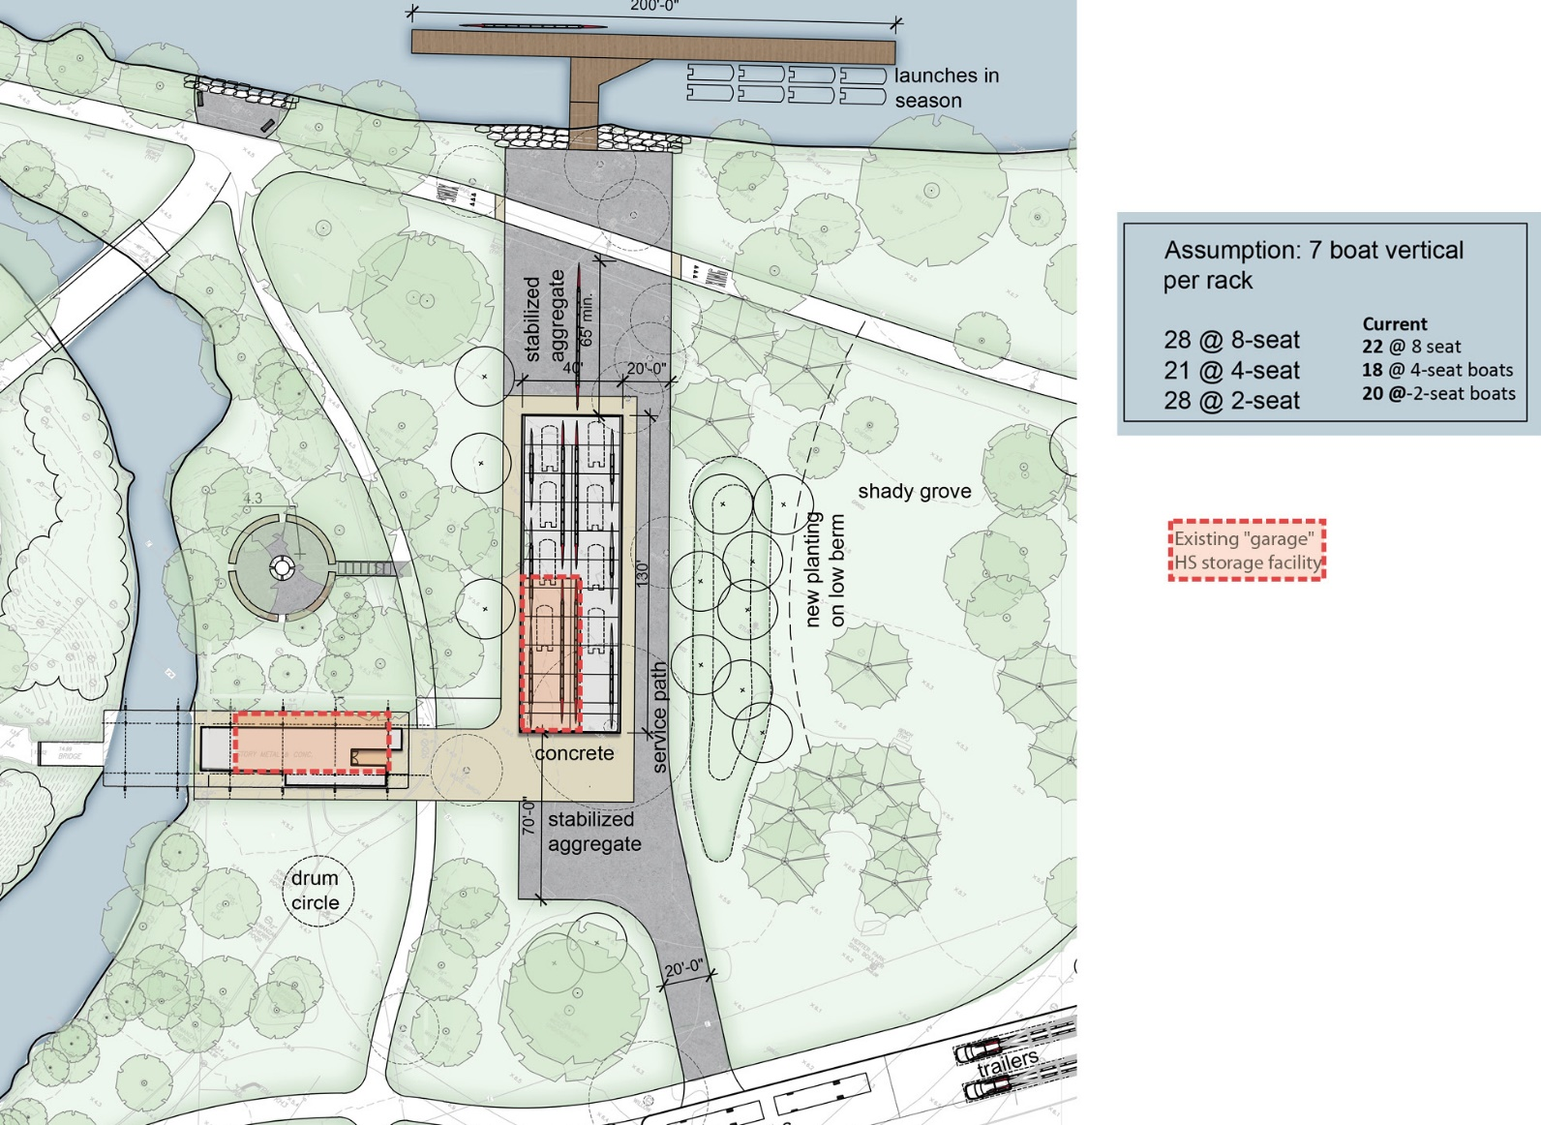
Herter Center Site Plan Concept: Alternative 1
Herter Center Adaptive Reuse: High School Rowing
Christian A. Herter Park Master Plan

Slide 20
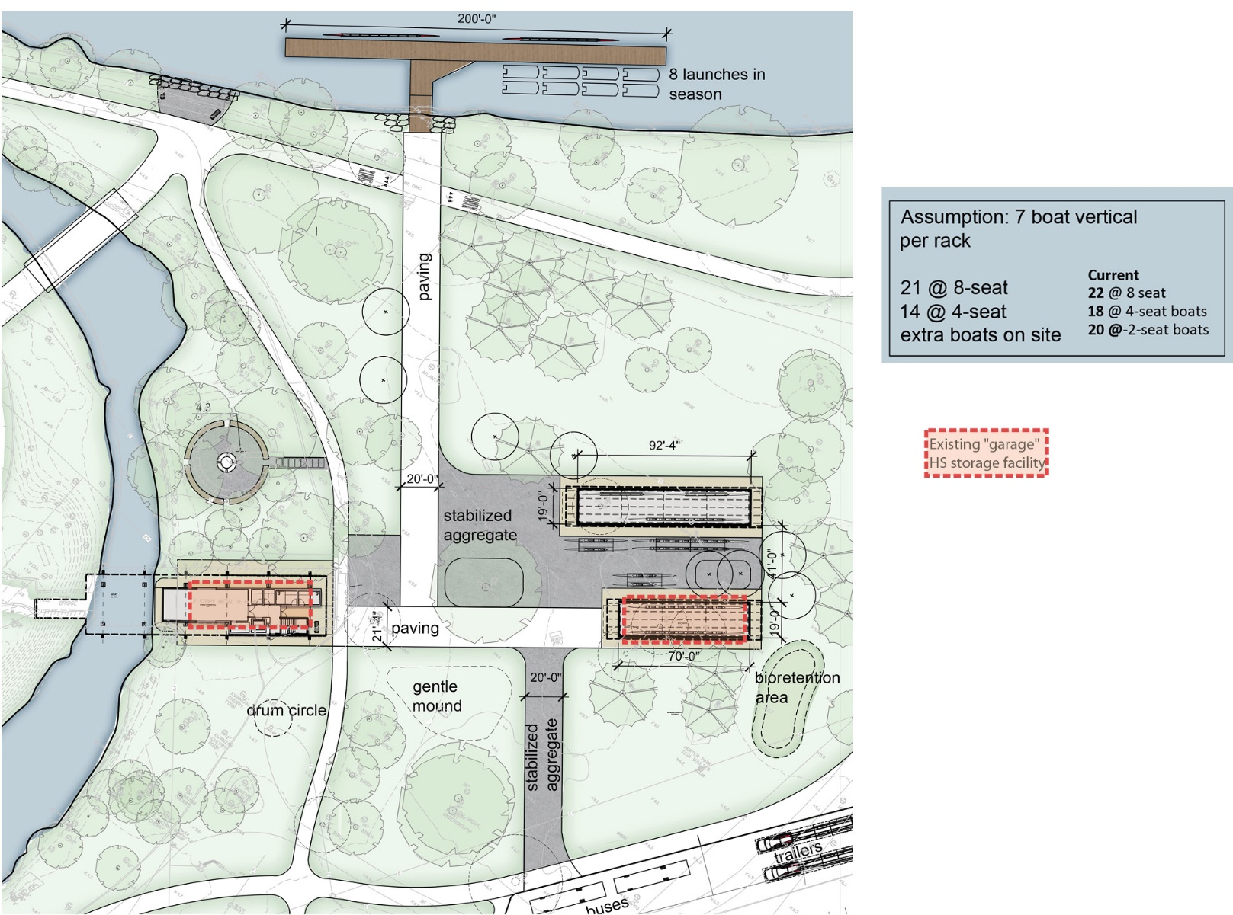
Herter Center Site Plan Concept: Alternative 2
Herter Center Adaptive Reuse: High School Rowing
Christian A. Herter Park Master Plan

Slide 21
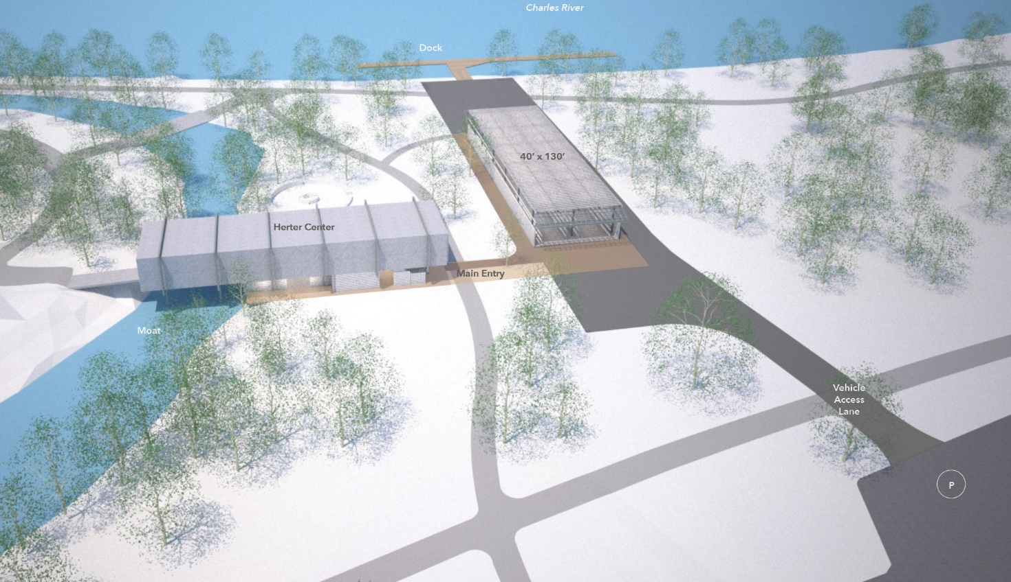
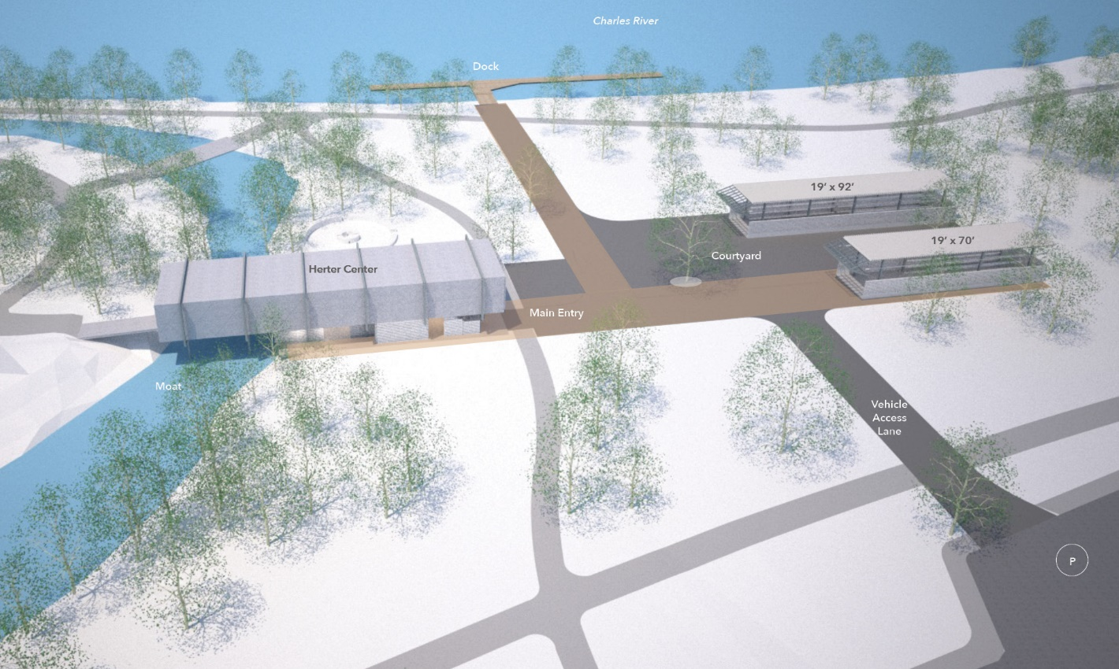
Herter Center Site Plan Concepts: Aerial Views of Alternatives 1 and 2
Alternative 1
Alternative 2
Herter Center Adaptive Reuse: High School Rowing
Christian A. Herter Park Master Plan

Slide 22
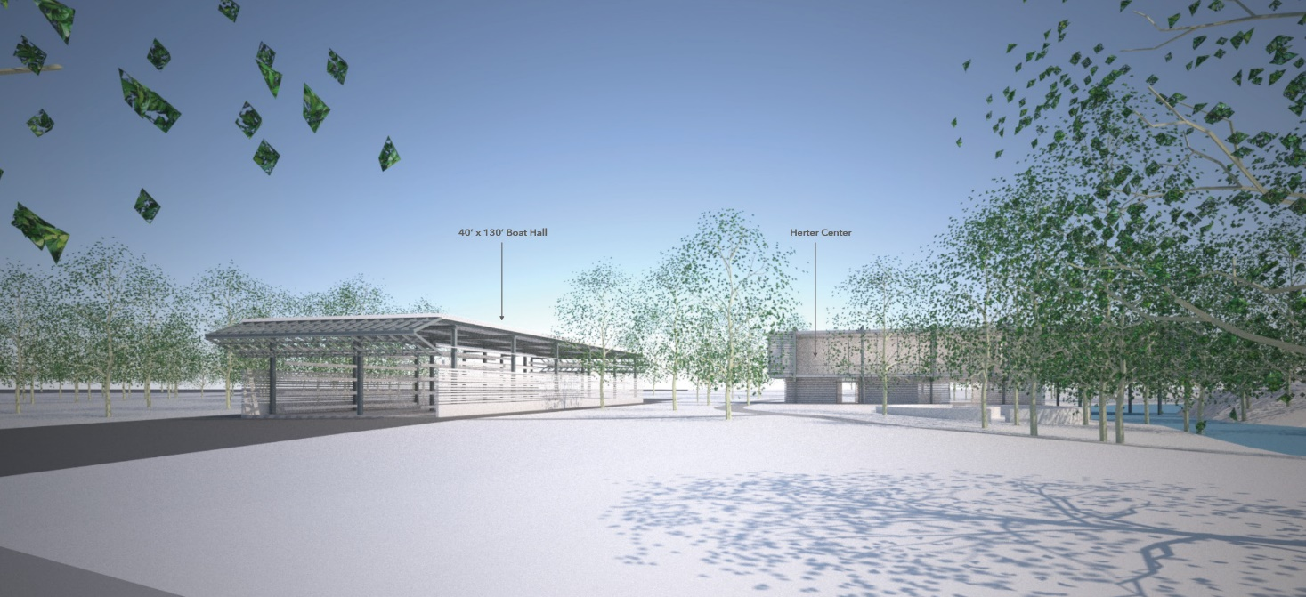
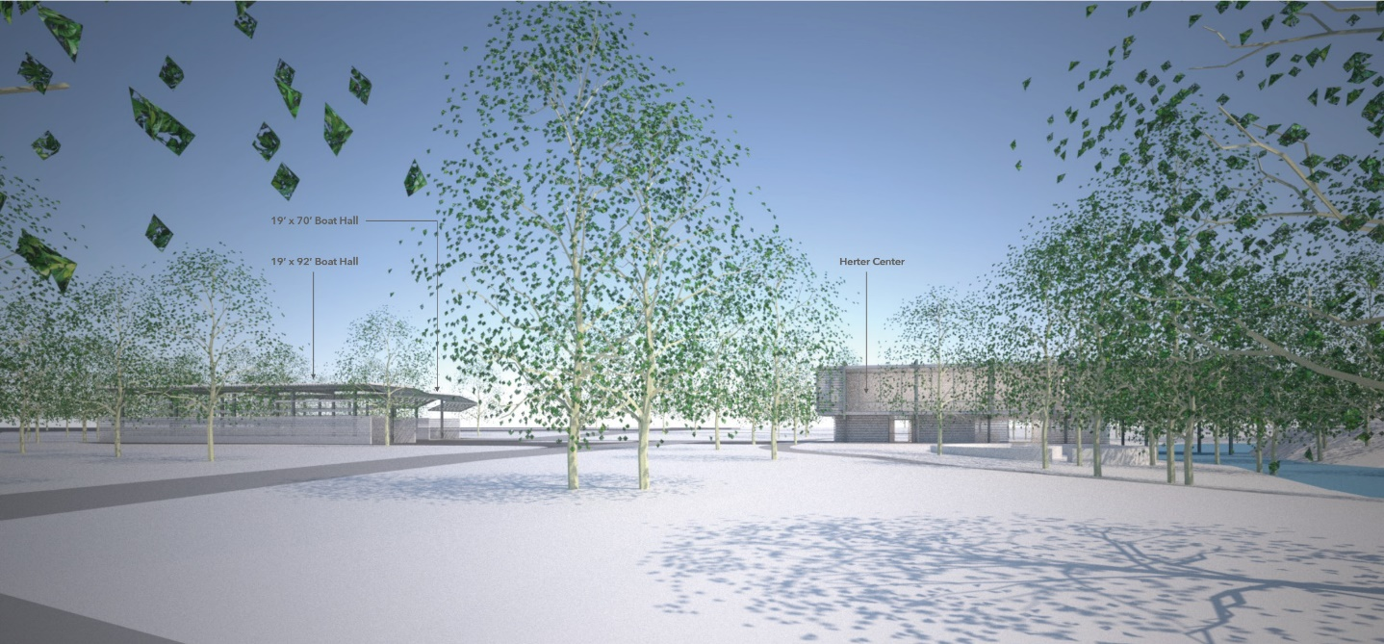
Herter Center Site Plan Concepts: Perspective Views Looking South
Alternative 1
Alternative 2
Herter Center Adaptive Reuse: High School Rowing
Christian A. Herter Park Master Plan

Slide 23
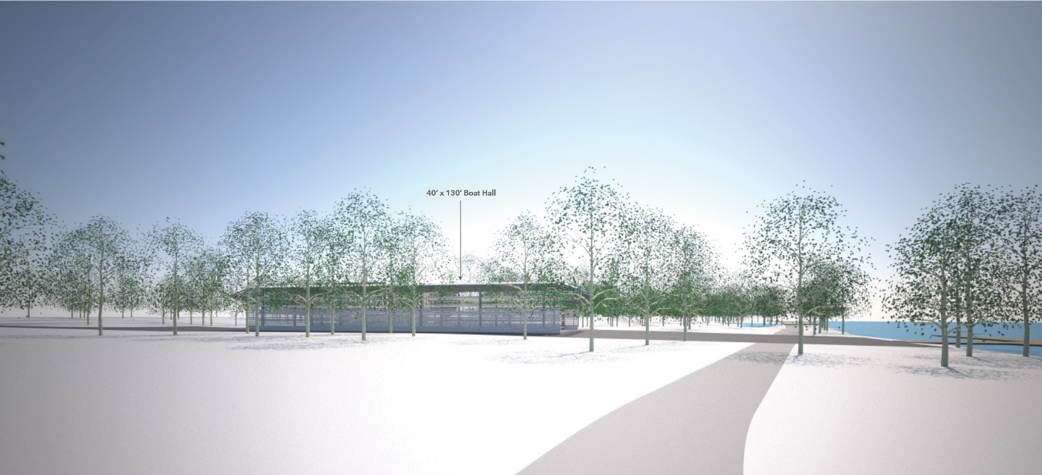
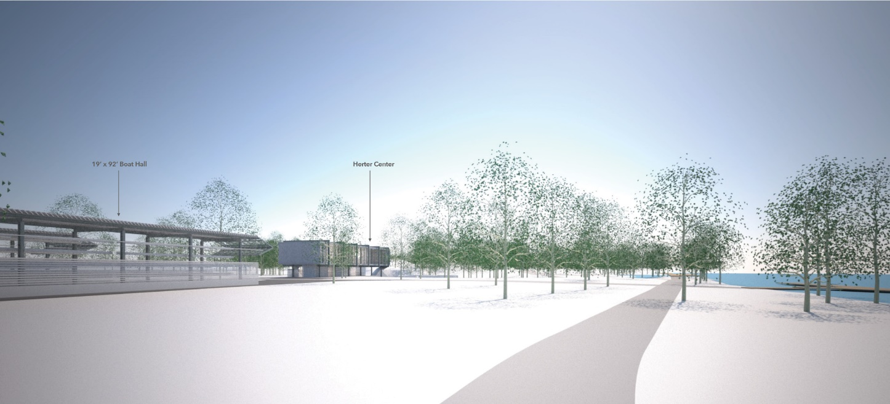
Herter Center Site Plan Concepts: Perspective Views Looking West
Alternative 1
Alternative 2
Herter Center Adaptive Reuse: High School Rowing
Christian A. Herter Park Master Plan

Slide 24
Community Gardens: Existing Conditions
Upstream of Henderson Boathouse showing existing gardens and conflict points.
Upstream of Amphitheater, showing existing gardens, blocked views and parking.
Community Garden Consolidation
Christian A. Herter Park Master Plan

Slide 25
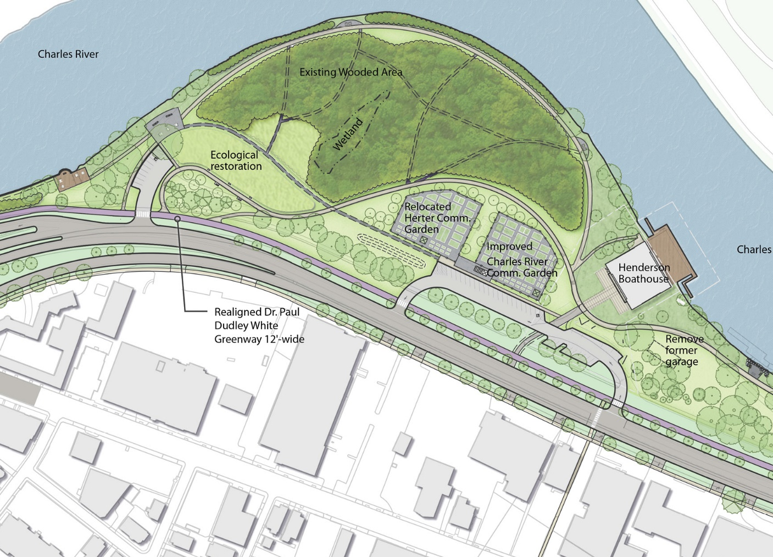
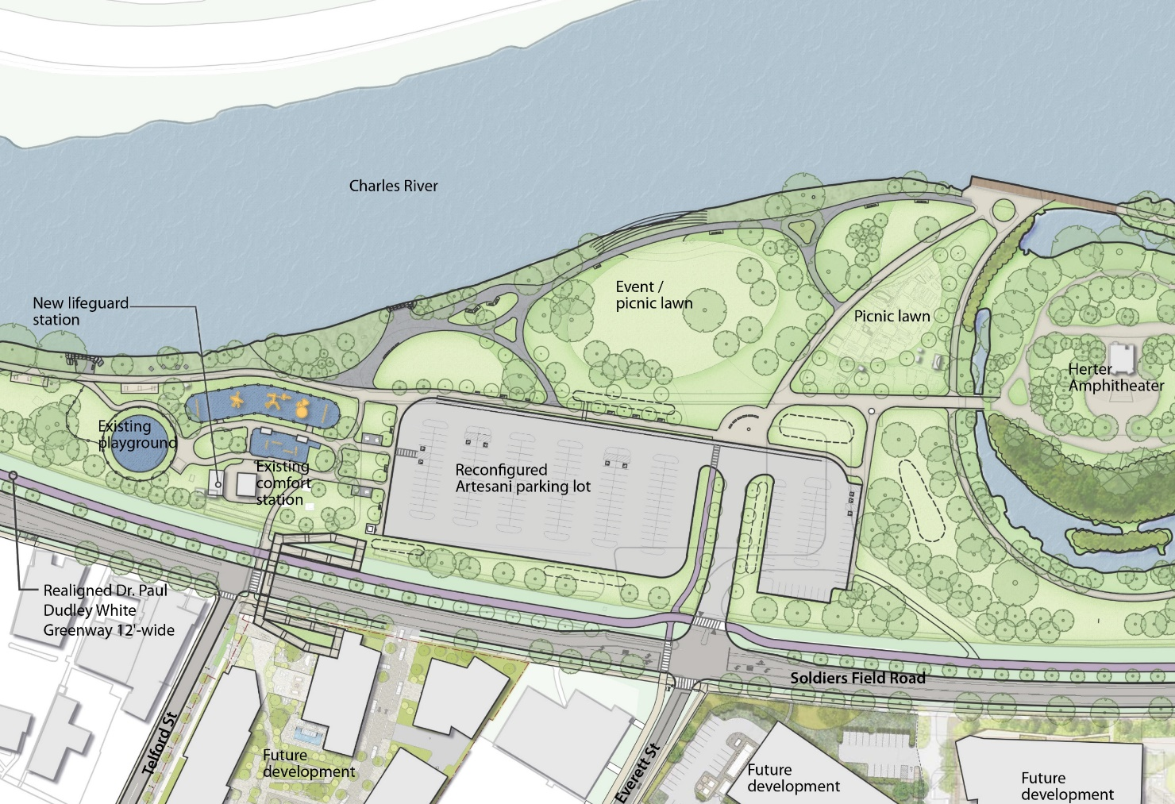
Community Garden Consolidation: Concept Plans
Upstream of Henderson Boathouse showing expanded gardens and parking.
Upstream of Amphitheater, showing expanded picnic/ event lawns.
Community Garden Consolidation
Christian A. Herter Park Master Plan

Slide 26
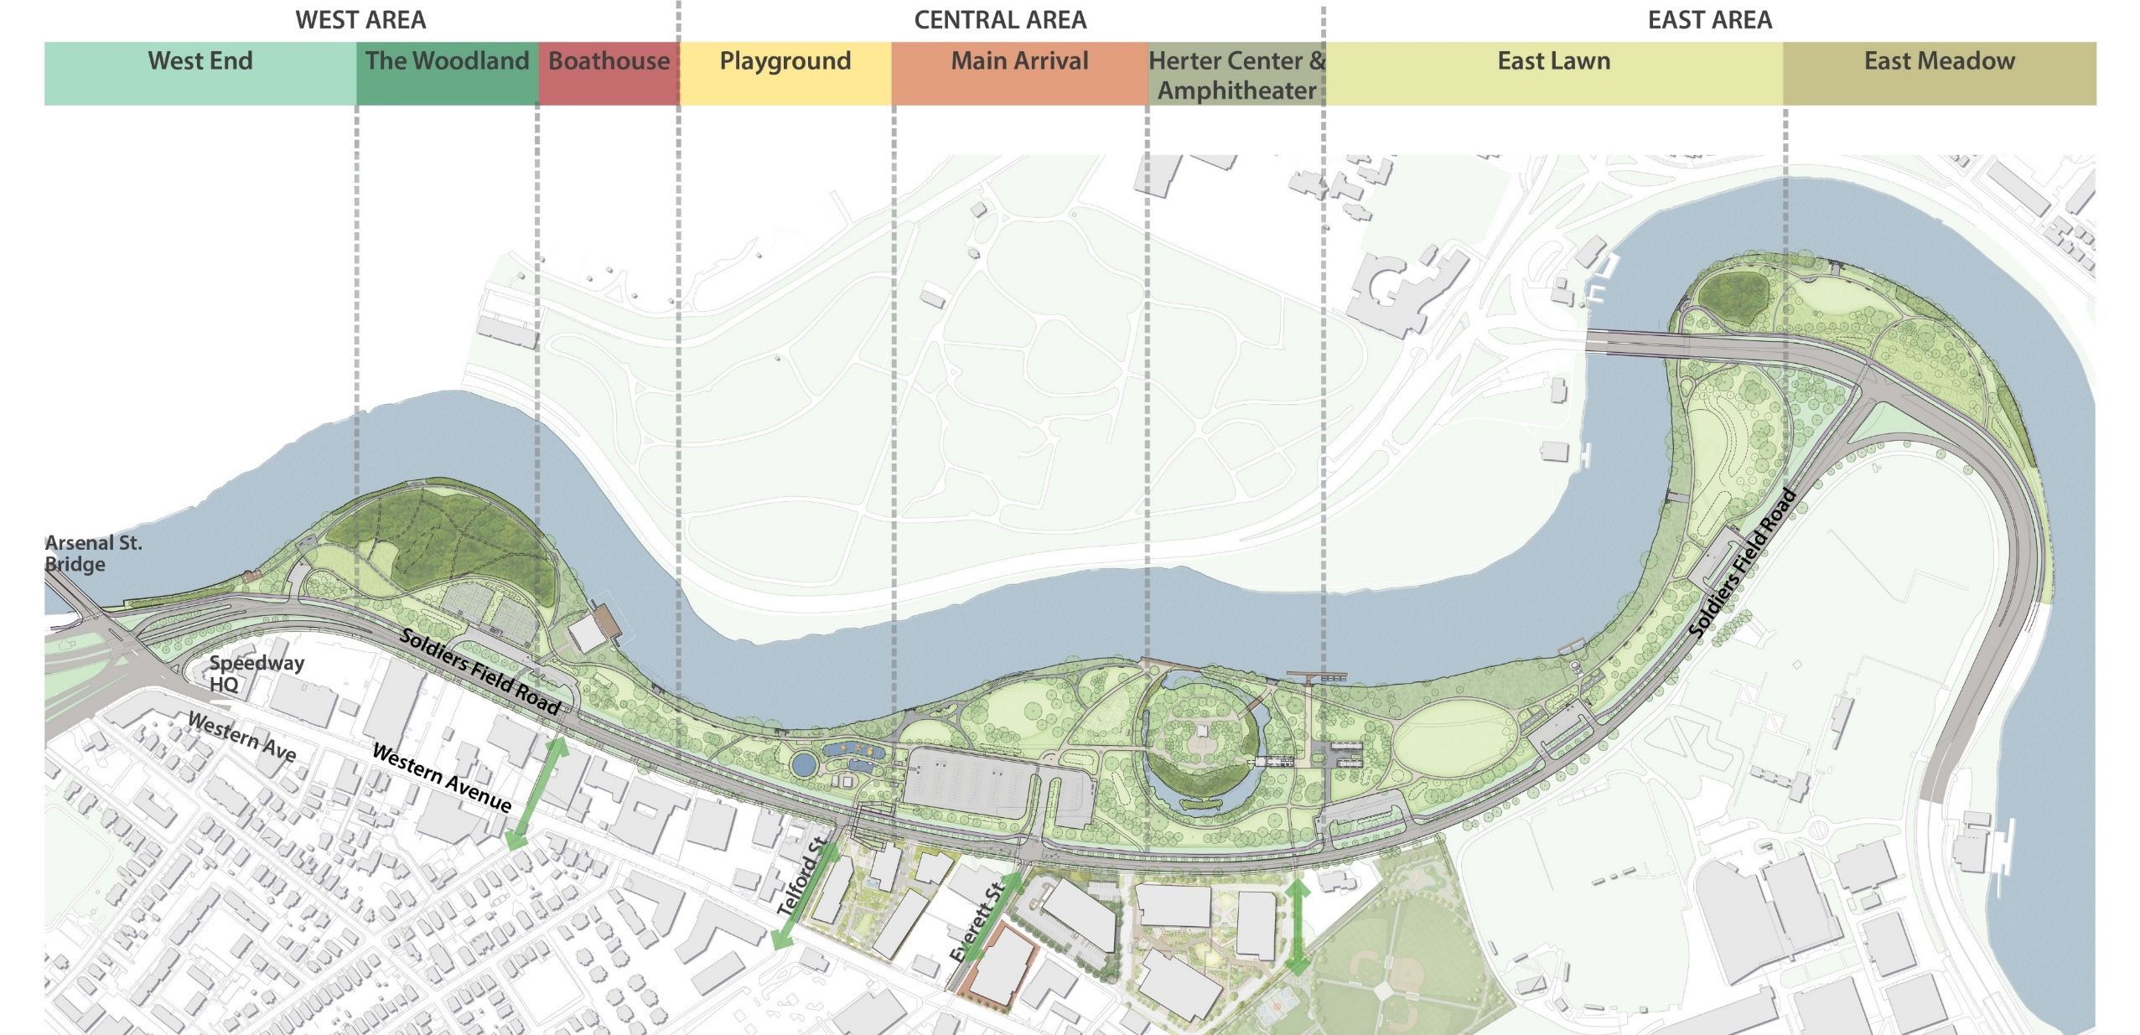
Proposed Plan with Park Areas
Park Concepts: Enlarged Plans
Christian A. Herter Park Master Plan

Slide 27
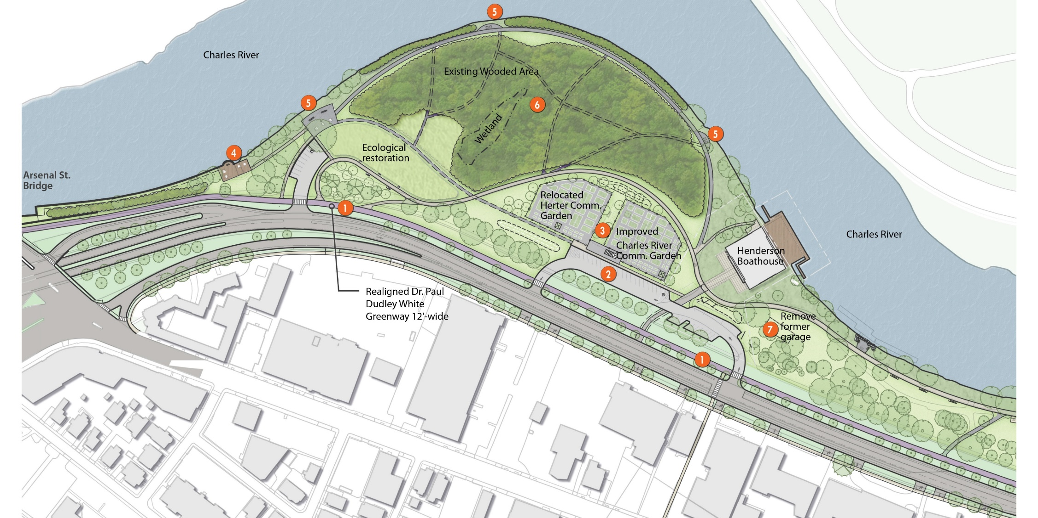
West Area
Realigned Dr. Paul Dudley White Greenway
Reconfigured Parking Lots
Community Gardens with Gathering Space
Fishing Dock
View Terraces
Restored Woodland
Demolished Comfort Station (when Rowing relocated)
Park Concepts: Enlarged Plans
Christian A. Herter Park Master Plan

Slide 28
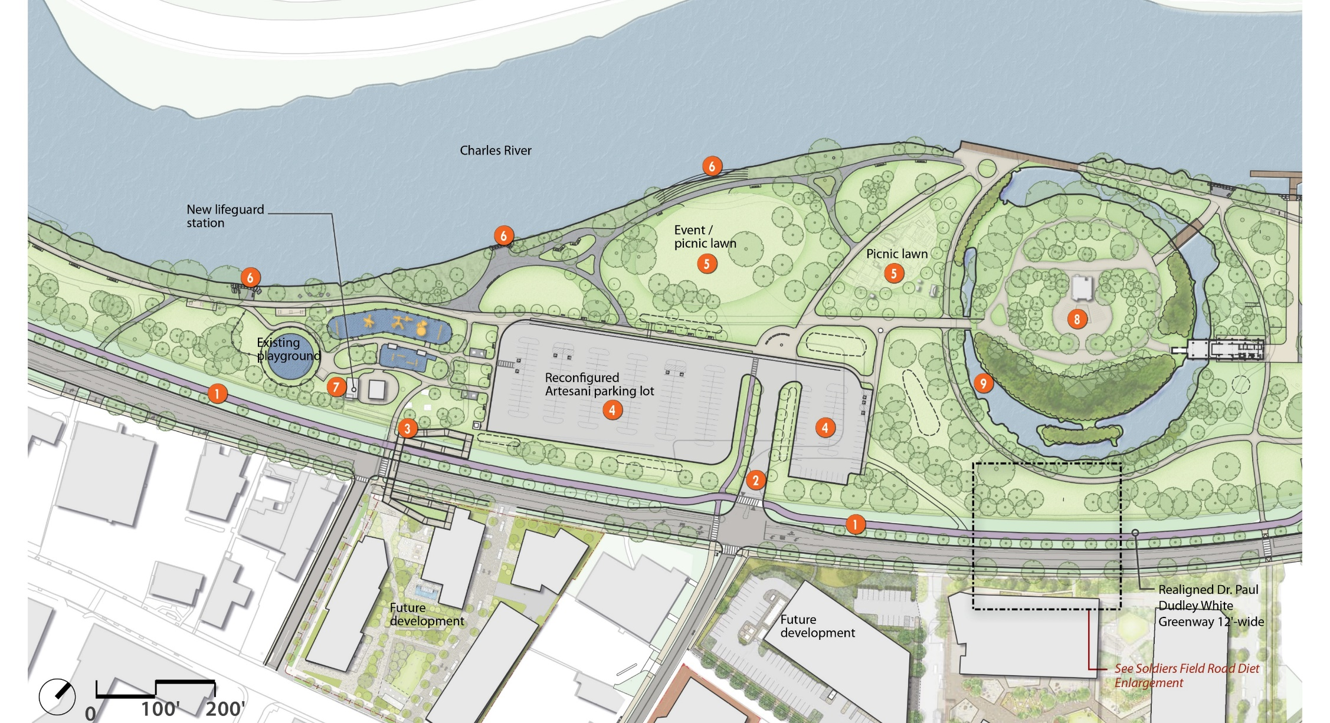
Central Area
Realigned Dr. Paul Dudley White Greenway
New Park Entry and Crosswalks
New Bridge Landing
Reconfigured Parking Lot
Expanded Special Event Picnic Lawn
View Terraces
New Lifeguard Station
Amphitheater Area Improvements
Moat Landscape Restoration
Park Concepts: Enlarged Plans
Christian A. Herter Park Master Plan

Slide 29
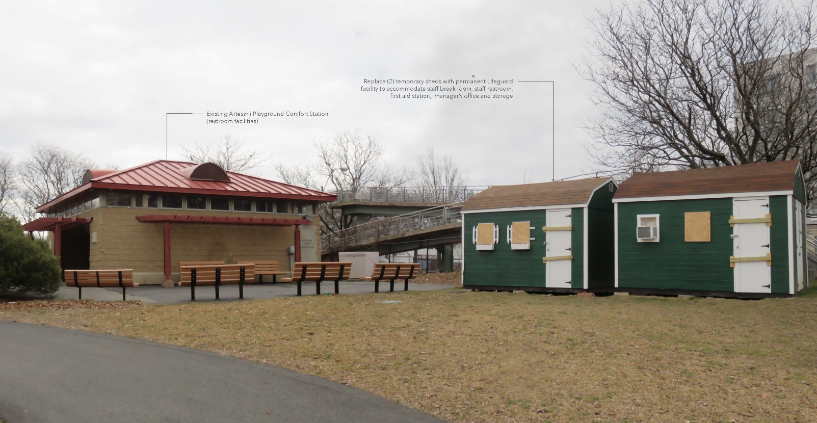
Lifeguard Station: Existing Conditions
Existing lifeguard break rooms and storage are housed in two temporary sheds.

Slide 30
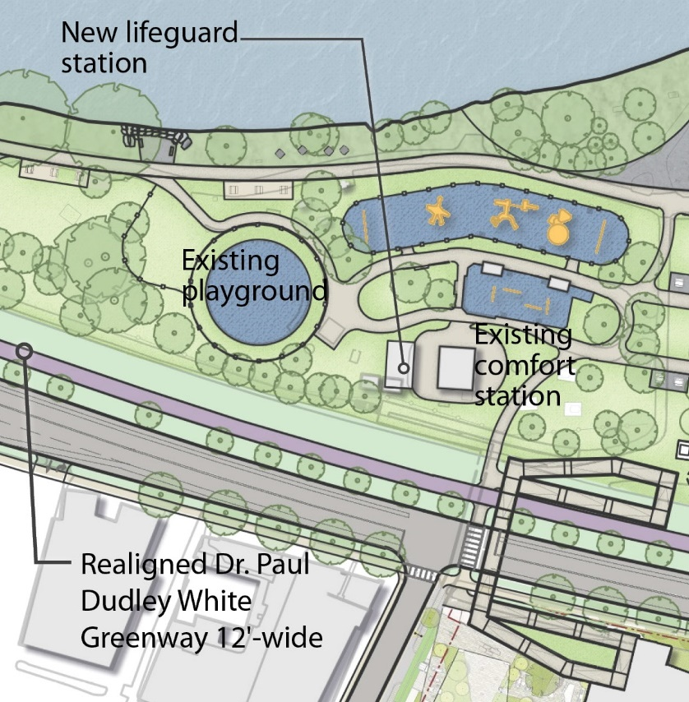
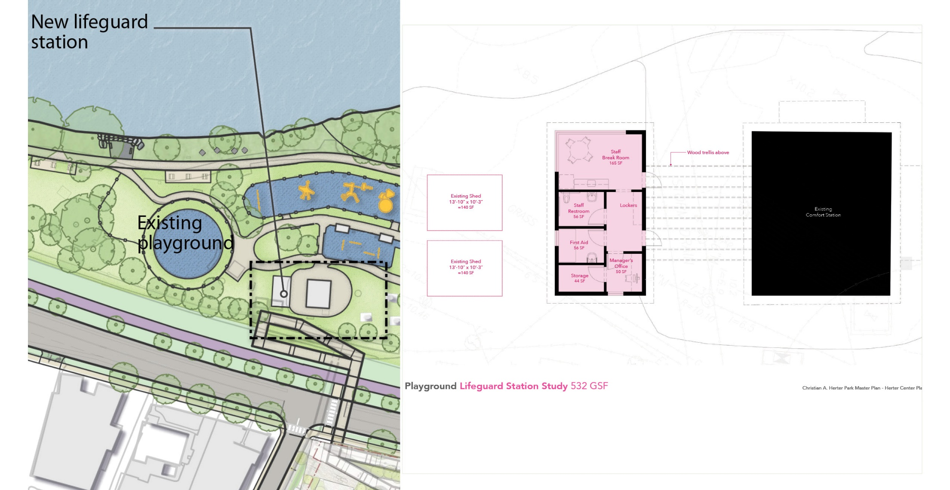
Lifeguard Station
_{Existing Comfort Station}
_{Size comparison}
Park Concepts: Enlarged Plans
Christian A. Herter Park Master Plan

Slide 31
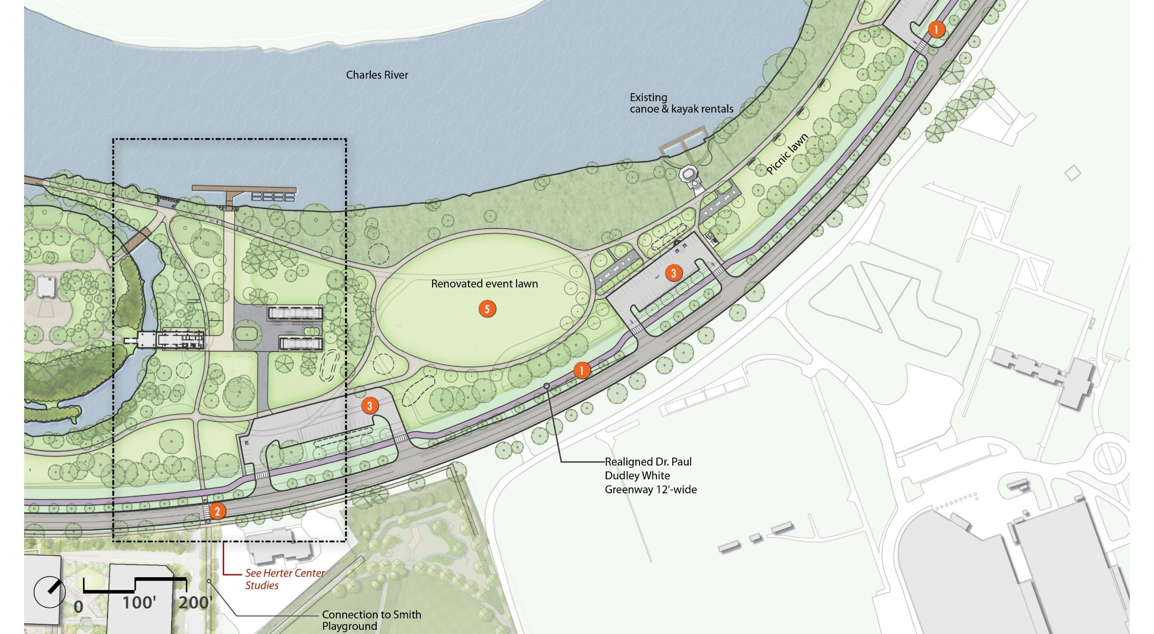
East Area: East Lawn
Realigned Dr. Paul Dudley White Greenway
New Crosswalk
Reconfigured Parking Lots
Herter Center Adaptive Reuse
Renovated Event Lawn
Park Concepts: Enlarged Plans
Christian A. Herter Park Master Plan

Slide 32
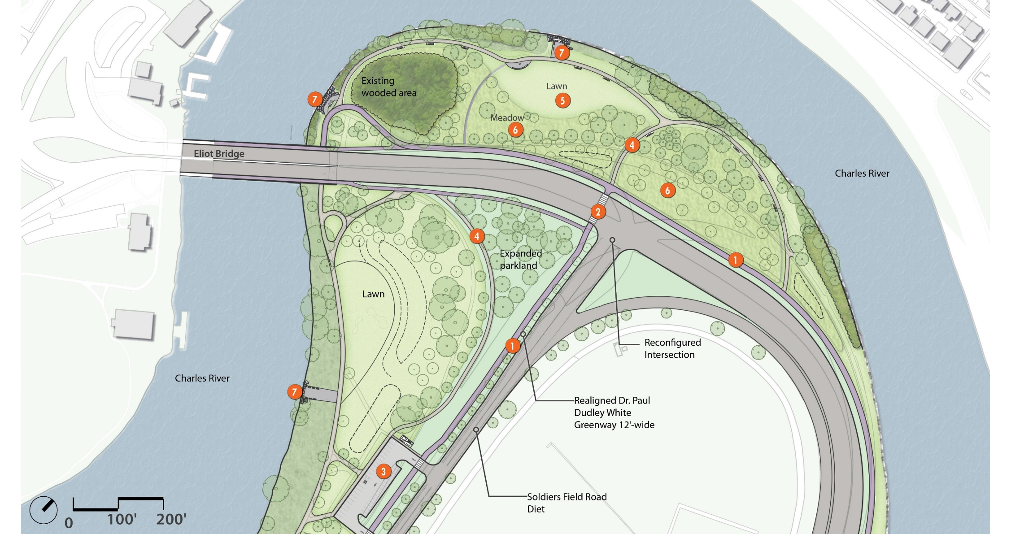
East Area: East Meadow
Realigned Dr. Paul Dudley White Greenway
New Crosswalks
Reconfigured Parking Lot
New Paths
Renovated Lawns
New Pollinator Meadow
View Terraces
Park Concepts: Enlarged Plans
Christian A. Herter Park Master Plan

Slide 33
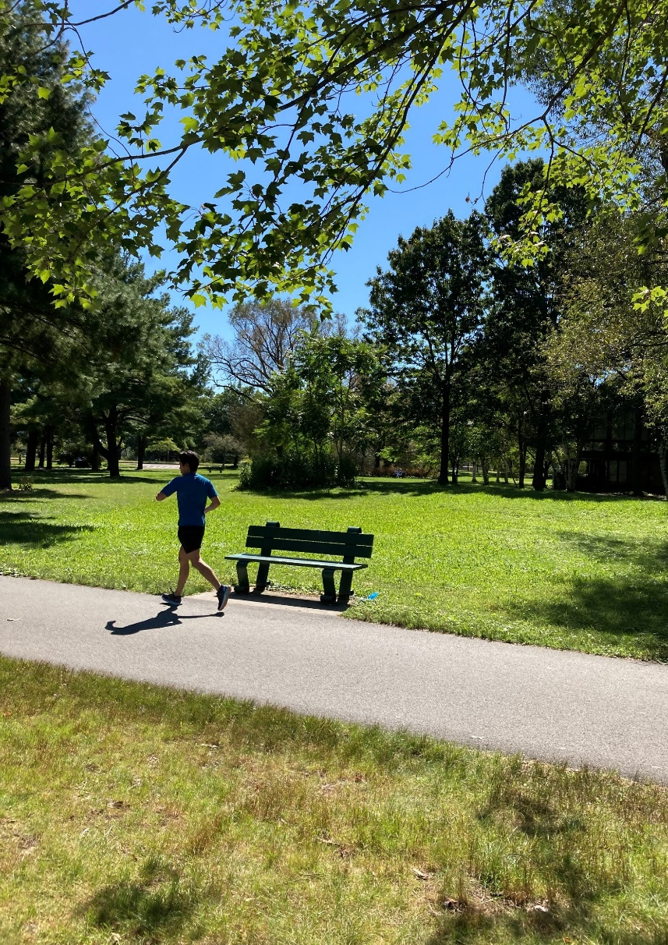
Discussion and Feedback
Concepts for Review and Comment:
1. Vehicular Circulation: SFR Road Diet
SFR Crosswalk Locations
Proposed Road Diet
Eliot Bridge Approach Intersection
2. Herter Center Adaptive Reuse: High School Rowing
Alt. 1: North-South Boathouse
Alt. 2: East-West Boathouses
3. Garden Consolidation
4. Park Concepts: Enlarged Plans
Review of Concept Proposals
Christian A. Herter Park Master Plan

Slide 34
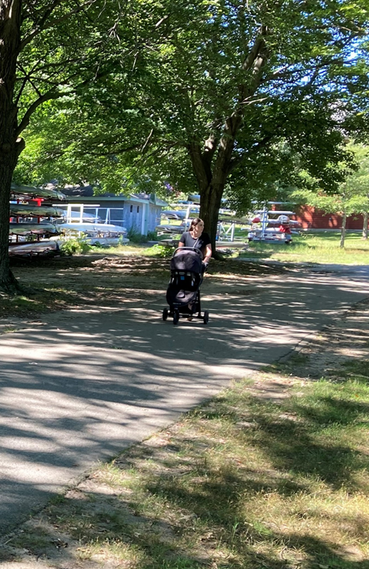
Master Plan Schedule and Next Steps
Phase 1: Site Inventory and Analysis
1. Site Walks w/ DCR Project Team | 1/22, 2/26, 5/10
2. Information Gathering | Spring 2021
3. Working Group Meeting #1 | 3/31/2021
4. Stakeholder Meeting #1 | 5/18/2021
5. Public Meeting #1 | 6/10/2021
Phase 2: Master Plan
1. Concept Sketches | Summer 2021
2. Legislator Review of Concepts | 9/13/2021
3. Working Group Meeting #2 | 9/15/2021
4. Stakeholder Meeting #2 | 9/23/2021
5. Public Meeting #2 | 9/29/2021
6. Final Master Plan | December 2021
Phase 3: Landscape Management Plan
1. LMP Submittal | January 2022
We are
here!
Schedule and Next Steps
Christian A. Herter Park Master Plan

Slide 35
Additional Information & Q&A
Our speakers will go through the presentation, asking everyone else to be muted.
You will have the opportunity to submit comments over the course of the next two weeks at ^{DCR Public Comments:​}
https://www.mass.gov/forms/dcr-public-comments
Two ways to ask questions during the meeting.
^{Raise your hand Zoom function}
^{Use the chat function}
Tonight's meeting will be recorded.
The recording and slide deck will be available shortly after the meeting at:
www.mass.gov/dcr/past-public-meetings

Slide 36
Thank you!
Review of Concept Proposals
Christian A. Herter Park Master Plan

